Slide 1
2016 LTSA Update
Doug Murray
3/22/2016

Slide 2
Agenda
Changes to Current Trends Scenario
Scenario Results
Status of Remaining Scenarios

Slide 3
Current Trends Changes Since February RPG
Retirements/Options to solve scarcity hours
  Fixed retirements
  Economic retirements
  Add extra CTs to limit scarcity hours
Decision was made to model retirements as economic only
  11,117 MWs of retirements
Rechecked GINR for Planning Guide Section 6.9 compliance
  Wind – 740 MWs
  Solar – 422 MWs
  Gas – 1,148 MWs

Slide 4
Current Trends Results
No unserved energy until 2031
Reserve margins in final year – 10.7%
Built 19,400 MWs solar, 220 MWs Wind

Slide 5
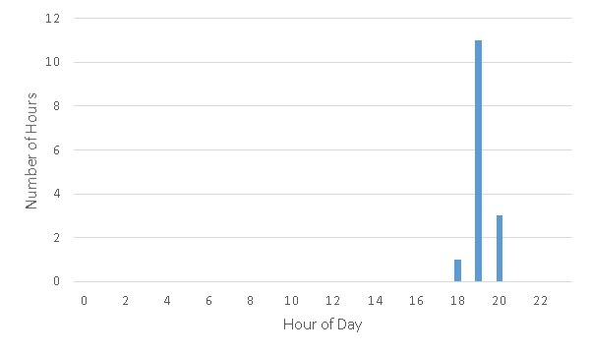
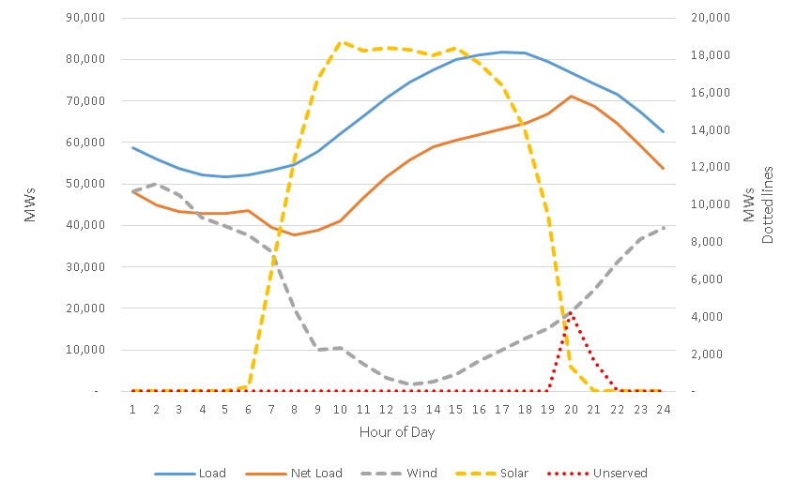
Current Trends Results
2031 Scarcity Hours

Slide 6
High Economic Growth Results
Small amounts of unserved energy in 2026 and 2031
Reserve margins in final year – 10.6%
Built 18,300 MWs solar, 100 MWs Wind
Economic retirements total 8,639 MWs

Slide 7
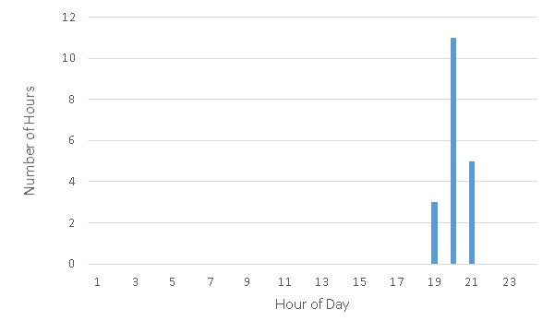
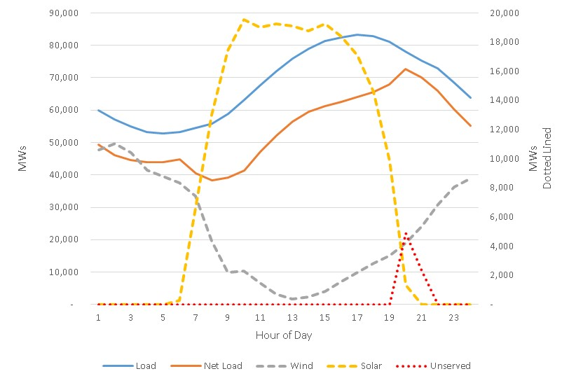
High Economic Growth Results
2031 Scarcity Hours

Slide 8
Schedule for Generation Expansion
Current Trends, High Economic Growth Scenarios completed
Environmental Mandate in process

Slide 9
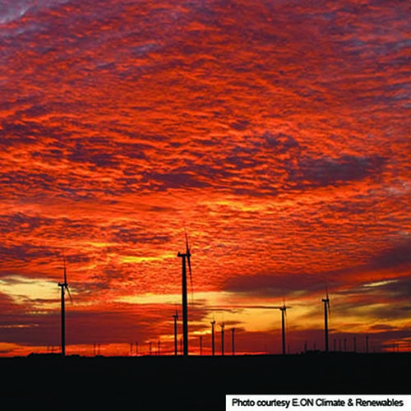
Questions
Contact info:
Doug Murray Julie Jin
douglas.murray@ercot.com julie.jin@ercot.com
512.248.6908 512.248.3982
Sandeep Borkar
sandeep.borkar@ercot.com
512.248.6642

