Slide 1
Changes to 2016 Ancillary Service Methodology to account for Reserve Discount Factor (RDF)
ERCOT Staff
March 23, 2016 QMWG

Slide 2
Discussion Points
Proposed Timeline
ERCOT Weather Zones
Reserve Discount Factor (RDF) Adjustment Analysis
Proposed changes to the 2016 Ancillary Service Methodology

Slide 3
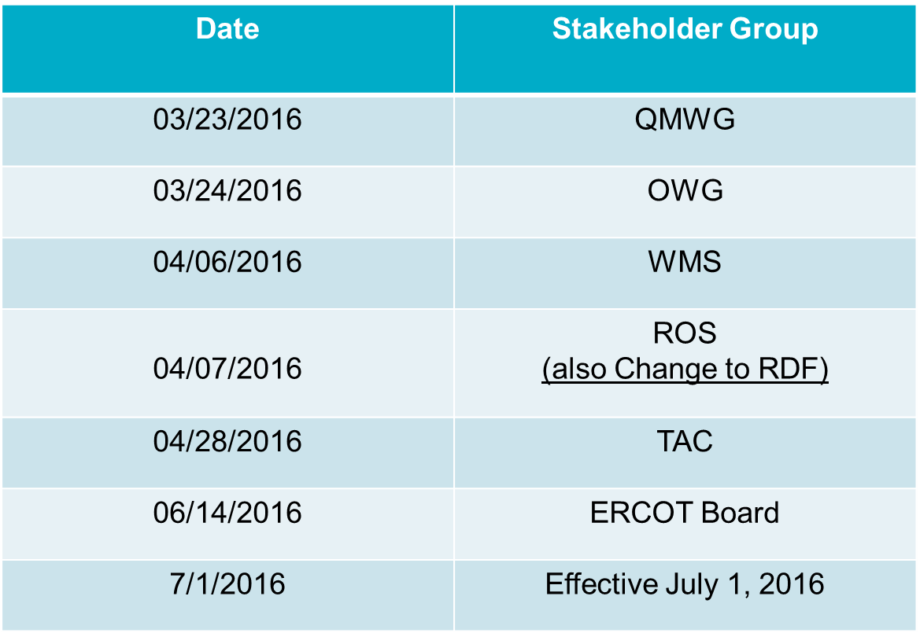
Proposed timeline for review of AS Methodology

Slide 4
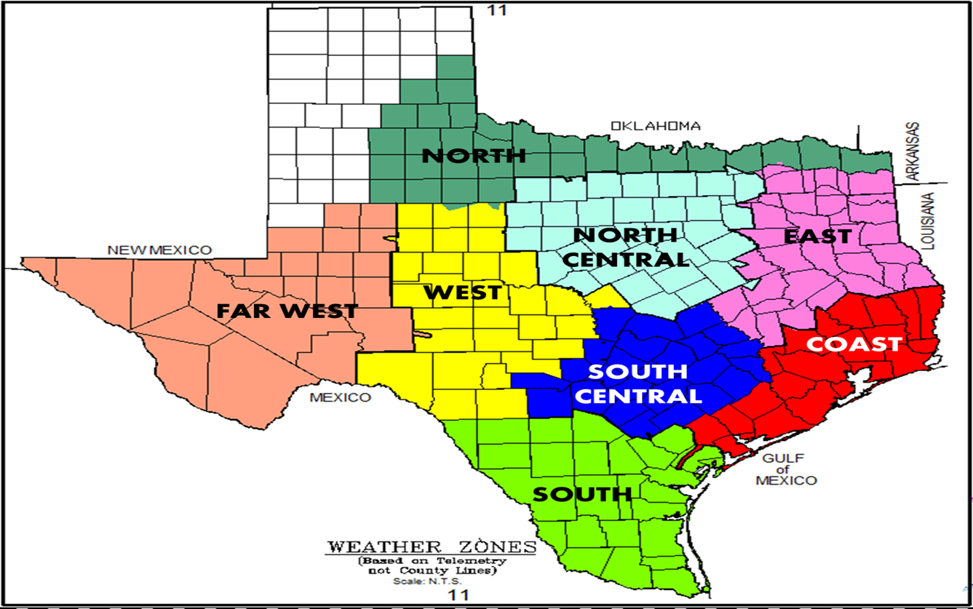
ERCOT Weather Zones

Slide 5
Weather Stations

Slide 6
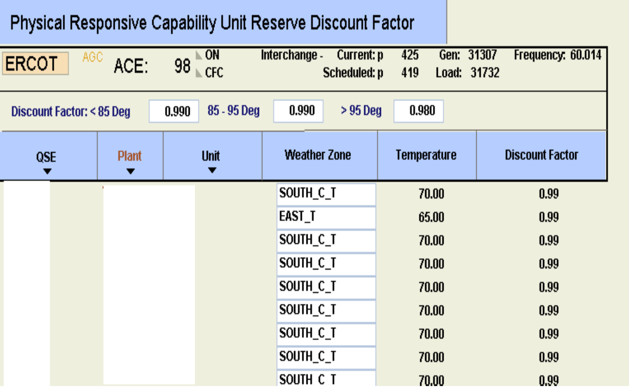
Reserve Discount Factor
Reserve Discount Factor

Slide 7
August 13th, 2015 Benchmark

Slide 8
August 13th, 2015 Benchmark
-PRC Actual (Calculated) determined using 0.98 RDF as in Real-Time.
-PRC calculated using a maximum 1% discount; effectively replacing any 0.98 RDF with a 0.99 RDF.
-PRC (No RDF) eliminates any discount from the HSL in the PRC equations for each individual unit.

Slide 9
Low PRC Intervals (<3,00MW)
299 sampled intervals where PRC < 3,000 MW between HE15 and HE18.

Slide 10
Difference Between Actual PRC and PRC with 1% RDF (<3,00MW)
-Average 159 MW Increase in PRC
-98th Percentile: 204 MW Increase or Less
-95th Percentile: 197 MW Increase or Less

Slide 11
Difference Between Actual PRC and PRC with no RDF (<3,00MW)
-Average 256 MW Increase in PRC
-98th Percentile: 345 MW Increase or Less
-95th Percentile: 324 MW Increase or Less
Notes:
No samples 17:40 and later

Slide 12
Lowest PRC Intervals (<3,00MW) with RDF Increase
RDF Increase Impact on PRC Intervals < 3,000 MW
 | PRC (1% RDF) MW | PRC (2% RDF) MW
Average
All (HE15 - HE18) | 159 | 256
HE15 - HE16 | 157 | 260
HE17 - HE18 | 158 | 234
98th Percentile
All (HE15 - HE18) | 204 | 345
HE15 - HE16 | 202 | 335
HE17 - HE18 | 205 | 355
95th Percentile
All (HE15 - HE18) | 197 | 324
HE15 - HE16 | 194 | 324
HE17 - HE18 | 197 | 325

Slide 13
ERCOT Temp –Weighted Weather zone temp – 4 Hour Block

Slide 14
Ancillary Service Methodology Changes
  Using this analysis, ERCOT recommends procuring a additional 200 MW of RRS during HE 15 through HE 18 (4 hour block) when there is higher likelihood of RDF being less than 1 across all the weather zones for all hours within a block. (This assumes up to 200 MW of RRS adjustment for 1% RDF)
  This increases RRS procurement for HE 15 through HE 18 in July, and August of 2016

Slide 15
Current Vs Proposed RRS

Slide 16
Current Vs Proposed RRS

Slide 17
Questions and Recommendations

Slide 18
ERCOT Temperature – Weighted Average Temp of Weather zone

Slide 19
ERCOT Temperature – Weighted Average Temp of Weather zone

