Slide 1
NPRR 649 Workshop
Resmi Surendran
ERCOT Market Operations
March 11, 2016

Slide 2
Agenda
  Statics on HDL Overrides
  Operational Improvements
  Option 1: Override RN LMP
  Option 2: Enter Constraints above RN

Slide 3
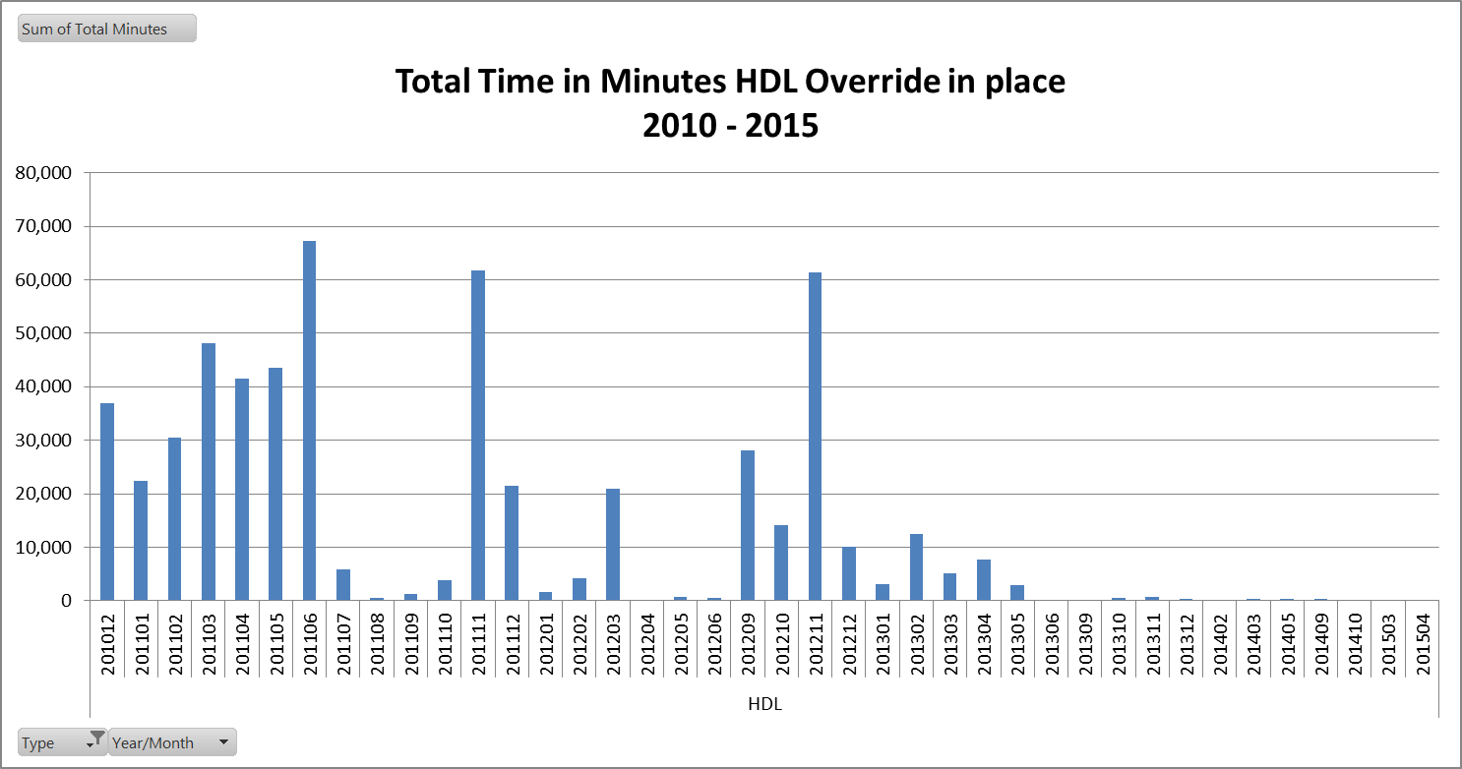
Statistics on HDL Overrides

Slide 4
Statistics on HDL Overrides
Operations has been working hard to reduce HDL overrides over time
Year | Cumulative SCED intervals
 | In Minutes | In Days
Dec - 2010 | 36,927 | 25.64
2011 | 348,190 | 241.8
2012 | 141,971 | 98.59
2013 | 32,826 | 22.8
2014 | 1,200 | 0.83
2015 | 57 | 0.04

Slide 5
Operational Improvements
HDL overrides have been reduced over time due to the following reasons:
  Increased operator training: no overrides unless >125% Emergency rating AND it is a cascading condition, OR an unsolved contingency, OR a base case overload
  The ability for the operators to enter manual constraints
  The availability of new Generic Transmission Constraints
  Improvements in topology

Slide 6
Reasons for current HDL Overrides
Operators are currently using HDL overrides to
  Pre-posture for Outages
    To avoid large negative prices to units which have slow ramp rates. This is done only when the study before initialing the outage shows that there will be big post contingency overload as soon as the outage is taken
  Ensure reliability against unsolved contingencies
    Significant overloading on a constraint could result in unsolved contingencies which would require manual action
  Reduce post-contingency flows which are above 125%
    due to potential IROL assessment requirements
  Resolve unit control system issues

Slide 7
Option 1: Override Resource Node LMP
Automated post process to override LMPs at the Resource node based on the SCED step 2 Energy Offer Curve (EOC) for a Resource limited by manually overridden HDL
Based on most recent valid EOC for the impacted intervals that was received by ERCOT before the HDL override was issued.
If no curve exists for the interval, ERCOT will use the most recent valid Energy Offer Curve received before the HDL override was issued for an interval prior to the interval undergoing the LMP adjustment.

Slide 8
Option 1: Override Resource Node LMP
Problems with the overriding LMP :
  Inconsistency between BP and LMP could arise if multiple resources are connected to the Resource Node and only one Resource gets the override
    Totally 98 Resource Nodes have at least 2 Resources mapped (Maximum 6)
    Totally 42 EPS Meters have at least 2 Electrical Buses mapped (Maximum 3)
  How to determine LMP if multiple resources receive the override and they each have different EOCs.
  Changes in LMP could result in increased charges to Loads for paying PTP which will be uplifted via RENA. This uplift could end up being higher than payments listed in NPRR649

Slide 9
Resource Nodes with Multiple Resources
    Totally 98 Resource Nodes have at least 2 Resources mapped (Maximum 6)
    Totally 42 EPS Meters have at least 2 Electrical Buses mapped (Maximum 3)
GEN 1
GEN 2
GEN 3
Transformer
EPS Meter
RN
GEN 4
GEN 5
GEN 6

Slide 10
Option 1: Override Resource Node LMP
Problems with the overriding LMP :
  There is no way to minimize the impact in DAM clearing of the RT HDL overrides that persists for multiple days
  There is no transparency unless a new report is created for it
  If the Resource knows before hand that they will receive an override, then there could be potential issues including changing their Energy Offer Curve and purchasing Point to Points

Slide 11
Option 2 : Enter Constraint above RN
Pre-position Network Model with a Manual Constraint associated with each Resource node
Change operator display to include the ability for the operator to pull up the TCM list of Manual Constraints by Resource Node. Operator would select the appropriate constraint and input the limiting value and the time duration that the constraint should be active.
The constraint would be passed to SCED with the limit and the duration which would appropriately set the price for the appropriate time period.
If the Operator believes the limit will be needed for the next Operating day, Day Ahead Market Operator will be notified and constraint limit will be entered in TCM for market systems so as to activate the constraint in the Day Ahead Market.

Slide 12
Option 2 : Enter Constraint above RN
Problems with constraints for Resources:
  Needs to be automated since manual activation of constraint can cause the constraint to be violated setting RN LMP at -$5k
  Operator training required
  Dependent on staff developing appropriate constraints for each unique resource node case
  Once developed, constraints must be maintained on an ongoing basis to keep up to date with the N/W model changes
  Setting of limits for DAM would still be manual

Slide 13
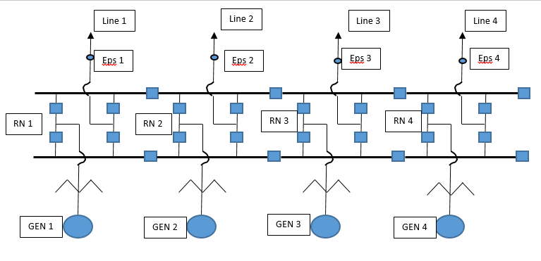
Option 2 : Enter Constraint above RN

Slide 14
Questions?

