Slide 1
Project Update and Summary of
Project Priority List (PPL) Activity
March 10, 2016

Slide 2
Project Update Agenda
Project Portfolio Update p. 3-6
Recent/Upcoming Project Highlights
2016 Release Targets
2016 Project Spending Forecast
SCR755 Comments
Appendix
Project Portfolio Gantt Chart p. 7-13
Location of Project Priority List (PPL): http://www.ercot.com/services/projects/index

Slide 3
Recent / Upcoming Project Highlights
2016 April Release – Week of 4/12/2016 In Flight
NPRR419 – Revise Real-Time Energy Imbalance and RMR Adjustment Charge
NPRR515 – Day-Ahead Market Self-Commitment of Generation Resources
NPRR728 – Removal of Language Related to NPRR484
Section 16.11.4.7 (2)
2016 June Release – Week of 6/14/2016 In Flight
NPRR515 – Day-Ahead Market Self-Commitment of Generation Resources
NPRR617 – Energy Offer Flexibility
NPRR700 – Utilizing Actual Fuel Costs in Startup Offer Caps
RMGRR126 – Add’l ERCOT Validations for Customer Billing Contact Information File
RMGRR127 – Efficiencies for Acquisition Transfer
Note: Projected Go-Live dates are subject to change. Please watch for market notices as the effective dates approach.

Slide 4
2016 Release Targets – Board Approved NPRRs / SCRs / xGRRs
February 2/2 – 2/4 | April 4/12 – 4/14 | June 6/14 – 6/16 | August 8/9 – 8/11 | October 10/11 – 10/13 | December 12/6 – 12/8
NPRR588 NPRR615 NPRR686(b) | NPRR419 NPRR515 NPRR728 | RMGRR126 RMGRR127 NPRR515 NPRR617 NPRR700 EMS Upgrade | NPRR495 NPRR662 NPRR736 RMGRR126 | NPRR219 SCR783 | NPRR210 NPRR272 NPRR573 NPRR714 RMGRR127 RRGRR003 RRGRR006 RRGRR007 SCR781
3 | 2 | 3 | 4 | 2 | 7
E
E
E
E
E
E
NS
E
NS
P
E
E
NS
H
NS
P
NS
NS
NS
May 26
EMS Upgrade “Chill”
2016 TBD Items (and point at which they became “TBD”)
2014 | November 2015 | December 2015 | February 2016
NOGRR084, NPRR664 | NPRR679 | SCR786 | NPRR210, SCR781 H, NOGRR147
Go-live dates can differ from Protocol effective dates – Please refer to market notices for more details
APPENDIX
Red Text: New additions and target release changes
Strike-Through Text: Previous target release changes
(a), (b), etc. indicates multiple phases
NPRR686(b) – Solar portion
In-Flight Items Planned for 2017 Delivery
CMM bundle (Planning): NPRR439, NPRR519, NPRR620, NPRR683, NPRR702
CRR Upgrade (Planning): SCR777
Release targets are subject to change
Project Status Codes: NS = Not Started, I = Initiation, P = Planning, E = Execution, H = On Hold

Slide 5
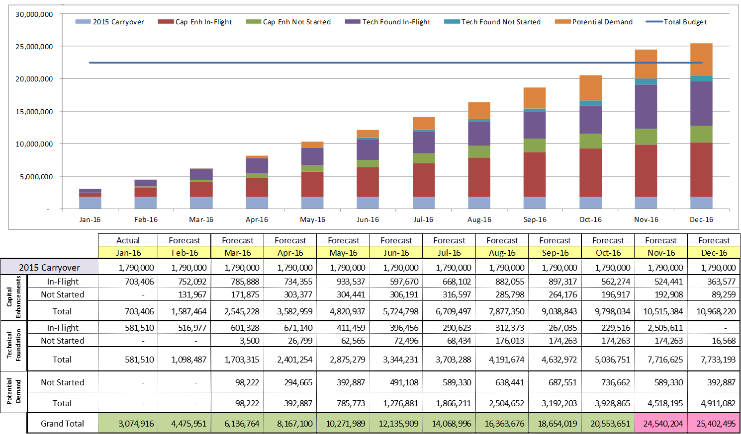
2016 Project Spending Forecast
2016 PPL Budget = $22.5M
“Potential Demand” represents internal ERCOT projects that have not been fully approved

Slide 6
SCR755 Comments
SCR755 – ERCOT.com Website Enhancements
Approved by the Board in 2010 for the Parking Deck
See filed ERCOT Comments for status of the 10 SCR requirements
ERCOT will file a final set of Comments upon completion of the SCR requirements

Slide 7
Appendix
2/29/2016 Project Gantt
In-flight items sorted by Project End Date
“On Hold” projects listed separately
“Not Started” items sorted by Project Start Date

Slide 8
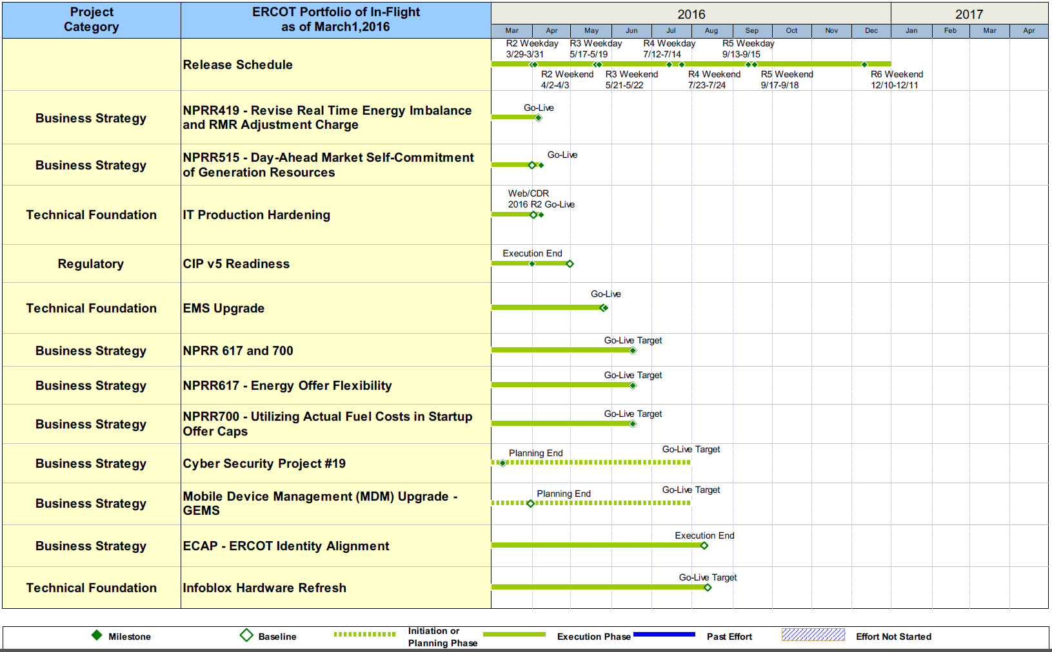
Project Portfolio Status – as of 2/29/2016

Slide 9
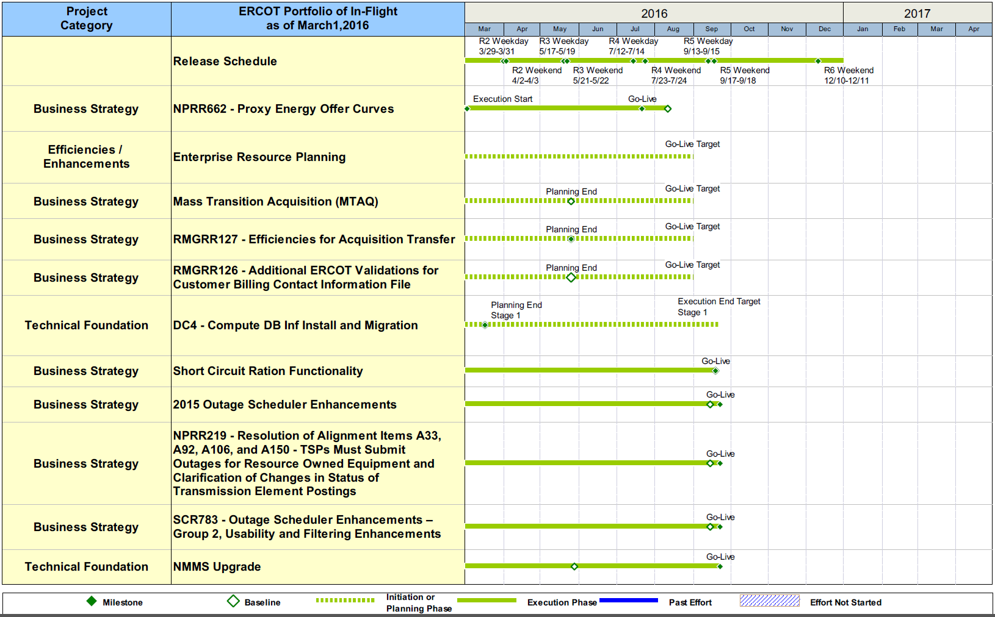
Project Portfolio Status – as of 2/29/2016

Slide 10
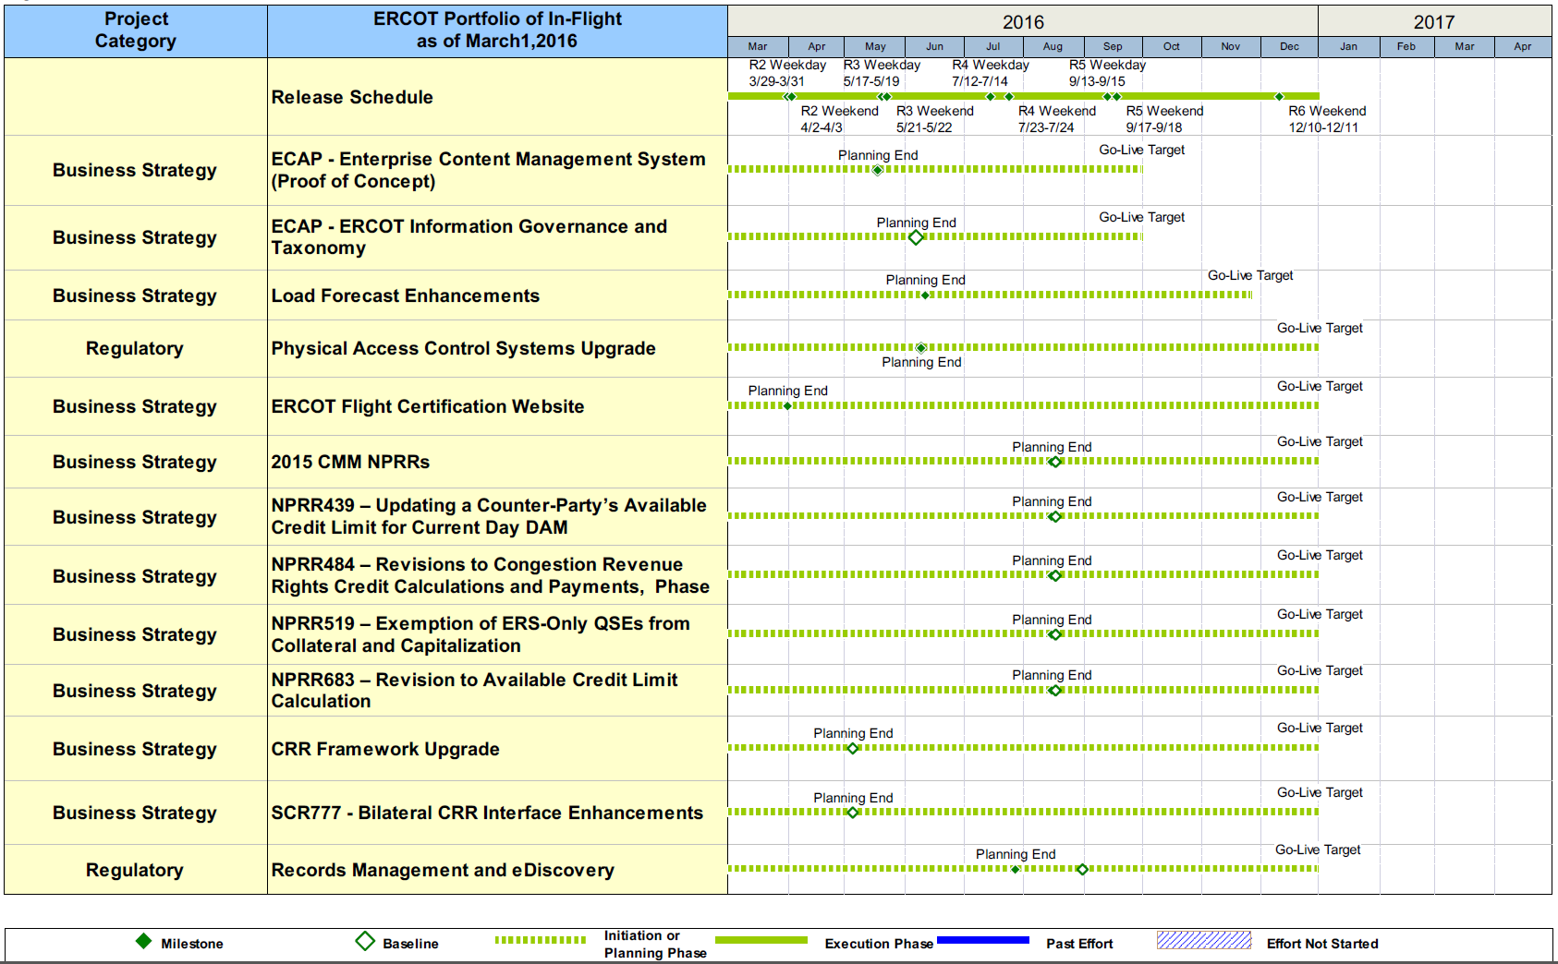
Project Portfolio Status – as of 2/29/2016

Slide 11
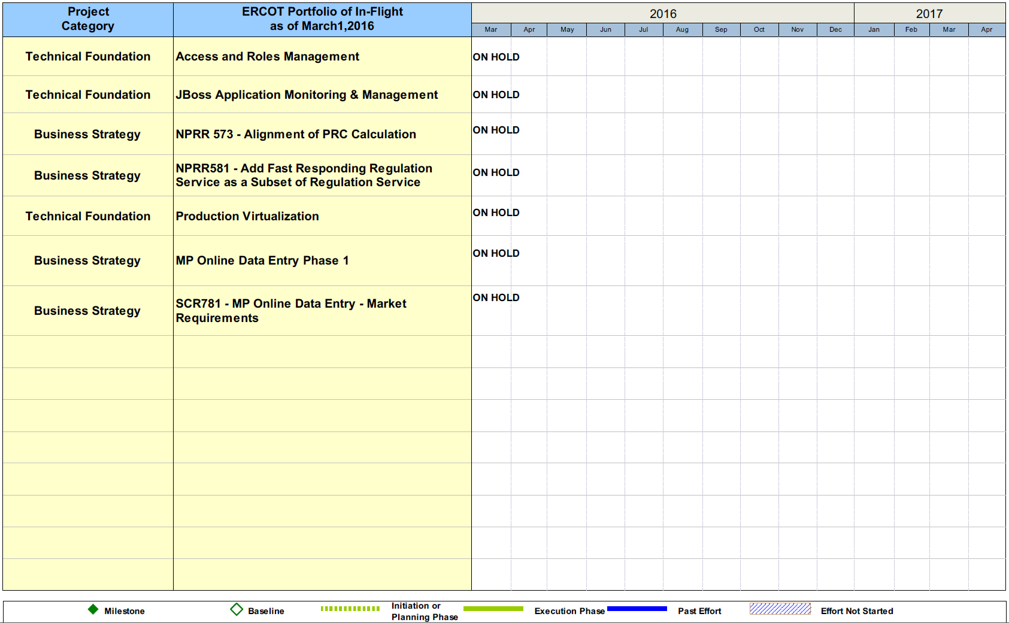
Project Portfolio Status – as of 2/29/2016

Slide 12
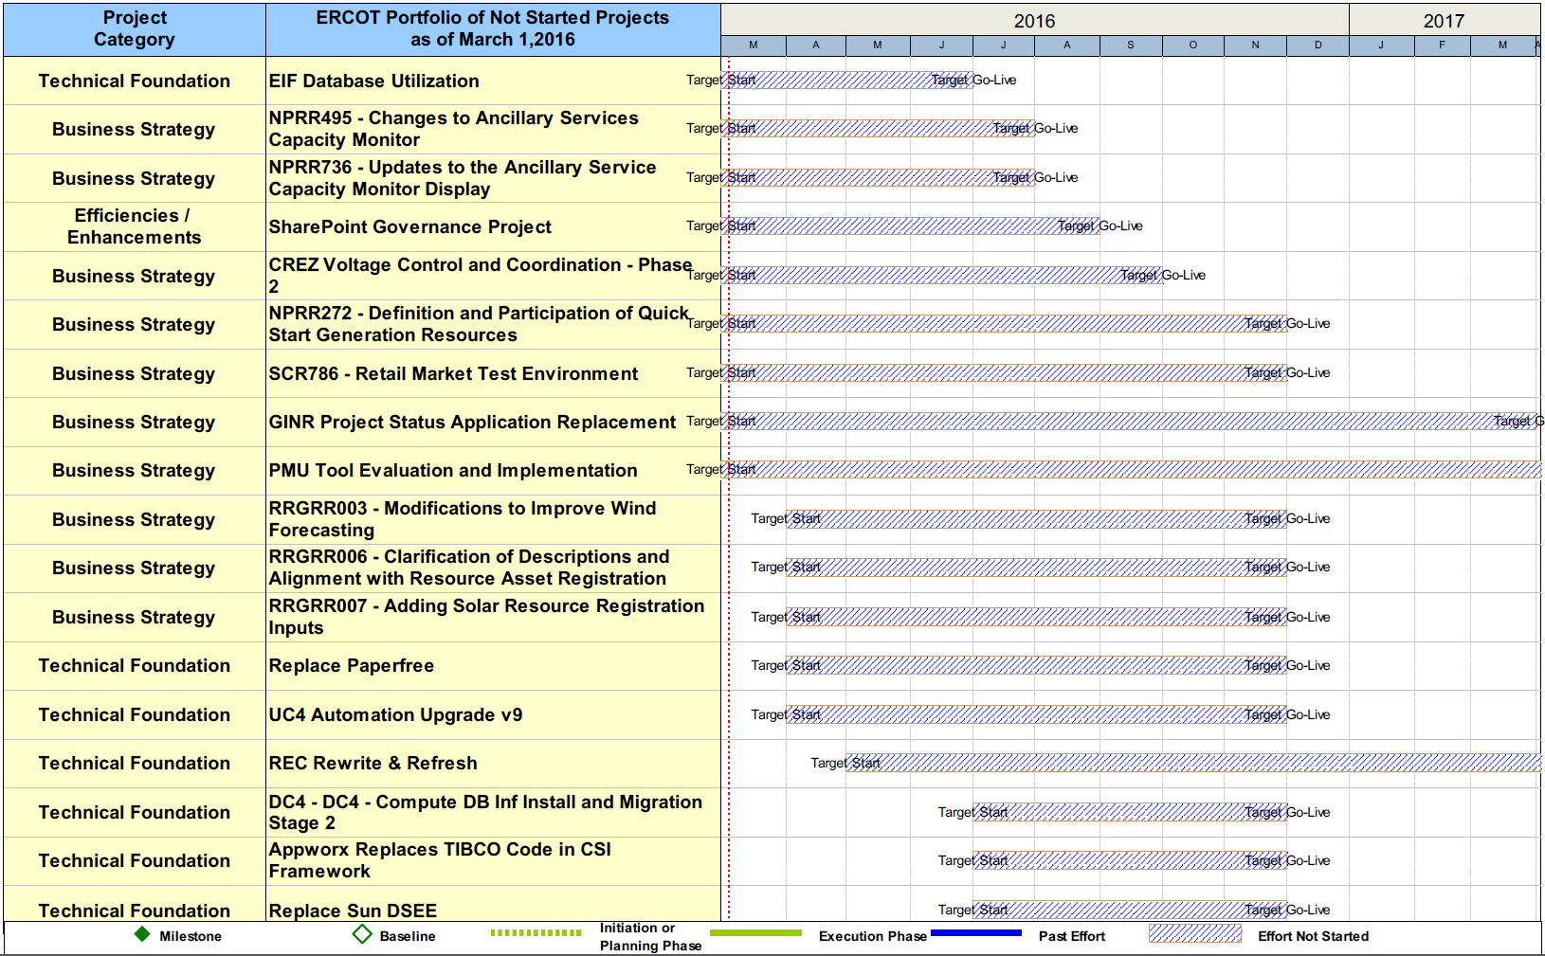
Project Portfolio Status – as of 2/29/2016

Slide 13
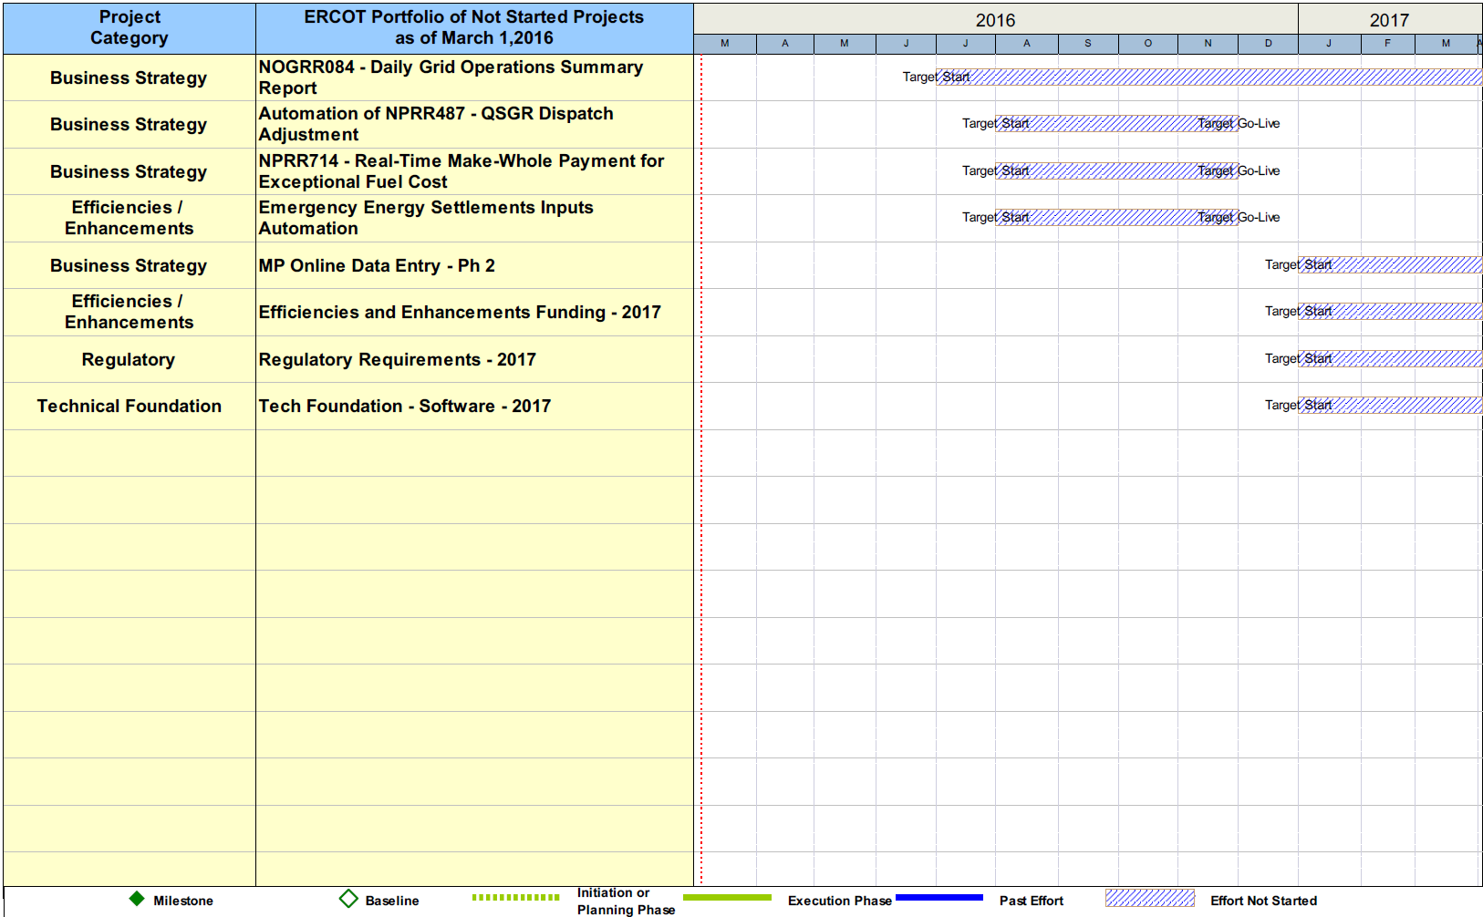
Project Portfolio Status – as of 2/29/2016

