Slide 1
Future Ancillary Services Cost Benefit Analysis - Additional Runs and Analysis
Julie Jin
March 10, PRS

Slide 2
Additional Runs and Analysis
2016 with Gas Price @ $2.36/MMBtu vs. $4.35/MMBtu
2016 with Gas Price @ $2.36/MMBtu and New IFRO (@1143 MW vs. 1240 MW)
2016 with Gas Price @ $2.36/MMBtu, IFRO @1143 MW and New NSRS Requirements approved by Board in December 2015.

Slide 3
CBA Findings (Brattle Slide 7)
 | CAS | FAS | Savings | Comment
Procure Less PFR by recognizing equivalency ratios and allowing more FFR (incl. FFR1)
2016 Avg MW | 1,468 | 1,329 | 140 | Allowing > 50% FFR; eliminates the need for buffer. Increasing FFR by 24 MW on average.
2024 Avg MW | 1,453 | 1,325 | 129 | Slightly less than 2016 due to higher net load & inertia. Increase FFR by 13 MW on average.
2024 Avg MW w/new tech | 1,453 | 1,267 | 186 | Assumes 62 MW of new batteries reducing avg. PFR by 57 MW; because residual avg. FFR opportunity (after load resources are considered) is only 62 MW and highly variable
Replace Non-Spinning Reserve with less CR and SR (the products are comparable because of common NSRS/CR/SR duties and supply base)
2016 Avg MW | 1,931 | 1,175 | 756 | FAS adapts requirements relative to system conditions; additionally CR is determined based on frequency obligations, and Non-Spinning Reserve is determined to meet deviations in net load.
2024 Avg MW | 2,000 | 1,210 | 790 | See above (note: assumptions about new tech do not affect CR)

Slide 4
Additional Runs and Analysis
 | CAS | FAS | Savings | Comment
Procure Less PFR by recognizing equivalency ratios and allowing more FFR (incl. FFR1)
2016 Avg MW w/gas @ $2.36/MMBtu | 1,384 | 1,307 | 78 | MW saving is less than the original 2016 CBA case due to CC replacing coal under lower gas price analysis .
2016 Avg MW w/gas @ $2.36/MMBtu & new IFRO | 1,384 | 1,214 | 170 | MW saving is higher than Row 1 above because the lower IFRO allows more FFR. MW saving is higher than in the original 2016 CBA.
Replace Non-Spinning Reserve with less CR and SR (products comparable because of common NSRS/CR/SR duties and supply base)
2016 Avg MW w/ gas @ $2.36/MMBtu | 1,931 | 1,215 | 716 | CR increased because CC replaces coal under the lower gas price analysis which also increases system inertia.
2016 Avg MW w/ gas @ $2.36/MMBtu & new IFRO | 1,931 | 1,215 | 716 | New IFRO didn’t change unit commitment.
2016 Avg MW w/ gas @$2.36/MMBtu, new IFRO & new NSRS | 1,571 | 1,215 | 356 | Based on the new NSRS method approved by Board in December 15. The reduced NSRS requirement (compared to original 2016 CBA case) reduces savings.

Slide 5
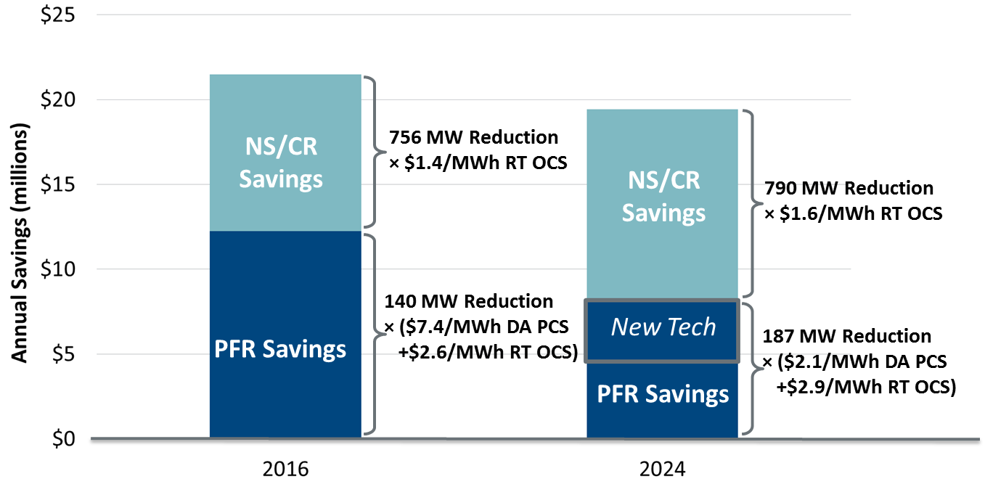
CBA Findings (Quantified Annual Benefits) (Brattle Slide 10)
In 2016, PFR reduction provides high DA production cost savings (DA PCS) per MWh because it enables greater coal dispatch. 2024 has higher net load, so coal is more fully baseloaded.
Real-time opportunity cost savings (RT OCS) analyzed through historical AS bids.
Compare these annual benefits to ERCOT’s one-time implementation cost of $12-15m.

Slide 6
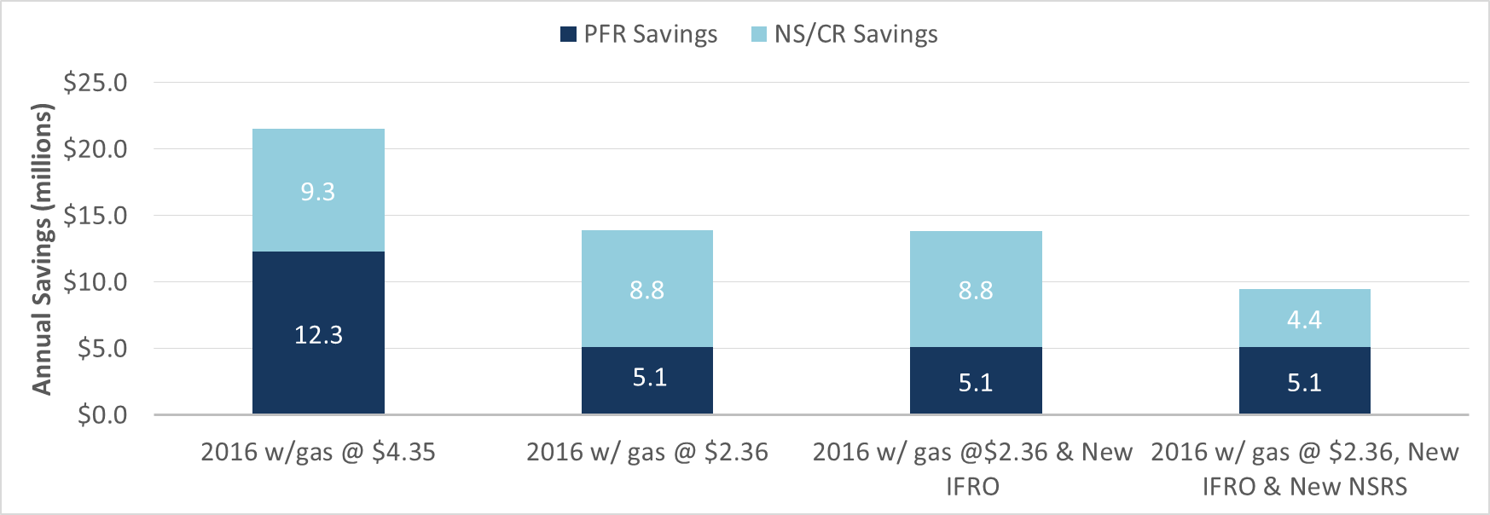
Additional Runs (Quantified Annual Benefits)
In Case 2016 w/ gas price @ $2.36/MMBtu, the day-ahead production cost saving is M$ 3.33 ($4.88/MWh).
In Case 2016 w/ gas price @ $2.36/MMBtu and new IFRO, the day-ahead production cost saving is M$ 3.31 ($2.22/MWh)
Real-time opportunity cost savings (RT OCS) for both PFR and NS/CR are calculated based on the average RT OC on Brattle Slide 10.

