Slide 1
PDCWG Report to ROS
Chair: Percy Galliguez, Brazos Electric Power Cooperative, Inc.
Vice Chair: Stewart Rake, Luminant
ROS
March 3rd, 2015

Slide 2
Report Overview & Notes
Report Overview
  Meeting Minutes
  BAL-001-TRE-1 FMEs & IMFR
  Frequency Control Report

Slide 3
Meeting Minutes
PDCWG Meeting 2/10/16
  GREDP Performance Analysis
  Regulation & Frequency Control Reports
  Reviewed 2 ERCOT Frequency Disturbance
    1/21/2016 @ 2314
      Loss of 823 MW
      727 MW/0.1HZ Response
      8 of 46 Generation Resources had less than 75% of their expected Initial Primary Frequency Response.
      12 of 46 Generation Resources had less than 75% of their expected Sustained Primary Frequency Response.
    1/26/2016 @ 2325
      Loss of 1,350 MW
      1,059 MW/0.1HZ Response
      11 of 52 Generation Resources had less than 75% of their expected Initial Primary Frequency Response.
      12 of 52 Generation Resources had less than 75% of their expected Sustained Primary Frequency Response.

Slide 4
Frequency Measurable Events Performance
January 2016

Slide 5
Frequency Measurable Events (CORRECTIONS)
There were 2 FMEs during the month of January.
  1/21/2016 23:14:45
    Loss of 823 MW
    819 of 46 Generation Resources had less than 75% of their expected Initial Primary Frequency Response.
    1215 of 46 Generation Resources had less than 75% of their expected Sustained Primary Frequency Response.
  1/26/2016 23:25:07
    Loss of 1350 MW
    1118 of 52 Generation Resources had less than 75% of their expected Initial Primary Frequency Response.
    1218 of 52 Generation Resources had less than 75% of their expected Sustained Primary Frequency Response.

Slide 6
Frequency Measurable Events
No FMEs during the month of February.

Slide 7
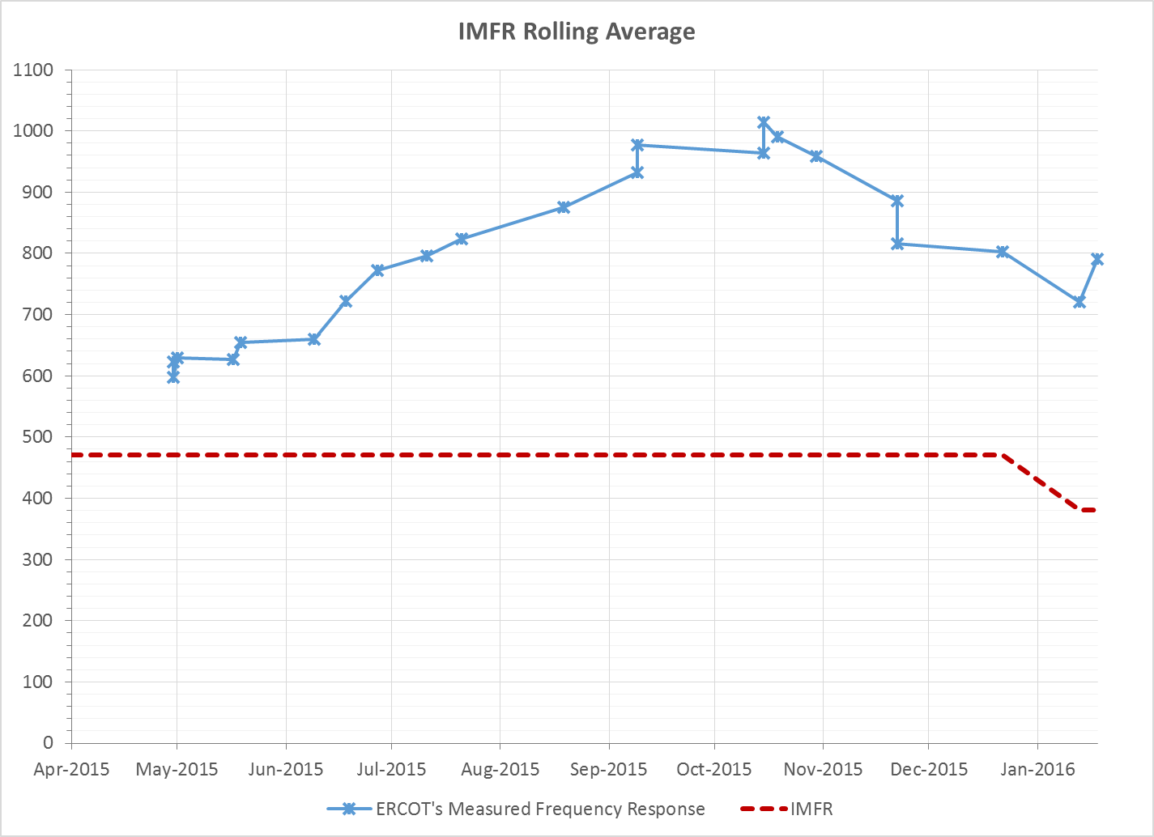
Interconnection Minimum Frequency Response (IMFR) Performance

Slide 8
Frequency Control Report
January 2016

Slide 9
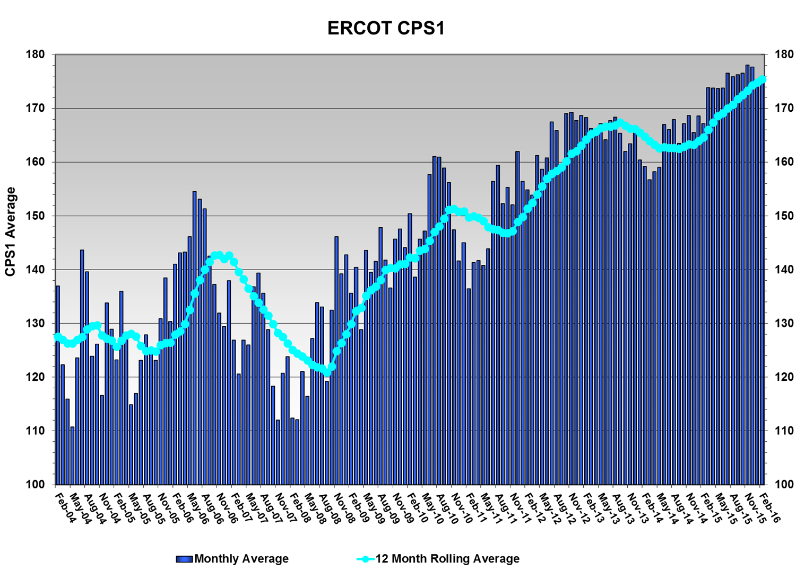
CPS1 Performance
CPS1 12 Month Rolling Average = 175.47%

Slide 10
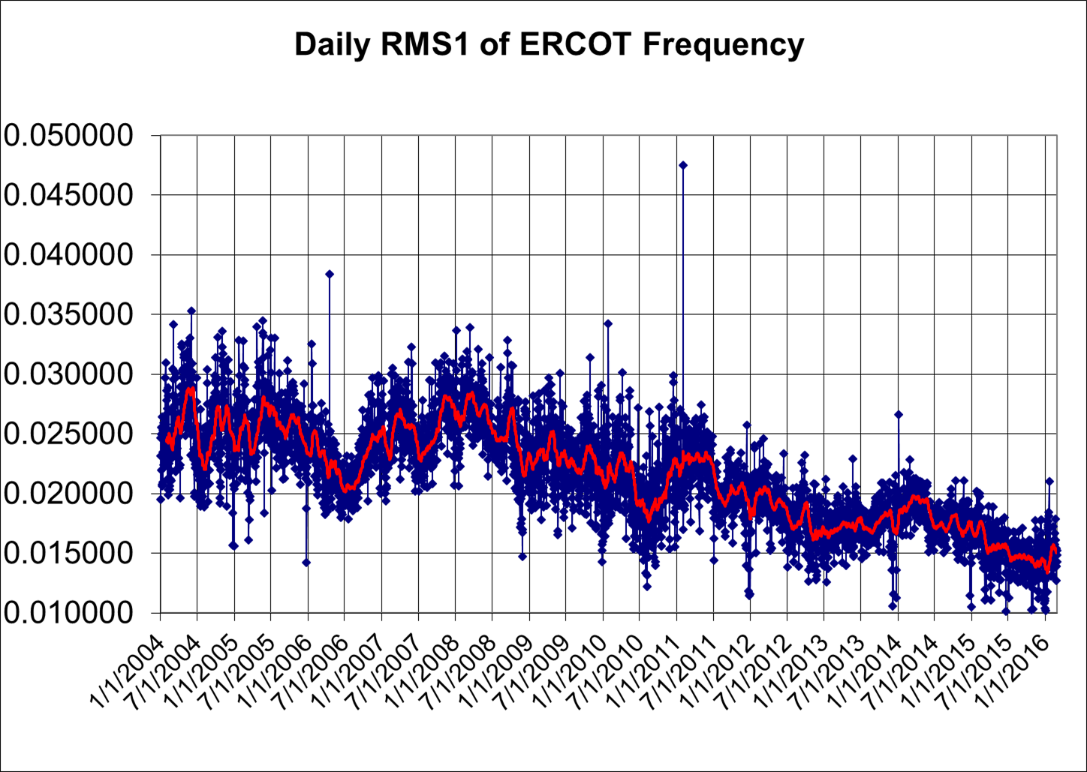
RMS1 Performance of ERCOT Frequency

Slide 11
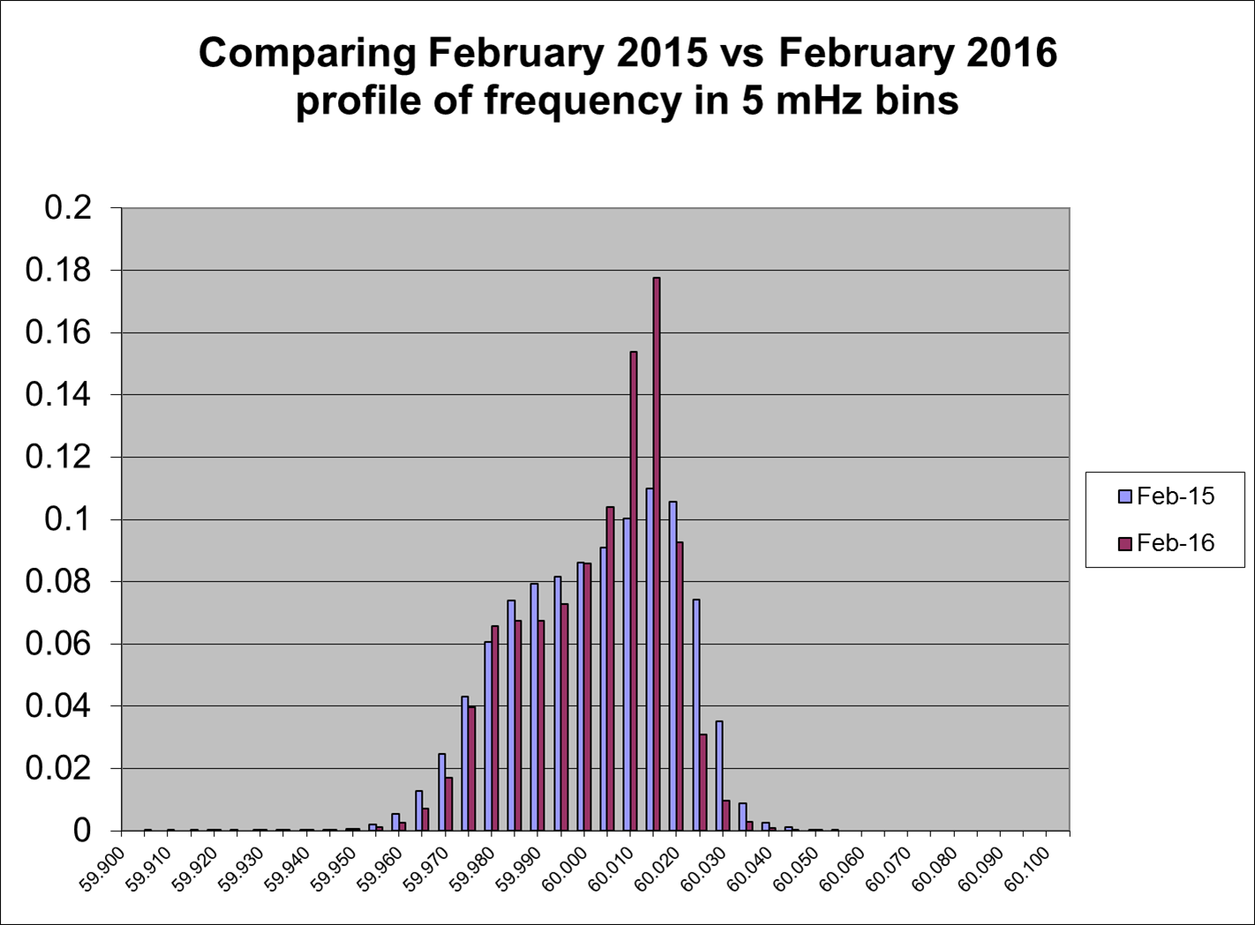
Frequency Profile Analysis

Slide 12
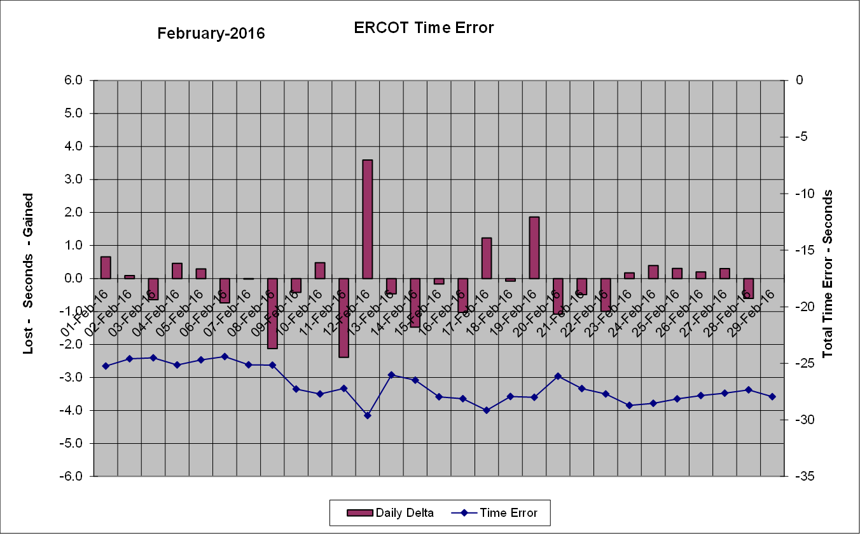
Time Error Corrections
There was two Time Error Corrections (TEC) in February.

Slide 13
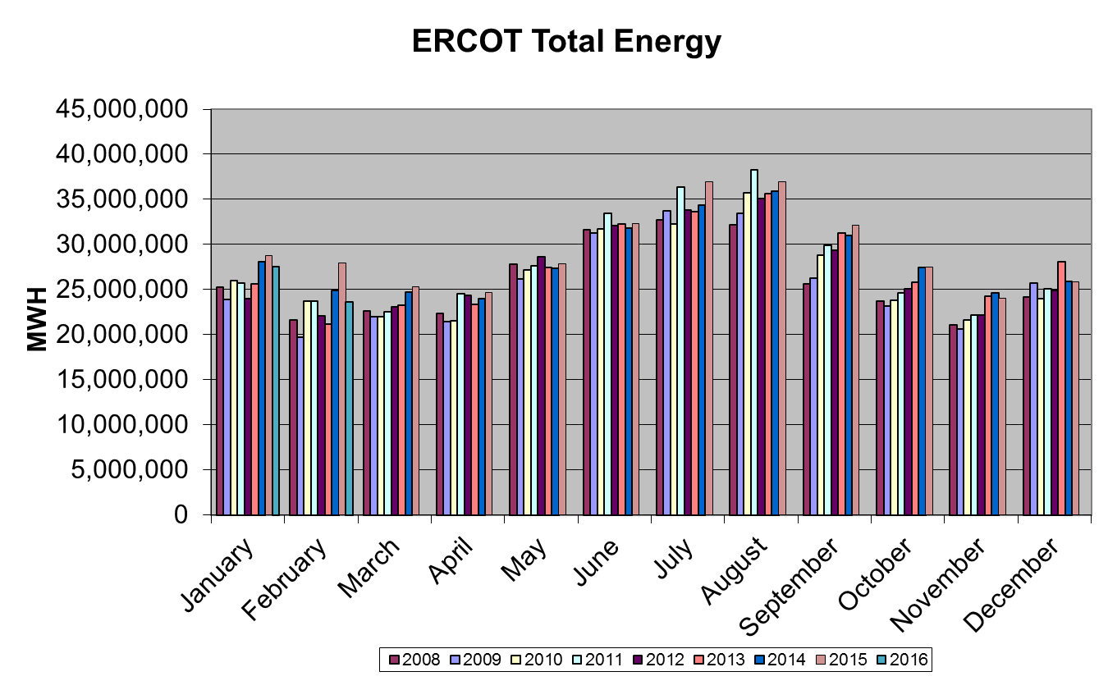
Wind Generation Performance

Slide 14
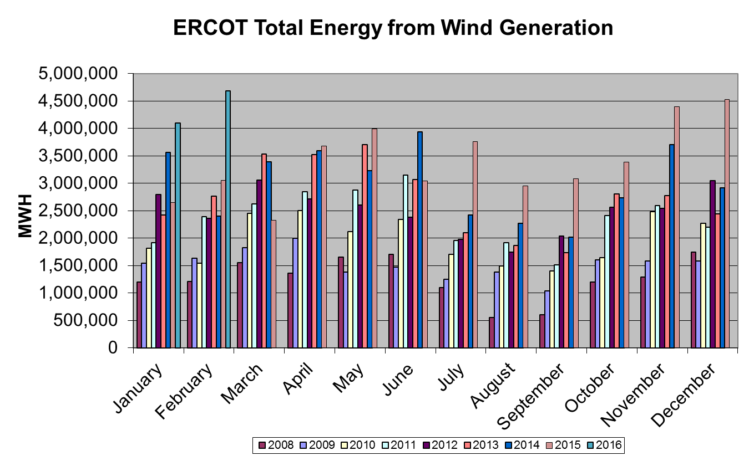
Wind Generation Performance

Slide 15
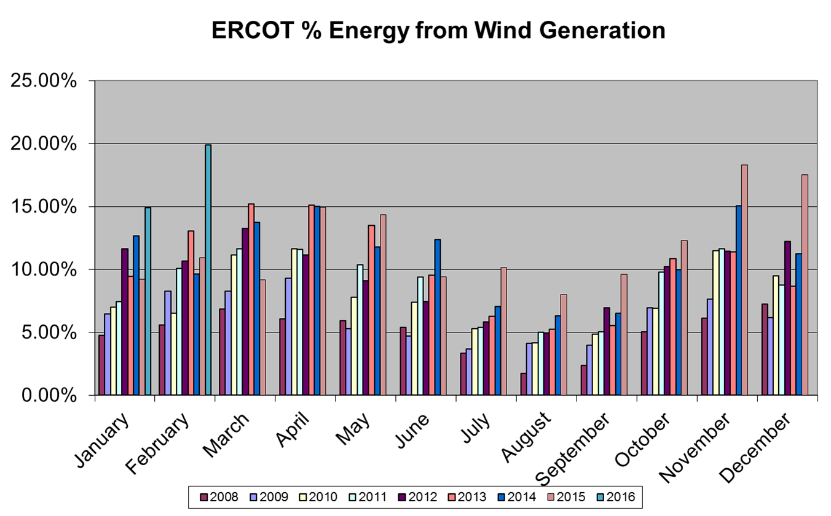
Wind Generation Performance
Record: 19.87% Wind Penetration

Slide 16
Questions?

