Slide 1
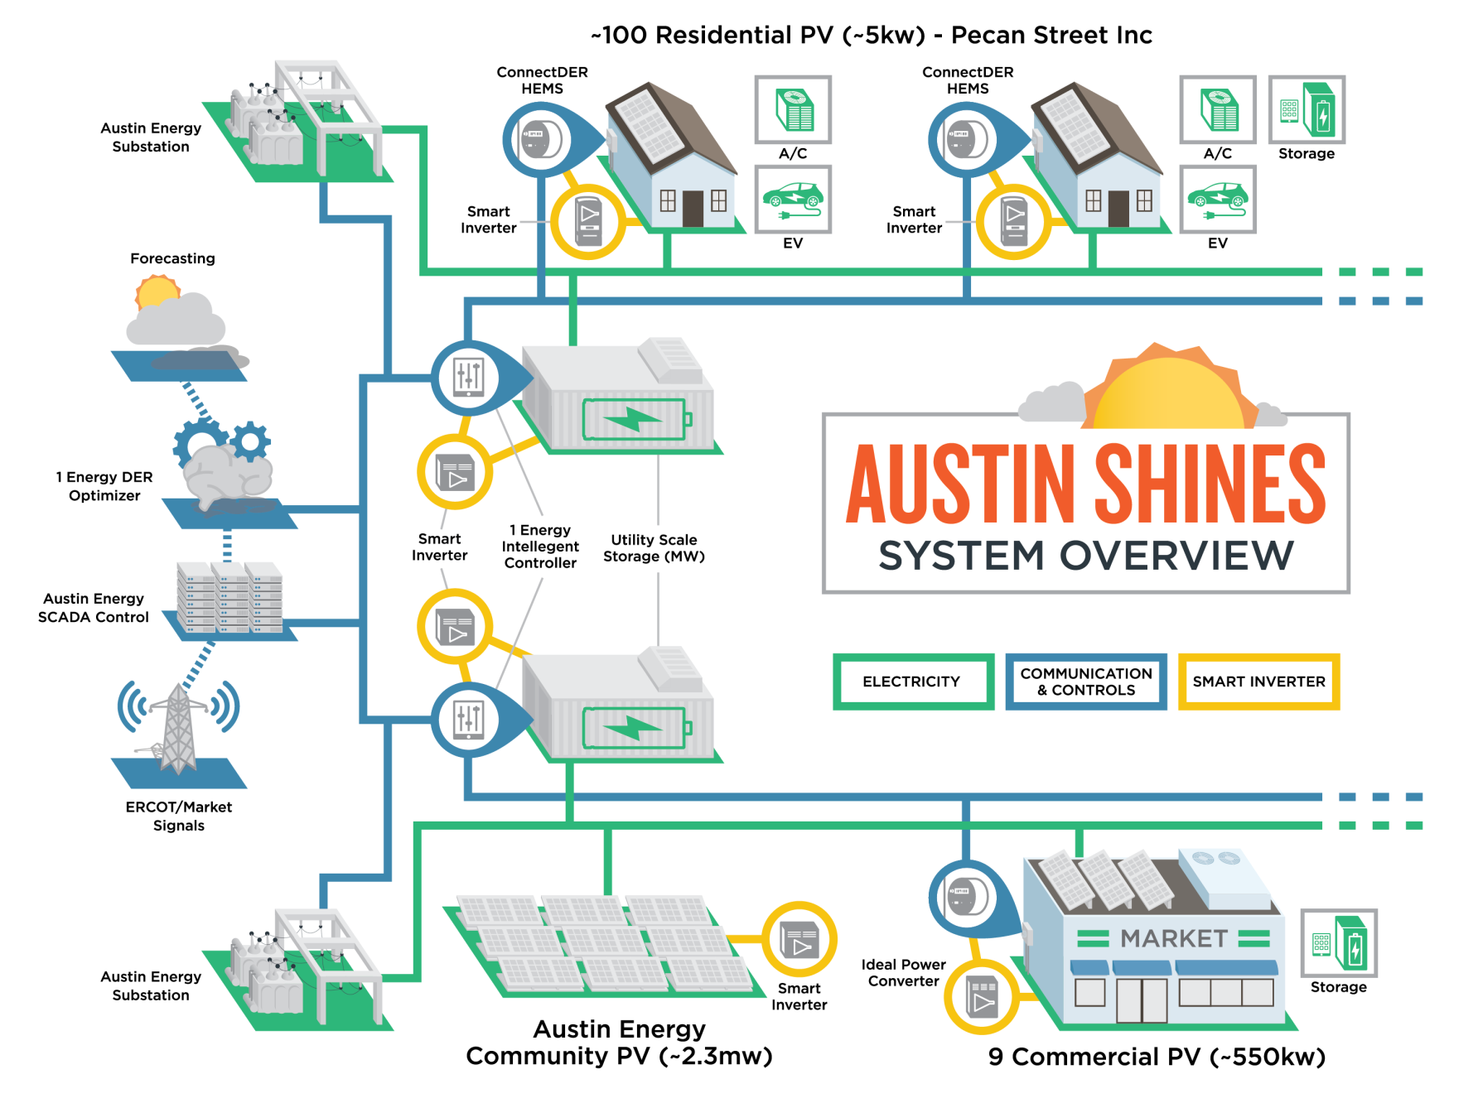
Russell Shaver– Austin Energy
Emerging Technology
March 2016
www.austinenergy.com

Slide 2
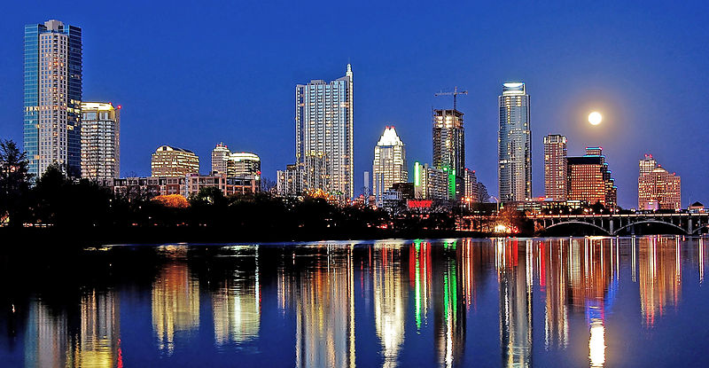
A bit about Austin Energy

Slide 3

Austin Energy 2025 Goals
900 950
55% MW + MW +
55% renewable energy
900 MW of savings from energy efficiency and demand response
Solar includes 200 from local;100 MW customer-sited; 10 MW local storage
All City of Austin facilities, operations and fleet carbon neutral
Subject to Affordability Goals

Slide 4
What is SHINES?
SHINES
Sustainable and Holistic IntegratioN of Energy Storage and Solar PV
… a DOE funding opportunity

Slide 5
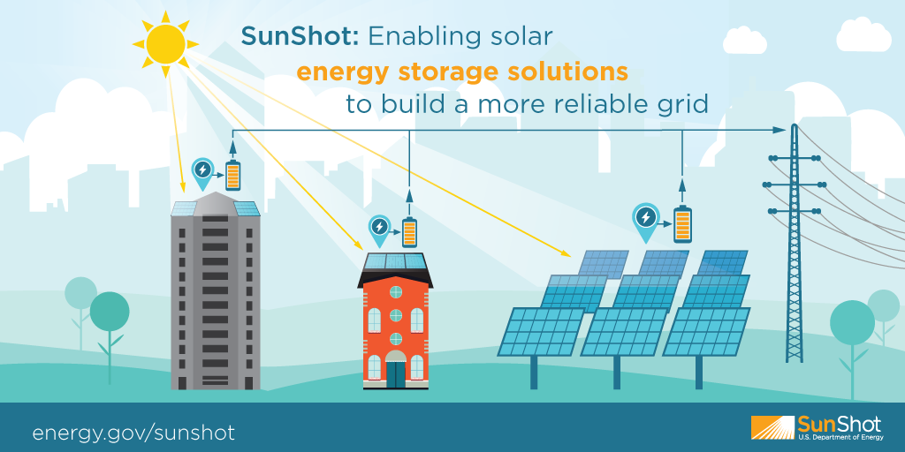
DOE SunShot & SHINES Vision
The projects will work to dramatically increase solar-generated electricity that can be dispatched at any time – day or night – to meet consumer electricity needs while ensuring the reliability of the nation’s electricity grid

Slide 6
SHINES Award Recipients - $18M
Austin Energy will receive $4.3 million to create a distributed energy resource management platform that is adaptable to any region and market structure, aiming to establish a template that can help to maximize the penetration of distributed solar PV
Carnegie Mellon University (Pittsburgh, Pa.) $1 million
Commonwealth Edison Company (Chicago) $4 million
The Electric Power Research Institute (Knoxville, Tenn.) $3.1 million
Fraunhofer USA Center for Sustainable Energy Systems (Boston) $3.5 million
The Hawaiian Electric Company (Honolulu) $2.4 million

Slide 7
The Austin SHINES Solution
Open standards based Distributed Energy Resource (DER) management platform
Includes the integration and optimization of DERs at the utility distribution level
Enables diverse strategies/business models for both utility and customer owned resources; to include direct, third-party, and autonomous resource management of DERs
Integrates 4 MW of distributed PV, more than 3 MW of distributed energy storage, 31 smart inverters and includes more than 700 PV customers
Includes affordability targets and captures holistic benefits via System Levelized Cost of Energy metrics
7

Slide 8

SHINES Conceptual Architecture
Utility Scale Energy Storage + PV
Commercial Energy Storage + PV
Residential Energy Storage + PV
DER Management Platform
Illustrative

Slide 9
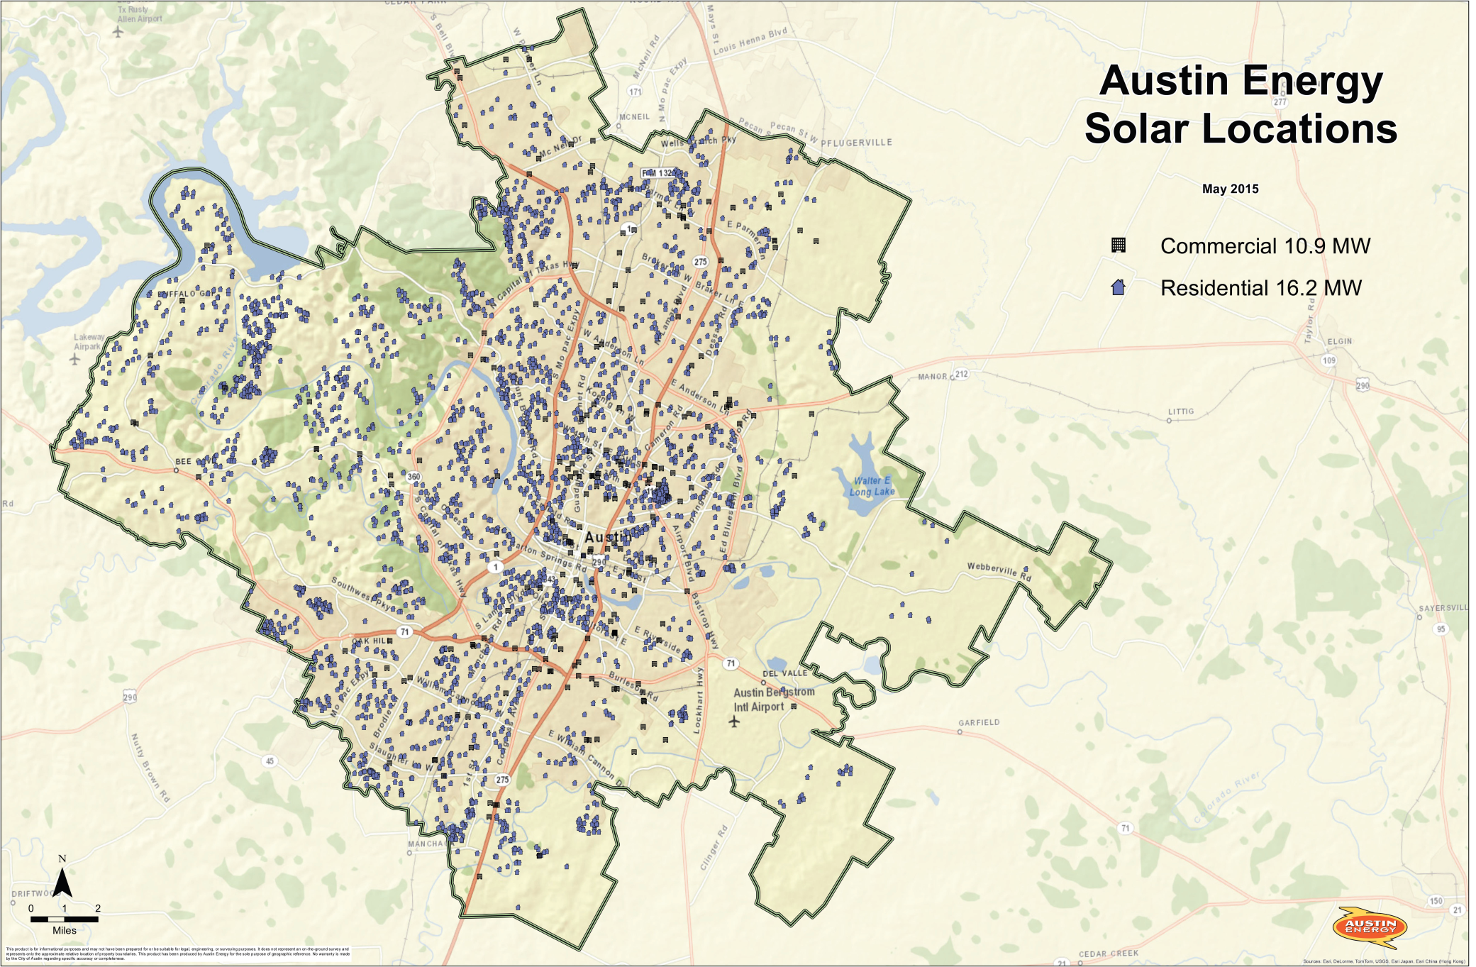
Customer Sited Solar
Mueller – Key Project Location

Slide 10
Key Benefits Derived from SHINES
  Advance utility’s local storage and solar goals
Strategic approach leverages existing and planned work to obtain external funding
  Ultimately reducing the overall cost for the customer
Discover best way to maximize DER value for AE and the customer
Modular approach allows utilities across the country to adopt the scale and use-cases right for them
Project designed to engage customers to develop new programs and consumer options

Slide 11



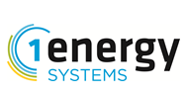









Austin SHINES Partnership

Slide 12
Russell Shaver – Austin Energy
Emerging Technologies
Russell.Shaver@AustinEnergy.com
www.austinenergy.com

