Slide 1
ERCOT Quarterly Performance Measures
ERCOT Total Market Overview (Fourth Quarter 2015)
ERCOT Public
February 2016

Slide 2
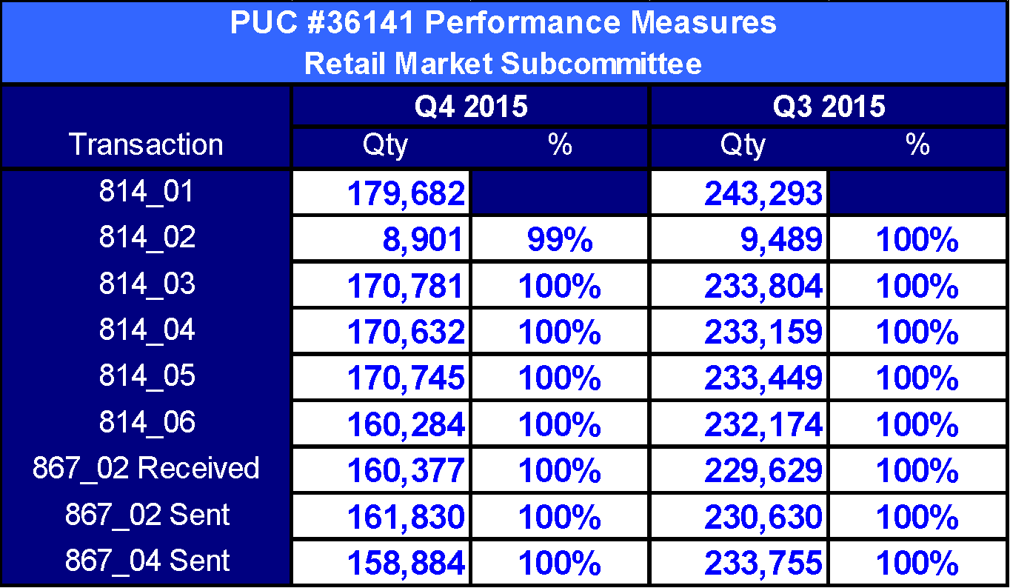
Switch

Slide 3
Standard Move-In

Slide 4
Same Day Move-In

Slide 5
Move-Out

Slide 6
ESI ID Create / Maintain

Slide 7
Count of Transactions

Slide 8

Questions

