Slide 1
Market Credit Working Group update to the Wholesale Market Subcommittee
3/02/2016

Slide 2
MCWG update to WMS
Joint meeting of MCWG and CWG on Wednesday, February 17
4 NPRRs reviewed for credit impacts
4 NPRRs had no credit impact
Discussion of CRR credit lock overlap
No recommendations to change
Seasonal Adjustment Factor – Option 1

Slide 3
MCWG update to WMS
ERCOT Forward Curve Evaluation
MCWG review of historical ICE data
Examine behavior of ICE ERCOT futures during pricing events and seasonal
See Appendix
Discuss how we can use this data in Forward Credit Exposure calculations
Proposal to utilize forward curve data to calculate a factor to adjust calculated exposures
Stakeholder review ongoing and feedback requested
CRIM meeting after WMS dedicated to this discussion

Slide 4
MCWG update to WMS
Review of Audited Financial Statement requirement for Counter-Parties with secured credit
Currently, all Counter-Parties or its guarantors must provide annual audited financial statements regardless of their use of unsecured credit.
Should a Counter-Party which doesn’t seek any unsecured credit be excused from providing annual audited financial statement?
Review of the default process related to collateral calls
Failure to satisfy a collateral call constitutes a material breach of the SFA and results in an event of default.
Forced exit from the market
Instead of a “hard default”, should ERCOT suspend QSE operation and prohibit from participation in any bidding activity for a period of time?
Take a time out and find funds (extended cure period?)
Doesn’t work for REPs

Slide 5
MCWG update to WMS
Treatment of Days With No Activity in EAL
Today, the Real-Time Liability Extrapolated (RTLE), the Unbilled Real-Time Amount (URTA), and Day-Ahead Liability Extrapolated (DALE) variables are based on the 14 (RTLE and URTA) or 7 (DALE) most recent calendar days divided by the number of Real-Time Initial Settlement Statements generated for the Counter-Party in the same period.
Operating Days with zero activity are not captured in the above calculations since Real-Time Settlement Statements are not generated for those Operating Days.
Draft NPRR requests to correct this by capturing the Operating Days with zero activity in the denominator of the RTLE, URTA, and DALE calculations.

Slide 6
Appendix

Slide 7
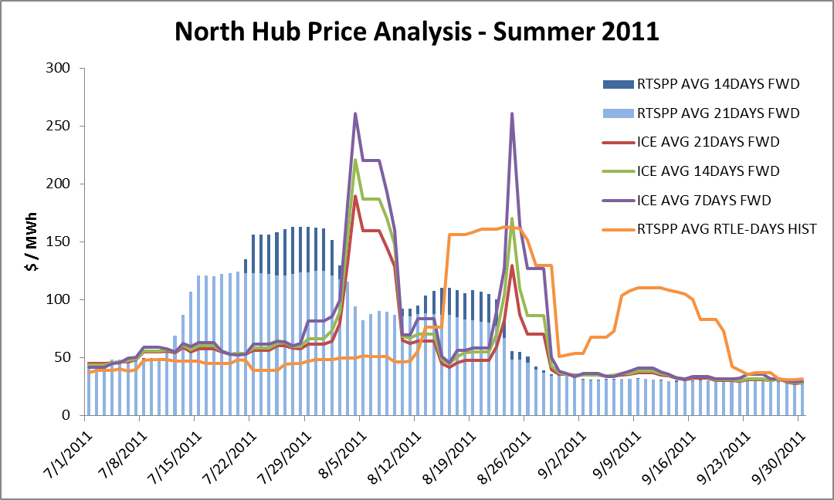
ICE Price Analysis

Slide 8
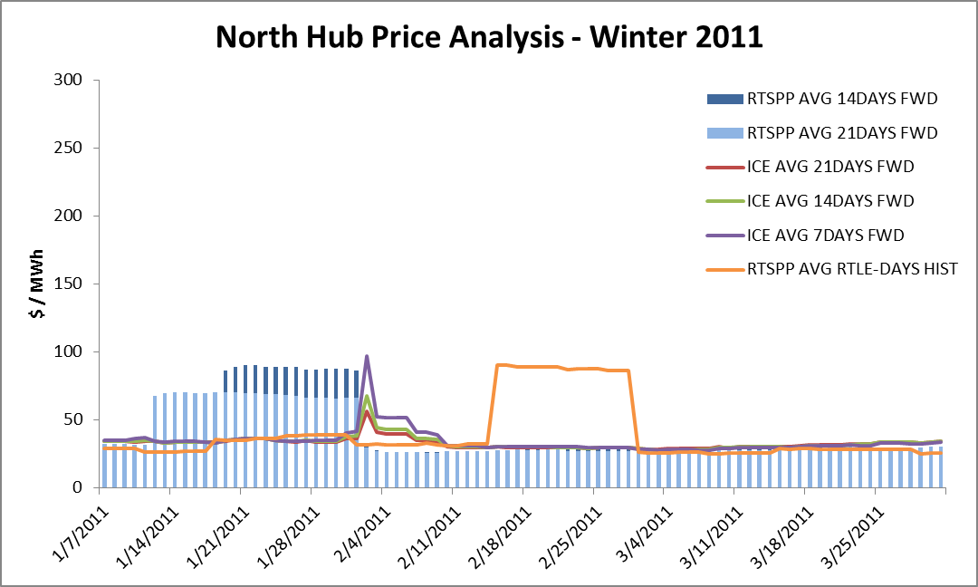
ICE Price Analysis

