Slide 1
Update on NPRR615 PVGR Forecasting
ERCOT Staff
March 1, 2016

Slide 2
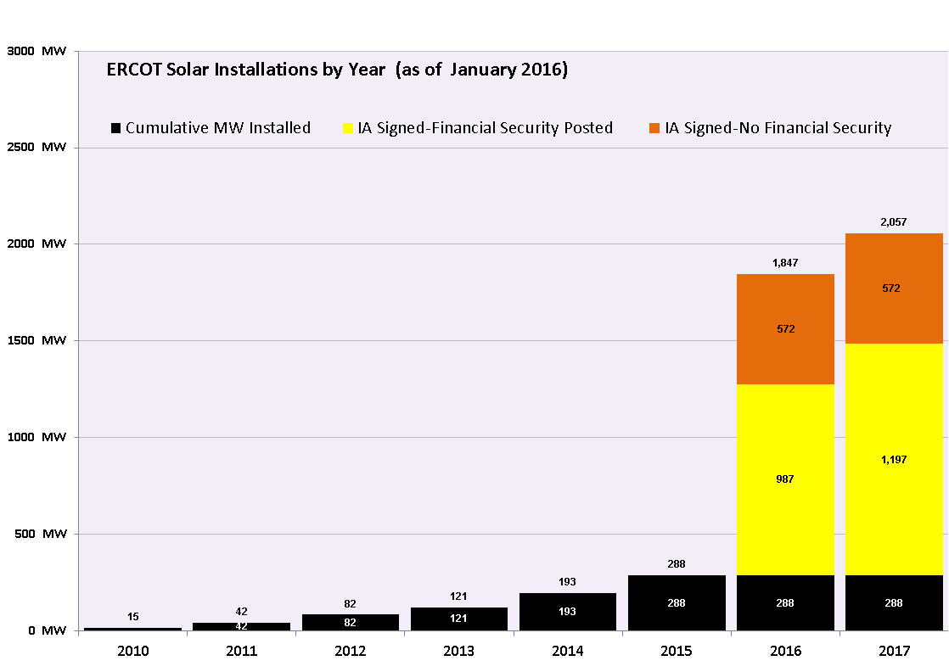
ERCOT Solar Installations by Year

Slide 3
Solar Forecast Implementation
Conducted RFP selecting MDA as our Solar Forecast vendor
Pass solar observation data to MDA every 5 minutes
Receive solar forecast from MDA hourly for the next 168-hour and distribute that to the Solar QSEs
The Solar QSEs use that forecast to update their COP

Slide 4
Current Operating Plan (COP) Submission
3.9.1 Current Operating Plan (COP) Criteria
(8) For the first 168 hours of the COP, a QSE representing a Wind-powered Generation Resource (WGR) must enter an HSL value that is less than or equal to the amount for that Resource from the most recent Short-Term Wind Power Forecast (STWPF) provided by ERCOT, and a QSE representing a PhotoVoltaic Generation Resource (PVGR) must enter an HSL value that is less than or equal to the amount for that Resource from the most recent Short-Term PhotoVoltaic Power Forecast (STPPF) provided by ERCOT.

Slide 5
COP Submission
All photovoltaic solar units are updating their COP on an hourly basis.

