Slide 1
Update on Storage Issues in ERCOT: Moving forward?
March 1st, 2016
Cyrus Reed, Lone Star Chapter, Sierra Club

Slide 2
Storage making strides in ERCOT and USA
Storage Growing Nationwide
New Laws and Rules in Texas
New Federal and State Funding
Technology & Costs Improving
Ancillary Services – from Fast Regulation Services to Fast Frequency Response? Enhanced vs. Future AS?
Synchronous Inertia Service?
Latest Long-Term Assessment points out storage future
DREAM Update for Storage
The Real McCoy – As Reliability Feature in Transmission Planning?
Next steps

Slide 3
Projects operating across the U.S.
Several MW-scale projects have 5+ years of operations
Source: DOE Global Energy Storage Database
Notes:
Energy storage projects now operate across the country, and many large projects now have operational track records going back more than 5 years.

Slide 4
Current trends in the US market
Source: GTM Research US Energy Storage Monitor
Annual installation expected to reach 850 MWs by 2019. 2nd Quarter 2015 highest ever; in Texas – AEP and Duke projects make up most of capacity

Slide 5
Costs expected to continue falling
Navigant: 4-hr battery install cost as low as $700/kW by 2020
Oncor: $350/kW install cost by 2020
Morgan Stanley: battery-only costs as low as $125/kW to come
Tesla: Li-ion battery-only cost $110/kWh already
Source: Energy Storage Association, 2015
Notes:
And as installations continue and technologies mature, costs will continue to decline. A recent article in the journal Nature found that energy storage costs declined faster 2007-2014 than expert projections.
With installs increasing and costs declining, how will your state deal with energy storage?

Slide 6
Studies Suggest Storage Grid Parity is Already Close to peaker plant
Citigroup January 2015 Study expect battery storage to fall to $230/MWh by 2020 and $150/MWh by 2030
Other studies are more optimistic in falling costs
Lazard November 2015 Storage Analysis finds current battery technology (zinc, lithium-ion and flow batteries) are currently at $220 to $320 per MWh, while Compressed Air Energy Storage technology currently can generate a MWh for $190
Lazard report suggests lithium-ion batteries will decrease capital costs by 47% and flow-batteries by 38% within five years (2020), and levelized cost at $190 per MWh.
PNLL 2013 National Assessment of Energy Storage found that flywheels, salt batteries, pumped hydro and demand response competitive with peaker plants now, and that lithium and flow batteries would beat peakers by 2020 in ERCOT and Western Grid as more renewables come on-line as balancing resource
BNEF forecasts that total installed energy storage in US will reach 3 GW within 7 years, while Navigant forecasts up to $3 billion industry by 2022
Brattle study for ONCOR suggested up to 5,000 MWs of storage possible in ERCOT

Slide 7
Current/Procured Utility-Scale Storage
Utility/Company | Amount | Use
Southern Ca. Edison | 260 MWs | Variety, including 100 MW Transmission-Tied to provide 3-4 hour peak replacement
AEP | 4 MW | Presidio Texas emergency needs at end of line
Duke Energy (NoTrees) | 36 MW Lead-Acid Battery but being replaced with Lithium-Ion | Mainly for fast regulation service - co-located with wind farm
Austin Energy | 1.3 MWs Lithium-Ion Battery | To be tied to community solar farm
AES Energy Storage | 20 MW | Proposed in DallasAirport area – mainly ancillary services but also some energy use
Austin Energy | Up to 170 MWs RFI | RFI to see potential of utility-scale storage for peak shaving, capacity, ancillary services, etc
APEX | 317 MWs Compressed Air Energy Storage | Proposed for ancillary and capacity in Anderson County – has interconnection agreement

Slide 8
Some municipal Utility Efforts
See Previous page for Austin Energy
CPS ENERGY issued RFP for up to 50 MW of local storage
Pedernales beginning On-Bill Financing “to qualifying residential and commercial members seeking to install photovoltaic and battery storage systems connected to the Cooperative's distribution system.”
Denton City Council has told Denton Municipal Electric to hire a third-party consultant to review the Denton Renewable Plan – a 70 percent renewable, 13% quick start gas unit plan – and also assess alternatives to quick start gas plants, including storage and DR

Slide 9
Conclusions from the Texas market
“Given the significant benefits that storage can bring to the system as a whole, enabling cost-effective investments in energy storage will require a regulatory framework that helps investors capture both the wholesale market values and the T&D system values associated with the storage devices.”
The Value of Distributed Electricity Storage in Texas, prepared by Brattle Group for Oncor, November 2014
Notes:
That’s why the Brattle Group’s report to Oncor in TX emphasizes that the regulatory framework must capture not just energy storage’s wholesale market values, but also T&D system values of energy storage.

Slide 10
Current Levelized COST of Energy from Lazard
Technology | Low-Cost, 2015 ($s/MWh) | High-Cost, 2015 ($s/MWh)
Solar PV-Thin Film Utility Scale | 50 | 60
Solar Thermal with Storage | 119 | 181
Wind | 32 | 77
Energy Efficiency | 0 | 50
Battery Storage, Flow Battery | 248 | 927
Battery Storage, Lithium-Ion | 321 | 658
Battery Storage, Sodium Battery | 365 | 948
Battery Storage, Zinc | 221 | 347
Battery Storage, Lead-Battery | 419 | 1,247
Compressed Air Energy Storage | 192 | 230
Diesel Reciprocating Engine | 212 | 281
Natural Gas Reciprocating Engine | 68 | 101
Gas Peaking | 165 | 218

Slide 11
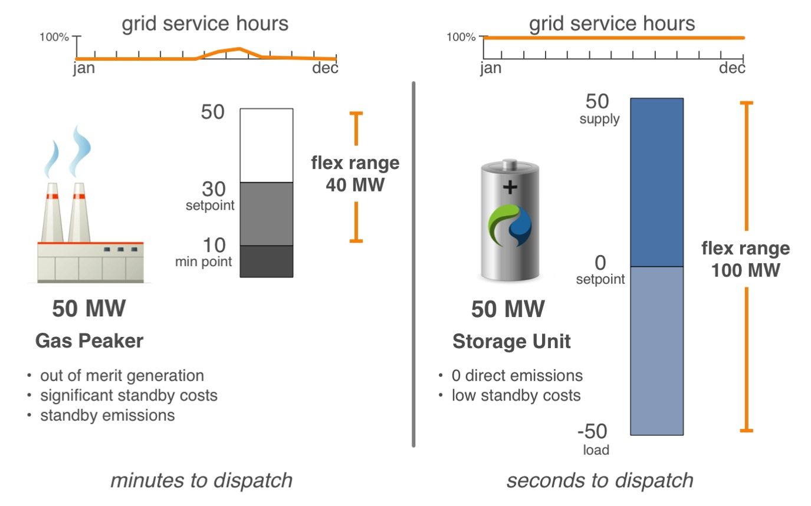
Energy storage as flexibility resource

Slide 12
Energy storage as capacity resource

Slide 13
Storage in ERCOT ready for prime-time
LEGISLATURE
SB 943: Texas Legislature enacted legislation (Utility Code 35.151-152) in 2011 that clarifies that energy storage facilities that wish to participate in competitive market are “generation assets” that must register with PUCT
Entitles such Energy Storage facilities to interconnection, to obtaining transmission service and participating in wholesale energy market
2009 and 2013 Separate legislation created new fund as part of TERP –Texas Emissions Reduction Plan – that allow grants for storage projects connected to renewables in air quality affected counties
Funded one round in 2014-2015; Another round coming up in 2016 with applications due February 16, 2016
Austin Energy 1.3 MW battery/community solar project being funded partially with TERP funds

Slide 14
What is driving storage in ercot
PUC
Project no. 39917
(1) PUC Substantive Rule 25.192
Wholesale storage is exempt from transmission service rates and wholesales storage load is excluded from ERCOT’s 4CP demand calculations
(2) PUC Substantive Rule 25.501 (m)
Defines Wholesale Storage –and states that the wholesale storage is wholesale load
Treated as other generation facilities in the sale of energy and ancillary services at wholesale
Energy acquired to charge a storage facility is wholesale – not subject to retail tariffs, rates or fees or with other ERCOT charges and credits because of ancillary obligations or load share ratios
Settlement prices at the Node if transmission-connected, and at the nearest electrical bus node if distribution level connected
If wanting to go between ERCOT and another ISO need FERC statement that will not impact ERCOT independence

Slide 15
PUC & ERCOT Past Continued
Project No. 40150
Allows ERCOT to conduct pilot projects and grant temporary exceptions from ERCOT rules
ERCOT
NPRR No. 410 (2011) – Definition of ESR (Energy Storage Resource) and Creation of an Energy Storage Load Zone for Each ESR of 1 MW or more in a way similar to DC ties
This NPRR did not move forward due to some opposition and the belief that separate PUC rule had dealt with issue
NPRR No. 461 (2012)– Implements PUC Rulemaking by allowing batteries, flywheels, CAES, pumped hydro and capacitors to enjoy Wholesale Storage Load provisions
NPRR 560 (2013) -- created a definition of Energy Storage Resource and specifies values for the various caps and floors used in the mitigation and make-whole calculation processes for such Resources.
NPRR 581 (2013) – Created a new ancillary service subset of Regulation Service known as Fast Responding Regulation Service

Slide 16
Federal Government also chipping in with Loan guarantees and Grants
Through Energy Efficiency and Renewable Energy Office at DOE there are literally hundred of grants and loan opportunities
https://eere-exchange.energy.gov
Recent SHINE Grant – gave out $15 million to utilities looking at pilot programs to combine distributed solar with storage
Austin Energy just received $4.3 million to pilot two battery storage facilities with onsite solar in Mueller development in Austin.

Slide 17
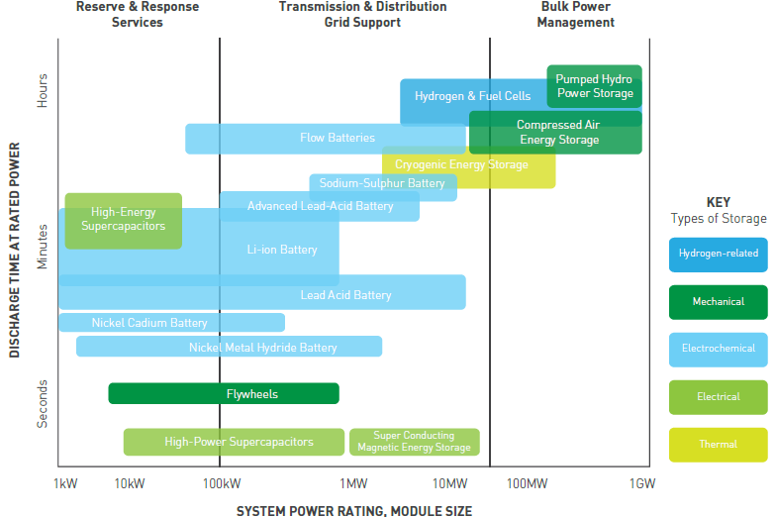
Energy storage CAN BE many things
Notes:
Energy storage is not one thing, just like “generation” is not one thing. Different technologies have different characteristics and fit different applications.

Slide 18
Numerous Applications on the Grid
Source: DOE/EPRI Handbook
Notes:
So energy storage has many applications—in bulk and ancillary services, in T&D infrastructure, and in end use. For you all today, I imagine the yellow highlighted applications are of particular note.

Slide 19
Current discussion on Storage in ERCOT’S Ancillary Services
NODAL PROTOCAL REVISION REQUEST 752 –ENHANCED ANCILLARY SERVICES
More modest proposal than 667 – does include Fast Frequency Response though maintains a 1:1 Ratio
Maintains Fast Regulation As Well allowing for trading among QSEs
Nodal Protocol Revision Request 667 – Future Ancillary Services
FAST would open up space by dividing responsive reserves into several products, and continuing an emphasis on fast regulation and fast responsive service (Fast Frequency Response)
Brattle Group analysis found battery storage would take up to some 7 % of FFR market by 2024
Creates a ratio between primary frequency and fast frequency response that is up to 2.2 to 1.
Continues Fast Regulation Service
Creates new contingency and supplemental reserves that replace more traditional spinning and non-spinning for capacity

Slide 20
Ancillary services Continued
FAS is more favorable to storage than Enhanced, but both would open up some space for storage
ERCOT favors 667 in part because they see need for faster acting resources with our current market and the future integration of large amounts of wind and solar
One area that has not been addressed is inertia service – a concern as coal plants come down and is largely replaced by renewables
Synchronous Inertial Response Service is a proposal yet to be fully developed
Definition:” Synchronous Inertial Response (SIR) is an instantaneous response that is continuously self-deployed from synchronous machines following disturbances” from ERCOT white paper

Slide 21
Long-Term System Assessment CONTINUED
ERCOT has finished draft current trends for 2016 and it is surprising
Current Trends Assumes No Major Storage Component but shows potential for underserved hours and potentially inertia and frequency problems
One of the scenarios being developed does include storage in general, as well as integration of EVs
Important to note that initial opposition to NPRR 667 was in part based on Brattle Analysis of Old Current Trend Scenario that did not find major issues in 2024… and found combined cycle plants would largely replace reduced output from coal
New analysis however would have led to different result in Brattle Study

Slide 22
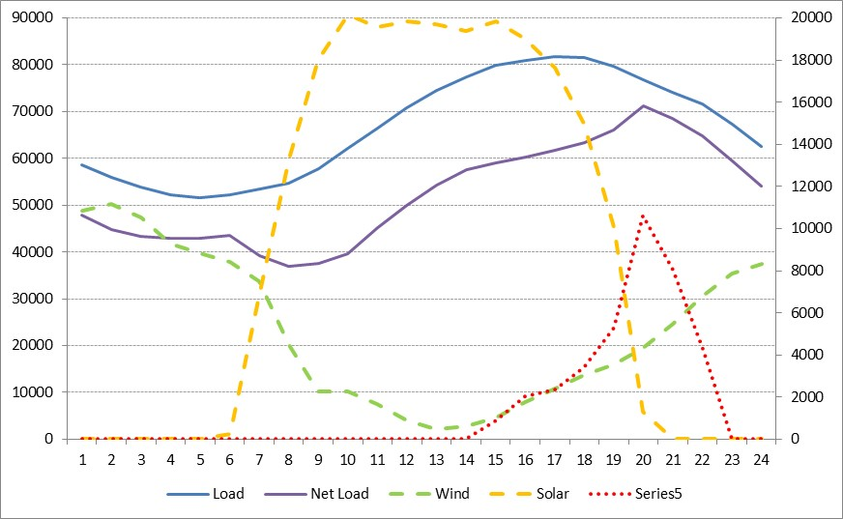
Long-Term System Assessment: Initial 2016 run of Current Trends LED TO ERCOT CONCERNS
Added PTC and ITC plus lower cost solar and wind remove chance for any large thermal builds
Solar additions – 21,400 MWs
Wind additions – 100 MWs
CT additions – 3,420 MWs
Total fixed retirements – 18,349 MWs
2,581 MWs retire before 2016
Fixed retirements are replaced mostly with solar resources
Largest MW shortage is 10,629 MWs with many hours over 5,000 MWs
125 scarcity hours most occur between 6 pm and 8 pm
Fixed retirement ages:
Coal – 55 years
NG – 50 years
Wind – 25 years
July 17, 2031

Slide 23
DREAM (Distributed Energy Resource and ancillarIES market) On!
Distributed level storage resources could participate more fully in DER-Light or DER-Heavy Scheme under ERCOT White Paper Proposal Significant work needed but storage has particular issues potentially with settlement
Particular focus could be extent to which EVs could be integrated into a DER ancillary or energy market offer
Aggregation of storage with other resources like solar
TAC has authorized DREAM to keep working, but significant issues remain going forward
Allowing aggregation within a load zone could be very important to getting storage plus other DER to participate in market
Issues on do you need to be associated with a Resource Node, Congestion Rights, etc.

Slide 24
Can Storage provide reliability services
Brattle Oncor proposal (to allow TDUs to build storage, charge ratepayers and then have third-parties operate them for energy and ancillary services) would require PUC and LEG change, but…
TDUs today can potentially use storage as reliability product today (ie AEP Presidio battery)
Capacitors already accepted as a transmission reliability device
ERCOT should place storage as an alternative that is assessed as part of discussion of RMR, Constraints and Needs report and annual Regional Transmission Plan
The RTP “shall identify reliability needs and transmission upgrades and additions required to meet the system needs per criteria set in the ERCOT Planning Guide Sections 3 and 4 and NERC TPL-001-4 reliability standard”
Storage devices should be assessed as part of this process
RMR decision-making should also incorporate storage as a potential alternative

Slide 25
Next steps on storage
Continue discussion on 667 vs. 752 – assess benefits of FFRS and of having a sliding ratio based upon conditions
Develop separate inertia ancillary service – ETWG could help sponsor this
Develop rules for distributed storage and energy resources participation, including aggregation
Expand planning rules so that in addition to capacitor banks, RTP process looks at storage devices as alternative to new transformers and lines, or a way to downsize
When assessing RMRs, look at storage as an alternative to having to run older uneconomic plants
This group could take on any of these tasks….

