Slide 1

Multi-Interval Real-Time Market (MIRTM) Updates (Additional Slides)
SAWG
Sean Chang
Market Analysis
February 25, 2016
ERCOT Public

Slide 2
Introduction
On 2/22/2016, SAWG requested additional analysis to be performed:
Remove current methodology from scatter plots and include only methodology with Modified GTBD and New STLF
Analysis on the specific period of July & August, 2015 Weekdays HE 14-18 for both Demand and Wind HSL estimation

Slide 3
Table of Contents
Improving Demand Estimation
Performance of All Intervals (Scatters only)
Performance of Intervals where System Lambda >= $75/MWh (Scatters only)
Performance of Intervals in July & August, 2015 Weekdays HE 14-18
Improving Wind HSL Estimation
Performance of All Intervals (Scatters only)
Performance of Intervals where System Lambda >= $75/MWh (Scatters only)
Performance of Intervals in July & August, 2015 Weekdays HE 14-18

Slide 4
Improving Demand Estimation

Slide 5
MIRTM Demand Estimation Performance
July 1, 2015 – December 31, 2015
All Intervals

Slide 6
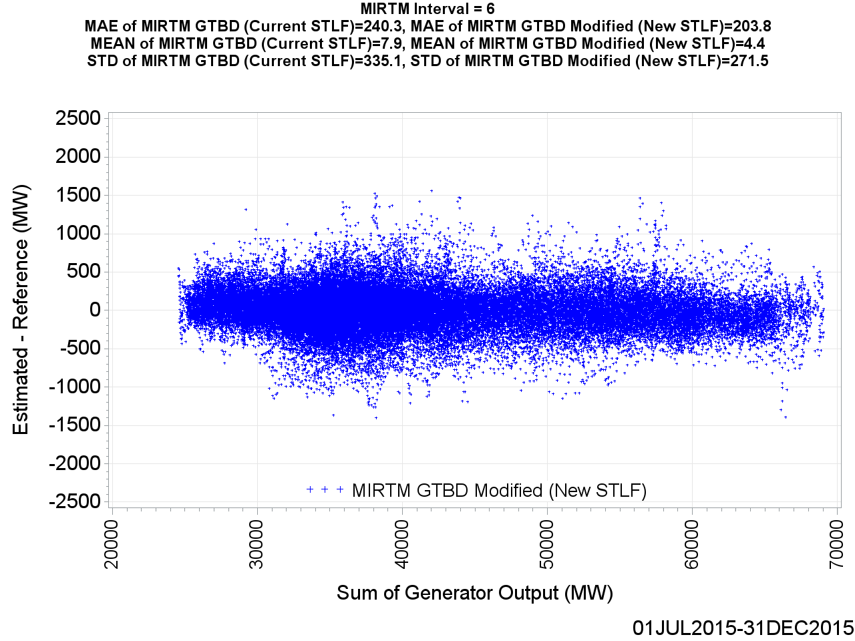
MIRTM GTBD Error by Reference (Interval = 6)

Slide 7
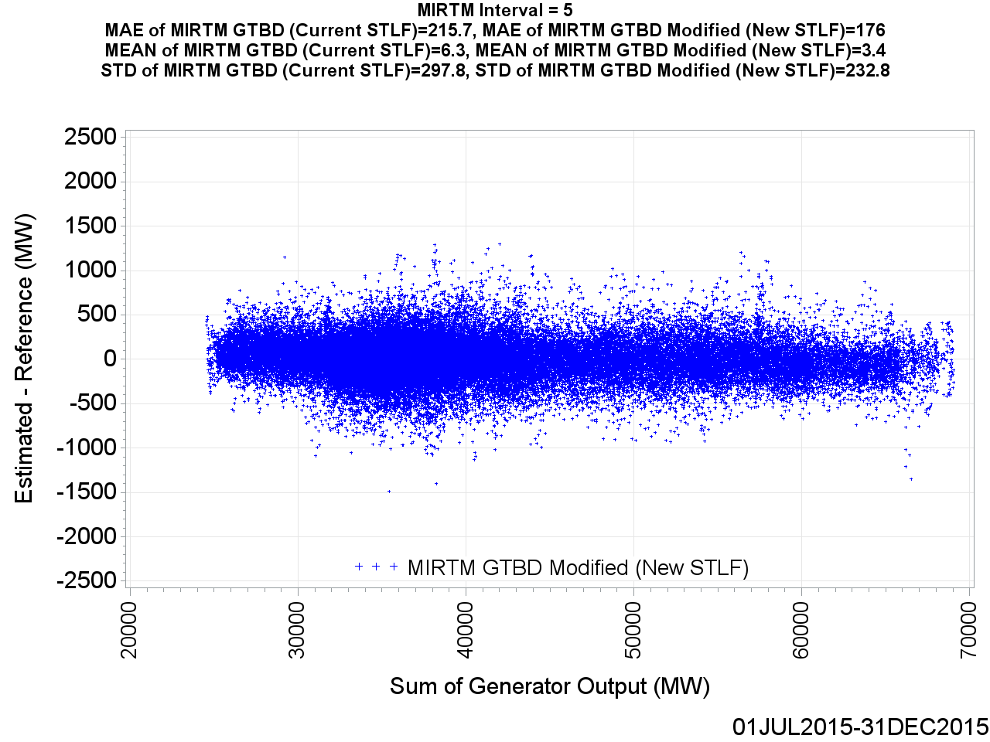
MIRTM GTBD Error by Reference (Interval = 5)

Slide 8
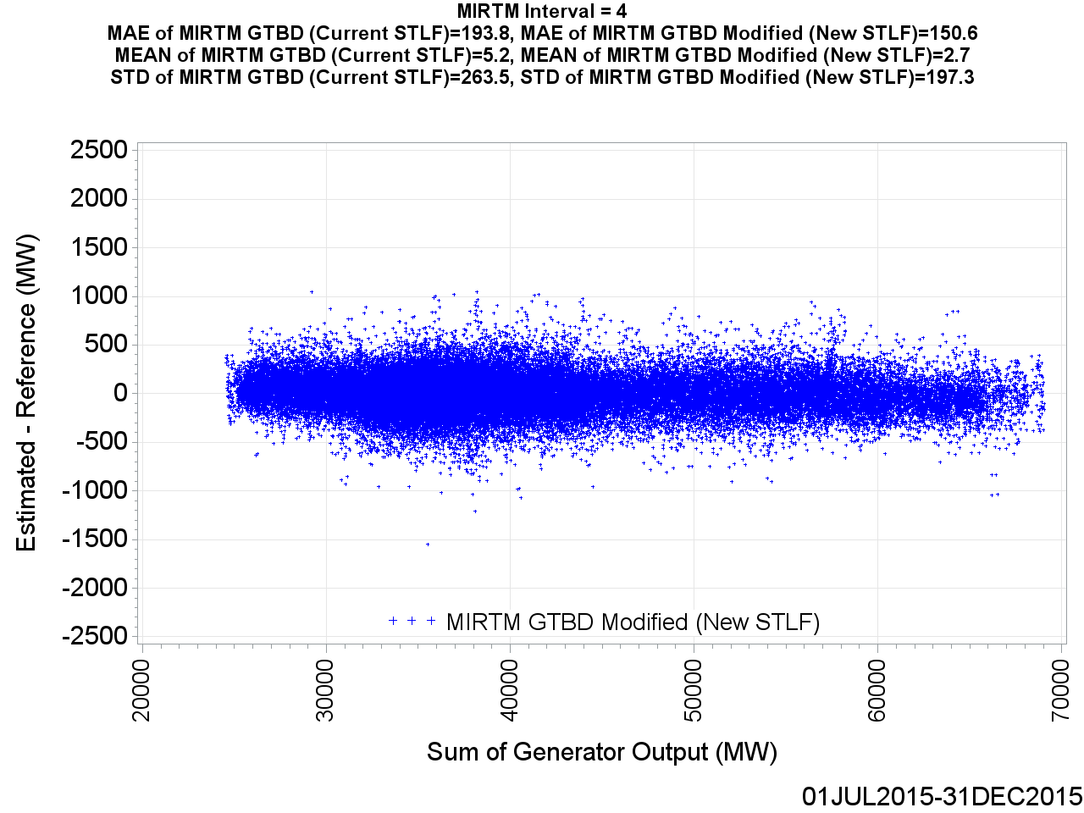
MIRTM GTBD Error by Reference (Interval = 4)

Slide 9
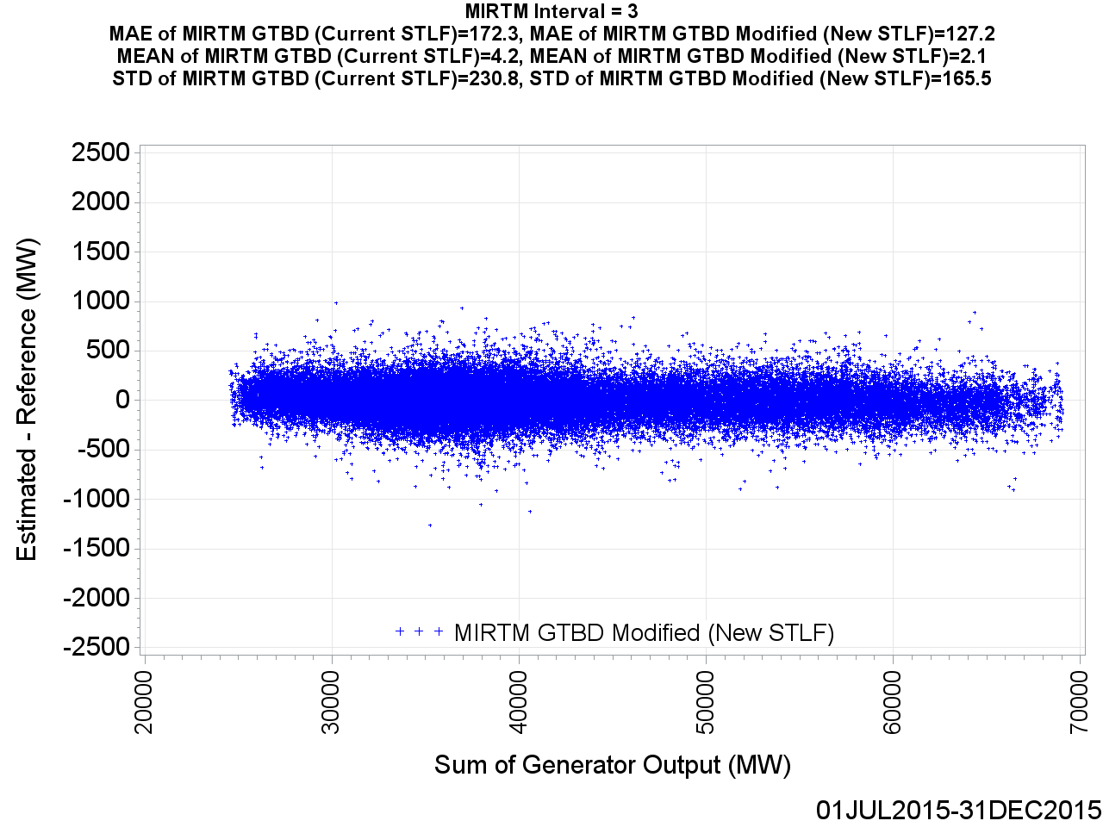
MIRTM GTBD Error by Reference (Interval = 3)

Slide 10

MIRTM GTBD Error by Reference (Interval = 2)

Slide 11
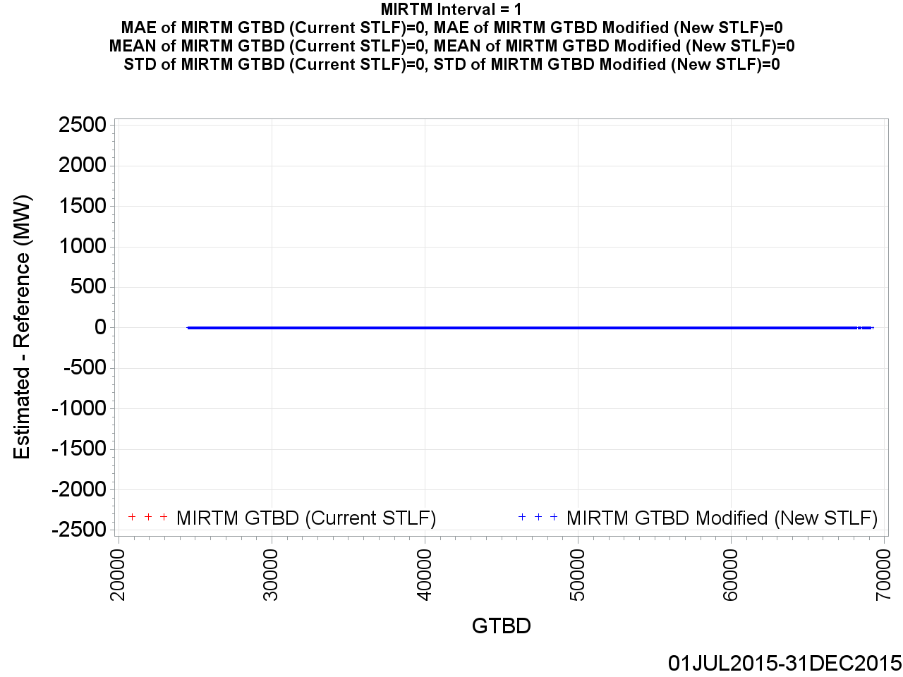
MIRTM GTBD Error by Reference (Interval = 1)

Slide 12
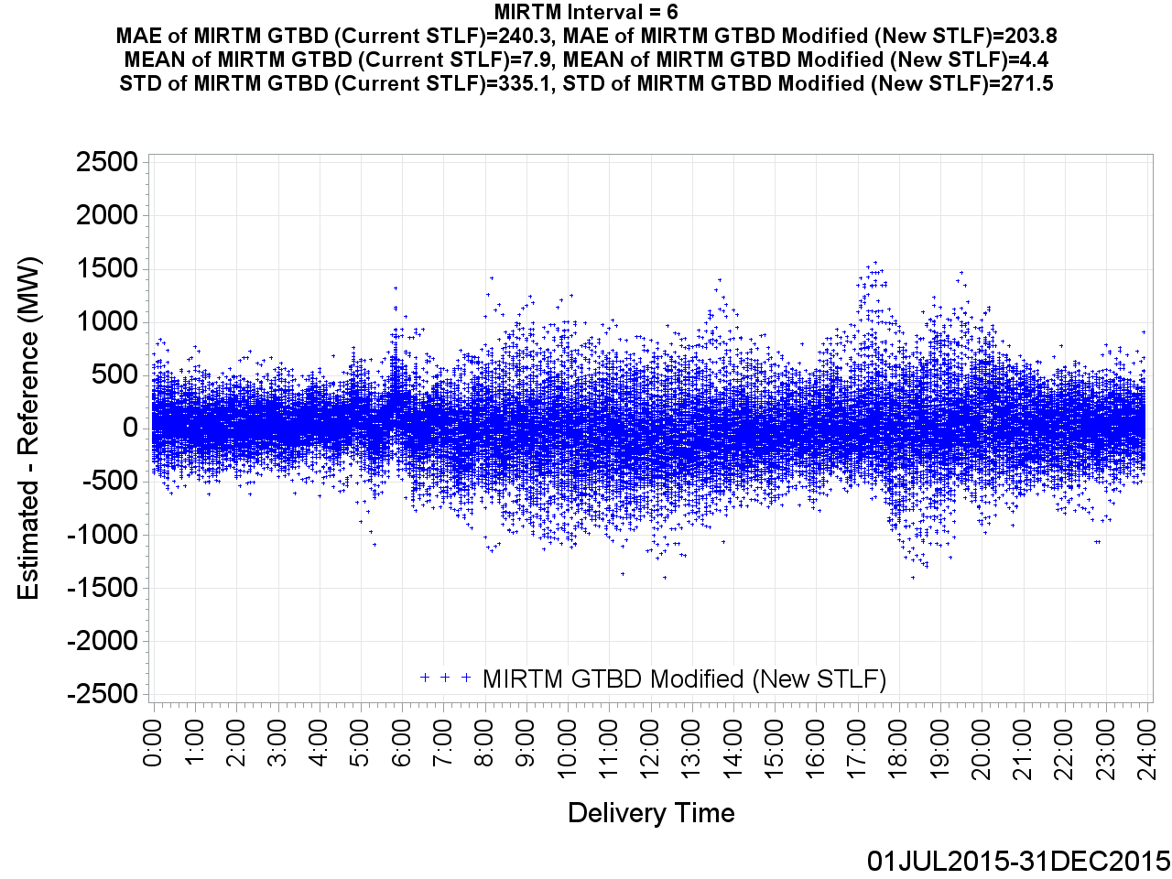
MIRTM GTBD Error by Delivery Time (Interval = 6)

Slide 13
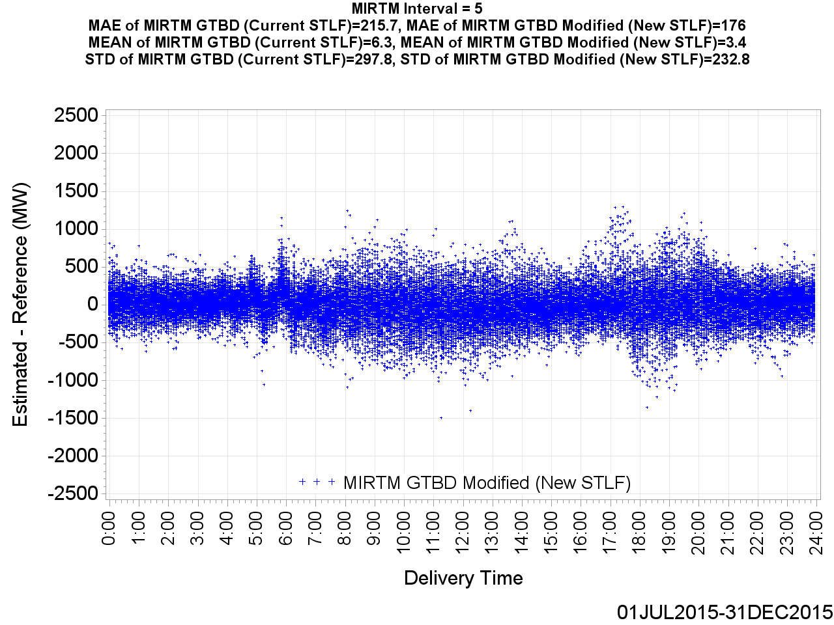
MIRTM GTBD Error by Delivery Time (Interval = 5)

Slide 14
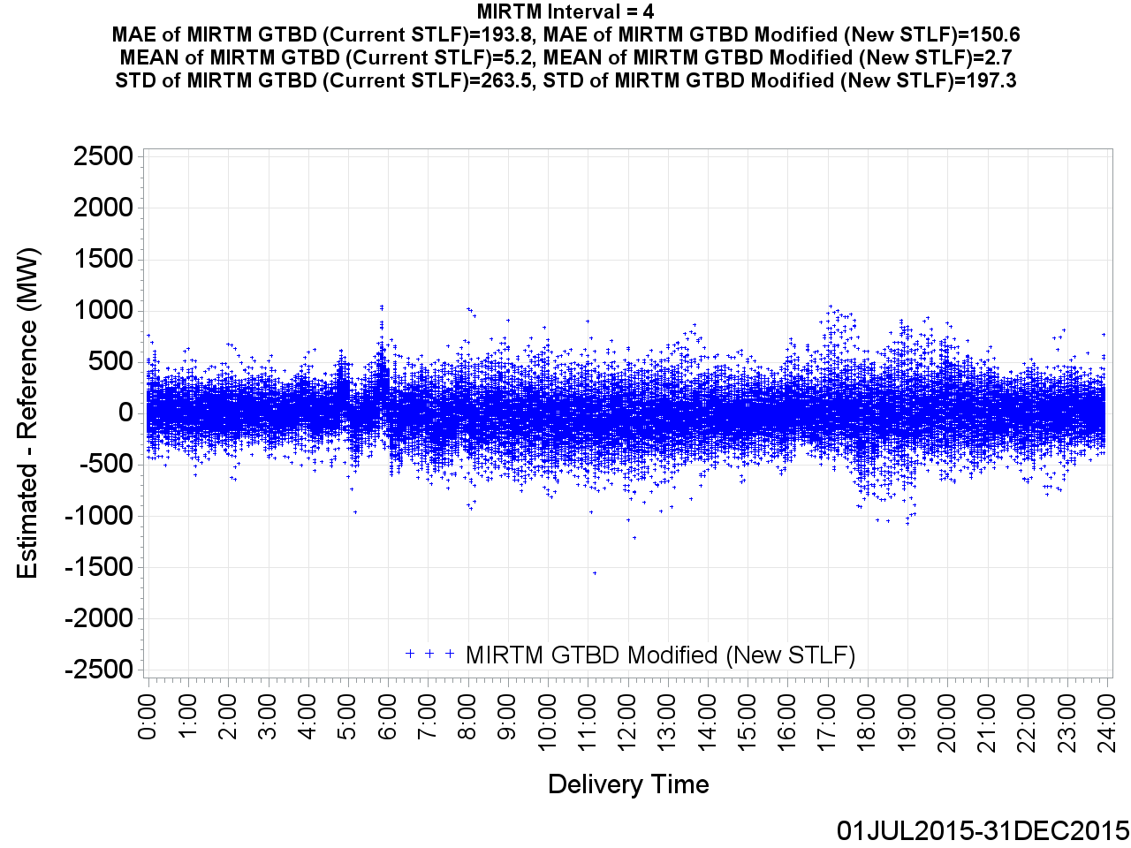
MIRTM GTBD Error by Delivery Time (Interval = 4)

Slide 15
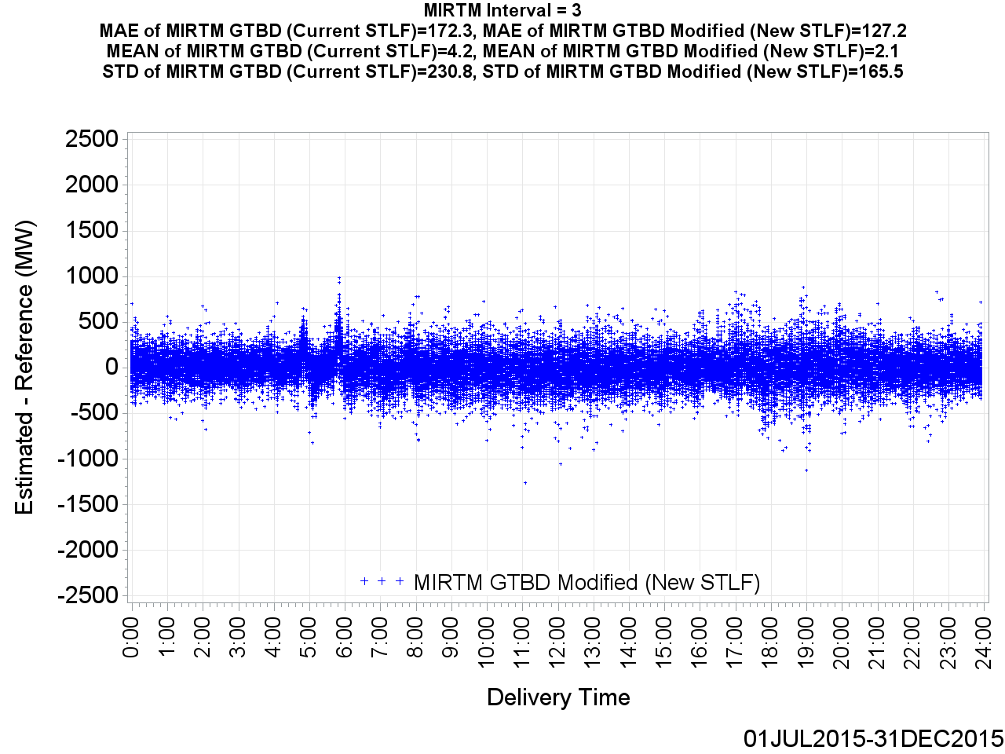
MIRTM GTBD Error by Delivery Time (Interval = 3)

Slide 16
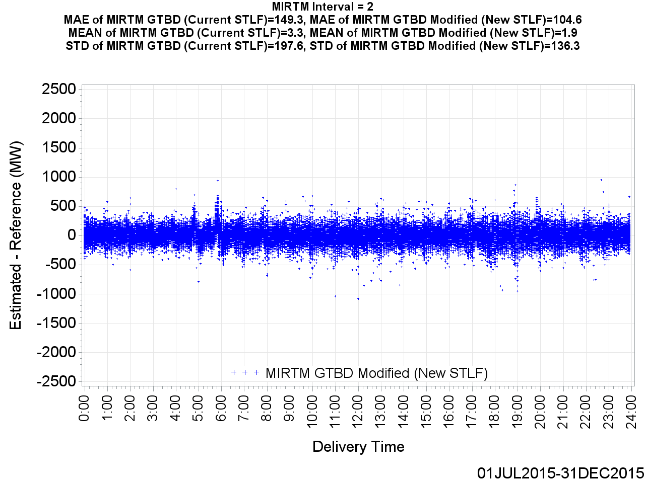
MIRTM GTBD Error by Delivery Time (Interval = 2)

Slide 17
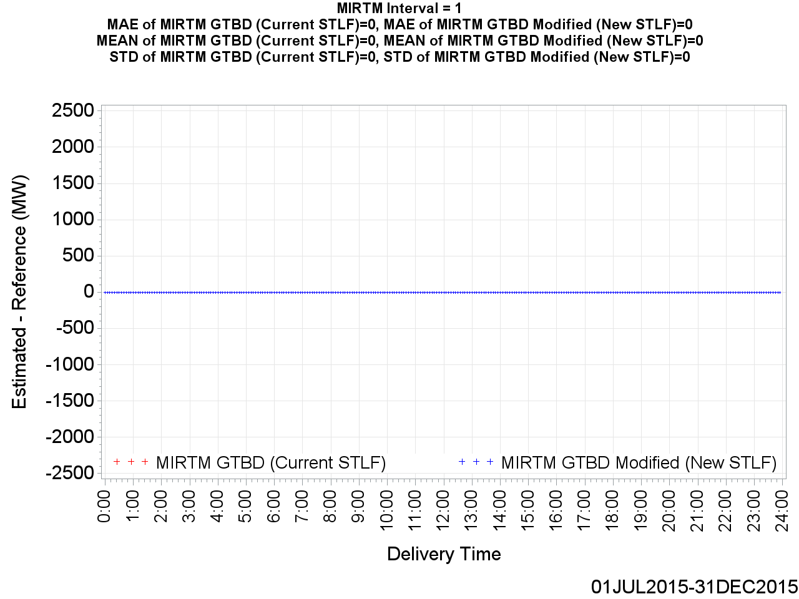
MIRTM GTBD Error by Delivery Time (Interval = 1)

Slide 18
MIRTM Demand Estimation Performance
July 1, 2015 – December 31, 2015
547 Intervals when System Lambda >= $75/MWh

Slide 19
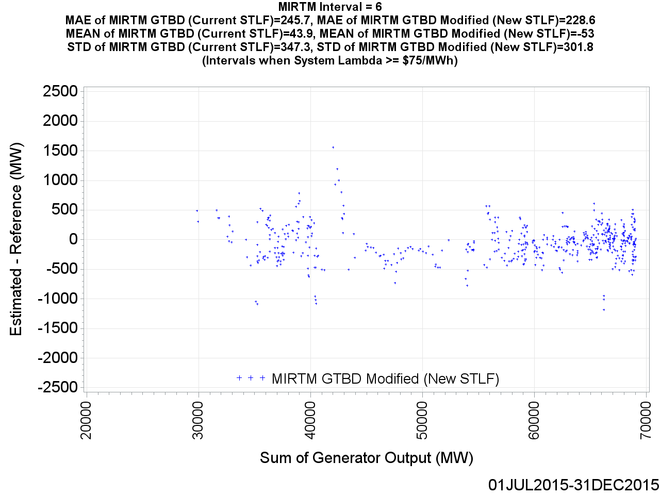
MIRTM GTBD Error by Reference (Interval = 6)

Slide 20

MIRTM GTBD Error by Reference (Interval = 5)

Slide 21

MIRTM GTBD Error by Reference (Interval = 4)

Slide 22

MIRTM GTBD Error by Reference (Interval = 3)

Slide 23
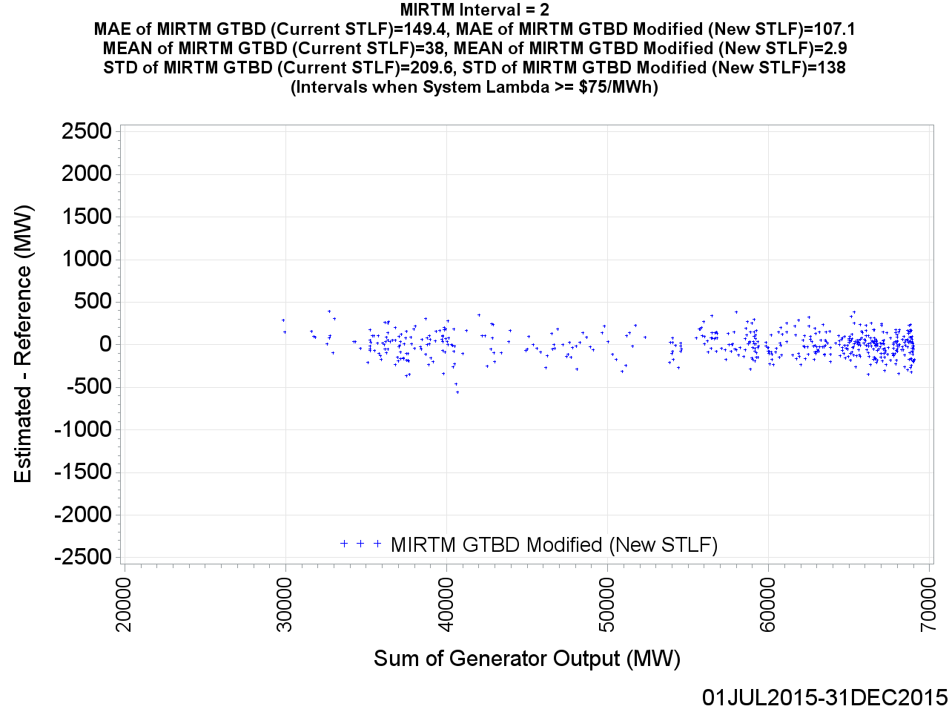
MIRTM GTBD Error by Reference (Interval = 2)

Slide 24
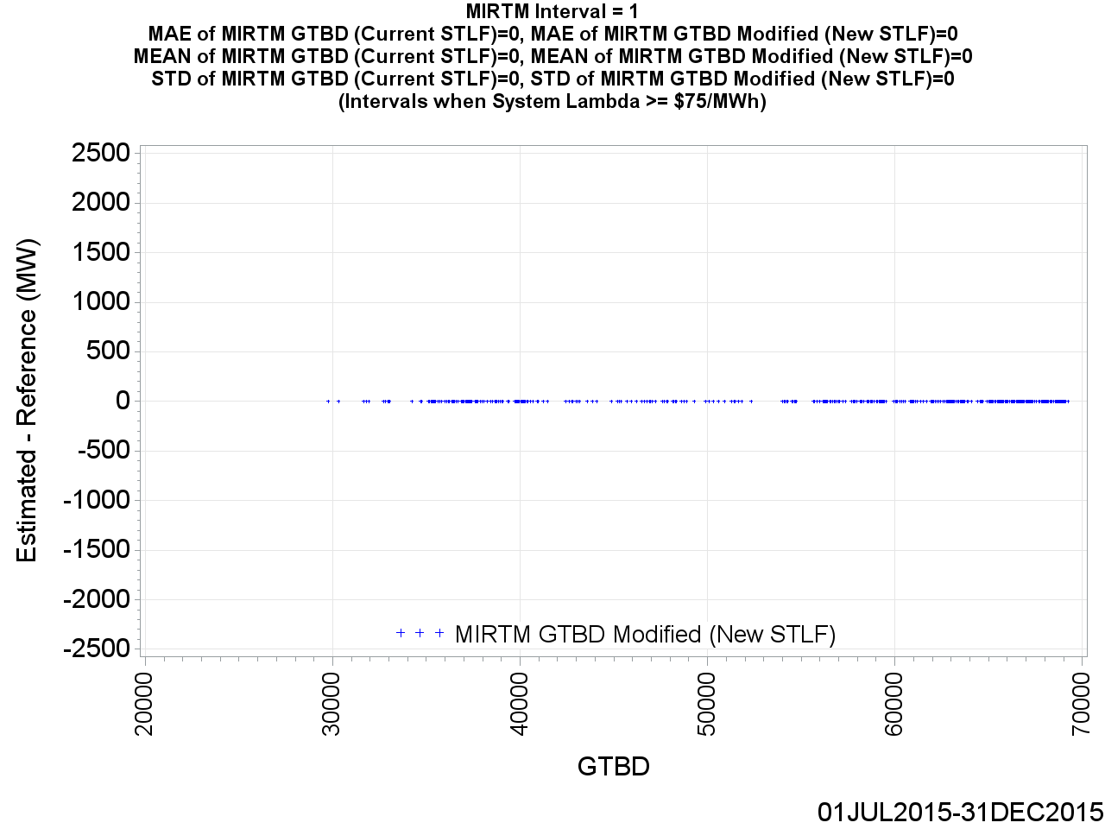
MIRTM GTBD Error by Reference (Interval = 1)

Slide 25
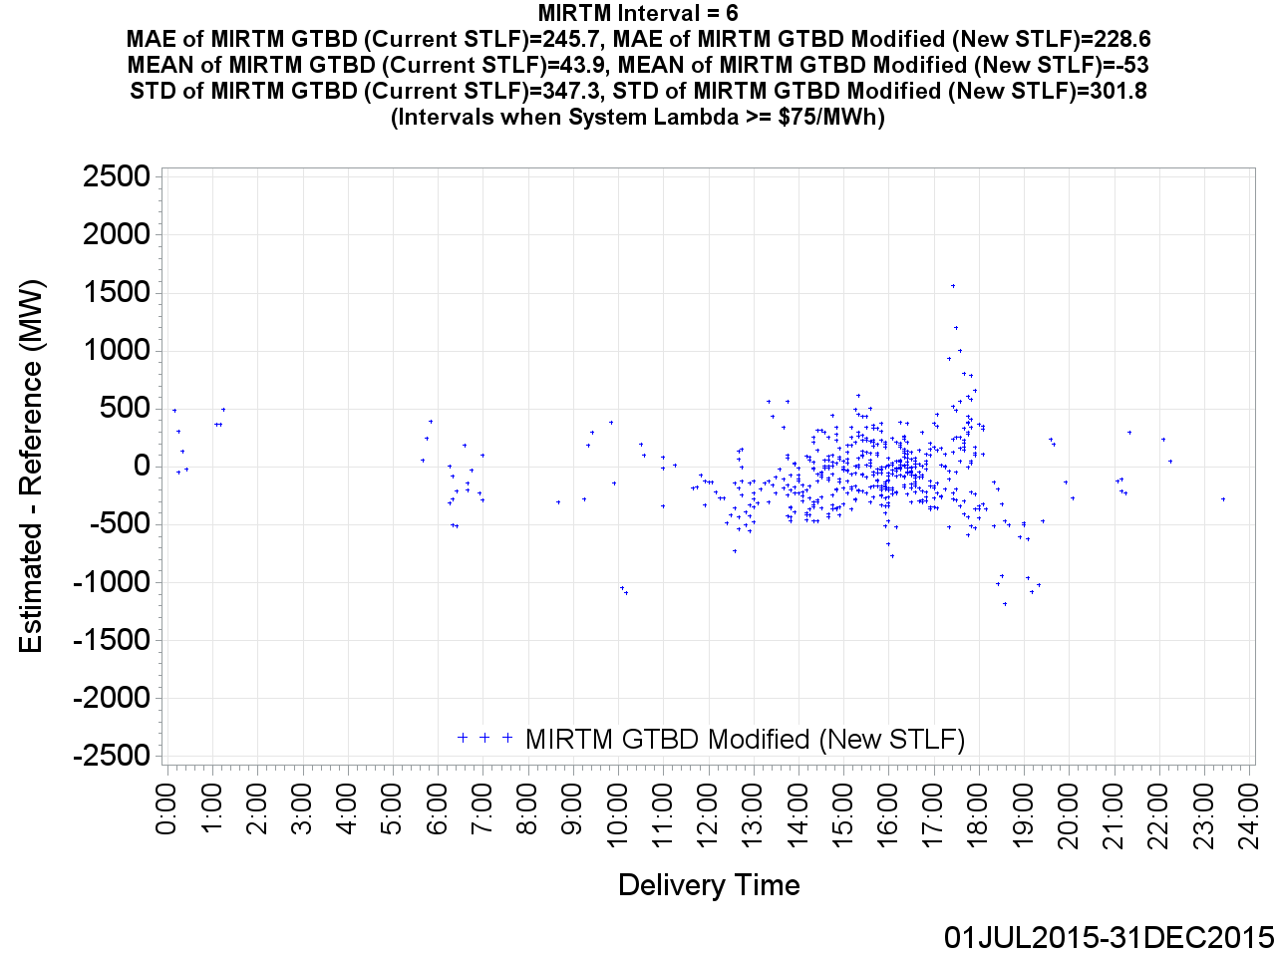
MIRTM GTBD Error by Delivery Time (Interval = 6)

Slide 26
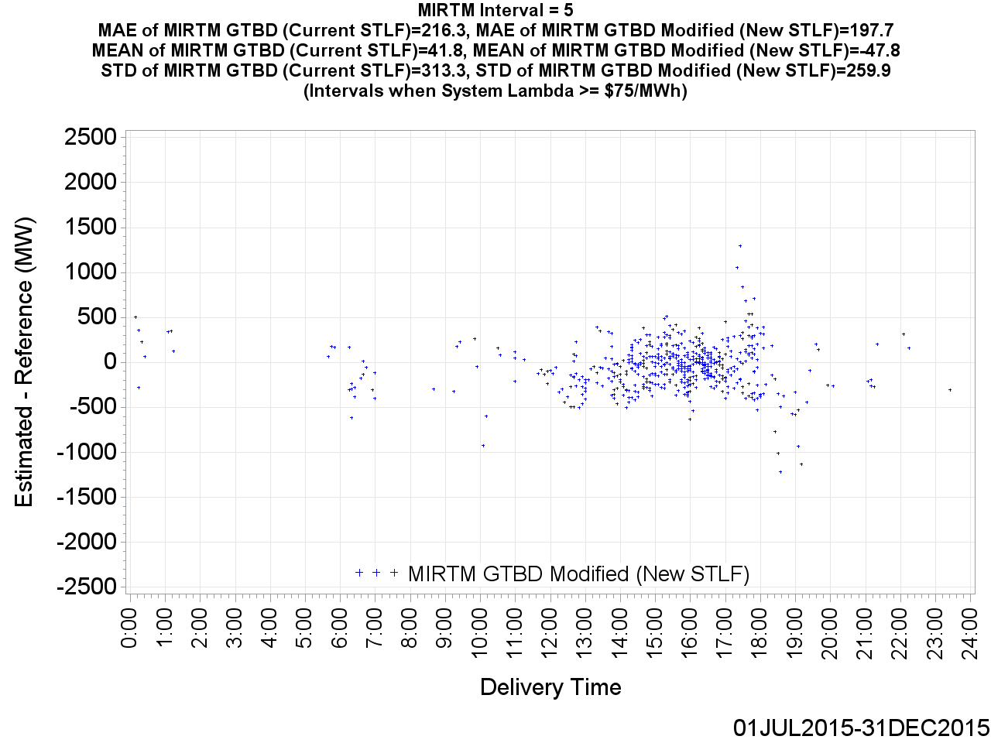
MIRTM GTBD Error by Delivery Time (Interval = 5)

Slide 27
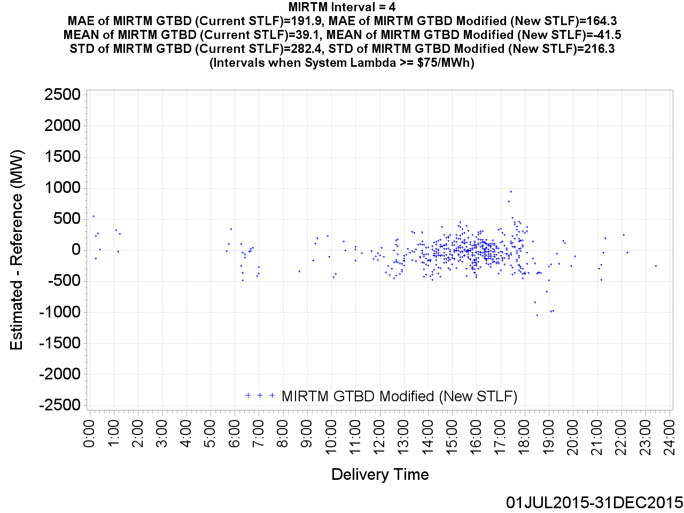
MIRTM GTBD Error by Delivery Time (Interval = 4)

Slide 28

MIRTM GTBD Error by Delivery Time (Interval = 3)

Slide 29

MIRTM GTBD Error by Delivery Time (Interval = 2)

Slide 30
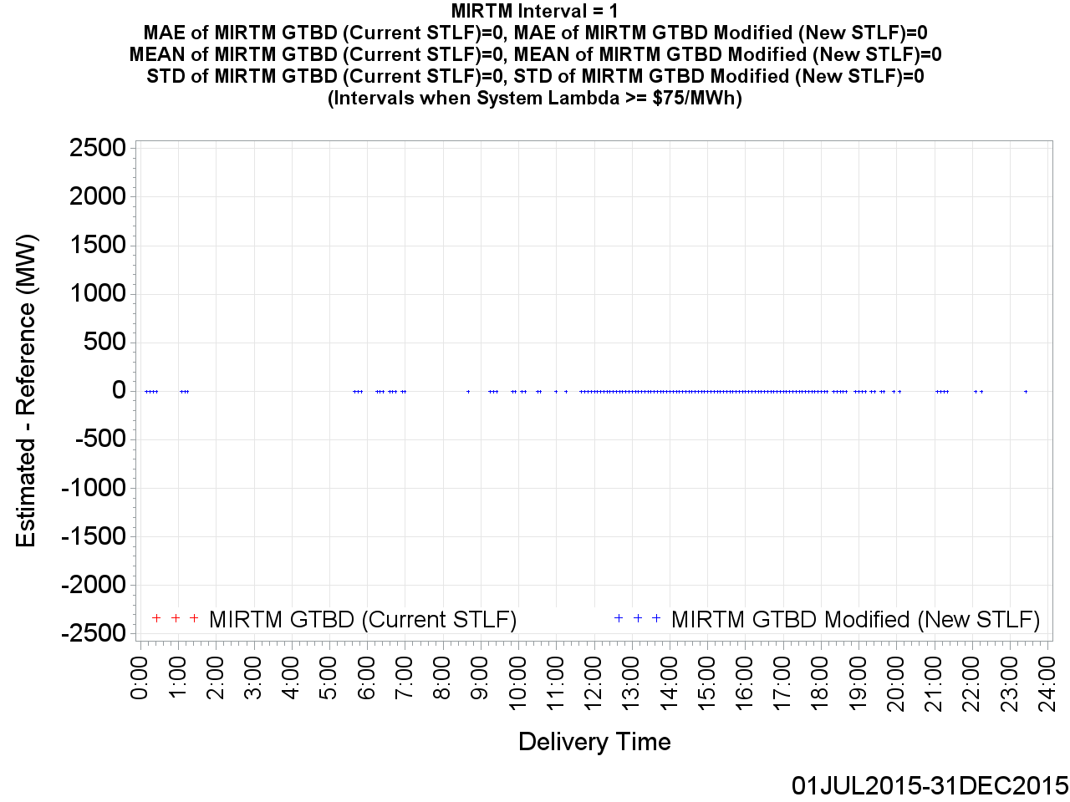
MIRTM GTBD Error by Delivery Time (Interval = 1)

Slide 31
MIRTM Demand Estimation Performance
July & August, 2015 Weekdays HE 14-18

Slide 32
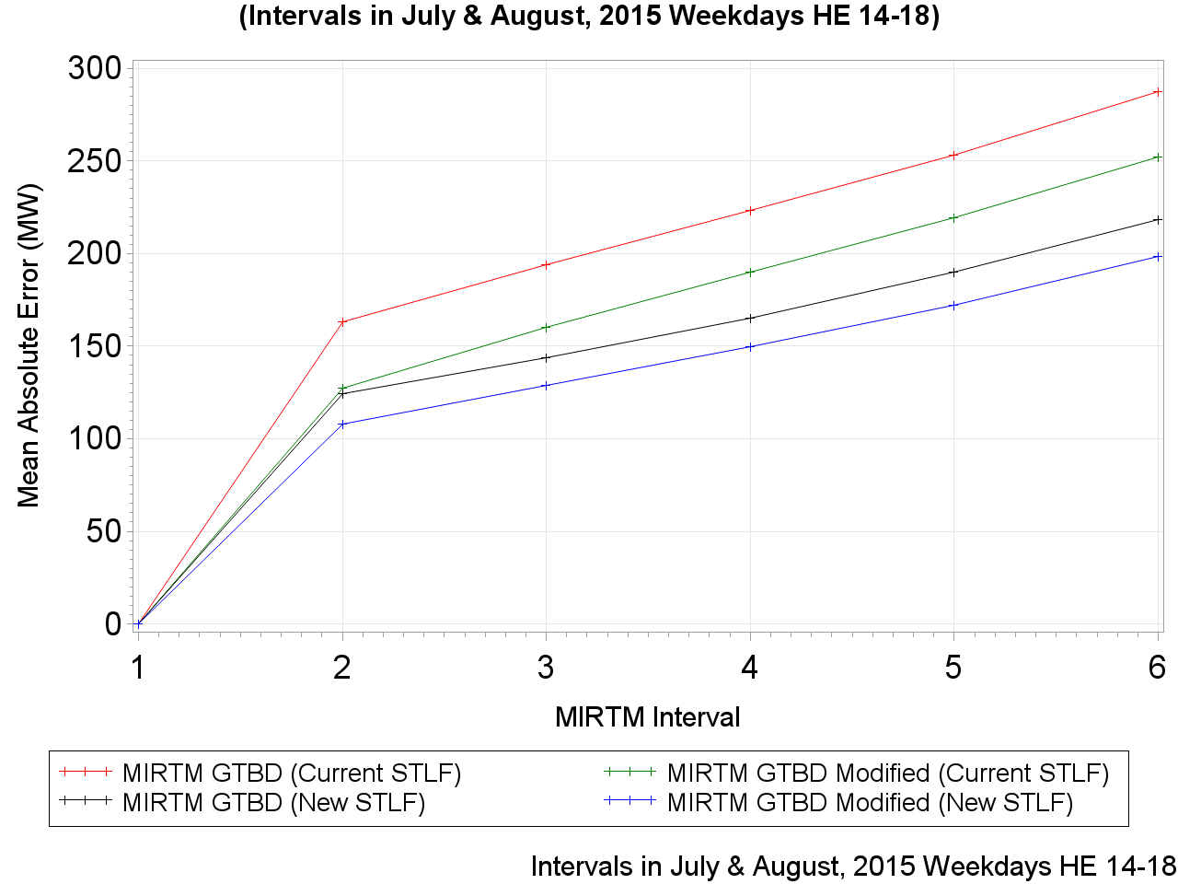
MAE of Estimated GTBD vs. Reference

Slide 33
MAE of Estimated GTBD vs. Reference

Slide 34
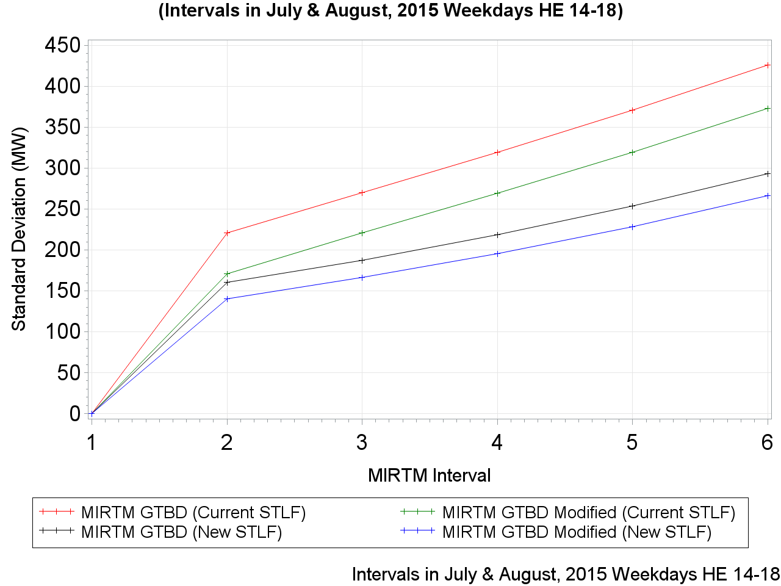
Standard Deviation of Estimated GTBD vs. Reference

Slide 35
Standard Deviation of Estimated GTBD vs. Reference

Slide 36
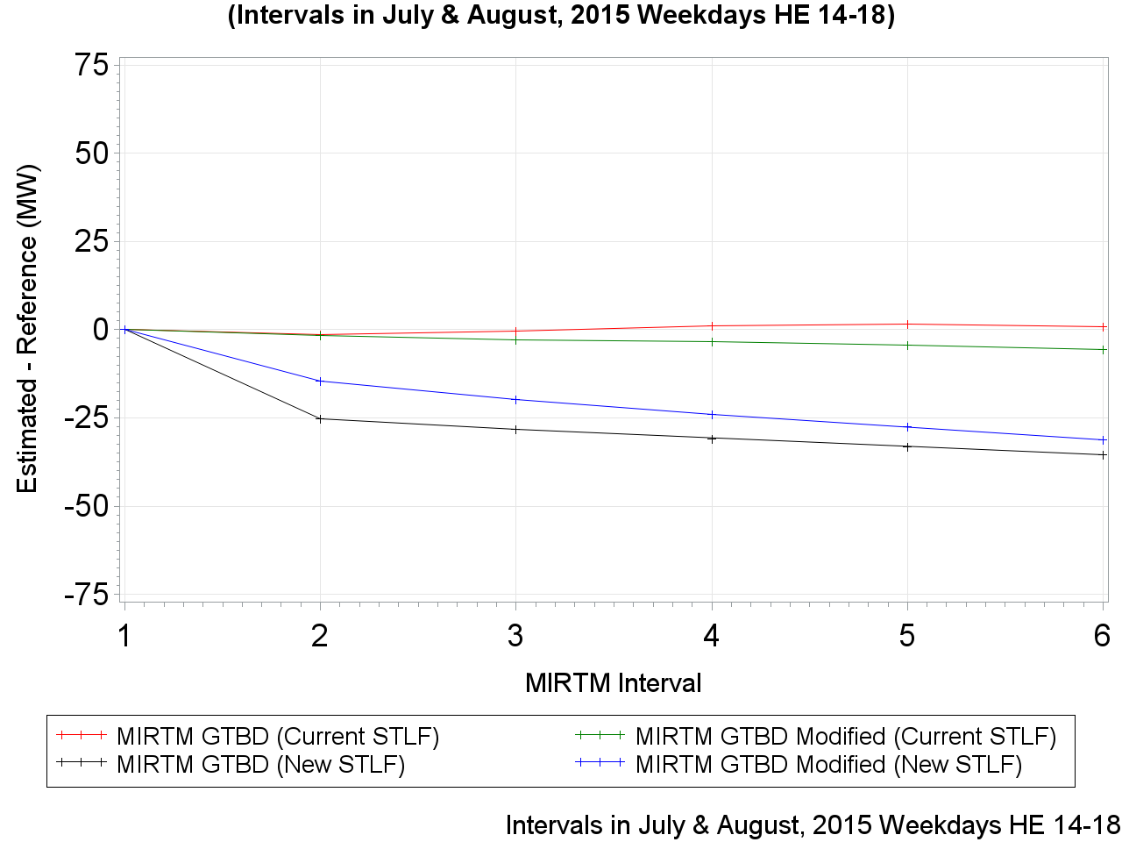
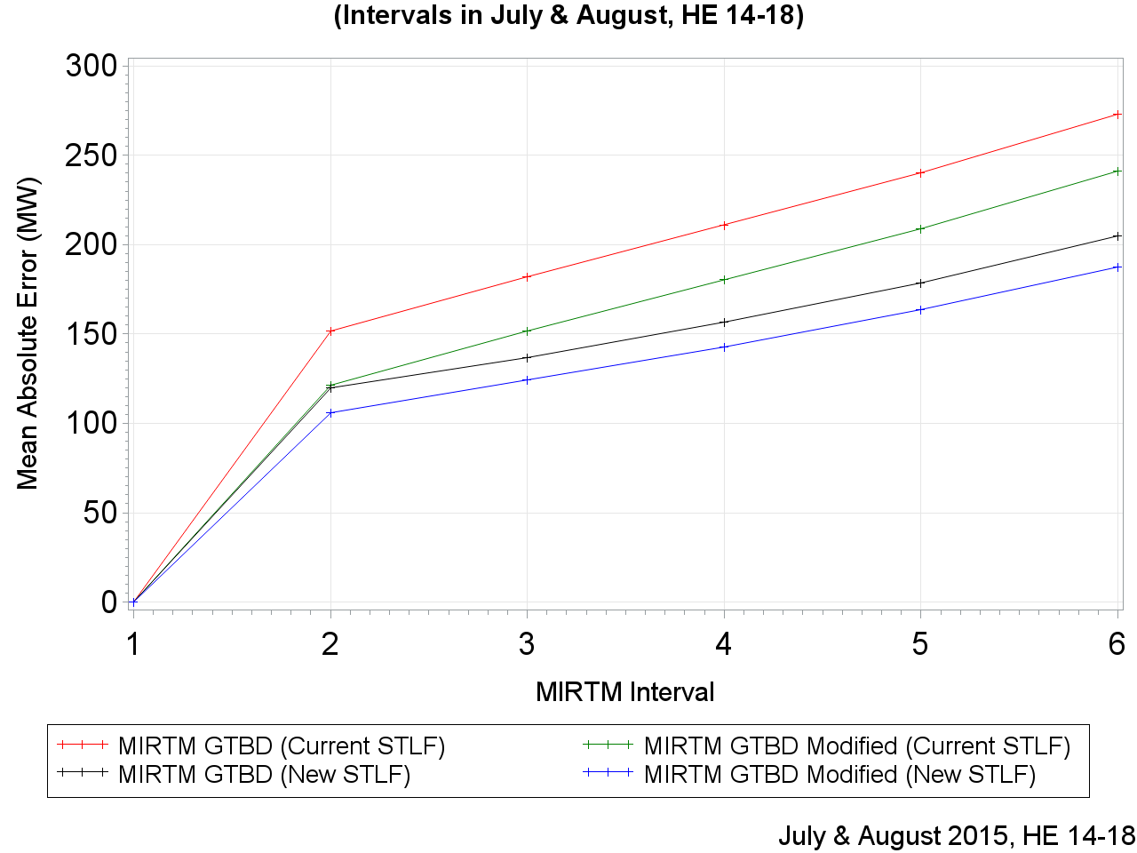
Mean of Estimated GTBD vs. Reference

Slide 37
Mean of Estimated GTBD vs. Reference

Slide 38
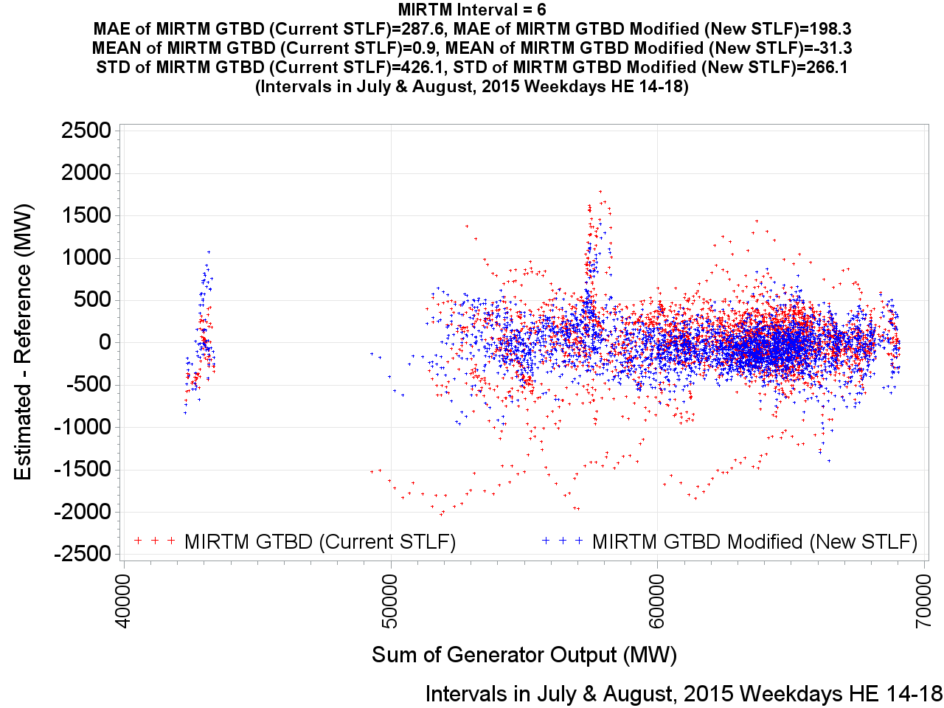
MIRTM GTBD Error by Reference (Interval = 6)

Slide 39
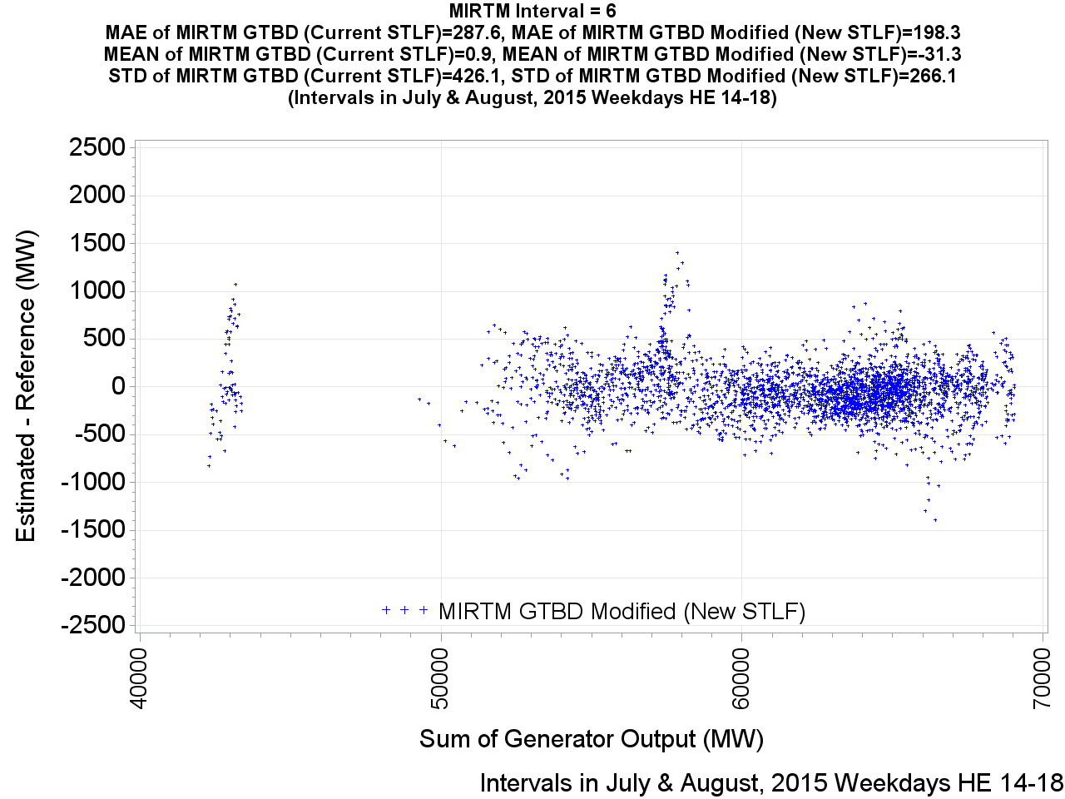
MIRTM GTBD Error by Reference (Interval = 6)

Slide 40

MIRTM GTBD Error by Reference (Interval = 5)

Slide 41
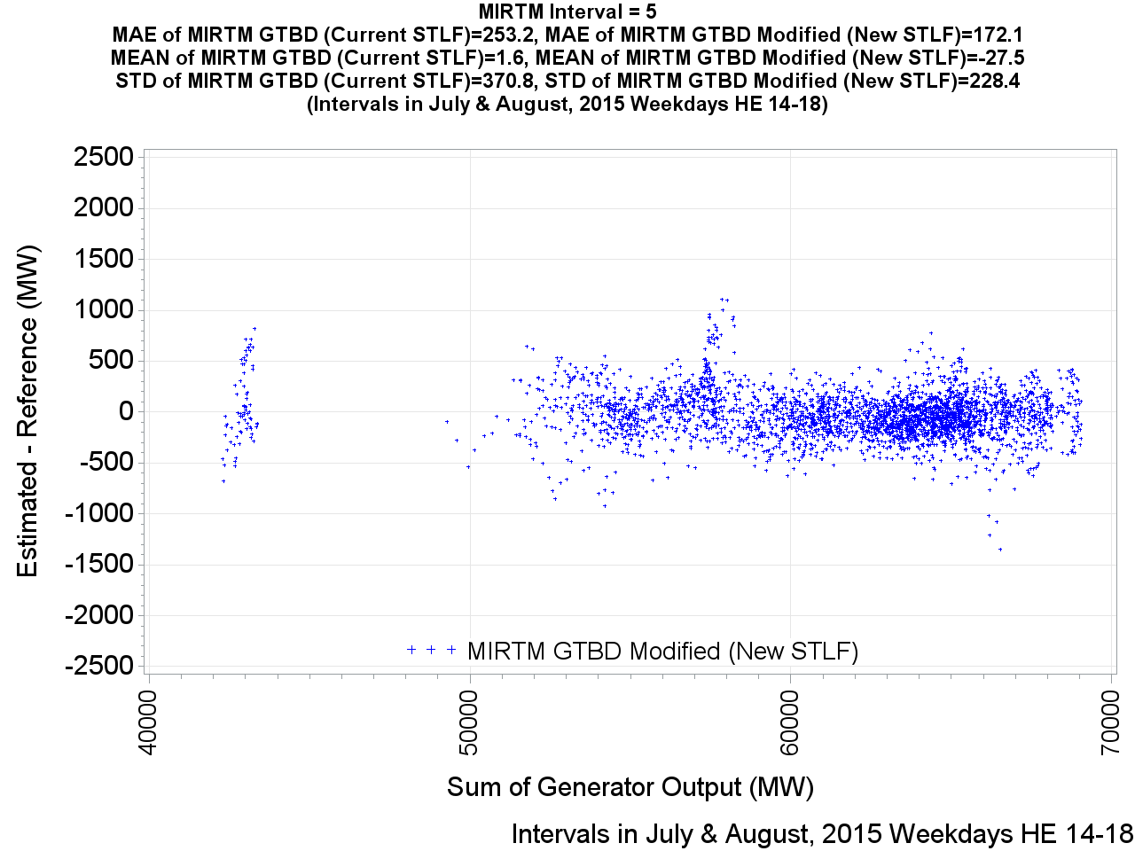
MIRTM GTBD Error by Reference (Interval = 5)

Slide 42

MIRTM GTBD Error by Reference (Interval = 4)

Slide 43
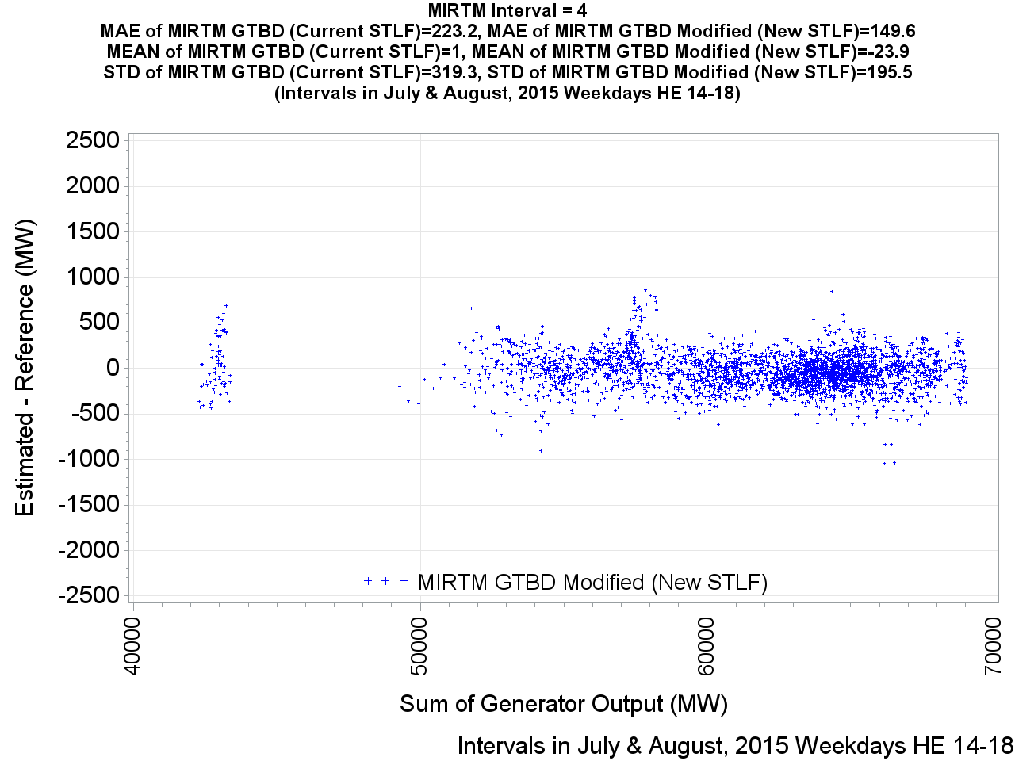
MIRTM GTBD Error by Reference (Interval = 4)

Slide 44
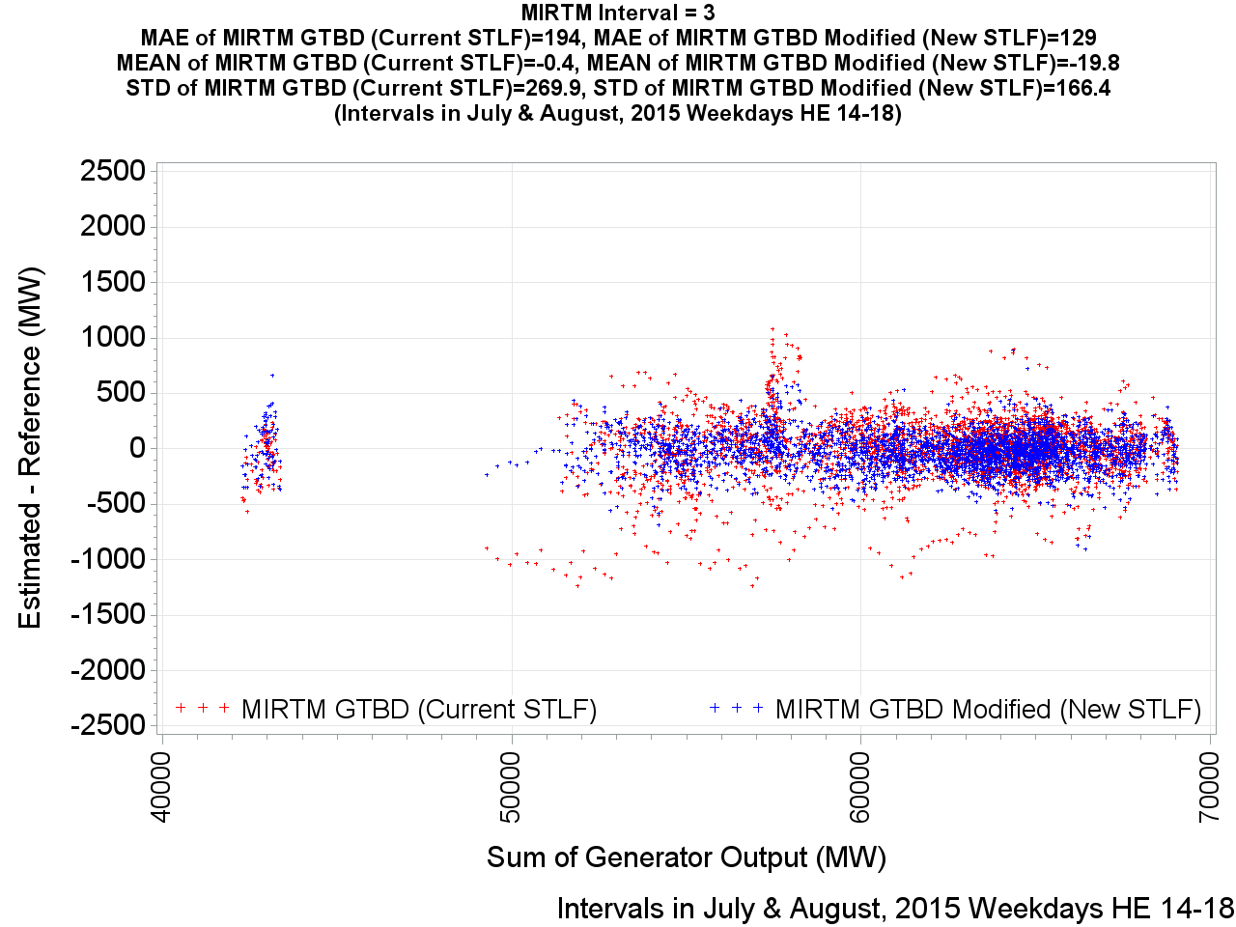
MIRTM GTBD Error by Reference (Interval = 3)

Slide 45
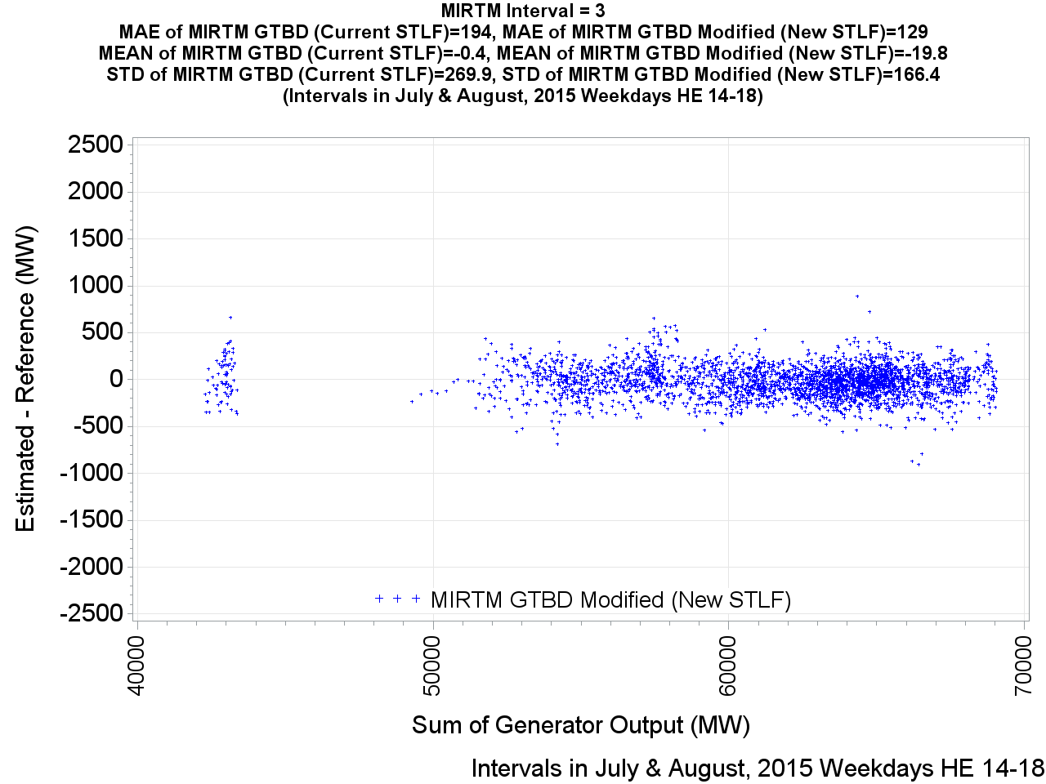
MIRTM GTBD Error by Reference (Interval = 3)

Slide 46
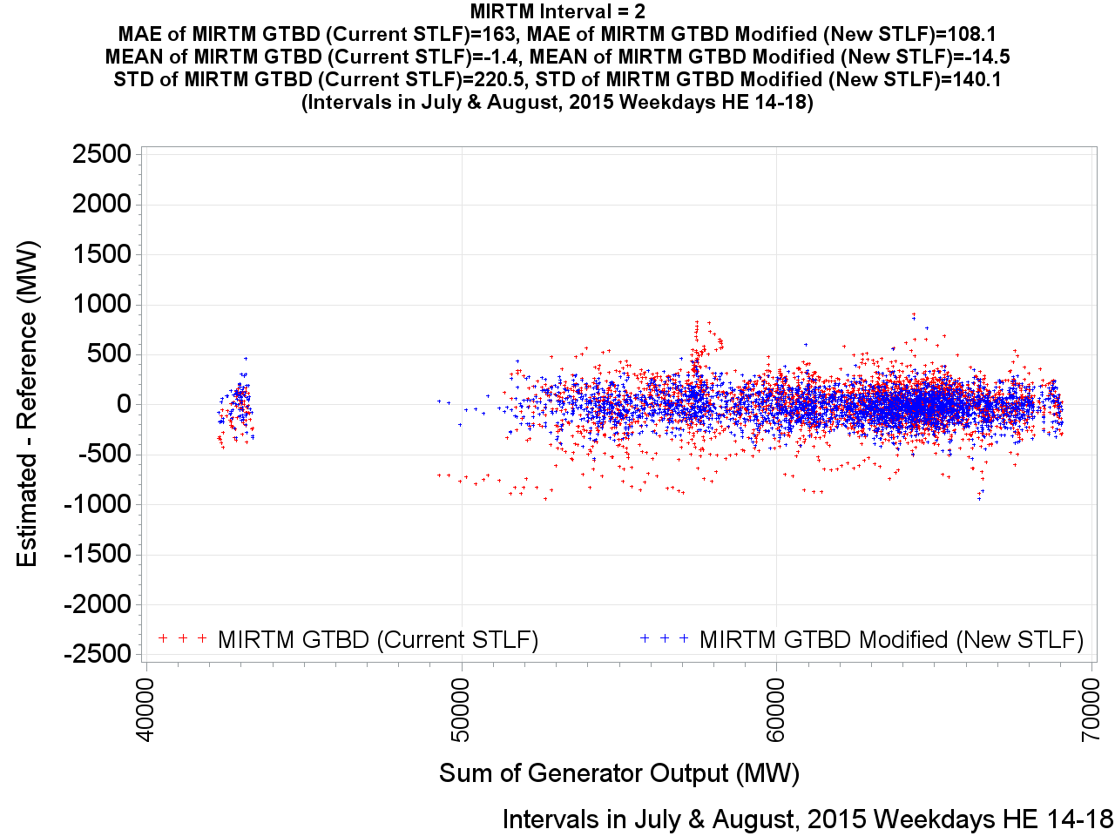
MIRTM GTBD Error by Reference (Interval = 2)

Slide 47
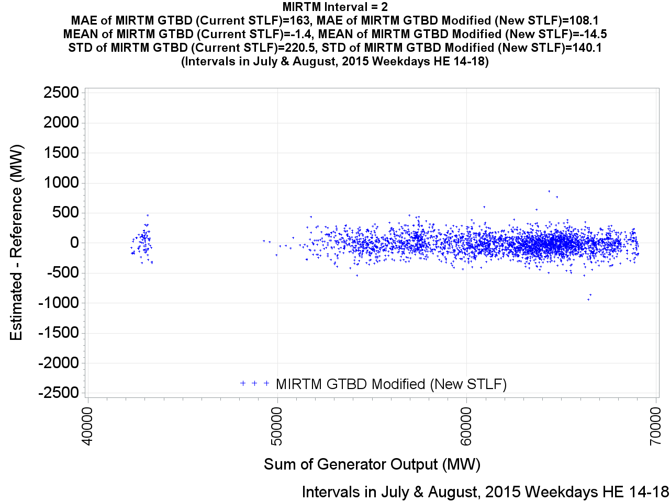
MIRTM GTBD Error by Reference (Interval = 2)

Slide 48
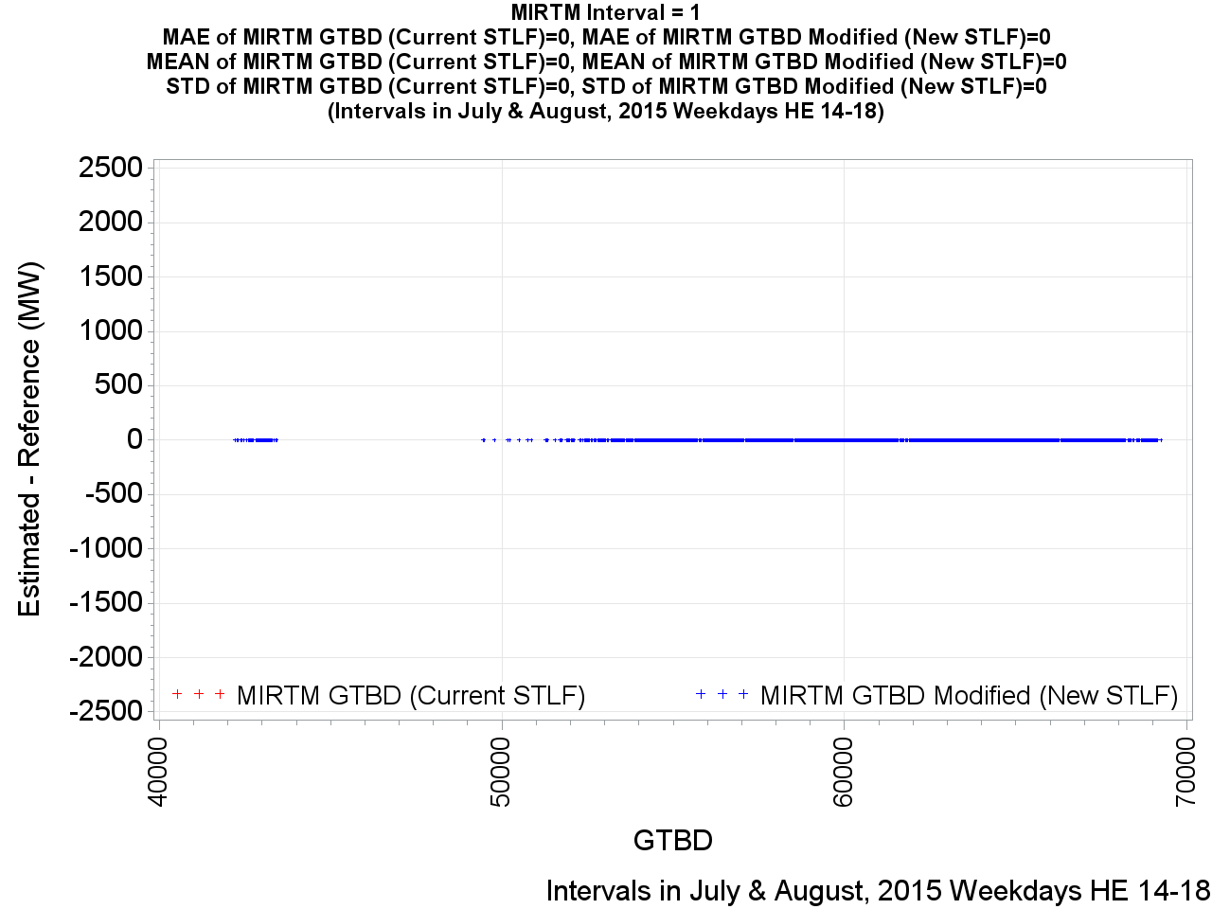
MIRTM GTBD Error by Reference (Interval = 1)

Slide 49
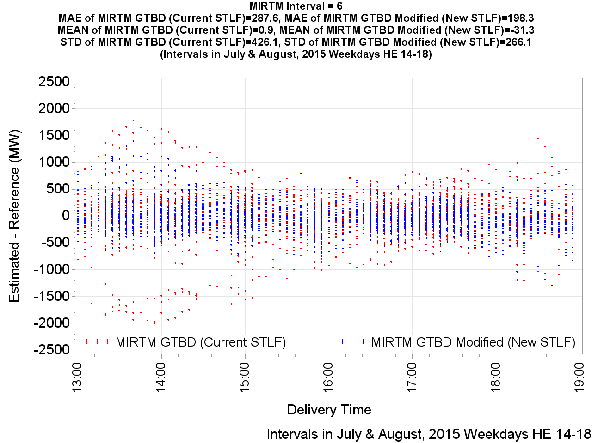
MIRTM GTBD Error by Delivery Time (Interval = 6)

Slide 50
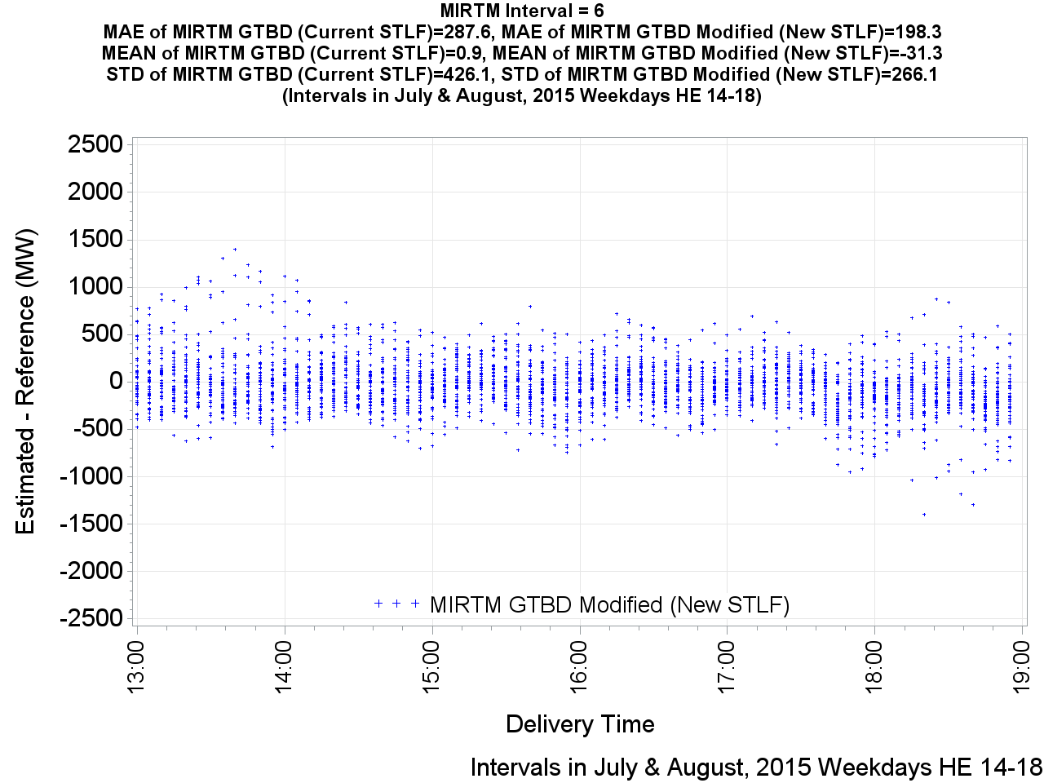
MIRTM GTBD Error by Delivery Time (Interval = 6)

Slide 51

MIRTM GTBD Error by Delivery Time (Interval = 5)

Slide 52

MIRTM GTBD Error by Delivery Time (Interval = 5)

Slide 53
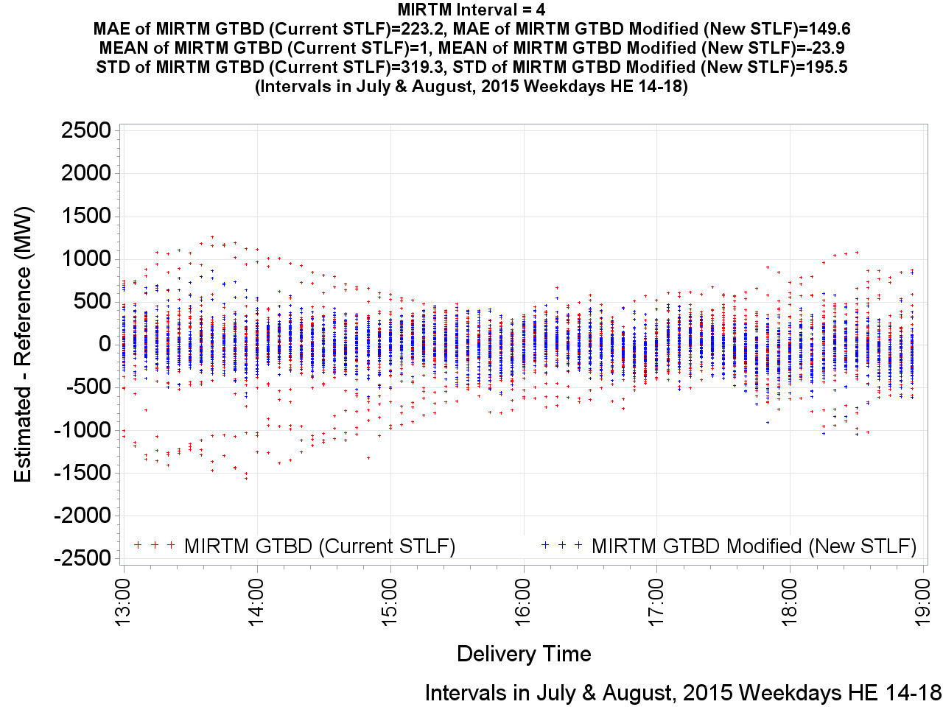
MIRTM GTBD Error by Delivery Time (Interval = 4)

Slide 54
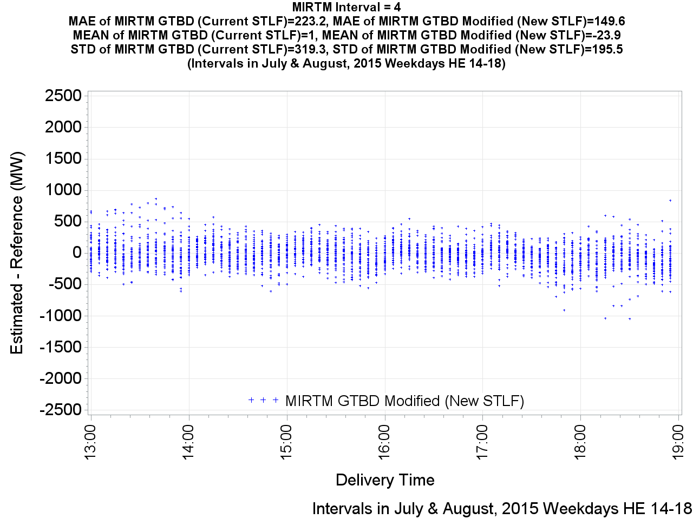
MIRTM GTBD Error by Delivery Time (Interval = 4)

Slide 55

MIRTM GTBD Error by Delivery Time (Interval = 3)

Slide 56
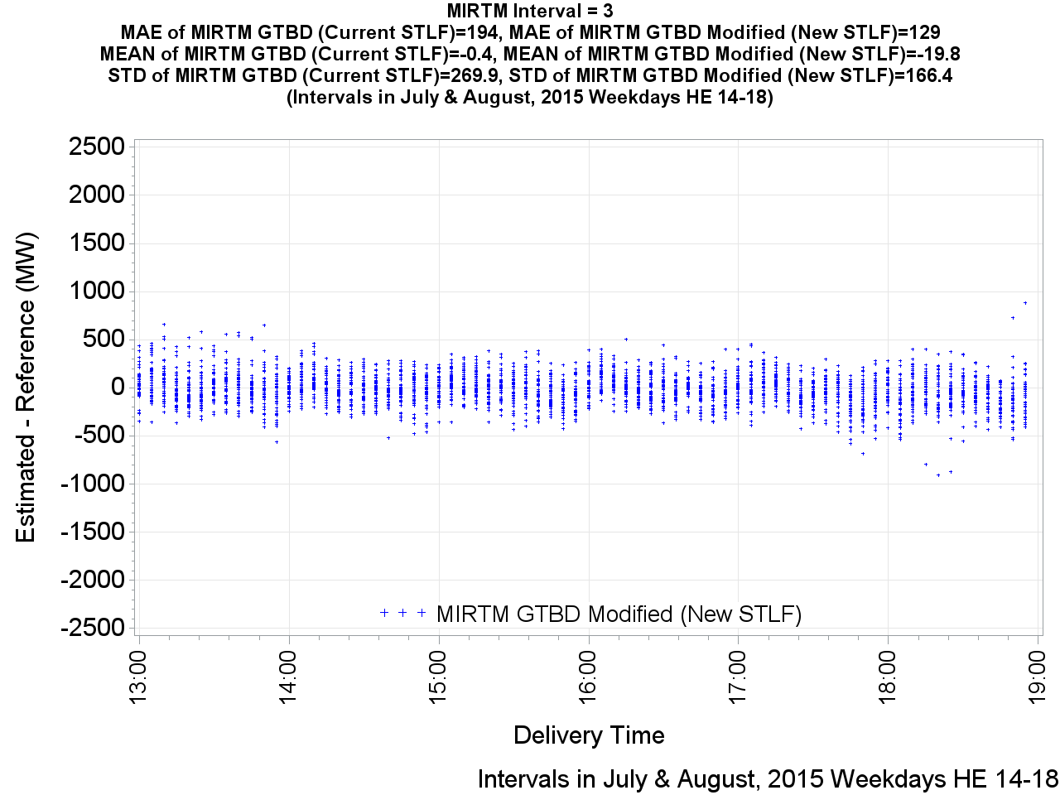
MIRTM GTBD Error by Delivery Time (Interval = 3)

Slide 57

MIRTM GTBD Error by Delivery Time (Interval = 2)

Slide 58
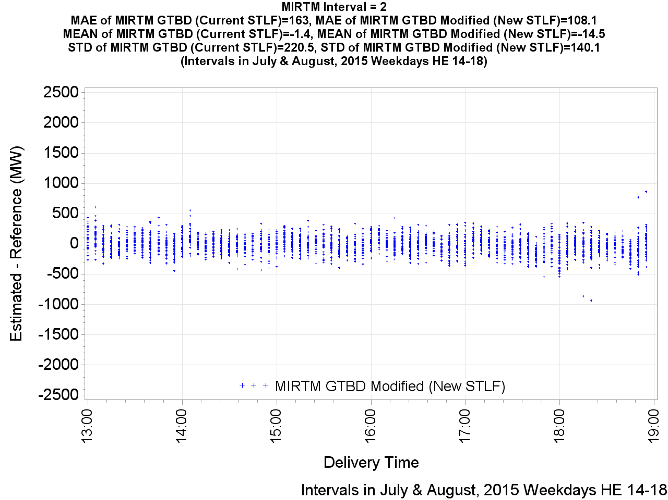
MIRTM GTBD Error by Delivery Time (Interval = 2)

Slide 59
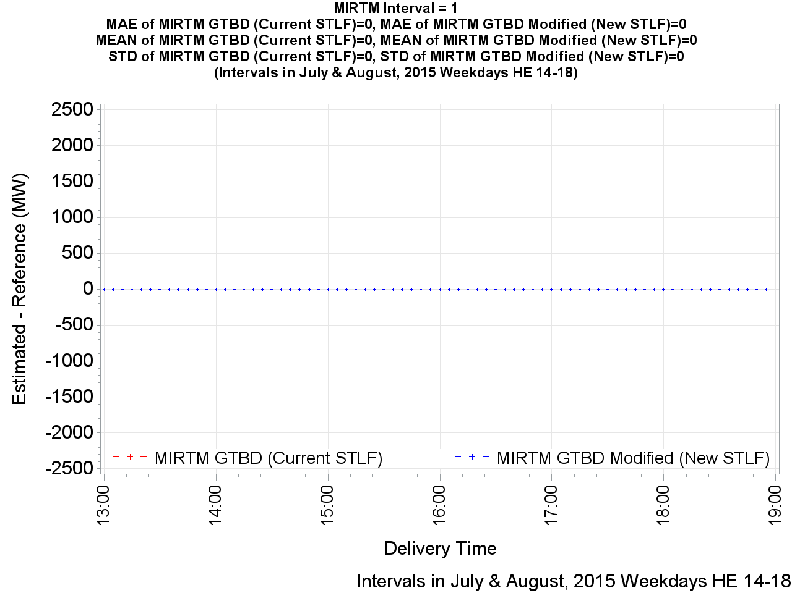
MIRTM GTBD Error by Delivery Time (Interval = 1)

Slide 60
Improving Wind HSL Estimation

Slide 61
Wind Estimation Performance
January 1, 2015 – December 31, 2015
All Intervals

Slide 62
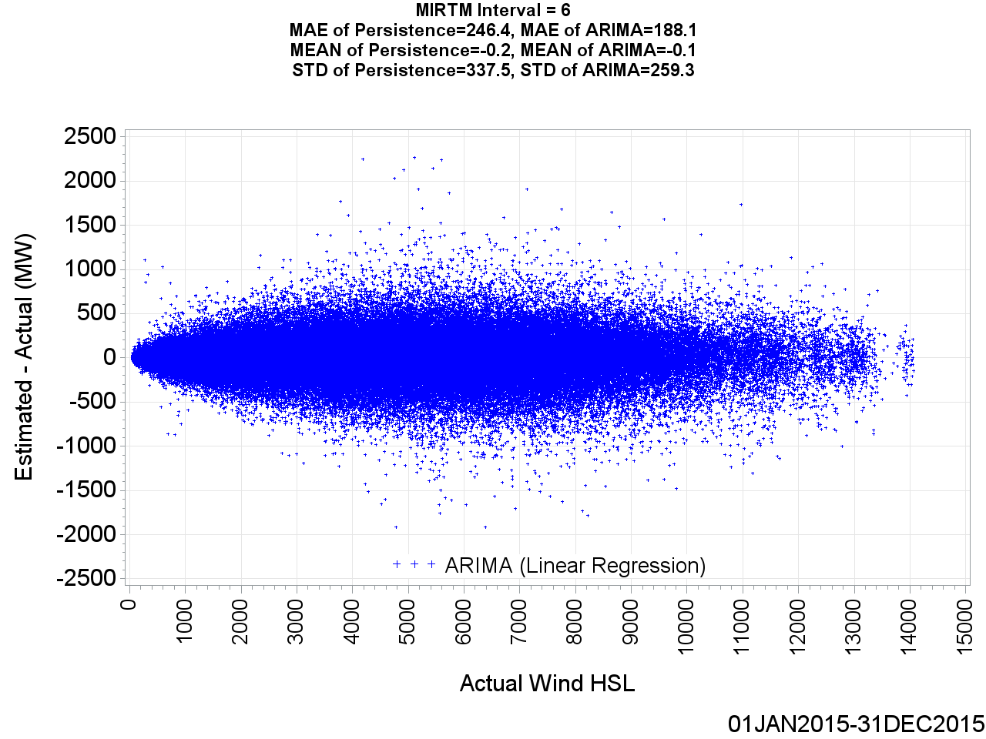
MIRTM Wind HSL Error by Actual Wind HSL (Interval = 6)

Slide 63
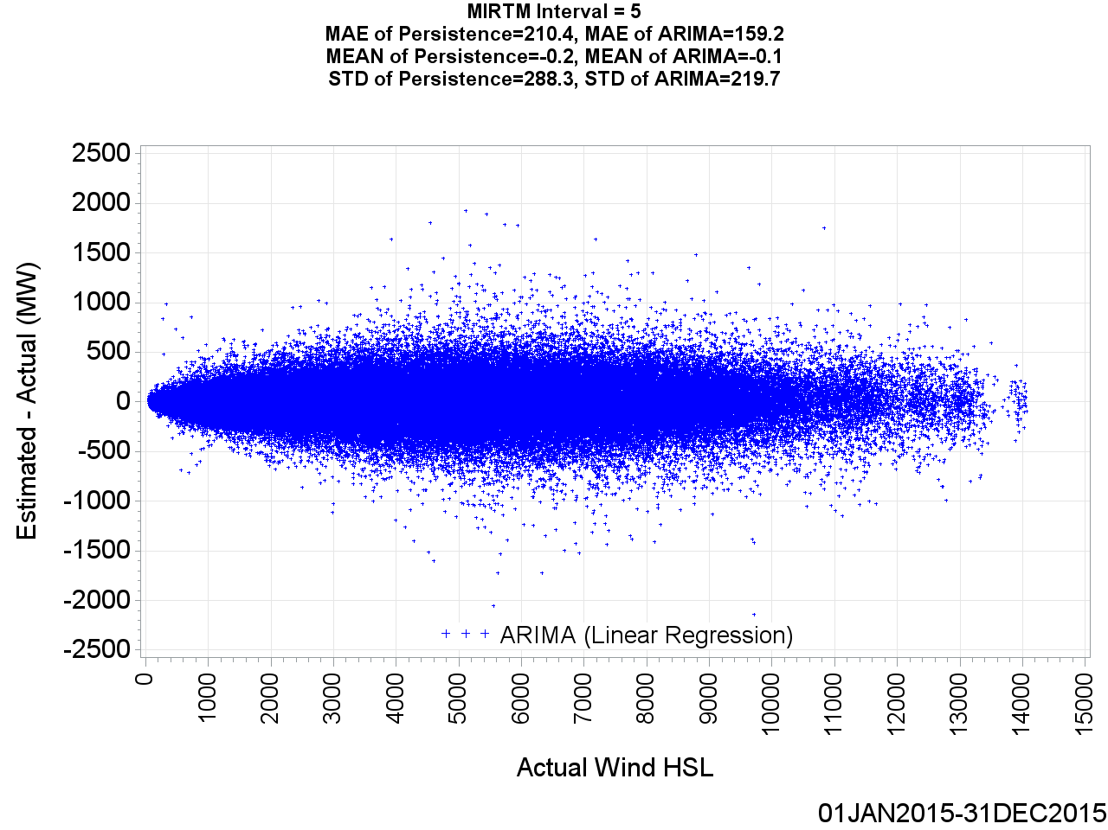
MIRTM Wind HSL Error by Actual Wind HSL (Interval = 5)

Slide 64
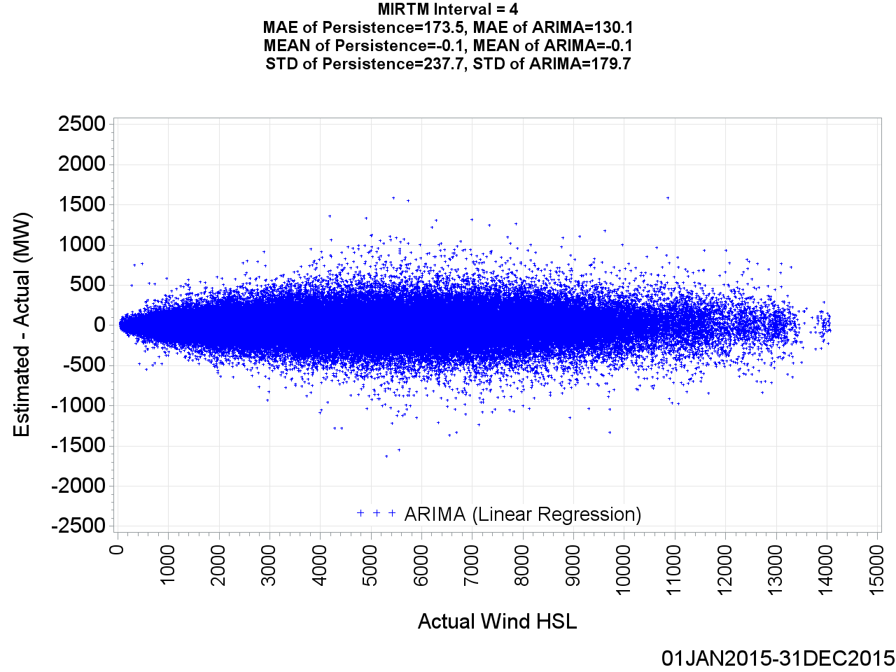
MIRTM Wind HSL Error by Actual Wind HSL (Interval = 4)

Slide 65
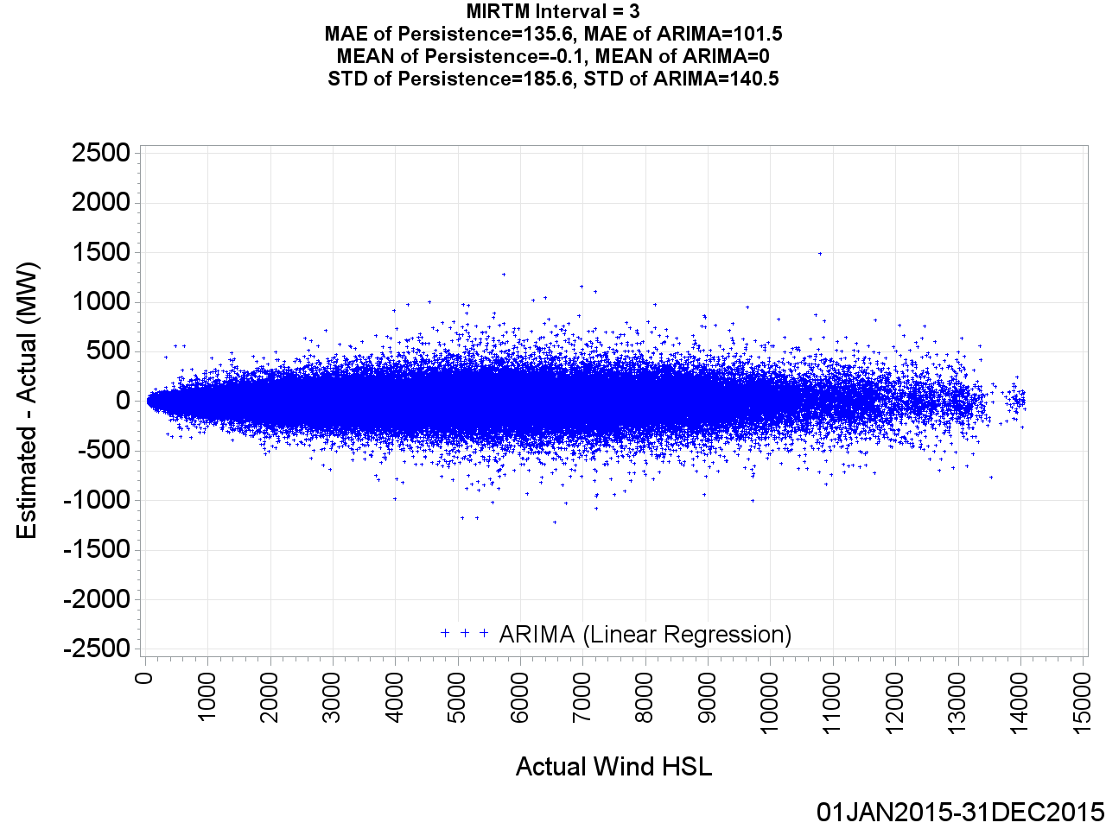
MIRTM Wind HSL Error by Actual Wind HSL (Interval = 3)

Slide 66

MIRTM Wind HSL Error by Actual Wind HSL (Interval = 2)

Slide 67
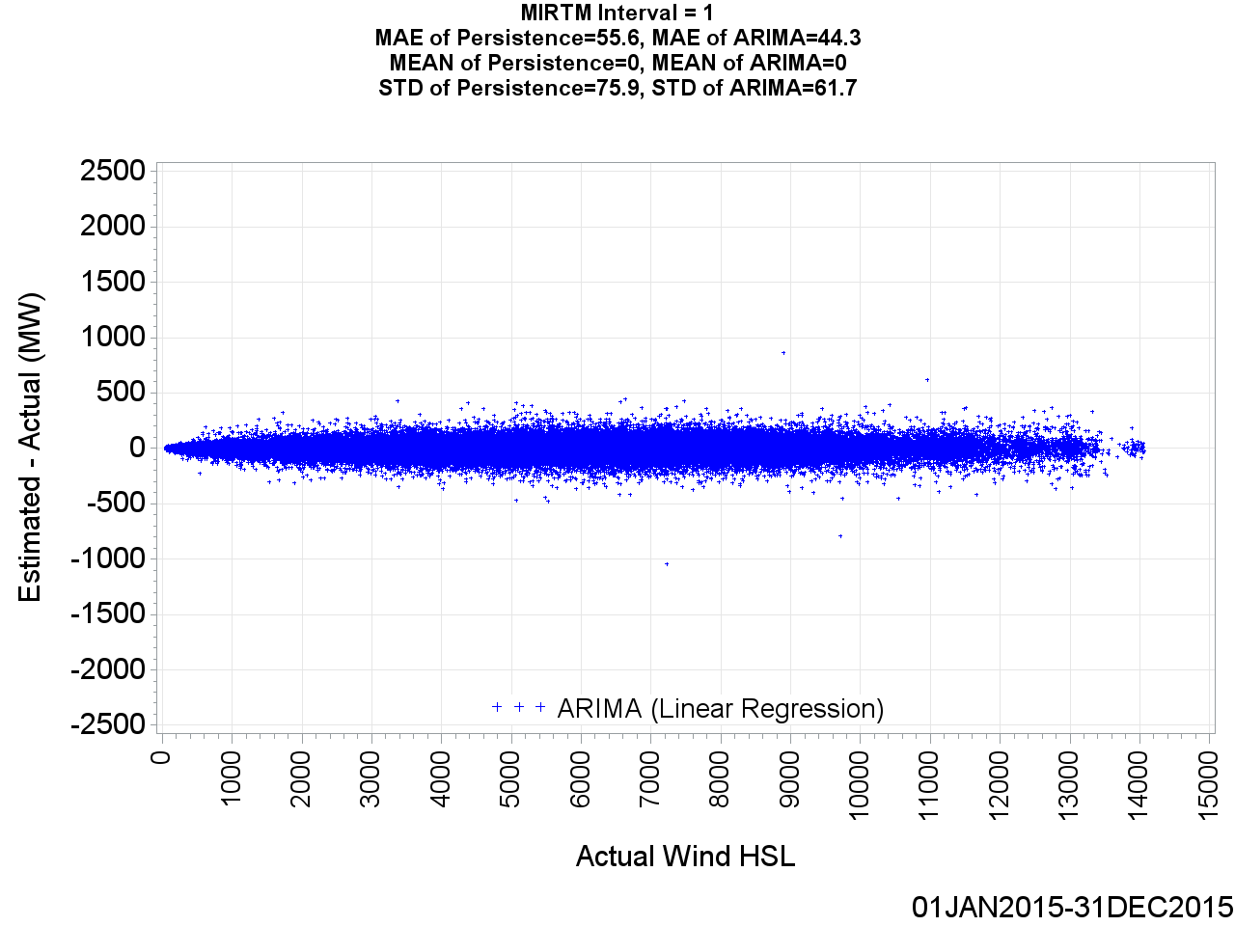
MIRTM Wind HSL Error by Actual Wind HSL (Interval = 1)

Slide 68
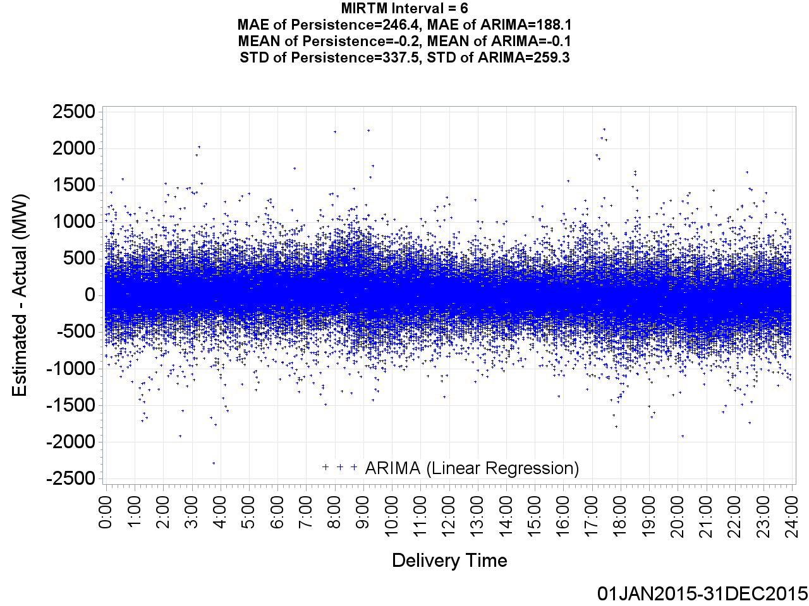
MIRTM Wind HSL Error by Delivery Time (Interval = 6)

Slide 69

MIRTM Wind HSL Error by Delivery Time (Interval = 5)

Slide 70
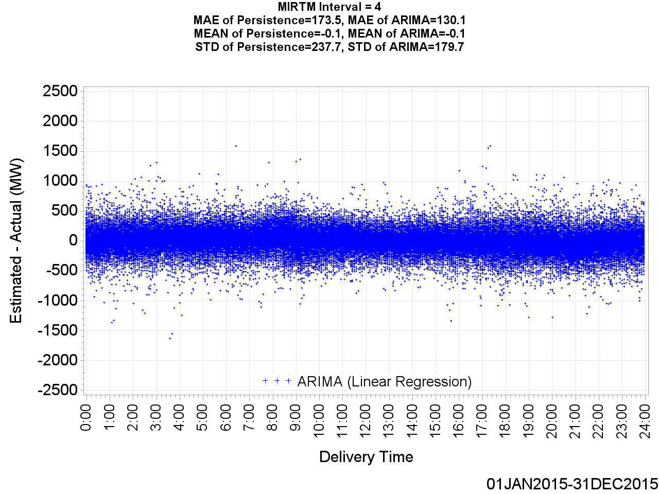
MIRTM Wind HSL Error by Delivery Time (Interval = 4)

Slide 71
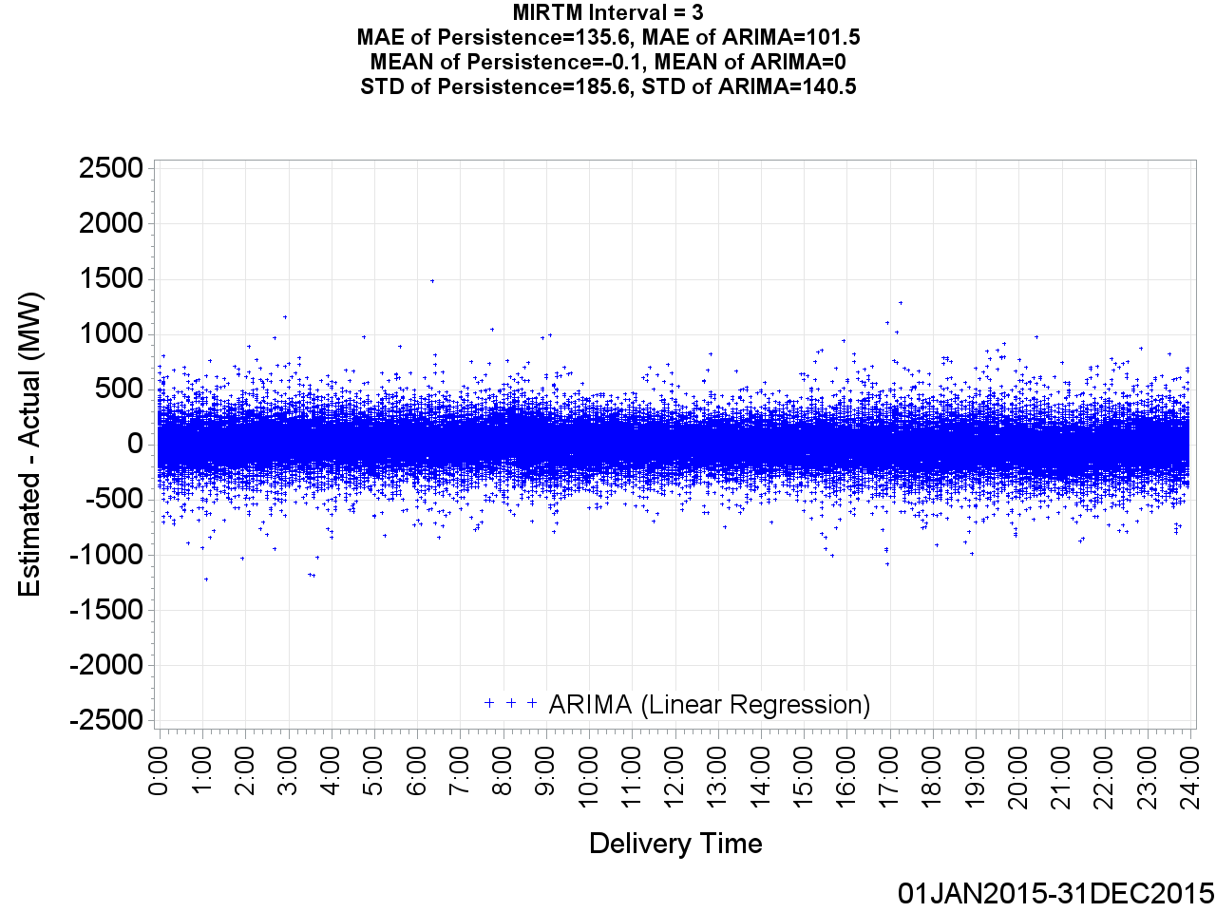
MIRTM Wind HSL Error by Delivery Time (Interval = 3)

Slide 72
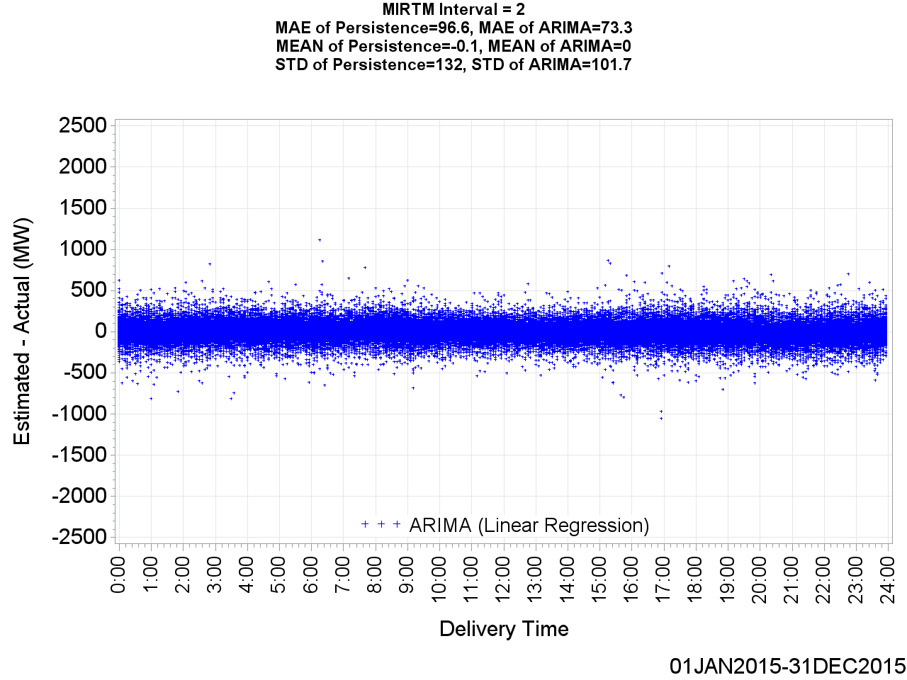
MIRTM Wind HSL Error by Delivery Time (Interval = 2)

Slide 73
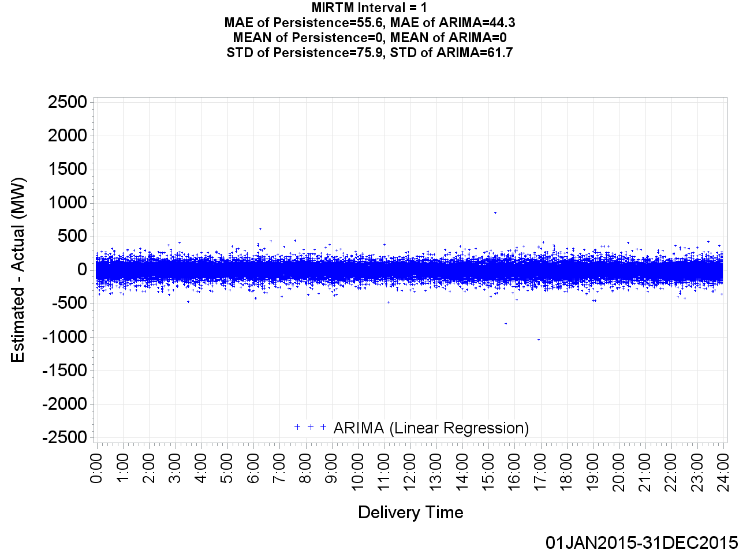
MIRTM Wind HSL Error by Delivery Time (Interval = 1)

Slide 74
MIRTM Wind HSL Estimation Performance
January 1, 2015 – December 31, 2015
1160 Intervals when System Lambda >= $75/MWh

Slide 75
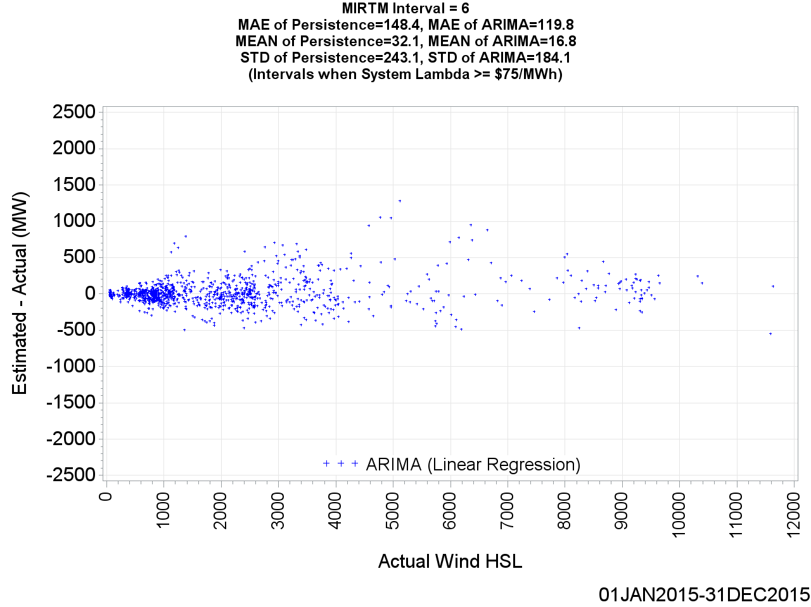
MIRTM Wind HSL Error by Actual Wind HSL (Interval = 6)

Slide 76
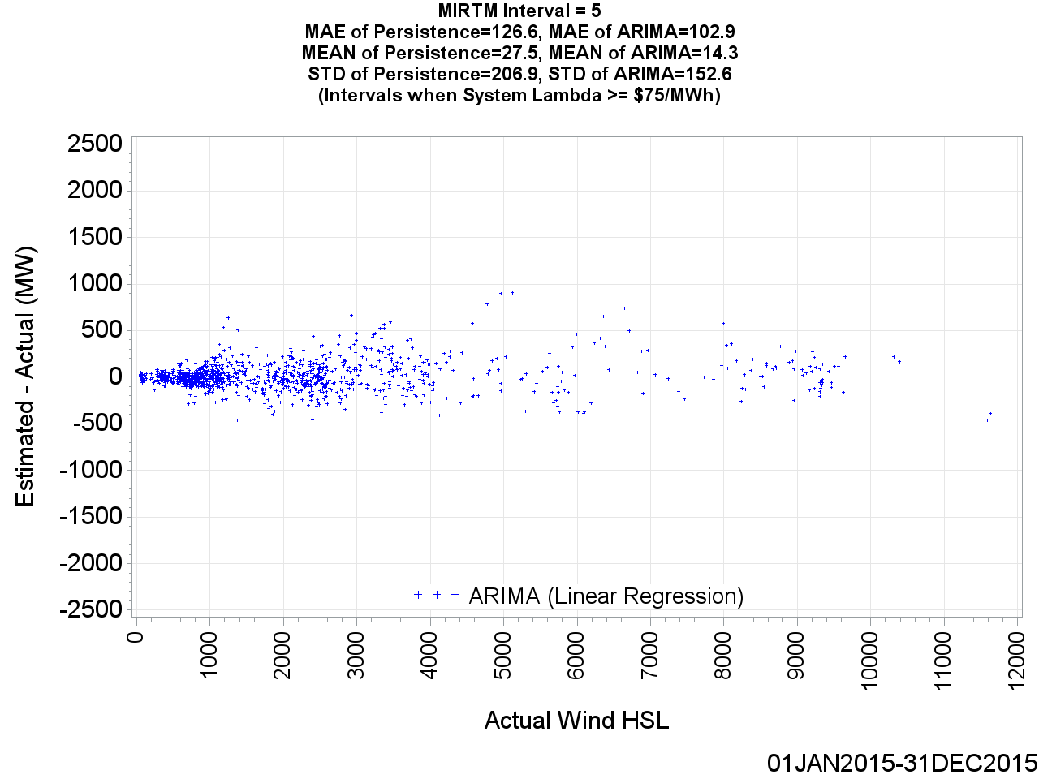
MIRTM Wind HSL Error by Actual Wind HSL (Interval = 5)

Slide 77

MIRTM Wind HSL Error by Actual Wind HSL (Interval = 4)

Slide 78

MIRTM Wind HSL Error by Actual Wind HSL (Interval = 3)

Slide 79

MIRTM Wind HSL Error by Actual Wind HSL (Interval = 2)

Slide 80

MIRTM Wind HSL Error by Actual Wind HSL (Interval = 1)

Slide 81

MIRTM Wind HSL Error by Delivery Time (Interval = 6)

Slide 82

MIRTM Wind HSL Error by Delivery Time (Interval = 5)

Slide 83

MIRTM Wind HSL Error by Delivery Time (Interval = 4)

Slide 84

MIRTM Wind HSL Error by Delivery Time (Interval = 3)

Slide 85

MIRTM Wind HSL Error by Delivery Time (Interval = 2)

Slide 86

MIRTM Wind HSL Error by Delivery Time (Interval = 1)

Slide 87
Wind Estimation Performance
July & August, 2015 Weekdays HE 14-18

Slide 88

MAE of Estimated Wind HSL vs. Actual Wind HSL

Slide 89
MAE of Estimated Wind HSL vs. Actual Wind HSL

Slide 90

Standard Deviation of Estimated Wind HSL vs. Actual Wind HSL

Slide 91
Standard Deviation of Estimated Wind HSL vs. Actual Wind HSL

Slide 92


Mean of Estimated Wind HSL vs. Actual Wind HSL

Slide 93
Mean of Estimated Wind HSL vs. Actual Wind HSL
The cause of the negative bias during peak hours is because wind had a tendency to actually ramp up during the end of the period

Slide 94

MIRTM Wind HSL Error by Actual Wind HSL (Interval = 6)

Slide 95

MIRTM Wind HSL Error by Actual Wind HSL (Interval = 6)

Slide 96

MIRTM Wind HSL Error by Actual Wind HSL (Interval = 5)

Slide 97

MIRTM Wind HSL Error by Actual Wind HSL (Interval = 5)

Slide 98

MIRTM Wind HSL Error by Actual Wind HSL (Interval = 4)

Slide 99

MIRTM Wind HSL Error by Actual Wind HSL (Interval = 4)

Slide 100

MIRTM Wind HSL Error by Actual Wind HSL (Interval = 3)

Slide 101

MIRTM Wind HSL Error by Actual Wind HSL (Interval = 3)

Slide 102

MIRTM Wind HSL Error by Actual Wind HSL (Interval = 2)

Slide 103

MIRTM Wind HSL Error by Actual Wind HSL (Interval = 2)

Slide 104

MIRTM Wind HSL Error by Actual Wind HSL (Interval = 1)

Slide 105

MIRTM Wind HSL Error by Actual Wind HSL (Interval = 1)

Slide 106


MIRTM Wind HSL Error by Delivery Time (Interval = 6)

Slide 107

MIRTM Wind HSL Error by Delivery Time (Interval = 6)

Slide 108

MIRTM Wind HSL Error by Delivery Time (Interval = 5)

Slide 109

MIRTM Wind HSL Error by Delivery Time (Interval = 5)

Slide 110

MIRTM Wind HSL Error by Delivery Time (Interval = 4)

Slide 111

MIRTM Wind HSL Error by Delivery Time (Interval = 4)

Slide 112

MIRTM Wind HSL Error by Delivery Time (Interval = 3)

Slide 113

MIRTM Wind HSL Error by Delivery Time (Interval = 3)

Slide 114

MIRTM Wind HSL Error by Delivery Time (Interval = 2)

Slide 115

MIRTM Wind HSL Error by Delivery Time (Interval = 2)

Slide 116

MIRTM Wind HSL Error by Delivery Time (Interval = 1)

Slide 117

MIRTM Wind HSL Error by Delivery Time (Interval = 1)

