Slide 1
SAWG Update to WMS
March 2nd, 2016
Brandon Whittle

Slide 2
Report Releases
None
Housekeeping
Leadership proposed for 2016
Chair - Brandon Whittle
Vice Chairs – Sandy Morris, Pete Warnken
Meeting dates posted

Slide 3
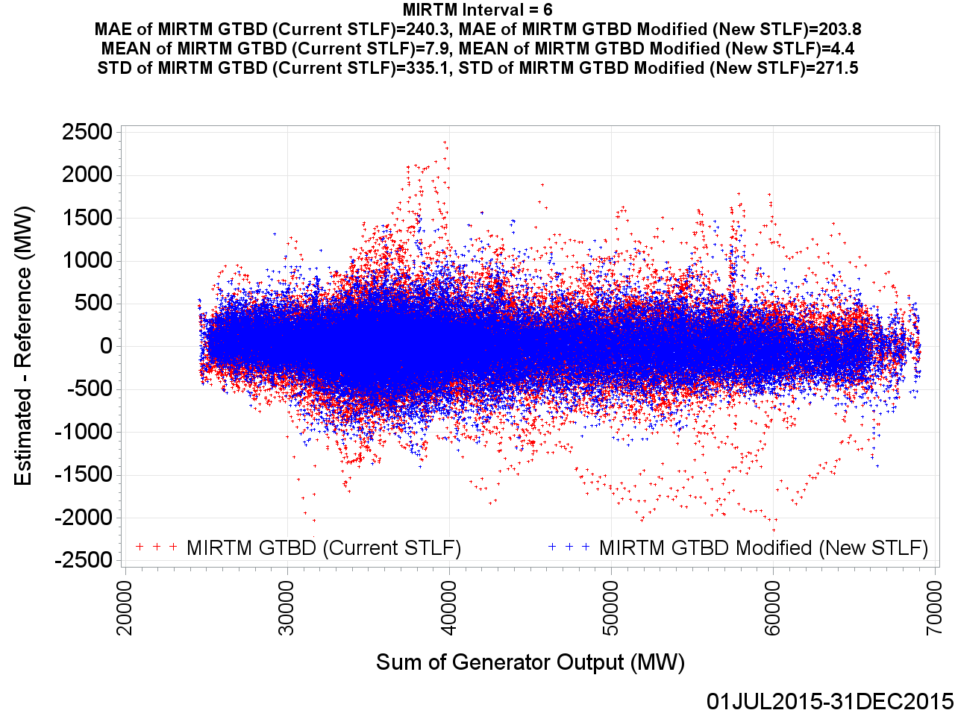
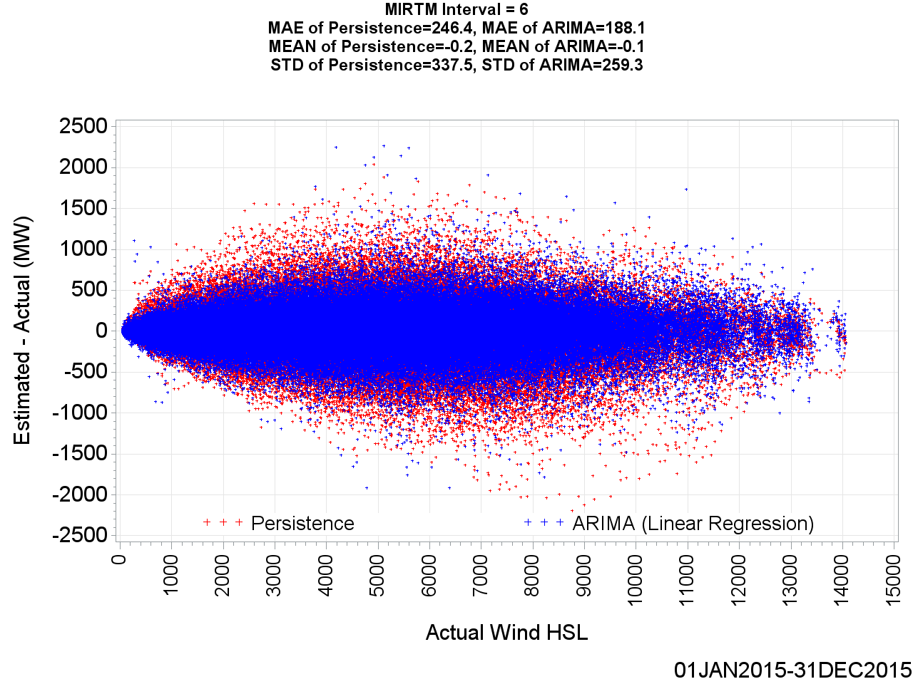
MIRTM – Update
ERCOT Update – ERCOT expects study to begin in late Spring and is working with stakeholders to develop appropriate metrics.
Forecast Analysis – ERCOT presented thorough analysis of the new STLF (left) and wind (right) forecasts indicate improvement, but concerns remain if they are “good enough” to commit. Most concern was around the wind forecast and the use of persistence during a large ramp.

Slide 4
CDR
SAWG is beginning the biannual process of reviewing the CDR. In addition to line by line evaluation, we will take up any suggestion made including, but not limited to the following:
Keep the 10 year horizon or reduce?
Keep one reserve margin or create scenarios which result in many different outcomes?
Make the planned generation qualification more stringent?
Institute an option for ERCOT to remove or add planned generation?
Consider environmental effects; e.g. Regional Haze?
Require deliverability?

Slide 5
Next Meeting – April 26th, 2016
Expected Agenda Items
MIRTM Update
CDR – Line by Line Review, Appetite for Scenarios?
NERC LTRA - Update

