Slide 1
EWS Redesign Business Case
A look at creating a reports client for new or small market participants

Slide 2
OVERVIEW
Focus on the “Get Reports” feature of the ERCOT External Web Services
Discuss my experience of setting up a client from the perspective of a new market participant.
Costs associated with developing client
Opportunities to improve the service

Slide 3
My Background
I Started with Denton Municipal Electric (DME) in June of 2014
DME’s QSE went live on October 1, 2014
My task:
  Back populate market data from the start of Nodal
  Design a system to automate the request, downloading, parsing and warehousing of ERCOT report data
I have implemented this solution in both .NET and Java
  Prototyped or P.O.C. in other languages: JavaScript, Python, Scala, Groovy, Ruby

Slide 4
Business Problem
The External Web Services interface, under the current design, is cost prohibitive for new or small market participants
  Essentially same design from 2007
  Relies on SOAP vs HTTP(S)
  No sdk’s or code examples for any language
  Documentation does not provide necessary details for configuration
  Pull only architecture is resource and code intensive
Knowledge base seems to only exist for entities around at time of implementation
  Left with the options:
    Purchase software
    Hire outside consultants

Slide 5
Problem Analysis- Documentation
In General, the EIP document is pretty thorough
  Exporting to pdf increases the readability
  Over 400 pages
  No getting started or “quick start” section
Light on the needed configuration
No mention of the need to manage multiple private keys
No Code examples

Slide 6
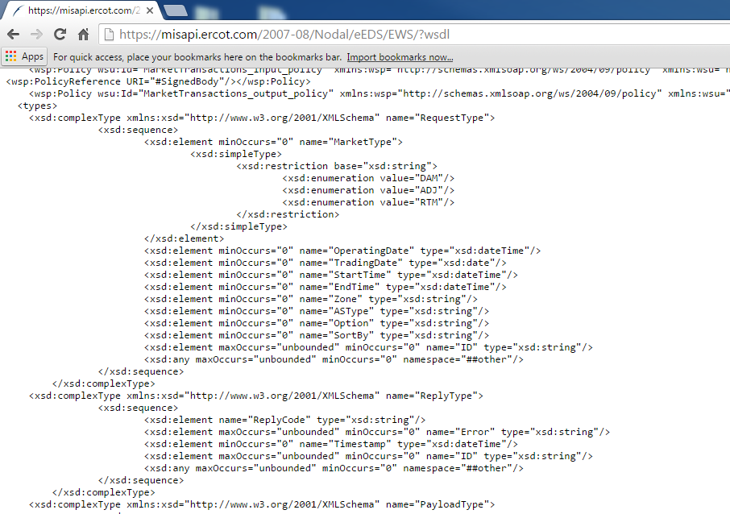
Problem Analysis – WSDL
Unable to generate WSDL from url: https://misapi.ercot.com/2007-08/Nodal/eEDS/EWS/?wsdl
WSDL file* does not have a WS-SecurityPolicy attached
*WSDL @ url does have wsp attached

Slide 7

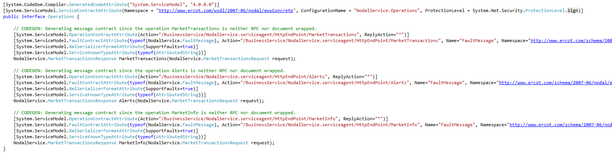
Problem Analysis - .NET
Web service stub generated by WCF/scvutil appears to generate correctly
But assigns a protection level of EncryptAndSign in service interface
  Ercot response is not encrypted
  Will throw a “The primary signature must be encrypted” exception
Couldn’t find code examples on setting up a .NET client referenced in the EIP

Slide 8

Problem Analysis - Java
Some web service libraries experienced naming collisions when parsing WSDL
  Eventually settled on a Maven plugin to provide more flexibility (JAXB)
  Some required .xjc bindings to generate stubs
Application servers make it difficult to authenticate with multiple private keys
  Requires to roll your own SSL http client to ensure the correct private key is used at run time
Couldn’t find code examples on setting up a Java client referenced in the EIP

Slide 9
Problem Analysis – “Polling” Requests
Have to develop a batch system to handle all the logic for requests
  Which reports
  When a new report becomes available
  Which client credentials
Requires the use of “polling” – making repeated requests

Slide 10
Cost Factors
Development time of a Report client
  Everything adds ups
  Lack of personnel
Polling architecture
  Network bandwidth
  Storage

Slide 11



Opportunity
Clear, intuitive, self documented API
  RESTful
  Stateless security
Subscription model
  Manage report subscriptions
  “Push” style notifications
  File type preference (cvs, xml)

