Slide 1

Multi-Interval Real-Time Market (MIRTM) Updates
SAWG
Sean Chang
Market Analysis
February 22, 2016
ERCOT Public
Version 0.9.3

Slide 2
Table of Contents
Introduction
Improving Demand Estimation
Performance of All Intervals
Performance of Intervals where System Lambda >= $75/MWh
Performance on Specific Days
Improving Wind HSL Estimation
Performance of All Intervals
Performance of Intervals where System Lambda >= $75/MWh
Performance on Specific Days
MAE of All Methodologies
Next Steps

Slide 3
Introduction
1. Improving Demand Estimation
Short-Term Load Forecast (STLF)
Generation-To-Be-Dispatched (GTBD) Calculation Methodology
2. Improving Wind HSL Estimation
Indicative Pricing Tool currently uses a heuristically determined linear equation to estimate wind HSL
Currently, proposal is for MIRTM to use Persistence (HSL telemetry only) to forecast wind HSL
Improvements to linear regression was devised to show potential improvement in short-term wind HSL estimation

Slide 4
Improving Demand Estimation

Slide 5
Short Term Load Forecast (STLF)
Both STLFs use weather and calendar variables as basic inputs.
Current STLF (Legacy system in the EMMS)
  Based on regression similar day model using lagged load values as well as lagged load from 24 hours ago of a similar day
New STLF (Blended Model)
  First 15 minutes is based on a regression model using lagged load values (forecast of total MW for a weather zone)
  Next 45+ minutes is based on a regression model of ramp rates (forecast of total MW change from last actual value)
See May 2015 SAWG meeting page for previous presentation: http://www.ercot.com/calendar/2015/5/27/55033-SAWG

Slide 6
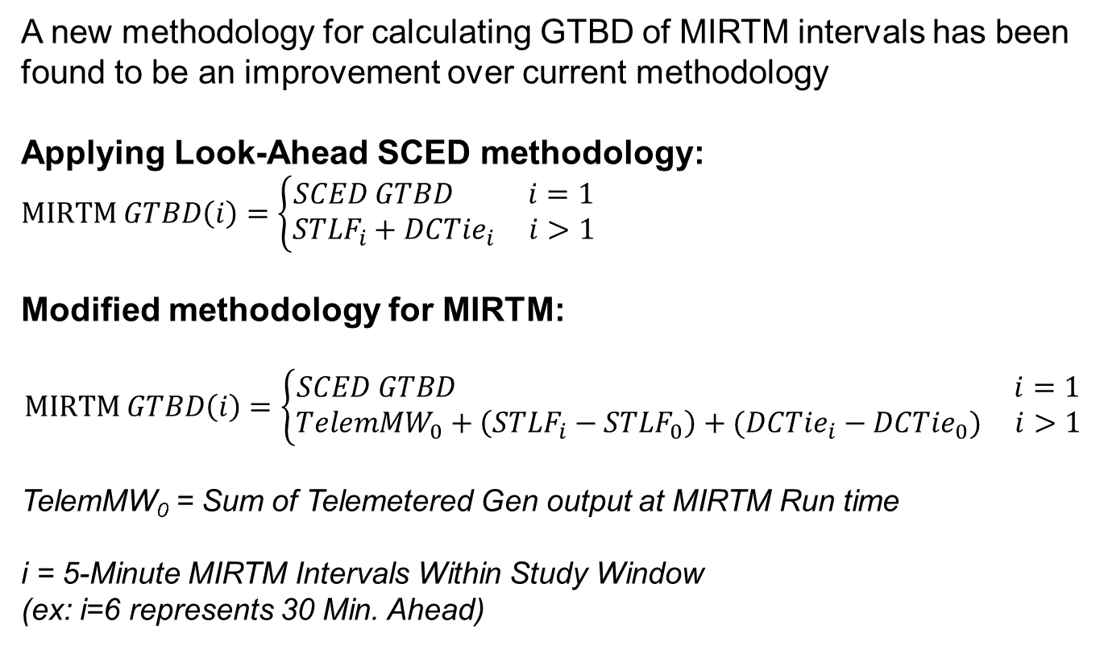
Improving Demand Estimation
A new methodology for calculating GTBD of MIRTM intervals has been found to be an improvement over current methodology
Applying Look-Ahead SCED methodology:
$$MIRTM GTBD\left(i\right)=\left\{\begin{aligned}SCED GTBD i=1 \\ {STLF}_{i}+DCTie_{i} i>1\end{aligned}\right.$$
Modified methodology for MIRTM:
$$MIRTM GTBD\left(i\right)=\left\{\begin{aligned}SCED GTBD i=1 \\ TelemMW_{0}+\left(STLF_{i}−STLF_{0}\right)+(DCTie_{i}−DCTie_{0}) i>1\end{aligned}\right.$$
TelemMW₀ = Sum of Telemetered Gen output at MIRTM Run time
i = 5-Minute MIRTM Intervals Within Study Window
(ex: i=6 represents 30 Min. Ahead)

Slide 7
Improving Demand Estimation
Both the current STLF and new STLF are used in the analysis along with the modified methodology for four combinations:
  MIRTM GTBD with current STLF
  MIRTM GTBD with new STLF
  MIRTM GTBD Modified with current STLF
  MIRTM GTBD Modified with new STLF
The calculated MIRTM GTBD errors are benchmarked using Estimated – Reference where Reference is:
  First interval (i=1): Actual SCED GTBD
  Intervals 2 – 6 (i=2…6): Sum of generator output at end of SCED interval

Slide 8
MIRTM Demand Estimation Performance
July 1, 2015 – December 31, 2015
All Intervals

Slide 9
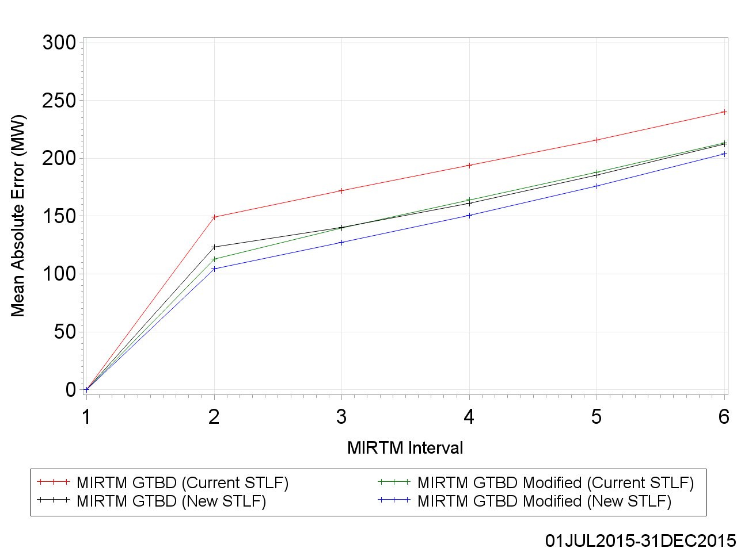
MAE of Estimated GTBD vs. Reference

Slide 10
MAE of Estimated GTBD vs. Reference

Slide 11
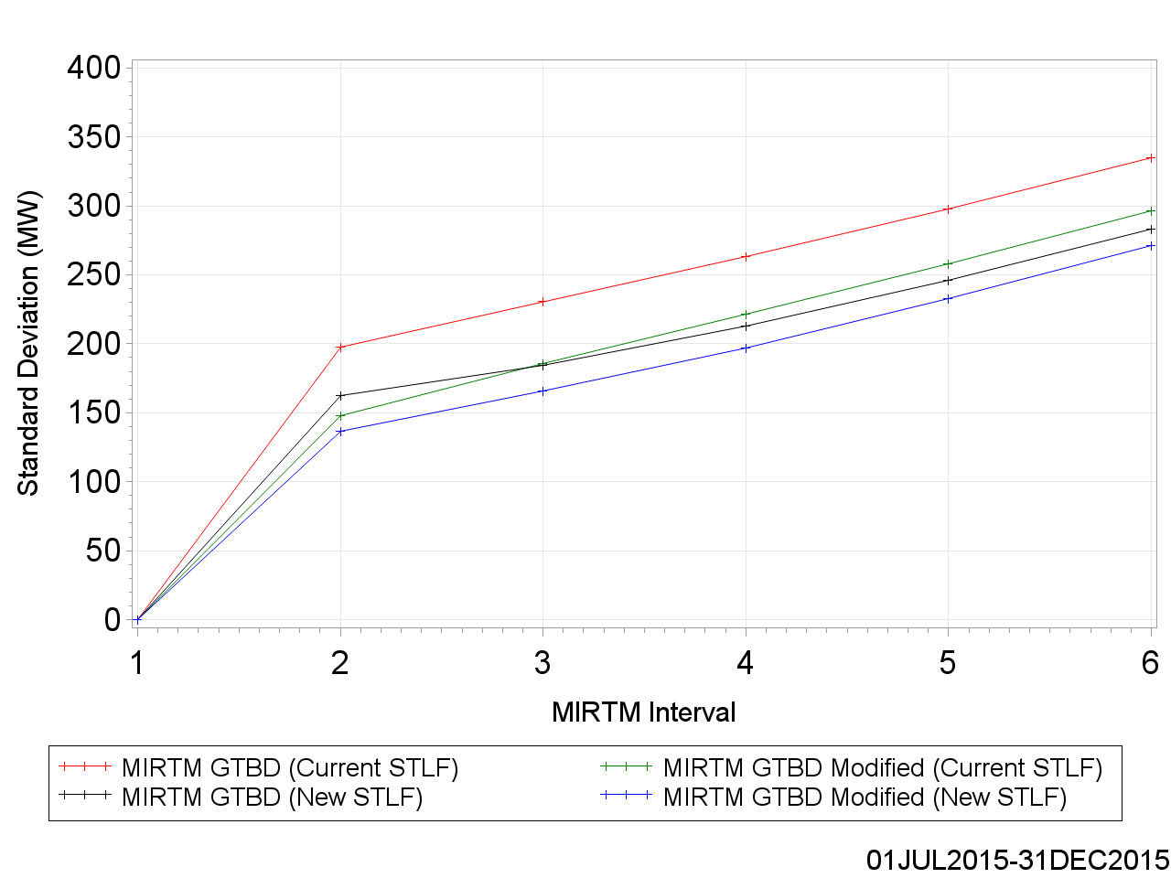
Standard Deviation of Estimated GTBD vs. Reference

Slide 12
Standard Deviation of Estimated GTBD vs. Reference

Slide 13
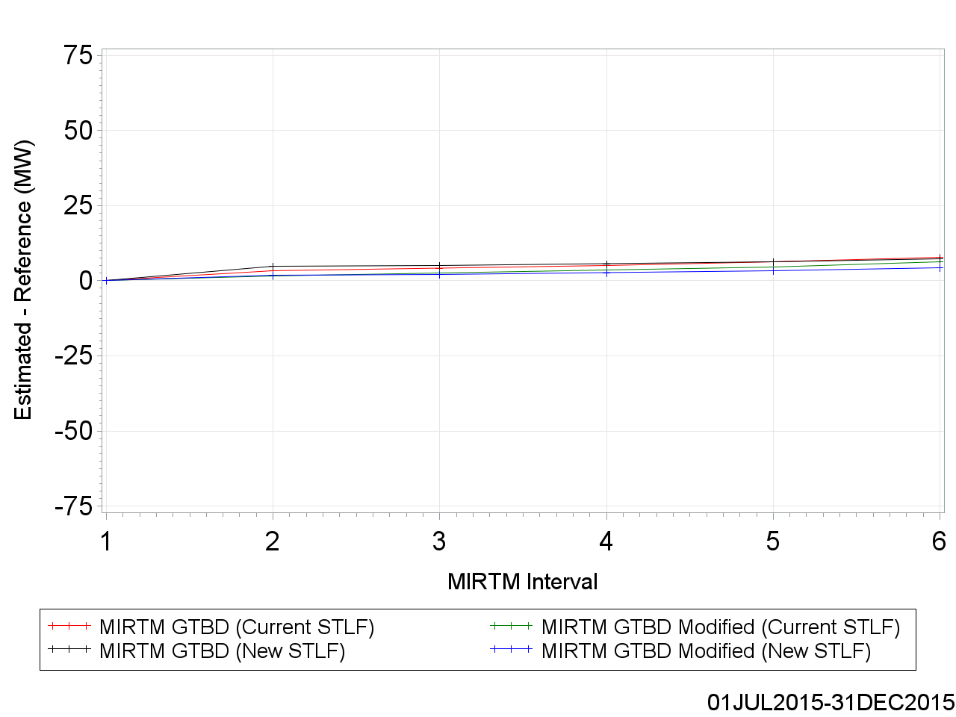
Mean of Estimated GTBD vs. Reference

Slide 14
Mean of Estimated GTBD vs. Reference

Slide 15
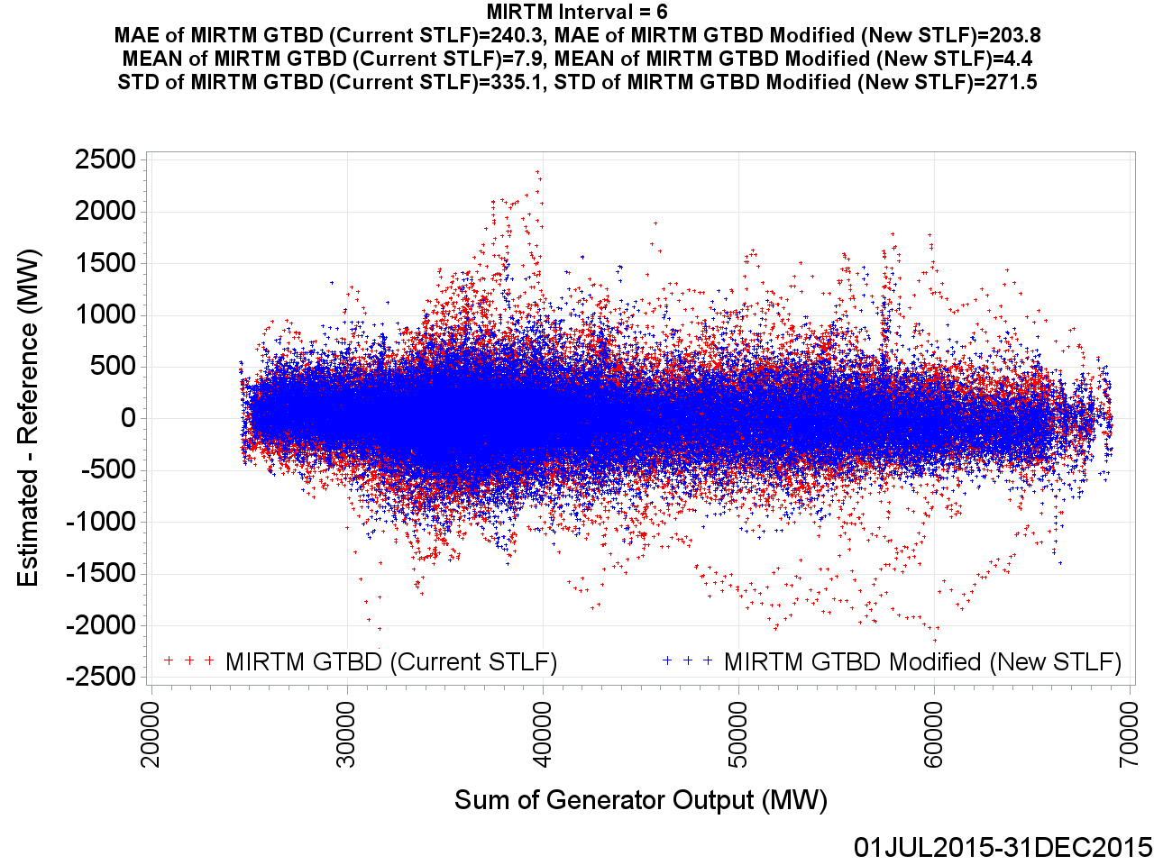
MIRTM GTBD Error by Reference (Interval = 6)

Slide 16
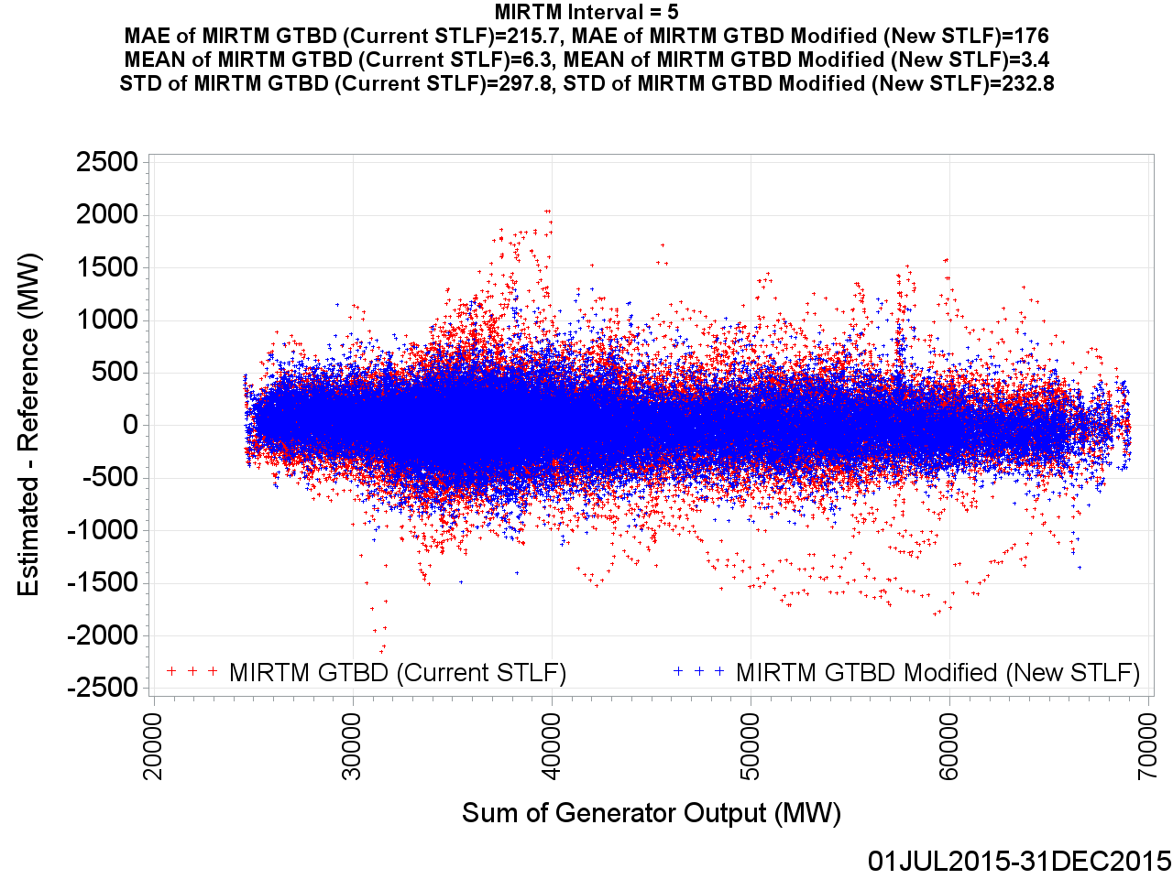
MIRTM GTBD Error by Reference (Interval = 5)

Slide 17

MIRTM GTBD Error by Reference (Interval = 4)

Slide 18
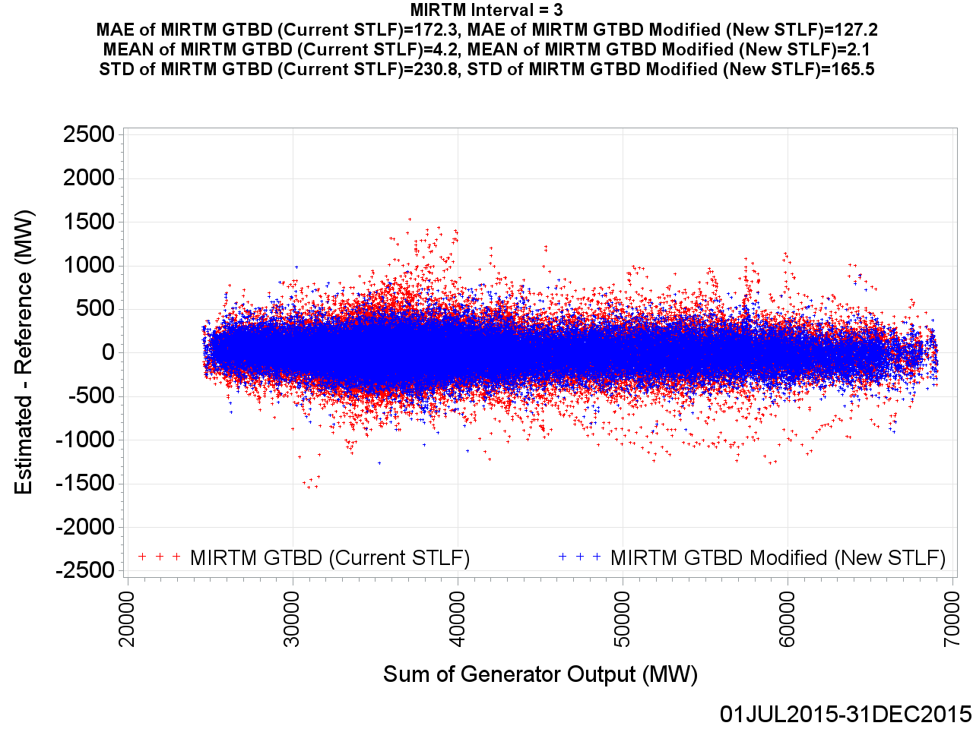
MIRTM GTBD Error by Reference (Interval = 3)

Slide 19
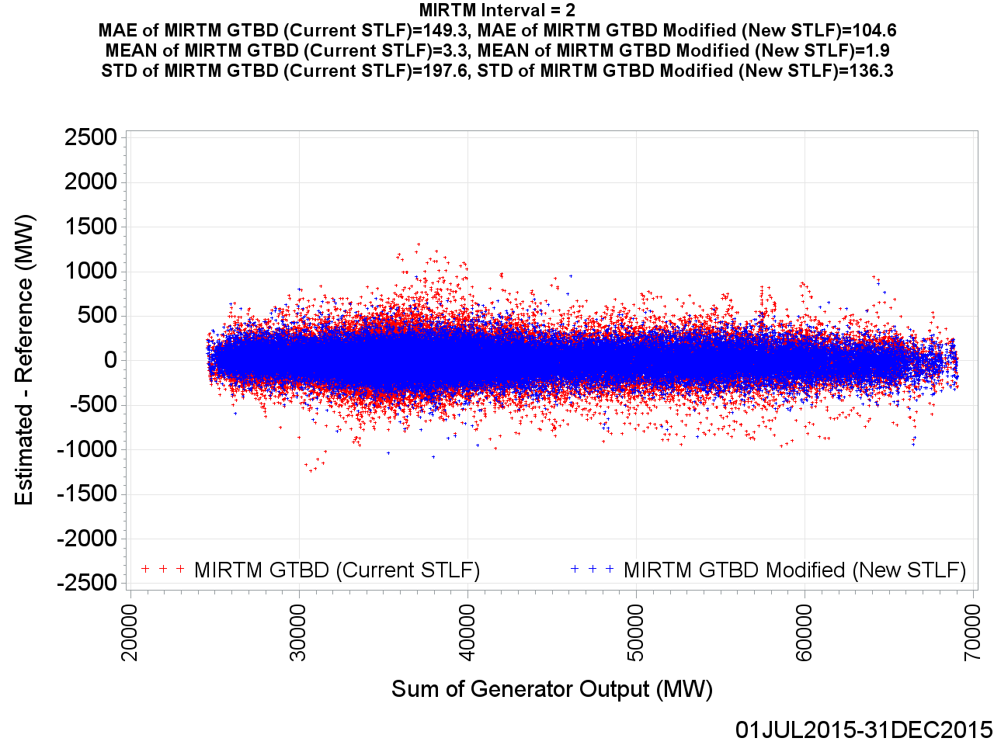
MIRTM GTBD Error by Reference (Interval = 2)

Slide 20
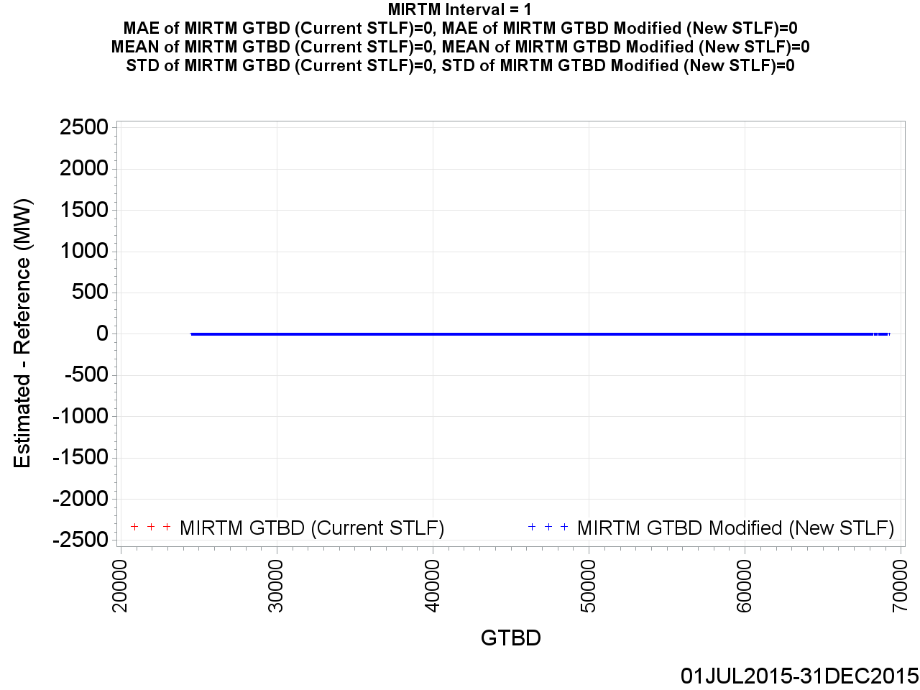
MIRTM GTBD Error by Reference (Interval = 1)

Slide 21
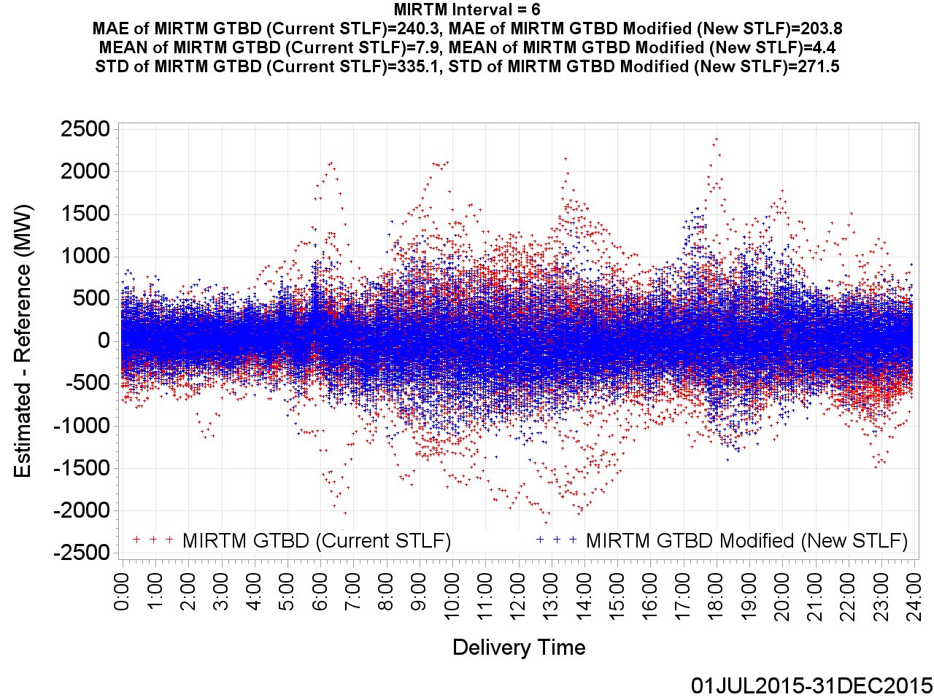
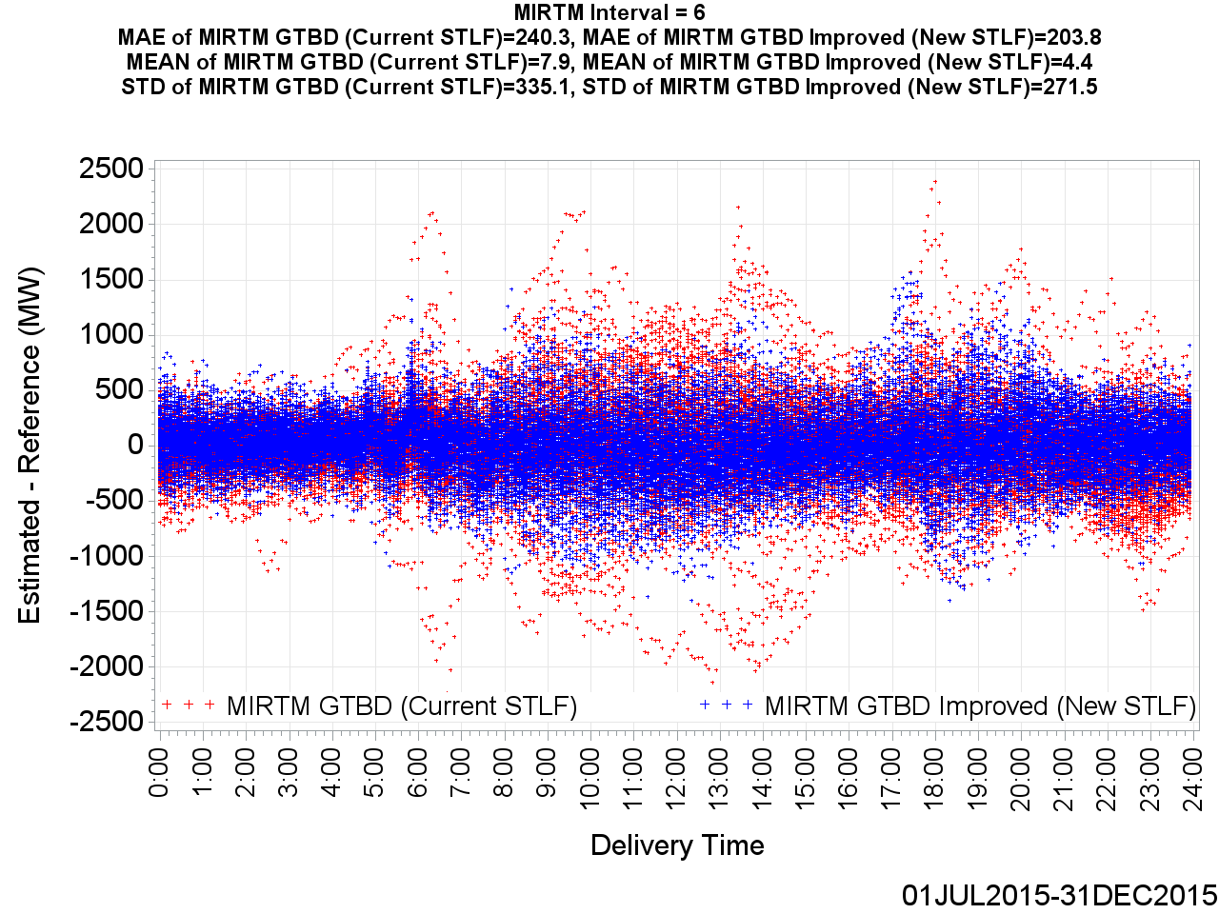
MIRTM GTBD Error by Delivery Time (Interval = 6)

Slide 22
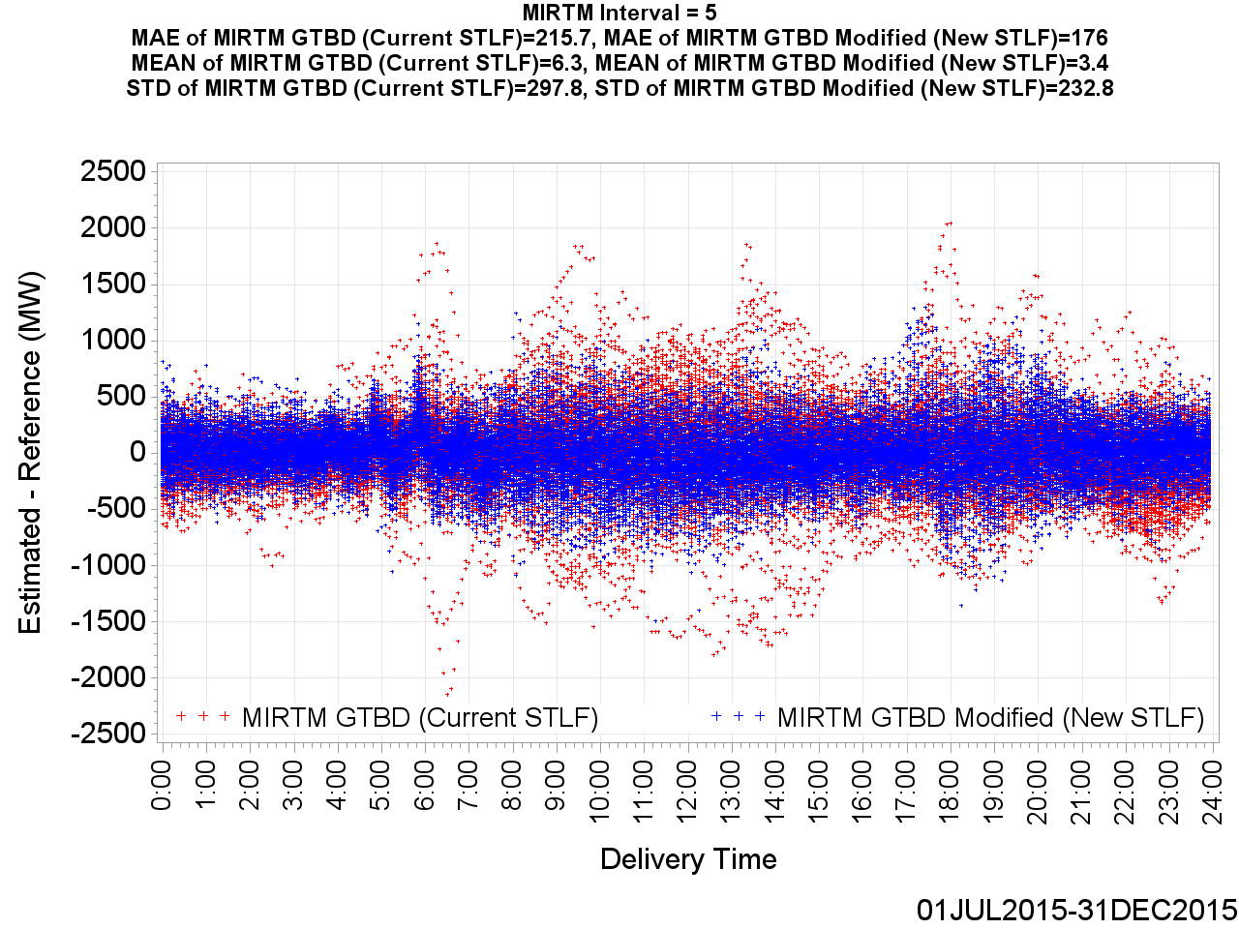
MIRTM GTBD Error by Delivery Time (Interval = 5)

Slide 23
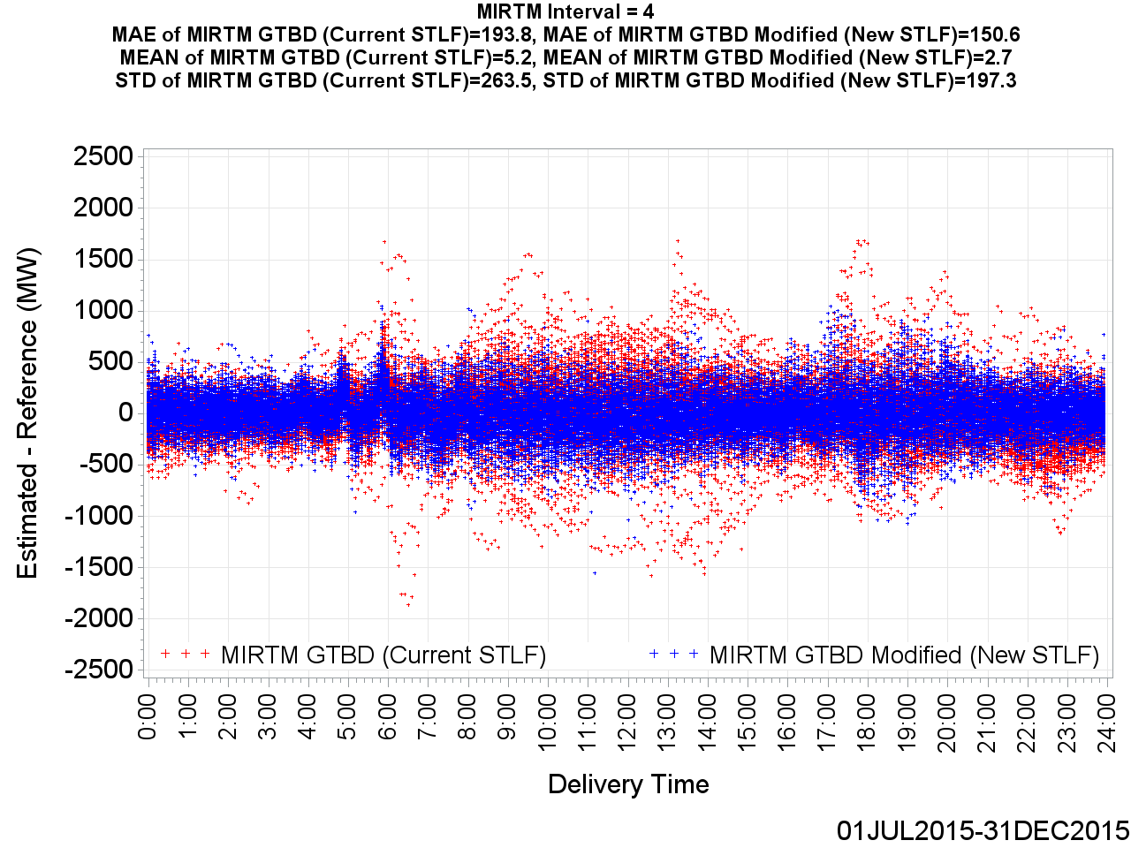
MIRTM GTBD Error by Delivery Time (Interval = 4)

Slide 24
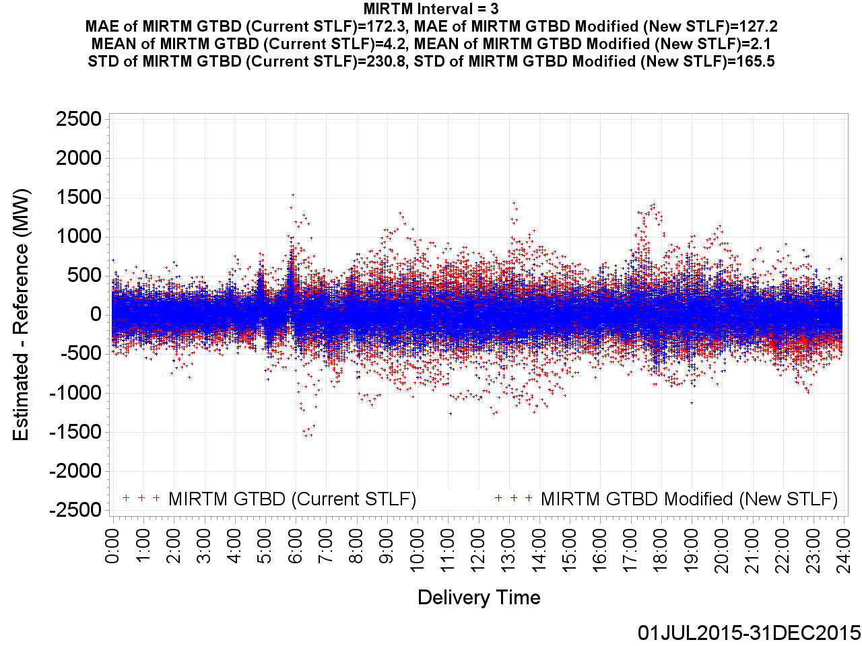
MIRTM GTBD Error by Delivery Time (Interval = 3)

Slide 25
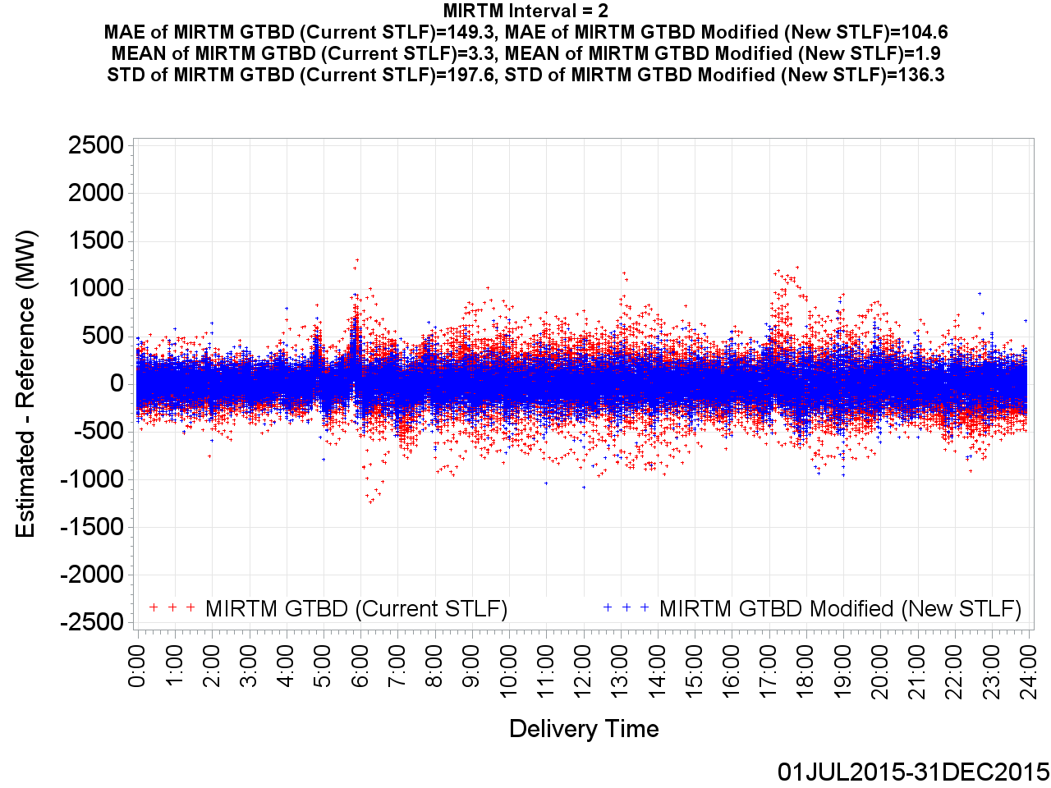
MIRTM GTBD Error by Delivery Time (Interval = 2)

Slide 26
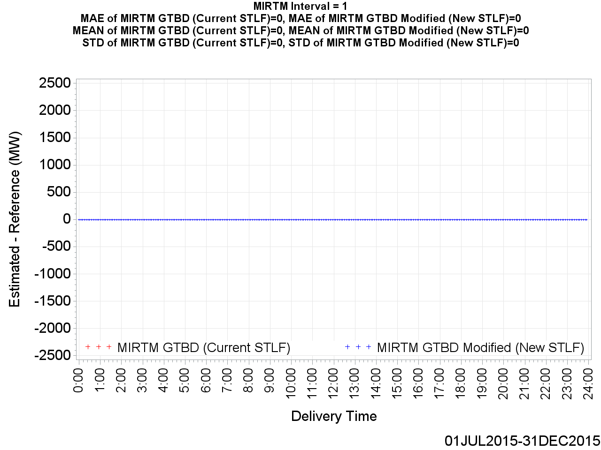
MIRTM GTBD Error by Delivery Time (Interval = 1)

Slide 27
MIRTM Demand Estimation Performance
July 1, 2015 – December 31, 2015
547 Intervals when System Lambda >= $75/MWh

Slide 28
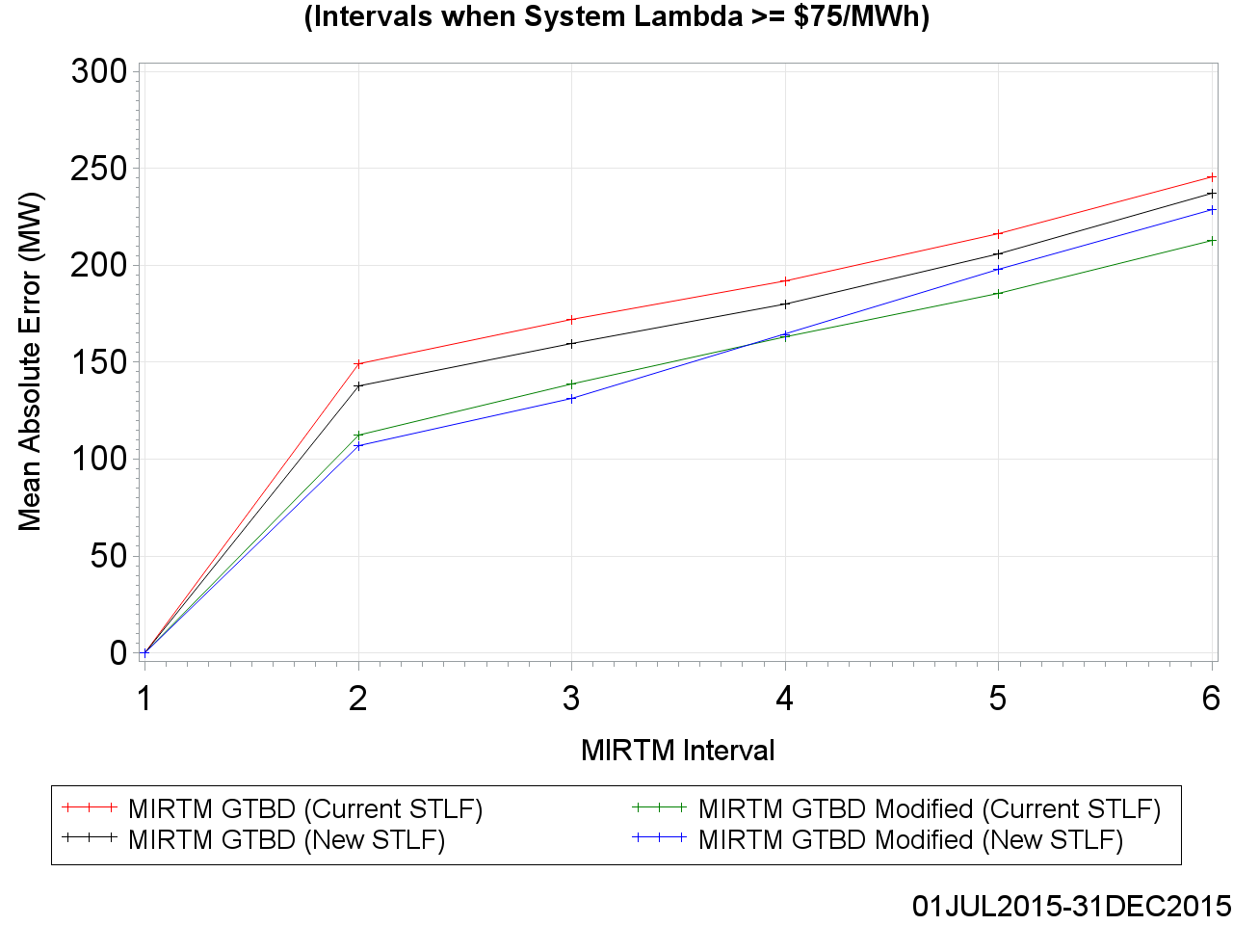
MAE of Estimated GTBD vs. Reference

Slide 29
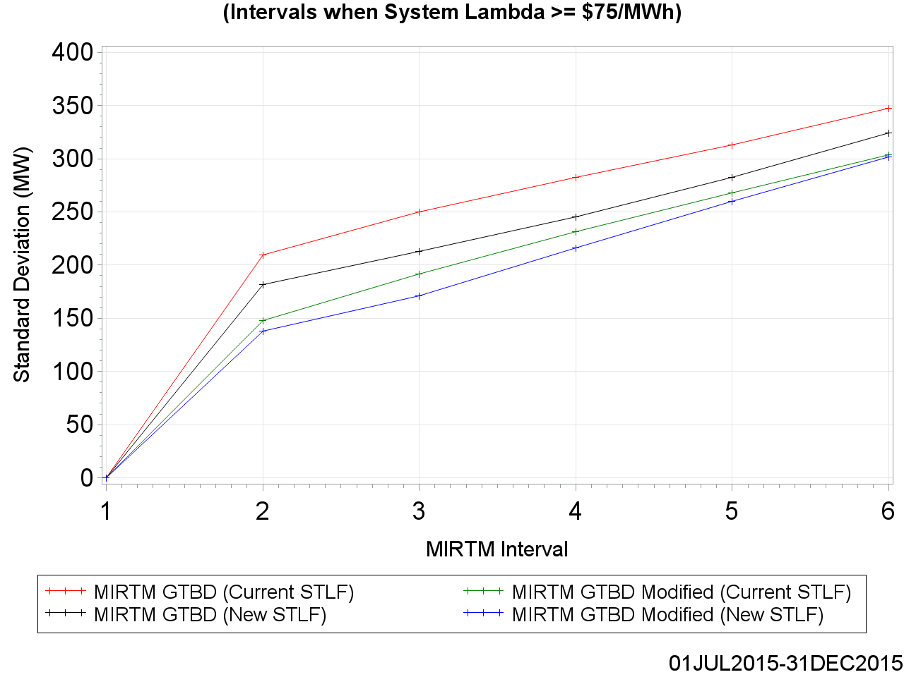
MAE of Estimated GTBD vs. Reference
For intervals 4-6, we are investigating why the current STLF performs better than the new STLF for the high price intervals using the modified methodology.

Slide 30
Standard Deviation of Estimated GTBD vs. Reference

Slide 31
Standard Deviation of Estimated GTBD vs. Reference

Slide 32
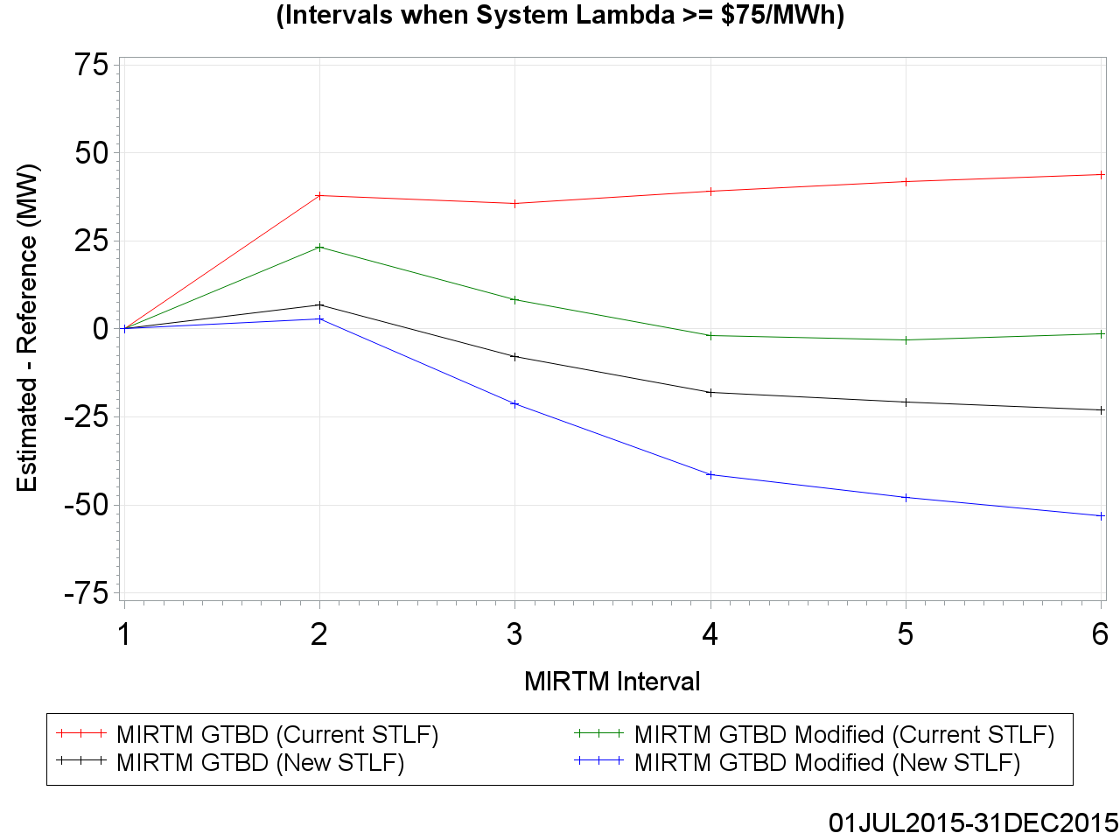
Mean of Estimated GTBD vs. Reference

Slide 33
Mean of Estimated GTBD vs. Reference

Slide 34
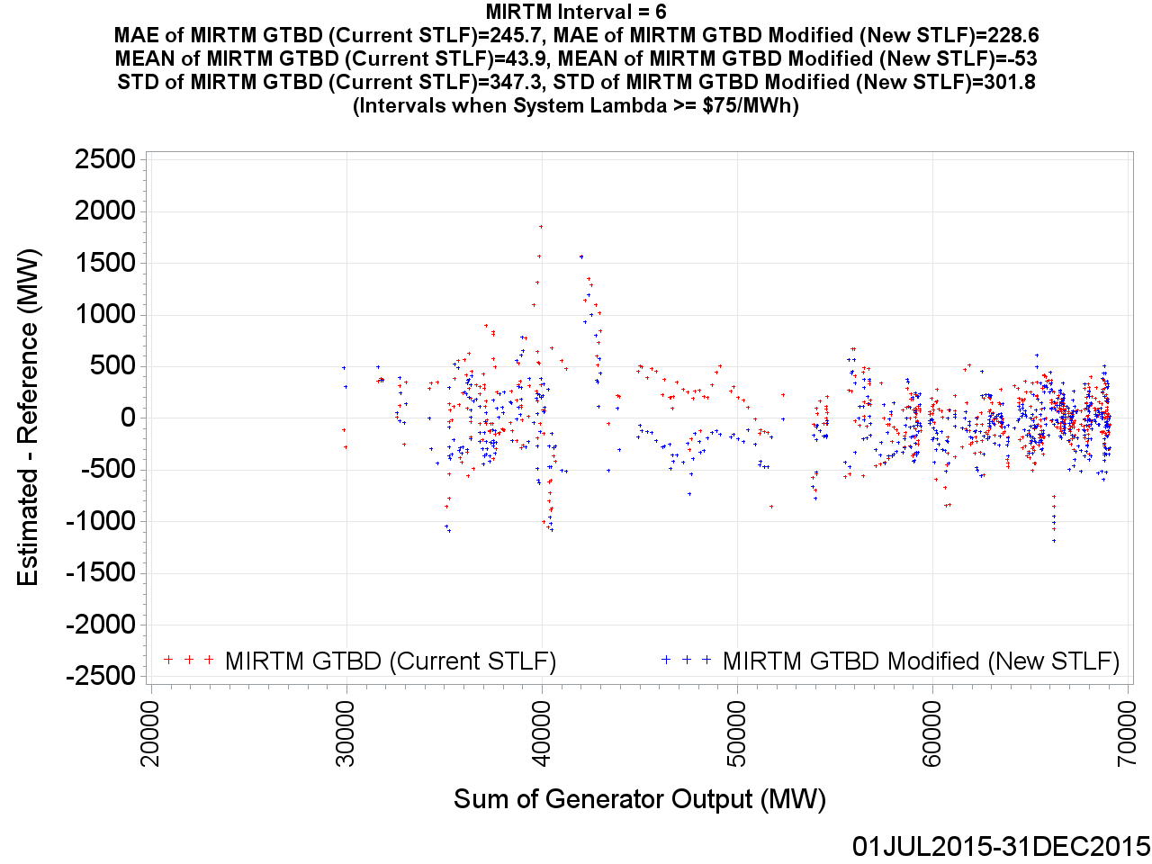
MIRTM GTBD Error by Reference (Interval = 6)

Slide 35

MIRTM GTBD Error by Reference (Interval = 5)

Slide 36
MIRTM GTBD Error by Reference (Interval = 5)

Slide 37
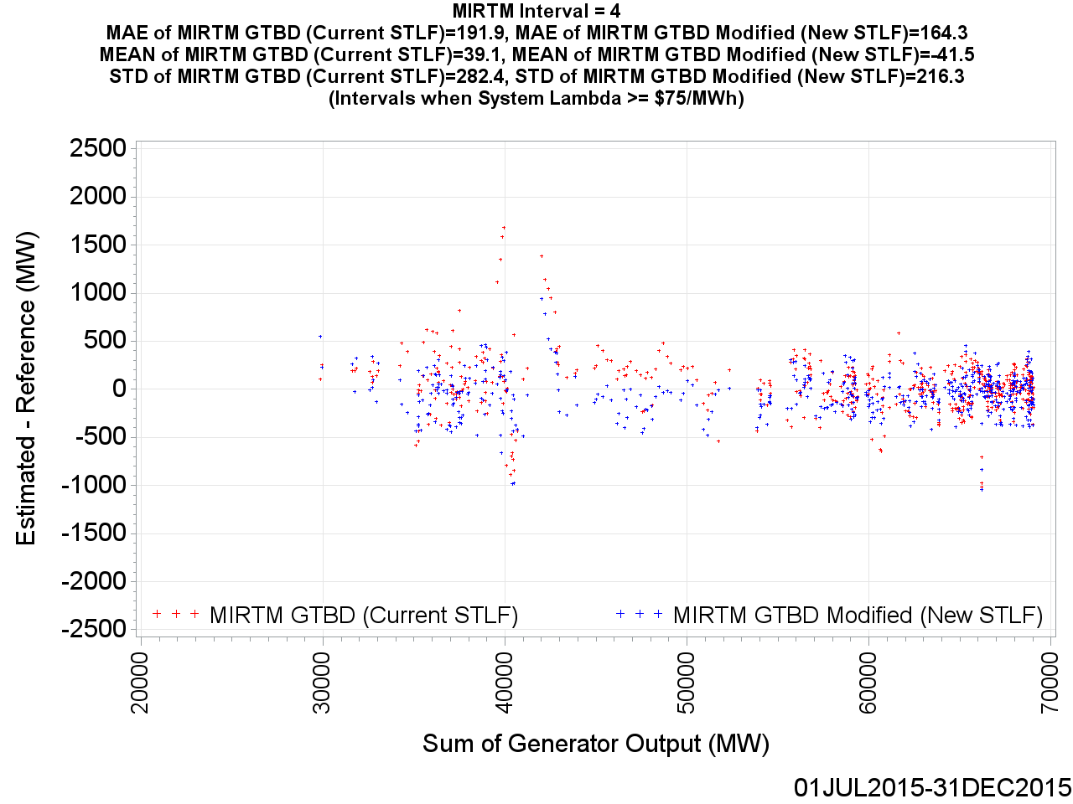
MIRTM GTBD Error by Reference (Interval = 4)

Slide 38
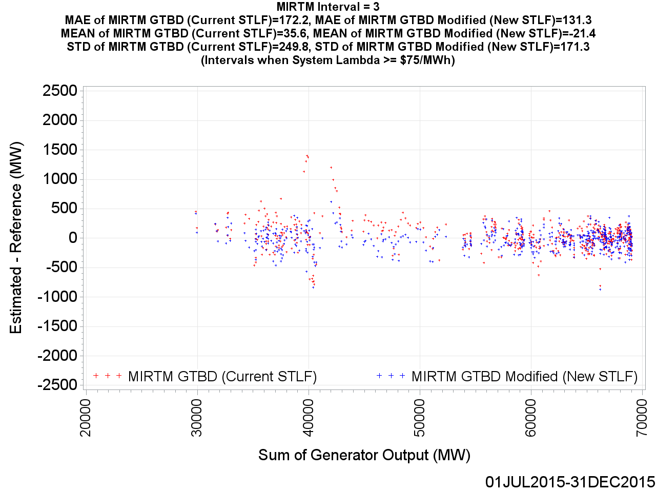
MIRTM GTBD Error by Reference (Interval = 3)

Slide 39

MIRTM GTBD Error by Reference (Interval = 2)

Slide 40
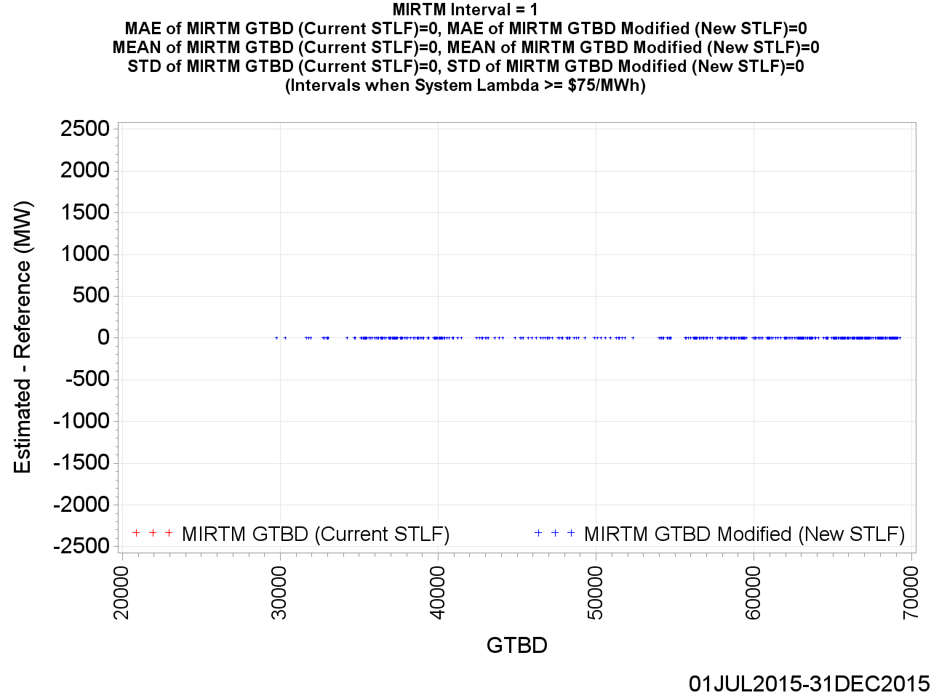
MIRTM GTBD Error by Reference (Interval = 1)

Slide 41
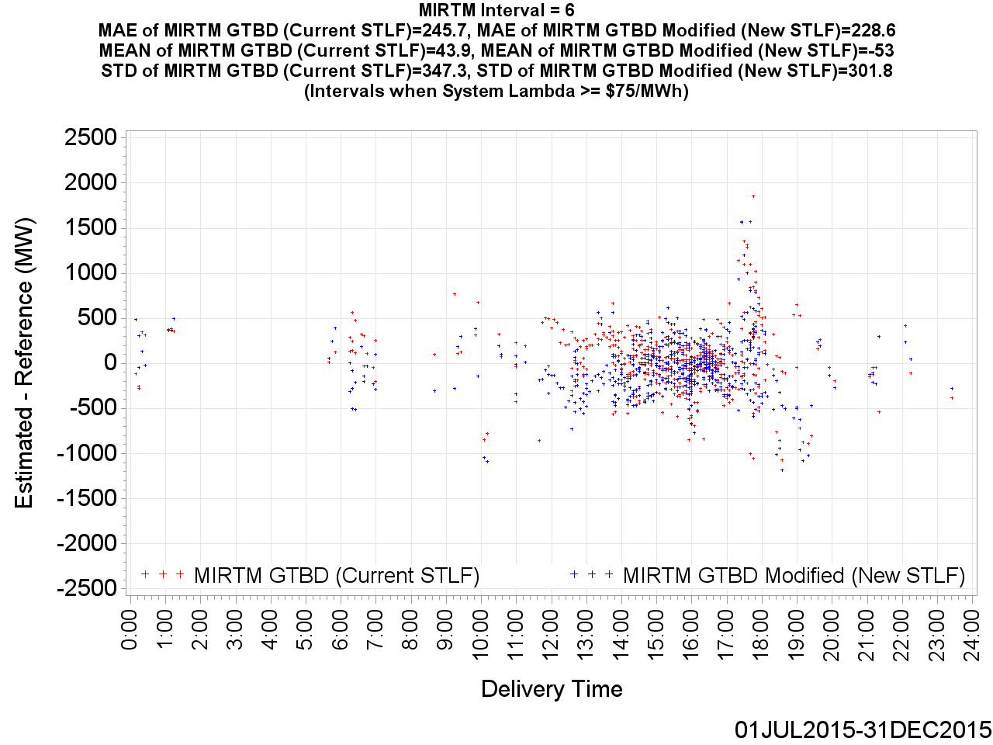
MIRTM GTBD Error by Delivery Time (Interval = 6)

Slide 42
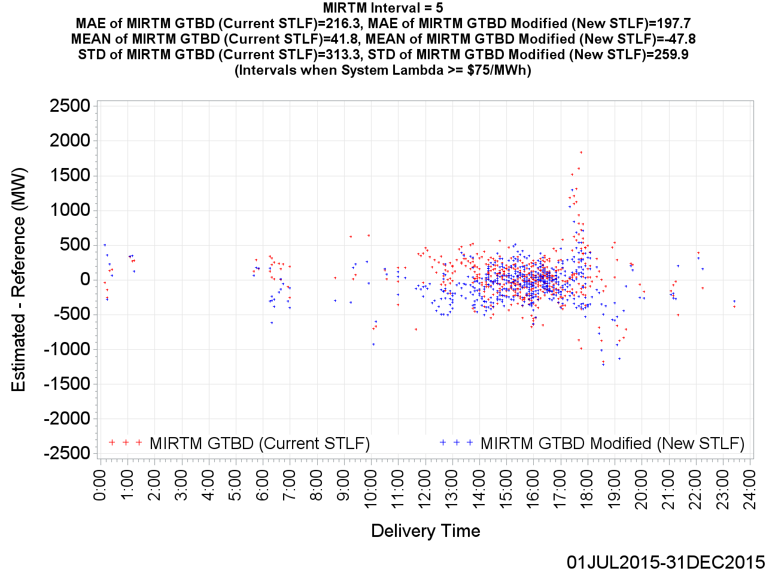
MIRTM GTBD Error by Delivery Time (Interval = 5)

Slide 43

MIRTM GTBD Error by Delivery Time (Interval = 4)

Slide 44
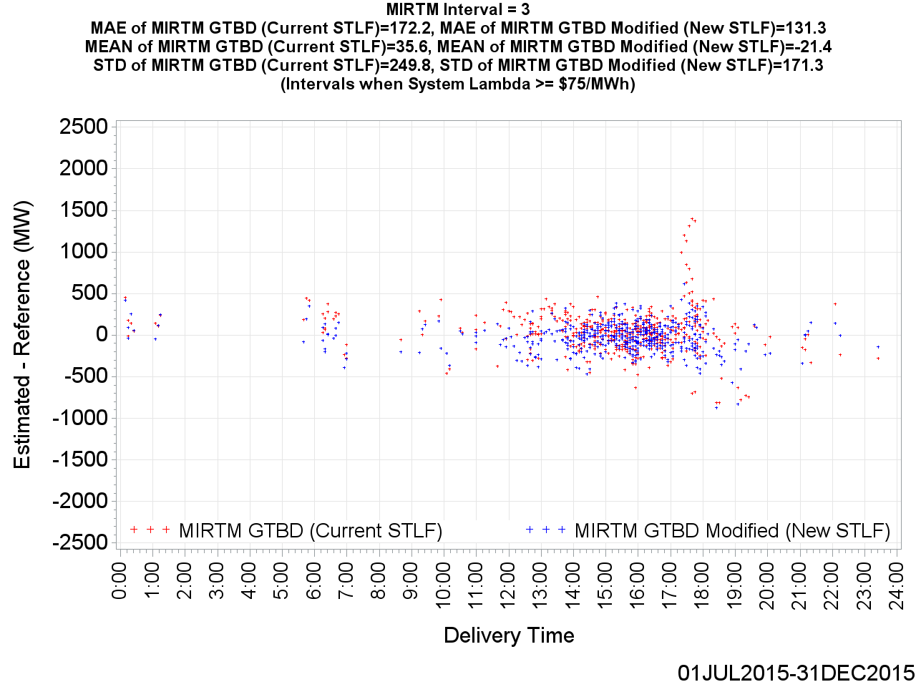
MIRTM GTBD Error by Delivery Time (Interval = 3)

Slide 45

MIRTM GTBD Error by Delivery Time (Interval = 2)

Slide 46
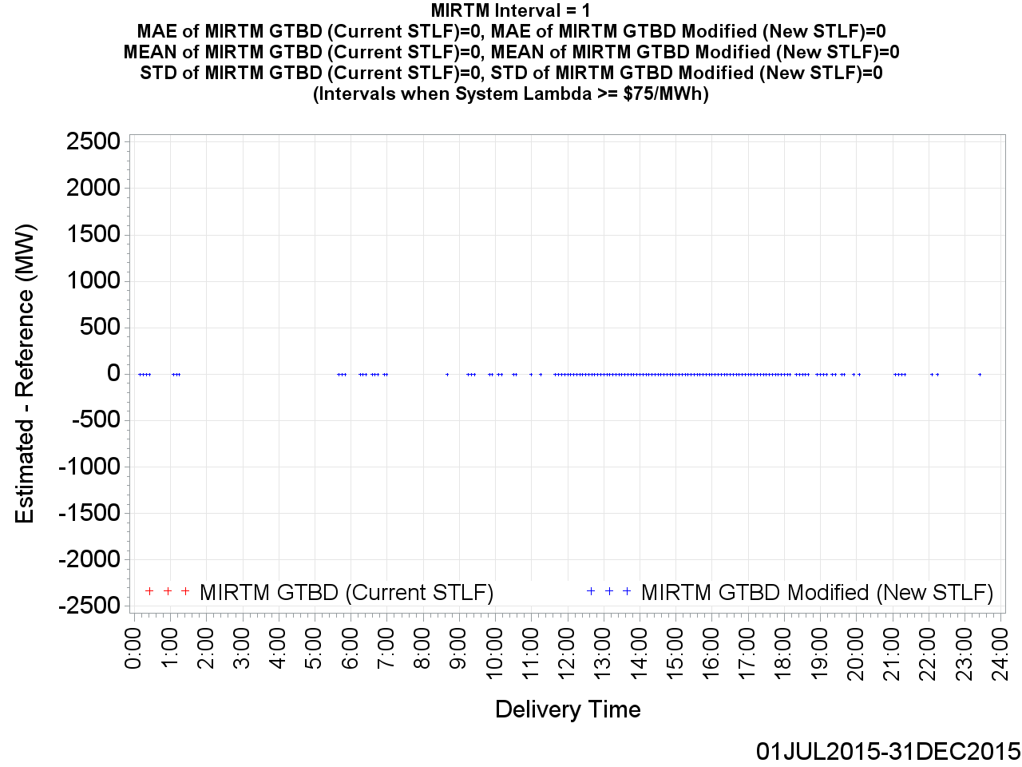
MIRTM GTBD Error by Delivery Time (Interval = 1)

Slide 47
MIRTM Demand Estimation Performance on Specific Days
In the following slides, the estimation performance of the following specific days are analyzed:
  August 13, 2015
  October 23, 2015
  November 11, 2015
  November 27, 2015
For each of these four dates, the two highest priced SCED intervals are further examined.
The LDL-HDL energy offer curve is shown along with the effects that the New STLF and Modified GTBD Methodology have on the resulting price based the curve.
This is not the actual LDL-HDL curve MIRTM would use for each interval (i). It is the LDL-HDL curve at the SCED snapshot (i =1) simply to give a representation of how sensitive the energy offer curve is to differing GTBD values.

Slide 48
MIRTM Demand Estimation Performance
August 13, 2015

Slide 49
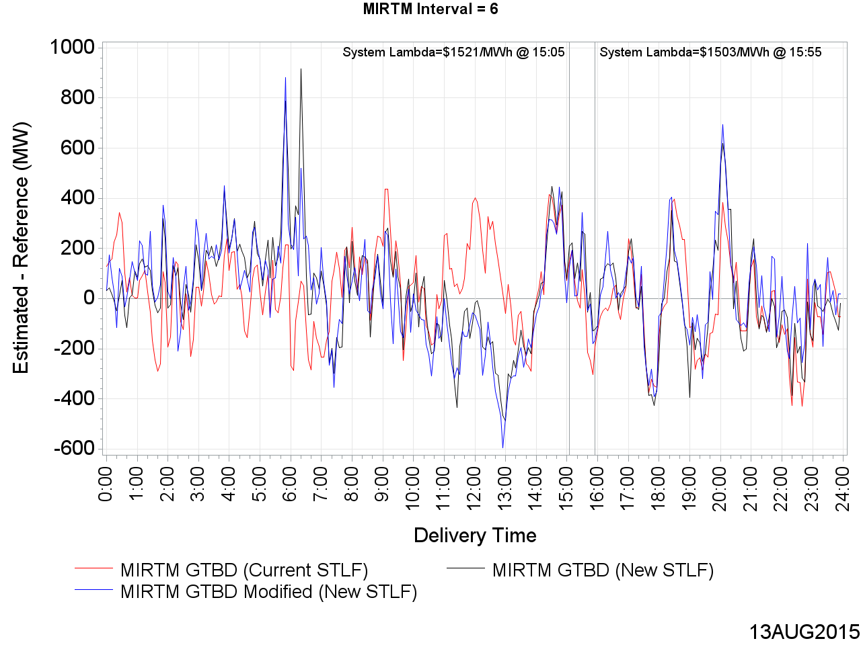
MIRTM GTBD Error on August 13, 2015 (Interval = 6)

Slide 50
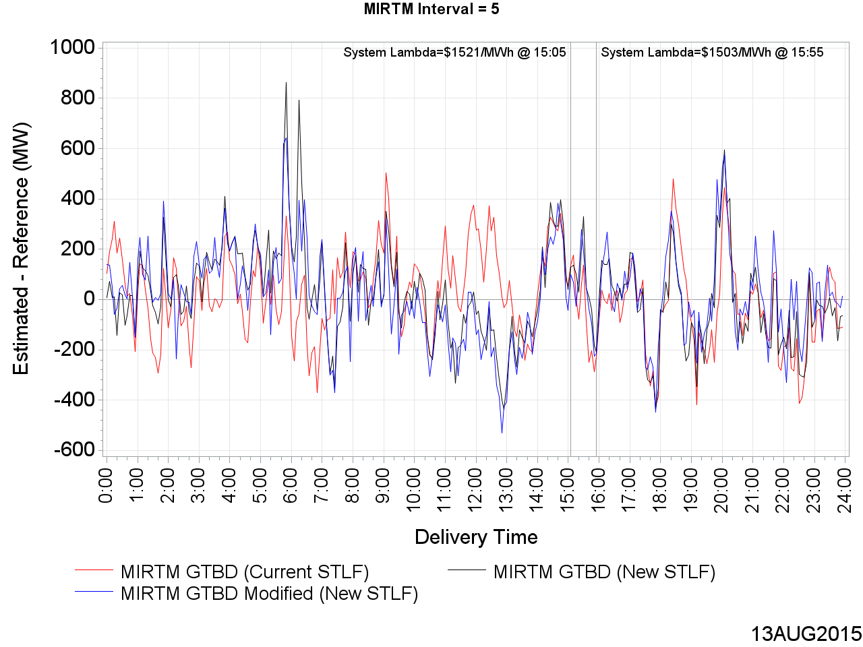
MIRTM GTBD Error on August 13, 2015 (Interval = 5)

Slide 51
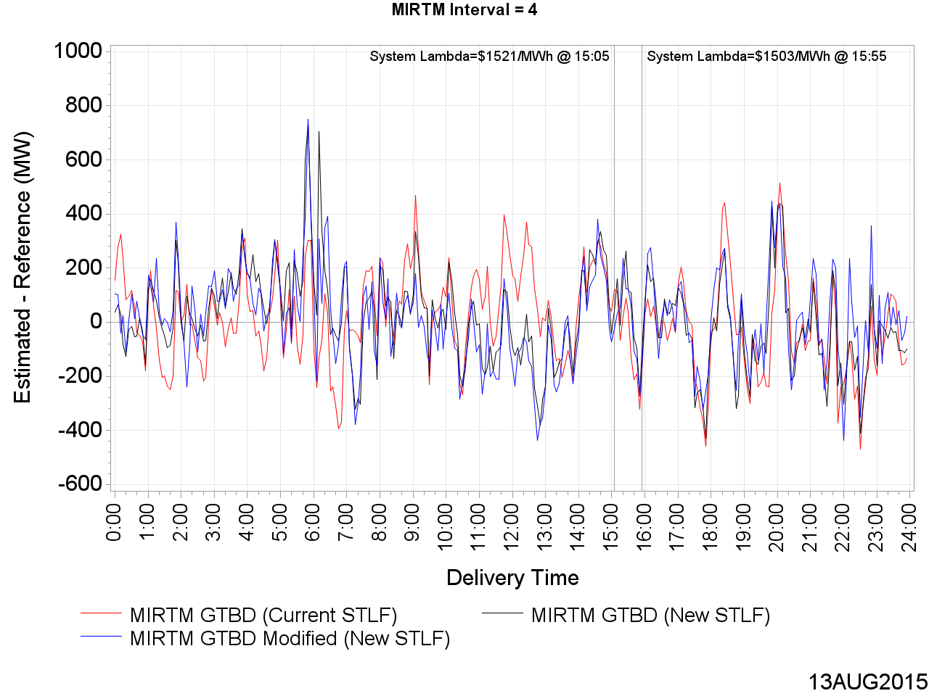
MIRTM GTBD Error on August 13, 2015 (Interval = 4)

Slide 52
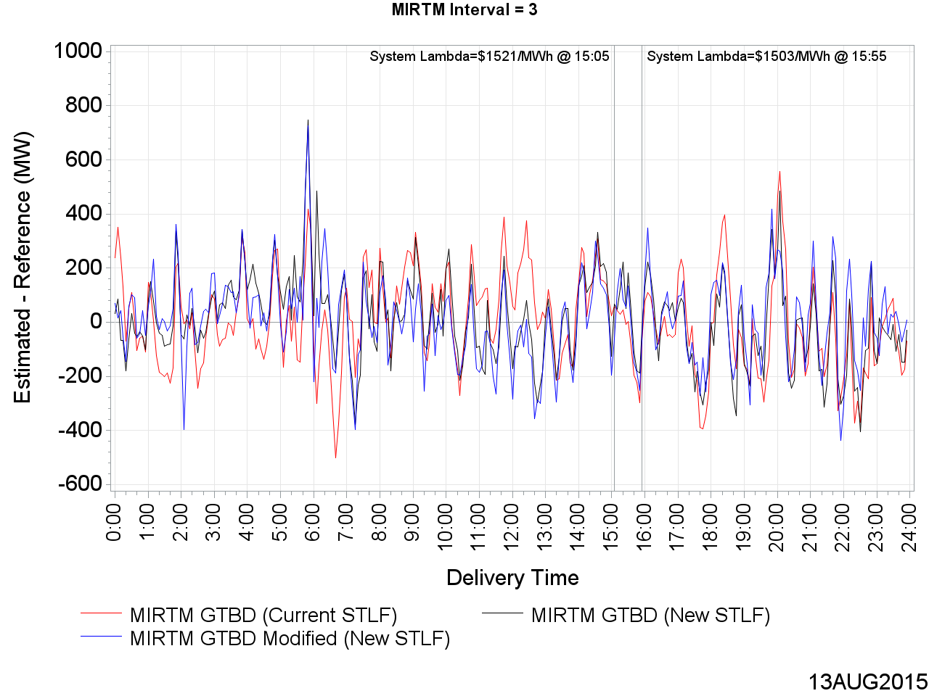
MIRTM GTBD Error on August 13, 2015 (Interval = 3)

Slide 53
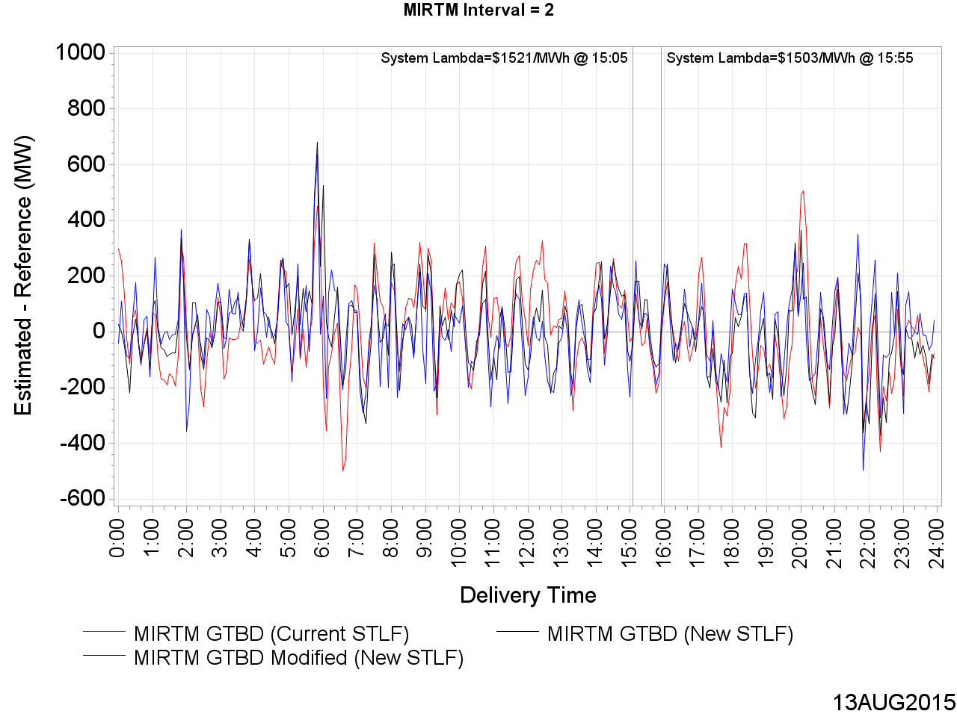
MIRTM GTBD Error on August 13, 2015 (Interval = 2)

Slide 54
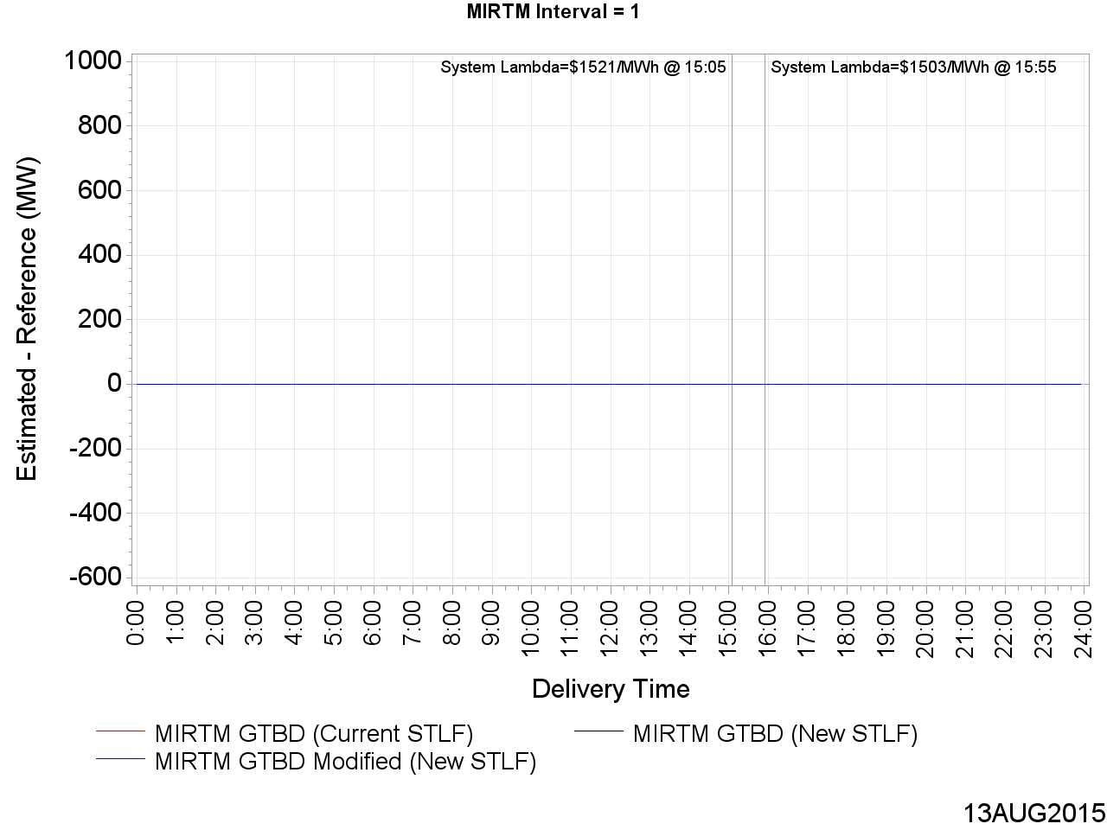
MIRTM GTBD Error on August 13, 2015 (Interval = 1)

Slide 55
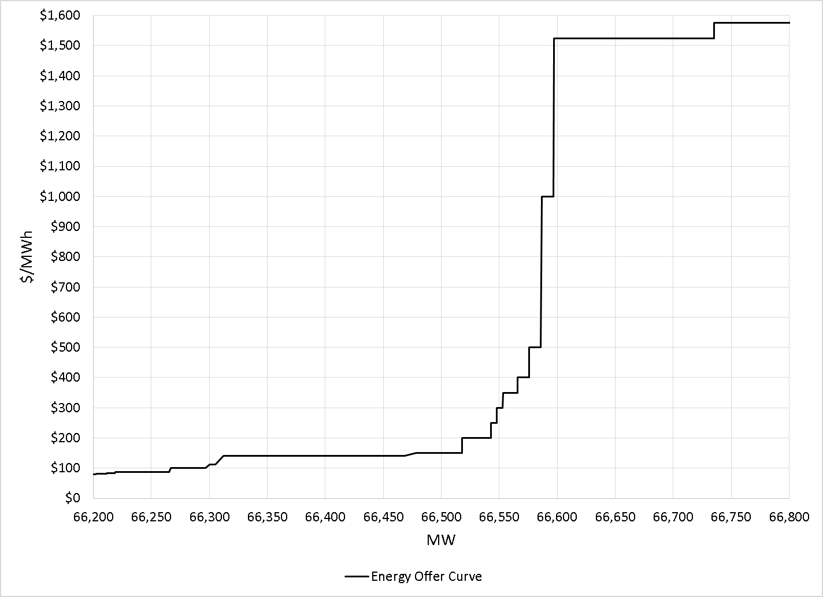
LDL to HDL Energy Offer Curve from August 13, 2015 15:05 SCED Run
Notes:
GTBD Estimation uses New STLF and Modified GTBD Methodology
No DC tie change

Slide 56
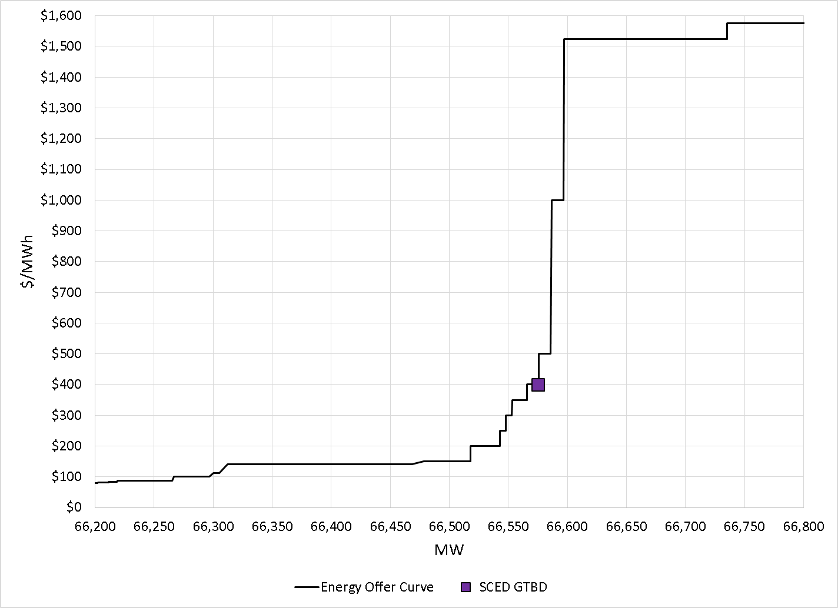
LDL to HDL Energy Offer Curve from August 13, 2015 15:05 SCED Run
Notes:
GTBD Estimation uses New STLF and Modified GTBD Methodology
No DC tie change

Slide 57
LDL to HDL Energy Offer Curve from August 13, 2015 15:05 SCED Run
At SCED Snapshot:
1.3 * 95 = 123.5 MW Load Ramp Component
0.5 * 156 = 78 MW Regulation Up Component
Recall that SCED GTBD =
= Sum of Generator Output (at snapshot)
+ K3 * Predicted Load Ramp
+ K4 * Regulation Deployed
Notes:
GTBD Estimation uses New STLF and Modified GTBD Methodology
No DC tie change

Slide 58
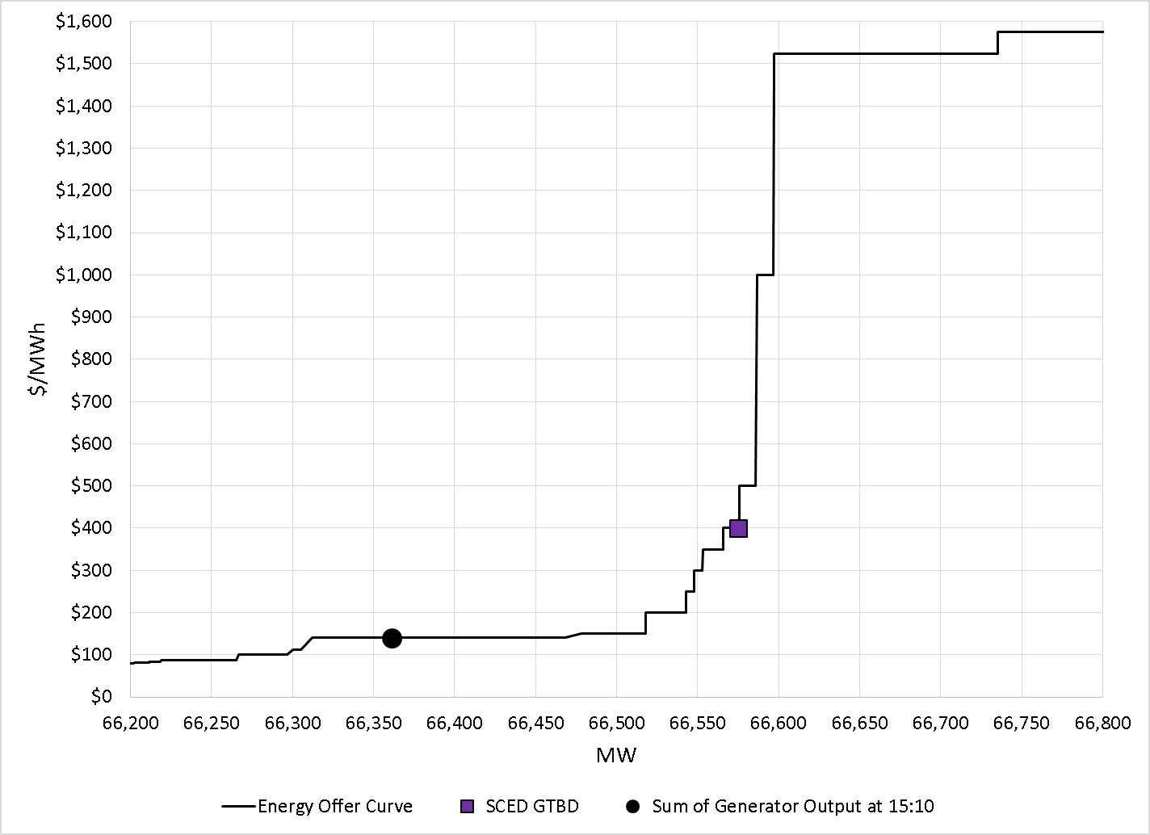
LDL to HDL Energy Offer Curve from August 13, 2015 15:05 SCED Run
Notes:
GTBD Estimation uses New STLF and Modified GTBD Methodology
No DC tie change

Slide 59
LDL to HDL Energy Offer Curve from August 13, 2015 15:05 SCED Run
At 15:10:
-22 MW Regulation Down Deployed
Notes:
GTBD Estimation uses New STLF and Modified GTBD Methodology
No DC tie change

Slide 60
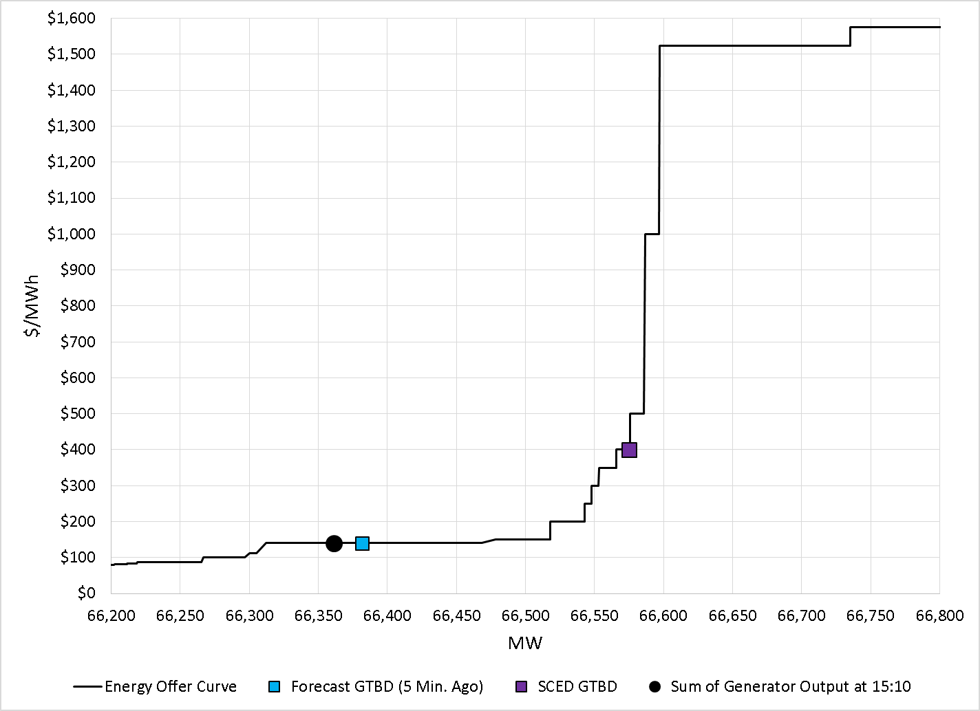
LDL to HDL Energy Offer Curve from August 13, 2015 15:05 SCED Run
Notes:
GTBD Estimation uses New STLF and Modified GTBD Methodology
No DC tie change

Slide 61
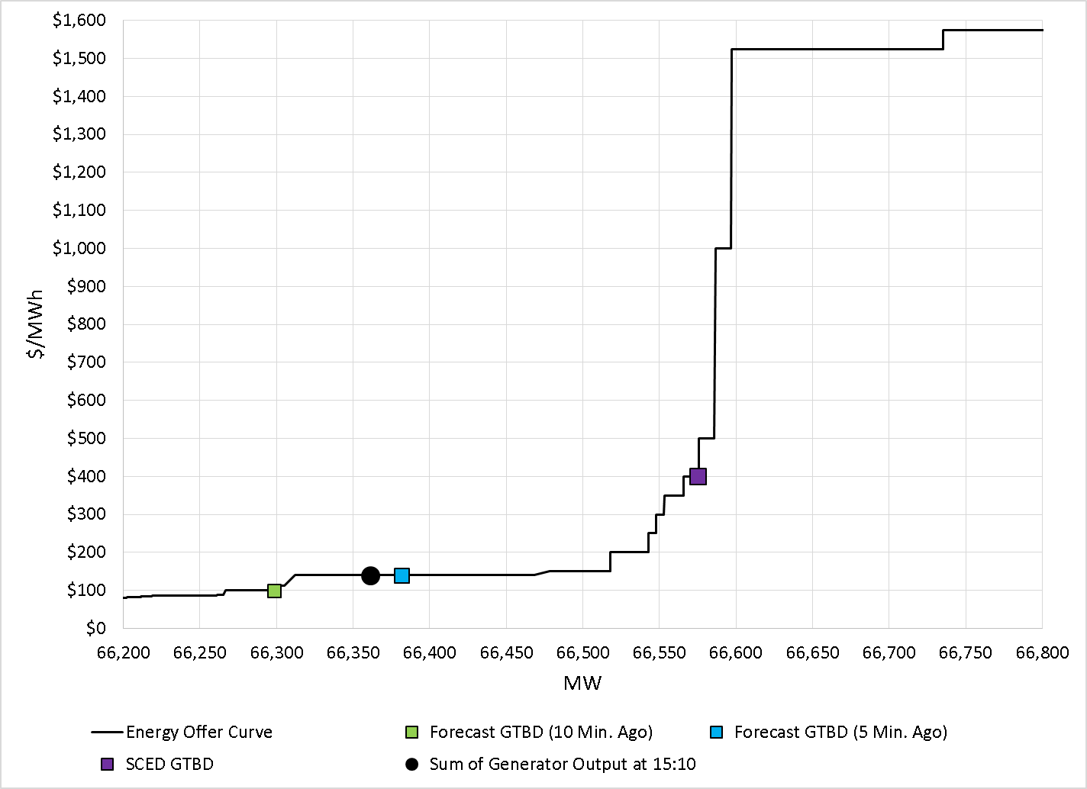
LDL to HDL Energy Offer Curve from August 13, 2015 15:05 SCED Run
Notes:
GTBD Estimation uses New STLF and Modified GTBD Methodology
No DC tie change

Slide 62
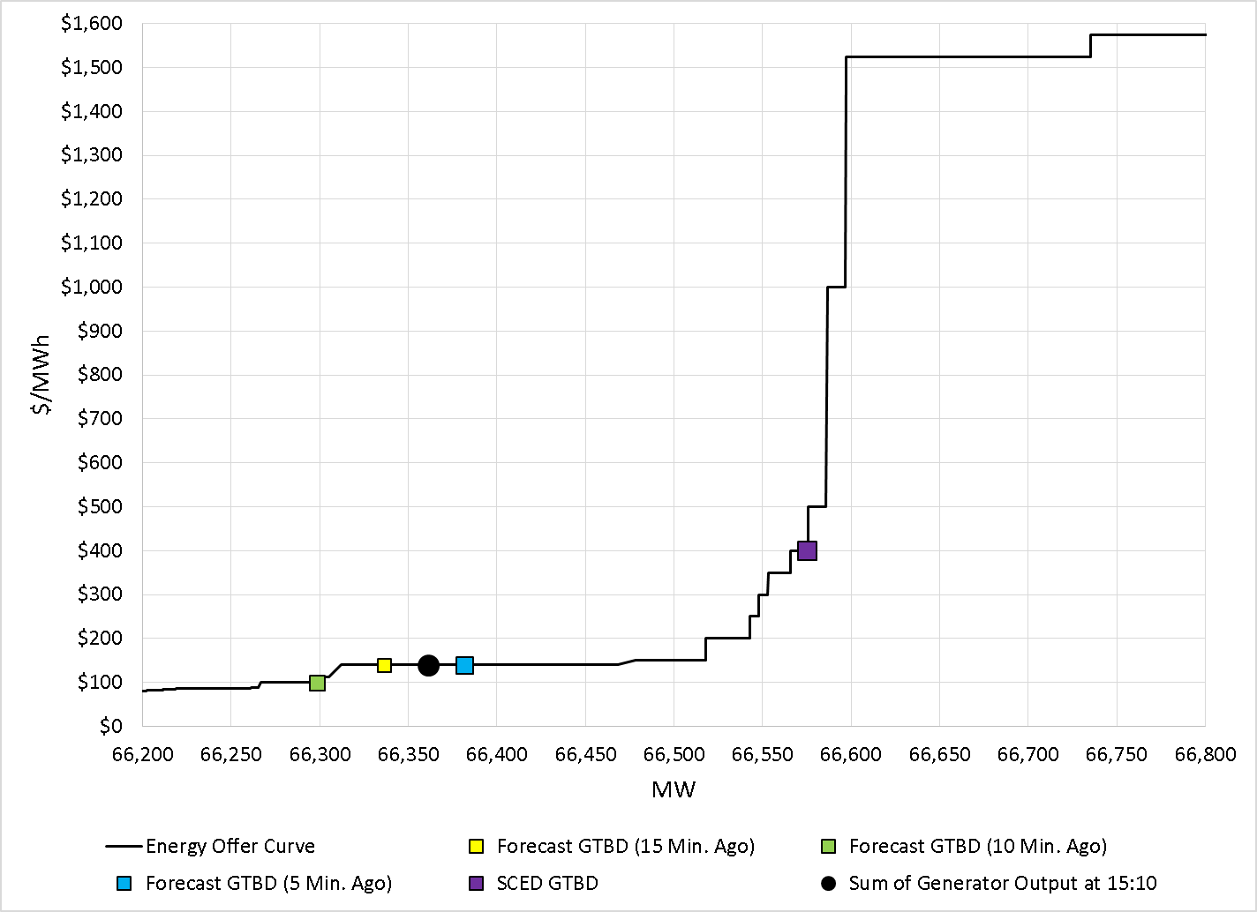
LDL to HDL Energy Offer Curve from August 13, 2015 15:05 SCED Run
Notes:
GTBD Estimation uses New STLF and Modified GTBD Methodology
No DC tie change

Slide 63
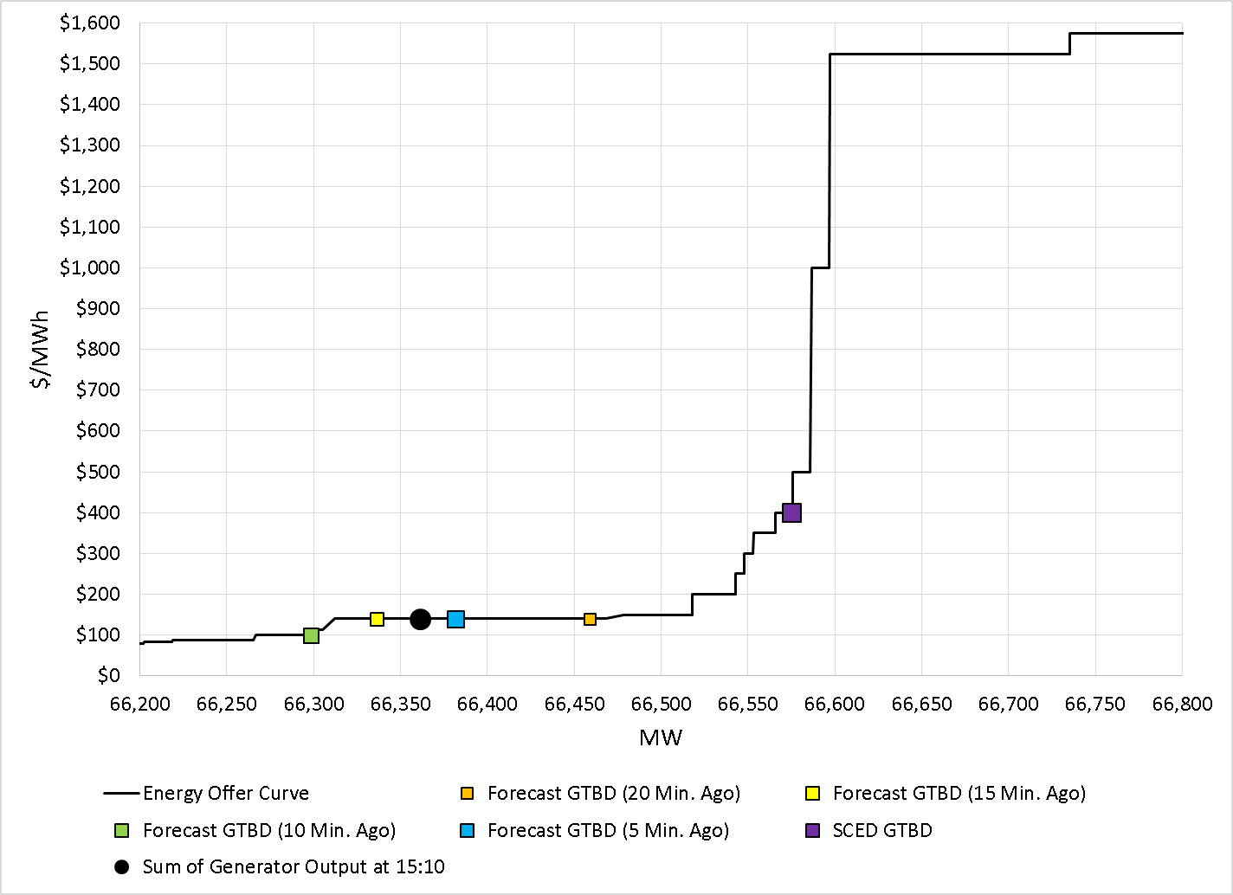
LDL to HDL Energy Offer Curve from August 13, 2015 15:05 SCED Run
Notes:
GTBD Estimation uses New STLF and Modified GTBD Methodology
No DC tie change

Slide 64
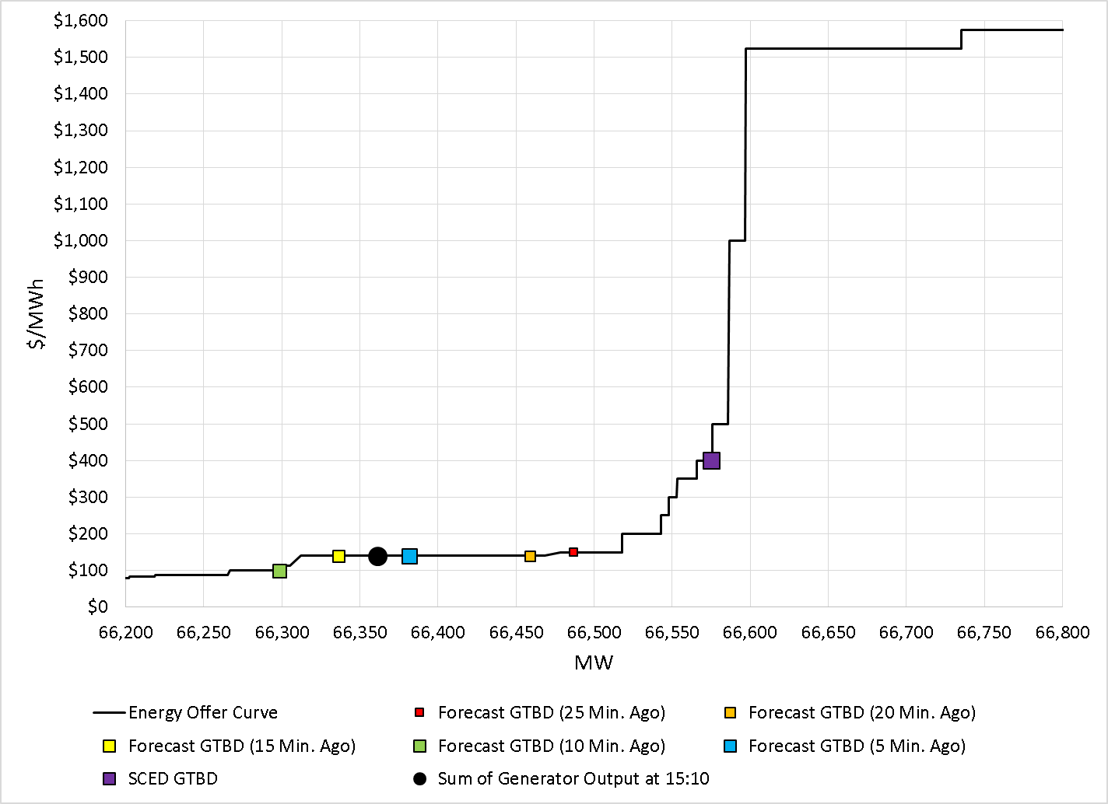
LDL to HDL Energy Offer Curve from August 13, 2015 15:05 SCED Run
Notes:
GTBD Estimation uses New STLF and Modified GTBD Methodology
No DC tie change

Slide 65
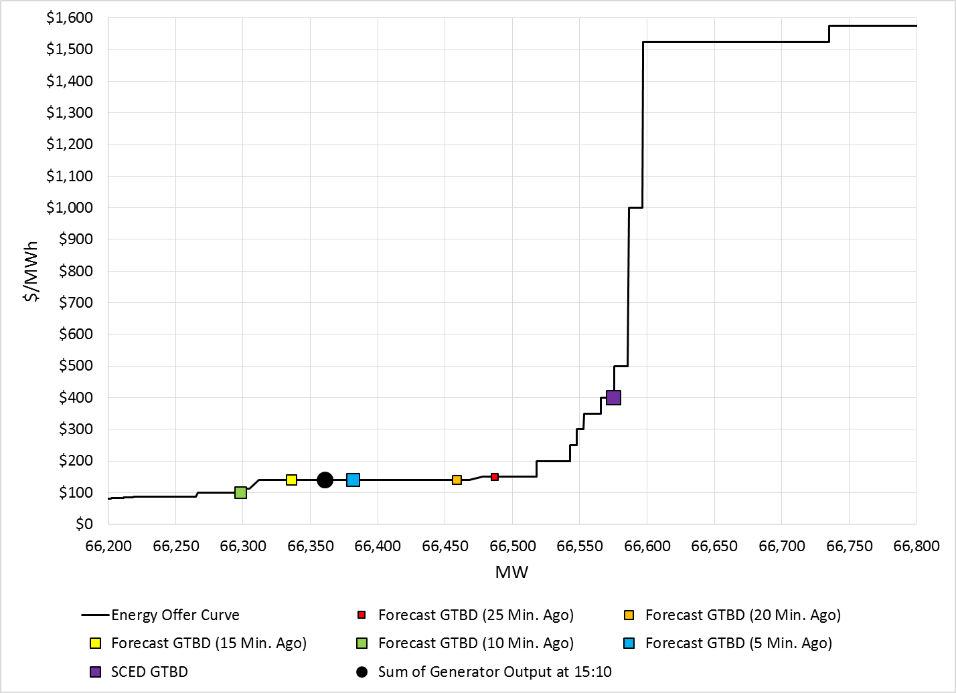
LDL to HDL Energy Offer Curve from August 13, 2015 15:05 SCED Run
At SCED Snapshot:
1.3 * 95 = 123.5 MW Load Ramp Component
0.5 * 156 = 78 MW Regulation Up Component
Recall that SCED GTBD =
= Sum of Generator Output (at snapshot)
+ K3 * Predicted Load Ramp
+ K4 * Regulation Deployed
At 15:10:
-22 MW Regulation Down Deployed
Notes:
GTBD Estimation uses New STLF and Modified GTBD Methodology
No DC tie change

Slide 66
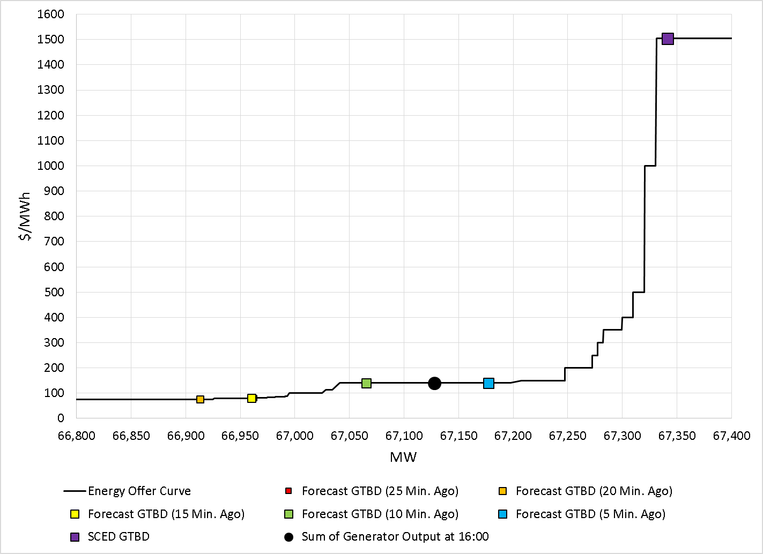
LDL to HDL Energy Offer Curve on August 13, 2015 15:55 SCED Run
At SCED Snapshot:
1.3 * 17 = 22.1 MW Load Ramp Component
0.5 * 211 = 105.5 MW Regulation Up Component
At 16:00:
56 MW Regulation Up Deployed
Notes:
GTBD Estimation uses New STLF and Modified GTBD Methodology
No DC tie change

Slide 67
MIRTM Demand Estimation Performance
October 23, 2015

Slide 68
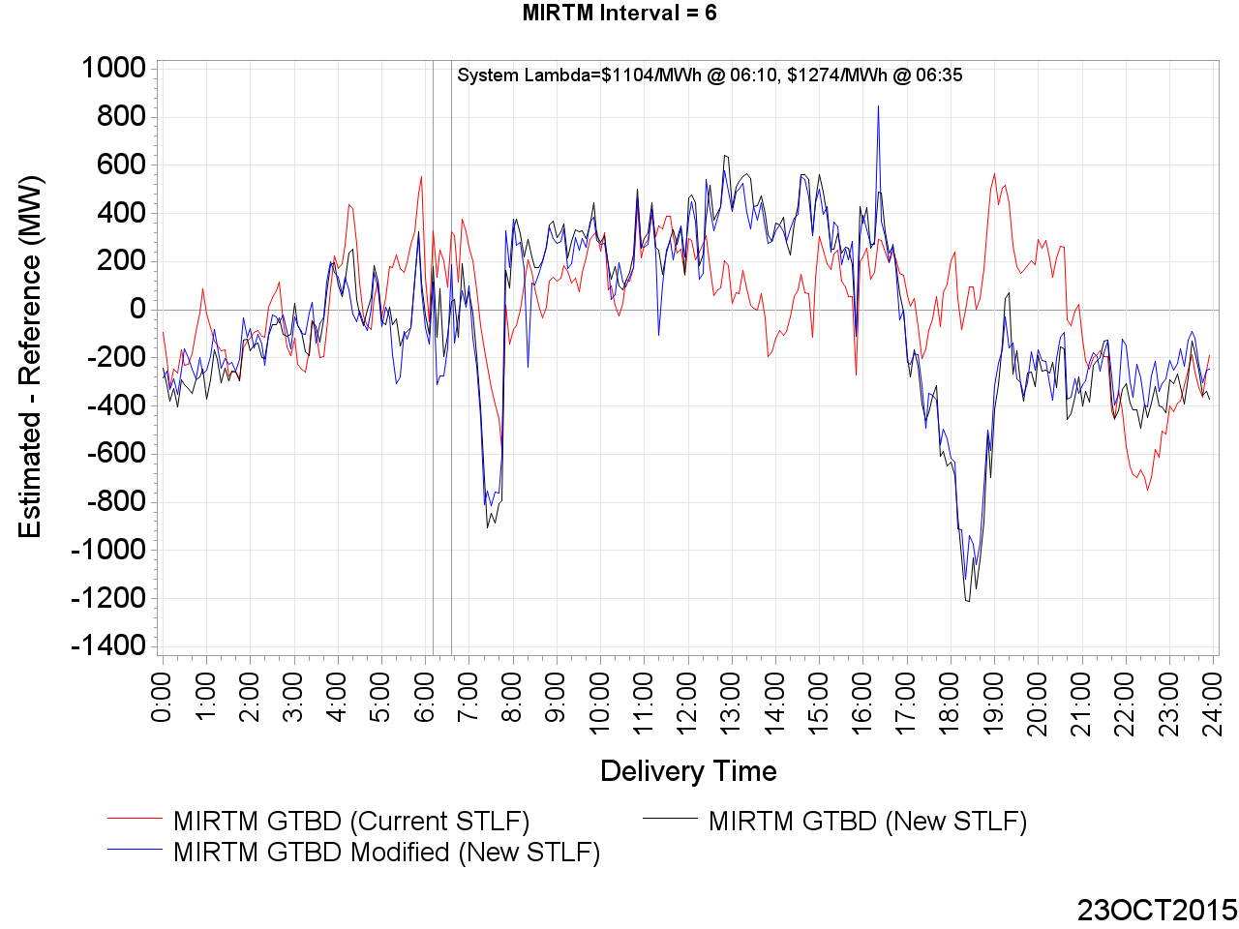
MIRTM GTBD Error on October 23, 2015 (Interval = 6)

Slide 69
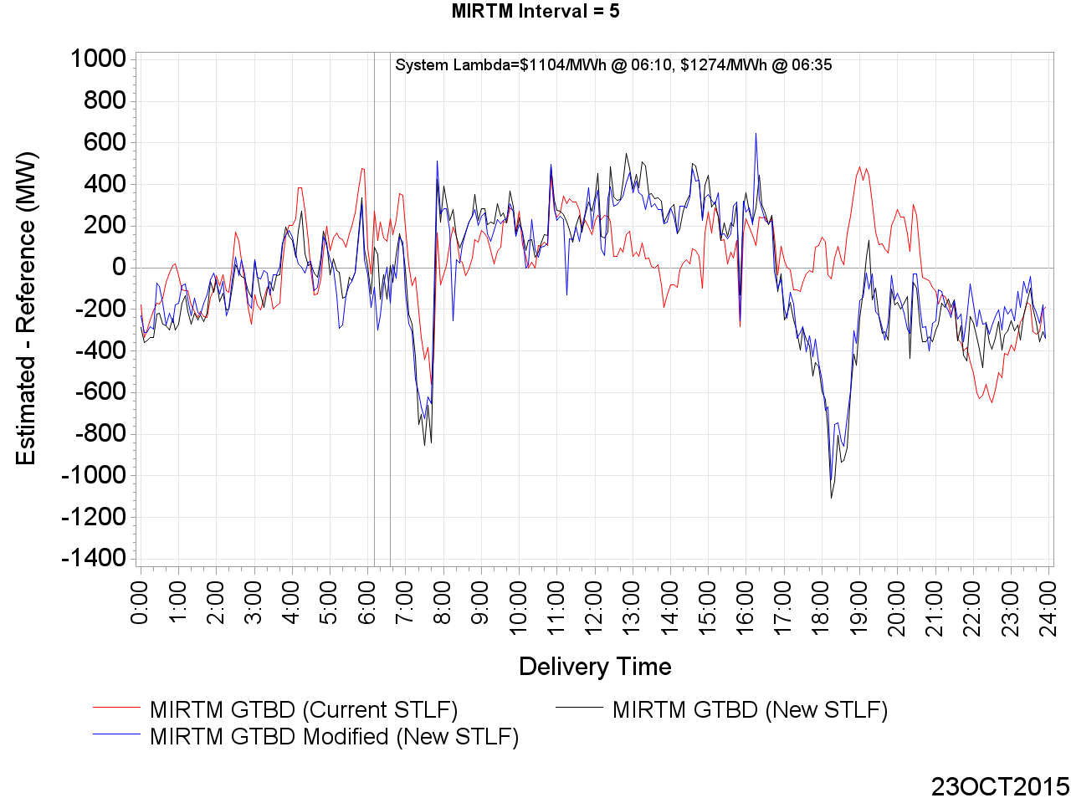
MIRTM GTBD Error on October 23, 2015 (Interval = 5)

Slide 70
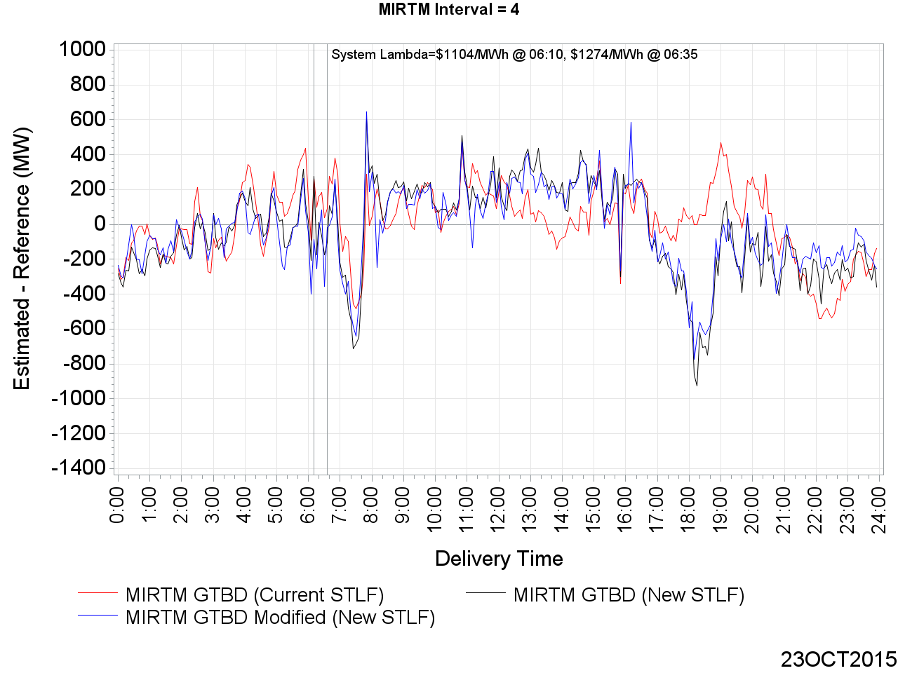
MIRTM GTBD Error on October 23, 2015 (Interval = 4)

Slide 71
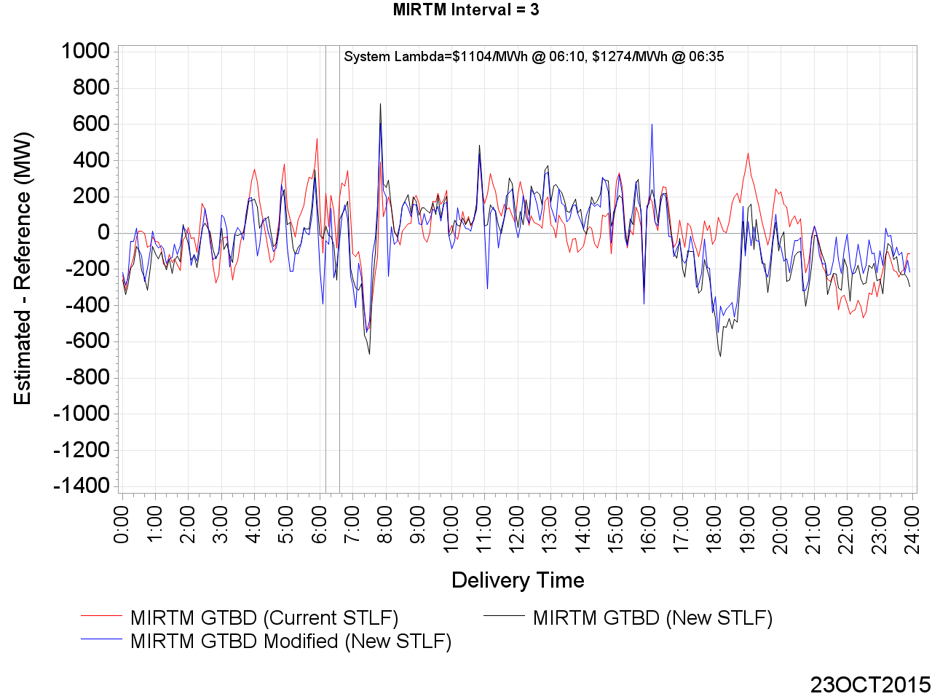
MIRTM GTBD Error on October 23, 2015 (Interval = 3)

Slide 72
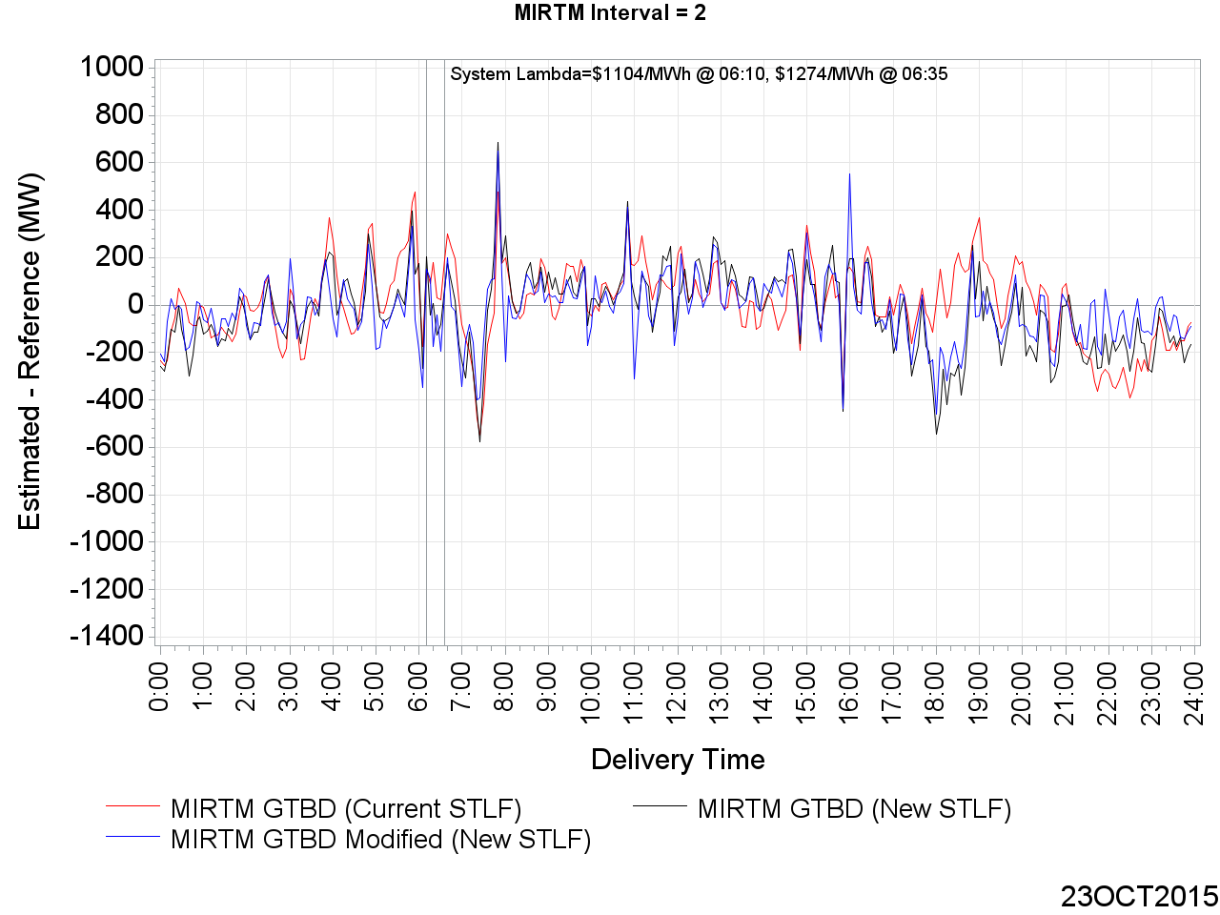
MIRTM GTBD Error on October 23, 2015 (Interval = 2)

Slide 73
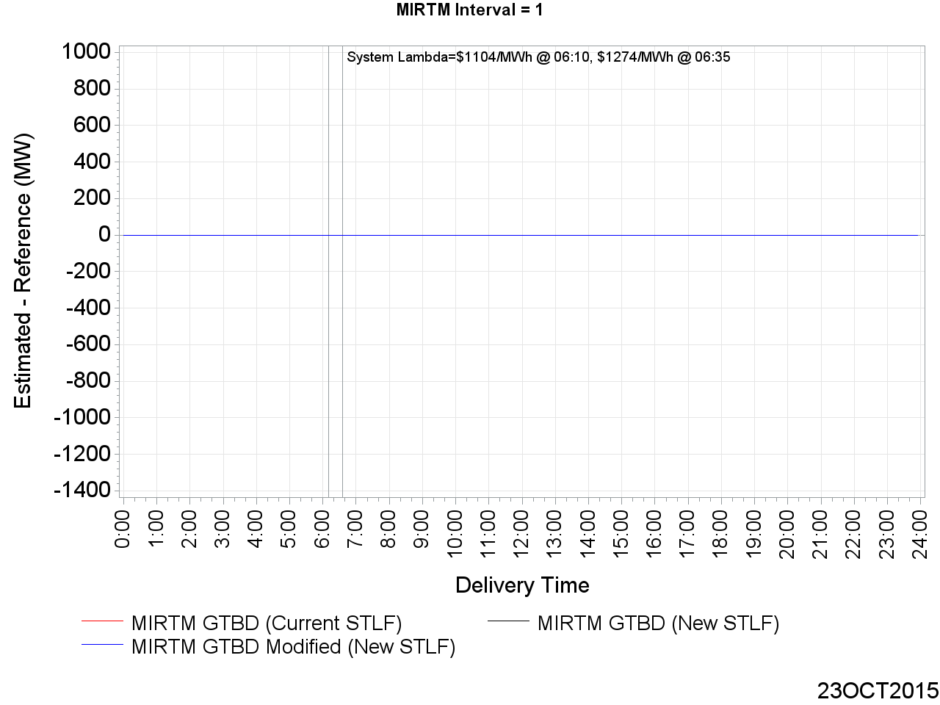
MIRTM GTBD Error on October 23, 2015 (Interval = 1)

Slide 74
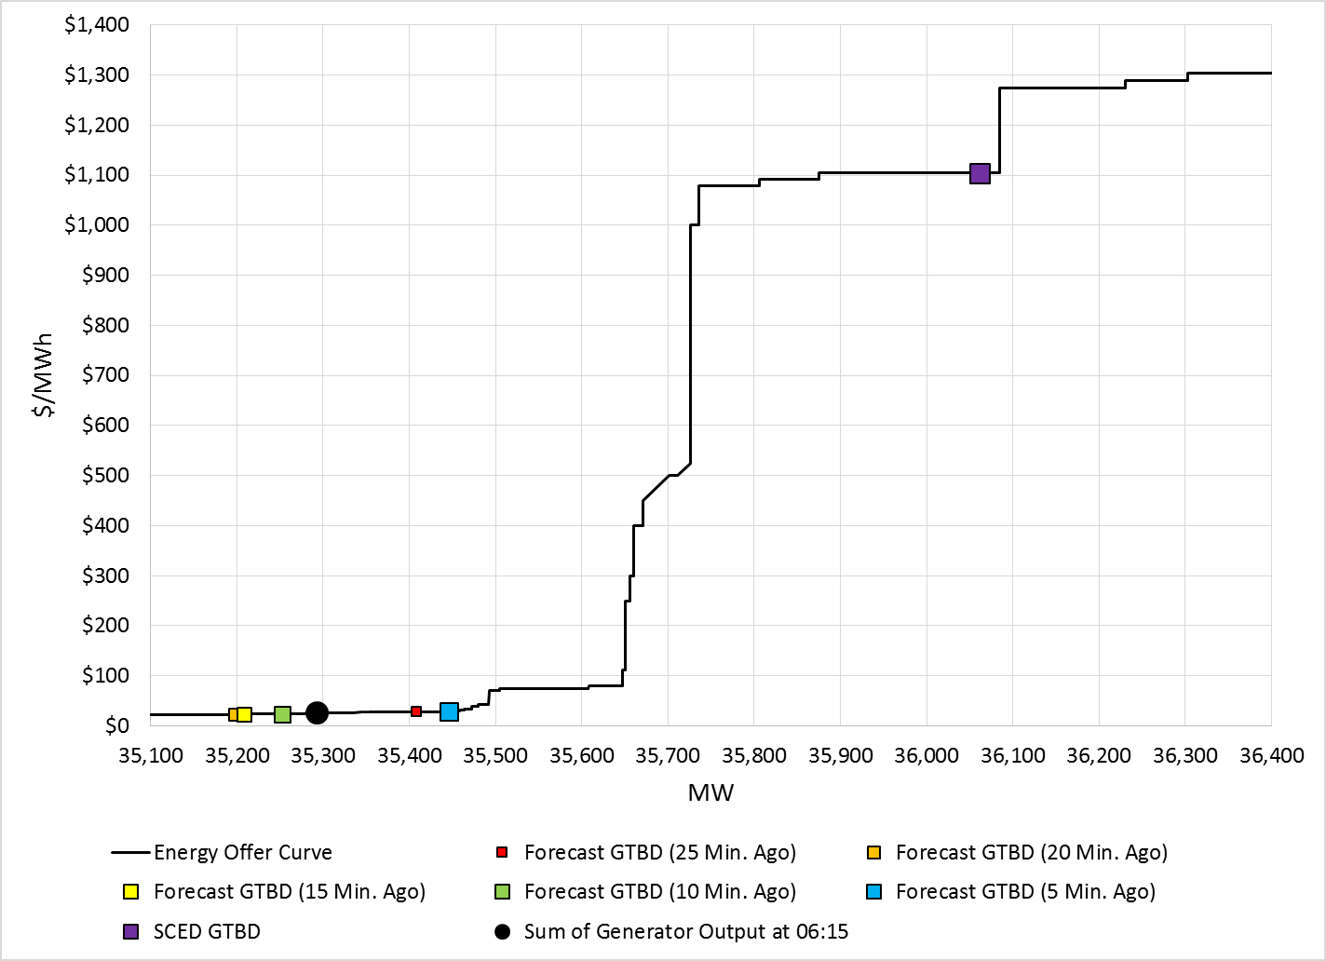
LDL to HDL Energy Offer Curve on October 23, 2015 06:10 SCED Run
At 06:15:
208 MW Regulation Up Deployed
At SCED Snapshot:
1.2 * 409 = 490.8 MW Load Ramp Component
0.4 * 660 = 264 MW Regulation Up Component
Notes:
GTBD Estimation uses New STLF and Modified GTBD Methodology
+62MW DC import change

Slide 75

LDL to HDL Energy Offer Curve on October 23, 2015 06:35 SCED Run
At 06:40:
-70 MW Regulation Down Deployed
At SCED Snapshot:
1.2 * 308 = 369.6 MW Load Ramp Component
0.4 * 173 = 69.2 MW Regulation Up Component
Notes:
GTBD Estimation uses New STLF and Modified GTBD Methodology
-46MW DC export change

Slide 76
MIRTM Demand Estimation Performance
November 11, 2015

Slide 77

MIRTM GTBD Error on November 11, 2015 (Interval = 6)

Slide 78

MIRTM GTBD Error on November 11, 2015 (Interval = 5)

Slide 79

MIRTM GTBD Error on November 11, 2015 (Interval = 4)

Slide 80

MIRTM GTBD Error on November 11, 2015 (Interval = 3)

Slide 81

MIRTM GTBD Error on November 11, 2015 (Interval = 2)

Slide 82

MIRTM GTBD Error on November 11, 2015 (Interval = 1)

Slide 83

LDL to HDL Energy Offer Curve on November 11, 2015 17:25 SCED Run
At SCED Snapshot:
1.2 * 321 = 385.2 MW Load Ramp Component
0.3 * 255 = 76.5 MW Regulation Up Component
At 17:30:
-88 MW Regulation Down Deployed
Notes:
-25MW DC export change

Slide 84

LDL to HDL Energy Offer Curve on November 11, 2015 17:35 SCED Run
At SCED Snapshot:
1.2 * 297 = 356.4 MW Load Ramp Component
0.3 * -26 = -7.8 MW Regulation Down Component
At 17:40:
0 MW Regulation Deployed
Notes:
-5MW DC export change

Slide 85
MIRTM Demand Estimation Performance
November 27, 2015

Slide 86

MIRTM GTBD Error on November 27, 2015 (Interval = 6)

Slide 87

MIRTM GTBD Error on November 27, 2015 (Interval = 5)

Slide 88

MIRTM GTBD Error on November 27, 2015 (Interval = 4)

Slide 89

MIRTM GTBD Error on November 27, 2015 (Interval = 3)

Slide 90

MIRTM GTBD Error on November 27, 2015 (Interval = 2)

Slide 91

MIRTM GTBD Error on November 27, 2015 (Interval = 1)

Slide 92

LDL to HDL Energy Offer Curve on November 27, 2015 16:55 SCED Run
At 17:00:
-129 MW Regulation Down Deployed
At SCED Snapshot:
1.2 * 77 = 92.4 MW Load Ramp Component
0.3 * 136 = 40.8 MW Regulation Up Component
Notes:
-34MW DC export change

Slide 93

LDL to HDL Energy Offer Curve on November 27, 2015 17:40 SCED Run
At 17:45:
-85 MW Regulation Down Deployed
At SCED Snapshot:
0.3 * -19 = -5.7 MW Regulation Down Component
1.2 * 63 = 75.6 MW Load Ramp Component
Notes:
+65 DC import change

Slide 94
Improving Wind HSL Estimation

Slide 95

Improving Wind HSL Estimation in MIRTM
Applying Look-Ahead SCED Implementation
$HSL\left(i\right)=$ $A∗TelemHSL\left(t\right)$
$$+ B ∗Telem HSL\left(t−5 min.\right)$$
$$+ C ∗Telem HSL \left(t−10 min.\right)$$
$$+ D∗TelemHSL\left(t−15 min.\right)$$
$$+ E∗STWPF(Hr\left(t\right))$$
t = Current Time
TelemHSL = Current telemetered HSL
STWPF = AWS Short-Term wind Power Forecast
Current Look-Ahead SCED coefficients:
$$A=0.9 B=0.025 C=0.015 D=0.01 E=0.05$$
Coefficients using Persistence:
$$A=1 B=0 C=0 D=0 E=0$$
New coefficients calculated using ARIMA (4,0,0) autoregressive model on 2014 wind:
$$A=1.36 B=−0.1306 C=−0.0591 D=−0.1703 E=0$$
Notes:
Performance is calculated using system-wide wind. Actual implementation would require each unit to be treated separate. Further work is being done.

Slide 96
Wind Estimation Performance
January 1, 2015 – December 31, 2015
All Intervals

Slide 97

MAE of Estimated Wind HSL vs. Actual Wind HSL

Slide 98
MAE of Estimated Wind HSL vs. Actual Wind HSL

Slide 99

Standard Deviation of Estimated Wind HSL vs. Actual Wind HSL

Slide 100
Standard Deviation of Estimated Wind HSL vs. Actual Wind HSL

Slide 101

Mean of Estimated Wind HSL vs. Actual Wind HSL

Slide 102
Mean of Estimated Wind HSL vs. Actual Wind HSL

Slide 103

MIRTM Wind HSL Error by Actual Wind HSL (Interval = 6)

Slide 104

MIRTM Wind HSL Error by Actual Wind HSL (Interval = 5)

Slide 105

MIRTM Wind HSL Error by Actual Wind HSL (Interval = 4)

Slide 106

MIRTM Wind HSL Error by Actual Wind HSL (Interval = 3)

Slide 107

MIRTM Wind HSL Error by Actual Wind HSL (Interval = 2)

Slide 108

MIRTM Wind HSL Error by Actual Wind HSL (Interval = 1)

Slide 109

MIRTM Wind HSL Error by Delivery Time (Interval = 6)

Slide 110

MIRTM Wind HSL Error by Delivery Time (Interval = 5)

Slide 111

MIRTM Wind HSL Error by Delivery Time (Interval = 4)

Slide 112

MIRTM Wind HSL Error by Delivery Time (Interval = 3)

Slide 113

MIRTM Wind HSL Error by Delivery Time (Interval = 2)

Slide 114

MIRTM Wind HSL Error by Delivery Time (Interval = 1)

Slide 115
MIRTM Wind HSL Estimation Performance
January 1, 2015 – December 31, 2015
1160 Intervals when System Lambda >= $75/MWh

Slide 116

MAE of Estimated Wind HSL vs. Actual Wind HSL

Slide 117

MAE of Estimated Wind HSL vs. Actual Wind HSL

Slide 118

Standard Deviation of Estimated Wind HSL vs. Actual Wind HSL

Slide 119
Standard Deviation of Estimated Wind HSL vs. Actual Wind HSL

Slide 120
Mean of Estimated Wind HSL vs. Actual Wind HSL

Slide 121
Mean of Estimated Wind HSL vs. Actual Wind HSL

Slide 122

MIRTM Wind HSL Error by Actual Wind HSL (Interval = 6)

Slide 123

MIRTM Wind HSL Error by Actual Wind HSL (Interval = 5)

Slide 124

MIRTM Wind HSL Error by Actual Wind HSL (Interval = 4)

Slide 125

MIRTM Wind HSL Error by Actual Wind HSL (Interval = 3)

Slide 126

MIRTM Wind HSL Error by Actual Wind HSL (Interval = 2)

Slide 127

MIRTM Wind HSL Error by Actual Wind HSL (Interval = 1)

Slide 128

MIRTM Wind HSL Error by Delivery Time (Interval = 6)

Slide 129

MIRTM Wind HSL Error by Delivery Time (Interval = 5)

Slide 130

MIRTM Wind HSL Error by Delivery Time (Interval = 4)

Slide 131

MIRTM Wind HSL Error by Delivery Time (Interval = 3)

Slide 132

MIRTM Wind HSL Error by Delivery Time (Interval = 2)

Slide 133

MIRTM Wind HSL Error by Delivery Time (Interval = 1)

Slide 134
MIRTM Wind HSL Estimation Performance on Specific Days
In the following slides, the estimation performance of the following specific days are analyzed:
  August 13, 2015
  October 23, 2015
  November 11, 2015
  November 27, 2015
Notes:
The effect of improving wind HSL estimation can be approximated by shifting the LDL-HDL energy offer curve, assuming dispatch does not change. They were not plotted in this analysis, but the relative magnitude of impact can be compared to the MIRTM Demand Estimation energy offer curve slides.

Slide 135
MIRTM Wind HSL Estimation Performance
August 13, 2015
Notes:
The effect of improving wind HSL estimation can be observed by shifting the LDL-HDL curve, assuming dispatch did not change. I wasn’t able to show sensitivity graphs on the energy offer curve since it was a bit more complicated.

Slide 136

MIRTM Wind HSL on August 13, 2015

Slide 137

MIRTM Wind HSL Error on August 13, 2015 (Interval = 6)

Slide 138

MIRTM Wind HSL Error on August 13, 2015 (Interval = 5)

Slide 139

MIRTM Wind HSL Error on August 13, 2015 (Interval = 4)

Slide 140

MIRTM Wind HSL Error on August 13, 2015 (Interval = 3)

Slide 141

MIRTM Wind HSL Error on August 13, 2015 (Interval = 2)

Slide 142

MIRTM Wind HSL Error on August 13, 2015 (Interval = 1)

Slide 143
MIRTM Wind HSL Estimation Performance
October 23, 2015

Slide 144

MIRTM Wind HSL on October 23, 2015

Slide 145

MIRTM Wind HSL Error on October 23, 2015 (Interval = 6)

Slide 146

MIRTM Wind HSL Error on October 23, 2015 (Interval = 5)

Slide 147

MIRTM Wind HSL Error on October 23, 2015 (Interval = 4)

Slide 148

MIRTM Wind HSL Error on October 23, 2015 (Interval = 3)

Slide 149

MIRTM Wind HSL Error on October 23, 2015 (Interval = 2)

Slide 150

MIRTM Wind HSL Error on October 23, 2015 (Interval = 1)

Slide 151
MIRTM Wind HSL Estimation Performance
November 11, 2015

Slide 152

MIRTM Wind HSL on November 11, 2015

Slide 153

MIRTM Wind HSL Error on November 11, 2015 (Interval = 6)

Slide 154

MIRTM Wind HSL Error on November 11, 2015 (Interval = 5)

Slide 155

MIRTM Wind HSL Error on November 11, 2015 (Interval = 4)

Slide 156

MIRTM Wind HSL Error on November 11, 2015 (Interval = 3)

Slide 157

MIRTM Wind HSL Error on November 11, 2015 (Interval = 2)

Slide 158

MIRTM Wind HSL Error on November 11, 2015 (Interval = 1)

Slide 159
MIRTM Wind HSL Estimation Performance
November 27, 2015

Slide 160

MIRTM Wind HSL on November 27, 2015

Slide 161

MIRTM Wind HSL Error on November 27, 2015 (Interval = 6)

Slide 162

MIRTM Wind HSL Error on November 27, 2015 (Interval = 5)

Slide 163

MIRTM Wind HSL Error on November 27, 2015 (Interval = 4)

Slide 164

MIRTM Wind HSL Error on November 27, 2015 (Interval = 3)

Slide 165

MIRTM Wind HSL Error on November 27, 2015 (Interval = 2)

Slide 166

MIRTM Wind HSL Error on November 27, 2015 (Interval = 1)

Slide 167
MAE of All Methodologies

Slide 168
Next Steps for Forecast data input to MIRTM
Continue maintaining metrics on MIRTM GTBD, Wind HSL forecasting and report to SAWG
  Request feedback on methodology and suggest improvements
For studies use:
  MIRTM GTBD Modified with new STLF
  ARIMA regression coefficients for Wind HSL estimation
Please provide feedback on other ways to present or analyze the data

Slide 169
Questions?

