Slide 1
DREAM TAC Update
February 25th 2017

Slide 2
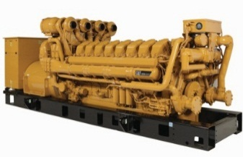
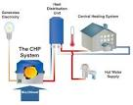
Introduction
ERCOT’s Technical Advisory Committee (TAC) chartered a Task force to investigate the current regulatory and market framework for distributed resource participation.
The DREAM Task Force reviewed specific topics while considering process improvements, equity with traditional resources, practicality of implementation, and system reliability.
DG Concept Paper
Process
Practicality
Reliability
Equity
Notes:
Photo Credit – G Thurnher SENA

Slide 3
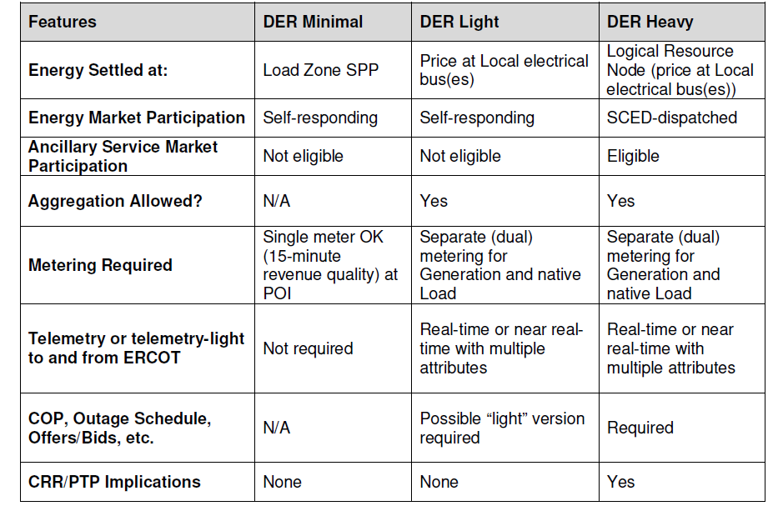
Comparison: WP proposals / DREAM Review
The ERCOT Whitepaper offered a spectrum of market frameworks to further discussion DG Integration
DREAM tackled issues and shortcomings with existing practices.

Slide 4
Targeted topics
DREAM held focused meetings on
Definitions, Reporting, Distribution Awareness, and potential DG Aggregation Rules
Interconnection Procedures, Metering, and Modeling
Local Pricing (Nodal), Resource Optionality
Compliance Metrics

Slide 5
Definitions and Reporting
Definitions:
Stakeholders observed a gap in current protocols; issued an NPRR to improve DG boundaries. Current protocols are not explicit for:
DG 10 MW or greater but connected at a distribution voltage
DG that intends to inject to the Distribution System, rather than reduce load
Use of the term Customer (ambiguous reference to distribution customer, load, etc.)
Reporting:
TDSPs currently report, annually, registered and non-registered DG in a PUC filing. The filing is only available in scanned PDF form (very difficult to sort and analyze.)
*Individual MPs filed NPRR 751, 757 to address Definitions and Reporting, respectively.

Slide 6
Reporting (Continued)
NPRR 719 and COPMGRR040
Removes the requirement to lower the Distributed Generation (DG) Registration Threshold,
Modifies the ERCOT DG report to include all unregistered DG sites in competitive territories by MW capacity by Load Zone and by the following primary fuel types.
Certain Market Participants suggested that similar improvements to Reporting on DG should be investigated in Non-Opt-In Entities (NOIE)

Slide 7
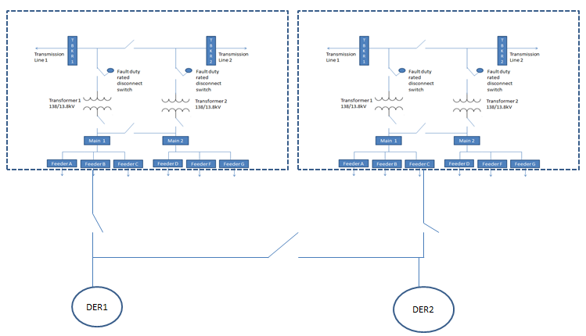
Lessons Learned: Distribution Awareness
ERCOT performed assessments of installed DG capacity, but lacks precise knowledge of Resource availability, behavior, and responsiveness to price.
Additionally, ERCOT does not have centralized dispatch authority of DG.

Slide 8
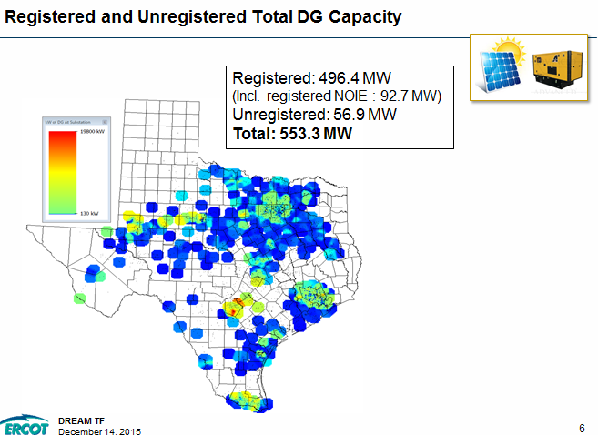
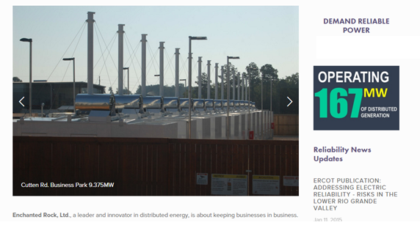
Lessons Learned: Distribution awareness and Existing Landscape of DG
*ERCOT reported unregistered values based upon competitive choice areas only, as submitted by each TDSP via profile codes.
Notes:
http://www.erockhold.com/ Check with MP on Graphic

Slide 9
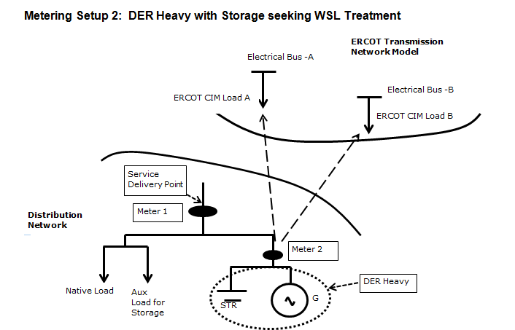
Reliability Lessons Learned: MP/ERCOT Visibility and dispatch
ERCOT expressed concerns about managing a grid that includes a growing population of distributed resources with limited visibility and no centralized dispatch function (SCED.)
At least one market participant was concerned about the limited transparency and behavior of price-responsive DG.

Slide 10
Lessons Learned: Interconnection Processes
Numerous market participants provided a detailed description of interconnection processes for distributed generation. Generally, interconnection processes were consistent throughout ERCOT, and varied as needed on a system specific basis.
The Task Force did not propose changes to the Interconnection Processes conducted by the TDSPs.

Slide 11
Process Lessons Learned: Modeling / Mapping
DG neither prohibited nor enabled to become Mapped to a Resource Node
Certain Market Participants expressed interest in mapping their DG to a new Resource Node.
Resource Nodes enable a Generation / Load Resource to participate in Security Constrained Economic Dispatch, Ancillary Service Markets, and Congestion Revenue Right (CRR) Markets.
ERCOT’s Business Practice does not have explicit provisions (or prohibitions) for DG to establish a Resource Node.

Slide 12
Mapping Resource Nodes
ERCOT does not currently (nor does it intend to) model the distribution system. However, to perform a dispatch for distribution connected resources, ERCOT must know where the resource connects relative to the ERCOT transmission system.
Currently, ERCOT maps distribution-connected Load Resources participating in RRS to a CIM (Common Information Model) Load and associated transmission interconnection point.
Expanding this practice to DG is possible, but the details and concerns have yet to be resolved. ERCOT / ERCOT Stakeholders have not determined if DG should be mapped at a LZ or more granular level.

Slide 13
Resource Nodes Enable
Participation in SCED
Participation in DAM, AS Markets
Participation in CRR Markets
To date, no market participants have expressed interest in participating in CRR Markets. DREAM suggests TAC consider development of a Resource Node that does not include participation in CRR Markets. (e.g. Distribution Node)

Slide 14
Resource Node Alternative
Continue to Map DG to a Load Zone (status quo) but enable:
Ancillary Service participation, and
Load Zone dispatch, and
Maintain Load Zone Settlement.
DREAM suggests further discussion, potentially within WMS.

Slide 15
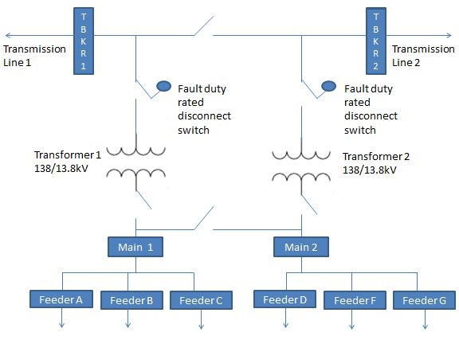
Mapping Resource Nodes: Distribution switching
To a limited extent distribution switching may temporarily or permanently re-locate a resource’s electric location relative to the transmission system.
Transmission and distribution provider one-line diagram / visibility
ERCOT visibility
Sub 1
Sub 2
CIM Load
CIM Load
DG1
Distribution switching is not currently modeled by ERCOT

Slide 16
Mapping Resource Nodes: Distribution switching issues
ERCOT has no visibility into distribution switching. If a resource were switched as a consequence of normal or emergency utility operations, the electrical path to the transmission system could change. Pricing and operations of the DG may change as a consequence of a switch.
Solutions may include
Select a reasonable transmission location for mapping, and ignore the potential for switching
Electrical locations will likely be similar, based upon physical limitations to load switching
Switching may be infrequent
Alternatively, ERCOT could calculate a blended location based upon numerous switchable locations.

Slide 17
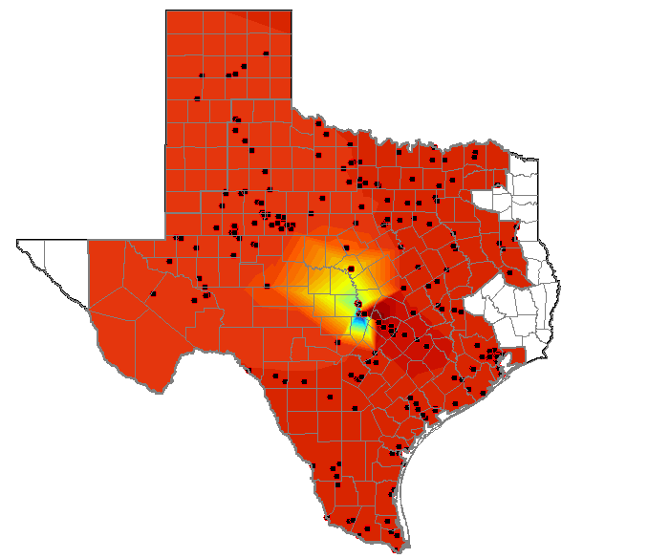
Practicality Lessons Learned: DG participation in CRR Markets needs further review
CRR markets operate with a finite number of Resource Nodes (~600)
ERCOT’s current DG population exceeds 7,600 unique sites (Competitive Areas only.)
ERCOT’s Stakeholder Process is reviewing
DG interest in CRR Market Participation
ERCOT System Limitations, based upon (1)
Market efficiency based upon (1) and (2)
Alternatives, including status-quo Load Zone Hedge
Current DG installations receive Load zone (LZ) pricing when injecting, regardless of electrical location with a LZ
Notes:
*7600 is from ERCOT Load Profiling Count (Feb 2016)

Slide 18
DG Participation in CRR Markets
Distributed Generation and its impact to radial constraints
Background: Distributed Generation has expressed interest in becoming associated with a resource node. Historically, an established resource node allows participation in SCED, and CRR Markets.
Should stakeholders consider a DG / RN that excludes CRR activity?
No market participants have expressed a desire for DG/CRR participation, electrically similar nodes may suffice for hedging.

Slide 19
Alternative transmission hedging for Distributed Generation
Is it appropriate for distributed generation to participate in CRR markets?
Currently, Distributed Generation is, by virtue of their settlement, hedged to load zone regardless of location.
If DG is not allowed to establish a RN associated with their site:
Are nearby existing electrical nodes sufficient to hedge congestion risk?
Other Solutions?

Slide 20
Mobile Generators / CRR Game
If mobile DG is allowed to establish a Resource Node that enables participation in CRR markets and Controls other DG interconnection sites
that enable a resource to move, and
are on opposing sides of a constraint, then
That resource owner could benefit from a CRR position that they could influence by moving a resource.
T/D Subs
Mobile DG Interconnection
Mobile DG Interconnection
DG
9MW
10MW
Mobile DG
This is only an issue if new market rules enable DG association with a RN with CRR participation.

Slide 21
Equity Lessons Learned: DG Economic Outages
Certain Market Participants expressed a desire to withdraw DG capacity associated with a Resource Node (if modified market rules allow DG affiliation with a RN) to self-serve load at the same site.
Behind-the-meter storage (not pictured) settled at a nodal price introduces additional, yet to be resolved issues.
LZ $
Nodal $ or LZ$
LZ $
LZ $
M
M
M
M
DG
M
DG
Load
Load

Slide 22
Equity Lessons Learned: DG Resource Node Optionality
Traditional Resources typically remain associated with a Resource Node for the entirety of their commercial operations.
Certain Market Participants expressed the desire to change their election to be mapped to a Resource Node (assuming association DG Resource Nodes are an option.)
Optionality to deliver to a Resource Node or Load Zone adds to DG value, but does not necessarily correspond to traditional Resource rules.

Slide 23
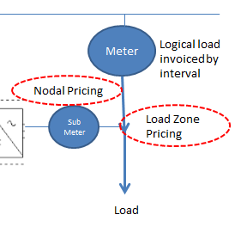
Load Zone/Nodal Optionality
Electrically equivalent location
Nodal and Load Zone prices may diverge when constraints bind
Resources and Loads may get inconsistent pricing at the same electrical bus

Slide 24
Nodal and Load Zone Price Divergence
If a customer site is in a load pocket within a Load Zone, Nodal prices may be very high, while Load Zone prices are relatively low.
If a customer site is in a generation pocket within a Load Zone, Load Zone pricing may be very high, while Nodal prices are very low

Slide 25
Equity Lessons Learned: Allowances for DG Aggregations
Aggregating Load Resources in ERCOT were established to enable participation in Ancillary Service and Energy Markets. To date, none have qualified for any service.
Aggregations enable smaller resources to participate in ERCOT markets that were previously inaccessible due to minimum size limitations.
Aggregations for DG may enable increased participation in ERCOT Ancillary Service and Energy Markets

Slide 26
Aggregation limitations
Historically, Aggregated Load Resources (ALRs) must all be located in the same Load Zone. Moving forward, stakeholders suggested we investigate:
Aggregations constrained by QSE, and dispatched based upon a weighted shift-factor
Aggregations constrained by Load Zone
Aggregations constrained by a pre-determined assessment of electrical equivalence (e.g. all resources within the aggregation have similar shift factors relative to constraints)
Aggregations by DSP Footprint

Slide 27
Equity Lessons Learned: Settlements
DG utilizing fossil fuels for their prime mover often have spent fuel associated with a self-dispatch in response to ERCOT Load Zone Prices.
DG injecting to the grid are typically settled during final settlements (55 days after the operating day) despite the availability of Advanced Metering Infrastructure Data (AMI) sufficient for expedited settlement.
ERCOT has authored and submitted NPRR 753 to allow expedited settlement timelines for DG.

Slide 28
Reliability lessons learned: Compliance
Self-Dispatched DG does not face the same obligations and compliance metrics as traditional resources (e.g. Reliability Unit Commitment (RUC), Base-point Deviation Charges, etc.)
The DREAM Task Force reviewed existing compliance metrics that can be adapted to be appropriate for DG that opts to participate in ERCOT Markets.
Existing compliance metrics for the following programs reviewed included:
Emergency Response Service,
Base-point Deviation,
Voltage Support and Governor Response,
Response to High/Low Voltage (LVRT) and Frequencies (UF relaying set-points), and
Ancillary Service Performance Criteria (if applicable.)

Slide 29
Questions / Potential Votes?
DREAM TF seeks TAC direction on the following policy cuts:
1: To enable and define distributed resources eligible to participate in the DAM with a Three-Part Supply Offer, Ancillary Service Offer, DAM offers/bids, CRR offers/bids, and/or QSE to QSE transactions, TAC directs DREAM to develop revisions to existing Protocols to achieve these ends, given existing PUCT rules. Revisions should include detailed requirements for registration, modeling, metering, pricing options, and compliance metrics associated with distributed resources participation.
2: Direct CMWG to review eligibility for Resource Nodes created for distributed resources to participate in CRR markets and report back to DREAM/TAC, including a review of the necessary revisions to Load Serving Entity (LSE) Settlement calculations for customers with nodal distributed resources.
3: Direct QMWG/DREAM to propose Protocol revisions, consistent with PUCT rules, to allow distributed resources registered with a Resource Node to allow for economic outages, including but not limited to, those outages initiated to allow a Load co-located with the DG to consume its output, and report back to TAC.

Slide 30
Questions / Potential Votes:
4: Direct QMWG and DSWG to update the ALR Other Binding Document and associated Protocols to reflect Option #(s) ___, detailed above in the Provisions for Aggregations section of this document.
Create aggregated distributed resources with a Load Zone-level identity
Create aggregated distributed resources with similarly situated electrical locations.
Create aggregated distributed resources with nodal identity at a resource level and a corresponding portfolio with weighted shift factors
Create aggregated distributed resources without shift factor limitations, as standard SCED operations would place curtailment risk on the aggregated DER should it contain systems with shift factors requiring curtailment (i.e. a lowest common denominator for reliability risk is applied to the entire aggregation). Thus Market Participants would be encouraged to design aggregations with nodal topography that makes the most economic sense for the participants in the aggregation.
5: Consider who should bear the cost of EPS meters deployed to support distributed resources, or put this matter on hold as we wait for the NPRR on use of AMI meters instead of EPS to work its way through the approval process.

Slide 31
Questions / Potential Votes:
Direct WMS / QMWG /DWSG to review the market impact of the status quo treatment for price responsive distributed resources. Passive distributed resources (e.g. solar, wind, or other non-price-responsive resources receiving negative Load Zone pricing when injecting) should be excluded from this assessment. WMS may consider and/or propose alternative arrangements that improve visibility and/or ERCOT control of price responsive resources.
Enable a distributed resource above a specified size to participate in energy and Ancillary Service markets on equal footing with a traditional resource by absorbing the cost of an EPS meter (in the rate base) per point of interconnect with the distribution system in the rate base, or put this matter on hold as we wait for the NPRR on use of AMI meters instead of EPS to work its way through the approval process.
Enable distributed resources to change their registration on a nodal basis (e.g. for the periodic inclusion and removal systems within an aggregation) and to allow a single registered distributed resource or an aggregation to participate in a Load Zone portfolio dispatch. The quickest frequency of either or both types of registration change should be X month(s).

