Slide 1
ERCOT Update to DSWG
Mark Patterson
February 19, 2016

Slide 2
Original Expenditure Limit Allocation Table for 2016 Program Year

Slide 3
Time Period 1 Procurement - FebMay16
Clearing Price: $19.87
MW Procured: 874.753
MW Not Procured: 11.875
Resources Procured: 585
Resources Not Procured: 3
Expenditure Limit | $4,691,250.00
Amount Spent | $4,484,386.26
Unspent | $206,863.74
 | NWS ERS -10 | NWS ERS-30
MW Procured | 366.951 | 507.802
ERS Generators (Resources) Procured | 9 | 13
Number of Resources Procured | 371 | 214

Slide 4
Time Period 2 Procurement - FebMay16
Clearing Price: $10.75
MW Procured: 987.062
MW Not Procured: 12.425
Resources Procured: 670
Resources Not Procured: 6
Expenditure Limit | $4,691,250.00
Amount Spent | $4,562,694.10
Unspent | $128,555.91
 | NWS ERS -10 | NWS ERS-30
MW Procured | 399.284 | 587.778
ERS Generators (Resources) Procured | 9 | 13
Number of Resources Procured | 397 | 273

Slide 5
Time Period 3 Procurement - FebMay16
Clearing Price: $1.86
MW Procured: 973.004
MW Not Procured: 19.140
Resources Procured: 666
Resources Not Procured: 11
Expenditure Limit | $469,125.00
Amount Spent | $466,925.16
Unspent | $2,199.84
 | NWS ERS -10 | NWS ERS-30
MW Procured | 401.933 | 571.071
ERS Generators (Resources) Procured | 9 | 13
Number of Resources Procured | 396 | 270

Slide 6
Time Period 4 Procurement - FebMay16
Clearing Price: $18.84
MW Procured: 949.258
MW Not Procured: 11.975
Resources Procured: 634
Resources Not Procured: 4
Expenditure Limit | $4,691,250.00
Amount Spent | $4,614,077.35
Unspent | $77,172.65
 | NWS ERS -10 | NWS ERS-30
MW Procured | 392.785 | 556.473
ERS Generators (Resources) Procured | 9 | 13
Number of Resources Procured | 387 | 247

Slide 7
Time Period 5 Procurement - FebMay16
Clearing Price: $11.67
MW Procured: 889.586
MW Not Procured: 12.375
Resources Procured: 575
Resources Not Procured: 6
Expenditure Limit | $2,814,750.00
Amount Spent | $2,678,418.90
Unspent | $136,331.10
 | NWS ERS -10 | NWS ERS-30
MW Procured | 376.621 | 512.965
ERS Generators (Resources) Procured | 9 | 13
Number of Resources Procured | 370 | 205

Slide 8
Time Period 6 Procurement - FebMay16
Clearing Price: $2.25
MW Procured: 788.768
MW Not Procured: 3.97
Resources Procured: 530
Resources Not Procured: 7
Expenditure Limit | $2,620,191.00
Amount Spent | $2,557,383.05
Unspent | $62,807.95
 | NWS ERS -10 | NWS ERS-30
MW Procured | 344.994 | 443.774
ERS Generators (Resources) Procured | 9 | 13
Number of Resources Procured | 360 | 170

Slide 9
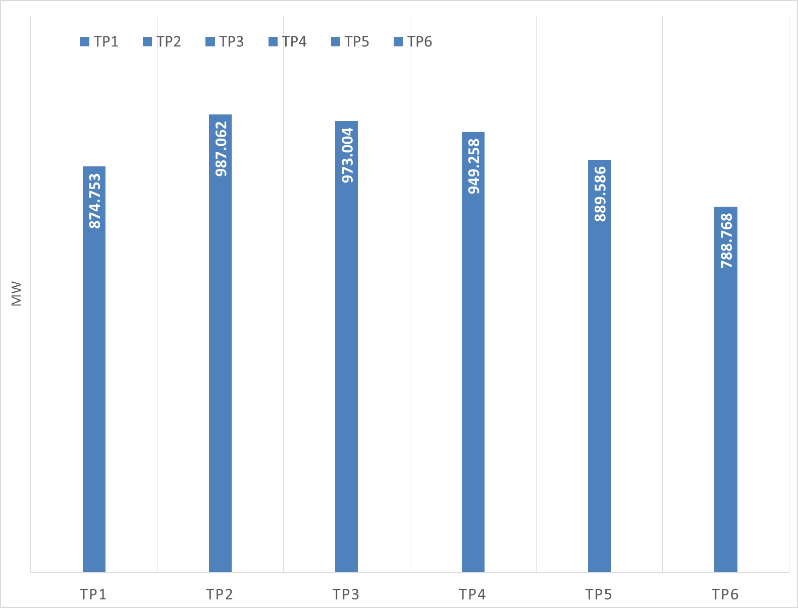
ERS MW Procurement

Slide 10
Emergency Response Service (ERS) Trends

Slide 11
Post Feb-May Procurement Expenditure Limit Allocation Table

Slide 12
Upcoming ERS Activities and Dates of Interest
Draft version of ERS Procurement Schedule for Jun-Sep 2016 now posted
Draft ERS Procurement Schedule
June through September 2016 Standard Contract Term
Date |  | Action
Friday | March 11, 2016 | DRAFT Technical Requirements & Scope of Work posted to ERS web page
Friday | March 25, 2016 | Market Participant comments on TRSOW due at ERCOT
Tuesday | March 29, 2016 | WebEx for TRSOW comments (if requested) Last date for QSEs to request baseline reviews
On or before | March 31, 2016 | Pre-Populated ERID books get posted to the MIS
Friday | April 1, 2016 | RFP posted to ERCOT ERS web page

