Slide 1
Credit Updates
Vanessa Spells
Credit Work Group
ERCOT Public
February 17, 2016

Slide 2
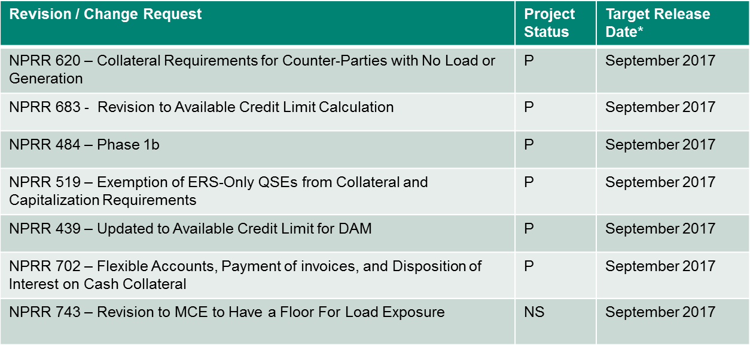
Credit Updates
Approved Revision / Change Requests
* Target Release Date is not firmed up until the project moves to Execution (E) phase
Project Status Codes: NS = Not Started, I = Initiation, P = Planning, E = Execution, H = On Hold

Slide 3
Credit Updates
Outstanding Revision / Change Requests
NPRR638 – Revisions to Certain Price Components of EAL
Tabled at PRS
NPRR 741 – Clarification to TPE and EAL Credit Exposure Calculations
Approved @ PRS on 2.11.16
IA needed
SCR 785 – Update RTL calculation to include Real-Time Reserve Price Adder-based components
WMS recommended that PRS table SCR785, including three billing determinants defined in SCR785, and an additional three determinants included in NPRR626 which are dependent on SCR785, until such time that this SCR and the related NPRR626 credit components can be implemented with reduced cost by combining with other projects.

Slide 4
Credit Updates
Requests or Assignments to CWG/MCWG
Development of Risk Appetite Goal
Other
CMM Tech Refresh concept
Concept and IA approved
ERCOT staff evaluation in progress to combine with NPRRs project

Slide 5
Credit Updates
Implemented Change Requests
NPRR 673 - Correction to Estimated Aggregate Liability (EAL) for a QSE that Represents Neither Load nor Generation
NPRR 671 – Incorporation of DAM Credit Parameters into Protocols
NPRR 670 – Clarification of Portfolio-Weighted Auction Clearing Price (PWACP)
NPRR 612 – Reduction of Cure Period Subsequent to Event of Default
SCR 778 – Credit Exposure Calculations for NOIE Options Linked to RTM PTP Obligations
NPRR 559 – Revisions to MCE Calculation
NPRR 597 - Utilize Initial Estimated Liability (IEL) Only During Initial Market Activity
NPRR 601 - Inclusion of Incremental Exposure in Mass Transitions to Counter- Parties that are Registered as QSEs and LSEs and Provide POLR Service
NPRR 639 - Correction to Minimum Current Exposure
NPRR 690 – Incorporation of Creditworthiness Standards in Protocols
NPRR 692 – Removal of MIS Posting Requirement of DAM Credit Parameters
NPRR 728 - Removal of Language Related to NPRR484, Revisions to Congestion Revenue Rights Credit Calculations and Payments, and NPRR554, Clarification of Future Credit Exposure Calculation
ERCOT Public

Slide 6
Credit Updates
Questions

