Slide 1
New Resource Modeling in SSWG

Slide 2
An overview of SSWG's process modeling future generation in the cases and what occurs when the planning information is missing from a generator's RARF

Slide 3
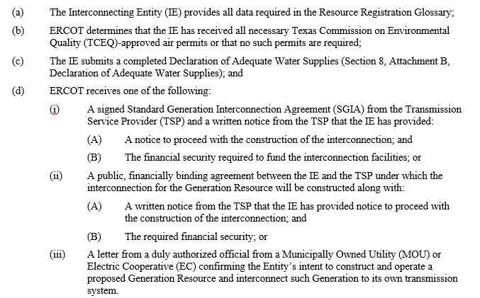
Requirements of Section 6.9(1)

Slide 4
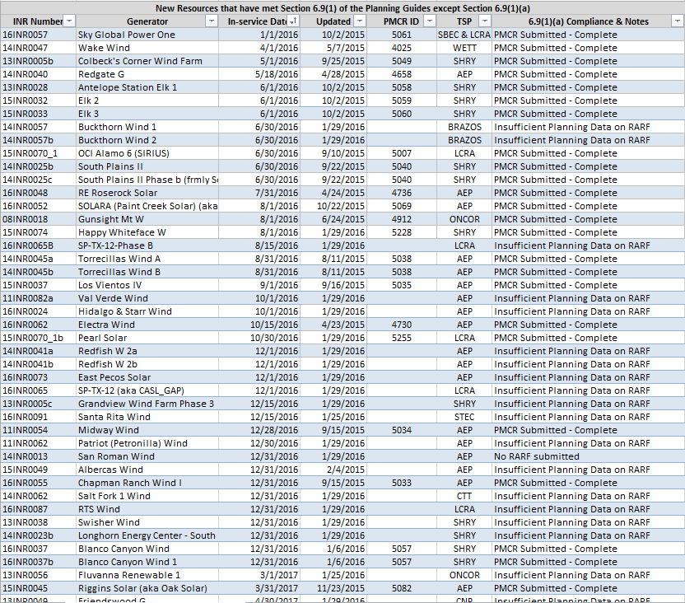
New Resources that have met Section 6.9(1) of the Planning Guides except Section 6.9(1)(a)

Slide 5
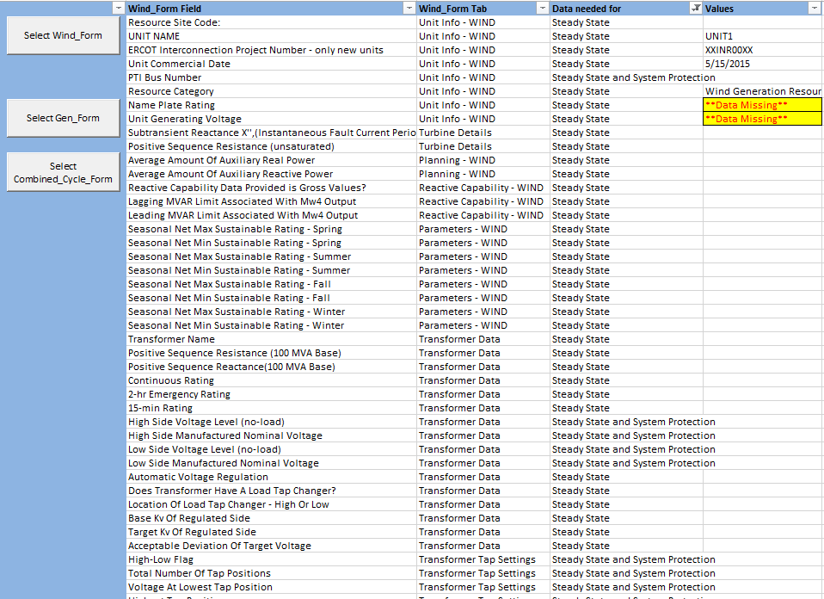
Review of RARF
Resource Registration Glossary – Planning Model (Column K)
http://www.ercot.com/mktrules/guides/resourcereg/library

Slide 6
What happens when Planning Data is incomplete?
The reviewer will send a screenshot of the table to the ERCOT planning engineer that is the point of contact for the RE.
The planning engineer will send a request to the RE to submit an updated RARF to include the missing data specifically identified in the table.
When an updated RARF is received, the updated RARF is reviewed as before. If the requested Planning data has been provided, the resource is modeled in MOD. Otherwise, a new request is sent to the RE following the same process as before.

Slide 7
Goals of this process
To have an open and transparent process with SSWG and the RE
To have one point of contact between the RE and ERCOT to ensure data consistency
To reiterate the importance of the RARF for data collection
To create base cases with as much verified information as possible
  This allows end-users to knowingly make any assumptions necessary for the analysis they are performing

Slide 8
Challenges in using data that hasn’t been provide by the RE in the SSWG
How to convey to the end users what data is RE provided and what has been assumed?
When a RE provides an update, how do we ensure that end users update any previously published models they may be using with the updated information?
Who will be creating the missing data and assuming the liability of those assumptions?

Slide 9

Questions

