Slide 1

2016 LTSA Update
Doug Murray
ERCOT
Sr. Planning Analyst
February 16, 2016

Slide 2
Agenda
Modeling Challenges
What’s Next?

Slide 3
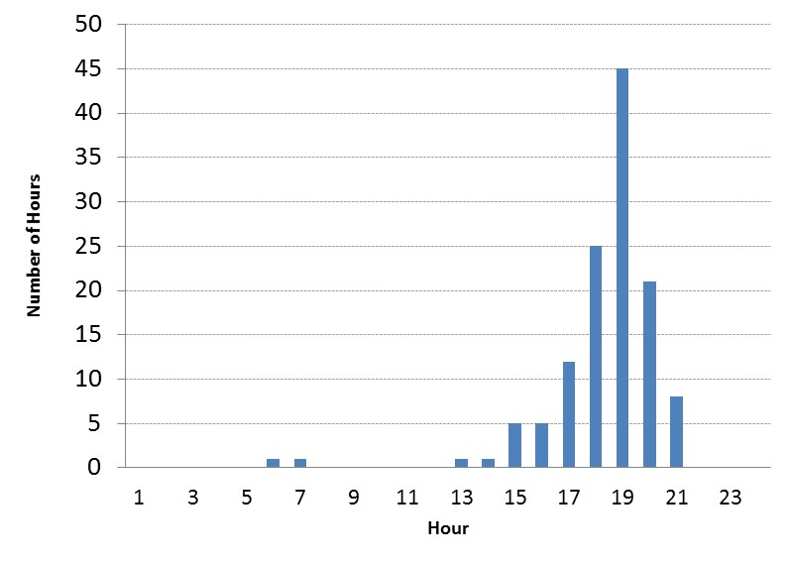
Initial Run of Current Trends
2031 Scarcity Hours

Slide 4
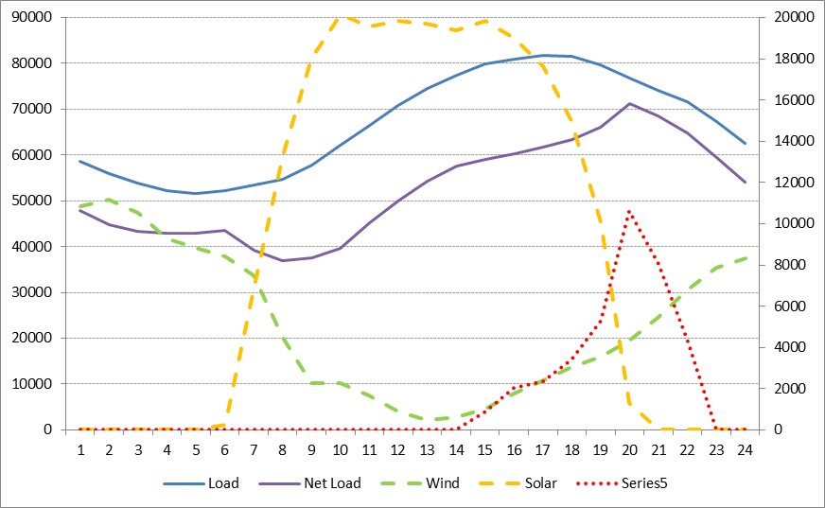
Initial run of Current Trends
Added PTC and ITC
Lower cost solar and wind remove chance for any thermal builds
  Solar additions – 21,400 MWs
  Wind additions – 100 MWs
  CT additions – 3,420 MWs
Total fixed retirements – 18,349 MWs
  2,581 MWs retire before 2016
Fixed retirements are replaced mostly with solar resources
Largest MW shortage is 10,629 MWs with many hours over 5,000 MWs
125 scarcity hours most occur between 6 pm and 8 pm
Fixed retirement ages:
  Coal – 55 years
  NG – 50 years
  Wind – 25 years
July 17, 2031

Slide 5
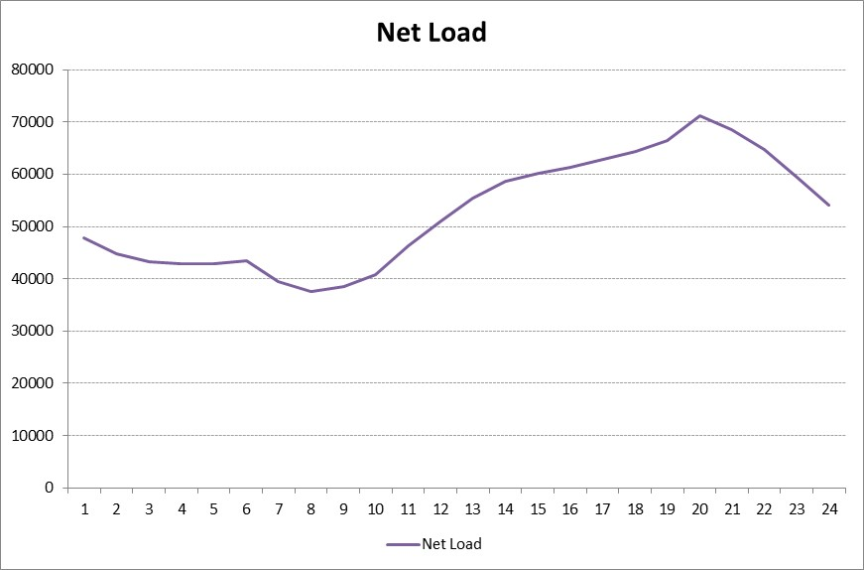
Initial run of Current Trends

Slide 6

Initial run of Current Trends

Slide 7
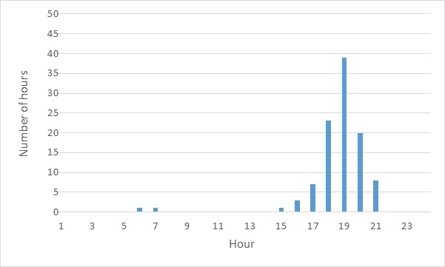
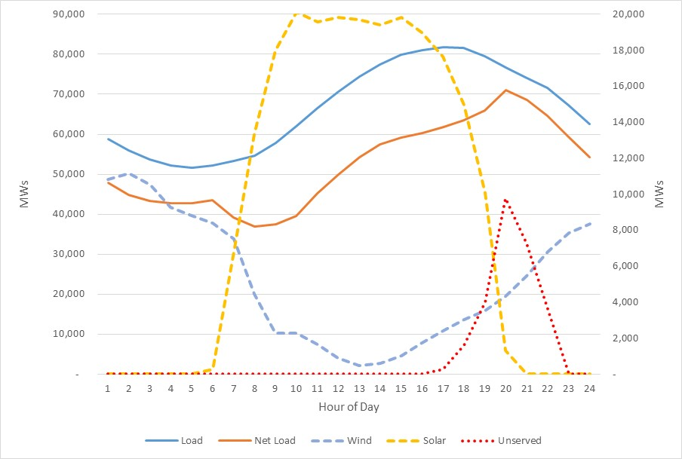
Adjusted Current Trends
Changed NG retirement age to 60 years
Adjusted fixed retirements – 14,192 MWs
  2,901 MWs of economic retirements
Solar additions – 21,400 MWs
Wind additions – 100 MWs
103 scarcity hours mostly occurring between 6 and 8 pm
Largest MW shortage is 9,778 MWs
July 17, 2031

Slide 8
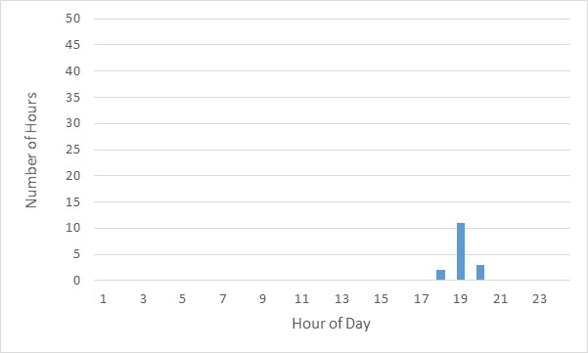
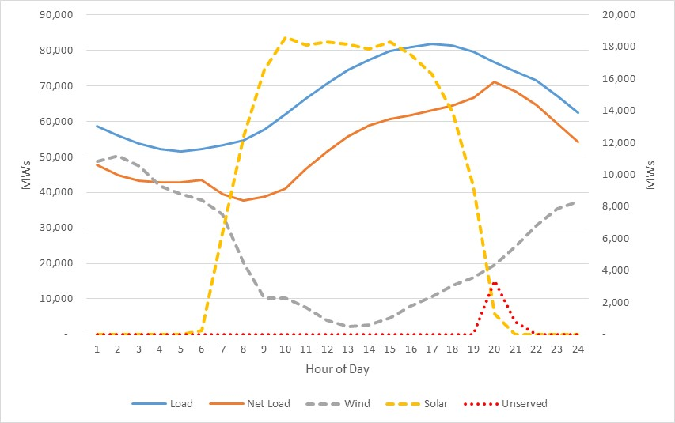
Adjusted Current Trends 2
No fixed retirements
Economic retirements – 9,569 MWs
Solar additions – 19,700 MWs
Wind additions – 100 MWs
16 scarcity hours all occurring between 6 and 8 pm
Largest MW shortage is 3,347 MWs
July 17, 2031

Slide 9
Options Going Forward
Run model with initial fixed retirement amounts of 18,349 MWs
Run model with adjusted fixed retirements amount of 14,192 MWs
Run model without fixed retirements and let model determine what gets retired through economics. Total retirements 9,569 MWs
Run model 1 or 2 or 3 above and add individual CTs to reduce unserved energy in 2031
Others?

Slide 10
Schedule for Generation Expansion
Current Trends Scenario in process

Slide 11

Questions
Contact info:
Doug Murray Julie Jin
douglas.murray@ercot.com julie.jin@ercot.com
512.248.6908 512.248.3982
Sandeep Borkar
sandeep.borkar@ercot.com
512.248.6642

