Slide 1
Load Scaling
PGRR042

Slide 2
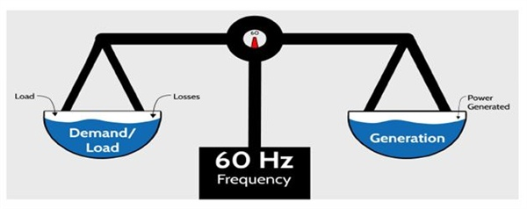
Objective
Determine best way to address load/ generation imbalance in ERCOT steady state planning analyses

Slide 3
Principles
Load + losses + reserves must balance with generation in a powerflow case
Load
If loads for all areas are represented at their peak in a case, the summed peak load will be greater than what would be expected due to the non-coincident nature of loads
Ideally, a separate case would be created to represent the peak for each “area” in the system; however, this would be impractical (potentially thousands of combinations)
Weather zones group together and separate areas that typically experience similar weather patterns – a large source of load non-coincidence
Generation
It is not likely that the generation fleet will be precisely known four to six years in the future due to unknown retirements and additions
The location and size of generators can have a significant impact on the assessment of transmission system needs
From a reliability planning perspective if more generation than actual is assumed in an area then the reliability needs may be understated; if less generation than actual is assumed in an area then the reliability needs may be overstated

Slide 4
When Load exceeds Generation in a case there are two options:
Decrease Load
Increase Generation

Slide 5
Study Area
Rest of ERCOT
~
~
~
~
~
~
When performing a transmission planning study, planners will often carve out the portion of the system relevant for the analysis. This is known as the “study area.”
Load and generation assumptions within the study impact the results and should be consistent with expected conditions
Load and generation assumptions outside the study are not as important – to the extent that changes in these assumptions do not significantly impact the power flows within the study area
Hence, changes to load or generation to balance the case should be made outside of the study area

Slide 6
Study Area
Rest of ERCOT
~
~
~
~
~
~
Okay, then, when changing assumptions outside of the study area is it better to scale load down or add generation?
Scaling load spreads out the effect of the change in MWs across a larger area than the particular location associated with the addition of speculative generation
Scaling load down mimics the natural non-coincidence of the system

Slide 7
Study Area
Rest of ERCOT
~
~
~
~
~
~
What if changes in load or generation outside of the study area significantly affect power flows within the study area?
Sensitivity analysis
Load? No – load assumption within the study area should not deviate from expected conditions or system will be under planned
Generation? Yes – sensitivities could be performed looking at ‘what if’ new generation under study within the study area moves forward
Need to also consider potential generation retirements

Slide 8
Proposal
For RTP and IR base case analysis keep current practice of load scaling
When conducting the IR of a major transmission proposal, ERCOT could perform generation sensitivities taking into account potential generator retirements and/or known potential additions if such changes are likely to have an impact on the project need or alternative selected
For example, include generators with SGIA that don’t meet all PG 6.9 requirements
Potential retirements may include units potentially impacted by environmental regulations or older units

