Slide 1
ICE Price Analysis
Suresh Pabbisetty, FRM, ERP, CQF, CSQA.
Lead Technical Analyst, Credit
February 17, 2016

Slide 2
Agenda
Data Inputs and Transformations
Assumptions
ICE Price correlations 2011-2015
Back-casting with forward RTSPP Average with;
  RTSPP Average of operating days considered into current RTLE calc
  ICE Average of 7 days forward
  ICE Average of 14 days forward
  ICE Average of 21 days forward
  Winter and Summer Price Events from 2011 through 2015

Slide 3
ICE Price Analysis
Inputs & Assumptions

Slide 4
ICE Price Analysis
Data Inputs and Transformations:
  ICE Futures prices pertaining to North Hub Settlement Point for Daily Peak (END) and Off-peak (NED) contracts
    ICE doesn’t have new pricing information available on weekends and holidays. The most recent available price of the same contract is substituted if a price is missing
    ICE Prices from early January 2011 through mid-December 2015
    Daily Average Price is calculated as (16 * Peak Price + 8 * Off-peak Price)/24

Slide 5
ICE Price Analysis
Data Inputs and Transformations:
  North Hub RTSPP from early January 2011 through mid-December 2015
    Daily Average Price is calculated using simple average of all interval RTSPPs in an Operating Day
  A logarithm is taken for both ICE Forward Prices and RTSPP to allow linear regression.

Slide 6
ICE Price Analysis
Assumptions:
  North Hub Price is a representation of Market wide price movements.
  Price component of a Counter-Party(CP)’s forward exposure is represented by average price over CP specific M1 days.
  M1 for ERCOT CPs ranges from 12 through 20 with a high concentration towards 14. So 14 forward days are used as general representation of forward price exposure for regression and back casting purposes.

Slide 7
ICE Price Analysis
ICE Price correlations 2011-2015

Slide 8
ICE Price Analysis
ICE Price regression 2011-2015:

Slide 9
ICE Price Analysis
Back-casting

Slide 10
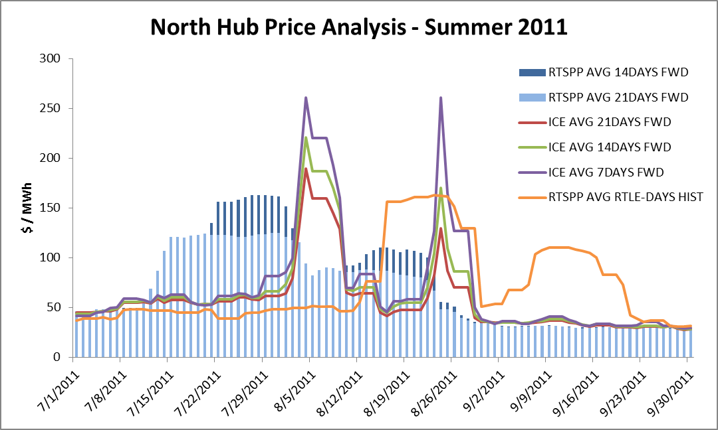
ICE Price Analysis
Chart Interpretation Guidance
Amount of Price Exposure estimated.
Line above the column means exposure covered.
Realized Price Exposure per day in case of default, for CPs with M1~=14
Prediction Lagging
(False Positive)
Realized Price Exposure per day in case of default, for CPs with M1~=21
Prediction Failed (False Negative)

Slide 11
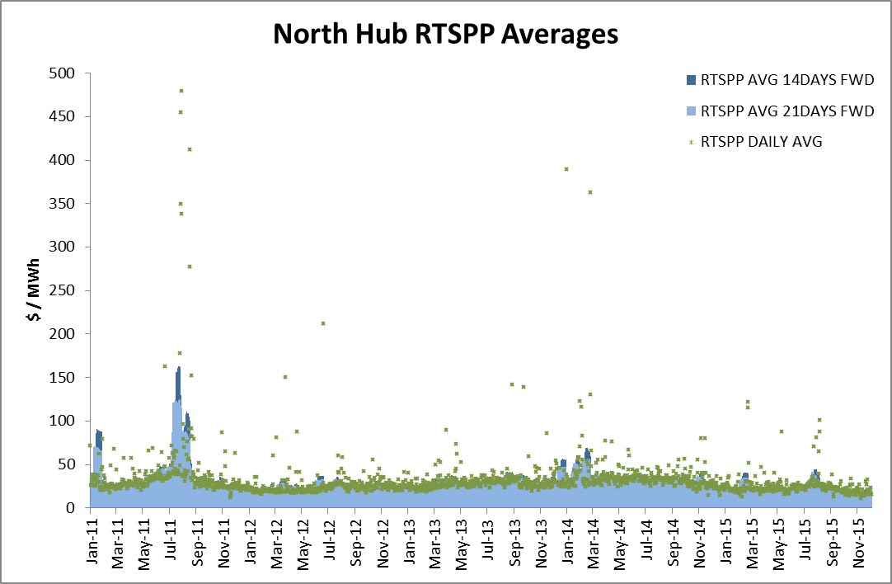
ICE Price Analysis

Slide 12
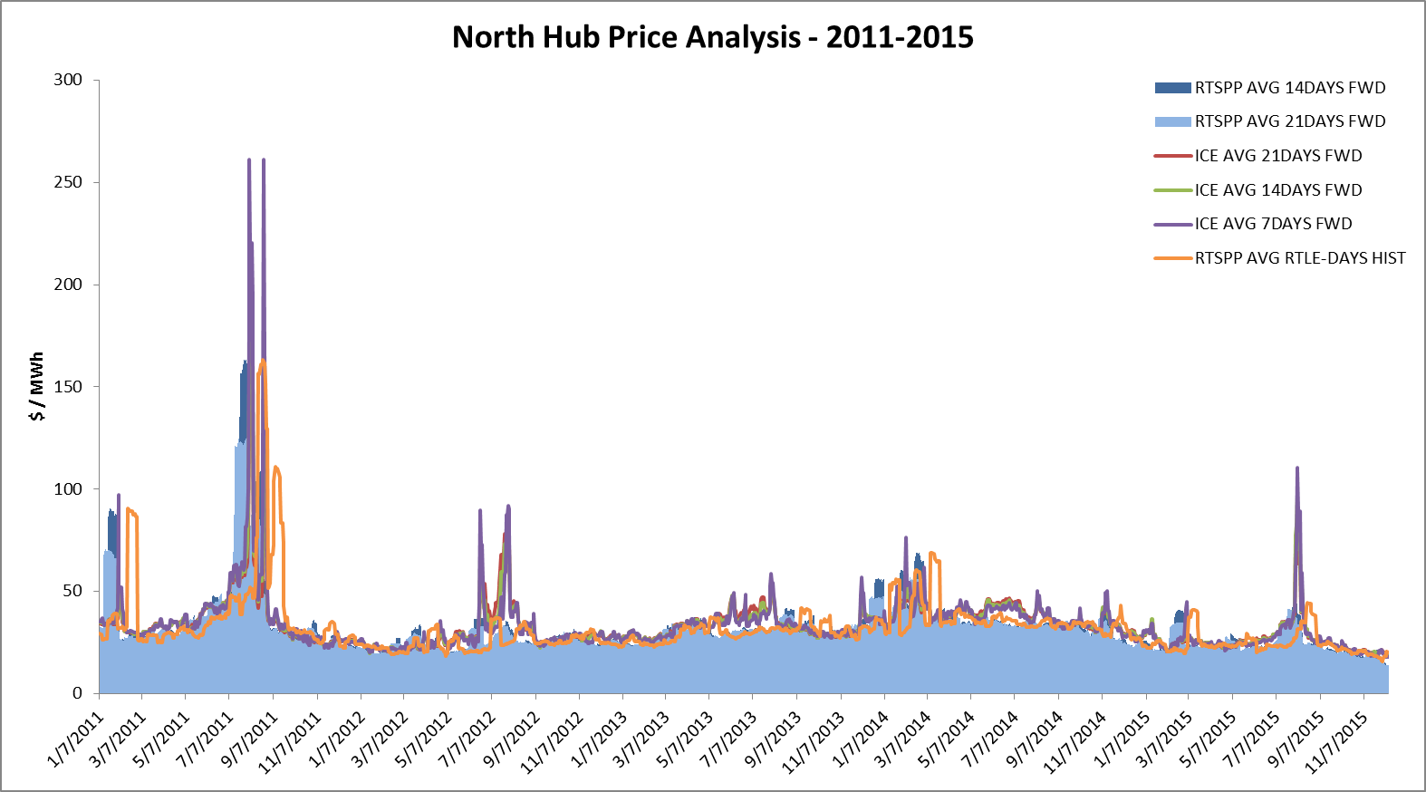
ICE Price Analysis

Slide 13
ICE Price Analysis
Price Events
Winter & Summer
2011-2015

Slide 14
ICE Price Analysis
Price Events identified by CWG/MCWG:
  August 1st, August 5th of 2011
  July 17th, August 5th of 2013
  January 6th, July 9th, August 6th of 2014
  July 15th, August 13th of 2015
  The following charts provides a comparison of various estimation methodologies of average daily forward price risk to the actual price exposure for ERCOT North Hub

Slide 15
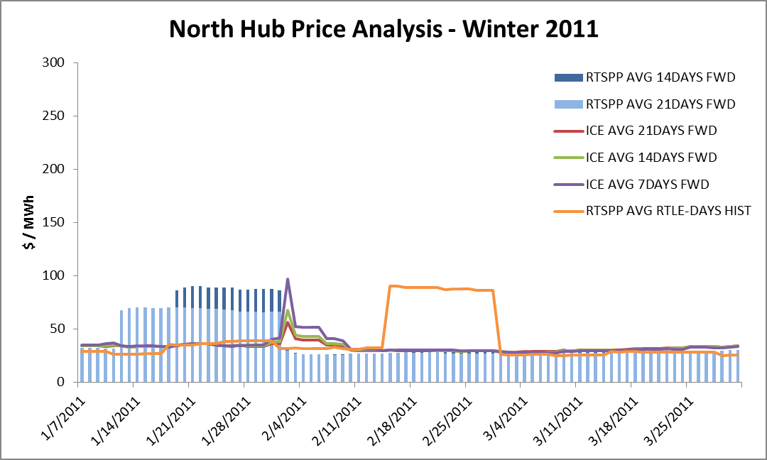
ICE Price Analysis

Slide 16
ICE Price Analysis

Slide 17
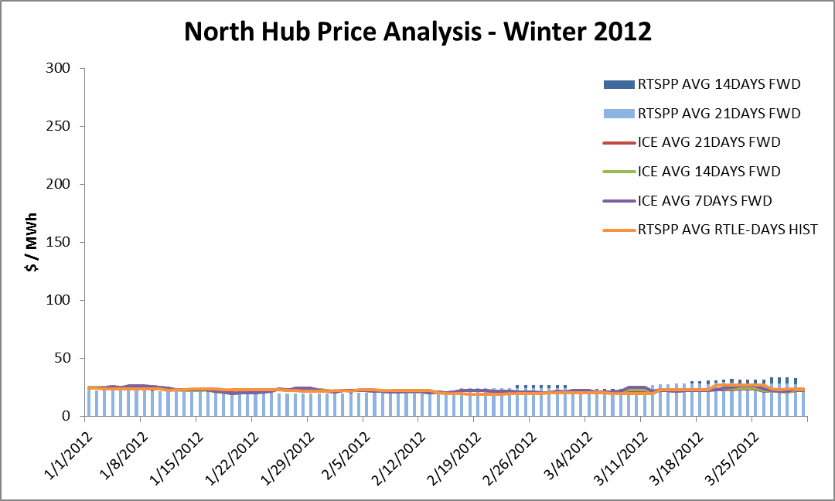
ICE Price Analysis

Slide 18
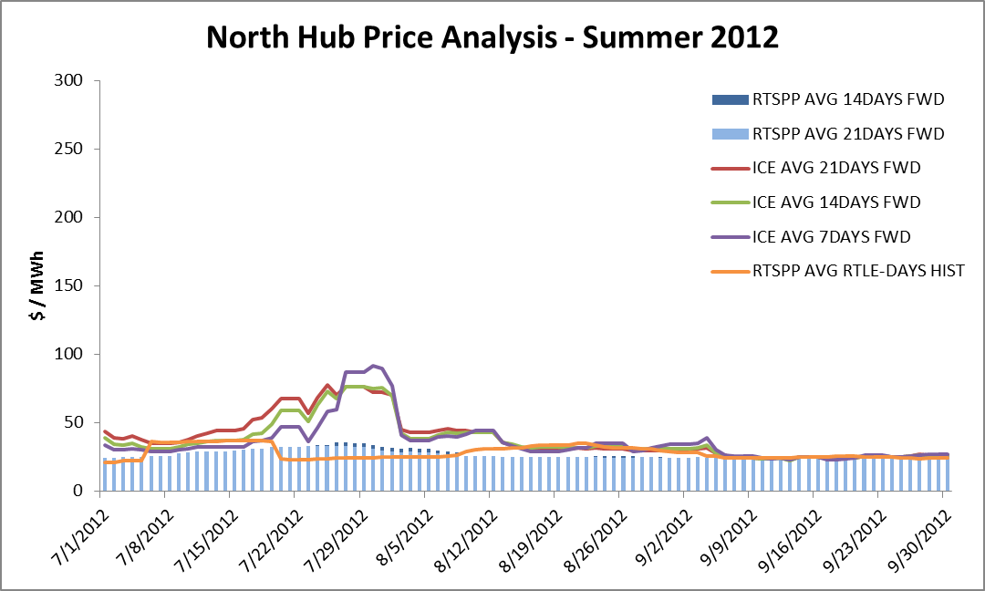
ICE Price Analysis

Slide 19
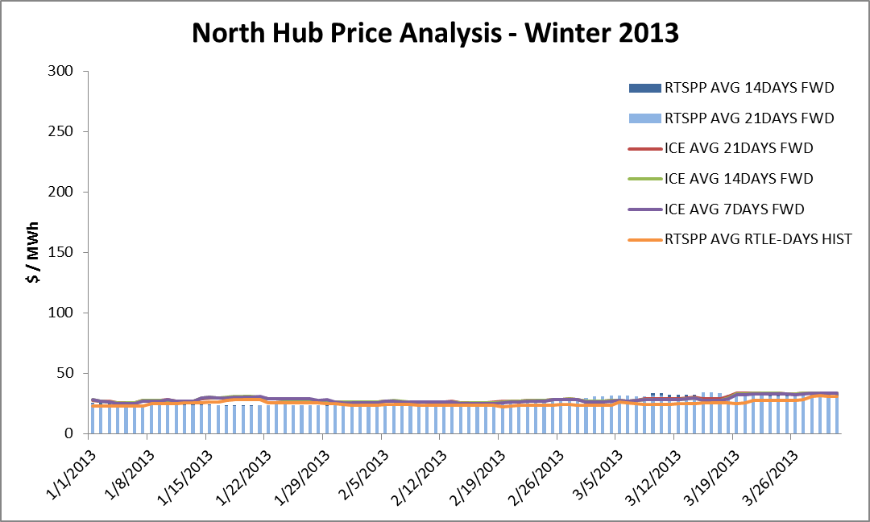
ICE Price Analysis

Slide 20
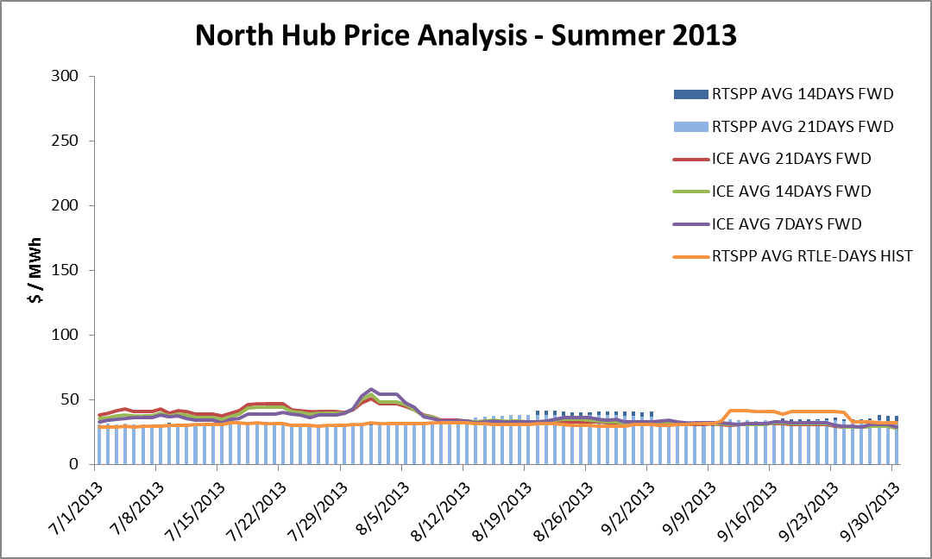
ICE Price Analysis

Slide 21
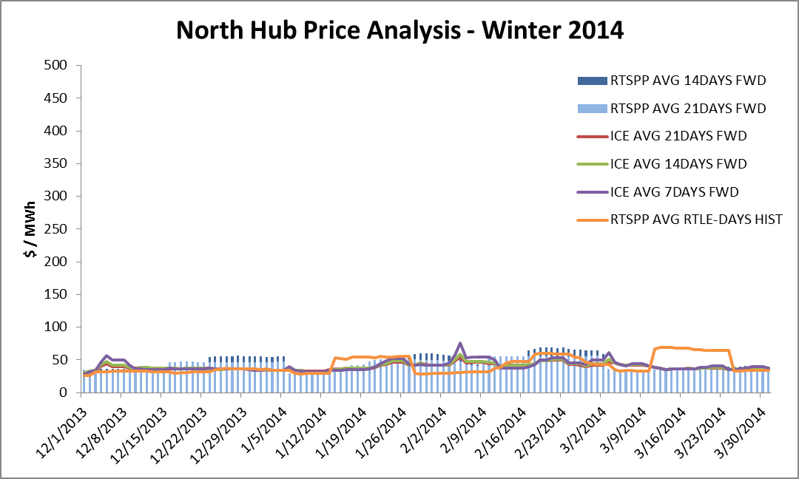
ICE Price Analysis

Slide 22
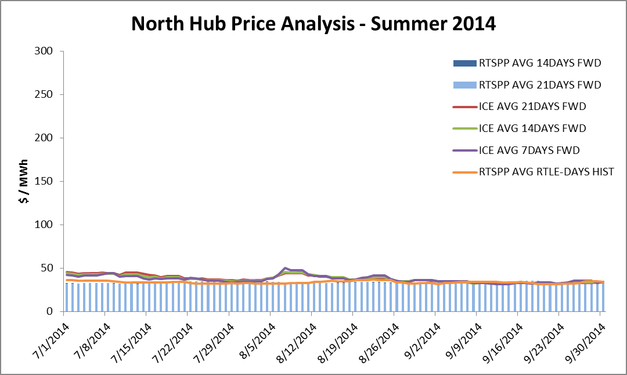
ICE Price Analysis

Slide 23
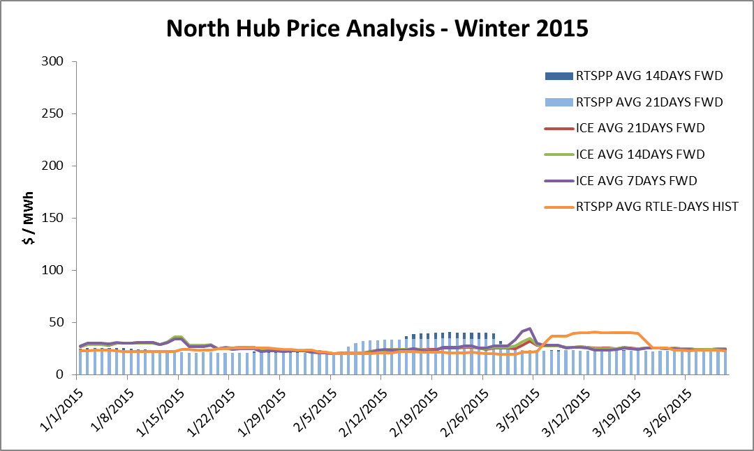
ICE Price Analysis

Slide 24
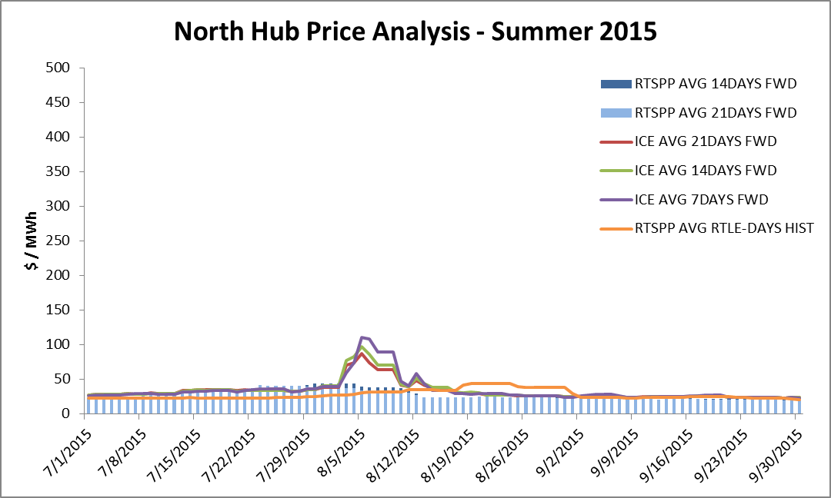
ICE Price Analysis

Slide 25
ICE Price Analysis
Questions

Slide 26
ICE Price Analysis
Appendix

Slide 27
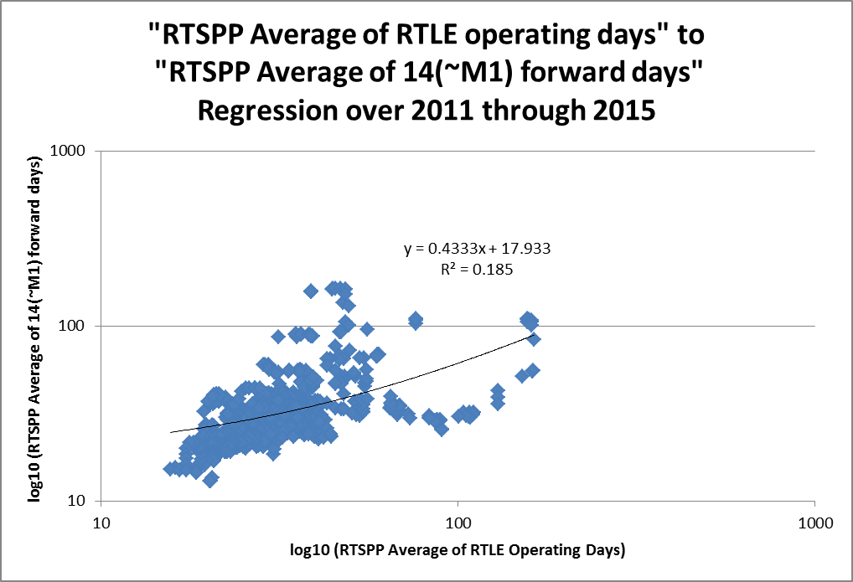
ICE Price Analysis

Slide 28
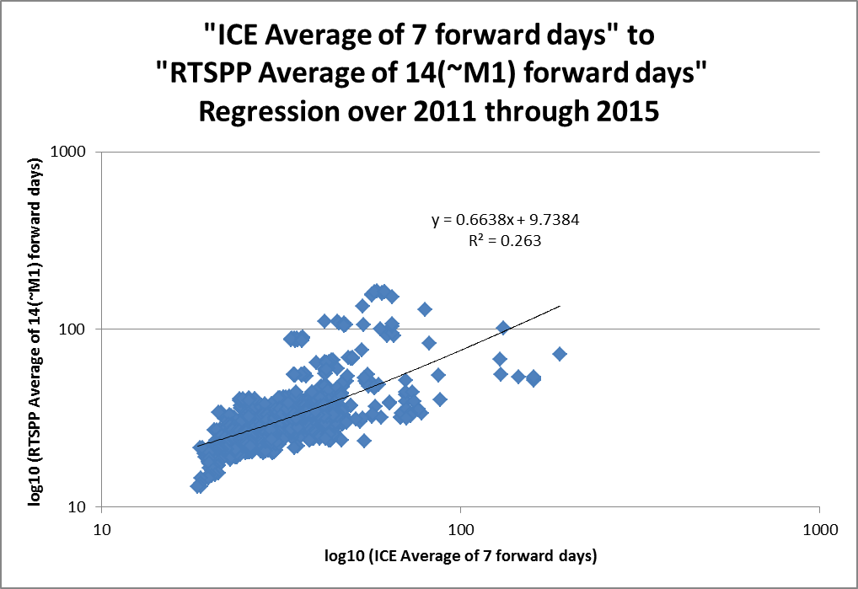
ICE Price Analysis

Slide 29
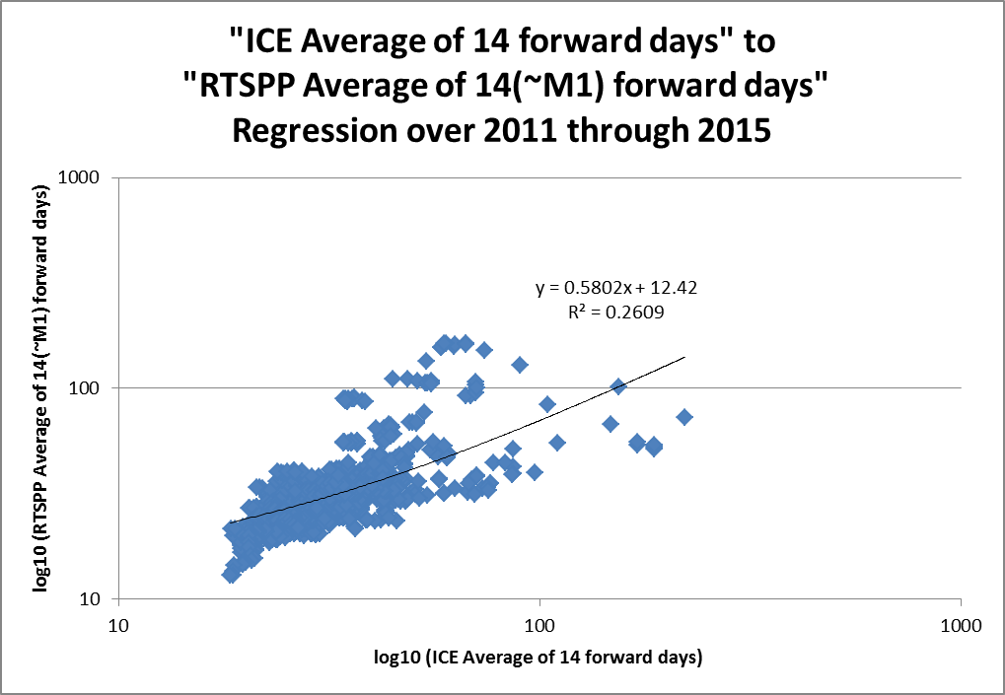
ICE Price Analysis

Slide 30
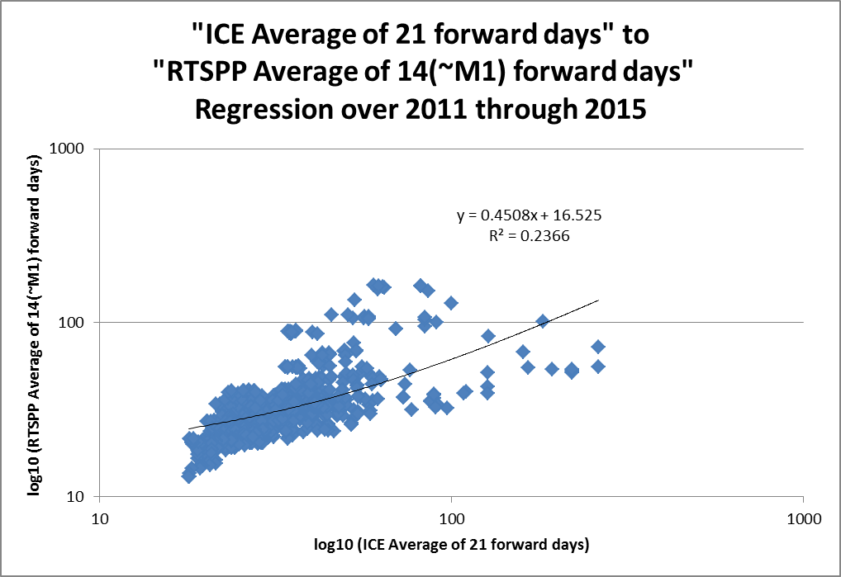
ICE Price Analysis

Slide 31
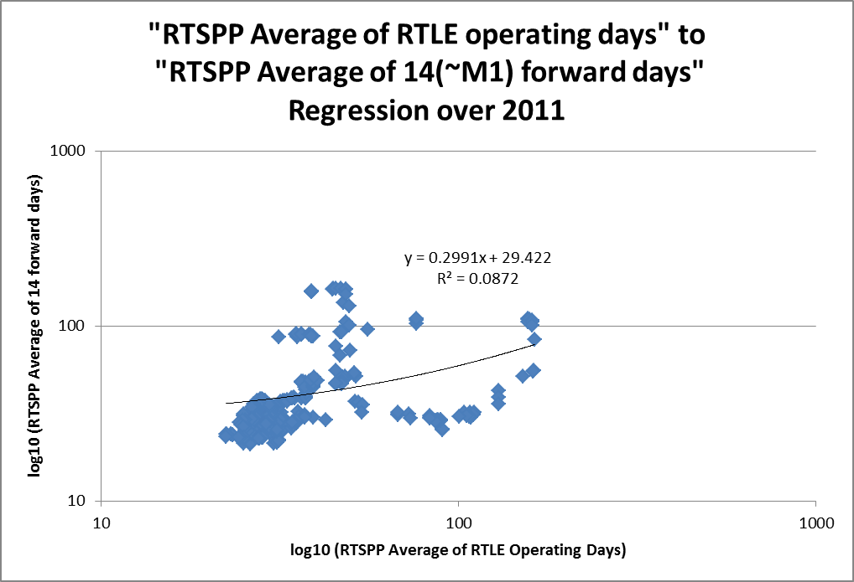
ICE Price Analysis

Slide 32
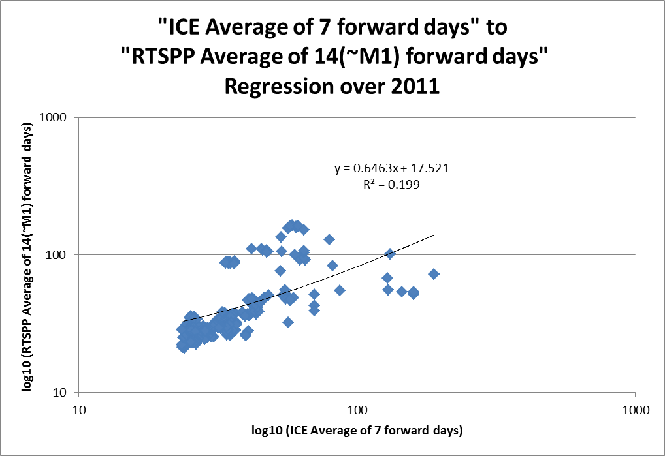
ICE Price Analysis

Slide 33
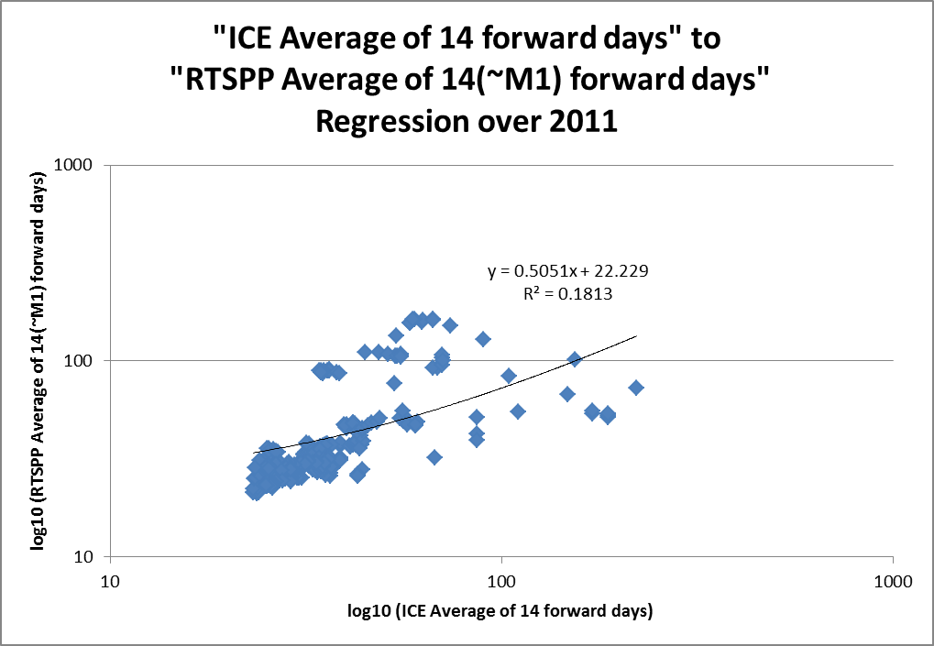
ICE Price Analysis

Slide 34
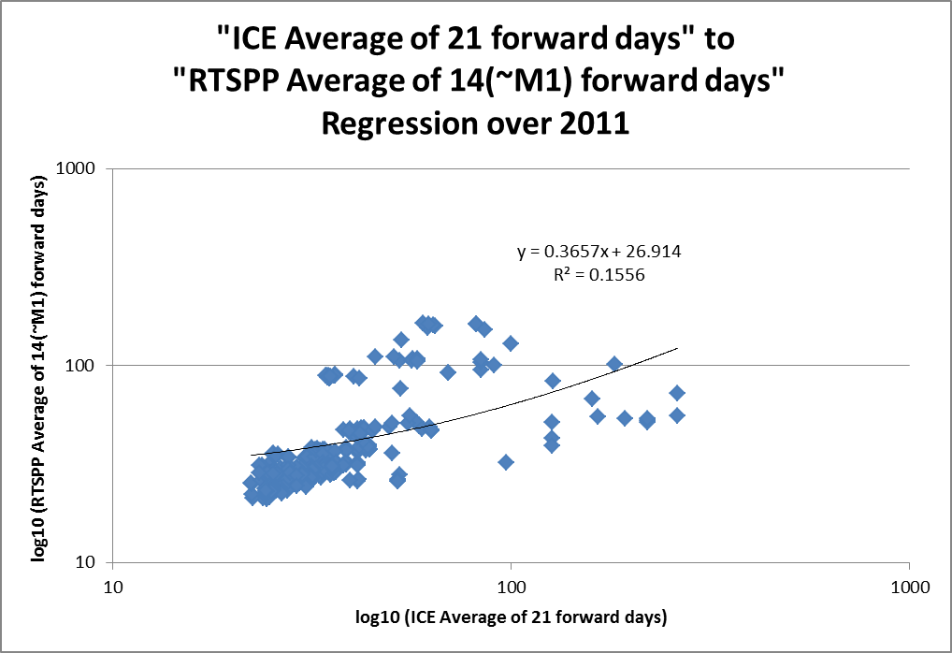
ICE Price Analysis

Slide 35
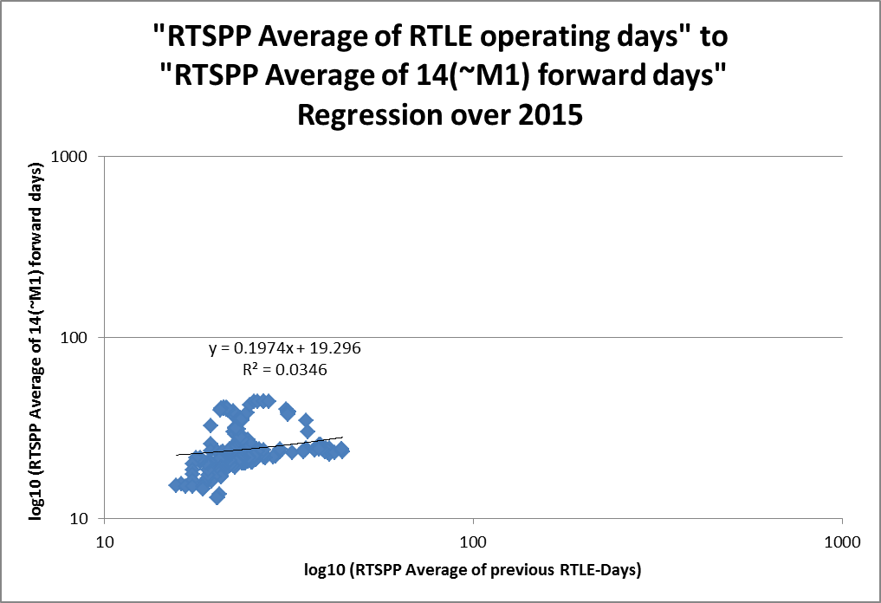
ICE Price Analysis

Slide 36
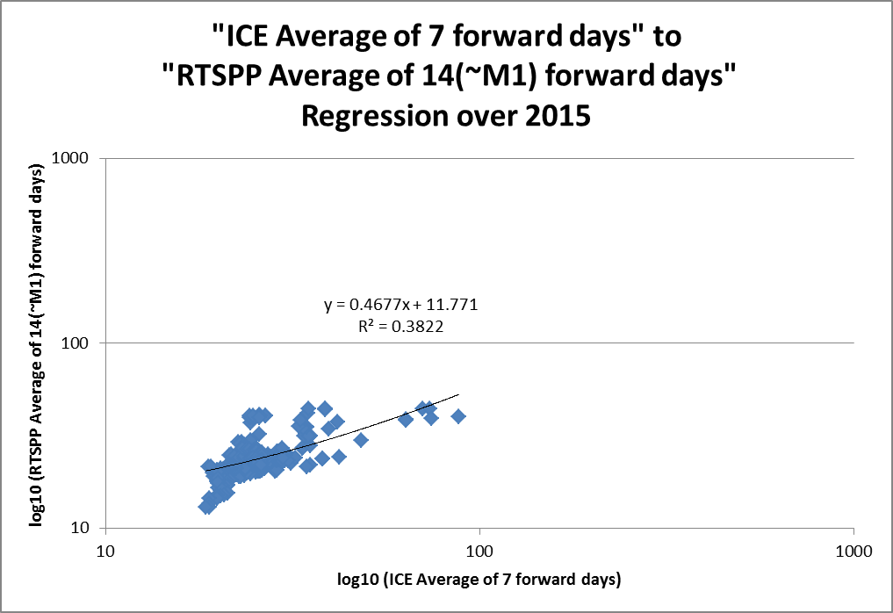
ICE Price Analysis

Slide 37

ICE Price Analysis

Slide 38

ICE Price Analysis

