Slide 1
Seasonal Adjustment Factor
Analysis for 2016
Suresh Pabbisetty, FRM, ERP, CQF, CSQA.
Lead Technical Analyst, Credit
February 17, 2016

Slide 2
Agenda
SAFs proposed for Summer 2016
SAF exposure impacts

Slide 3
SAF Options for 2016
CWG is exploring options for SAF 2016

Slide 4
SAF Options for 2016
Average Exposure (TPEA) ($m)

Slide 5
SAF Options for 2016
Maximum Exposure (TPEA) ($m)

Slide 6
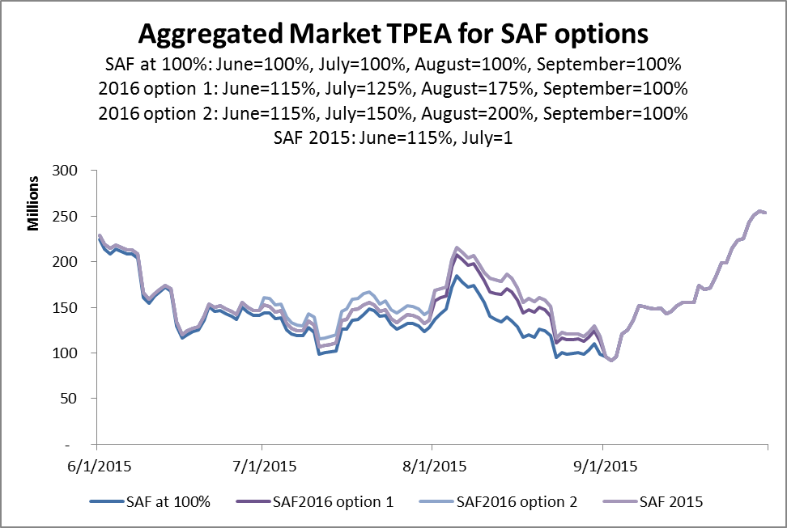
SAF Options for 2016

Slide 7
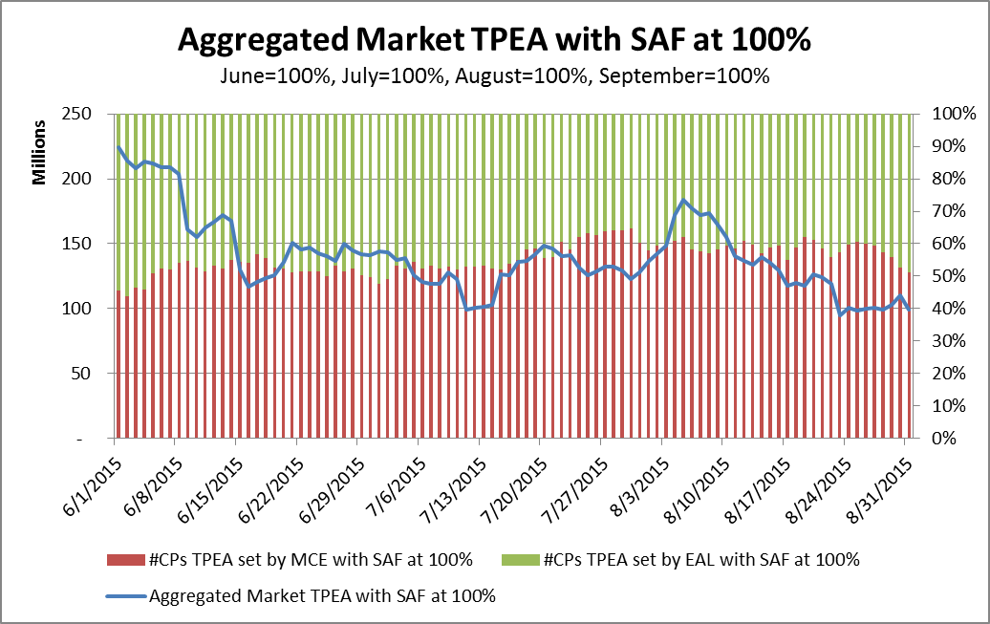
SAF Options for 2016

Slide 8
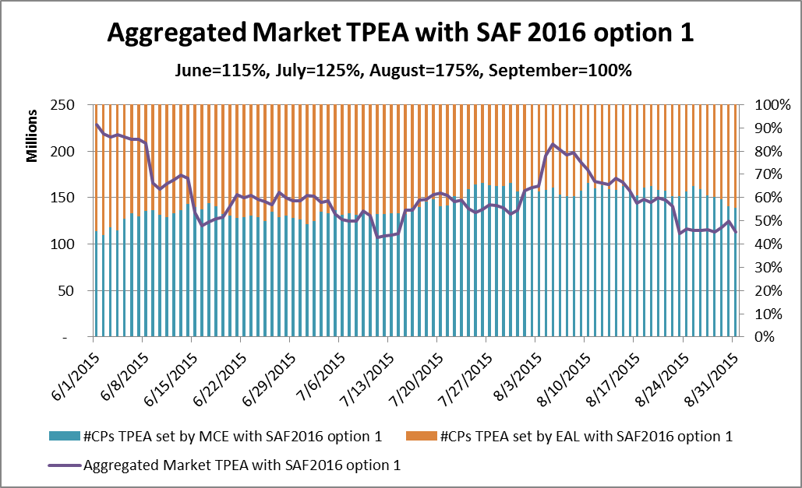
SAF Options for 2016

Slide 9
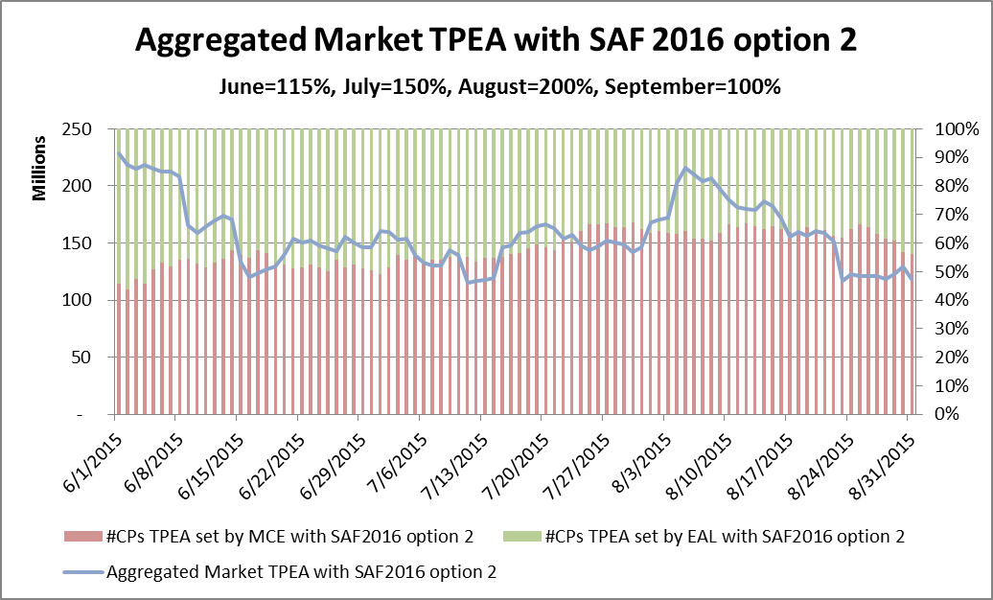
SAF Options for 2016

Slide 10
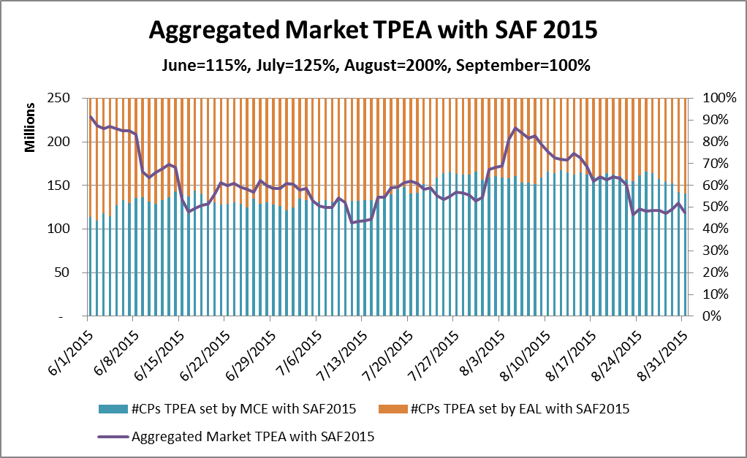
SAF Options for 2016

Slide 11
SAF Options for 2016
Questions

