Slide 1
Project Update and Summary of Project Priority List (PPL) Activity
February 11, 2016
ERCOT Public

Slide 2
2016 Project Update – Agenda
  Project Portfolio Update p. 3-7
    Recent/Upcoming Project Highlights
    2016 Release Targets
    2016 Project Spending Forecast
    ERCOT Internal Labor Rate Revision
    Revision Request Impact Analysis Process Review
  Appendix
    Project Portfolio Gantt Chart p. 8-15
Location of Project Priority List (PPL): http://www.ercot.com/services/projects/index
ERCOT Public

Slide 3
Recent / Upcoming Project Highlights
2016 February Release – Week of 2/2/2016 Complete
  NPRR588 – Clarifications for PV Generation Resources
  NPRR615 – PVGR Forecasting
  NPRR686 – Changing the IRR Forecast from Next 48 Hours to Next 168 Hours
    Solar elements
2016 April Release – Week of 4/5/2016 In Flight
  NPRR419 – Revise Real-Time Energy Imbalance and RMR Adjustment Charge
  NPRR515 – Day-Ahead Market Self-Commitment of Generation Resources
2016 June Release – Week of 6/14/2016 In Flight
  NPRR617 – Energy Offer Flexibility
  NPRR700 – Utilizing Actual Fuel Costs in Startup Offer Caps
  RMGRR126 – Add’l ERCOT Validations for Customer Billing Contact Information File
  RMGRR127 – Efficiencies for Acquisition Transfer
The May 2016 release has been moved back by 3 weeks (from 5/24 to 6/14) to avoid conflicts with the implementation of the EMS Upgrade
Note: Projected Go-Live dates are subject to change.
Please watch for market notices as the effective dates approach.
ERCOT Public

Slide 4
2016 Release Targets – Board-Approved NPRRs / SCRs / xGRRs
February 2/2 – 2/4 | April 4/5 – 4/7 | June 6/14 – 6/16 | August 8/9 – 8/11 | October 10/11 – 10/13 | December 12/6 – 12/8
NPRR588 NPRR615 NPRR686(b) | NPRR419 NPRR515 NPRR617 NPRR700 | RMGRR126 RMGRR127 NPRR617 NPRR700 EMS Upgrade | NPRR495 NPRR662 NPRR736 | NPRR219 SCR783 | NPRR210 NPRR272 NPRR573 RRGRR003 RRGRR006 RRGRR007 SCR781
3 | 2 | 4 | 3 | 2 | 7
E
E
I
I
E
E
E
NS
P
NS
E
E
NS
NS
H
NS
NS
NS
H
May 26
EMS Upgrade “Chill”
2016 TBD Items (and point at which they became “TBD”)
2014 | October 2015 | November 2015 | December 2015
NOGRR084, NPRR327 , SCR777 H, NPRR664 | NPRR439 P, NPRR519 P, NPRR620 P, NPRR683 P, NPRR702 P | NPRR679 | NPRR649, NOGRR147, SCR786
Go-live dates can differ from Protocol effective dates – Please refer to market notices for more details
APPENDIX
Red Text: New additions and target release changes
Strike-Through Text: Previous target release changes
(a), (b), etc. indicates multiple phases
NPRR686(b) – Solar portion
In-Flight Items Planned for 2017 Delivery
CMM bundle (Planning): NPRR439, NPRR519, NPRR620, NPRR683, NPRR702
CRR Upgrade (Planning): SCR777
Release targets are subject to change
Project Status Codes: NS = Not Started, I = Initiation, P = Planning, E = Execution, H = On Hold
ERCOT Public

Slide 5
2016 Project Spending Forecast
2016 PPL Budget = $22.5M
“Potential Demand” represents internal ERCOT projects that have not been fully approved
ERCOT Public

Slide 6
ERCOT Internal Labor Rate Revision
ERCOT has maintained a $65/hour rate for internal labor on capital projects for >10 years.
The ERCOT Finance department has evaluated current ERCOT staffing cost and has determined the $65/hour rate is not sufficient to account for average hourly cost for ERCOT staff who work on projects.
For 2016, the ERCOT labor rate attributed to projects is $75/hour.
Future internal labor rate changes to be evaluated in future budget cycles.
ERCOT has allocated a $400k contingency for 2016-2017 market projects to ensure PPL funding for Board-approved Revision Requests is not impacted ($800k total).
ERCOT Public

Slide 7
Revision Request Impact Analysis (IA) Process Review
ERCOT is in the process of evaluating the entire IA process
  After initial data collection and review, various components will be considered:
    IA data gathering process
    Cost estimation approach
    Duration estimation approach
    Communication
    Training
  We are also planning to come to PRS to:
    Share initial research findings
    Discuss improvement ideas
    Ask for market input on all the above components
ERCOT Public

Slide 8
2016 Project Update – Appendix
  Appendix
    1/31/2016 Project Gantt
      In-flight items sorted by Project End Date
      “On Hold” projects listed separately
      “Not Started” items sorted by Project Start Date
ERCOT Public

Slide 9
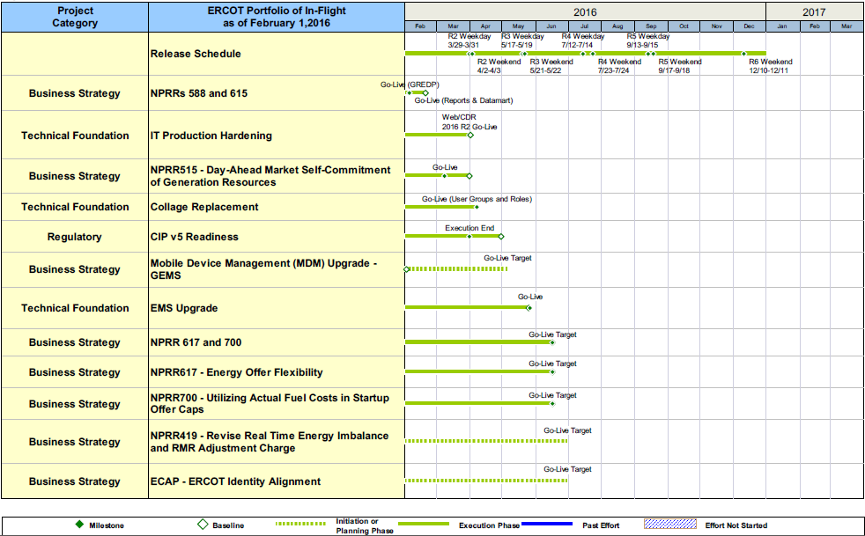
Project Portfolio Status – as of 1/31/2016
ERCOT Public

Slide 10
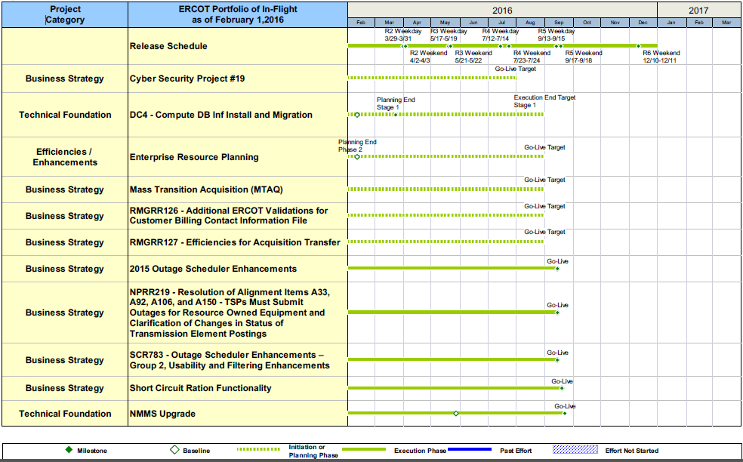
Project Portfolio Status – as of 1/31/2016
ERCOT Public

Slide 11
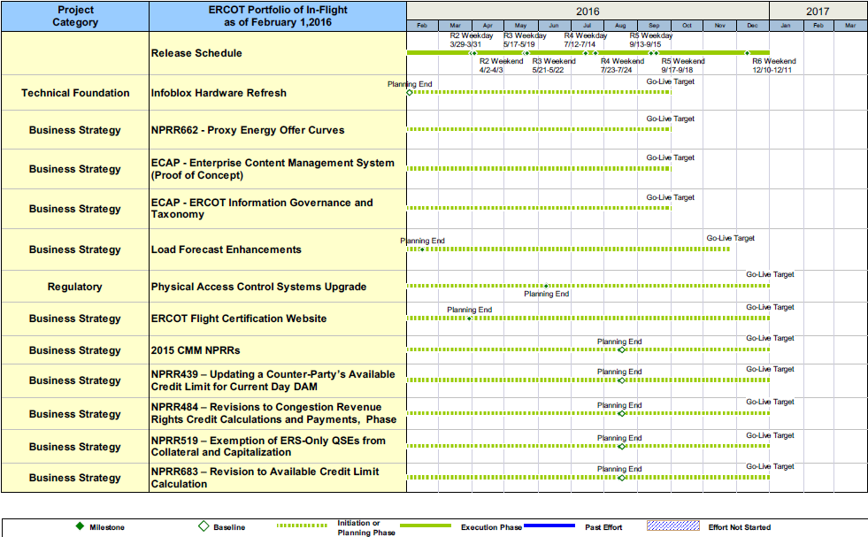
Project Portfolio Status – as of 1/31/2016
ERCOT Public

Slide 12
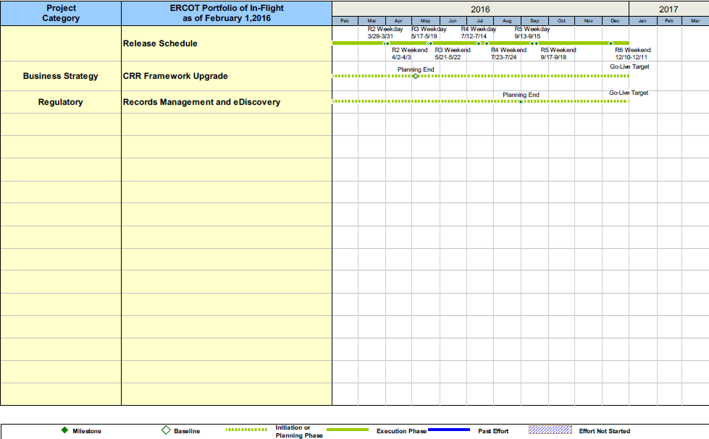
Project Portfolio Status – as of 1/31/2016
ERCOT Public

Slide 13
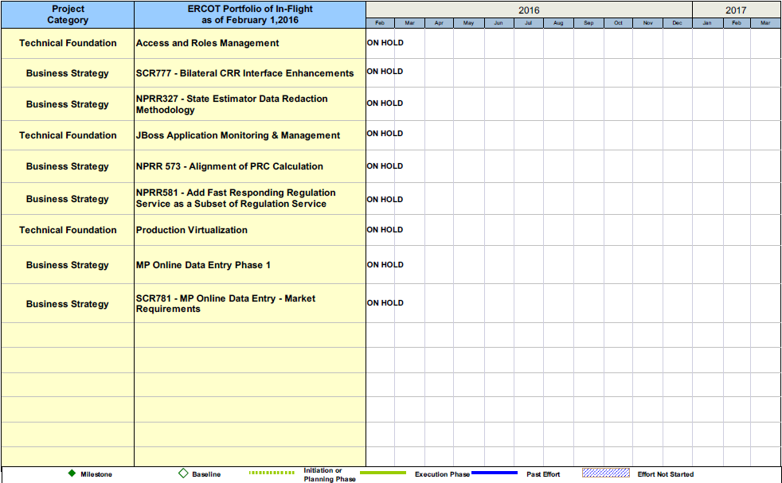
Project Portfolio Status – as of 1/31/2016
ERCOT Public

Slide 14
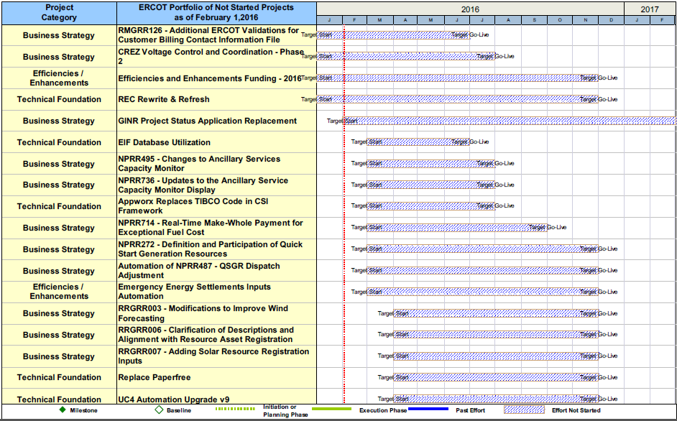
Project Portfolio Status – as of 1/31/2016
ERCOT Public

Slide 15
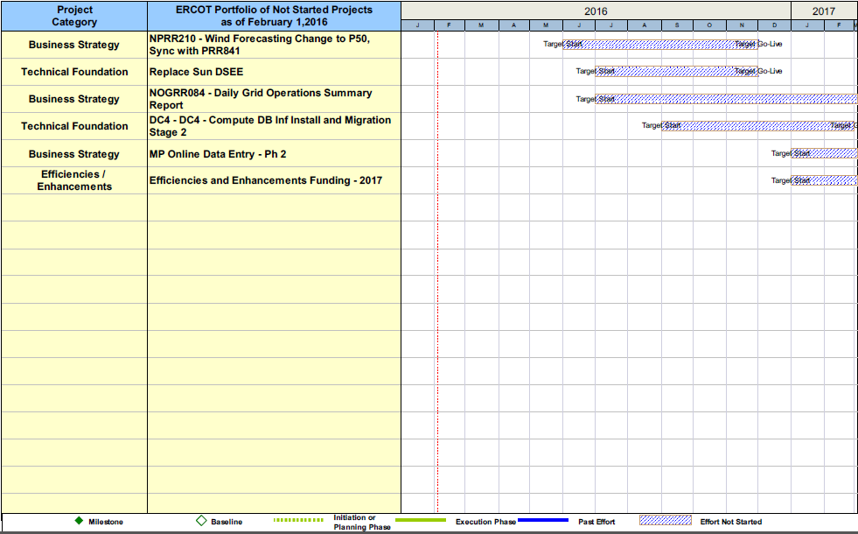
Project Portfolio Status – as of 1/31/2016
ERCOT Public

