Slide 1
Distributed Energy Resources (DER) Modeling
José Conto
System Planning

Slide 2
Project Motivation
Potential for fast and significant growth
Need to understand the potential reliability impact steady-state and dynamic analysis to bulk electric system
Notes:
According to EPRI, distributed energy resources, or DERs are smaller power sources that can be aggregated to provide power necessary to meet local or larger demand. Due to growing interest in clean energy technologies and improvements in cost and performance of DERs such as residential rooftop solar, there is potential for fast and significant growth in number of installations in the our region.
ERCOT has taken steps to prepare for some of these possible impending changes, hosting a DER workshop that focused on registration and metering and starting a DER task force to develop market rules for DER participation.
There is a need to understand and address the potential reliability impact these DER generation sources may have on the bulk electric system. We know that there are many benefits to DER integration, like curbed peak loads and diminished line losses, but also challenges such as increased load uncertainty and variability.

Slide 3
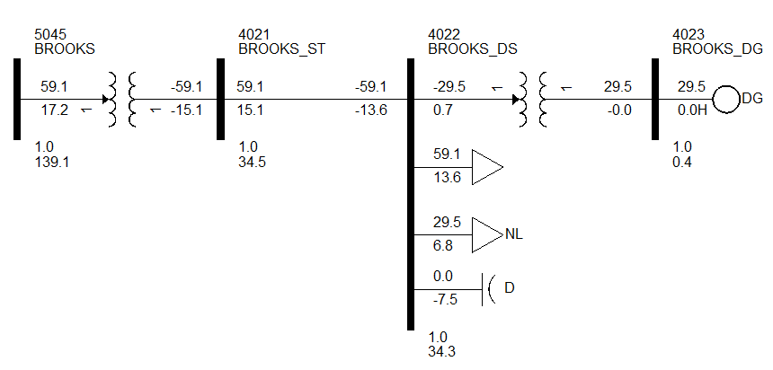
Modeling and Validation
Original Load Model
Notes:
At selected load buses we add the distribution system components and move the original load down the feeder.
Next, to add the DER, we make an assumption to maintain system balance between generation and load. We allow a DER penetration factor, as an example we’ll say 50%. Then we increase the load at this new bus by 50%, and meet that increase in demand by distributed generation, one generator to model the aggregation of all DERs on the system. Essentially, the DER is only being used to meet local demand and is not being pushed out into the transmission network, applicable to residential solar.

Slide 4
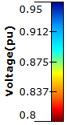
System Impact Analysis
Power Factor Control
Voltage Control
Notes:
Assumptions: for one contingency
Result: voltage does not fall as far, prevents over 20% of the DER from having to disconnect

Slide 5
System Impact Analysis
Notes:
For varying DER penetration levels, for both power factor and voltage controlled operation, run contingency analysis and compare the number of under voltage violations in the new cases with the original.
For the power factor control case, you can see that the addition of the DER model contributes to the number of violations and that the number of violations increases with increasing penetration. Why is this? Generally, voltage drops as you go down a distribution feeder, so if a disturbance causes the voltage at the original load bus to drop, further along the line there may be a low voltage violation. Additionally, if we are operating the DER at unity power factor, the DER does not provide any reactive power which is helpful for voltage support.
For the voltage control case, there are generally fewer violations, because the DER system is set to maintain a certain voltage, and will generate reactive power to support that, up to a limit dependent on the size of the DER. As the penetration increases, the reactive power capacity of the DERs increases, which contributes to the drop in violations with increasing penetration.

Slide 6
System Impact Analysis
Cascade Analysis
Cascade Studies
Repetitive load flow analysis of overloads and voltage violations under contingency
Assumptions
Control : power factor 1.0
Area Penetration: 100%
Undervoltage: 0.90 pu
DER Disconnect: 0.90 pu
Undervoltage Limit: 10 buses
CTG | # undervoltage buses | DER MW dropped
1 | 14 | 23.69
2 | 15 | 85.84
3 | 23 | 34.39
4 | 14 | 23.69
5 | 22 | 34.39
Notes:
It should be noted that most, if not all, new violations due to DER are in the distribution system.
Per protection protocols, DERs must disconnect from the system within a certain period of time if their voltage or frequency is outside of a certain range.
For cascade analysis, we submit the case to just one contingency at a time and check for violations.
If a DER is below the required the operating voltage level, it is disconnected from the network and that generation is lost. The power flow is run again, DER voltages checked and DERs disconnected, if necessary. This continues until either the case does not converge or a threshold of DERs or load tripped is reached. This cascade of DERs disconnecting that would certainly begin to affect the transmission level, even leading to a local or system-wide voltage collapse.
In a case for cascade analysis and for a particular region, 8 contingencies would lead to a local voltage collapse. Each case dropping anywhere from 24 to 86 MW of generation and three cases not being able to converge after disconnecting.

Slide 7
PV Dynamic Response - Voltage

Slide 8
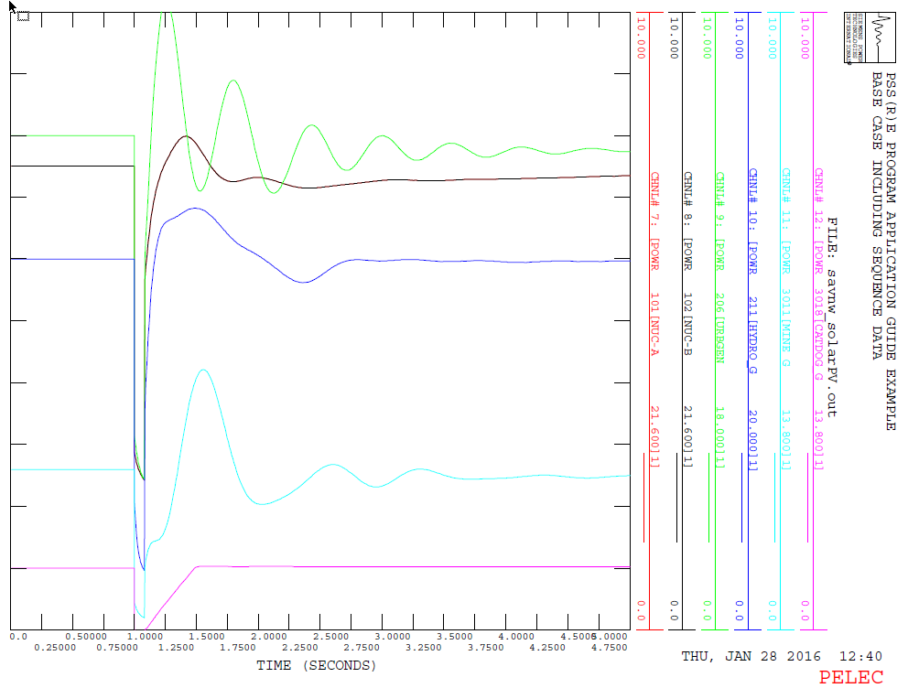
PV Dynamic Response – Power MW

Slide 9
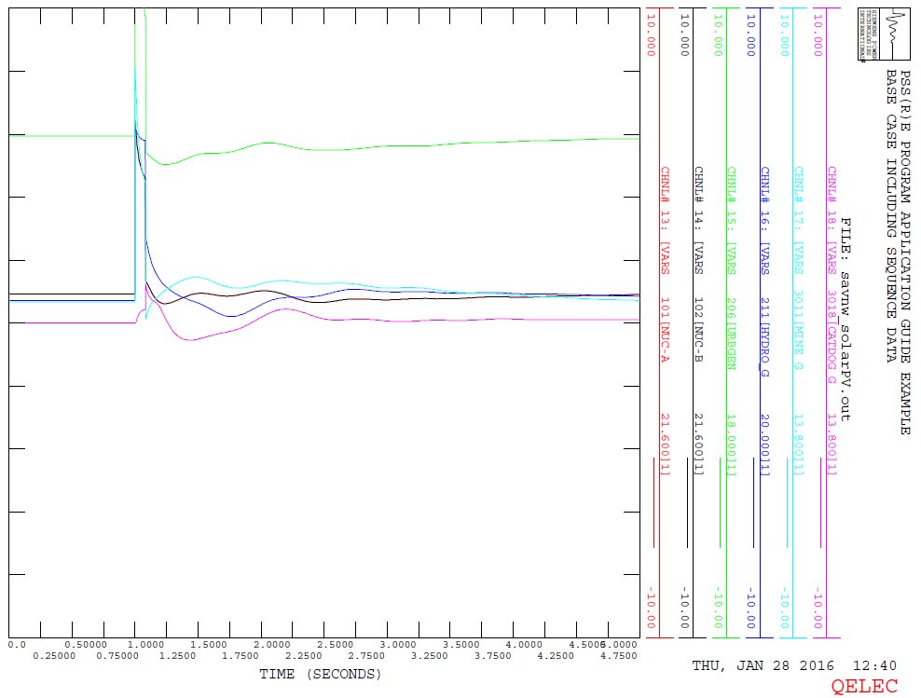
PV Dynamic Response – Reactive Power MVAR

Slide 10
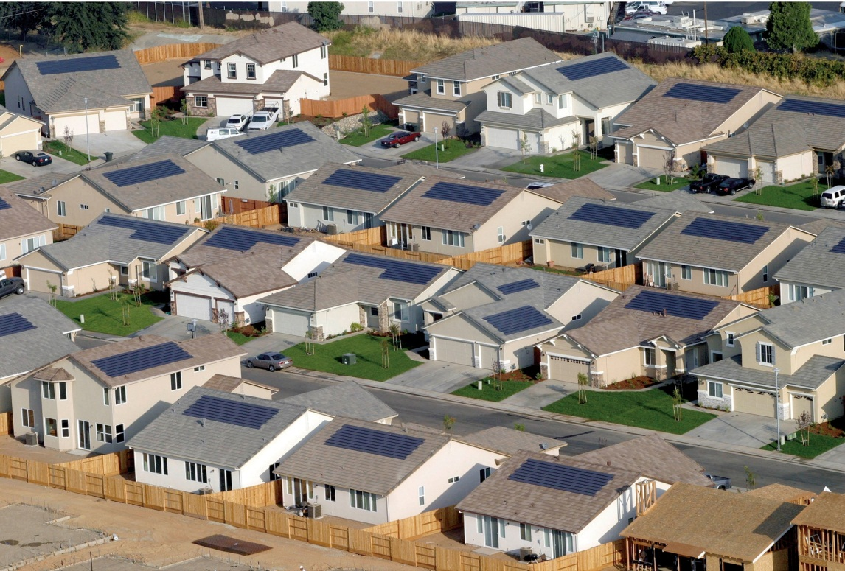
Questions?

