Slide 1
PDCWG Report to ROS
Chair: Percy Galliguez, Brazos Electric Power Cooperative, Inc.
Vice Chair: Stewart Rake, Luminant
ROS
February 4th, 2015

Slide 2
Report Overview & Notes
Report Overview
  Meeting Minutes
  BAL-001-TRE-1 FMEs & IMFR
  Frequency Control Report

Slide 3
Meeting Minutes
PDCWG Meeting 11/11/15
  GREDP Performance Analysis
  Regulation & Frequency Control Reports
  Reviewed 1 ERCOT Frequency Disturbance
    123015 @ 1117
  PDCWG 2016 Nominations for Chair and Vice Chair for ROS Approval
    Chair: Percy Galliguez, Brazos Electric Power Cooperative, Inc.
      pgalliguez@brazoeselectric.com
    Vice Chair: Stewart Rake, Luminant Power
      stewart.rake@luminant.com

Slide 4
Frequency Measurable Events Performance
January 2016

Slide 5
Frequency Measurable Events
There were 2 FMEs during the month of January.
  1/21/2016 23:14:45
    Loss of 823 MW
    19 of 46 Generation Resources had less than 75% of their expected Initial Primary Frequency Response.
    15 of 46 Generation Resources had less than 75% of their expected Sustained Primary Frequency Response.
  1/26/2016 23:25:07
    Loss of 1350 MW
    18 of 52 Generation Resources had less than 75% of their expected Initial Primary Frequency Response.
    18 of 52 Generation Resources had less than 75% of their expected Sustained Primary Frequency Response.

Slide 6
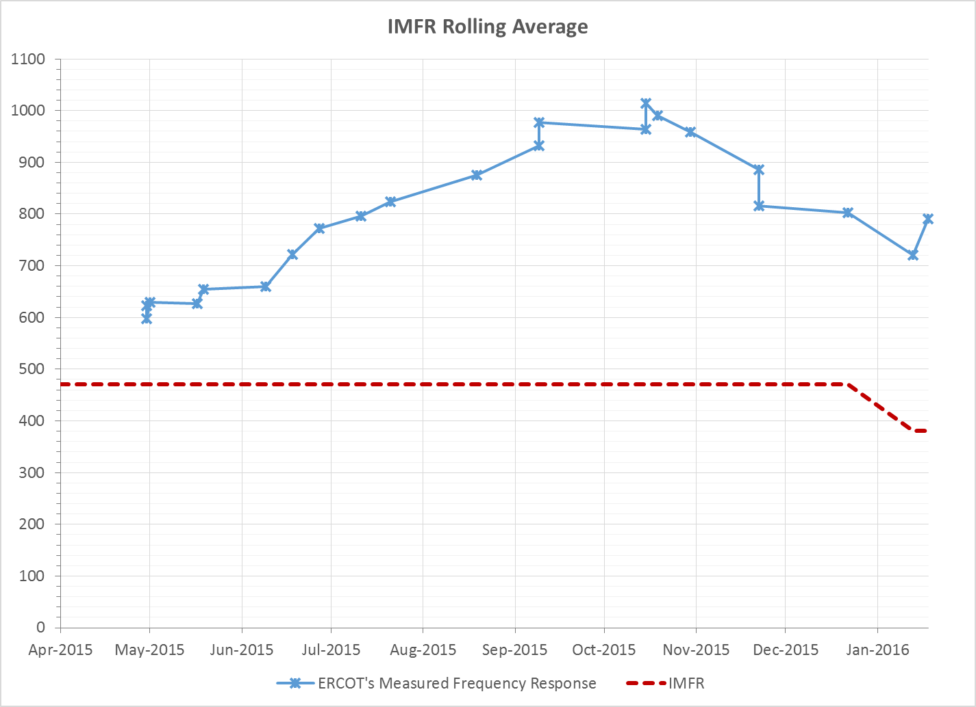
Interconnection Minimum Frequency Response (IMFR) Performance

Slide 7
Frequency Control Report
January 2016

Slide 8
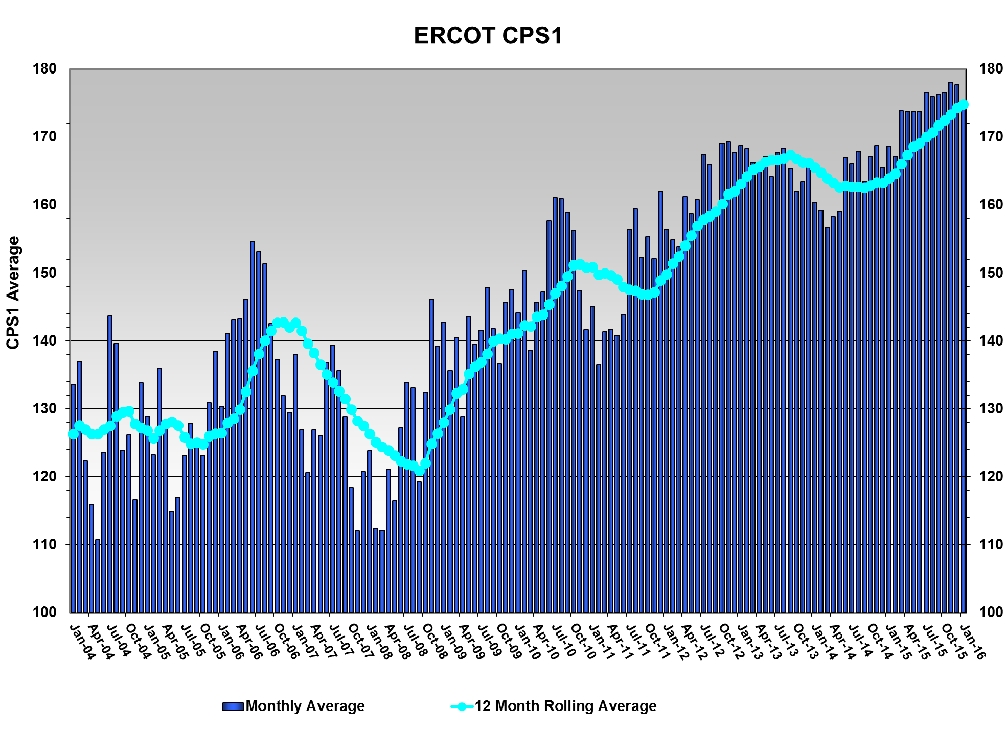
CPS1 Performance
CPS1 12 Month Rolling Average = 174.84%

Slide 9
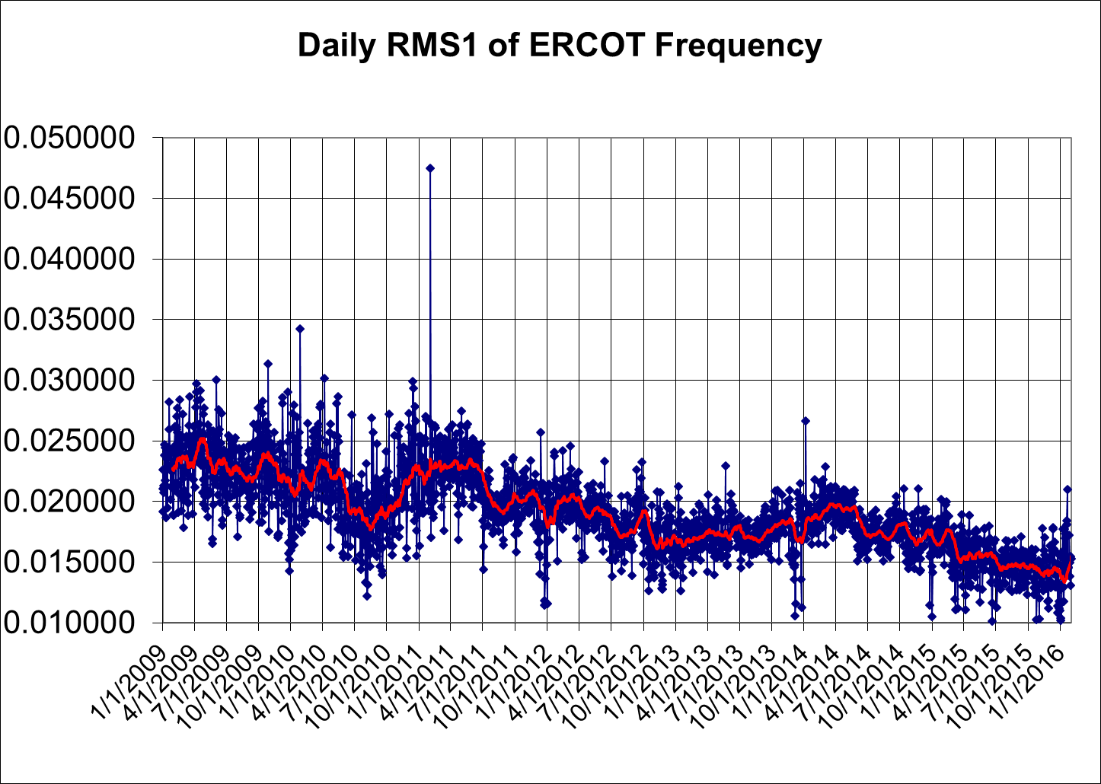
RMS1 Performance of ERCOT Frequency

Slide 10
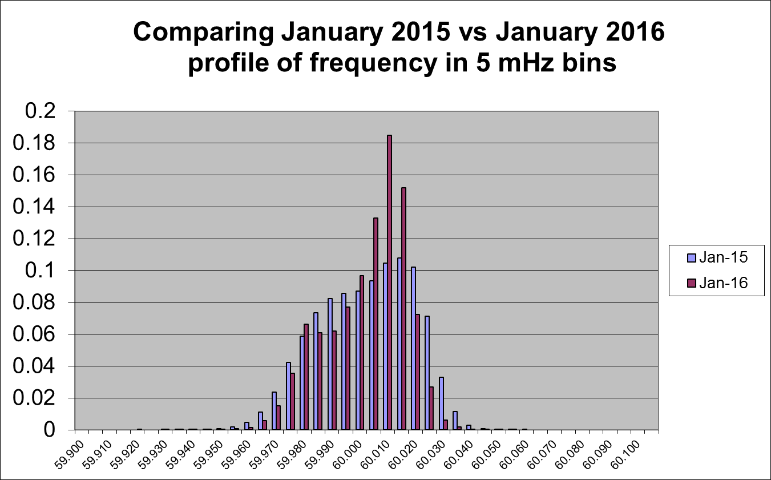
Frequency Profile Analysis

Slide 11
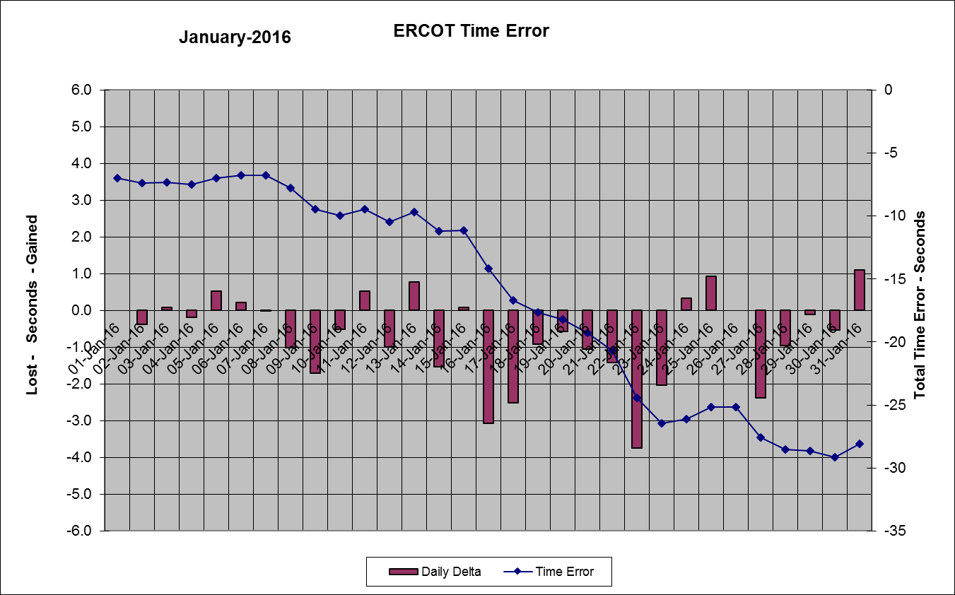
Time Error Corrections
There was one Time Error Corrections (TEC) in January. The previous TEC was on May 18th, 2015.

Slide 12
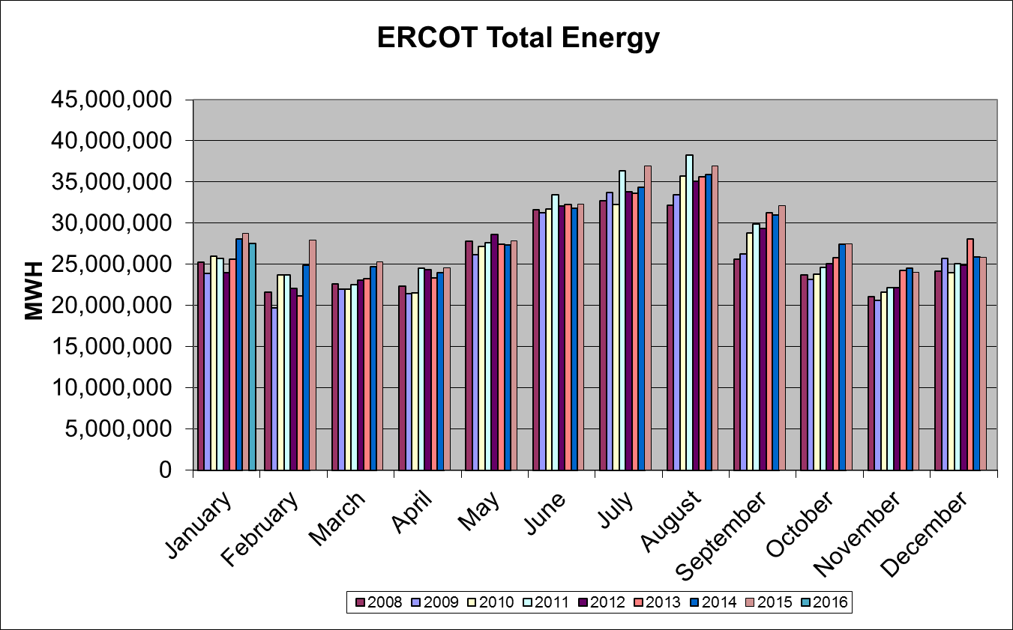
Wind Generation Performance

Slide 13
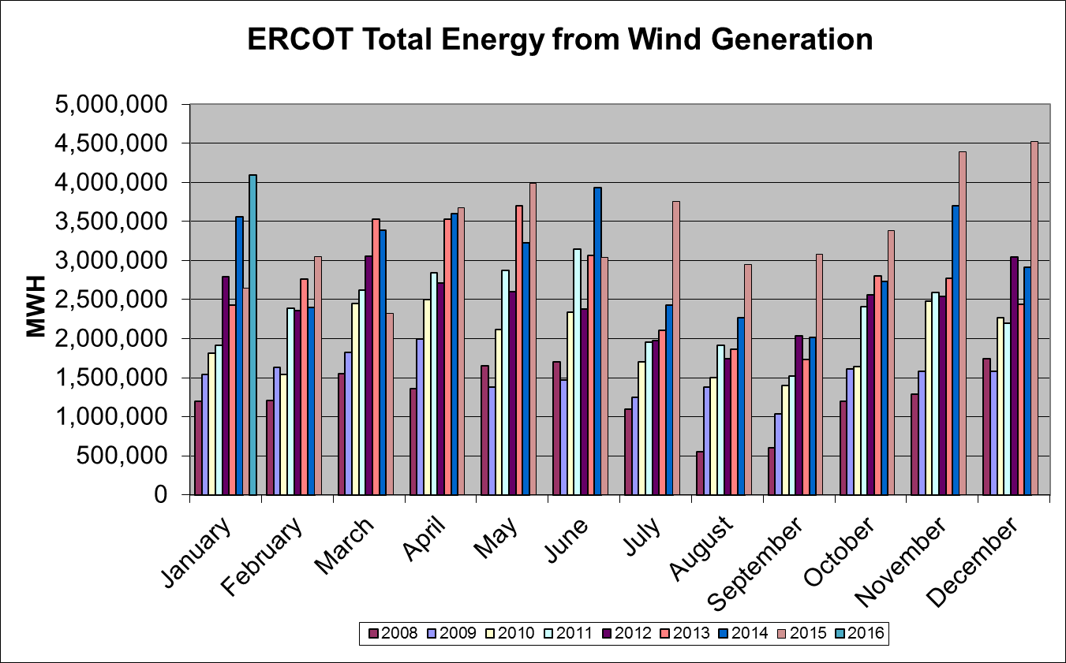
Wind Generation Performance

Slide 14
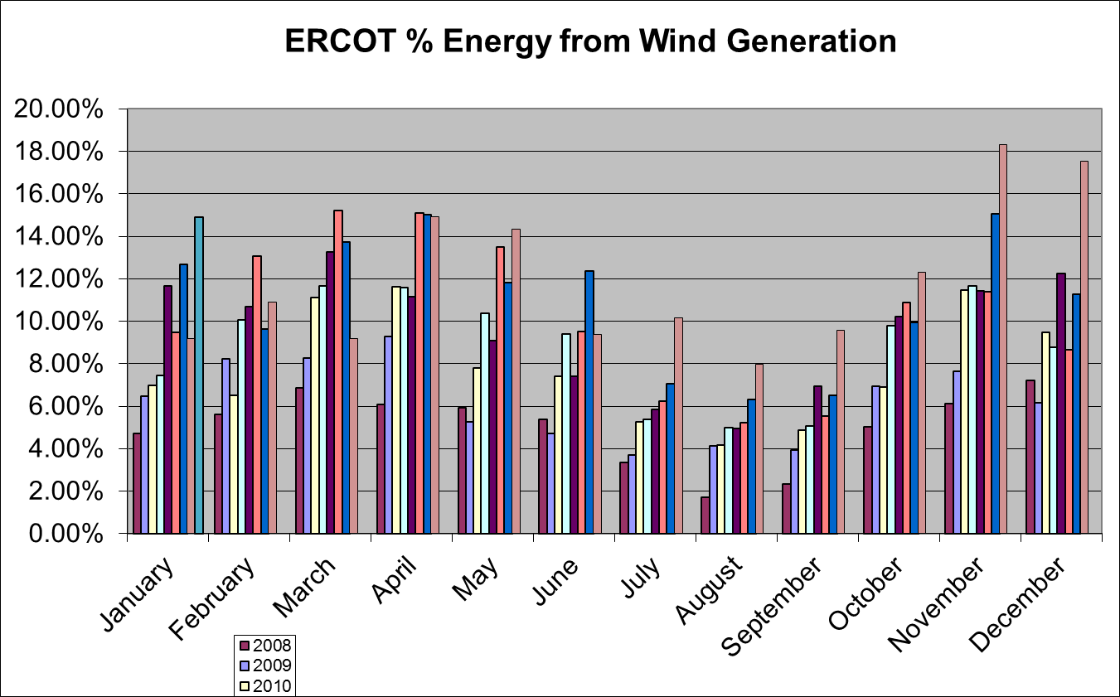
Wind Generation Performance

Slide 15
Questions?

