Slide 1

Subsynchronous Resonance Update
Jeff Billo, Senior Manager
ERCOT Transmission Planning
February 3, 2016
Wholesale Market Subcommittee

Slide 2
Three Workshops in 2015
#1 on March 13, 2015
Refined SSR definition
Proposed SSR assessment scope, methodology, and criteria
Proposed a study plan to revise SSR study criteria
#2 on May 29, 2015
Discussed stakeholders’ comments
Presented the SSR RFI status and progress of SSR studies to revise criteria
#3 on December 4, 2015
Presented the SSR study results
Identified generation plants for detailed time-domain analysis
Discussed the SSR process to be considered for Protocol and Guides revision requests

Slide 3
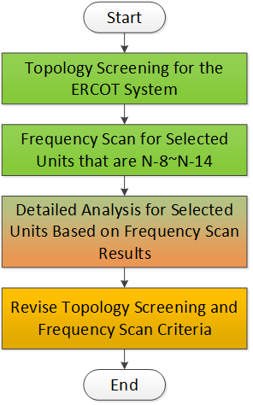
Assessment Plan to Revise Topology Screening and Frequency Scan Criteria
Identify existing generation plants that can be radial to the series capacitors within 14 circuit outages (Complete)
A double circuit line is counted as two transmission circuits
Request SSR data (mainly plants between N-8 and N-14) for frequency scan analysis (Complete)
RFI to 33 plants – 22 plants provided data
ERCOT perform frequency scan analysis for plants with data (Complete)
Identify generation plants to perform detailed analysis (Complete)
Review detailed analysis results and revise topology screening and frequency scan criteria (2Q, 2016)

Slide 4
Frequency Scan Summary
# | Type | minNx | SSR
1 | W | 1 | M
2* | W | 4 | M (P)
3 | SG | 4 | No
4 | SG | 5 | >=1
5 | SG | 5 | >=2
6 | W | 6 | 6
7 | W | 6 | No
8 | W | 6 | No
9 | SG | 7 | >=5
10 | SG | 7 | >=5
11 | W | 7 | 7
12 | SG | 7 | No
13 | W | 7 | No
14 | W | 7 | No
15 | SG | 8 | No
16 | SG | 9 | No
17 | W | 9 | No
18 | SG | 9 | >=7
19 | SG | 10 | >=5
20 | SG | 10 | >=5
# | Type | minNx | SSR
21 | SG | 10 | >=8
22 | W | 10 | M
23 | W | 10 | M
24 | SG | 10 | >=7
25 | SG | 10 | No
26 | SG | 10 | >=8
27 | SG | 10 | No
28 | W | 10 | No
29 | SG | 11 | >=4
30 | SG | 11 | >=4
31 | SG | 11 | >=10
32 | W | 11 | No
33 | SG | 12 | >=11
34 | W | 12 | No
35 | W | 13 | No
36 | SG | 14 | No
37 | SG | 15 | >=11
The existing generation plants that
are identified to be radially connected to the series capacitors within N-14 circuit outages.
provided sufficient SSR model data
Note
W: wind
SG: synchronous generator
minNx: # of circuit outages to be radially connected to series caps
SSR: potential SSR vulnerability in terms of N-x circuit outages
M: mitigation installed
P: protection installed
* Include multiple wind plants in Panhandle

Slide 5
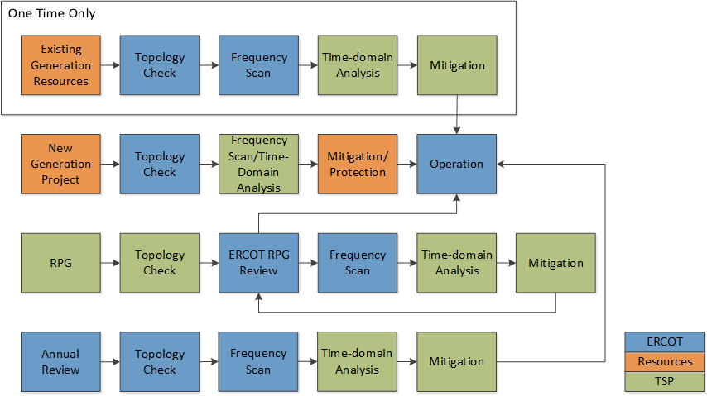
Study Approach, Process, and Responsibility
Resource is responsible for providing its Facility model and data.

Slide 6
Next Steps
TSPs will perform detailed analyses for selected generation plants. Expect to complete the study by Q2, 2016.
ERCOT, TSPs, and REs will review the detail study results and revise the study criteria if needed (by Q2, 2016).
Draft NPRR, NOGRR, PGRR (tentatively Q2, 2016).

