Slide 1
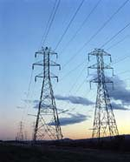

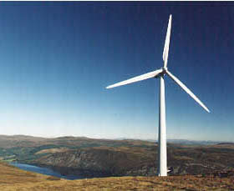
System Strength Assessment of the Panhandle System
Electranix Corporation
February 4, 2016

Slide 2
Presentation Overview
Introduction to Electranix
Background on Study
Study Objectives
Modeling Background
Key Results
Recommendations
Questions
2
Notes:
Simulation and study of complex systems involving power electronics, distributed generation and transmission. This includes the development of advanced simulation models such as FACTS, electric arc and induction furnaces, wind generation systems and others.
Custom models in PSSE, PSLF, or PSCAD, including highly detailed PSCAD models utilizing actual hardware code. These models have been prepared for many major wind turbine manufacturers.
Feasibility and system impact studies for new generation, as well as help with interconnection standard compliance.
SSR (Sub-synchronous resonance) analysis and shaft damage due to torsional oscillations, as well as SSTI, and SSCI analysis for power electronic interactions with each other and with series compensated transmission systems.
HVDC and AC transmission systems, transmission feasibility studies, reliability assessment, loss evaluation, cost analysis and preparation of technical specifications.
Insulation coordination of AC and HVDC systems, lightning studies, switching surge studies and ferro-resonance.
Power quality, D-STATCOM and DVAR applications, flicker control, harmonics, active filters, co-ordination of fast response controls.
Detailed modeling and simulation of digital and analog controls with interfaces to PSCAD/EMTDC, Matlab and real time controllers.
Voltage sourced converter transmission, upgrading of existing AC lines, transmission alternatives when new overhead transmission has a lengthy permitting process.
Variable speed drives, cyclo-converters, written pole motors.
Integration of wind farms and solar systems into AC systems. Reactive power requirements and voltage regulation studies using all types of machines and supporting equipment.
System impact and Interconnection Studies, as well as full capability in standard power system planning software.
Transmission line and cable modeling and studies. PLC (power line carrier) analysis.
Tri-pole DC research and application. Tri-pole DC is a very new technology used to upgrade existing 3-phase AC transmission line ratings without any increase in right-of-way requirements.

Slide 3
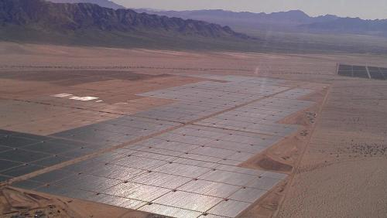
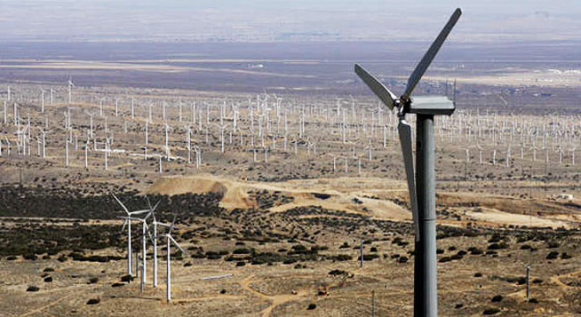
Introduction and Overview
ELECTRANIX Corporation is an independent specialist engineering company providing services in transmission and distribution studies and simulation, HVDC transmission, FACTS, modeling and simulation tools, training, and renewable energy generation.
3
Notes:
ELECTRANIX Corporation was established in 2000 as a Power Systems Consulting firm dedicated to providing high quality specialty engineering services and studies. It was formed by Dennis Woodford and Garth Irwin, who along with Dr. Ani Gole of the University of Manitoba were the principle developers of the world's most popular electromagnetic transient program, PSCAD/EMTDC. Electranix has become known for excellence in simulation and studies work, as well as for the broad scope of knowledge available as support for power systems engineers.
ELECTRANIX Corporation is an independent specialist engineering company providing services in transmission and distribution studies and simulation, HVDC transmission, FACTS and Custom Power, and transmission for renewable energy generation.
Our specialty is assisting utilities, generation owners and transmission providers with the detailed studies required to complete their projects. Our expertise in transmission and distribution, power electronics, HVDC and other fields is complemented by our software capabilities - particularly PSCAD/EMTDC, E-TRAN, and popular Loadflow/Transient Stability packages. Our involvement with the wind industry, in conjunction with our understanding of conventional power systems have enabled us to assist in renewable energy projects around the world. Our special knowledge of PSCAD/EMTDC has enabled us to provide support for more challenging technical projects, such as the GPFC HVDC interconnection in Lamar Colorado. With the help of our extensive network of associates and partners, we can provide you with the services you require to get your studies completed in a competent and timely fashion.

Slide 4



Who Are We?
Leadership and Consulting Team
Dennis Woodford – President, Owner
Garth Irwin – VP, Owner
Andrew Isaacs – VP, Study Engineer
Studies Team
Anuradha Dissanayaka M.Sc. – Study Engineer
Francisco Gomez Ph.D. – Study Engineer
Chaminda Amarasinghe Ph.D. – Modeling Specialist Engineer
Xiuyu Chen Ph.D. – HVDC Specialist Engineer
Amit Jindal Ph.D. – Study Engineer
Jake Wiebe – Study Engineer
Jeremy Sneath M.Sc. – Study Engineer
Software Team
Joel Dyck – Computer Scientist
Nathan Kroeker – Computer Scientist
4
Notes:
Dennis joined the English Electric Company in 1966 and worked on variable speed drives and HVDC transmission until 1970. He completed a Master's degree in Electrical Engineering at the University of Manitoba and joined Manitoba Hydro in 1972. There he worked in transmission planning of AC and DC EHV transmission and wrote the EMTDC algorithm. In 1986 he was appointed Executive Director of the fledgling Manitoba HVDC Research Centre. He has worked on many projects and conducted business all over the world, and serves as an Adjunct Professor at the University of Manitoba. Recently Dennis was awarded the prestigious Uno Lamm Award by the IEEE in recognition of his services and contributions to the field of Power Systems Engineering.
Garth joined the Manitoba HVDC Research Centre after graduating from the University of Manitoba in 1987. At the Centre, he undertook studies and projects including insulation coordination of HVDC transmission substations, subsynchronous resonance, and digital controls development. As leader of the PSCAD/EMTDC development team, he was responsible for the improvements to the EMTDC solution algorithm and the precision modeling of transmission lines and cables.
Andrew has been working at Electranix since 2003. He has performed system impact and planning studies for transmission utilities, ISOs, and private generation companies across Canada and internationally. Additional project involvement includes PSCAD studies, software training, HVDC large system segmentation, specialized transient stability analysis, device specification and probabilistic reliability analysis. Andrew is past-chair of the Winnipeg Chapter of the IEEE Power & Energy Society, and holds an M.Sc. (EE) from the University of Manitoba in the field of transmission expansion planning.
Chaminda received his BSc.(Eng) degree from the University of Moratuwa, Sri Lanka in 2000 and his PhD in the field of electricity markets from the University of Manitoba, Canada in 2008. Since joining Electranix in 2007, he is involved with various types of power system planning and system impact studies for utilities and developers both in Canada and internationally. Additional project involvement includes PSSE custom model developments, PSCAD studies and segmentation studies. He is a member of the IEEE.

Slide 5
What do we do?
PSCAD Simulation and Studies
Custom Modeling in PSCAD, PSSE, PSLF
Specialty PSCAD device models with real code interfaces
Interconnection studies (Powerflow, Stability, etc)
Power Electronic Device Interaction Studies
Path/Transfer Capability and Operating Studies
Sub-synchronous Interaction Analysis
Analysis and Preparation of HVDC technical specifications
SVC, STATCOM, Series capacitor technical specifications
TOV, TRV, Lightning/Steep front, Insulation coordination
Ferro-resonance Analysis
E-TRAN Translation tool for large PSCAD models
E-TRAN Plus Hybrid and Parallel simulation tools
Custom Training
Technical/Consulting support
5
Notes:
Simulation and study of complex systems involving power electronics, distributed generation and transmission. This includes the development of advanced simulation models such as FACTS, electric arc and induction furnaces, wind generation systems and others.
Custom models in PSSE, PSLF, or PSCAD, including highly detailed PSCAD models utilizing actual hardware code. These models have been prepared for many major wind turbine manufacturers.
Feasibility and system impact studies for new generation, as well as help with interconnection standard compliance.
SSR (Sub-synchronous resonance) analysis and shaft damage due to torsional oscillations, as well as SSTI, and SSCI analysis for power electronic interactions with each other and with series compensated transmission systems.
HVDC and AC transmission systems, transmission feasibility studies, reliability assessment, loss evaluation, cost analysis and preparation of technical specifications.
Insulation coordination of AC and HVDC systems, lightning studies, switching surge studies and ferro-resonance.
Power quality, D-STATCOM and DVAR applications, flicker control, harmonics, active filters, co-ordination of fast response controls.
Detailed modeling and simulation of digital and analog controls with interfaces to PSCAD/EMTDC, Matlab and real time controllers.
Voltage sourced converter transmission, upgrading of existing AC lines, transmission alternatives when new overhead transmission has a lengthy permitting process.
Variable speed drives, cyclo-converters, written pole motors.
Integration of wind farms and solar systems into AC systems. Reactive power requirements and voltage regulation studies using all types of machines and supporting equipment.
System impact and Interconnection Studies, as well as full capability in standard power system planning software.
Transmission line and cable modeling and studies. PLC (power line carrier) analysis.
Tri-pole DC research and application. Tri-pole DC is a very new technology used to upgrade existing 3-phase AC transmission line ratings without any increase in right-of-way requirements.

Slide 6
Proudly independent! Who are our Customers?
Manufacturers
Transmission Companies and ISOs
Research Bodies
Generation Companies
Consultants
6

Slide 7
What makes us unique?
Best knowledge of PSCAD modeling in the world
(Dennis headed HVDC Research Center, Garth headed PSCAD devel. For 15 years)
Trusted by Manufacturers
NDA agreements in place with many or most, longstanding working relationships, in many cases we developed their PSCAD models, we provide advanced PSCAD training for largest manufacturers
Unique software and modelling capabilities
E-TRAN Plus for PSCAD and PSSE is recently for sale, but hasn’t been widely adopted by consultants yet. We are leading the world in large system EMT modeling.
Culture of innovation, teamwork, and knowledge transfer
We are small and agile, excited about solving unique problems, and we want to help others expand and develop their capabilities
State-of-the-Art Skills and Information
We are heavily invested in research and are active participants in Cigre and IEEE
7

Slide 8
Panhandle Study Background A Collaborative Effort!
ERCOT System Planning completed the Panhandle Study Report in April 2014, identifying several key recommendations for the Panhandle wind development, including:
WSCR metric for evaluating system strength
Preliminary transmission system build-out to support wind at varying future levels
Due to the unprecedented nature of the interconnections, and the limitations of existing analysis tools, ERCOT issued an RFP for study in January 2015 to help confirm their study results and provide confidence and information moving forward.
Starting in Spring of 2015, Electranix began work on a ground-breaking new type of study, working in close collaboration with ERCOT
8

Slide 9
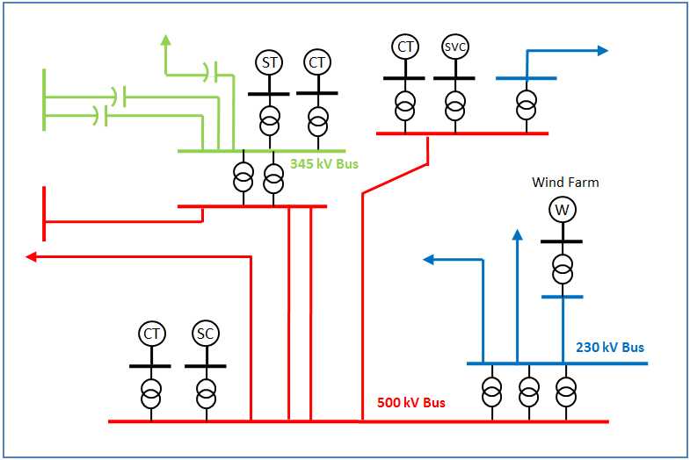
What is a strong system?
9

Slide 10
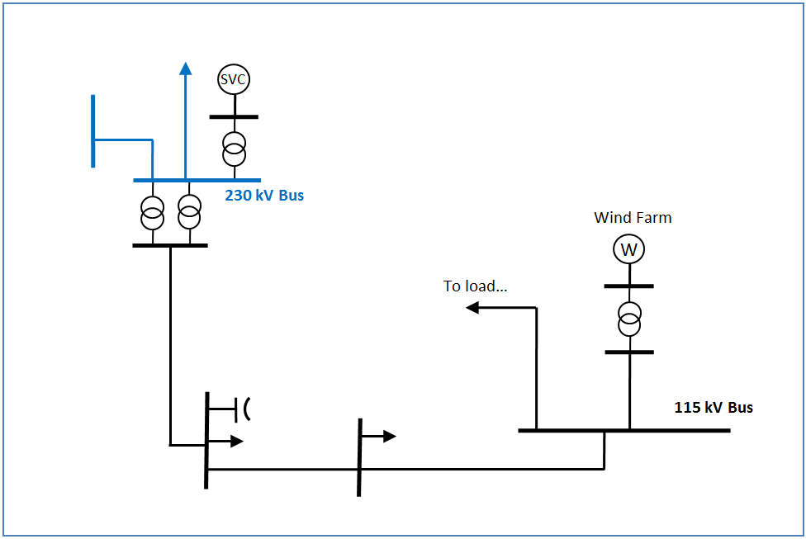
What is a weak system?
10

Slide 11


What is a weak system in a place like Texas?
11

Slide 12
Is the network weak or strong?
Imagine putting a fault on the system, and measuring the current in the fault… strong systems will have lots of current!
We calculate an MVA number based on this current, called “Short Circuit MVA”, or SCMVA
STRONG SYSTEM = Big SCMVA
Weak System = Little SCMVA
12

Slide 13
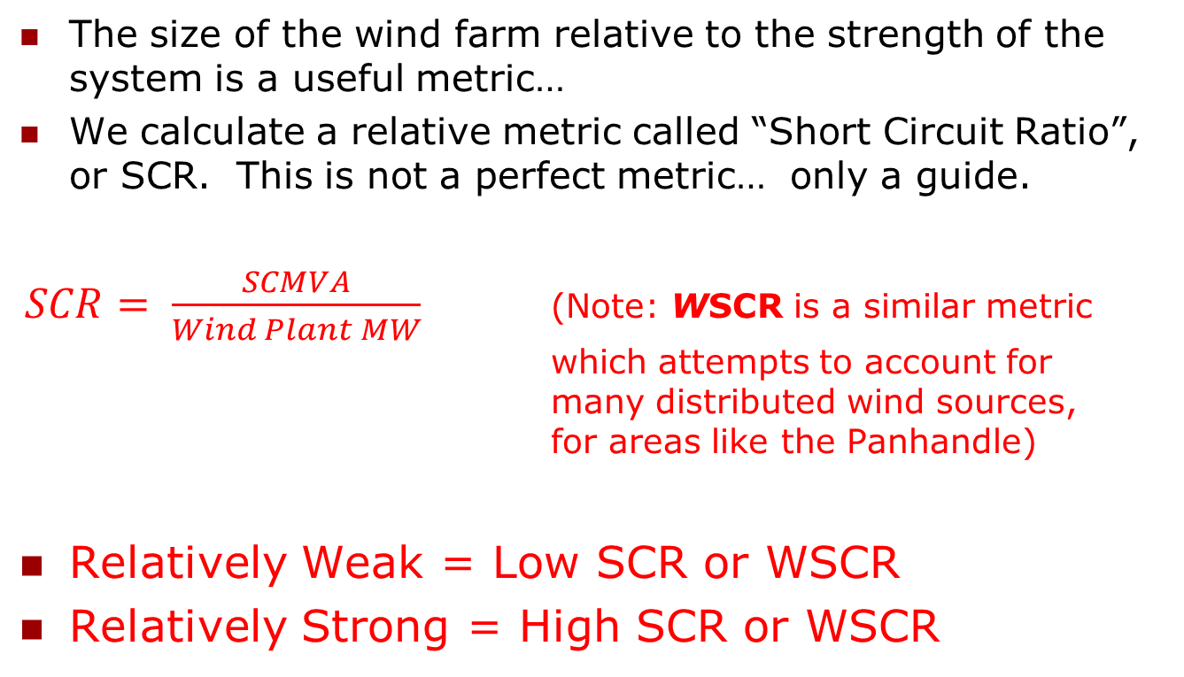
Is the network relatively weak or strong?
The size of the wind farm relative to the strength of the system is a useful metric…
We calculate a relative metric called “Short Circuit Ratio”, or SCR. This is not a perfect metric… only a guide.
$SCR= \frac{SCMVA}{Wind Plant MW}$ (Note: WSCR is a similar metric which attempts to account for many distributed wind sources, for areas like the Panhandle)
Relatively Weak = Low SCR or WSCR
Relatively Strong = High SCR or WSCR
13

Slide 14
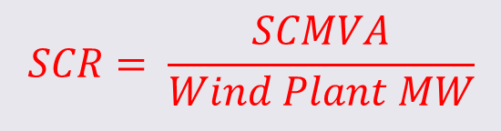
Why is low SCR a problem?
If the wind plant is relatively large with respect to the system strength (low SCR):
Wind plant has a large capacity to affect, or move the system
Fast power electronics require a steady voltage and frequency to operate in a stable way
Conventional power systems study tools may not be sufficiently detailed to represent controls in weak systems
14

Slide 15
Panhandle Study Objectives
Perform an detailed EMTP type analysis for the Panhandle region to validate the WSCR-based planning and operating thresholds proposed by ERCOT, and propose adjustments if necessary.
Provide recommendations and information relating to simulation tool adequacy.
Using very detailed models, validate the effectiveness of ERCOT proposed transmission buildout for near-term wind expansion up to 4300 MW.
Provide recommendations on area-wide voltage regulation strategies.
Transfer study tools and knowledge to ERCOT engineers.
15

Slide 16
Modeling Background: Development of the world’s largest working PSCAD model.
Pure PSS/E Model (Used for Prior ERCOT analysis)
Advantages:
Widely understood and embedded in industry understanding
Runs quickly, allowing many cases to be automated and run
Represents wide-area dynamics
Disadvantages:
Unable to represent detailed control and protection behaviour in weak systems
Approximates control functionality, giving rise to some uncertainty in model behaviour
Unable to represent unbalanced conditions, or any phenomena other than 60 Hz phenomena.
16

Slide 17
Modeling Background: Development of the world’s largest working PSCAD model.
Pure PSCAD Model
Advantages:
Very accurate within study region
Correctly represents control and protection of power electronics (assuming accurate models are used)
Correctly represents unbalanced conditions (eg. SLG faults)
Accounts for phenomena at sub-synchronous and super-synchronous frequencies
Disadvantages:
Computationally intensive, requiring care in selecting study area and study cases. This may be mitigated to some extent using parallelization software (E-Tran Plus for PSCAD).
Requires advanced training for correct end-use
Requires very detailed models which require specialists to produce, and may contain proprietary data
Requires approximations at the edge of study area (difficult to represent very large systems)
17

Slide 18
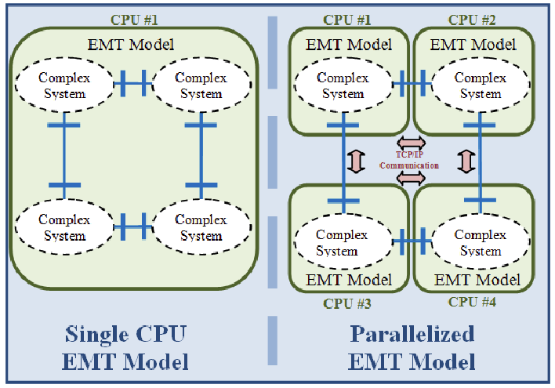
Modeling Background: Development of the world’s largest working PSCAD model.
18

Slide 19
Modeling Background: Development of the world’s largest working PSCAD model.
Hybrid PSCAD/PSSE Model
Advantages:
Most accurate model, removing approximations at the edge of the study area, and allowing very large system models to be used and wide-area dynamics to be represented.
All the advantages of the pure PSCAD model.
Disadvantages:
Requires special software and additional training for engineers.
Requires detailed models.
Computationally intensive.
19

Slide 20
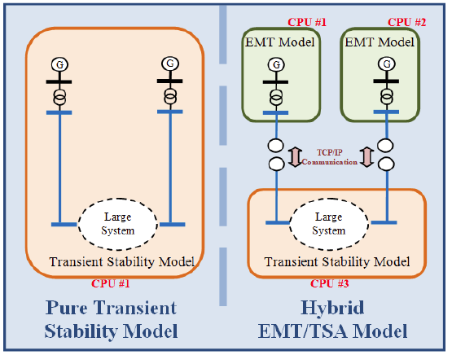
Modeling Background: Development of the world’s largest working PSCAD model.
20

Slide 21
ERCOT Panhandle Region Overview: Development of the world’s largest working PSCAD model.
20 wind generation projects with total of 4300 MW capacity will be interconnected to the 345 kV transmission grid in Panhandle.
Models in the PSCAD include:
13 wind projects with developer provided PSCAD models
7 projects that no PSCAD provided were modeled based on similar technology and size of a wind project with proper adjustment.
DVAR models if provided
Transmission grid in Panhandle
SVCs in Panhandle
Synchronous Condensers in Panhandle
21

Slide 22
Modeling Background: ERCOT Panhandle Wind Farms
Wind Farm/DVAR
Code | Panhandle Wind | Name | Size (MW/MVAR) | Dispatch (3700 MW) (MW/MVAR) | Location
WK | 1 | Wake | 299.3 | 257.3 | Cottonwood
SP | 2 | South Plains 1 | 200 | 172 | White River
 | 3 | South Plains 2 | 150 | 130.5
 | 4 | South Plains 3 | 150 | 127.7
CP | 5 | CottonPlains1 | 50.4 | 43.3 | White River
 | 6 | Old Settler | 151.2 | 130
BR | 7 | Briscoe | 149.9 | 128.9 | Tule Canyon
LH | 8 | Longhorn | 360 | 309.6 | Tule Canyon
SW | 9 | Swisher | 299.5 | 257.5 | Ogallala
HF | 10 | Hereford | 99.9 | 85.9 | Windmill
 | 10 | Hereford | 100 | 86
 | 11 | JumboRd | 299.7 | 257.8
SS | 12 | SpinningSpur2 | 161 | 138.4 | AJ Swope
 | 13 | SpinningSpur3 | 194 | 166.8
CW | 14 | Conway1 | 211.22 | 181.7 | Alibates
 | 15 | Conway2 | 390.22 | 335.6
R6 | 16 | Route66 | 150 | 129 | Alibates
PH1 | 17 | Panhandle1 | 218.3 | 187.8 | Railhead
PH2 | 18 | Panhandle2 | 181.7 | 156.2
MM | 19 | Miami1a | 288.6 | 248.2 | Gray
SF | 20 | Salt Fork | 200 | 172 | Gray
BS |  | Blue Summit | 135.4 ^{Note1} | 108.3 ^{Note1} | Jimtree
Total |  |  | 4304.8 | 3702.2
22

Slide 23
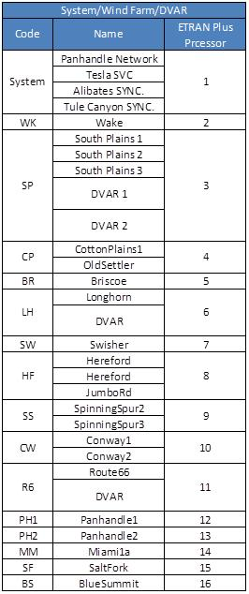
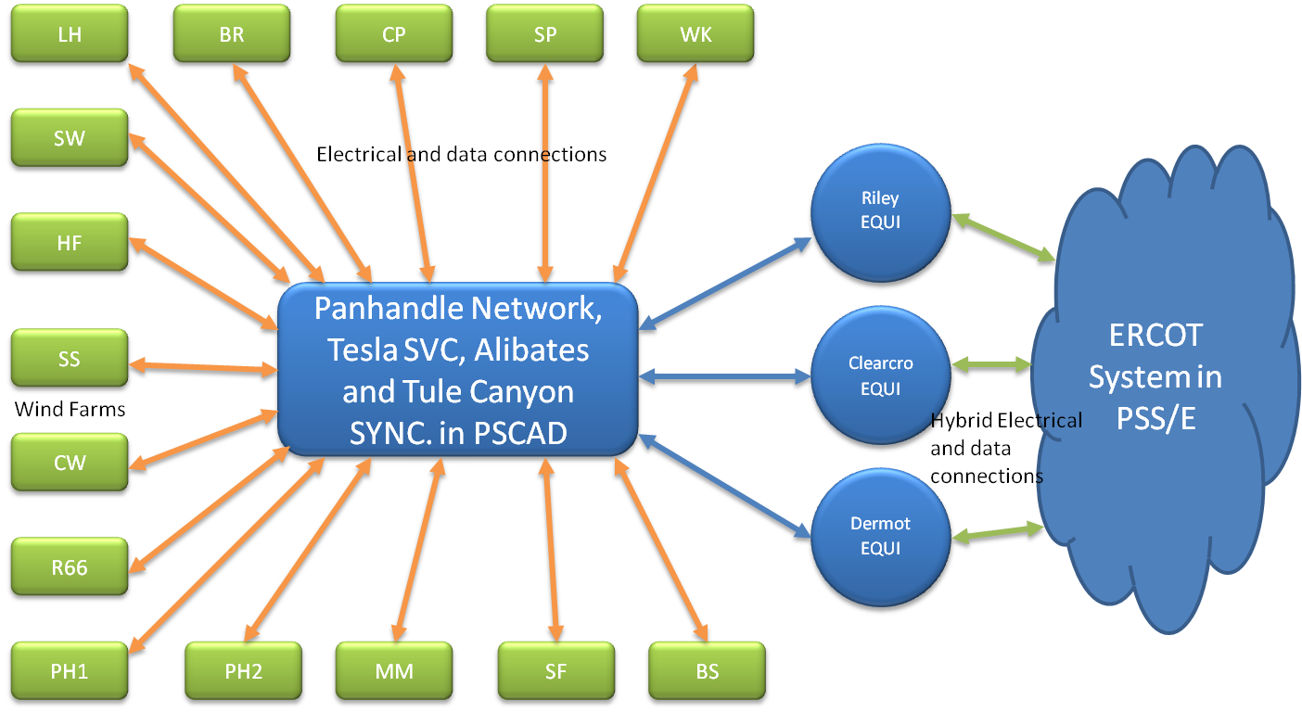
Modeling Background: ERCOT Hybrid PSCAD/PSSE model.
23

Slide 24
Key Results: Dynamic Performance
Case | Panhandle Wind Capacity (MW) | Panhandle Wind Dispatch (MW) | Upgrades (Second Circuit + 150 MVA x2 Sync.Cond.) | Upgrades (Second Circuit + 150 MVA x2 STATCOM) | Upgrades (Second Circuit + 150 MVA x2 SVC) | Plant Voltage Controls | WSCR | Results | Total Wind Tripped (MW)
1 | 4300 | 3700 | No | No | No | No* | 1.2 | Fail | ≈3150
2 | 4300 | 3700 | No | No | No | Yes** | 1.2 | Wind Trips | ≈250
3 | 4300 | 3700 | Yes | No | No | No | 1.5 | Good | 0
4 | 4300 | 3700 | No | Yes | No | No | 1.3 | Wind Trips | ≈375
5 | 4300 | 3700 | No | No | Yes | No | 1.3 | Wind Trips | ≈150
6 | 4300 | 3900 | Yes | No | No | No | 1.4 | Marginal | 0
(*) default Plant Control Voltage setting based on the submitted models
(**) Plant voltage controller tuned to respond with reactive power in approximately 3 seconds
WSCR = 1.5 prior to fault performs well!
24

Slide 25
Contingencies
Dynamic Analysis (PSS/E)
~200 contingencies were tested in and close to Panhandle region
3-phase fault, single-line-to-ground (SLG) fault
Normal clearing and delayed clearing (breaker failure)
PSCAD
18 contingencies identified in the dynamic analysis were tested in and close to Panhandle region
3-phase fault, single-line-to-ground (SLG) fault
Normal clearing and delayed clearing (breaker failure)
25

Slide 26
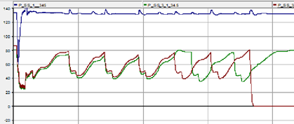
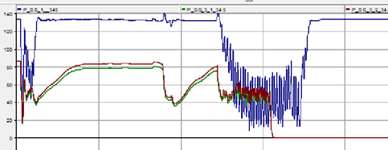
Key Results: Dynamic Performance
Case | Panhandle Wind Capacity (MW) | Panhandle Wind Dispatch (MW) | Upgrades (Second Circuit + 150 MVA x2 Sync.Cond.) | Upgrades (Second Circuit + 150 MVA x2 STATCOM) | Upgrades (Second Circuit + 150 MVA x2 SVC) | Plant Voltage Controls | WSCR | Results | Total Wind Tripped (MW)
1 | 4300 | 3700 | No | No | No | No* | 1.2 | Fail | ≈3150
2 | 4300 | 3700 | No | No | No | Yes** | 1.2 | Wind Trips | ≈250
3 | 4300 | 3700 | Yes | No | No | No | 1.5 | Good | 0
4 | 4300 | 3700 | No | Yes | No | No | 1.3 | Wind Trips | ≈375
5 | 4300 | 3700 | No | No | Yes | No | 1.3 | Wind Trips | ≈150
6 | 4300 | 3900 | Yes | No | No | No | 1.4 | Marginal | 0
26

Slide 27
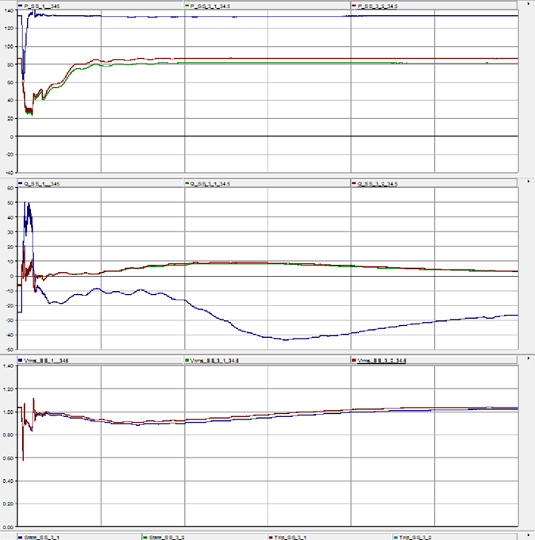
Case | Panhandle Wind Capacity (MW) | Panhandle Wind Dispatch (MW) | Upgrades (Second Circuit + 150 MVA x2 Sync.Cond.) | Upgrades (Second Circuit + 150 MVA x2 STATCOM) | Upgrades (Second Circuit + 150 MVA x2 SVC) | Plant Voltage Controls | WSCR | Results | Total Wind Tripped (MW)
1 | 4300 | 3700 | No | No | No | No* | 1.2 | Fail | ≈3150
2 | 4300 | 3700 | No | No | No | Yes** | 1.2 | Wind Trips | ≈250
3 | 4300 | 3700 | Yes | No | No | No | 1.5 | Good | 0
4 | 4300 | 3700 | No | Yes | No | No | 1.3 | Wind Trips | ≈375
5 | 4300 | 3700 | No | No | Yes | No | 1.3 | Wind Trips | ≈150
6 | 4300 | 3900 | Yes | No | No | No | 1.4 | Marginal | 0
27

Slide 28
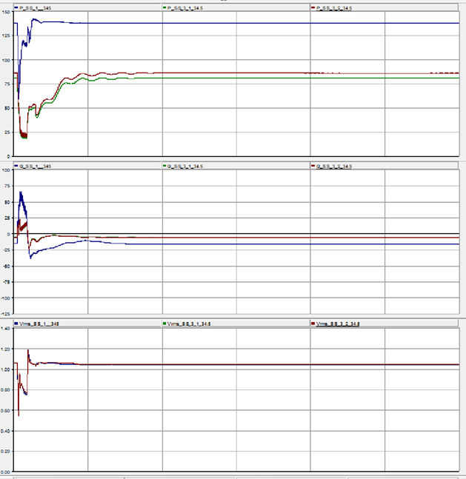
Case | Panhandle Wind Capacity (MW) | Panhandle Wind Dispatch (MW) | Upgrades (Second Circuit + 150 MVA x2 Sync.Cond.) | Upgrades (Second Circuit + 150 MVA x2 STATCOM) | Upgrades (Second Circuit + 150 MVA x2 SVC) | Plant Voltage Controls | WSCR | Results | Total Wind Tripped (MW)
1 | 4300 | 3700 | No | No | No | No* | 1.2 | Fail | ≈3150
2 | 4300 | 3700 | No | No | No | Yes** | 1.2 | Wind Trips | ≈250
3 | 4300 | 3700 | Yes | No | No | No | 1.5 | Good | 0
4 | 4300 | 3700 | No | Yes | No | No | 1.3 | Wind Trips | ≈375
5 | 4300 | 3700 | No | No | Yes | No | 1.3 | Wind Trips | ≈150
6 | 4300 | 3900 | Yes | No | No | No | 1.4 | Marginal | 0
28

Slide 29
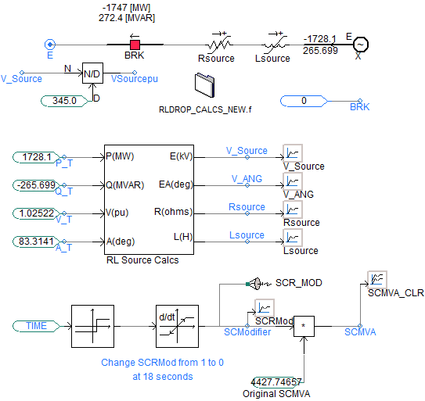
Key Results: Parametric SCR Reduction
Concept: Leave the Panhandle alone, and weaken the ERCOT source linearly
29

Slide 30
Key Results: Parametric SCR Reduction
WSCR | Small Signal Stable | Large Signal Stable
1.5 | Yes | Yes
1.4 | Yes | Yes
1.35 | Yes | Yes
1.25 | Yes | No
1.1 | Yes | No
1 | Yes | No
0.9 | No | No
Replace Sync. Condenser with STATCOM
1.3* | Not done | No
Replace Sync. Condenser with SVC
1.3* | Not done | No
* For these cases, the system is the same as the upgraded system, but the effective WSCR is reduced due to the absence of Synchronous Condensers
WSCR=1.4 after fault performs well!
30

Slide 31
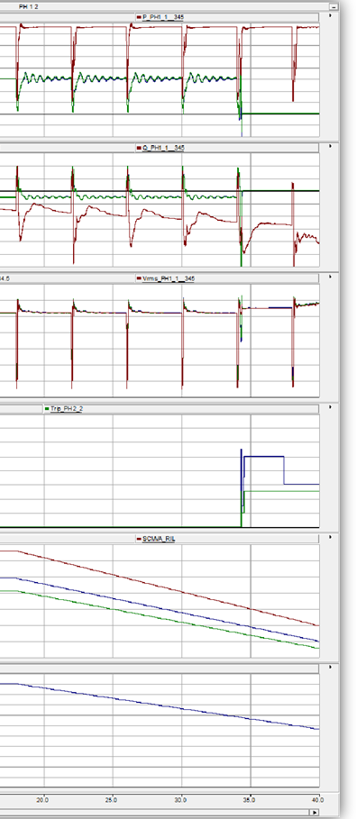
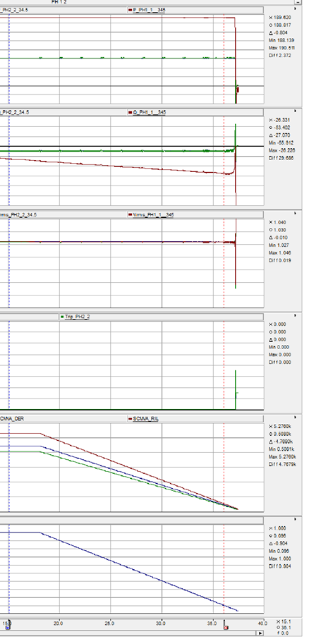
Large Signal Ramp Test:
Small Signal Ramp Test:
31

Slide 32
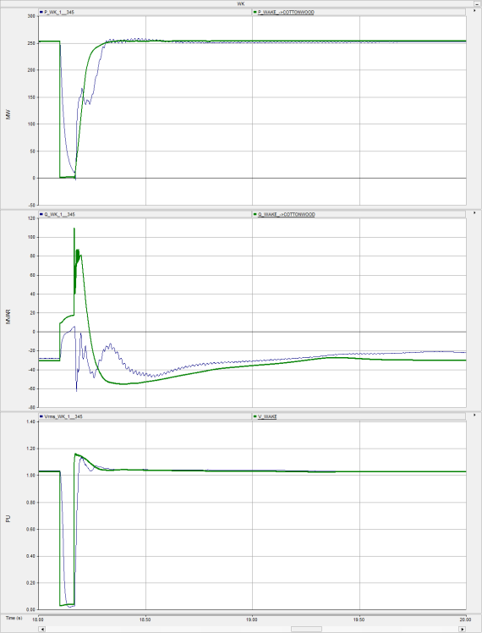
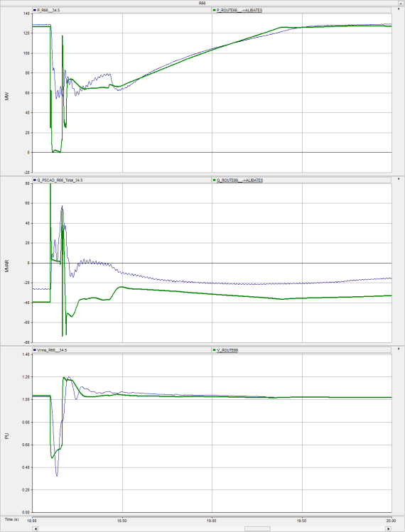
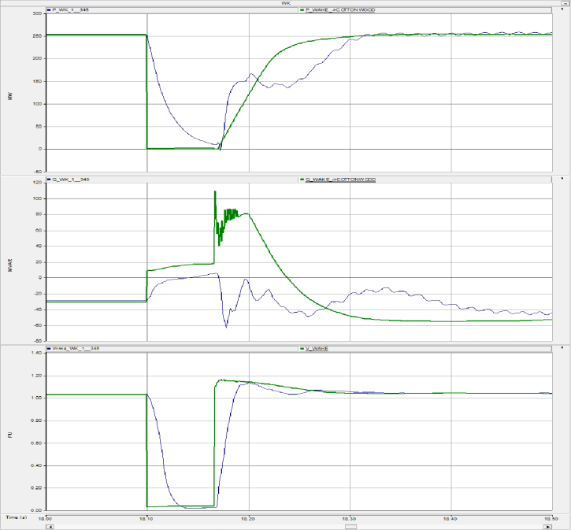
Key Results: Simulation Tool Comparison for faults inside Panhandle
General recovery dynamics track quite well
Active power recovery is perfectly smooth in PSSE
Oscillatory reactive power response in PSCAD as inverters struggle to control Voltage
Fast reactive power response quickly drives voltage high in PSSE
Instantaneous rms voltage measurements in PSSE
32

Slide 33
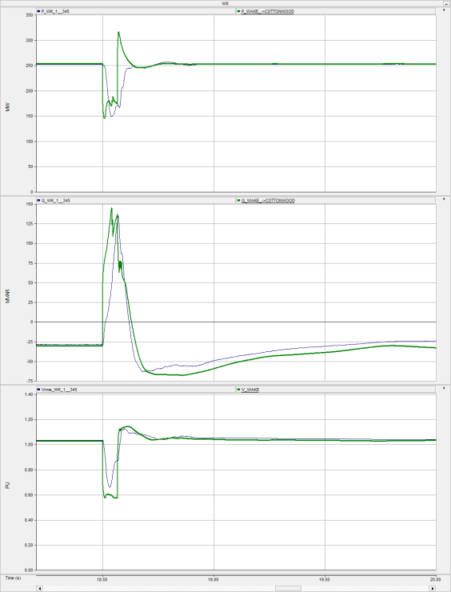
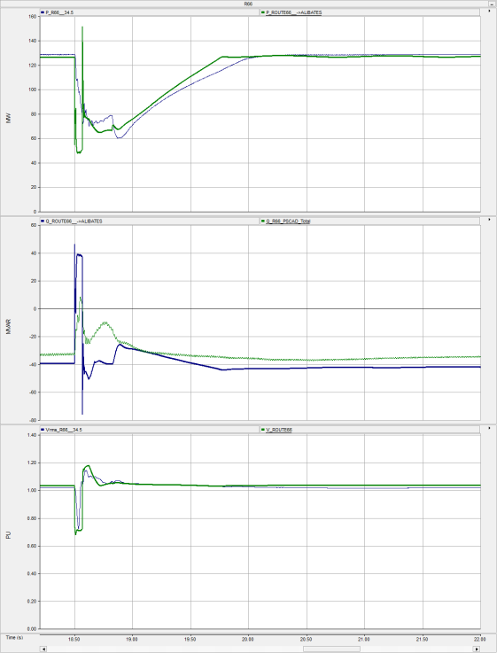
Key Results: Simulation Tool Comparison for faults outside Panhandle
33

Slide 34
Recommendations¹ WSCR
WSCR = 1.5 is a suitable planning level for the Panhandle region for the proposed topology
Dynamic performance tests and SCR ramp tests both indicate that WSCR of 1.5 provides robust performance.
Includes some margin for model error and assumptions, and planning uncertainty
Additional restrictions may be imposed on wind capacity, not only wind dispatch.
Care should be taken when applying this level in other regions… further analysis may be required.
Specific issues identified at lower WSCR values could potentially be mitigated through detailed design review and study iterations with manufacturer involvement.
Note 1: Please refer to full report for details on each recommendation!
34

Slide 35
Recommendations¹ Simulation Tool Adequacy
For the Panhandle as studied, with WSCR > 1.5, PSSE studies are good, but may be occasionally validated using PSCAD. For WSCR < 1.5, PSCAD analysis should be done.
Studies well outside the Panhandle region do not need to model the Panhandle in PSCAD, unless specific dynamic behaviour is evident.
Hybrid simulation is more accurate, and may tend to provide more stable results.
If PSS/E is used for planning studies, key limitations should be considered (protection may not be accurate, unbalance conditions are not correctly represented, and response may differ in post-fault period) Further details on these limitations are included in the report.
Note 1: Please refer to full report for details on each recommendation!
35

Slide 36
Recommendations¹ Panhandle Voltage Regulation
Fast wind power plant voltage control can provide benefit to improve the response under weak grid conditions.
Some dynamic VARs should be provided by dedicated system devices (such as Sync. Cons, STATCOMs, or SVCs).
Care should be taken in studying VAR adequacy in PSSE studies (eg. consider 0-30 second timeframe in Powerflow)
Fast (eg. support within 3 seconds) response times for plant controllers could be very beneficial, but would require some additional analysis and timely detailed (PSCAD) model submissions for all relevant resources.
Note 1: Please refer to full report for details on each recommendation!
36

Slide 37
Recommendations¹ Further Study
Our appendix is more than 2500 pages of simulation traces, but there is a lot more to look at!
Fast plant controllers should be examined in more detail with consultation from stakeholders
If significant deviations from ERCOT plan are considered, sensitivity analysis should be undertaken
Applicability of WSCR recommendations to other regions and network topologies remains to be seen
Periodic PSCAD studies are recommended to validate conventional transient stability models, and improve understanding of system behaviour.
ERCOT PSSE models and studies should be reviewed with an eye to short term dynamic VAR adequacy
Further examination into specific cases which may weaken individual areas without reducing WSCR substantially should be done.
Specific issues observed may be mitigated with further detailed study
Note 1: Please refer to full report for details on each recommendation!
37

Slide 38
Further Observations
The proposed Panhandle system upgrades for the near term are adequate to solve the voltage stability and weak system issues identified for the wind dispatch scenarios considered.
The direct replacement of the proposed synchronous condensers with either STATCOMs or SVCs indicate wind plant control challenges under weakened system conditions.
This analysis was done with wind generation capacity at the pre-defined planning level of 4300 MW. If significant additional capacity is required to be connected (even assuming a constant reduced power dispatch) without corresponding network upgrades, more analysis should be done, as increased inverter capacity may degrade performance if not accompanied by a corresponding increase in system strength.
38

Slide 39
Acknowledgements
Electranix gratefully acknowledges Shun-Hsien (Fred) Huang and John Schmall from Transmission Planning at ERCOT for their valuable assistance and participation in these studies.
…Thanks!
39

Slide 40
Questions?
40

