Slide 1
Why Go FAST?
A Review of Why We Are Here
In Response To Questions At The
1/28/2016 TAC Meeting
Dan Woodfin
Director, System Operations
TAC FAST Workshop
February 1, 2016

Slide 2
“Ancillary” Services (AS)
The 5-minute dispatch alone does not ensure that sufficient resources with appropriate characteristics are available to meet reliability requirements
Additional mechanisms, which are “ancillary” to the energy market, are needed to help maintain balance
The procurement of Ancillary Services ensures that sufficient resources are on-line, or able to be brought on-line in a timely manner, with appropriate characteristics to provide continual instantaneous rebalancing
Ancillary Services ensure that ERCOT can balance any additional variability that is not covered by the energy market without frequency getting too far off 60 Hz too often

Slide 3
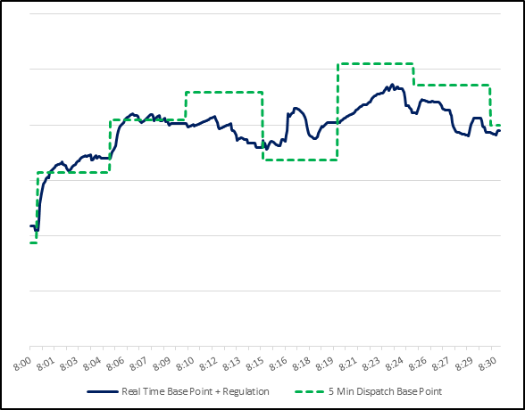
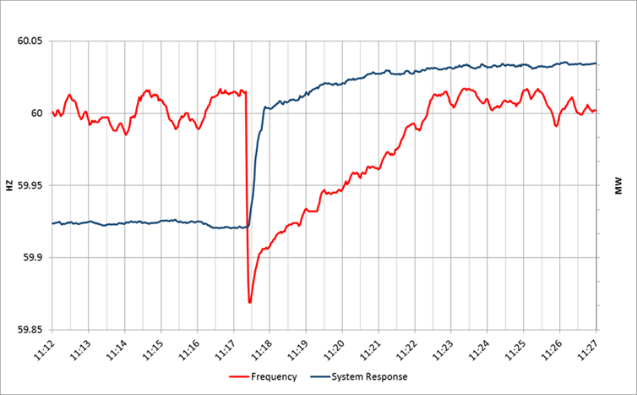
Current Ancillary Services
Regulation Up
Regulation Down
Responsive
Non-Spin

Slide 4
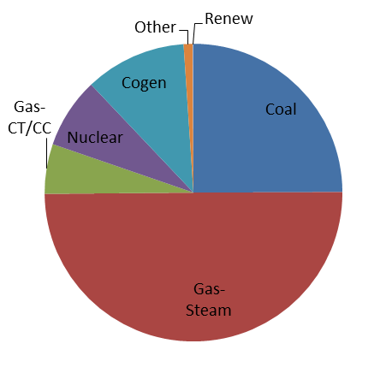
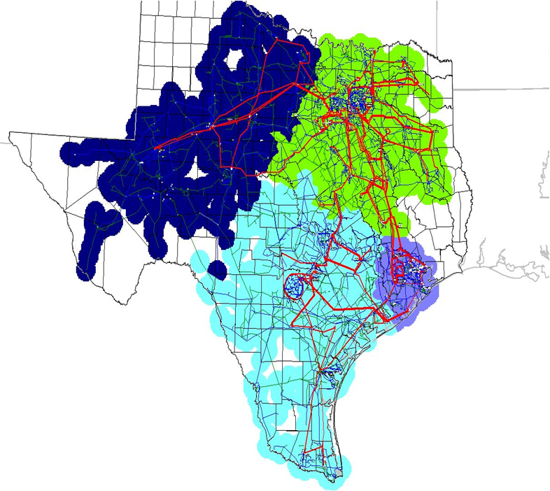
History of Current AS Framework
Installed Capacity by Unit Type
This is the world for which the current set of Ancillary Services was designed in the late 1990s

Slide 5
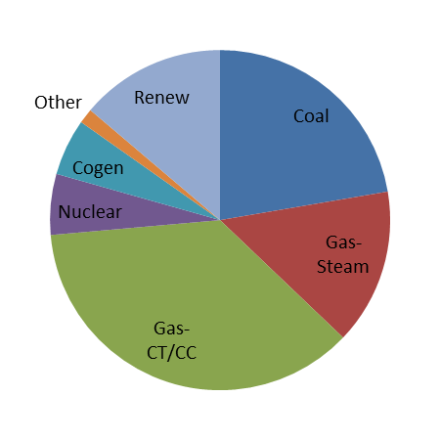
Changing Resource Mix
Installed Capacity by Unit Type
Late 1990s
2015

Slide 6
Goal of Redesign Effort
Future AS Framework
Technology neutral
Market-based
Based on fundamental needs of the system, not resource characteristics
Unbundled services
Flexible for new technologies
Current AS Framework
Based on capabilities of conventional steam generating units
Unique services bundled together due to inherent capabilities of conventional units
Mix of compensated and uncompensated services
New technologies are cobbled on, with difficulty
You Are Here
6+ Years
Now
3+ Years

Slide 7
Drivers for Strategic Redesign of AS Framework
Align the AS framework with the changing technical needs of the ERCOT System
Remove barriers to entry for new resource types that could meet the fundamental requirements for AS
Improve the efficiency in AS procurement

Slide 8
Proposed Future Ancillary Services
Current
Proposed
Regulation Up
Fast-Responding Regulation Up
Regulation Up
Fast-Responding Regulation Up
Mostly unchanged
Regulation Down
Fast-Responding Regulation Down
Regulation Down
Fast-Responding Regulation Down
Fast Frequency Response 1
59.8 Hz, Limited duration
Fast Frequency Response 2
59.7 Hz, Longer duration
Responsive
Primary Frequency Response
Contingency Reserves 1
SCED-dispatched
Contingency Reserves 2
Manually dispatched
Non-Spin
Supplemental Reserves 1
SCED-dispatched
Supplemental Reserves 2
Manually dispatched
Synchronous Inertial Response
Ongoing development

Slide 9
4 to 5
Current
Proposed
Regulation Up
Fast-Responding Regulation Up
Regulation Up
Fast-Responding Regulation Up
Regulation Down
Fast-Responding Regulation Down
Regulation Down
Fast-Responding Regulation Down
Fast Frequency Response 1
Fast Frequency Response 2
Responsive
Primary Frequency Response
Contingency Reserves 1
Contingency Reserves 2
Non-Spin
Supplemental Reserves 1
Supplemental Reserves 2
Synchronous Inertial Response

Slide 10
Substitution of Services: e.g. FFR vs. PFR
Low Load;
High Wind
High Load;
Low Wind
System Conditions
Low Inertia
High Inertia
2.2
1
Value of MW of FFR Relative to Value of 1 MW of PFR
Minimum of 1240 MW of PFR is needed, but substitution allowed above this level
PFR – Primary Frequency Response
FFR – Fast Frequency Response

Slide 11
FAS Timeline
3 Years?
Spring
2016
9/2013
11/2014
2019?
Implementation
Stakeholder/Board Approval
ERCOT Posts Future
Ancillary Services White Paper
~25 Stakeholder work sessions
to gather input and improve proposal
Additional stakeholder workshops
and Cost/Benefit Study
ERCOT Files Protocol change,
with significant modifications to original
proposal based on stakeholder input
Future dates are tentative

Slide 12
Cost/Benefit Assessment (CBA)
ERCOT engaged Brattle to perform CBA of FAS
Analysis was quantitative and qualitative, and looked at several scenarios
Baseline for CBA incorporated recent changes in RRS and Non-Spin Procurement
From Executive Summary of Brattle’s 12/21/2015 Report:
“In summary, we found that FAS is good market design, and it offers economic benefits on the order of 10 times the implementation costs. FAS will also improve reliability and provide greater flexibility for meeting reliability needs as system conditions and resource capabilities evolve.”

Slide 13
Synchronous Inertia Service (SIR)
Not initially included in Protocol change
Holding series of workshops to flesh out details
Separate service should be more efficient way to get inertia than by Reliability Unit Commitment or by procuring additional PFR to commit additional synchronous generation
Unbundles provision of synchronous inertia from requirements for PFR
Workshops will also look at whether “super-fast” FFR could lower need for inertia service

Slide 14
Why Go FAST?
Specifies a holistic set of distinct Ancillary Services needed to meet the changing technical needs of the ERCOT System
Provides efficient, market-based procurement process to obtain these services
Provides a coordinated transition to meet these needs instead of a piecemeal approach

