Slide 1

Future Ancillary Services
Cost Benefit Analysis Overview
Julia Matevosyan
February 1, 2016 FAS Workshop

Slide 2
CBA Findings
Estimated benefits of roughly $20 million per year.
If discounting 10 years of benefits at 7.5%, their present value would be $137 million.
The net present value accounting for ERCOT implementation costs would be over $120 million, and the benefit-cost ratio would be approximately 10.
Brattle found that FAS is good market design, and will improve reliability and provide greater flexibility for meeting reliability needs as system conditions and resource capabilities evolve.

Slide 3
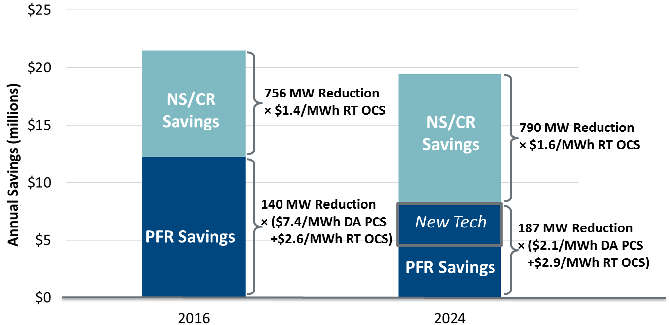
CBA Findings (Quantified Annual Benefits)
Figure 5: Quantified Annual Benefits
  In 2016, PFR reduction provides high DA production cost savings (DA PCS) per MWh because it enables greater coal dispatch. 2024 has higher net load, so coal is more fully baseloaded.
  Real-time opportunity cost savings (RT OCS) analyzed through historical AS bids.
  Compare these annual benefits to ERCOT’s one-time implementation cost of $12-15m.

Slide 4
CBA Findings
 | CAS | FAS | Savings | Comment
Procure Less PFR by recognizing equivalency ratios and allowing more FFR (incl. FFR1)
2016 Avg MW | 1,468 | 1,329 | 140 | Allow > 50% FFR; no need for buffer. Increase FFR by 24 MW on average.
2024 Avg MW | 1,453 | 1,325 | 129 | Slightly less than 2016 due to higher net load & inertia. Increase FFR by 13 MW on average.
2024 Avg MW w/new tech | 1,453 | 1,267 | 186 | 62 MW assumed new batteries reduce avg. PFR by 57 MW; small because residual avg. FFR opportunity (after load resources) is only 62 MW and highly variable
Replace Non-Spinning Reserve with less CR and SR (products comparable because of common NSRS/CR/SR duties and supply base)
2016 Avg MW | 1,931 | 1,175 | 756 | FAS adapts requirements to system conditions; additionally CR is determined based on frequency obligations, and Non-Spinning Reserve is determined to meet deviations in net load.
2024 Avg MW | 2,000 | 1,210 | 790 | See above (note: assumptions about new tech do not affect CR)

Slide 5
RRS Assumptions in the CBA
Same as in 2016 AS methodology: In the CBA RRS requirements are not flat 2800 MW but based on expected system inertia.
Differently from 2016 AS methodology: In the CBA, RRS is determined for every hour in the CBA, not as six 4-hourly blocks for a month.
>> Estimated savings reflect 2016 AS Methodology for determining RRS quantities. (Approved by BOD December 2015)

Slide 6
NSRS Assumptions in the CBA
Differently from 2016 AS methodology: In the original CBA runs NSRS amounts were determined as per 2015 AS methodology.
However, Brattle was able to estimate savings in each scenario with NSRS requirements calculated based on 2016 AS methodology and reduced IFRO.

Slide 7
Benefits not quantified in the CBA
The CBA was executed assuming both CAS and FAS quantities were determined in the DA. Any approach in which quantities for CAS are determined in advance of DA will include a buffer and the savings from FAS would be higher.
Reliability benefits are not quantified in the CBA
FAS removes uncertainty of load resource participation
FFR1 supports frequency at 59.8 Hz instead of 59.7 Hz. Most events would not activate FFR2, so FFR2 will have higher probability of being available for (the next) worst event.
If deployed, FFR1 can reset in 10 minutes and be ready for the next event.
In FAS, the amount of PFR that a resource can carry is based on its performance (instead of 20% HSL under CAS).
A single resource will be limited to carry up to 25% of the system wide regulation requirement in FAS, leading to a more distributed and reliable response than CAS.

Slide 8
Concerns Raised and Action Items
The gas price forecast used in the analysis for 2016 seems too high. ACTION: ERCOT is planning to run 2016 with a more recent gas price forecast. Plan to have results available for March 2016 discussion.
CBA did not take into consideration the implementation costs for Stakeholders. ACTION: ERCOT requests that Stakeholders provide estimates of the cost to implement changes required for NPRR 667 for March 2016 discussion.

Slide 9
Appendix: RRS, PFR/FFR Quantities
Quantities are based on hourly system inertia from 2016, 2024 Current Trends and 2024 Stringent Environmental Scenarios simulation in Plexos, 8760 values
Hourly system inertia is matched to one of 13 cases and corresponding RRS, PFR/FFR quantities and FFR to PFR equivalency ratio are selected for each hour.
Minimum RRS from generation or minimum PFR is based on NERC BAL-003 IFRO
 | Case 0 | Case1 | Case2 | Case3 | Case4 | Case5 | Case6 | Case7 | Case8 | Case9 | Case10 | Case11 | Case12
Inertia, GWs | 100 | 120 | 136 | 152 | 177 | 202 | 230 | 256 | 278 | 297 | 316 | 332 | 350
Eq. Ratio | 2.35 | 2.2 | 2 | 1.5 | 1.4 | 1.3 | 1.25 | 1.13 | 1.08 | 1 | 1 | 1 | 1
PFR Requirement (no FFR), MW | 7358 | 5200 | 4700 | 3750 | 3370 | 3100 | 3040 | 2640 | 2640 | 2240 | 2280 | 2140 | 2140
Min PFR Requirement, MW | 1240 | 1240 | 1240 | 1240 | 1240 | 1240 | 1240 | 1240 | 1240 | 1240 | 1240 | 1240 | 1240

