Slide 1
Frequency Response and Contingency Reserve Service (CRS
ERCOT is a single Balancing Authority Interconnection (not synchronously connected with other grids)
The Future Ancillary Service unbundles RRS into FFRS, PFRS and CRS-10 minute service
The above mentioned ancillary service suits are designed to restore the frequency back to 60 Hz within 10 minutes post frequency disturbance event (where MSSC don’t trigger FFR)
CRS will ensure that the Frequency is quickly restored to 60 Hz and PFRS is fully recovered.

Slide 2
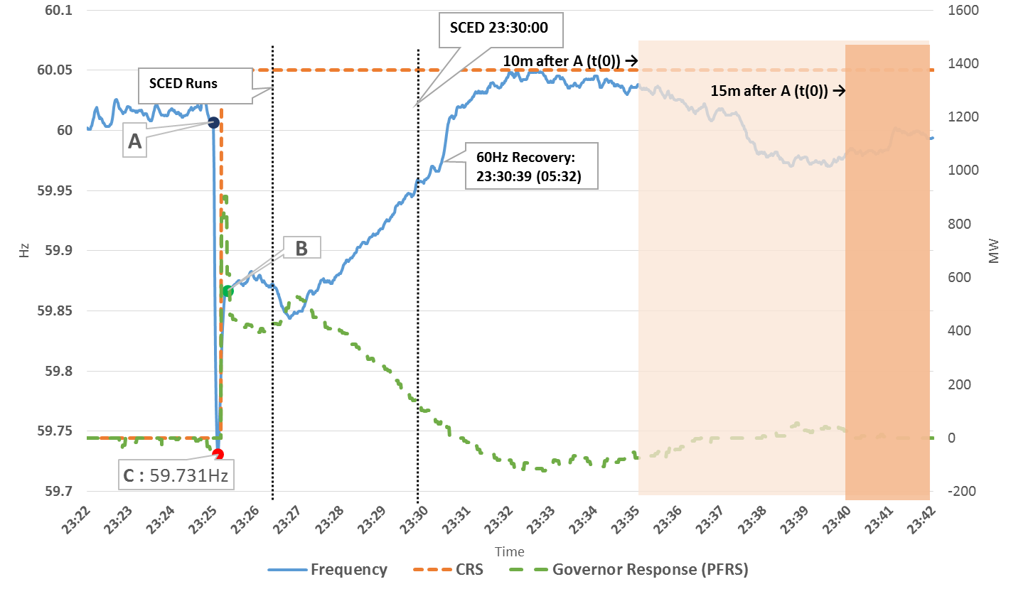
ERCOT Frequency Event - Future Ancillary Service Framework

Slide 3
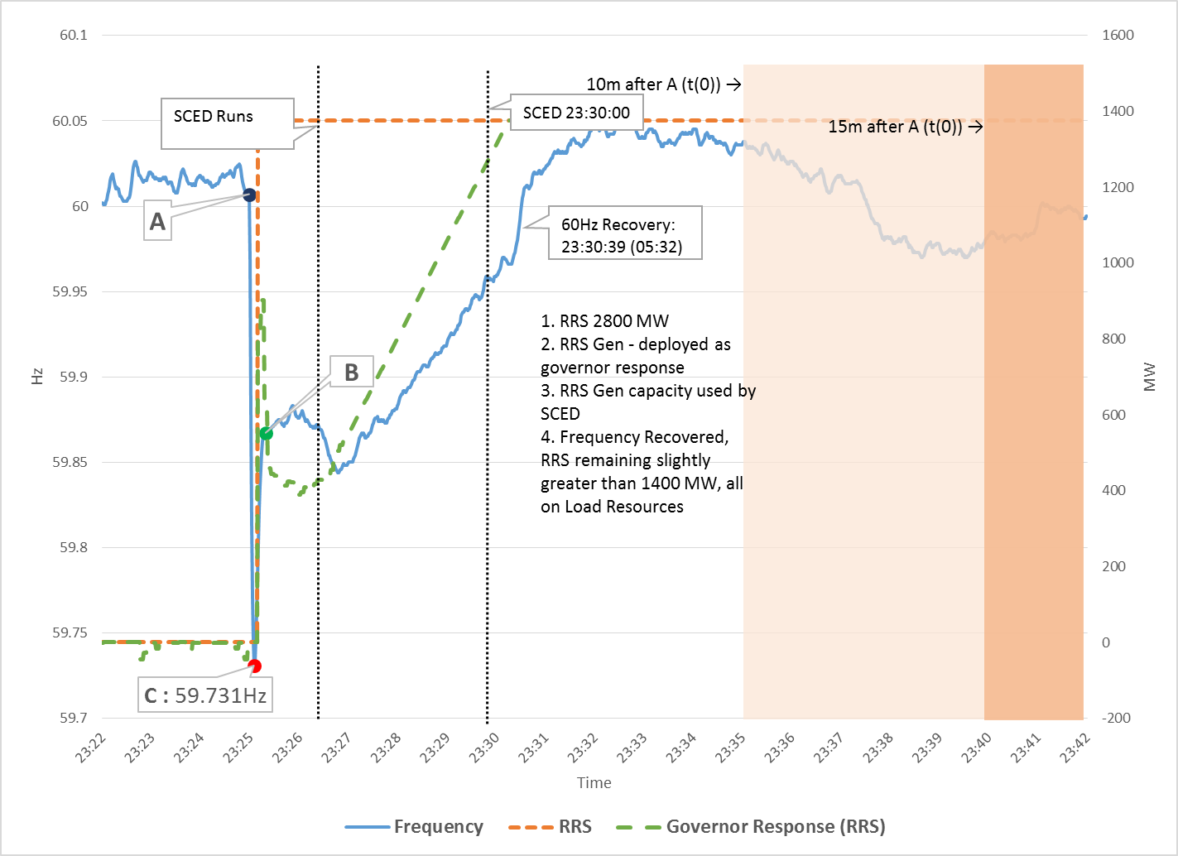
ERCOT Frequency Event - Current Ancillary Service Framework

