Slide 1
Congestion Revenue Right Market Update
David Maggio
Congestion Management Working Group
February, 2016

Slide 2
Agenda Items
Outages in the February Monthly Auction Model
Distribution factors for Hubs
General auction activity update

Slide 3
Outages in the February Monthly auction model

Slide 4
February Monthly Auction Model Outages
While preparing recent auction models, ERCOT reviewed updated network data along with the February Monthly model information and identified discrepancies in how three planned transmission outages were applied to the February Monthly auction model.
These outages were:
Equipment Name | From Station Acronym | To Station Acronym | Equipment Type | Nature of Work
ARCO_DENARCOC21 | ARCO | DENARCOC | 138 kV Line | New Equipment Energization
WYL_ELMG1 | ELMGROVE | WYLIESW | 138 kV Line | New Equipment Energization
WYL_NEVA1 | NEVADA | WYLIESW | 138 kV Line | New Equipment Energization

Slide 5
February Monthly Auction Model Outages
This discovery occurred after the February Monthly auction had been executed.
Because Market Participants would not be able to adjust their portfolios and given historical feedback and the potential delays in auction deadlines, ERCOT used the posted model.
The impact of the model difference was minimal.
ERCOT wanted to bring this issue to your attention, and discuss how the market would like to handle similar scenarios should they occur in the future.

Slide 6
February Monthly Auction Model Outages
During the model build process, there was uncertainty in how the outages should be applied to the new transmission equipment given the current system one-lines and the CRR bus-branch model
As a result, three branches were manually taken out of service in an attempt to capture the outages
Details about the specific branches are provided on the next two slides
We are working with other teams within ERCOT to find any additional information about future equipment that can be used and are increasing the amount of peer review for the model build process moving forward

Slide 7
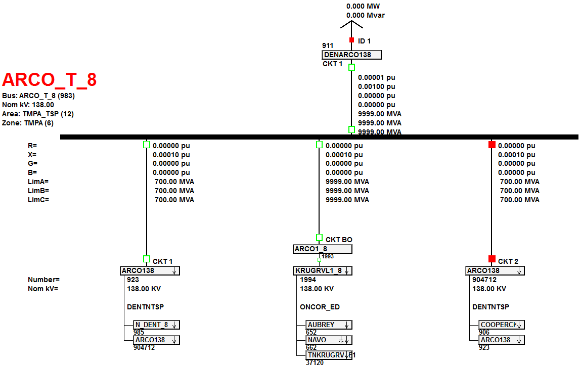
February Monthly Auction Model Outages
The ARCO_DENARCOC21 outage:

Slide 8
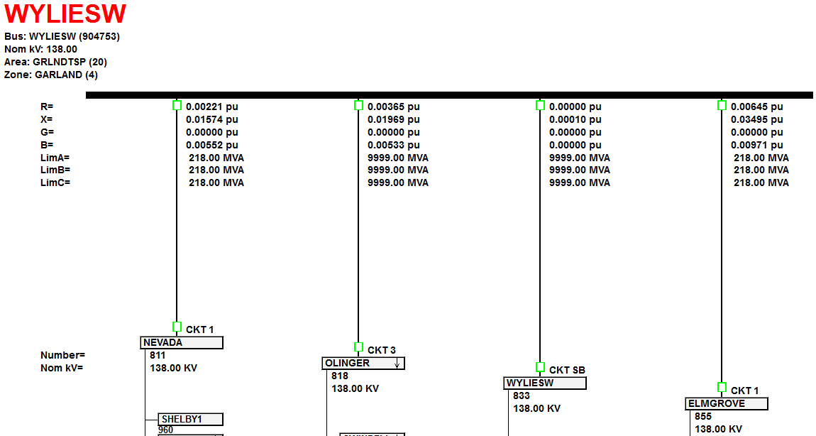
February Monthly Auction Model Outages
The WYL_ELMG1 and WYL_NEVA1 outages:

Slide 9
Distribution factors for Hubs

Slide 10
Distribution of Flows for Hubs during Outages
ERCOT has discovered an inconsistency with how flows into or out of Hubs are being modeled between CRR and DAM in cases in which a PSS-E bus that is part of a Hub is on outage.
A simple example illustrating the difference will be discussed.
ERCOT believes that an internal change should improve consistency between CRR and DAM for planned transmission outages and wanted to make CMWG aware of the change before implementing it.

Slide 11
Illustrative Example of the Current Systems
As a simple example, lets assume a Hub that is defined by two Hub Busses:
One Hub Bus consists of two PSS-E busses
The other Hub Bus consists of one PSS-E bus
A PSS-E bus represents one or more Electrical Busses
There is a 100 MW PTP that “sinks” at this Hub and that is the only PTP in the system.
The next slides will examine how that 100 MW would flow based on current CRR logic, both with and without a disconnection of one of the three PSS-E busses in the base case.

Slide 12
Flow in CRR with No PSS-E Bus Outages
Rest of the Transmission System
100 MW
Hub
50 MW
50 MW
Hub Bus 1
Hub Bus 2
25 MW
25 MW
50 MW
PSS-E Bus 1
PSS-E Bus 2
PSS-E Bus 3

Slide 13
Flow in CRR with PSS-E Bus 1 Disconnected
Rest of the Transmission System
100 MW
Hub
33 MW
67 MW
Hub Bus 1
Hub Bus 2
0 MW
33 MW
67 MW
PSS-E Bus 1
PSS-E Bus 2
PSS-E Bus 3

Slide 14
Flow in DAM with No PSS-E Bus Outages
Rest of the Transmission System
Flows are no different, relative to CRR
100 MW
Hub
50 MW
50 MW
Hub Bus 1
Hub Bus 2
25 MW
25 MW
50 MW
PSS-E Bus 1
PSS-E Bus 2
PSS-E Bus 3

Slide 15
Flow in DAM with PSS-E Bus 1 Disconnected
Rest of the Transmission System
Flows are different, relative to CRR
100 MW
Hub
50 MW
50 MW
Hub Bus 1
Hub Bus 2
0 MW
50 MW
50 MW
PSS-E Bus 1
PSS-E Bus 2
PSS-E Bus 3

Slide 16
Future Steps
There is a relatively simple change that ERCOT can make for CRR and DAM to be consistent for planned transmission outages of an PSS-E bus that is part of a Hub.
This change will be implemented for all CRR Auction models moving forward.
ERCOT plans to implement the change with the April Monthly CRR Auction.

Slide 17
General auction activity Update

Slide 18
CRR Cost vs. Value

Slide 19
CRR Balancing Account Fund

Slide 20
Monthly Auction Transactions

Slide 21
Long-Term Auction Sequence Transactions

Slide 22
Monthly Auction Net Revenue

Slide 23
Long-Term Auction Sequence Net Revenue

Slide 24
Current CRR Inventory (as of 1/25/16)

