Slide 1

Market Update
ERCOT Market Analysis
QSE Managers Working Group
1/29/2016

Slide 2
Supplemental Ancillary Services Market (SASM) Update
  11/17 SASM insufficient – 16.5MW REGUP HE8
Notes:
Non-reconfiguration SASMs

Slide 3
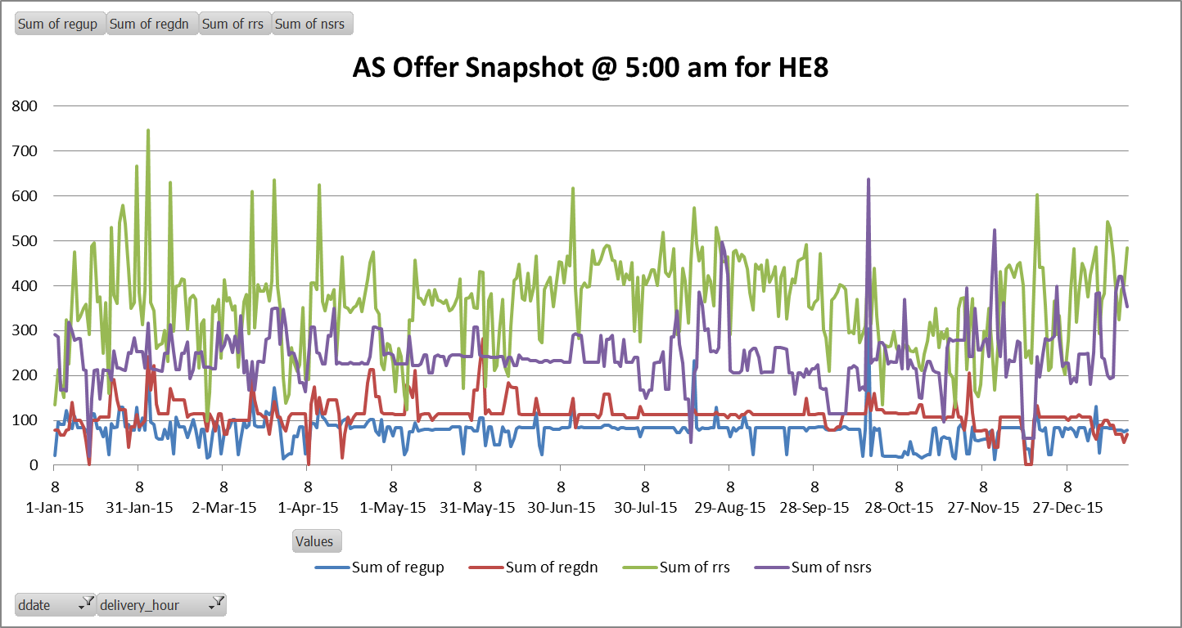
Supplemental Ancillary Services Market (SASM) Update
  Chart may not reflect actual SASM Offers due to changes that could be made after SASM notification
  Additional Reg-up offers made for 11/17 SASM after notification for HE9-12, but not HE8 in this case

Slide 4
Supplemental Ancillary Services Market (SASM) Update
  NPRR589/701 which corrected settlements for Reconfiguration SASMs was implemented September 24, 2015
  No Reconfiguration SASM activity since NPRR589/701 implementation

Slide 5
Manual Overrides
  None

Slide 6
QUESTIONS / COMMENTS???

