Slide 1
Summary for RMS
February 2, 2016

Slide 2
MTTF Goals 2015
2015 Goals
Approval and implementation of RMGRR – Revision to Customer Rescission Completion Timeline
Transition on-going responsibilities to Texas Data Transport Working Group (TDTWG)
‘Sunsetting’ of Task Force

Slide 3
MTTF Accomplishments 2015
RMGRR 129 – Revision to Customer Rescission Completion Timeline – accelerated the timeline for CRs to complete a customer rescission MT issue after a switch transaction.
RMGRR 131 – Guidelines for Notification of Invoice Dispute – aligned RMG with current market practices of utilizing MarkeTrak tool for invoice disputes
RMGRR 133 - Clarification of Inadvertent Gain Valid Reject Reasons – minimize confusion of the valid reject reason to improve resolution time for IAG MTs. Specifically, a Gaining CR may submit a MT when they do not have an agreement w/ the Customer. The Losing CR (who has an agreement) should regain the Customer even if the Customer indicates their REP of choice is not the Losing CR.

Slide 4
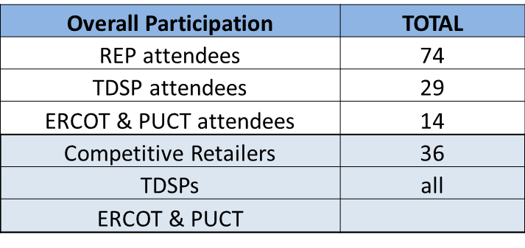
MTTF Accomplishments 2015
Inadvertent Gain (IAG) Training Roadshow – successfully developed, facilitated, and presented an IAG roadshow in Austin, Houston, and Dallas with the following participation…
MarkeTrak Subtypes Quick Reference matrix – developed a listing of all MT subtypes by Category, Subtype, Use, Submitter, and associated reference in the User’s Guide

Slide 5
MTTF Accomplishments 2015
MarkeTrak issues – Premature closing of IGL/Rescission Subtypes – review of Serena upgrade - As a result of root cause analysis of the February issues where the “clock” for auto-closure was changing from 15 days to 15 minutes, it was noted MT Serena version was not using the most current version. MTTF evaluated the options and recommended an upgrade be reviewed again in 6 – 12 months.
MarkeTrak SLO results – MTTF, ERCOT, and API Users (CenterPoint and Oncor) worked to establish new SLOs that were more reflective of actual response times experienced.

Slide 6
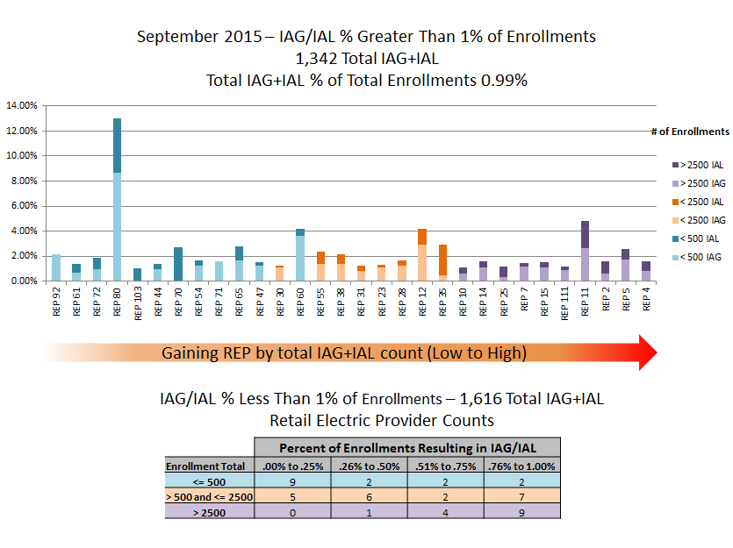
MTTF Accomplishments 2015
New Inadvertent Gain Reporting – Impact by REP - developed new reporting format offering visibility on IGL and Rescission causing REPs market-wide, establishing a “goal” of >1% of IGLs to total monthly enrollments

Slide 7
MTTF Accomplishments 2015
Switch Hold Review – evaluated the current switch hold process and provided a list of issues for further review at TDTMS
Service Level Agreements for MarkeTraks – revisited the SLAs for subtypes in an effort to increase transparency in the market. Metrics were requested of ERCOT for further evaluation by TDTMS
Transfer of key documents to TDTMS

Slide 8
MTTF Accomplishments 2015
Sunsetting of the MarkeTrak Task Force

