Slide 1
ERCOT MARKET EDUCATION
Retail 101

Slide 2
Legal Disclaimers and Admonitions
PROTOCOL DISCLAIMER
This presentation provides a general overview of the Texas Nodal Market Implementation and is not intended to be a substitute for the ERCOT Nodal Protocols (available at http://nodal.ercot.com/protocols/index.html), as amended from time to time. If any conflict exists between this presentation and the ERCOT Nodal Protocols, the ERCOT Nodal Protocols shall control in all respects.
ANTITRUST ADMONITION
ERCOT strictly prohibits Market Participants and their employees who are participating in ERCOT activities from using their participation in ERCOT activities as a forum for engaging in practices or communications that violate the antitrust laws. The ERCOT Board has approved guidelines for members of ERCOT Committees, Subcommittees and Working Groups to be reviewed and followed by each Market Participant attending ERCOT meetings. If you have not received a copy of these Guidelines, an electronic version is available at http://www.ercot.com/about/governance/index.html. Please remember your ongoing obligation to comply with all applicable laws, including the antitrust laws.

Slide 3


Housekeeping
  Restrooms
  Refreshments
  Attendance sheet
  Questions
  Microphones
  Please turn off cell phones & other electronics
Notes:
Also cover the handouts for the course.
Have students verify their email addresses on the sign-up sheet.
Encourage students to take the exam in class.

Slide 4
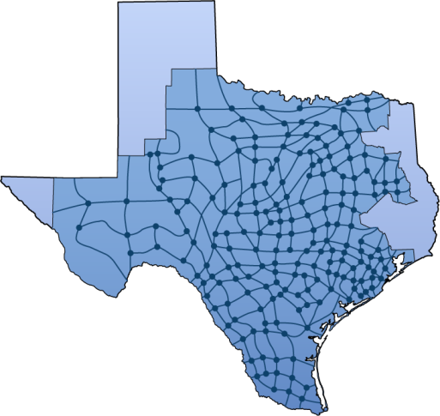
ERCOT Market Education
  Training Curriculum
  Retail 101
  MarkeTrak Web-Based Training
  Nodal 101
  Load Serving Entity 201
  Various Workshops as needed
Notes:
Please visit the ERCOT website to view the training curriculum. The Nodal Market Education program offers many courses, covering a wide range of topics on system operations, market operations as well as financial settlement.

Slide 5
Course Introduction

Slide 6




Target Audience
This course is designed for Market Participants who are new to the ERCOT Competitive Retail Market or have taken on new roles in the Market.
  Includes:
    Retail Electric Providers
    Transmission and Distribution
    Providers
    PUCT Staff
    ERCOT Staff
    Others

Slide 7

Course Objectives
Upon completion of this course, you will be able to:
  Describe how the Retail Market grew out of the
  vertically integrated utilities
  Summarize the key responsibilities of various players
  in the ERCOT Retail Market
  Identify Market Rules that impact Retail Market Operations
  Illustrate the life cycle of the Move-in, Move-out and Switch Request Processes
  Identify the tools and information available for tracking, troubleshooting and reconciling Retail Market Transactions
  Recognize the impacts of Advanced Meter Technology
Notes:
The objective of this course is to provide LSEs with information about the ERCOT-facilitated Nodal Market and help them identify the impacts of its Operations on the Wholesale Market.

Slide 8
Course Modules
Modules in this course include:
1
From Bundled Utilities to Current Market Design
Introductions, Roles and Responsibilities
Market Rules
Retail Transaction Processing
Advanced Meter Technology
Data Transparency and Availability
2
3
4
5
6

Slide 9
Module 1
From Bundled Utilities to Current Market Design

Slide 10
Overview
Topics in this lesson . . .
  Vertically Integrated / Bundled Utilities
  Market Restructuring
    Senate Bill 7
    Competition and Customer Choice
    Exemptions
    A few other mandates
  Emergence of ERCOT
    ISO
    Governance

Slide 11


Regulated Utilities
In the beginning,
there were vertically integrated utilities. . .

Slide 12
Vertically Integrated Utilities
Reliability Coordinator
(ERCOT)
Generation
System Operations
Transmission
Utility
Distribution
Physical Power Flow
Customers
Scheduling and Dispatch

Slide 13
Vertically Integrated Utilities - Structure
Basic characteristics
  Regulated rate of return
    Regulated price for customers
    Approved through “rate case”
    Based on utility’s cost plus reasonable profit margin
  “Captive” customer base
  Multiple control areas with limited power flows between utilities

Slide 14

Mid 1990s – Restructuring
Texas Legislature amended the Public Utility Regulatory Act (PURA)
  Allowed for wholesale deregulation
  Opened the doors to competitive
  wholesale producers
  Ensured open access to
  transmission system

Slide 15
Vertically Integrated Utilities with Wholesale Deregulation
Reliability Coordinator
(ERCOT)
ISO
(ERCOT)
Generation
System Operations
Generation
Merchant Generation
Transmission
Utility
Wholesale
Marketers
Distribution
Other
Utilities
Physical Power Flow
Customers
Scheduling and Dispatch
Financial Relationships
Notes:
<Click for animation> These changes to PURA allowed the emergence of Merchant Generators who would operate generation for profit outside the traditional utility structure.
<Click for animation> These changes also brought about the need for an Independent System Operator, or ISO would facilitate open access to the transmission system for the new Merchant Generators. ERCOT, as Reliability Coordinator was ideally situated to perform this function, and in 1996, was christened as the first North American ISO.
<Click for animation> The rise of Merchant Generators also brought about the rise of Wholesale Power Marketers. These new marketers would buy power from the Merchant Generators and the traditional Utilities and sell to Utilities who needed the power. These types of transactions are referred to as Bilateral Trades.

Slide 16
Late 1990s – Restructuring
Texas Legislature passed Senate Bill 7 (SB7)
  Called for “the establishment of a
  fully competitive electric power industry”
  Ordered functional unbundling of
  Investor-Owned Utilities
    Generation companies sell into the
    competitive wholesale market
    Retail Electric Providers buy wholesale
    power and re-sell to retail customers
    Transmission and Distribution companies move power from generation to customer and remain regulated

Slide 17
Late 1990s – Restructuring
Texas Legislature passed Senate Bill 7 (SB7)
  Retail Market Changes
    Retail Electric Providers responsible for
    customer interaction
    Retail customers allowed to choose
    between competing providers
  System Operational Changes
    ERCOT responsible for transmission grid operations
    Establishment of single control area

Slide 18
Retail and Wholesale Competition
System Operations
(ERCOT ISO)
Generation
Wholesale
Marketers
Transmission
Utility
Distribution
Retail Electric Providers
Physical Power Flow
Customers
Scheduling and Dispatch
Financial Relationships

Slide 19

Retail and Wholesale Competition
Not all Utilities were required to unbundle
  Not all Utilities were investor-owned
    Municipal Utilities
    Electric Cooperatives
  Exempt from unbundling
  Can choose to opt-in to Retail Deregulation
Munis and Co-ops who choose not to opt-in are called Non-Opt-In Entities, or NOIEs

Slide 20
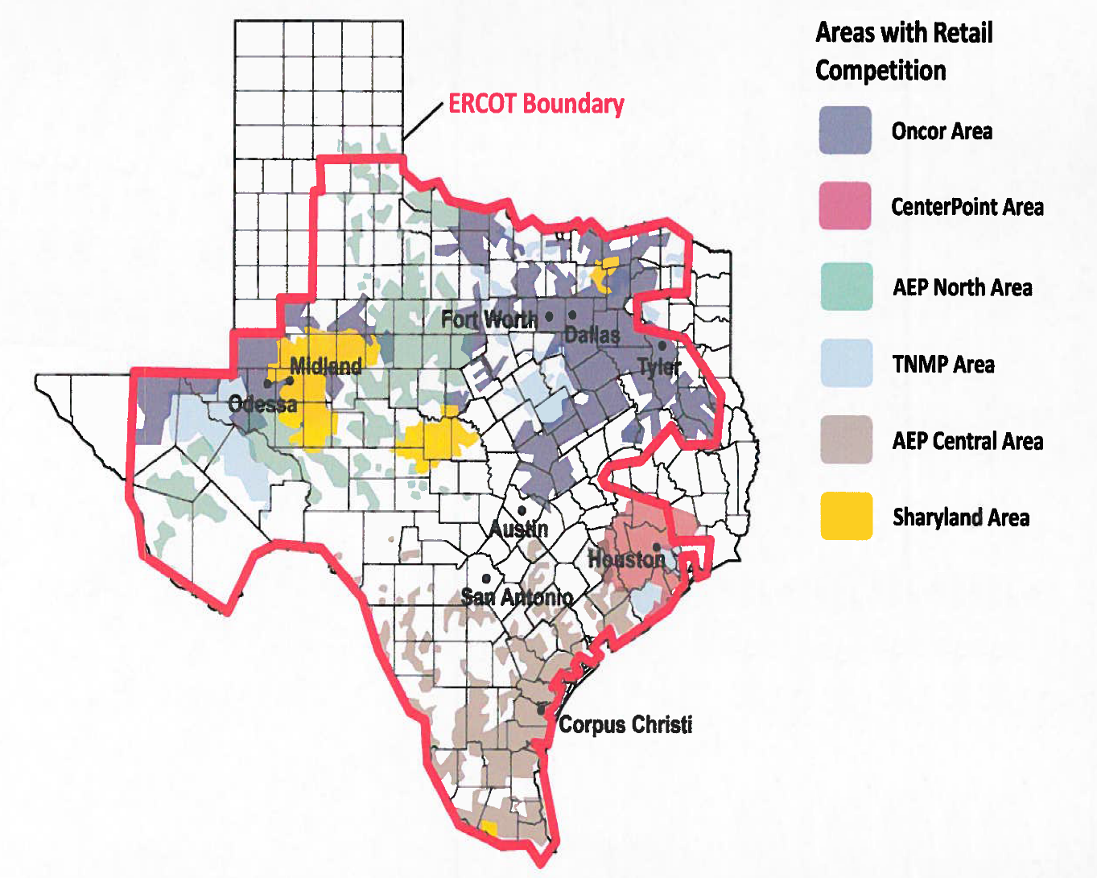
Competitive Areas
So, what areas have Retail Competition?

Slide 21
Retail and Wholesale Competition
Other provisions of Senate Bill 7
  Price to Beat
  Renewable Portfolio Standard
  Governance for ERCOT

Slide 22

Price to Beat
To foster competition, the affiliated REP of each Investor-Owned Utility had to offer a “Price-to-Beat”
  Residential and small commercial customers only
  Six percent lower than rates
  on January 1, 1999.
  Requirement expired
  January 1, 2007
Price
To
Beat

Slide 23

Renewable Portfolio Standard
SB7 established mandates for renewable generation
  Set targets for installed renewable generation capacity
  Established Renewable Energy Credits (REC) program
  Required Retail Electric Providers to purchase RECs
For more details, see Protocol Section 14

Slide 24

Governance
SB7 required the ISO to set up a Board of Directors
  Oversee ISO operations
  Approve budget and staffing
  Establish Market Rules and approve
  subsequent changes

Slide 25
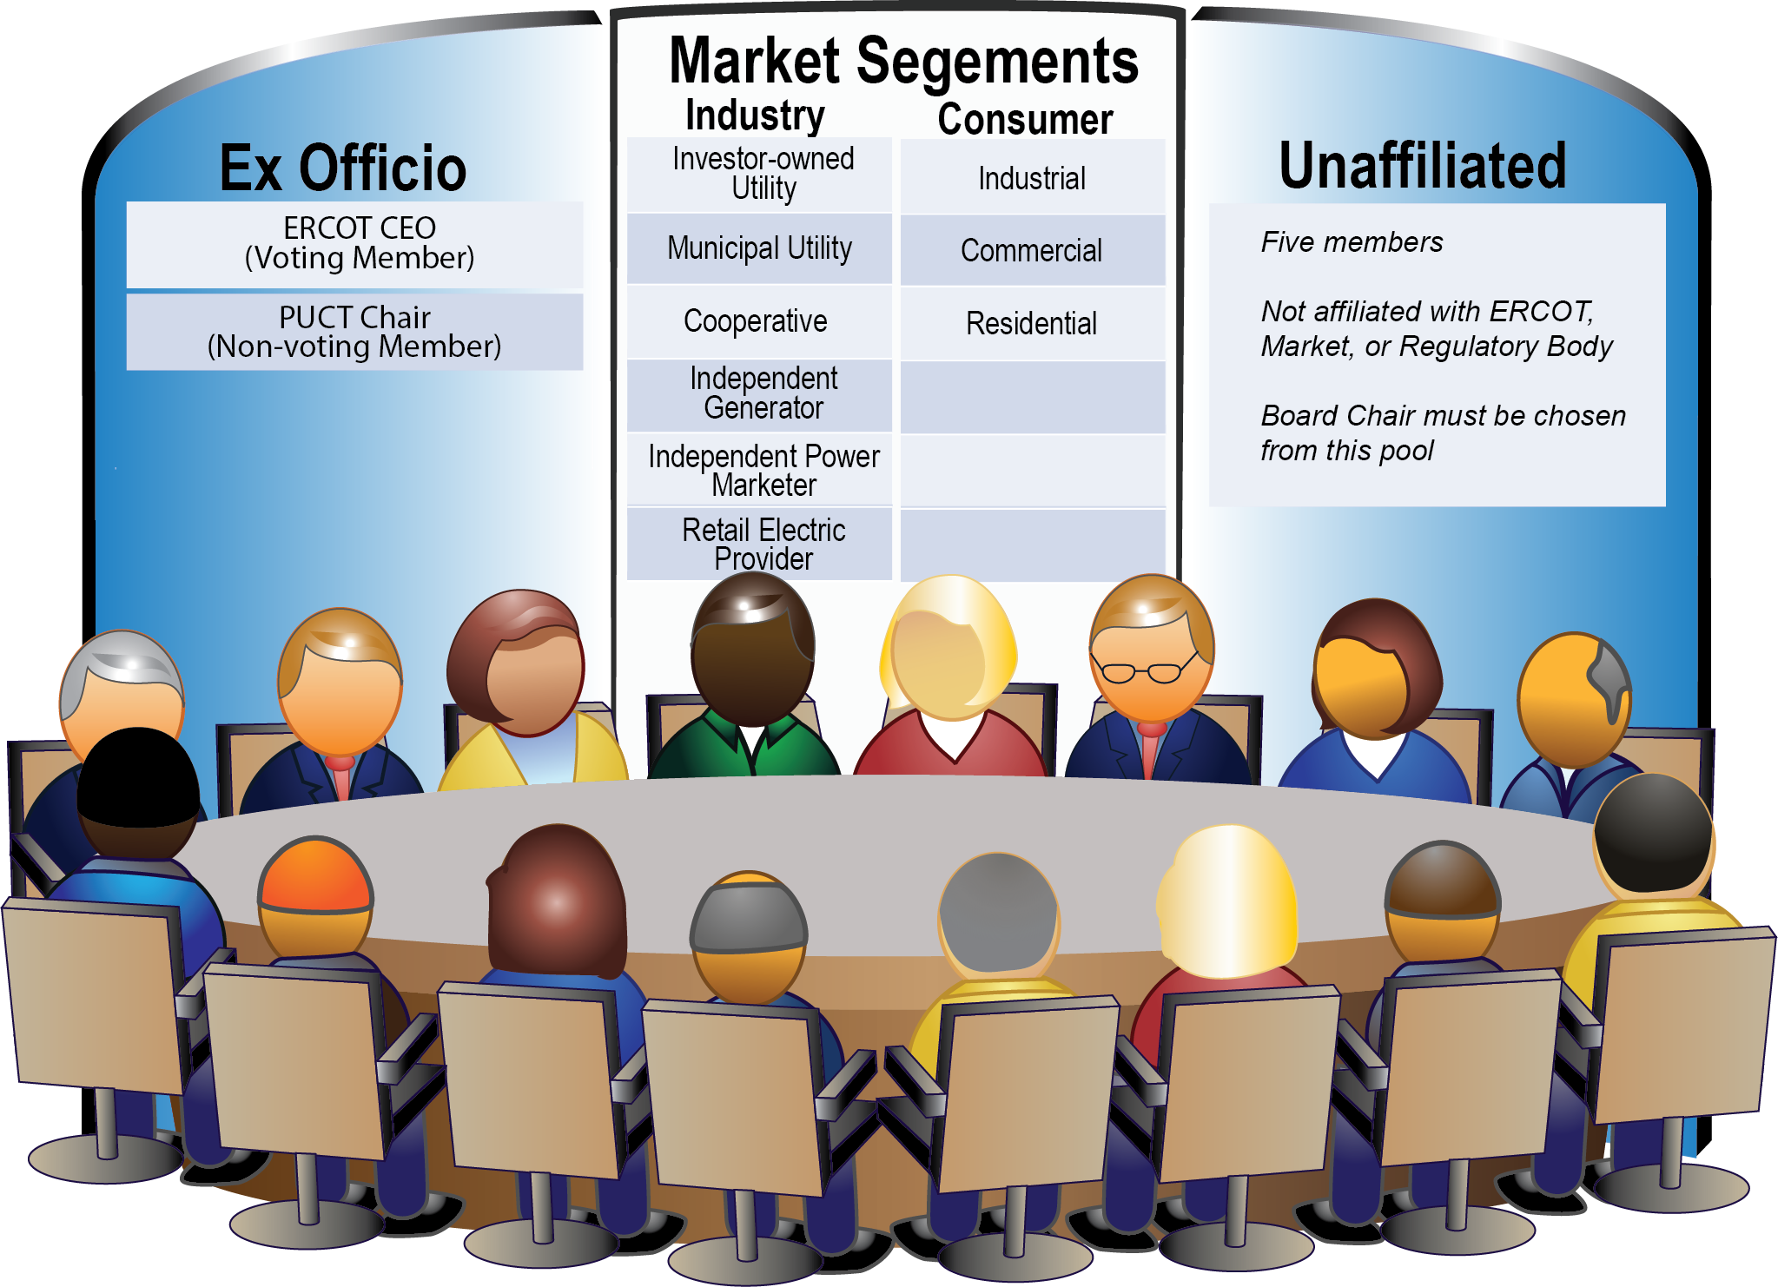
Current structure of ERCOT Board of Directors

Slide 26
ERCOT Board and Stakeholder Groups
Board is advised by Stakeholder Groups
Board
Of
Directors
Technical Advisory
Committee
(TAC)
TAC makes policy recommendations to Board
Retail Market Subcommittee (RMS)
Reliability Operations Subcommittee (ROS)
Wholesale Market Subcommittee (WMS)
Commercial Operations Subcommittee (COPS)
Protocol Revision Subcommittee (PRS)
Subcommittees recommend changes to Market Rules and Operating Guides

Slide 27
Module 2
Introductions, Roles and Responsibilities

Slide 28
Overview
Topics in this lesson . . .
  Two Basic Definitions
  Market Relationships
  Roles and Responsibilities
    ERCOT
    REPs
    TDSPs
    PUCT

Slide 29
Two Basic Definitions
Premise / ESI-ID

Slide 30

Two Basic Definitions
Premise – A Service Delivery Point or combination of Service Delivery Points that is assigned a single identifier for ERCOT settlement and registration.
  Metered
  Unmetered, such as
    Street Lights
    Traffic Lights
    Billboards
Electrons R Us

Slide 31

Two Basic Definitions
ESI ID – Electric Service Identifier
  The unique identifier assigned to each Premise
  Used for all retail transactions in ERCOT
    Enrolling Customers
    Switching retail providers
    Load metering
Retail Electric Provider (REP)

Slide 32
Market Relationships

Slide 33


Market Participants
  Who are the ERCOT Players?
QSE
  Qualified Scheduling Entities
LSE
  Load Serving Entities
  Transmission and/or Distribution Service Providers
TDSP
Resource
Entity
  Resource Entities
Notes:
Before, we go any further, let’s introduce the players in the Market. This is a list of all of the entities who must register with ERCOT. Over the next few slides, we will look at how these players fit into the overall market structure and focus on the relationships between them.

Slide 34
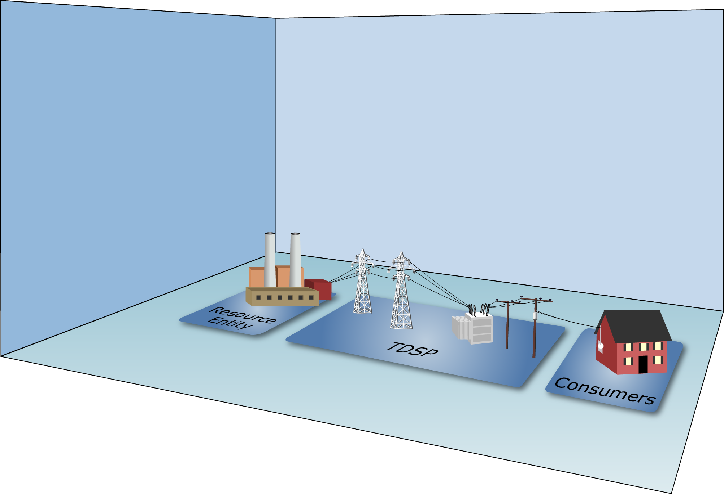
Market Relationships

Slide 35
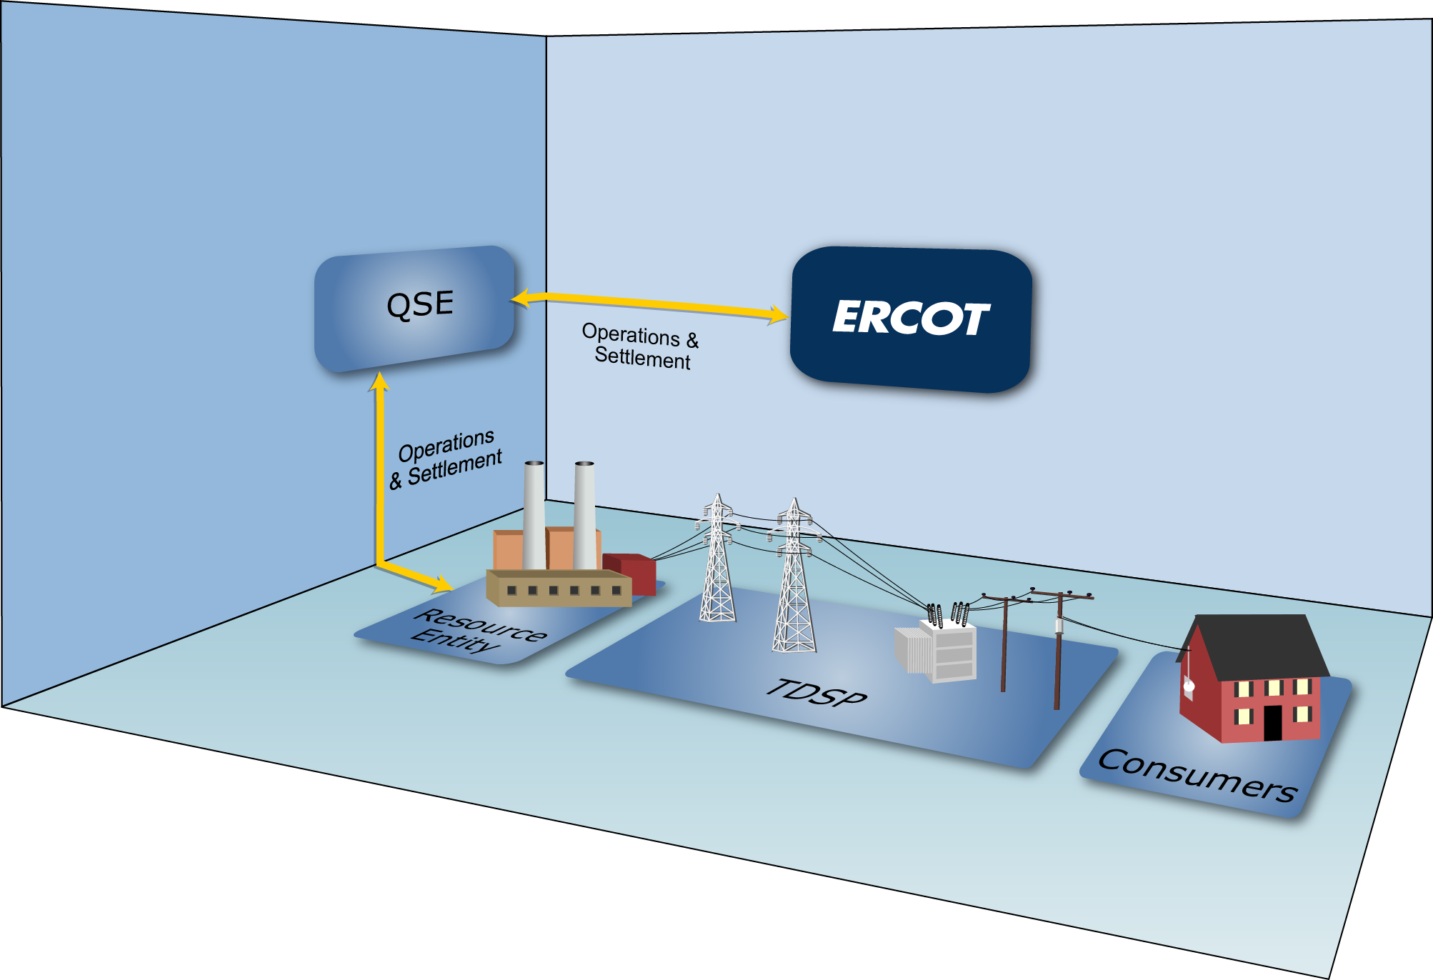
Market Relationships

Slide 36
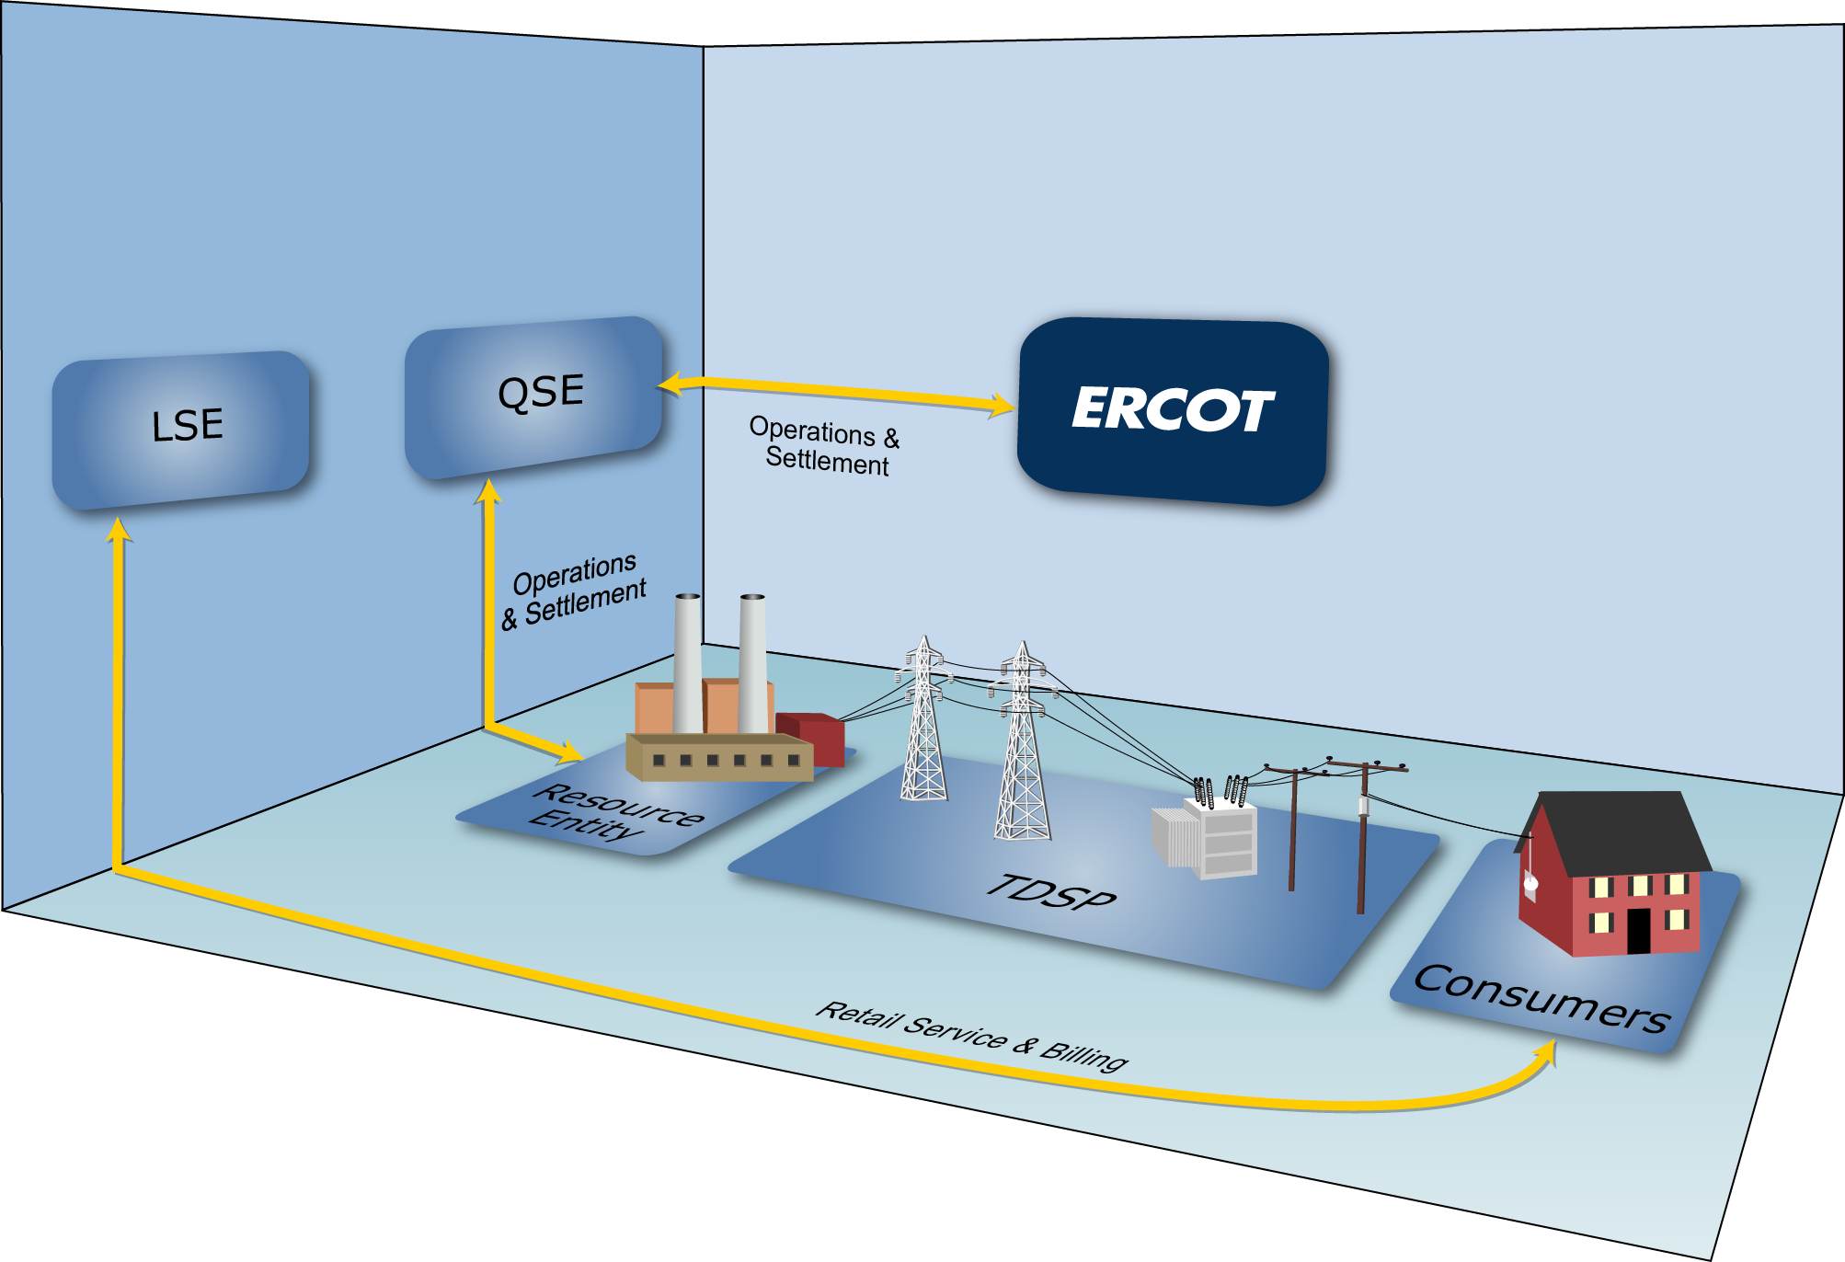
Market Relationships

Slide 37

Market Relationships

Slide 38

Market Relationships
A Load Serving Entity (LSE) provides electric service to end-use Customers
Notes:
Load serving entities (LSEs) provide electric service to end-use Customers. As mentioned in defining the audience for this course, LSEs include:
Retail Electric Providers – entities that sell electric energy to retail Customers in the areas of Texas where the sale of electricity is open to retail competition
Electrical Cooperatives – businesses owned by the people who use their services
Municipally-Owned Utilities – providers owned by the municipalities they serve

Slide 39
Market Relationships
Types of LSEs:
  Retail Electric Providers
  (AKA Competitive Retailers)
  Electrical Cooperatives
  Municipally-Owned Utilities
Notes:
LSEs include:
Retail Electric Providers – entities that sell electric energy to retail Customers in the areas of Texas where the sale of electricity is open to retail competition
Electrical Cooperatives – businesses owned by the people who use their services
Municipally-Owned Utilities – providers owned by the municipalities they serve

Slide 40

Market Relationships
Types of LSEs:
  Retail Electric Providers
  (AKA Competitive Retailers)
  Electrical Cooperatives
  Municipally-Owned Utilities

Slide 41
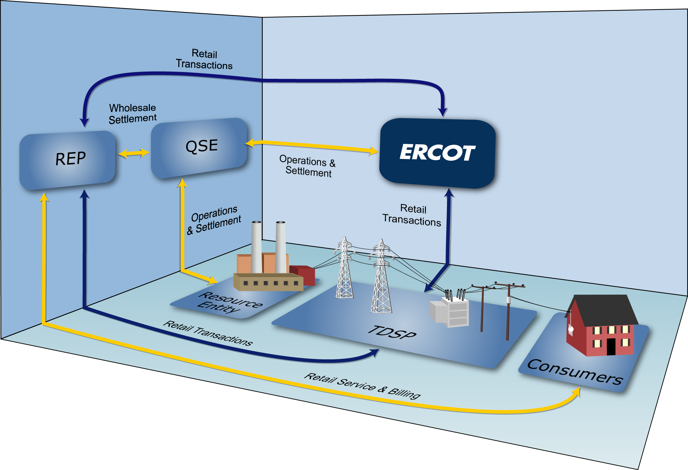
Market Relationships

Slide 42
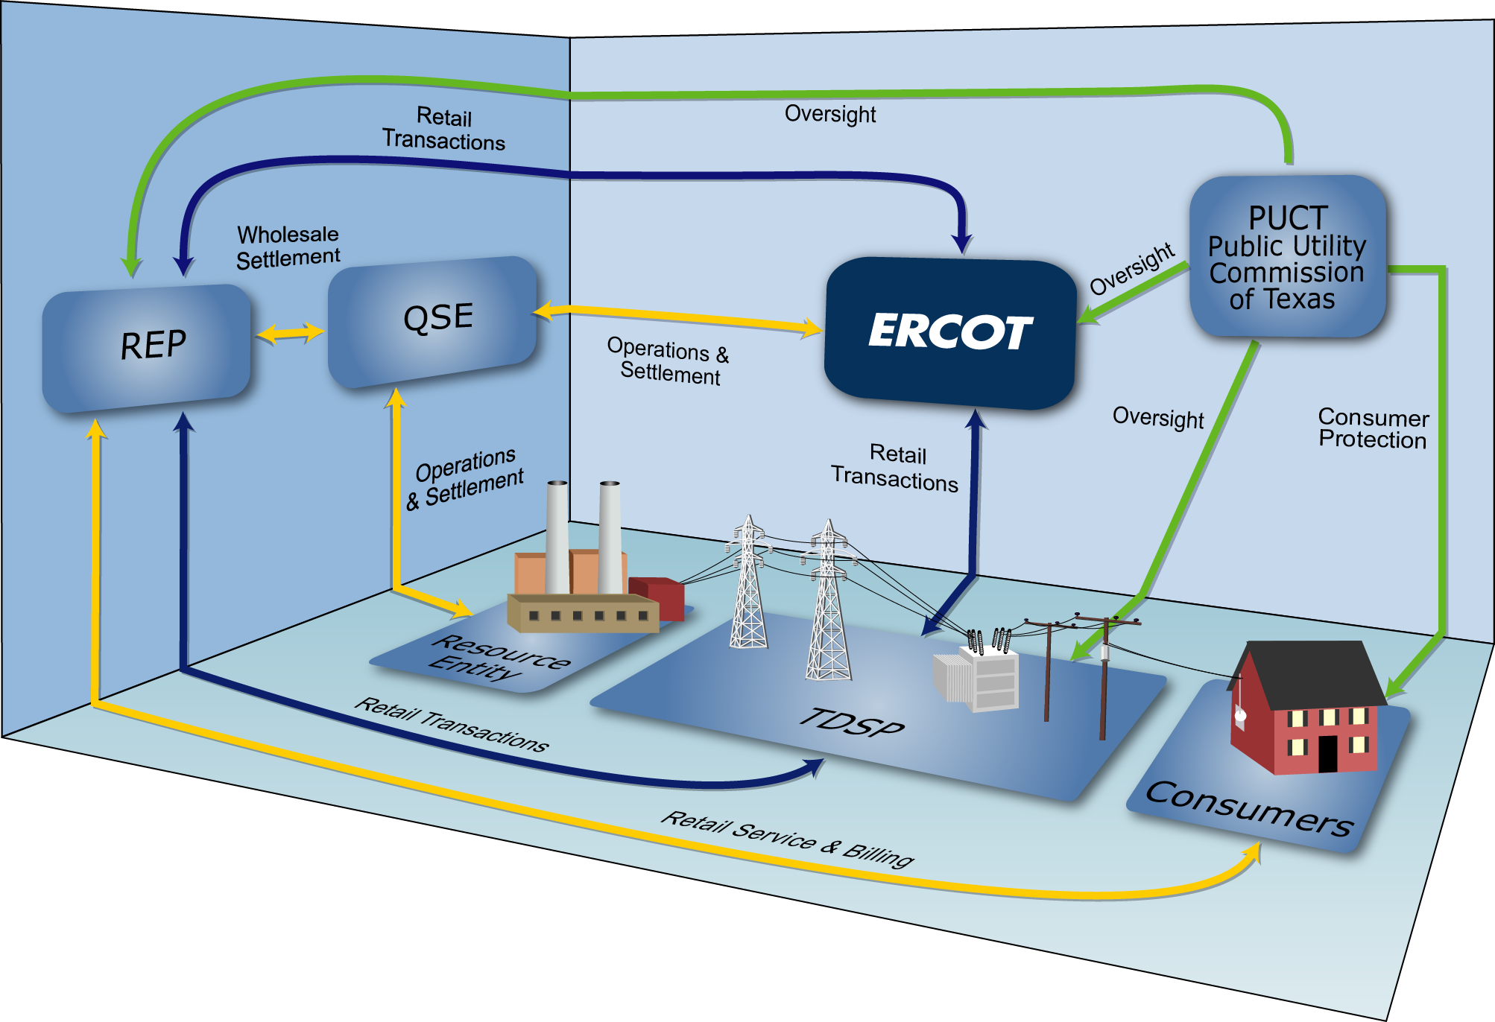
Market Relationships

Slide 43
Roles and Responsibilities

Slide 44

ERCOT Responsibilities
Maintain Reliability of the Bulk Electric System
  Ensures generation meets demand
  Operate transmission grid within established limits
Executes competitive markets for reliability services
Notes:
ERCOT’s primary responsibility is to ensure the day-to-day reliability of the ERCOT Transmission Grid. To achieve reliability, ERCOT must match generation output and system demand, and make sure that the transmission system is operating within its established limits.
This process requires continual dispatch of generation to meet the rise and fall in system demand.
In order to be able to perform this dispatch at the least cost, ERCOT executes competitive markets to purchase energy and capacity services needed to reliably serve the system demand.

Slide 45
ERCOT Responsibilities
Maintain Registration Database
Qualified Scheduling Entity (QSE)
ERCOT facilitates enrollment and switching of retail Customers
Retail Electric Provider (REP)

Slide 46
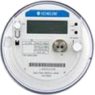
ERCOT Responsibilities
Settle the Wholesale Markets
Adjusted Metered Load (QSE)
Qualified Scheduling Entity (QSE)
Retail Electric Provider (REP)
Unaccounted For Energy (UFE)
Losses
Meter Data

Slide 47




REP Responsibilities
Service Retail Customers
  Negotiate competitive contracts with retail Customers
  Manage retail Customer’s ESI IDs
  Act as primary contact for electric service issues

Slide 48





REP Responsibilities
Meet Financial Responsibilities
  Pay and/or dispute invoices
    Buy electricity at wholesale
    Pay TDSPs for delivery costs
  Invoice retail Customers for their monthly usage
$$$$

Slide 49
REP Responsibilities
Investigate Customer Switching issues
  Work with TDSPs and other REPs to resolve inadvertent gains and losses
REP #1
REP #2

Slide 50
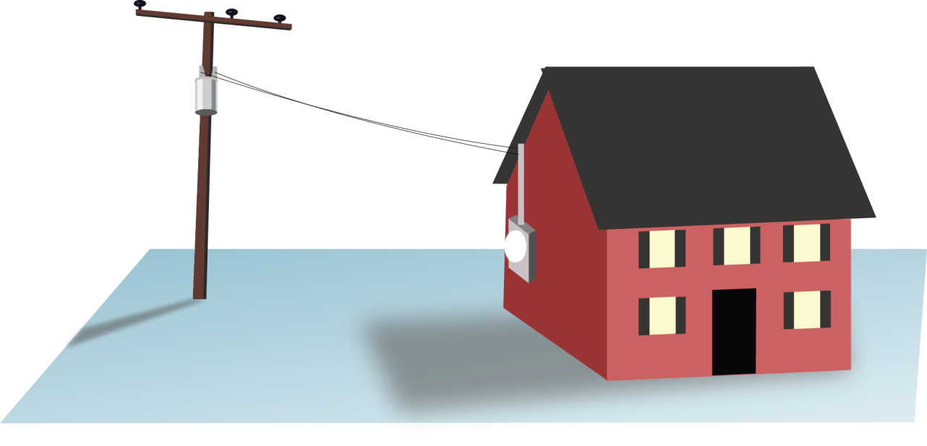

TDSP Responsibilities
Physical System Operations
  Maintain reliable transmission and distribution system
  Physically connect Customer Premise to ERCOT grid
  Maintain metering systems at Customer Premises
  Resolve power outages

Slide 51
TDSP Responsibilities
Retail System Operations
  Establish ESI IDs
  Facilitate Enrollments and Service Order Requests
  from REPs
  Provide ESI ID usage data
  for ERCOT Settlement
  and REP billing
REP #1
REP #2

Slide 52
TDSP Responsibilities
The anatomy of an ESI ID
10xxxxxzzz..zz
Where:
10 Placeholder for future
xxxxx Five digit DOE code for TDSP
zzz..zz Up to 29 alphanumeric characters assigned by TDSP
Notes:
Speaking of ESI IDs, we should spend a little time looking at the basic anatomy of an ESI ID. When the TDSP sets up an ESI ID, they must follow a prescribed format defined in Protocol Section 15. Every ESI ID today will begin with “10,” originally set up as a future placeholder, but holds no physical meaning today. The next five digits (the Xs) are the most significant portion of the number for our purposes here, because they define the TDSP who set up the ESI ID in the first place. So this part of the code will tell a REP at a glance which TDSP services this premise. The remaining digits are any combination of up to 29 alphanumeric characters, used at the TDSPs discretion.

Slide 53
TDSP Responsibilities
The anatomy of an ESI ID
10xxxxxzzz..zz
XXXXX | TDSP Name
20404 | AEP TX North
03278 | AEP TX Central
08901 | CenterPoint
13830 | Nueces Electric Coop
44372 | Oncor Electric Delivery
17699 | Oncor/SESCO
03109 | Sharyland Utilities
17008 | Sharyland Utilities-McAllen
40051 | Texas New Mexico Power (TNMP)
Notes:
Speaking of ESI IDs, we should spend a little time looking at the basic anatomy of an ESI ID. When the TDSP sets up an ESI ID, they must follow a prescribed format defined in Protocol Section 15. Every ESI ID today will begin with “10,” originally set up as a future placeholder, but holds no physical meaning today. The next five digits (the Xs) are the most significant portion of the number for our purposes here, because they define the TDSP who set up the ESI ID in the first place. So this part of the code will tell a REP at a glance which TDSP services this premise. The remaining digits are any combination of up to 29 alphanumeric characters, used at the TDSPs discretion.

Slide 54
TDSP Responsibilities
Invoice REPs according to tariffs
  Delivery charges based on usage
  Discretionary charges
Please refer to each TDSP’s website for details

Slide 55


TDSP Responsibilities
Investigate Customer Switching issues
  Work with REPs to resolve inadvertent gains and losses
MarkeTrak
MarkeTrak

Slide 56
PUCT Responsibilities
Public Utility Commission of Texas (PUCT)
  Provides regulatory oversight
    ERCOT operations and budget
    TDSPs operations and tariffs
    REP certification / oversight

Slide 57
PUCT Responsibilities
Public Utility Commission of Texas (PUCT)
  Provides consumer protection
    Creates Substantive Rules that govern
    all other Market Rules and Protocols
    Maintains Power to Choose website
    Receives and investigates Customer complaints

Slide 58
Module 3
Market Rules

Slide 59
Overview
Topics in this lesson . . .
  Introduction to Market Rules
    Public Utility Regulatory Act (PURA)
    PUCT Substantive Rules
    ERCOT Protocols and Market Guides
  Finding the Rules
  Revision Process

Slide 60



Hierarchy of Rules
Public Utility Regulatory Act (PURA)
PUCT Substantive Rules
ERCOT Protocols
and Market Guides

Slide 61
State of Texas Laws
Public Utility Regulatory Act (PURA)
  Amended by Senate Bill 7 in 1999 to restructure the electric utility industry in ERCOT
    Implement customer choice in certain areas by January 1, 2002
    PUCT and ERCOT responsible for determining specifics
  Defines the Public Utility Commission of Texas (PUCT) and it’s role
  Continues to evolve

Slide 62
Hierarchy of Rules
Public Utility Regulatory Act (PURA)
PUCT Substantive Rules
ERCOT Protocols
and Market Guides

Slide 63

Public Utility Commission of Texas (PUCT) Rules
PUCT Substantive Rules
  Implement PURA requirements, including
    Customer protection rules
    Standard terms and conditions (Tariffs)
    for utilities
  Electric Substantive Rules are contained in Chapter 25
  Refer to PUCT Website for complete rules

Slide 64
PUCT Substantive Rules
A Few Key Rules for Retail Electric Providers
§ 25.43 | Provider of Last Resort (POLR) Default provider for customers due to REP failure Several chosen by PUC in each service area
§ 25.107 | Certification of Retail Electric Providers (REPs) Financial Technical Managerial
§ 25.214 | Terms and Conditions of Retail Delivery Service Provided by Investor Owned Transmission and Distribution Utilities (Tariffs)
§ 25.454 | Rate Reduction Program Low Income Discount (LITE UP) for eligible customers Currently funded through August 2016
§ 25.471 through § 25.500 | Customer Protection Rules

Slide 65
PUCT Substantive Rules
Customer Protection Rules (Part 1)
§ 25.471 | General Provisions of Customer Protection Rules | § 25.478 | Credit Requirements and Deposits
§ 25.472 | Privacy of Customer Information | § 25.479 | Issuance and Format of Bills
§ 25.473 | Non-English Language Requirements | § 25.480 | Bill Payment and Adjustments
§ 25.474 | Selection of REP | § 25.481 | Unauthorized Charges
§ 25.475 | General REP Requirements and Information Disclosures to Customers | § 25.482 | Prompt Payment Act
§ 25.476 | Renewable and Green Energy Verification | § 25.483 | Disconnection of Service
§ 25.477 | Refusal of Electric Service | § 25.484 | Electric No-Call List

Slide 66
PUCT Substantive Rules
Customer Protection Rules (Part 2)
§ 25.485 | Customer Access and Complaint Handling | § 25.492 | Non-Compliance with Rules or Orders
§ 25.487 | Obligations Related to Move-In Transactions | § 25.493 | Acquisition and Transfer of Customers from one REP to Another
§ 25.488 | Procedures for a Premise with No Service Agreement | § 25.495 | Unauthorized Change of REP
§ 25.489 | Treatment of Premises with No Retail Electric Provider of Record | § 25.497 | Critical Load, Critical Care and Chronic Condition Customers
§ 25.490 | Moratorium on Disconnect on Move-Out | § 25.498 | Prepaid Service
§ 25.491 | Record Retention and Reporting Requirements | § 25.500 | Privacy of Advanced Metering System Information

Slide 67
Hierarchy of Rules
Public Utility Regulatory Act (PURA)
PUCT Substantive Rules
ERCOT Protocols
and Market Guides

Slide 68


ERCOT Protocols and Market Guides
ERCOT Protocols
  Outline the procedures and processes used by ERCOT and Market Participants for the orderly functioning of the ERCOT system and markets.
ERCOT Market Guides
  Based upon the ERCOT protocols
  Detailed reference documents for establishing market and operating processes.

Slide 69
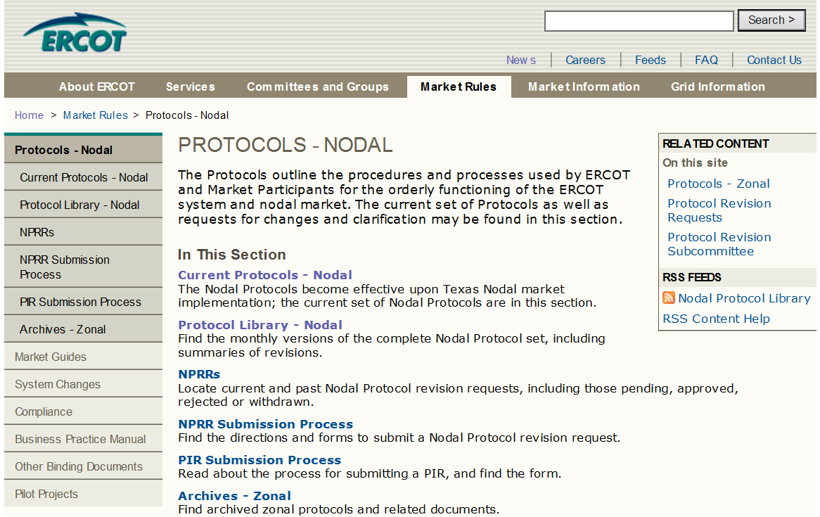
ERCOT Protocols
Notes:
Instructor should point out that current protocols are housed under the top link. However, all previous versions are also available under the “Protocol Library” link.
Instructor should also point out the “Other Binding Documents” link in the navigation bar and briefly mention that these other documents supplement the Protocols.

Slide 70

ERCOT Protocols
Protocol Overview for Retail Electric Providers
Sections | Description
1-2 | Construction and Definitions
3-9 | System Operations and Wholesale Markets
10 | Metering
11 | Data Aggregation
14 | Renewable Energy Credit Trading Program
15 | Customer Registration
16 | Market Participant Registration
19 | Texas Standard Electronic Transactions
20 | Alternative Dispute Resolution Process
21 | Revision Request Process

Slide 71
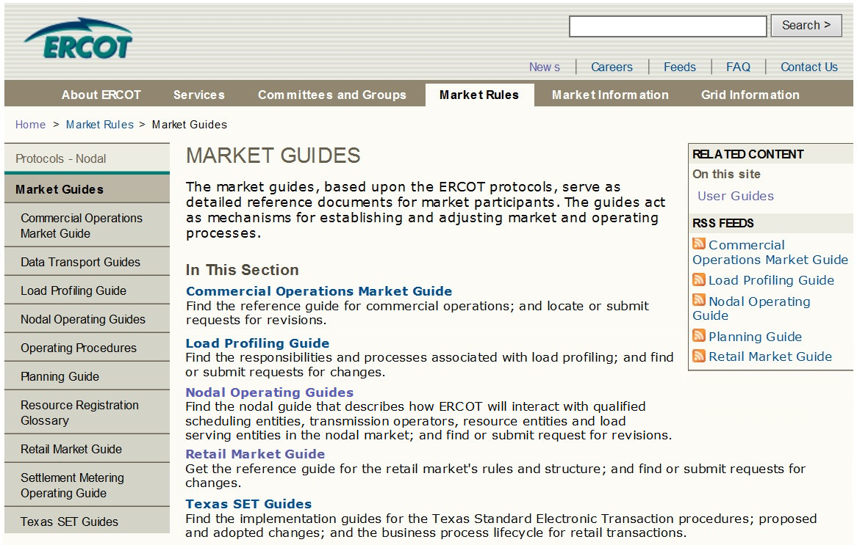
ERCOT Market Guides

Slide 72
Protocol and Market Guide Revision Process
Board
Of
Directors
Board and TAC approve Protocols and Market Guides
Technical Advisory
Committee
(TAC)
Retail Market Subcommittee (RMS)
Reliability Operations Subcommittee (ROS)
Wholesale Market Subcommittee (WMS)
Commercial Operations Subcommittee (COPS)
Protocol Revision Subcommittee (PRS)
Subcommittees recommend changes to the
ERCOT Protocols and Market Guides

Slide 73
Protocol and Market Guide Revision Process
Changes are proposed through formal Revision Requests
  NPRR – Nodal Protocol Revision Request
  * GRR – [Name] Guide Revision Request, such as
    RMGRR – Retail Market Guide
    COPMGRR – Commercial Operations Market Guide
    NOGRR – Nodal Operating Guide
  SCR – System Change Request
NPRR711
RMGRR132
Revision Requests are posted with applicable documents on ercot.com

Slide 74
Module 4
Retail Transaction Processing

Slide 75
Overview
  Topics in this lesson . . .
  Introduction to Texas SET Retail
  Transactions
  Systems used by ERCOT, REPs and
  TDSPs for processing Retail Transactions
  Market Processes that use Retail Transactions
  Timing of Retail Transaction flow

Slide 76

An Important Definition
Retail Transaction:
  A Communication that enables and facilitates retail business processes in the deregulated Texas Electrical Market
  Involves REPs, TDSPs and ERCOT
  Electronic Data Interchange (EDI)
  format, based on ANSI
  ASC X12 Standards

Slide 77
Texas Standard Electronic Transactions (TX SET)
Retail Transactions are defined by TX SET Implementation Guides
  Developed and maintained by TX SET Working Group
  High level description in Protocol Section 19
  Detailed Implementation Guides posted on ERCOT.com

Slide 78
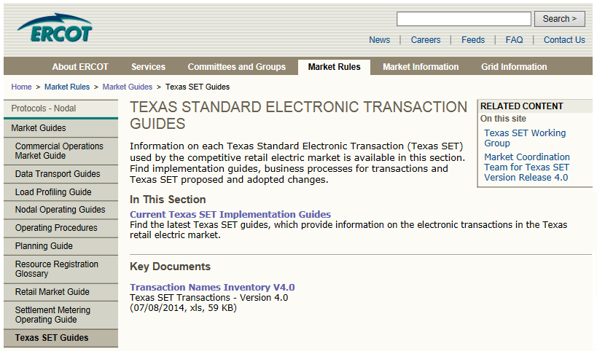
Texas Standard Electronic Transactions (TX SET)
Transaction Names Inventory and Pocket Card
Notes:
But for quick reference, there is also a Transaction Name Inventory posted on ERCOT.com, complete with a handy pocket card. We printed and laminated pocket cards to give you here today. We hope that you will find them as useful as we do. We also hope that you will use them in the upcoming class scenarios!

Slide 79
Texas Standard Electronic Transactions (TX SET)
Many transactions involve ERCOT
Transaction Type | Use
814’s – ESI ID info and Relationships (Many flavors) | Enrollments; Switch Requests; Move-Ins; Move-Outs; ESI ID Maintenance
867’s – Premise Usage | Initial Meter Read; Historical / Monthly Usage
824’s – Reject Notification | Notice of Invoice / Usage Rejection
Notes:
Instructor should point students to the pocket card for this discussion. Point out how many different 814’s there are.

Slide 80
Texas Standard Electronic Transactions (TX SET)
Some transactions do not involve ERCOT
Transaction Type | Use
810’s – Invoice | Bills for Charges between Market Participants
820’s – Payments | Payments between Market Participants
650’s – Service Order Requests | Disconnects for Non-Pay; Reconnects Switch Hold and Switch Hold Removal; Planned Outage Notification
824’s – Reject Notification | Invoice or Usage Rejection
These are called Point-to-Point Transactions
Notes:
Of course, there are some transactions that do not involve ERCOT. These transactions flow between TDSPs and REPs and are called Point-to-Point Transactions.

Slide 81
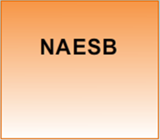

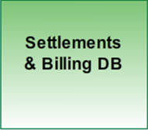
ERCOT Involved Transactions
What are the systems?
North American Energy Standards Board
Electronic Delivery Mechanism
Standards for data delivery
Allows standardized communication
System of Record for Relationships
Currently Siebel
System of Record for ESI ID data
System of Record for usage
ERCOT-developed system
Notes:
Let’s spend some time looking at the transactions involving ERCOT. We want to start by looking at the systems that are involved in these transactions.

Slide 82
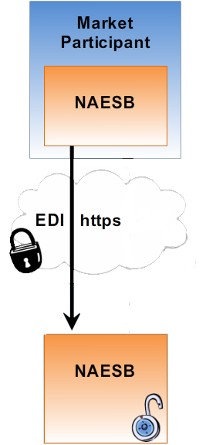

Systems for ERCOT Involved Transactions
Transaction is initiated by Market Participant
Market Participant NAESB Server initiates secure communication over Secured Socket Layer (SSL)
Market Participant sends encrypted EDI package
ERCOT NAESB Server identifies and decrypts EDI files
ERCOT Systems

Slide 83
Systems for ERCOT Involved Transactions
Data is validated and forwarded
Validated against TX SET and ANSI X12
Translated for other ERCOT systems
ERCOT Systems

Slide 84
Systems for ERCOT Involved Transactions
Registration Database (Siebel)
Stores REP registration information
Manages ESI ID to REP relationships
ERCOT Systems

Slide 85
Systems for ERCOT Involved Transactions
Settlements and Billing Database
Stores all ESI ID characteristics
Receives ESI ID to REP relationships through daily batch process
Incorporates relationship data into Service History for use in the settlement process
ERCOT Systems

Slide 86
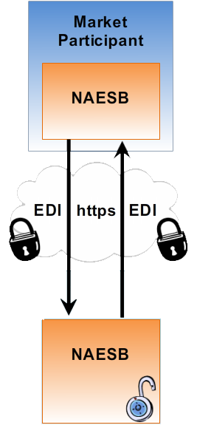
Systems for ERCOT Involved Transactions
Some transactions are initiated by ERCOT
ERCOT NAESB Server initiates secure communication over Secured Socket Layer (SSL)
ERCOT sends encrypted EDI package
Market Participant NAESB Server identifies and decrypts EDI files
ERCOT Systems

Slide 87
Another Definition
Market Process:
  A pre-defined package of retail transactions that must occur in a particular sequence
  Developed and maintained by ERCOT and the TX SET Working Group
REP
814_16
ERCOT
814_03
TDSP
814_04

Slide 88
ERCOT Involved Transactions
Typical Retail Market Processes
  Move-In
  Switch Request
  Move-Out
REP #1
REP #2
These processes are typically initiated by customer request

Slide 89
Customer Move-In
From
To
Transaction Type
ERCOT
TDSP
REP
ERCOT
TDSP
REP
Move In Request
814_16
Enrollment
Notification Request
814_03
Enrollment
Notification Response
814_04
CR Enrollment
Notification Response
814_05
Historical Usage
(If requested by REP)
867_02
2
1
1
2
Initial Meter
Read
867_04
2
1
1
2
Summaries of scenarios provided upon completion
Notes:
The following set of scenarios illustrate three major market processes that utilize ERCOT-Involved transactions. Important: Learners must have their pocket cards (handed out earlier) to participate in this activity. These scenarios allow the instructor to walk the class through these processes step by step and encourage students to use the pocket card to begin speaking the transaction lingo.
As we can see here, the move-in process involves multiple transactions. In fact, the Move-In market process is a pre-defined package of transactions that must occur in a particular sequence. Notice that the sequence is initiated with the Move-In Request transaction. What follows is an ERCOT-facilitated exchange of information between ERCOT, a Competitive Retailer (REP), and the TDSP that physically connects the retail premise to the grid. Each transaction has a code number as specified in Texas SET. A transaction will always flow between at least two parties.
[Instructor should facilitate this classroom exercise as follows:]
As we have said, a Move-In Request is used to begin the Customer enrollment process for a Move-in. Using the reference cards that we handed out earlier, can someone tell me the transaction number?
Great! <Click to display number> And what parties does the transaction flow from and to?
Great! <Click to display dots> The Move-In Request is sent from the REP to ERCOT
The next transaction is the Enrollment Notification Request. What’s the number for that one? <Click to display> Who sends and receives it? <Click to display>
Great! This transaction notifies the TDSP of a Move-In, so that they can schedule meter reads.
The next transaction is the Enrollment Notification Response. What’s the number for that one? <Click to display> Who sends and receives it? <Click to display>
Great! With this transaction, the TDSP acknowledges the enrollment request and provides the Scheduled Meter Read Date.
The next transaction is the CR Enrollment Notification Response. What’s the number for that one? <Click to display> Who sends and receives it? <Click to display>
Perfect! This transaction passes the TDSP acknowledgement back to the REP, so that they will also know the Scheduled Meter Read Date. This is important because it effectively marks the beginning of the REP’s service history with this customer.
The Historical Usage, if requested through the Move-in Request, provides the REP with up to 12 months of historical metered consumption at the premise. This data provides the REP with a starting point for estimating energy consumption for this customer, so that they can adequately prepare for it at the wholesale level. What’s the number for this transaction? <Click to display> Who sends and receives it? <Click to display> [Two clicks this time. Instructor may need to facilitate the two steps here]
Perfect! This transaction actually requires two steps. First the TDSP provides the Historical Usage to ERCOT, and then ERCOT passes the data on to the REP.
Lastly, the Initial Meter Read also occurs in two steps. What’s the number for this transaction? <Click to display> Who sends and receives it? <Click to display> [Two clicks again]. Great! The TDSP provides the Initial Meter Read to ERCOT, and then ERCOT passes the data on to the REP. This meter read forms the starting point for the REP’s service history with the customer. ERCOT will also use this information as the starting point for calculating wholesale energy consumption at the QSE level.

Slide 90
Switch Request
From
To
Transaction Type
ERCOT
Old REP
TDSP
New REP
ERCOT
Old REP
TDSP
New REP
Switch Request
814_01
Enrollment
Notification Request
814_03
Enrollment
Notification Response
814_04
CR Enrollment
Notification Response
814_05
Loss Notification
814_06
Final Usage
867_03
2
1
1
2
Initial Meter Read
867_04
2
1
1
2
Summaries of scenarios provided upon completion
Notes:
The next scenario, a Switch Request, becomes more complicated. Notice that there are simply more transactions. Plus, this type Service Order Request involves two REPs!
[Instructor should facilitate as in previous scenarios]

Slide 91
Customer Move-Out
From
To
Transaction Type
ERCOT
TDSP
REP
ERCOT
TDSP
REP
Move Out Request
814_24
2
1
1
2
Move Out Response
814_25
2
1
1
2
Final Meter Read
867_03
2
1
1
2
Others illustrated at http://www.ercot.com/mktrules/guides/txset/sw/index
Summaries of scenarios provided upon completion
Notes:
Our next scenario, the Move-Out Business, is a little bit simpler.
[Instructor should facilitate as in previous scenario]

Slide 92
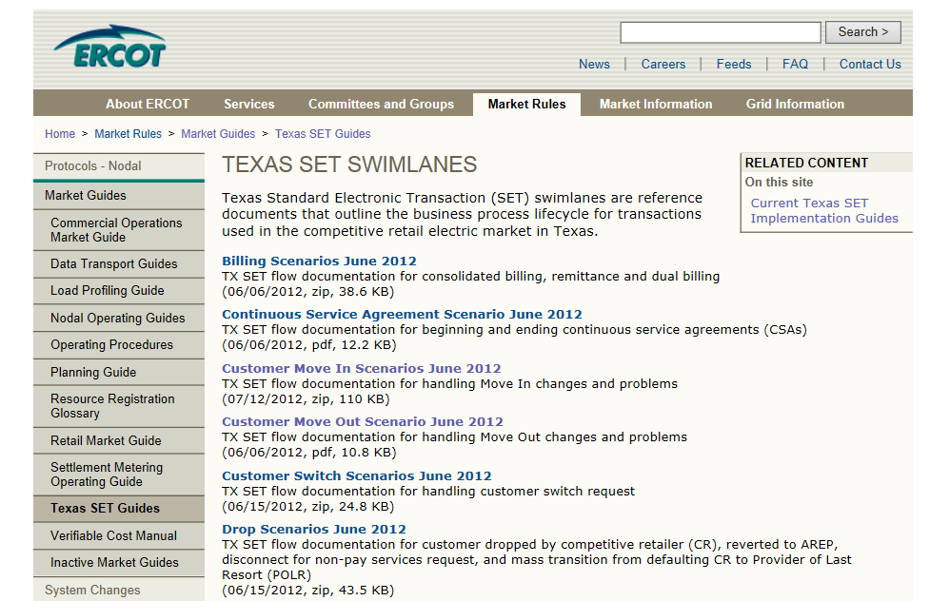
The Swimlanes!
Notes:
<Instructor should ask,> Has anyone heard of the Texas SET Swimlanes?”
If you have heard that they are scary, don’t worry, they are simply the detailed illustrations of retail market processes like the three we just covered . We’re not going to dive down to that level of detail right now; however, it is important that you know where to find the Swimlanes for future reference and further exploration.

Slide 93
Common Transaction Timelines
Enrollment type Initiating Transaction | AMS Remote (AMSR) | AMS Manual (AMSM) | Non-AMS
Move-In 814_16 | Same Day | 2 Business Days | 2 Business Days
Standard Switch 814_01 | Same Day | Same Day | Within Next 4 Business Days
Self Selected Switch 814-01 | Same Day | Same Day | At Least 2 Business Days
Move-Out 814_24 | Same Day | 2 Business Days | 2 Business Days
For purposes of determining these minimum timelines, business hours end at 1700
Notes:
Please note the different turnaround times for AMS and Non-AMS meters. Also AMS meters with remote connect/disconnect capabilities also have different turnaround times for Move-ins (and Disconnects for non-payment, as we shall see later)

Slide 94
Systems for Point-to-Point Transactions
Transaction is initiated by one Market Participant
Market Participant NAESB Server initiates secure communication and sends encrypted EDI package
Receiving Market Participant NAESB Server decrypts EDI files
Data is validated and routed to back-office systems
Market Participant
Back-office systems may vary by Market Participant
Back-Office
Systems

Slide 95
Disconnect/Reconnect for Non-Payment
From
To
Transaction Type
TDSP
REP
TDSP
REP
Service Order: Request for DNP/RNP
650_01
Service Order: Response for completion of DNP/RNP
650_02
Timing requirements vary depending on circumstances. Details in PUCT Substantive Rules and Retail Market Guide

Slide 96
Billing and Payment
From
To
Transaction Type
ERCOT
TDSP
REP
ERCOT
TDSP
REP
Monthly Usage
867_03
2
1
1
2

Slide 97
Billing and Payment
From
To
Transaction Type
ERCOT
TDSP
REP
ERCOT
TDSP
REP
Monthly Usage
867_03
2
1
1
2
From
To
Transaction Type
TDSP
REP
TDSP
REP
Invoice
(Wires Charges)
810_02
Remittance Detail
820_02
REP Pays TDSP through HACHA/Wire Transfer

Slide 98
Module 5
Advanced Meter Technology

Slide 99
Overview
Topics in this lesson . . .
  Meter Data – The Big Picture
  A Few Definitions
  Impacts of Advanced Meter Technology
  on the Retail Market

Slide 100
Meter Data – The Big Picture

Slide 101

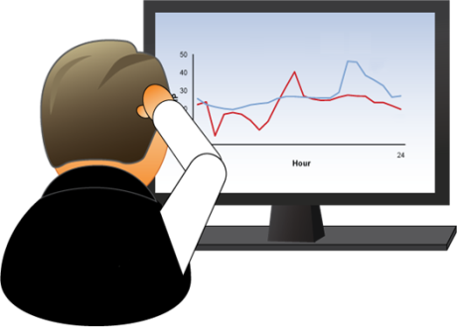



The Big Picture – AMS Meter Data Flow
Monthly Billing
Available
Day 2
Customer
Wholesale Settlement
Transmitted
periodically
Day 1
Day 1
Monthly – 867
Monthly – 810
Validation, Editing & Estimation (VEE)

Slide 102

The Big Picture – Meter Data in Settlements
Adjusted Metered Load (QSE)
Qualified Scheduling Entity (QSE)
Calculated for each 15 minute interval
Retail Electric Provider (REP)
Unaccounted For Energy (UFE)
Losses
Collected by TDSPs
Meter Data
Notes:
We saw this picture earlier in the course. <Click for animation> Load meter data is collected and sent to ERCOT by TDSPs. Ultimately, ERCOT must roll all meter data up to the QSE level in order to settle the Wholesale Markets. ERCOT adjusts the metered load data to incorporate Losses and UFE and calculates each QSE’s Adjusted Metered Load. <Click for animation> Since ERCOT settles the Wholesale Markets on a fifteen minute interval, the QSEs’ Adjusted Metered Load must be calculated for each fifteen minute interval.

Slide 103
The Big Picture – Meter Data in Settlements
Load Related Charges
Adjusted Metered Load (QSE)
Qualified Scheduling Entity (QSE)
ERCOT settles with QSE based on Adjusted Metered Load
  Energy usage
  Other load-related charges

Slide 104
The Big Picture – Meter Data in Settlements
Adjusted Metered Load (QSE)
Qualified Scheduling Entity (QSE)
Load Related Charges
QSE Settles with REP
  Energy usage
  Other load-related charges
Retail Electric Provider (REP)

Slide 105
The Big Picture – Meter Data in Settlements
Adjusted Metered Load (QSE)
Qualified Scheduling Entity (QSE)
REP Bills Customers
  Energy usage based on Meter Data
  Other service-related charges
Retail Electric Provider (REP)
Notes:
Other service-related charges include TDSP delivery and discretionary charges

Slide 106
A Few Definitions

Slide 107
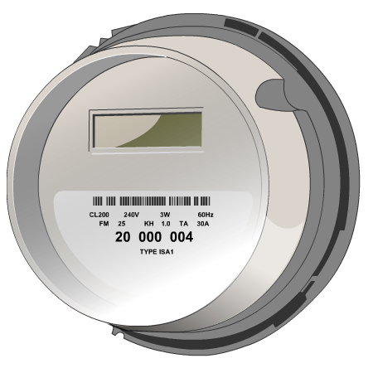

A Few Definitions
Meter – A device that measures electrical usage over a period of time
Notes:
Just so everyone is clear, when we speak of a meter, we are speaking of a device that measures electrical usage over some period of time. The time component of this definition is important, because it will help us distinguish between the various meters that are utilized in ERCOT.

Slide 108
A Few Definitions
Meter Technologies
Advanced Meter System
(AMS) Meters
  AMSR – remote (R) connectivity
  AMSM – manual (M) connectivity
Non AMS Meters
  Scalar, Analog, Digital
  Interval Data Recorder (IDR) Meters

Slide 109
A Few Definitions
Various types of meters today
Standard*
  Advanced Meter System– Remote (AMSR)
Non-Standard*
  Advanced Meter System- Manual (AMSM)
  Interval Data Recorder (IDR) Meter
  Non-IDR
*As defined in TDSP Tariffs (PUCT 25.215)

Slide 110

A Few Definitions
Interval Data Recorder (IDR) Meter
  Usage is measured in
  15-minute intervals
  Data is already shaped for 15 minute Wholesale Settlement
  Typically reported monthly through 867 transactions
  Predominantly installed on large customers > 700 kW/kVA demand
  May require manual field activities
ERCOT Settles the Real-time Wholesale Market in 15-minute intervals

Slide 111
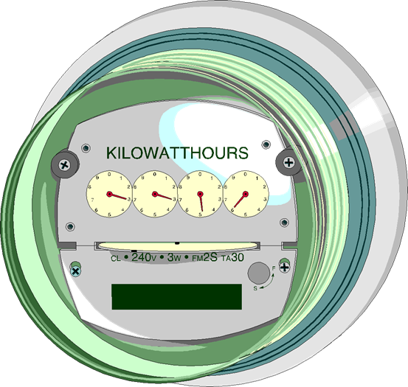
A Few Definitions
Non-IDR Meter
  Traditional Meter
  Usage is a scalar measurement for an entire month
  Data must be shaped for 15 minute Wholesale Settlement
  Requires manual field activities

Slide 112
A Few Definitions
Advanced Meter System (AMS) Meter
  Usage is recorded in 15 minute intervals
  Data is already shaped for 15 minute Wholesale Settlement
  Remote capabilities
    AMSR (≤ 200 amp)
      Remote / automatic reading
      Remote connect/disconnect
    AMSM
      Remote / automatic reading
      Manual connect/disconnect
Also known as a “Smart Meter”

Slide 113
Impacts of
Advanced Meter Technology on the Retail Market

Slide 114
Impact of Advanced Meter Technology
So, what does Advanced Meter Technology mean for the Retail Market?
  Meter data is more detailed
  Meter data is available faster
  Greater visibility of data
  More opportunities for retail products
  Other benefits

Slide 115
Meter Data is More Detailed
Before Advanced Meters
  ~58% of competitive load was settled with NIDR meters
    Had to be shaped with Load Profile
    Actual customer load pattern might have been different
    Errors contributed to UFE

Slide 116
Meter Data is More Detailed
After Advanced Meters
  ~98% of competitive load is now settled using interval data
    REP can discover customer’s actual usage pattern
    More accurate REP settlement with QSE
    Less UFE

Slide 117
Meter Data is Available Faster
More Accurate Initial Settlement
  Today, ~73% actual load data used in Initial
  Before Advanced Meters, ~ 39% actual load data was used in Initial
ERCOT Real-Time Settlements Timeline
Operating Day
Day 5
Day 55
Day 180
Initial Statement
Final
Statement
True-Up Statement

Slide 118
Meter Data is Available Faster
Faster Execution of Retail Market Processes
Enrollment type Initiating Transaction | AMS Remote (AMSR) | AMS Manual (AMSM) | Non-AMS
Move-In 814_16 | Same Day | 2 Business Days | 2 Business Days
Standard Switch 814_01 | Same Day | Same Day | Within Next 4 Business Days
Self Selected Switch 814-01 | Same Day | Same Day | At Least 2 Business Days
Move-Out 814_24 | Same Day | 2 Business Days | 2 Business Days

Slide 119


Greater Visibility of Data
Available
Next
Afternoon
Customer
Available
Next
Afternoon
Transmitted
periodically
Uploaded
After Midnight

Slide 120
More Opportunities
Advanced Meter technology offers the promise of new Retail products
  Prepay
  Demand Response
  Time-of-Use Rate offerings
Qualified Scheduling Entity (QSE)
Retail Electric Provider (REP)
These products are
available now. More are
on the way!
Notes:
Smart Meter technology also offers the promise of new Retail products? The greater timeliness of meter data allows for better prepay products, where a customer pays in advance to use a certain amount of electricity over a certain period of time. The greater precision and interval measure of meter data allows for further enhancement of demand response products. Having interval data for most customers allows REPs to offer the long-sought time-of-use pricing.
<Click for animation> These products are available now, in some form. But there is probably more to come. Convenience and economic incentives should spur demand for these types of products, improving the current offerings, and bringing new offerings to market!

Slide 121
Other Benefits
Fringe Benefits of AMS
  Improved service reliability with automated outage notification
  Earlier detection
    Faulty meters
    Meter tampering
  Environmental benefits – remote service orders minimize the need for manual field activities

Slide 122
Module 6
Data Transparency and Availability

Slide 123
Overview
Topics in this lesson . . .
  The Market Information System (MIS)
  Data Extracts
  MarkeTrak

Slide 124
Market Information System (MIS)

Slide 125

Market Information System (MIS)
Welcome to the ERCOT Data Club
. . . where membership has its perks!
Notes:
The ERCOT Market Information System (MIS) is like one of those membership stores. We’ll call this one the Data Club

Slide 126
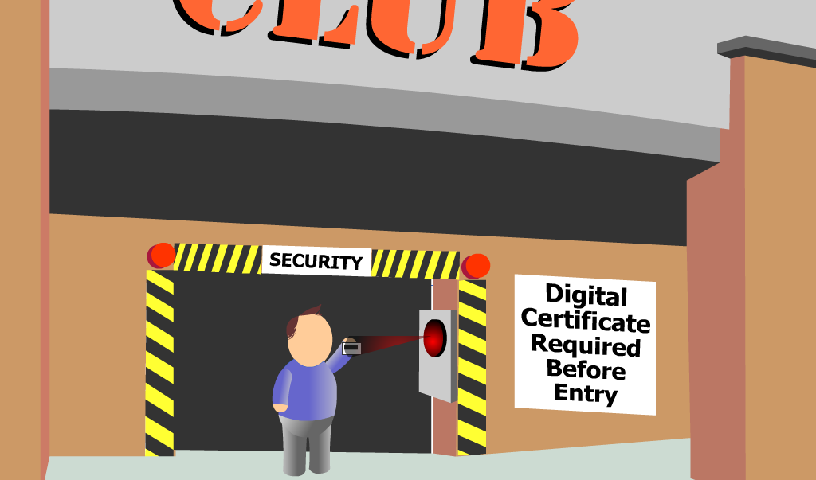
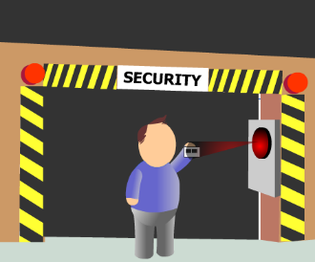
Market Information System (MIS)
Don’t forget your membership card!
Notes:
Of course, like any membership store, you must scan your membership card to enter. For the ERCOT Market Information System, the membership card takes the form of a digital certificate. Your digital certificate is what gets you in the door!

Slide 127

Digital Certificate
ERCOT issues a Digital Certificate to the
User Security Administrator (USA) for each
registered Market Participant
  General access to MIS is defined by
  the Certificate and DUNS number
  Specific access defined by users’ roles
The USA issues user Digital Certificates to individual employees at the company
  USA responsibilities outlined in Protocol 16.12
  Assigns individual user roles
  Revoke certificates as needed

Slide 128
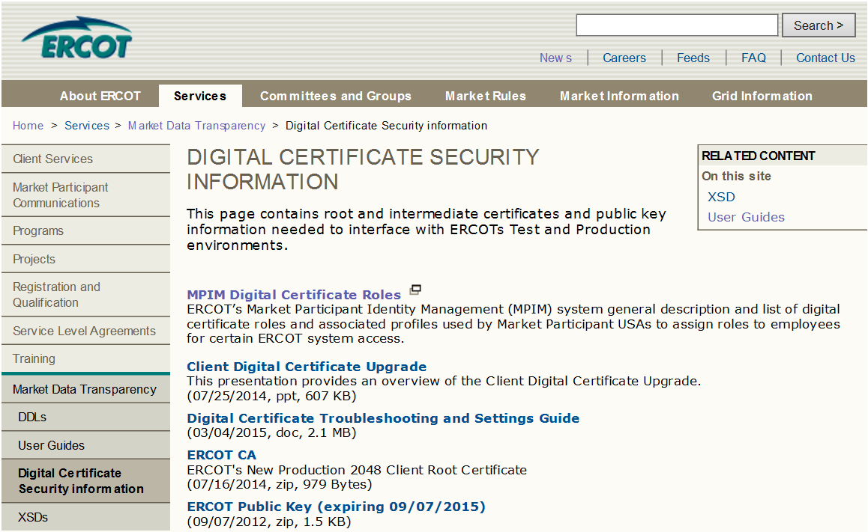
Additional Digital Certificate Information

Slide 129

Inside the Market Information System (MIS)
Notes:
Once inside the door, there are three different levels of data available, depending on membership (Digital Certificate).
Public Data is information available to the general public, but is also provided here at the Data Club as a convenience to members.
Secure Data is information available only to club members (Registered Market Participants), but is available to all club members.
Certified Data is customized information available only to individual members. Access to these racks is controlled by the Digital Certificates.

Slide 130





Examples of Public Data
Load Profiles
Load Forecasts
TDSP ESIID Extract
Market prices
Public Data is also available across
the street at Bit Mart (www.ercot.com)

Slide 131



Examples of Secure Data
Demand & Energy Monthly Reports
TDSP Monthly Load
Report
Transmission Outages
Arbitrator Summary of ADR Dispute

Slide 132


Examples of Certified Data
Data Extracts
Missing Consumption Reports (TDSP)
Potential Load Loss Reports (REP)
Marketrak Reports
User’s assigned Digital Certificate roles determine visibility

Slide 133

Can’t find what you’re looking for?
Just ask EMIL!
Notes:
However, as you browse the store, if you can’t find what you want, just ask EMIL.
EMIL knows where everything is. He knows when inventory is restocked and how long things stay on the shelf. He even knows what can be ordered for auto-delivery right to your mailbox!

Slide 134
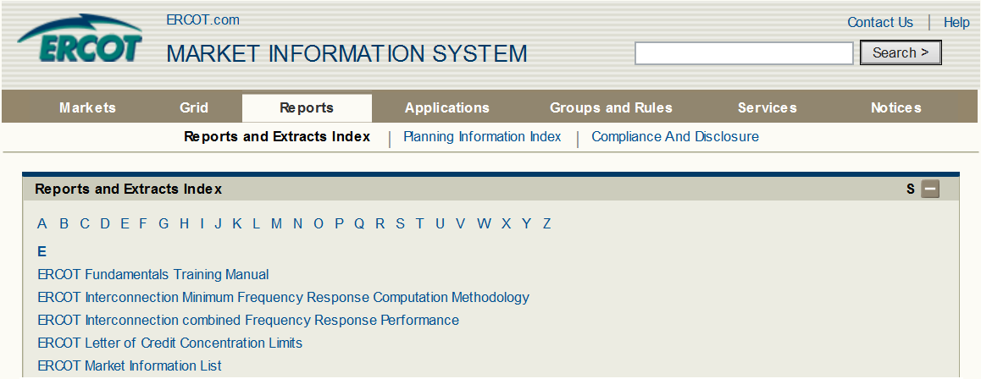

ERCOT Market Information List (EMIL)
EMIL knows all
  Location
  Frequency of Posting
  Who gets to see the data

Slide 135
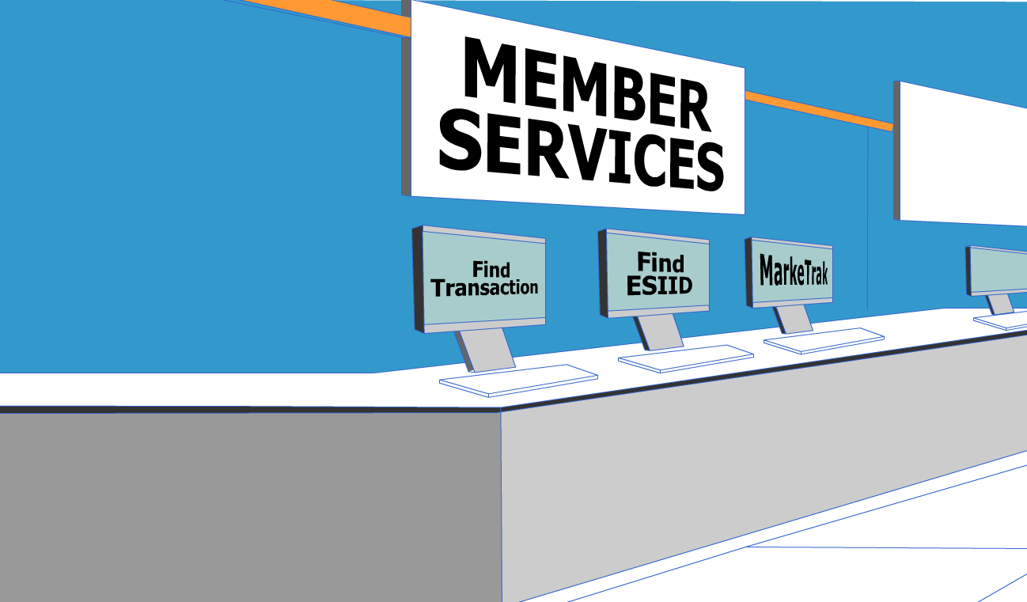
Launch other ERCOT Applications from within MIS
User’s assigned Digital Certificate roles determine which applications are available
Notes:
The Data Club even offers additional Member Services, where you can launch other ERCOT Applications from one convenient location! Please note that your individual membership (Digital Certificate) determines the specific applications that are available to you.

Slide 136
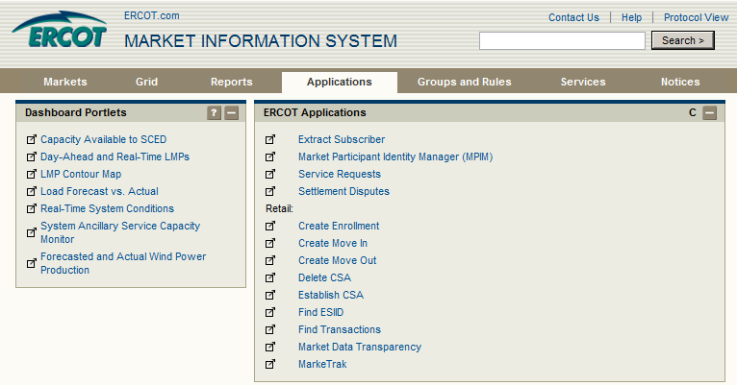
Launch other ERCOT Applications from within MIS
Notes:
Let’s look at two of these applications in particular: Find ESIID and Find Transactions. Looking at this particular screenshot, bear in mind that your view may vary depending on the assigned roles from your digital certificate. If you believe you should have more links available to you, please contact your User Security Administrator (USA).

Slide 137
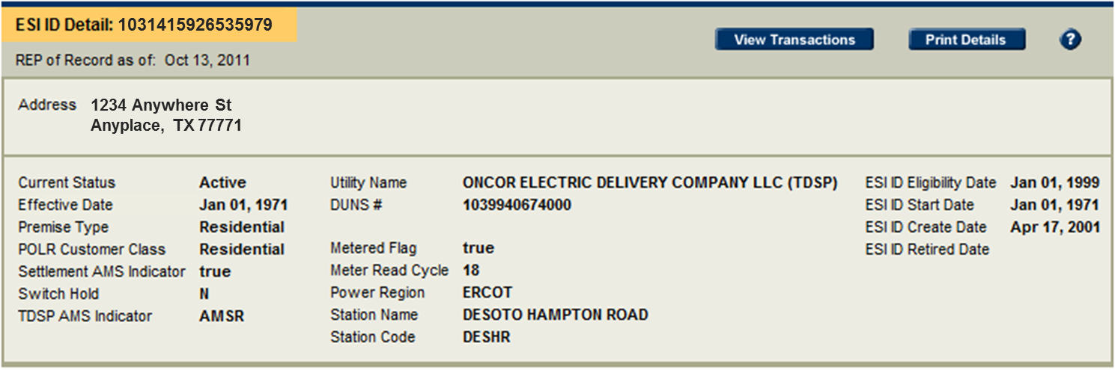

Find ESIID
Three ways to search
  Single ESIID
  Multiple ESIID
  Premise Address
Notes:
Find ESIID is a quick way to find pertinent information about particular customers or potential customers. This tool allows you to search either for a single ESIID or a group or ESIIDs. If you don’t already know the ESIID, you may also search based on the Premise address.

Slide 138
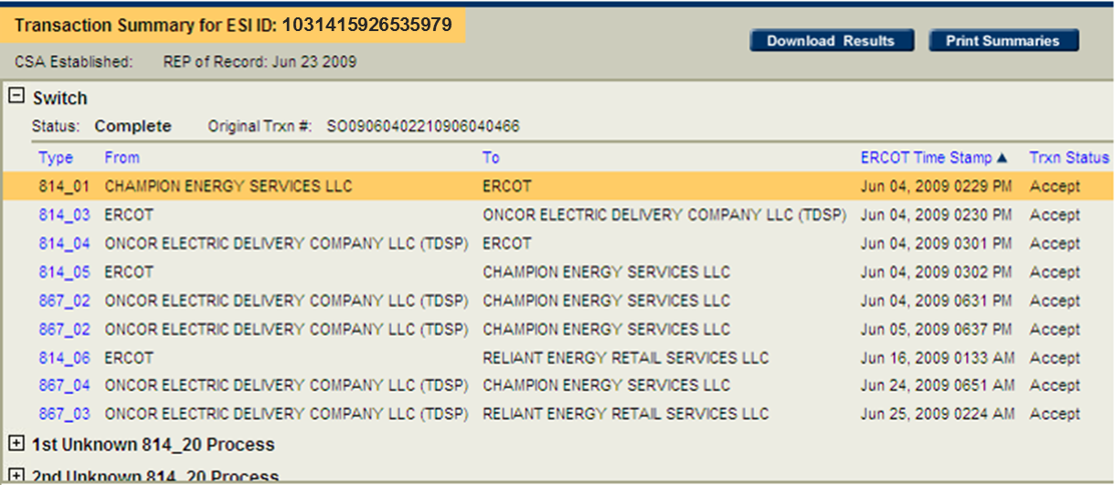
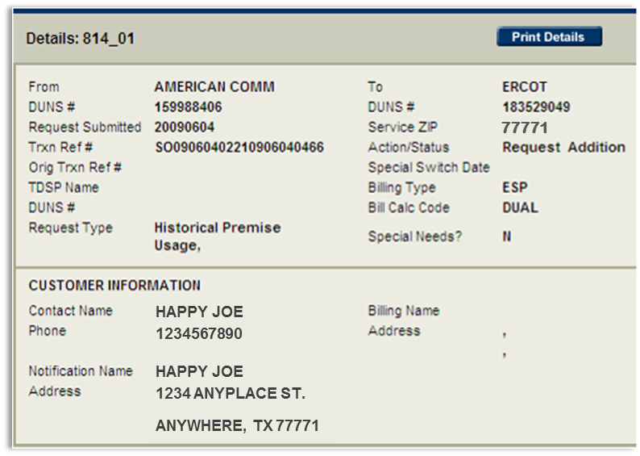
Find Transaction
Notes:
Find Transaction is a tool to research historical transactions associated with an ESIID or group of ESIIDs. Please note that if you are a Retail Electric Provider, you will be allowed to see only those transactions that took place when you were the REP-of-Record for that ESIID.

Slide 139
MarkeTrak

Slide 140

Where to Turn When Issues Arise
What happened?
  ESIID should be with
  REP #1
  ESIID is actually with
  REP #2
REP #1
REP #2
?
What can a Retail Electric Provider do?

Slide 141
Where to Turn When Issues Arise
What happened?
!
Available
Day 2
Customer
  Received monthly 810 from TDSP
  Monthly 867 is missing
Transmitted
periodically
Day 1
Monthly – 867
Monthly – 810

Slide 142

Where to Turn When Issues Arise
Market Participants turn to . . .
MarkeTrak
The Market-approved issue resolution
tool used to track and manage ERCOT
Retail Market data discrepancies
MarkeTrak
MarkeTrak

Slide 143
Launching the MarkeTrak Application

Slide 144
Using the MarkeTrak Application
Common issues reported/resolved using MarkeTrak
  Inadvertent Gains and Losses
  Cancel with/without Approval
  Missing Transactions
  Usage and Billing issues
MarkeTrak
MarkeTrak

Slide 145
Using the MarkeTrak Application
Goals of MarkeTrak
  Facilitate resolution of issues between Market Participants
    Discovery and visibility
    Tracking and status
  Enable historical reporting of issues
MarkeTrak
MarkeTrak

Slide 146
Data Extracts

Slide 147

Data Extracts
Data Extracts are an automated delivery mechanism for certain packages of MIS data

Slide 148




Data Extracts – The Big Picture
Transport data from ERCOT database to your database
ERCOT
Taylor, TX
Great MP
Somewhere, TX
May contain:
Customer info
Usage data
Settlement Data
DBA
Notes:
Extracts are sets of data used by ERCOT to manage and settle the energy market. For example, information related to the Day Ahead Market and Real Time Market is available on a daily basis via a downloadable ERCOT data extract.
It is easy to confuse a data extract with a data report. An extract is a raw data file that is intended to be uploaded into a computer database for analytical purposes. Reports are more person-friendly and exist to provide readable, summarized information to the user.

Slide 149
Data Extracts – The Big Picture
Transport data from ERCOT database to your database
ERCOT
Taylor, TX
Great MP
Somewhere, TX
Packaged in two formats:
Comma Separated Value (.csv)
Extensible Markup Language (.xml)
DBA
Notes:
Extracts are sets of data used by ERCOT to manage and settle the energy market. For example, information related to the Day Ahead Market and Real Time Market is available on a daily basis via a downloadable ERCOT data extract.
It is easy to confuse a data extract with a data report. An extract is a raw data file that is intended to be uploaded into a computer database for analytical purposes. Reports are more person-friendly and exist to provide readable, summarized information to the user.

Slide 150



Data Extracts – The Big Picture
Transport data from ERCOT database to your database
  Database must be structured properly to receive ERCOT Data
  ERCOT provides structural files for Market Participant use
    Data Definition Language (DDL) for .csv files
    XML Schema Definition (XSD) for .xml files
DBA
Notes:
For this process to work as designed, the Market Participant database must be structured properly to receive data from ERCOT. Fortunately, this is not simply guesswork. ERCOT provides structural files for the Market Participant to execute against their database. The correct structure depends on the packaging format chosen by the Market Participant. For .csv files, a Data Definition Language or DDL file is used to build the appropriate database structure. For .xml files, the XML Schema Definition or XSD file should be used.
Please note that the DDL files created by ERCOT are designed to be executed against an ORACLE database. The DDLs can be modified by the user to accommodate other common database formats. Market participants should consult with a qualified database administrator to chose the best utilization of extracts for their company.

Slide 151
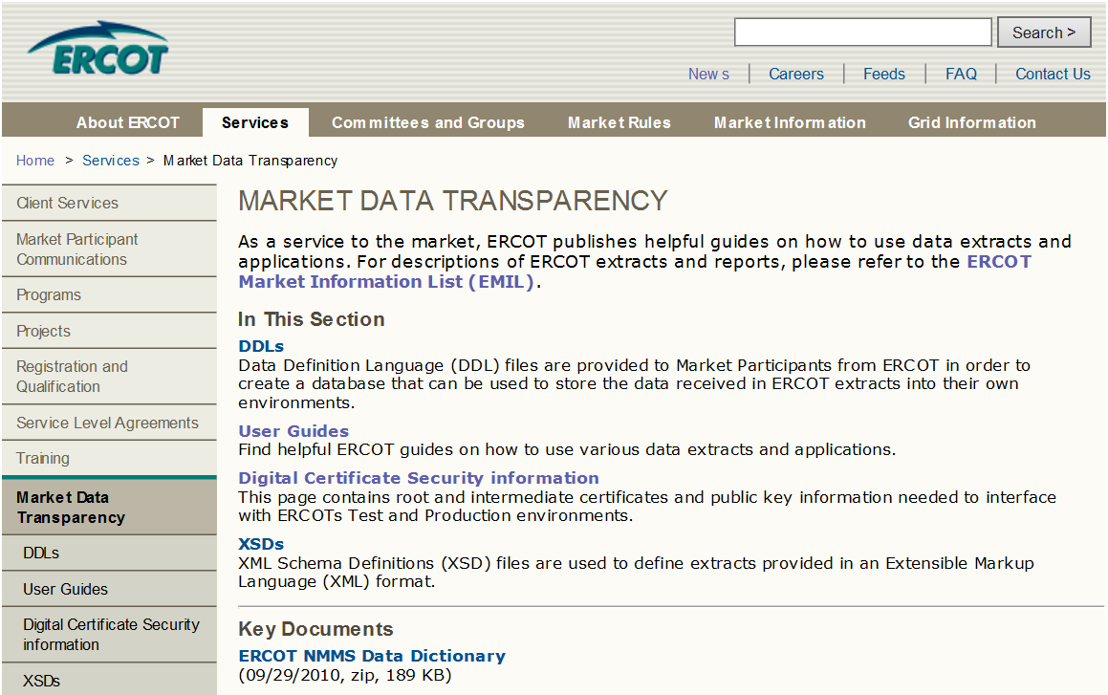
DDLs, XSDs and User Guides

Slide 152
Extract Subscriber

Slide 153

ESIID Service History and Usage Extract (a.k.a 727 Extract)
Provides Service History Information
  Start/Stop time for ESIID to REP relationship
  Other ESIID-level data
    Load Zone
    Servicing TDSP
    Profile Class
Retail Electric Provider (REP)

Slide 154


ESIID Service History and Usage Extract (a.k.a 727 Extract)
Provides Usage Data by ESIID
  Monthly Meter Data
  Available three days after data posts with ERCOT
Retail Electric Provider (REP)

Slide 155

Supplemental AMS Interval Data Extract
Provides Interval Usage Data by ESIID
  Daily Meter Data by 15-minute settlement interval
  Available three days after data posts with ERCOT
Retail Electric Provider (REP)

Slide 156
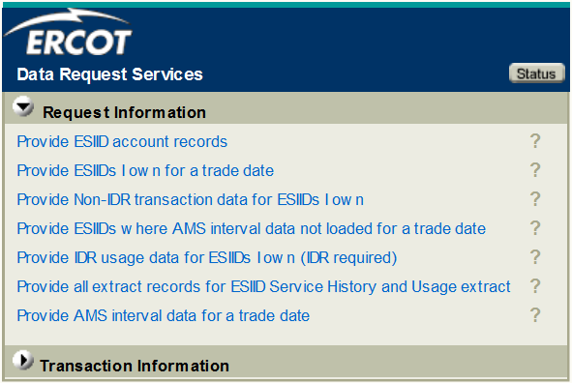
Market Data Transparency Web Service
Provides similar information on ad hoc basis

Slide 157
Market Data Transparency Web Service

Slide 158

Data Extracts
So, what does a vigilant REP do with all this data?
  Settlement reconciliation
  Planning and forecasting
Service History
Usage
Move-ins
Switches Meter Reads
ESIID
Data
ESIID
Data
Because sometimes things don’t go as planned

Slide 159
Course Conclusion
Notes:
Congratulations. You have just completed the final portion of the Nodal 101 Web-Based Training course. We hope these sessions have been informative. Thank you for your attention.

Slide 160
Additional Resources
  ERCOT Client Services
  Clientservices@ercot.com
  ERCOT Mailing Lists
  http://lists.ercot.com/
  Smart Meter Texas
  http://lists.ercot.com/
  ERCOT Training
  http://www.ercot.com/services/training/
  Market Education Contact
  Training@ercot.com
Notes:
For additional resources, please visit the ERCOT Nodal Website or reference the Nodal Protocols.
For more information about the concepts covered in this course or for a list of available courses, please visit Nodal Market Education online or contact us at NodalTraining@ercot.com

Slide 161
Summaries from Move-In, Switch Request, and Move-Out Scenarios in Module 4
Notes:
Congratulations. You have just completed the final portion of the Nodal 101 Web-Based Training course. We hope these sessions have been informative. Thank you for your attention.

Slide 162
Customer Move-In Summary
Transaction Type |  | Purpose
Move-in Request | 814_16 | Initiating Transaction
Enrollment Notification Request | 814_03 | Notifies TDSP to schedule meter reads
Enrollment Notification Response | 814_04 | TDSP provides the scheduled meter read date
CR Enrollment Notification Response | 814_05 | Communicates scheduled meter read date to REP
Historical Usage (If requested in 814_16) | 867_02 | Provides REP a starting point for estimating future usage by customer
Initial Meter Read | 867_04 | Forms the starting point for REP’s service history with customer

Slide 163
Switch Request Summary
Transaction Type |  | Purpose
Switch Request | 814_16 | Initiating Transaction
Enrollment Notification Request | 814_03 | Notifies TDSP to schedule meter reads
Enrollment Notification Response | 814_04 | TDSP provides the scheduled meter read date
CR Enrollment Notification Response | 814_05 | Communicates scheduled meter read date to new REP
Loss Notification | 814-06 | Notifies old REP of a customer drop
Final Meter Read | 867_03 | Forms the ending point for old REP’s service history with customer
Initial Meter Read | 867_04 | Forms the starting point for new REP’s service history with customer

Slide 164
Customer Move-Out Summary
Transaction Type |  | Purpose
Move Out Request | 814_24 | Initiating Transaction
Move Out Response | 814_25 | TDSP confirms the final meter read date
Final Meter Read | 867_03 | Forms the ending point for REP’s service history with customer

