Slide 2
January 2016 CMWG

Slide 3
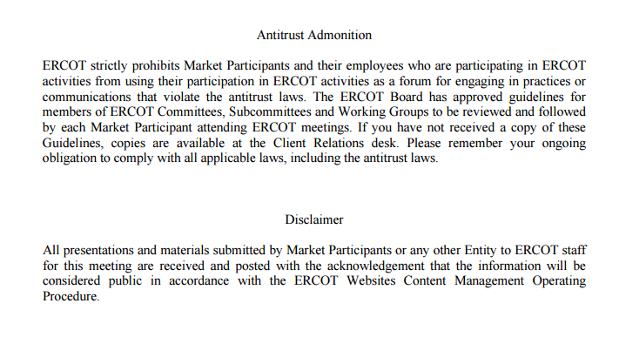
Anti-trust Admonition

Slide 4
DG Participation in CRR Markets
Distributed Generation and its impact to radial constraints
Background: Distributed Generation has expressed interest in becoming associated with a resource node. Historically, an established resource node allows participation in SCED, and CRR Markets.

Slide 5
Distributed Generation and its impact to radial constraints
Historically, radial lines to generators are ignored
If a DG sites on a radial circuit to the transmission system, and can carry local load, does the islanded system set price by the DG?
T/D Subs
DG
20MW
10MW
Should the radial constraint be honored?

Slide 6
Distributed Generation and its impact to radial constraints
Historically, radial lines to generators are ignored
If a DG sites on a radial circuit to the transmission system, and cannot carry local load, does the islanded system set price at VOLL?
T/D Subs
DG
9MW
10MW
Should the radial constraint be honored?

Slide 7
Mobile Generators / CRR Game
If mobile DG is allowed to establish a Resource Node that enables participation in CRR markets and Controls other DG interconnection sites
that enable a resource to move, and
Are on opposing sides of a constraint, then
That resource owner could benefit from a CRR position that they could influence by moving a resource.
T/D Subs
Mobile DG Interconnection
Mobile DG Interconnection
DG
9MW
10MW
Mobile DG

Slide 8
CRRs for Distributed Generation
Is it appropriate for distributed generation to participate in CRR markets?
Currently, Distributed Generation is, by virtue of their settlement, hedged to load zone regardless of location.
If DG is not allowed to establish a RN associated with their site:
Are nearby existing electrical nodes sufficient to hedge congestion risk?
Other Solutions?

