Slide 1
Annual TAC Review of the Market Impacts of Reliability Unit Commitments
Analysis of 1/1/15 through 12/31/15
ERCOT Market Analysis

Slide 2
Change in Protocol Language
Old Requirement
6.4.4.1 Energy Offer Curve for RUC-Committed Resources
The Technical Advisory Committee (TAC) shall review the market impacts of the dollar value for energy for Generation Resources committed by the RUC process for RUC-Committed Intervals every January.
New Requirement
5.8 Annual RUC Reporting Requirement
(1) ERCOT shall report to the Technical Advisory Committee (TAC), each January, an assessment of market impacts and Settlements for the aggregate Reliability Unit Commitment (RUC) activity, delineated by type of RUC instruction as follows:
(a) RUC instructions issued for Ancillary Service shortages (failure to sufficiently procure one or more Ancillary Service markets in the Day-Ahead Market (DAM) or subsequent Supplemental Ancillary Service Markets (SASMs)); (NONE in 2015)
(b) RUC instructions issued for irresolvable transmission system constraints;
(c) RUC instructions issued in anticipation of extreme cold weather/startup failures; (NONE in 2015)
(d) RUC instructions issued for capacity;
(e) RUC instructions issued for system inertia; (NONE in 2015) and
(f) A summary of RUC Settlements;
(i) RUC charges associated with RUC Make-Whole Amount Total per RUC, as defined in Section 5.7.4.1, RUC Capacity-Short Charge; and
(ii) RUC Shortfall Total, as defined in Section 5.7.4.1.1, Capacity Shortfall Ratio Share.

Slide 3
RUC Commitments Hours
411 Instructed RUC Unit Hours in 2015
20 hours (4.9%) for Voltage/Reactive Support
383 hours (93.2%) for Congestion
8 hours (1.9%) for Capacity
141 hours were successfully bought back through ONOPTOUT
Notes:
For resources that were RUC’d, they were in these areas:
Valley 176 hours
Dallas 137 hours
Houston 41 hours
Other 57 hours
When RUC’d for congestion, the congestion was located in these general areas:
Valley 28%
Dallas 27%
Houston 10%
Laredo 9%
San Antonio / Austin 11%
141 hours calculated by Settlements. There were 163.9 hours with a SCED status = ONOPTOUT, 151.3 hours with a COP status = ONOPTOUT, and 183.5 hours with either SCED or COP status = ONOPTOUT.
8 hours for capacity were for MDANP_CT4 on October 23 for HE 14 to HE 21 after about 2000MW tripped and HRUC saw a need for committing resources.

Slide 4
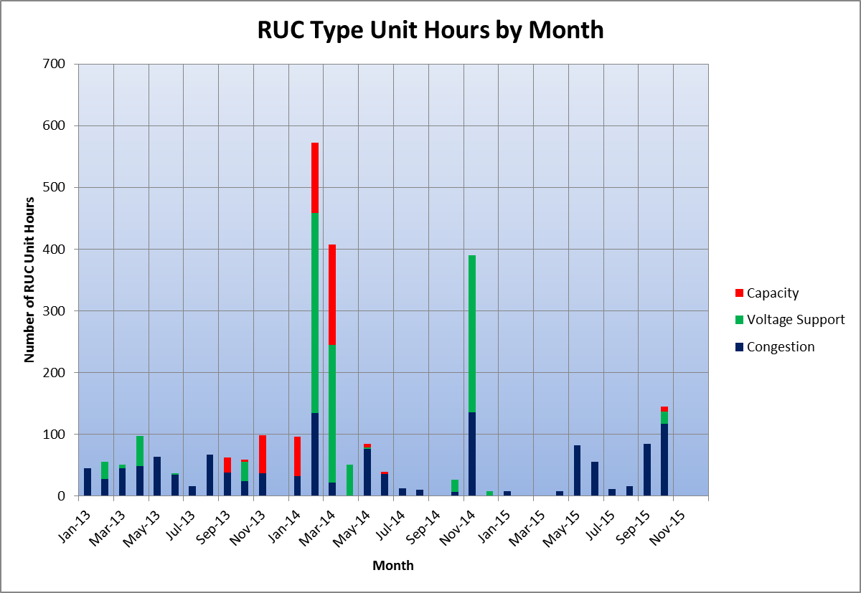
RUC Type Unit Hours by Month

Slide 5
RUC Committed Resources Dispatched above LDL
20.1 hours (5.1%) were dispatched above LDL out of 398 Instructed Effective RUC Unit Hours
No SCED intervals out of the 20.1 hours were dispatched at a price above the RUC offer floor
7.2 hours were dispatched above LDL due to incorrect EOC
12.9 hours were dispatched above LDL due to mitigation of EOC
3.9 hours (1.0%) were dispatched above LDL for capacity
2.7 hours were dispatched due to incorrect EOC
0.6 hours had insufficient time to change EOC’s
0.6 hours were mitigated
Note: Difference between 411 (from slide 3) and 398 (above) is a result of resources starting up, shutting down, still being off-Line for some portion of the RUC committed hours, or resources not following RUC instructions
Notes:
RN LMP = System lambda + small buffer & BP> LDL => Resource is moved up for capacity since there is no congestion
RN LMP > System lambda + small buffer & BP> LDL => Resource can contribute to reducing congestion and hence could be moved up for transmission.

Slide 6
Telemetry Issues and Inconsistency with Settlements
Before NPRR 626, EOC non-compliance when settling as RUC – 43.1 hrs
After NPRR626,
Settling as RUC with telemetry status different from ONRUC
Reliability Price Adder should have been created – 25.6 hrs
Issue if submitted offer curve is below RUC floor - 22.9 hrs
Settling as OPTOUT with ONRUC telemetry
Reliability Price Adder is created when it should not have been created – 2.1 hrs
Non-RUC interval telemetering ONRUC status
Reliability Price Adder is created when it should not have been created – 1.6 hrs
Notes:
The 2.2 hours is split between the 4 hours with short notice and the 12 hours with adequate notice.

Slide 7
RUC Make-Whole Amount Total and RUC Shortfall Total
 | RUC Make-Whole Amounts (RUCMWAMTTOT) (in $) | RUC Shortfall Total (RUCSFTOT) (in MW-hours) | RUCMWAMTTOT / RUCSFTOT ($/MW-hours)
Jan-15 | 0 | 0 | $0.00
Feb-15 | 0 | 0 | $0.00
Mar-15 | 0 | 0 | $0.00
Apr-15 | (4,651) | 114,649 | ($0.04)
May-15 | (240,020) | 937,609 | ($0.26)
Jun-15 | (16,227) | 202,076 | ($0.08)
Jul-15 | (1,849) | 33,890 | ($0.05)
Aug-15 | (13,079) | 321,290 | ($0.04)
Sep-15 | (138,803) | 1,680,431 | ($0.08)
Oct-15 | (64,823) | 1,103,079 | ($0.06)
Nov-15 | 0 | 0 | $0.00
Dec-15 | 0 | 0 | $0.00

Slide 8
Conclusion
411 Instructed RUC Unit Hours resulting in 398 Instructed Effective RUC Hours in 2015
Total RUC Make Whole Payments of ($479,452) for 2015
Total RUC Shortfall Total of 4,393,024 MW-hours resulting in a near zero Make-Whole Uplift Charge
Even after automating creation/flooring of EOC at RUC floor with NPRR626 implementation, there is still EOC non-compliance and inconsistency with settlement due to error in telemetry and inconsistency of COP and telemetry.

Slide 9
Appendix

Slide 10
Comparison of 2012, 2013, 2014 and 2015 (1 of 2)

Slide 11
Comparison of 2012, 2013, 2014 and 2015 (2 of 2)

