Slide 1
Stability Limit Management
Chad Thompson
Manager, Operations Support
Planning Working Group Meeting
ERCOT Public
January 20, 2016

Slide 2
Issues
Transparency in Planning Studies with regards to stability limits
Deliverability issue currently at PLWG
Weak Grid shift factor issue currently at CMWG ($$)
Policy discussion of what should happen with an FIS, and the operational expectations of new generation sites

Slide 3
Background
Increasing use of Generic Transmission Constraints
Increase in N-1 / N-1-1 stability issues identified in Full Interconnection Studies (FIS) due to turbine control instability
These stability issues can not be explicitly modeled in ERCOT systems

Slide 4
ROS Recap
The FIS is just one checkpoint in the resource commissioning process
No requirements to address (or fix) issues identified in the FIS
Thermal = “OK”
Non-Thermal = “Not OK”
FIS not always complete until just before commissioning begins
GTCs end up created near (or during) commissioning
Increased GTC use poses situational awareness risk

Slide 5
So…
If an FIS identifies a stability problem, are there (or should there be) provisions to mitigate the stability issues laid out in the FIS before the generator begins commissioning?
Who is on the hook?
Why would/should an FIS be approved if a proposed facility introduces stability issues?
What can be done to strengthen the interconnection process?

Slide 6
Appendix
Commissioning Timeline
GTC Development
Resources

Slide 7
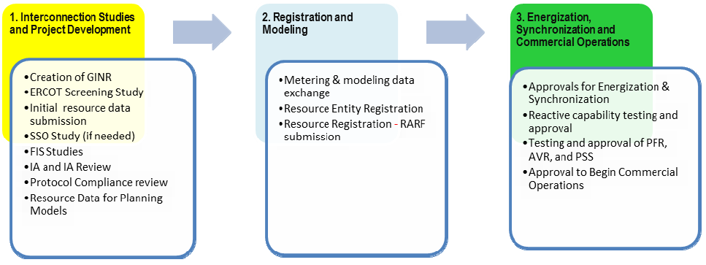
Generation Interconnection Process

Slide 8
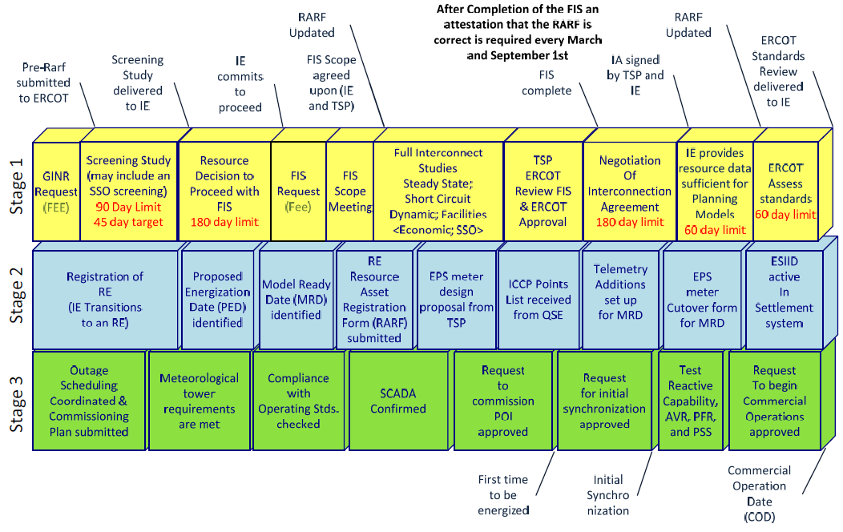
Generation Interconnection Process

Slide 9
The Challenge of a GTC
Complexity
PI displays / ad-hoc operator tools
Multi-limit tables
Monitoring medium (VSAT, TSAT, EMS, etc)
Situational Awareness
SCED and constraint visibility
Operator Training
Market Impacts
Getting GTC modeled in time for CRR auctions
GTC considerations in DAM prior to implementation in the network model

Slide 10
Development of a GTC
The development of a new GTC is a muli-step process
Typically takes a minimum of one month to implement
Can take more depending on the nature and complexity of the underlying stability problem

Slide 11
Phases of GTC Development
1. Identification /Scope
2. NOMCR
3. Situational Awareness Tools
4. GTC Documentation
5. Market Notice/ Implementation
Identification and Scope
NOMCR Submission
Development of Real-time Situational Awareness Tools
Development of GTC Documentation
Market Notice and Implementation

Slide 12
Phases of GTC Development
1. Identification /Scope
2. NOMCR
3. Situational Awareness Tools
4. GTC Documentation
5. Market Notice/ Implementation
Stability studies conducted by ERCOT Planning identify type and scope of the stability problem requiring the GTC
Based on the study results…
The lines comprising the interface covered by the GTC are identified
It is determined whether the stability limit can be calculated in real-time using VSAT/TSAT or if a static table of values will be needed

Slide 13
Phases of GTC Development
1. Identification /Scope
2. NOMCR
3. Situational Awareness Tools
4. GTC Documentation
5. Market Notice/ Implementation
A NOMCR is submitted to create the GTC in the ERCOT network operations model
Time from submission to implementation is typically 3-4 weeks
ERCOT cannot enforce the GTC until it is added to the model

Slide 14
Phases of GTC Development
1. Identification /Scope
2. NOMCR
3. Situational Awareness Tools
4. GTC Documentation
5. Market Notice/ Implementation
If the stability limit for the GTC can be calculated in real-time, a new VSAT/TSAT case must be developed
Once created, the case is tested using offline studies and validated against the existing planning studies
PI tags must be created to allow for data capture and analysis
Control room VSAT tools must also be updated to include the new GTC

Slide 15
Phases of GTC Development
1. Identification /Scope
2. NOMCR
3. Situational Awareness Tools
4. GTC Documentation
5. Market Notice/ Implementation
If the stability limit for the GTC must be set using a static table:
An automated PI display tool must be developed to alarm operators when the limit must be updated in real-time to a new value on the static table
Displays vary in complexity. Some have had to monitor flows, breaker, and disconnect statuses for as many as 20 lines. All are based on significant amounts of Visual Basic code

Slide 16
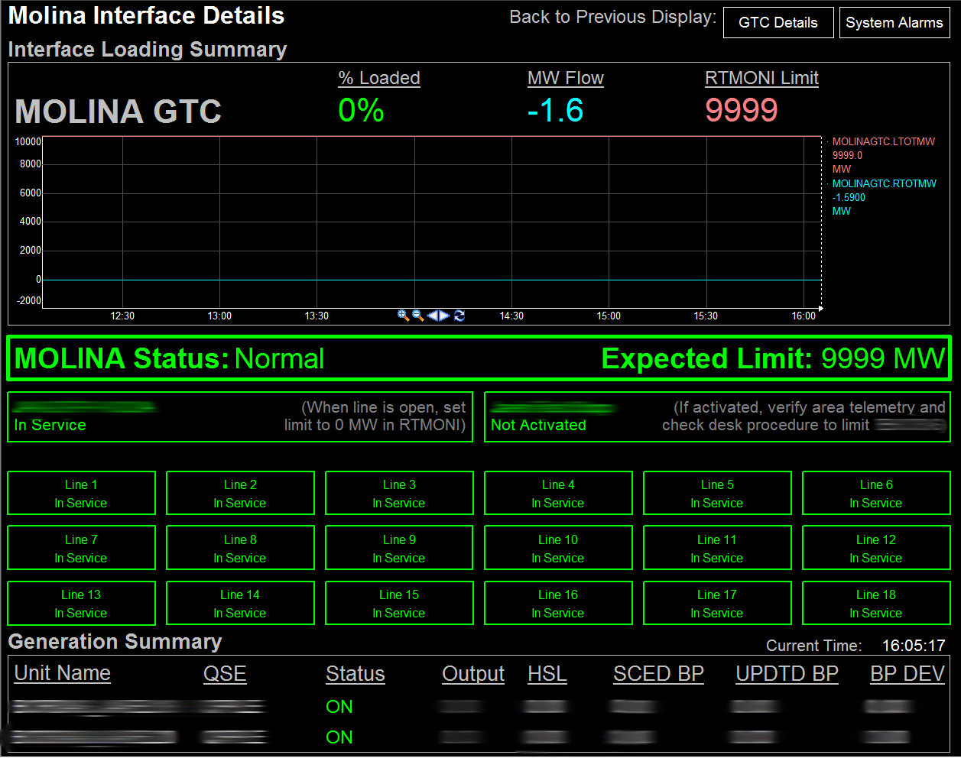
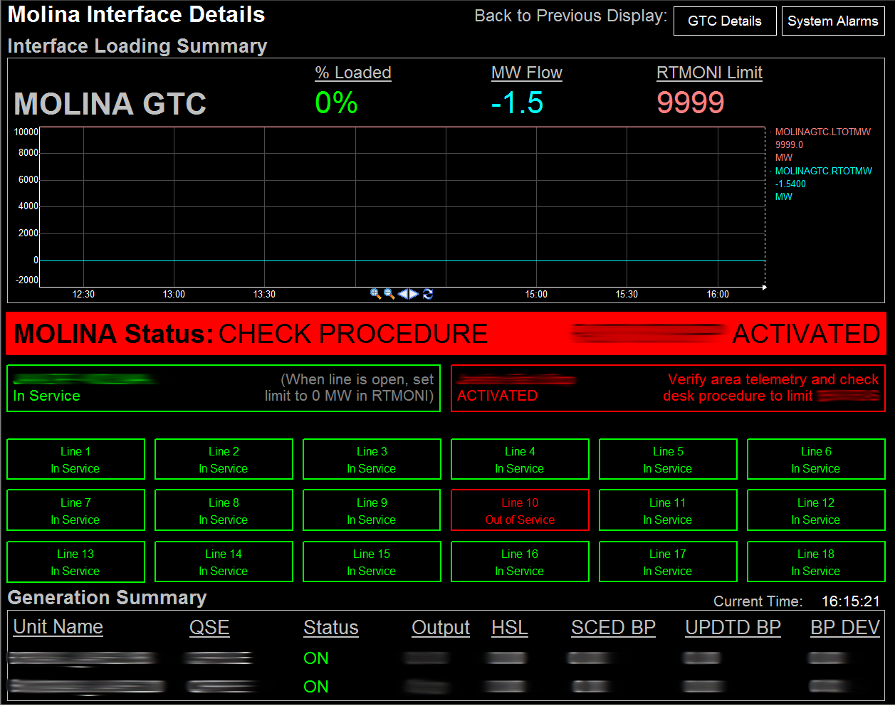
Display Examples
1826 Lines of Code

Slide 17
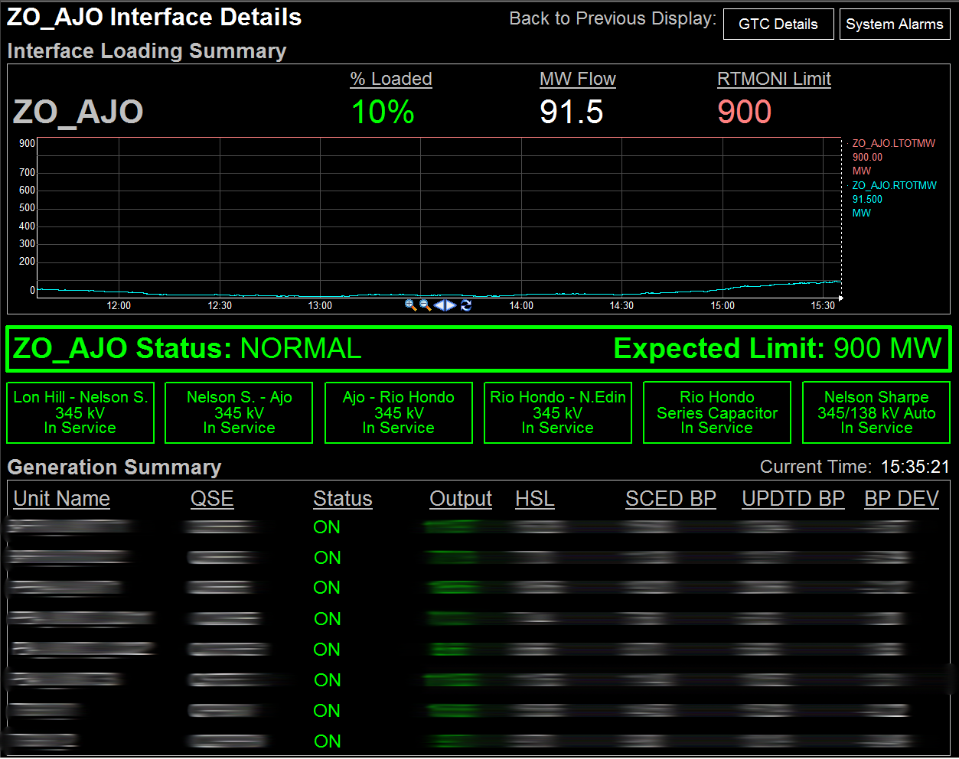
Display Examples
2259 Lines of Code

Slide 18
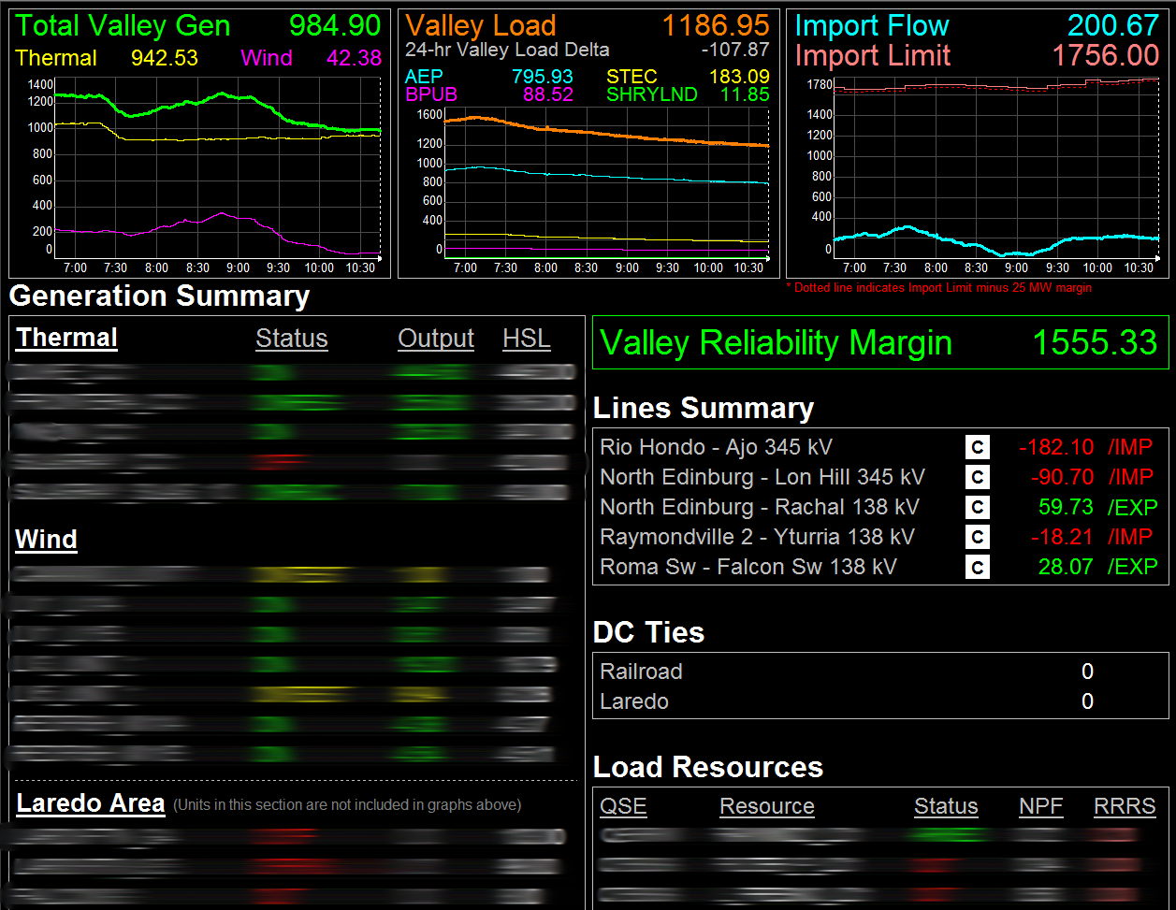
Display Examples
4303 Lines of Code

Slide 19
Phases of GTC Development
1. Identification /Scope
2. NOMCR
3. Situational Awareness Tools
4. GTC Documentation
5. Market Notice/ Implementation
Development time for situational awareness tools varies depending on the complexity of the GTC
Can be started before, but cannot be finished until after, GTC is added to the ERCOT model
ERCOT operator crews must also be trained on any new tools that are developed

Slide 20
Phases of GTC Development
1. Identification /Scope
2. NOMCR
3. Situational Awareness Tools
4. GTC Documentation
5. Market Notice/ Implementation
A report is generated describing
The underlying stability issue that led to the creation of the GTC
The methodology for calculating the GTC in real-time
Any static tables or the results of any offline stability studies that will be used to set the limit in real-time
ERCOT cannot begin enforcing the GTC until this report has been completed and posted to the MIS secure area

Slide 21
Phases of GTC Development
1. Identification /Scope
2. NOMCR
3. Situational Awareness Tools
4. GTC Documentation
5. Market Notice/ Implementation
Once the GTC has been fully developed
Information is provided to Market Operations Support to ensure the GTC is accurately represented in CRR auctions and the Day Ahead Market (DAM)
A market notice is issued describing the new GTC. Depending on the timing of the notice, an OCN may also be issued
ERCOT Operations will begin enforcing the GTC in real-time

Slide 22
Timing of GTC Development
1. Identification /Scope
2. NOMCR
3. Situational Awareness Tools
4. GTC Documentation
5. Market Notice/ Implementation
The implementation of the NOMCR is typically the longest part of the GTC process at 3-4 weeks
However, this is not always the case
Some GTCs require the development of complex situational awareness tools that must be accompanied by extensive operator training

Slide 23
Resources
Resource Interconnection Handbook
http://www.ercot.com/content/services/rq/re/reg/Resource%20Interconnection%20Handbookv1.pdf
GTC Methodology
ERCOT MIS under Grid → Transmission → Generic Transmission Limits

