Slide 1
ICE Price Data Analysis
CWG/MCWG
Suresh Pabbisetty, CQF, ERP, CSQA.
ERCOT Public
January 20, 2016

Slide 2
ICE Price Analysis
Background:
CWG/MCWG is considering using ICE futures prices as an input to determine ERCOT’s credit risk exposure
ERCOT staff has been running a Capacity Forecast Model (CFM) since early 2015 to estimate Excess Reserves by Operating Hour
CWG/MCWG has reviewed preliminary analysis results at their December 2015 meeting
Additional analysis was requested to compare ICE prices to actual RTM prices to market-wide TPE
Run descriptive statistics of relation between ICE prices to RTM prices
ERCOT Public

Slide 3
ICE Price Analysis
Data Inputs and Transformations:
ICE Futures prices pertaining to North HUB Settlement Point for Daily Peak (END) and Off-peak (NED) contracts
ICE doesn’t have new pricing information available on weekends and holidays. The most recent available price of the same contract is substituted if a price is missing
ICE Prices from early January 2011 through mid-December 2015
Daily Average Price is calculated as (16 * Peak Price + 8 * Off-peak Price)/24
North HUB RTSPP from early January 2011 through mid-December 2015
Daily Average Price is calculated using simple average of all interval RTSPPs in an Operating Day
ERCOT Public

Slide 4
ICE Price Analysis
Data Inputs and Transformations (continued):
Capacity Forecast Model (CFM) Excess Reserves from mid-March 2015 through mid-December 2015
Prior tests of data indicated that relationship between CFM Excess Reserves and RTSPP is non-linear
A logarithm is taken for both CFM Excess Reserves and RTSPP to allow linear regression.
Regression is performed to the above mentioned to identify the linear relationship as;
Log10(CFM Predicted Price) =
(-0.6521)*Log10(CFM Excess Reserves) + 4.2027
A slope of -0.6521 indicates a negative correlation, so that 1 unit of increase in Log10(Excess Reserves) would result in a decrease of 0.6521 units to Log10(CFM Predicted Price).
ERCOT Public

Slide 5
ICE Price Analysis
Data Inputs and Transformations (continued):
CFM Predicted Prices are available only for 6 forward days. Most recently available (6th Day) Forward Price is used for 7th through 21st forward days
Aggregated market-wide TPE from October 2012 through mid-December 2015
Forward Price Averages of 21 days, 15 days and 7 days are calculated and used for analysis purposes
ERCOT Public

Slide 6
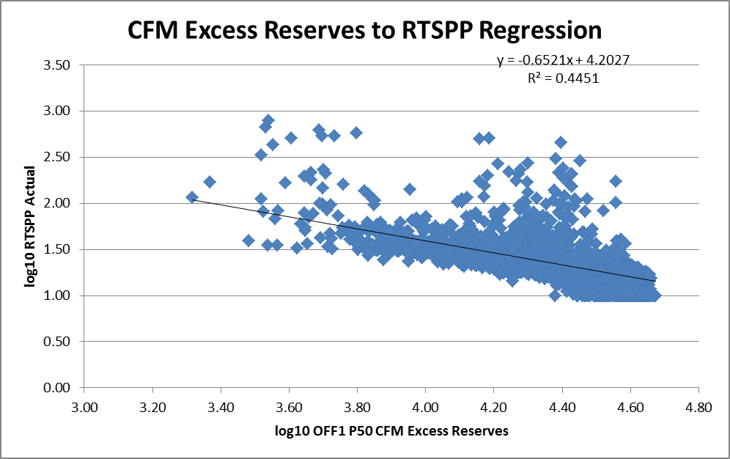
ICE Price Analysis
OFF1 P50 Excess Reserves to RTSPP regression by Hour:
ERCOT Public

Slide 7
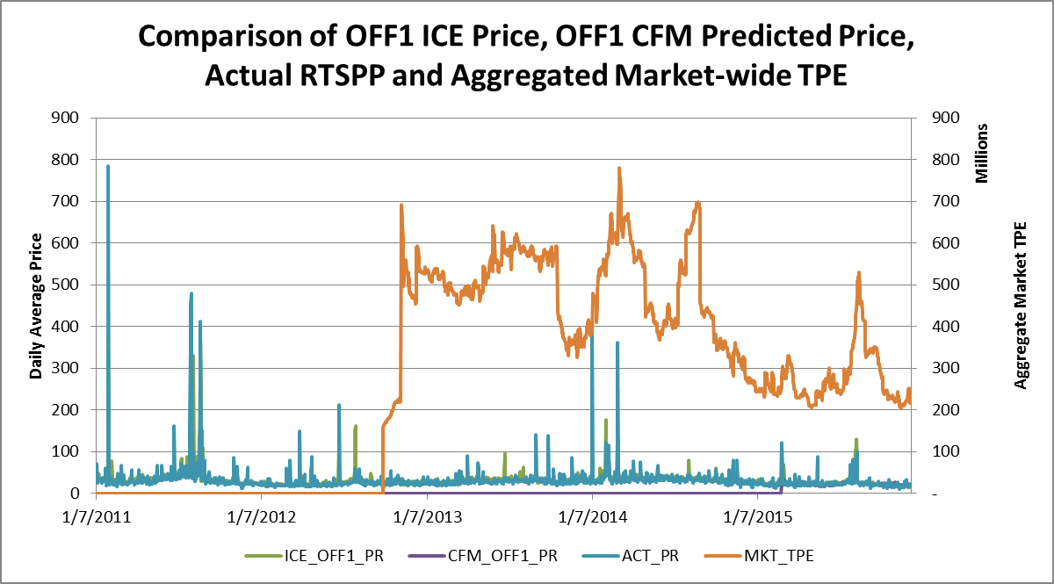
ICE Price Analysis
Price and TPE Comparison (2011 to 2015):
ERCOT Public

Slide 8
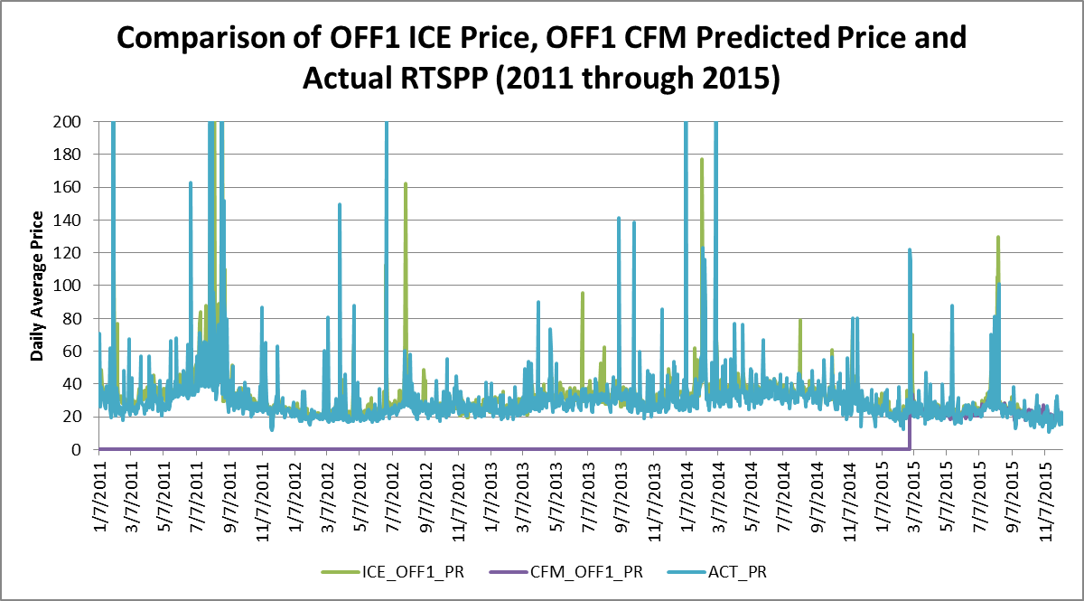
ICE Price Analysis
Price Comparison (2011 to 2015):
ERCOT Public

Slide 9
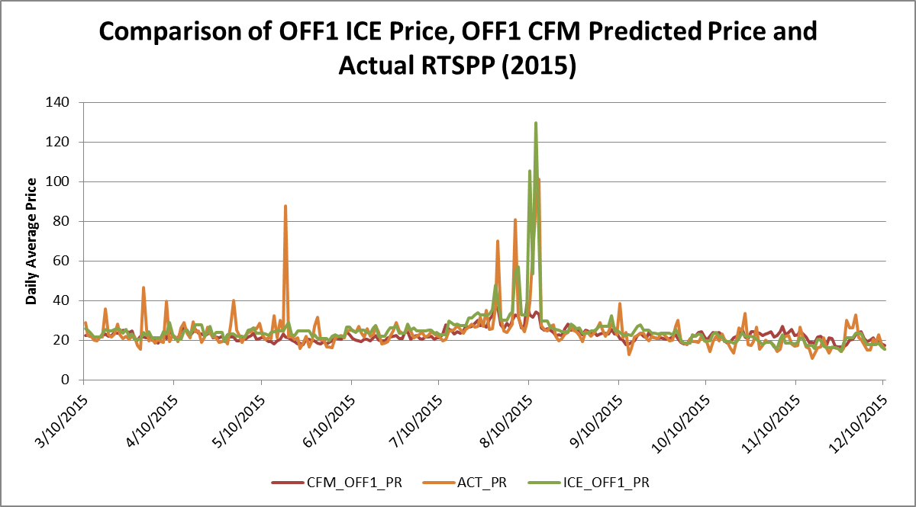
ICE Price Analysis
Price Comparison (2015):
ERCOT Public

Slide 10
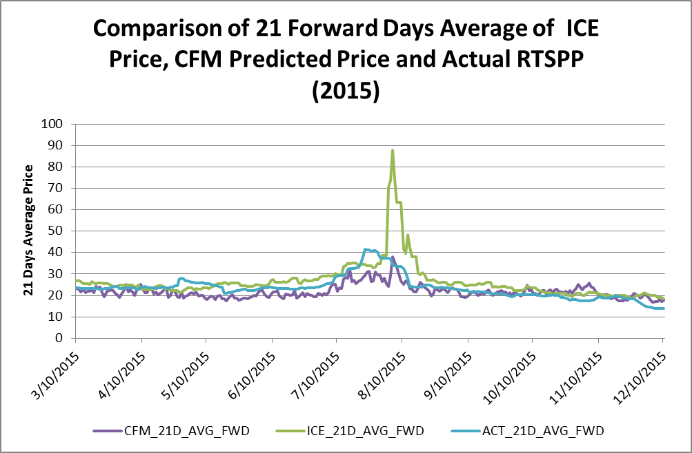
ICE Price Analysis
21 Days Average Price Comparison (2015):
ERCOT Public

Slide 11
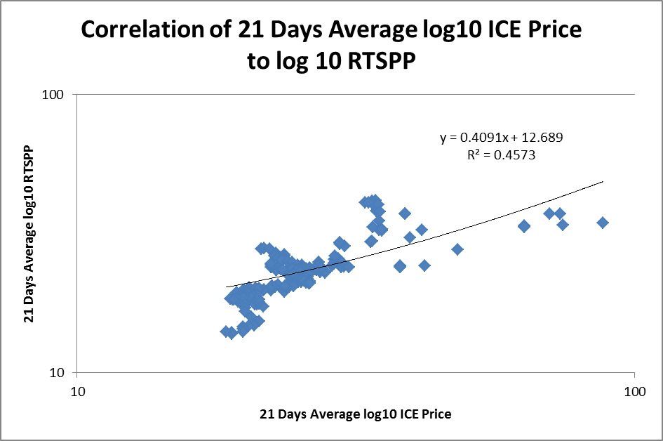
ICE Price Analysis
21 Days Average of ICE Price to RTSPP Correlation (2015):
ERCOT Public

Slide 12
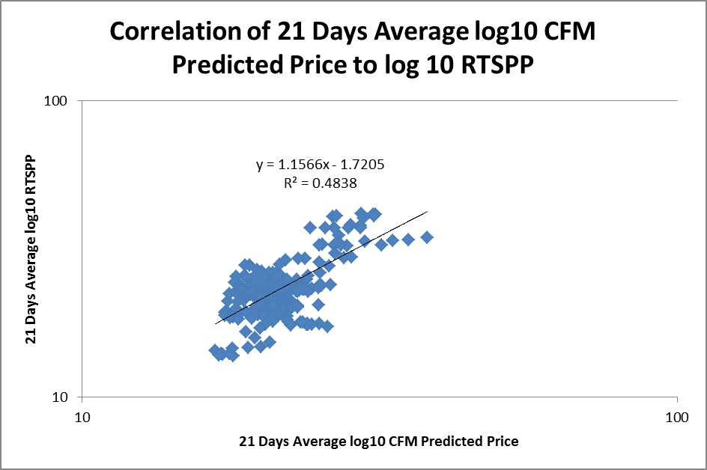
ICE Price Analysis
21 Days Average of CFM Predicted Price to RTSPP Correlation (2015):
ERCOT Public

Slide 13
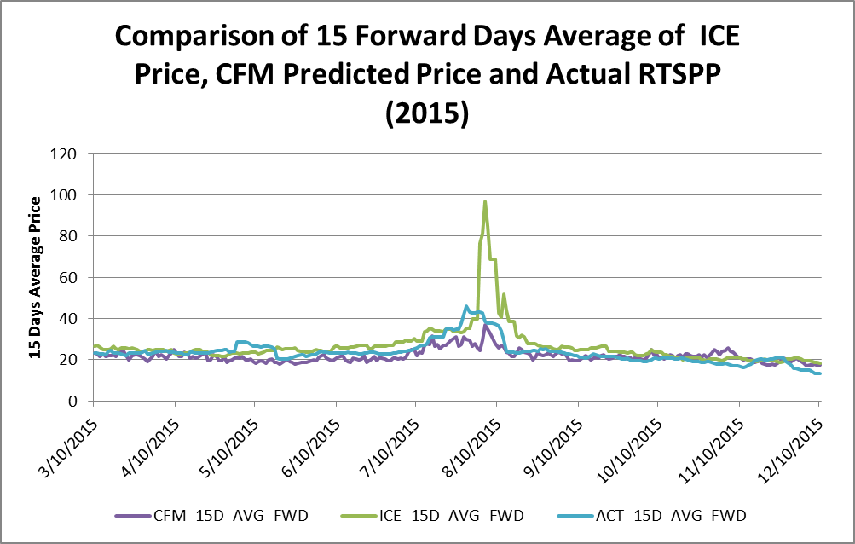
ICE Price Analysis
15 Days Average Price Comparison (2015):
ERCOT Public

Slide 14
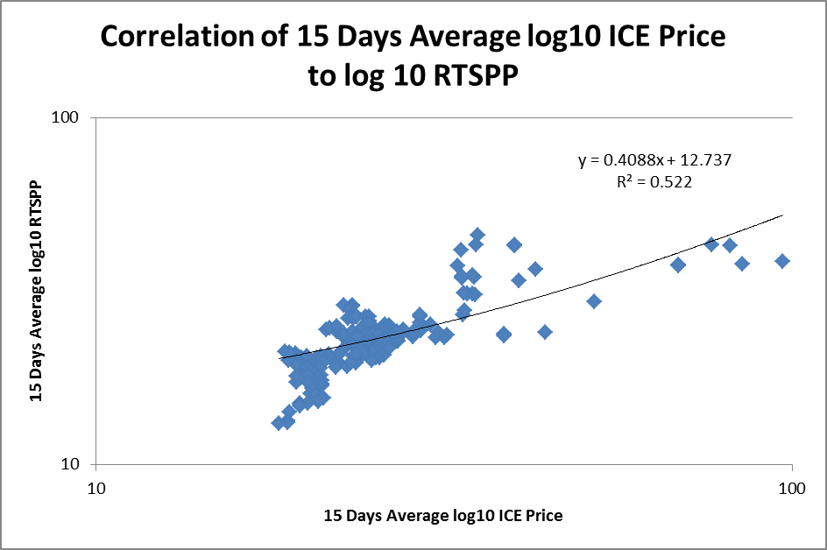
ICE Price Analysis
15 Days Average of ICE Price to RTSPP Correlation (2015):
ERCOT Public

Slide 15
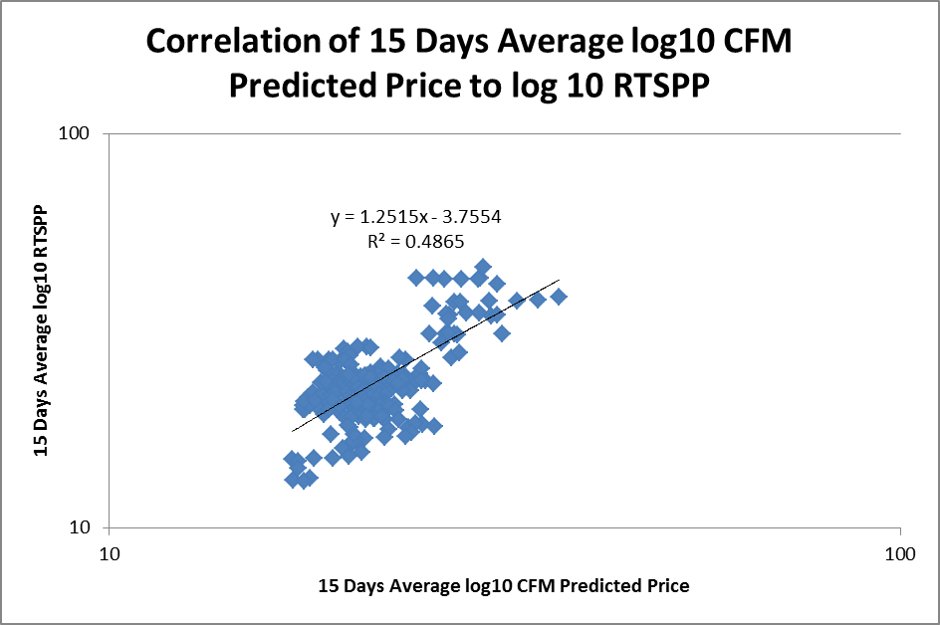
ICE Price Analysis
15 Days Average of CFM Predicted Price to RTSPP Correlation (2015):
ERCOT Public

Slide 16
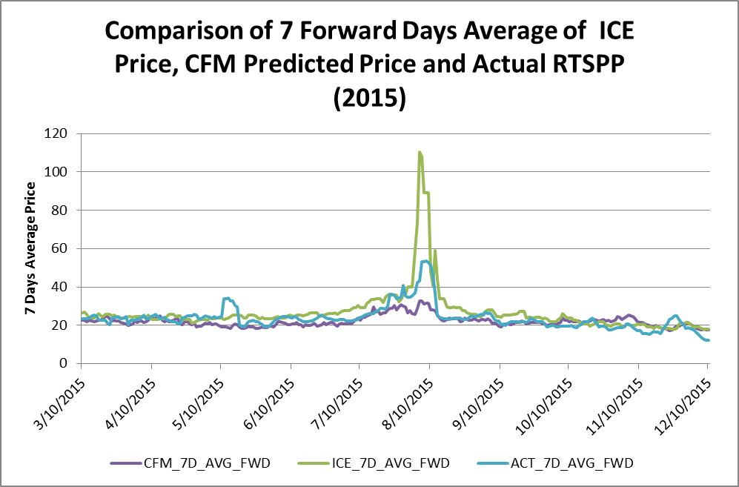
ICE Price Analysis
7 Days Average Price Comparison (2015):
ERCOT Public

Slide 17
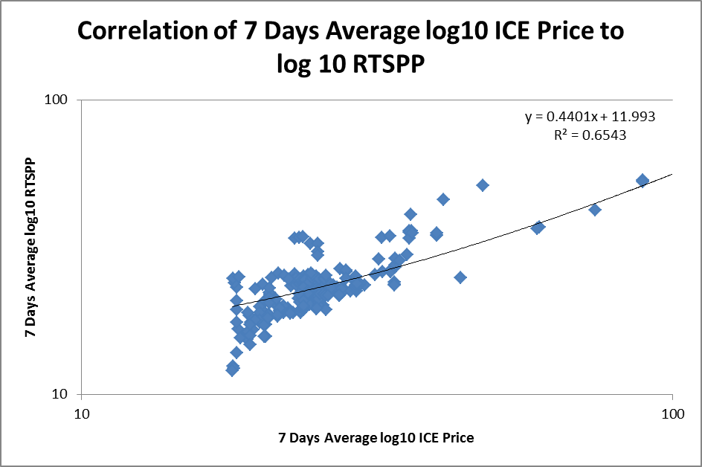
ICE Price Analysis
7 Days Average of ICE Price to RTSPP Correlation (2015):
ERCOT Public

Slide 18
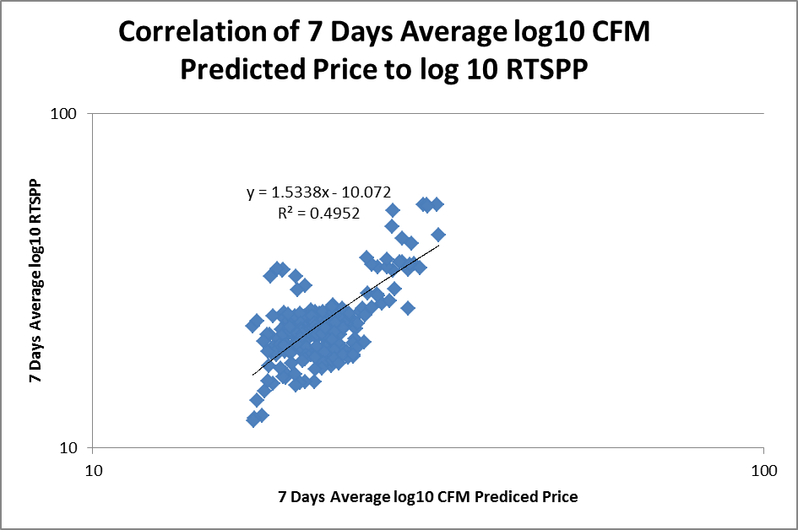
ICE Price Analysis
7 Days Average of CFM Predicted Price to RTSPP Correlation (2015):
ERCOT Public

Slide 19
ICE Price Analysis
Statistics of ICE Price Errors (Actual RTSPP – ICE/CFM Price):
ERCOT Public

Slide 20
ICE Price Analysis
Statistics of CFM Predicted Price Errors (Actual RTSPP – ICE/CFM Price) - continued:
ERCOT Public

Slide 21
ICE Price Analysis
R-Square Matrix:
ERCOT Public

Slide 22
Questions
ERCOT Public

