Slide 1
ERCOT – Planning Review
Regional Planning Group
ERCOT Public
January 19, 2016

Slide 2
Outline
Congestion Overview
Load and Generation Changes
Transmission Investment

Slide 3
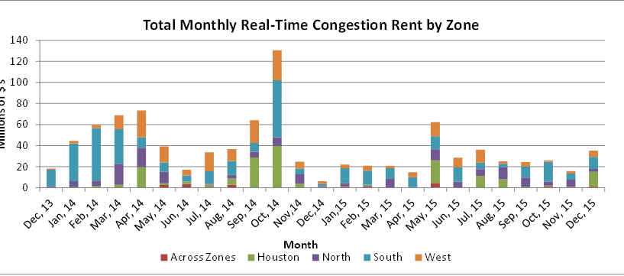
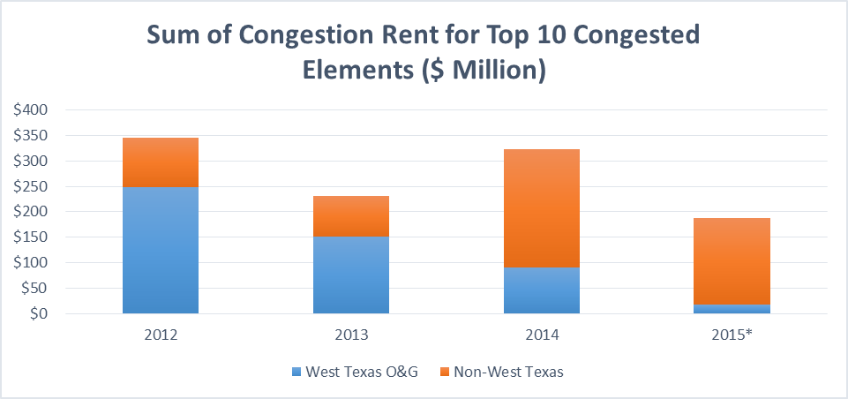
Congestion
Key Observations
2015 congestion lower than previous years
West Texas reliability limit exceedances caused high amount of congestion in 2012 through 2014
Outages caused or exacerbated most of top congested elements

Slide 4
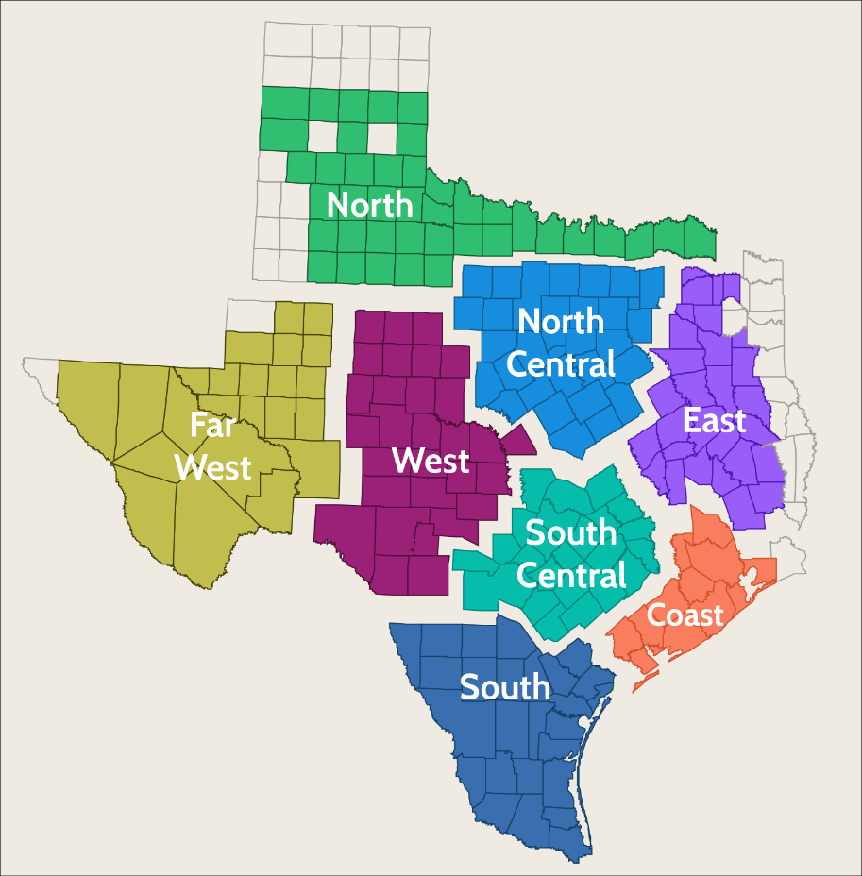
Grid Changes by Weather Zone
Transmission system needs are driven by load and generation changes
The following two slides show ERCOT load and generation changes by weather zone since 2004

Slide 5
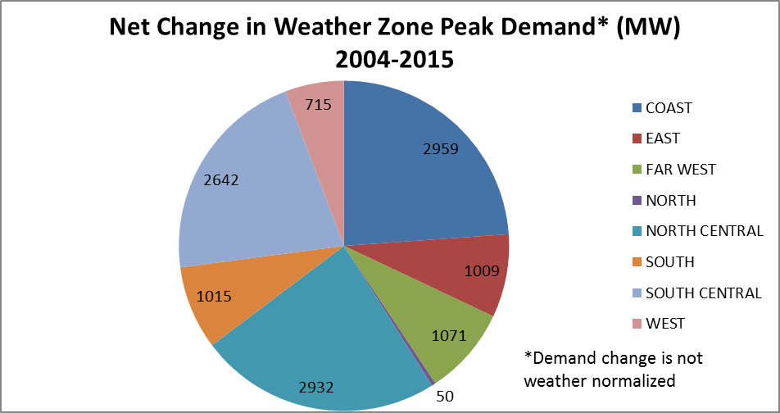
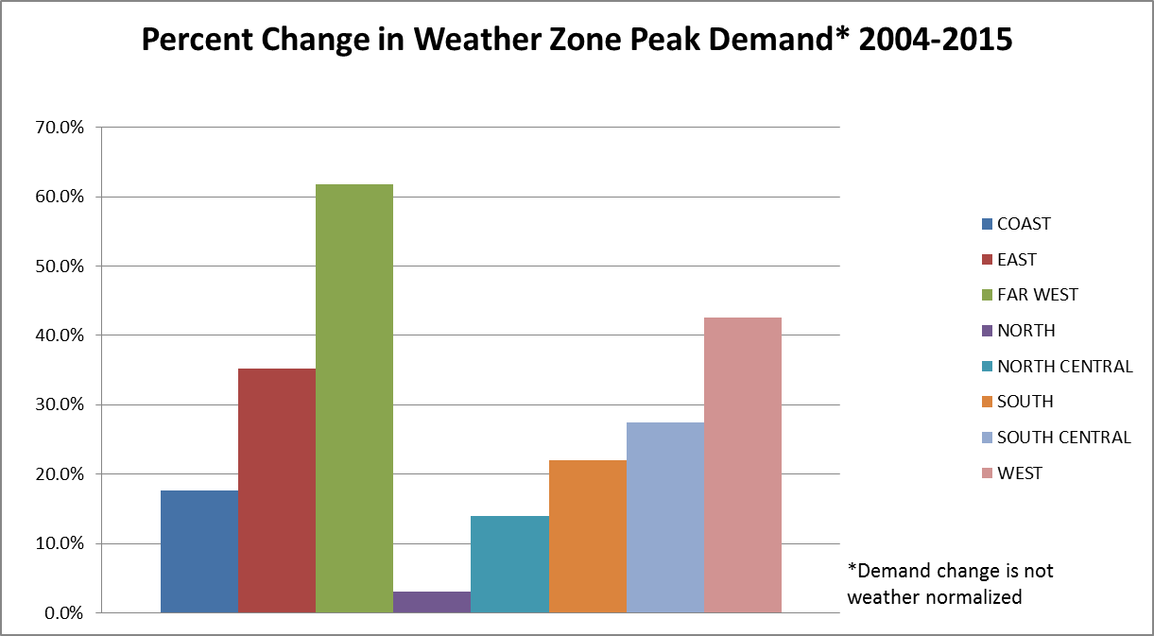
Grid Changes – Load
Key Observations
Largest weather zones saw largest MW growth
West and Far West weather zones had largest percent change in load growth

Slide 6
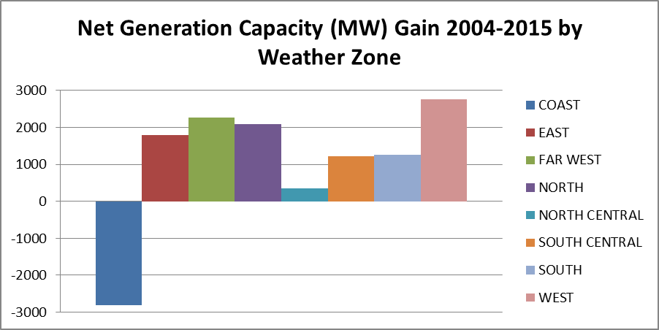
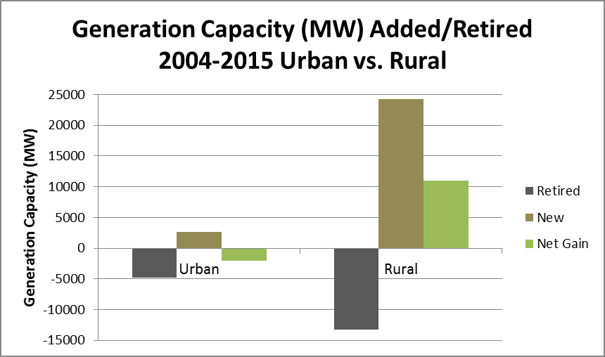
Grid Changes – Generation
Key Observations
Coast only weather zone to see net loss in generation capacity
Generation is becoming more rural
Net loss in coal and gas generation capacity in ERCOT since 2004
+13,379 MW
Non-Fossil Fuel
-4,441 MW
Fossil Fuel
Generation Capacity Change 2004-2015

Slide 7
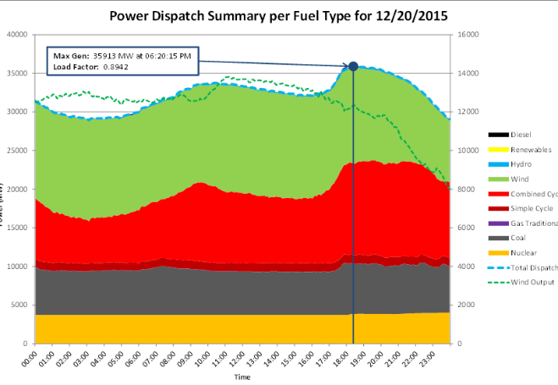
December 20, 2015 Generation
Wind supplied 38.4% of daily energy
Maximum wind penetration ~44%

Slide 8
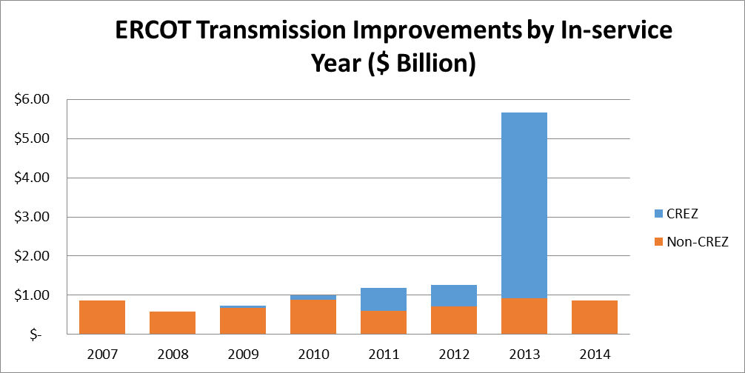
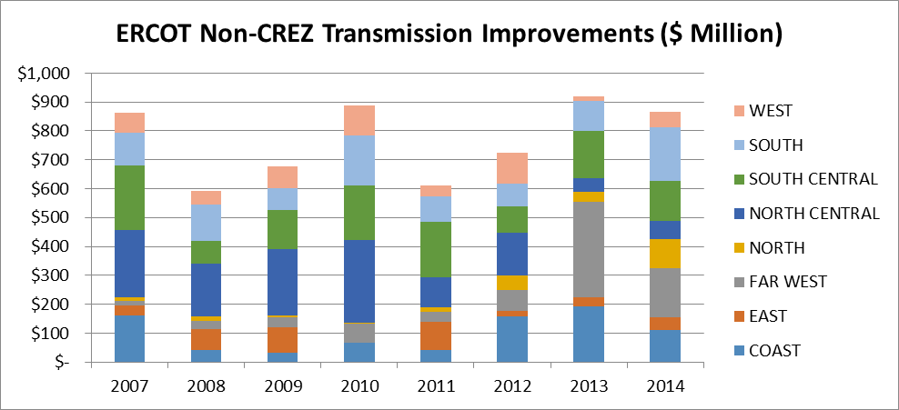
Transmission Investment
Key Observations
CREZ investment approximately equal to eight years of non-CREZ investment
Non-CREZ transmission spending relatively flat between 2007 and 2014
Significant increase in Far West weather zone transmission investment in recent years

Slide 9
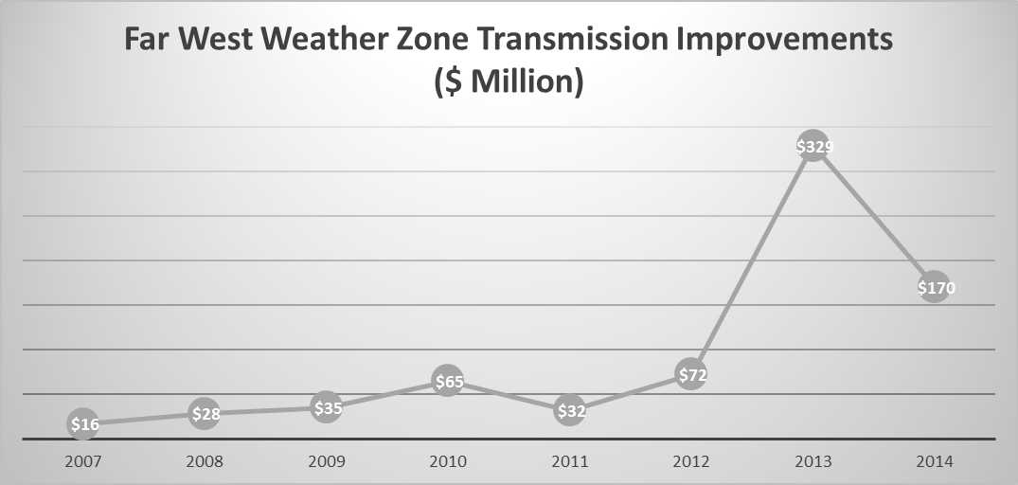
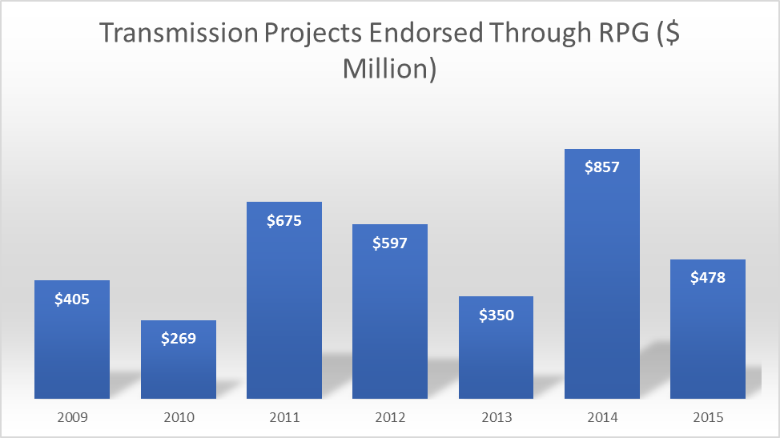
Transmission Investment (additional information)

Slide 10
Questions?

Slide 11
End Notes
Slide 3
Top congestion chart based on internal ERCOT congestion tracking database
Bottom congestion chart based on prior Constraints and Needs reports
2012 through 2014 data based on January through October congestion for that calendar year; 2015 data based on October 2014 through September 2015 congestion
Slide 5
Peak load data based on Demand and Energy Reports
Slide 6
Generation capacity data based on Steady State Working Group base cases and RARF data
Bottom left chart assumes counties with a population of 500,000 and greater are urban, all other counties are rural
Wind generation capacity counted at 100%
Slide 7
Generation data based on internal ERCOT database
Slides 8 and 9
Transmission investment dollars based on TPIT with Costs database
Transmission Projects Endorsed by RPG from monthly ERCOT ROS report

