Slide 1
Project Update and Summary of Project Priority List (PPL) Activity
January 14, 2016

Slide 2
2016 Project Update – Agenda
  Project Portfolio Update p. 3-7
    Recent/Upcoming Project Highlights
    2015 Release Summary
    2016 Release Targets
    2015 Project Spending Summary
    2016 Project Spending Forecast
  Appendix
    Project Portfolio Gantt Chart p. 8-14
Location of Project Priority List (PPL): http://www.ercot.com/services/projects/index

Slide 3
Recent / Upcoming Project Highlights
2015 December Release – Week of 12/7/2015 Complete
  NPRR680 – Allow QSEs to Self-Arrange AS Quantities Greater Than Their AS Obligation
  NPRR686 – Changing the IRR Forecast from Next 48 Hours to Next 168 Hours
    Wind elements
  NPRR703 – Clarification of Disclosure Requirements for GINR Study Information
  NPRR718 – Correct Requirement for Posting AML Data
  PGRR044 – MIS Classification of GINR Study Information
2016 February Release – Week of 2/2/2016 In Flight
  NPRR588 – Clarifications for PV Generation Resources
  NPRR615 – PVGR Forecasting
  NPRR686 – Changing the IRR Forecast from Next 48 Hours to Next 168 Hours
    Solar elements
Note: Projected Go-Live dates are subject to change.
Please watch for market notices as the effective dates approach.

Slide 4
2015 Release Summary – Board-Approved NPRRs / SCRs / xGRRs
February 2/2 – 2/12 | March 3/23 – 3/27 | June |  | September 9/7 – 9/11 | October 10/19 – 10/23 | December 12/7 – 12/11
NPRR500 SCR772 | SCR778 SCR779 | NPRR559 NPRR597 NPRR601 NPRR639 | NPRR543 NPRR626 NPRR645 NPRR665 SCR774(b) SCR775 OBD (Shadow Price Caps) | SCR771 NPRR589(b) NPRR701 | NPRR556 NPRR595 NPRR698 NPRR706 NPRR710 | NPRR680 NPRR686(a) NPRR703 NPRR718 PGRR044
2 | 2 | 11 |  | 3 | 5 | 5
6/13 (CMM)
6/22 – 6/26
September
9/21 – 9/25
Late May
Go-live dates can differ from Protocol effective dates – Please refer to market notices for more details
Red Text: New additions and target release changes
NPRR589(b) – S&B portion
NPRR686(a) – Wind portion
SCR774(b) – Addition of Comments field
Strike-Through Text: Previous target release changes
Release targets are subject to change
(a), (b), etc. indicates multiple phases
Project Status Codes: NS = Not Started, I = Initiation, P = Planning, E = Execution, H = On Hold

Slide 5
2016 Release Targets – Board-Approved NPRRs / SCRs / xGRRs
February 2/2 – 2/4 | April 4/5 – 4/7 | May 5/24 – 5/26 | July 7/19 – 7/21 | September 9/13 – 9/15 | December 12/6 – 12/8
NPRR553 NPRR588 NPRR615 NPRR686(b) | NPRR419 NPRR515 NPRR617 NPRR700 | NPRR419 RMGRR126 EMS Upgrade | NPRR495 NPRR662 NPRR736 | NPRR219 NPRR573 SCR783 | NPRR210 NPRR272 NPRR573 RRGRR003 RRGRR006 RRGRR007 SCR781
3 | 4 | 1 | 3 | 2 | 7
E
E
P
P
NS
E
NS
P
NS
E
E
NS
NS
H
NS
NS
NS
H
Note on NPRR553
Project to automate
Manual workaround has been in effect since 2013
CMM Bundle
Release Date TBD
EMS Upgrade “Chill”
2016 TBD Items (and point at which they became “TBD”)
2014 | October 2015 | November 2015 | December 2015
NOGRR084, NPRR327 H, SCR777 H, NPRR664 | NPRR439 I, NPRR519 I, NPRR620 I, NPRR683 I, NPRR702 I | NPRR679 | NPRR649, NOGRR147, SCR786
Go-live dates can differ from Protocol effective dates – Please refer to market notices for more details
Red Text: New additions and target release changes
NPRR686(b) – Solar portion
Strike-Through Text: Previous target release changes
Release targets are subject to change
(a), (b), etc. indicates multiple phases
Project Status Codes: NS = Not Started, I = Initiation, P = Planning, E = Execution, H = On Hold

Slide 6
2015 Project Spending Summary
2015 Project Budget = $21.65M
Any excess spending in 2015 will be offset by equal reductions in 2016 spending (ERCOT projects only) -- $1.79M
December includes a Data Center Refresh hardware purchase that will be offset by 2016 Data Center funding -- $3.65M

Slide 7
2016 Project Spending Forecast
2016 PPL Budget = $22.5M
“Potential Demand” represents internal ERCOT projects that have not been fully approved

Slide 8
2016 Project Update – Appendix
  Appendix
    12/31/2015 Project Gantt
      In-flight items sorted by Project End Date
      “On Hold” projects listed separately
      “Not Started” items sorted by Project Start Date

Slide 9
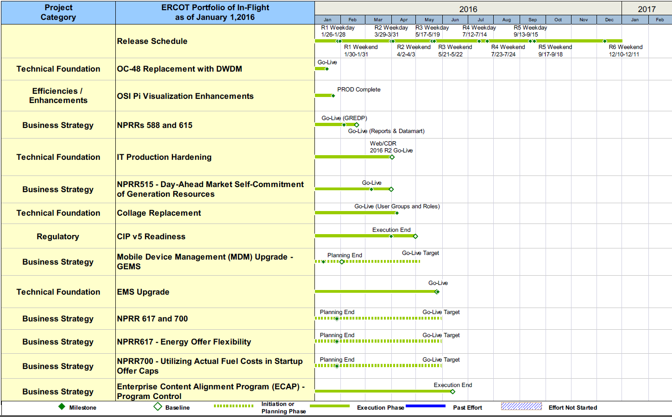
Project Portfolio Status – as of 12/31/2015

Slide 10
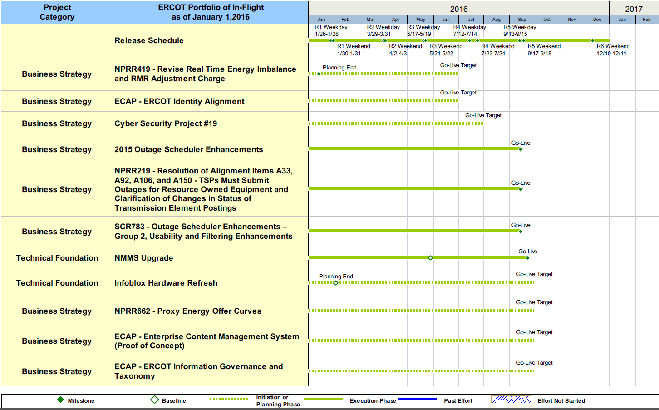
Project Portfolio Status – as of 12/31/2015

Slide 11
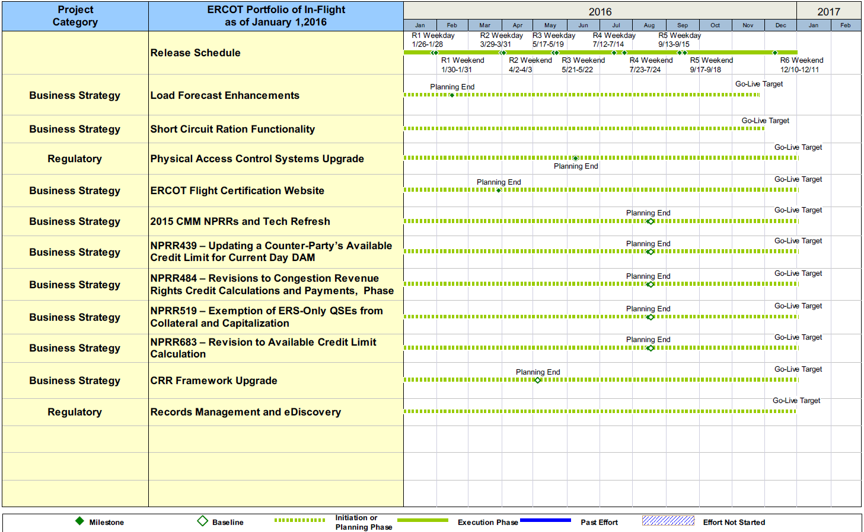
Project Portfolio Status – as of 12/31/2015

Slide 12
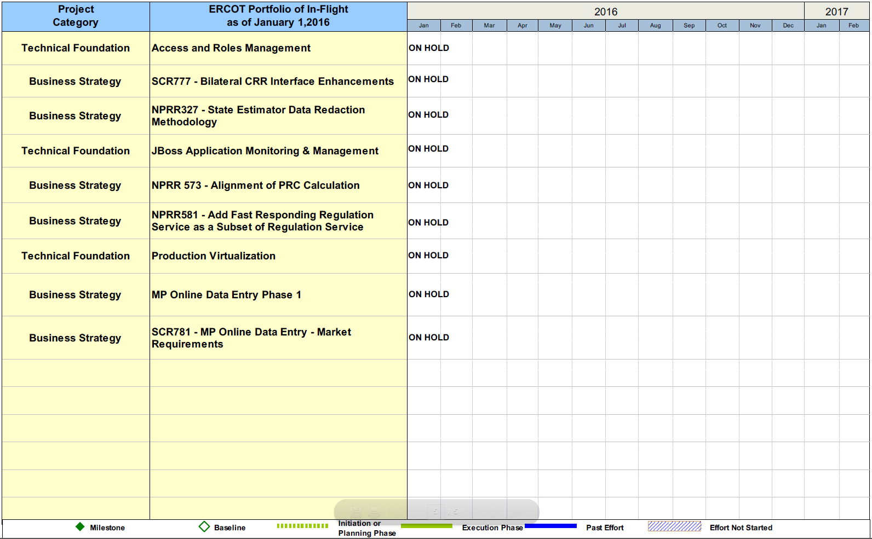
Project Portfolio Status – as of 12/31/2015

Slide 13
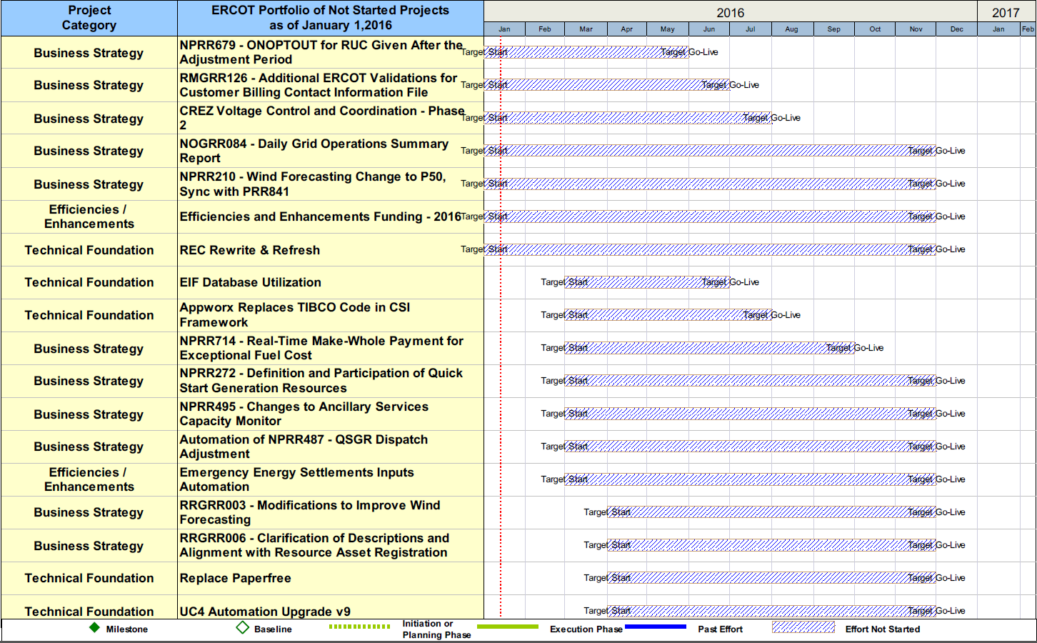
Project Portfolio Status – as of 12/31/2015

Slide 14
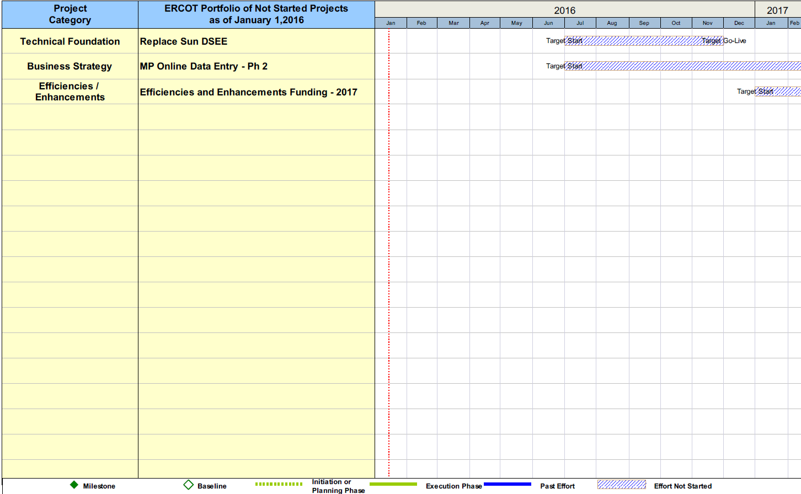
Project Portfolio Status – as of 12/31/2015

