Slide 1
ERCOT MARKET EDUCATION
Retail 101

Slide 2
Advanced Meter Technology

Slide 3
Overview
Topics in this lesson . . .
Meter Data – The Big Picture
A Few Definitions
Impacts of Smart Meter Technology on REPs

Slide 4
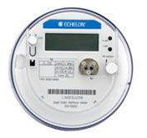
Advanced Meter Technology
Meter Data – The Big Picture
Adjusted Metered Load (QSE)
Qualified Scheduling Entity (QSE)
Calculated for each 15 minute interval
Retail Electric Provider (REP)
Unaccounted For Energy (UFE)
Losses
Collected by TDSPs
Meter Data
Notes:
We saw this picture earlier in the course. <Click for animation> Load meter data is collected and sent to ERCOT by TDSPs. Ultimately, ERCOT must roll all meter data up to the QSE level in order to settle the Wholesale Markets. ERCOT adjusts the metered load data to incorporate Losses and UFE and calculates each QSE’s Adjusted Metered Load. <Click for animation> Since ERCOT settles the Wholesale Markets on a fifteen minute interval, the QSEs’ Adjusted Metered Load must be calculated for each fifteen minute interval.

Slide 5
Advanced Meter Technology
Meter Data – The Big Picture
Load Related Charges
Adjusted Metered Load (QSE)
Qualified Scheduling Entity (QSE)
ERCOT settles with QSE based on Adjusted Metered Load
Energy usage
Other load-related charges

Slide 6
Advanced Meter Technology
Meter Data – The Big Picture
Adjusted Metered Load (QSE)
Qualified Scheduling Entity (QSE)
Load Related Charges
QSE Settles with REP
Energy usage
Other load-related charges
Retail Electric Provider (REP)

Slide 7
Advanced Meter Technology
Meter Data – The Big Picture
Adjusted Metered Load (QSE)
Qualified Scheduling Entity (QSE)
REP Bills Customers
Energy usage based on Meter Data
Other service-related charges
Retail Electric Provider (REP)

Slide 8
A Few Definitions

Slide 9
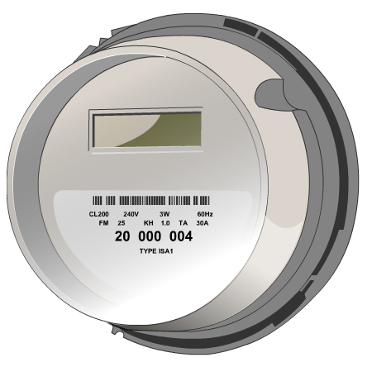
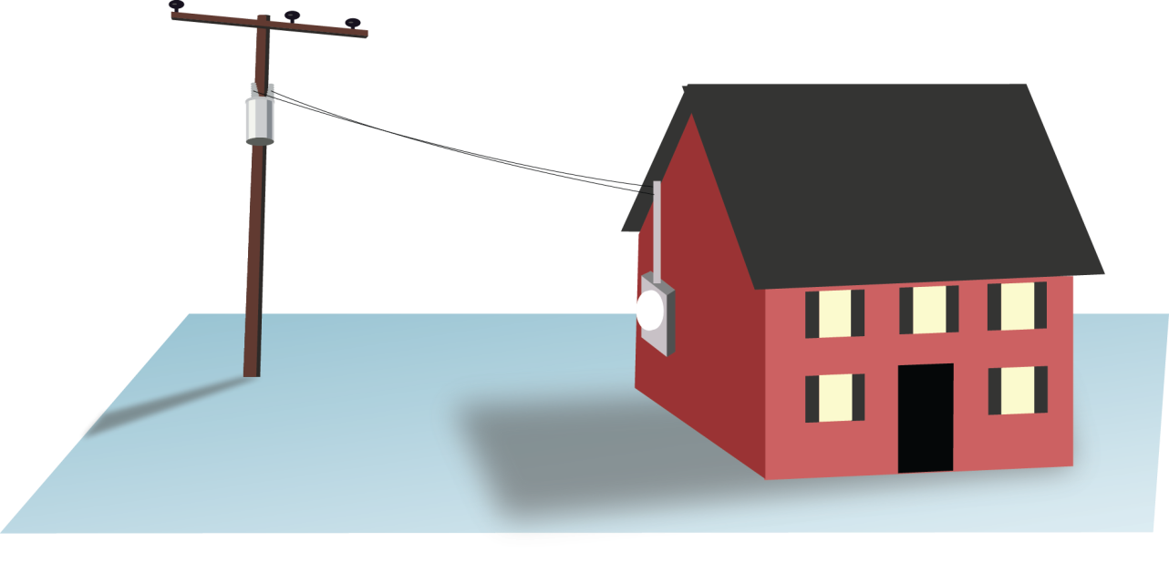
A Few Definitions
Meter – A device that measures electrical usage over some period of time
Notes:
Just so everyone is clear, when we speak of a meter, we are speaking of a device that measures electrical usage over some period of time. The time component of this definition is important, because it will help us distinguish between the various meters that are utilized in ERCOT.

Slide 10
A Few Definitions
Advanced Meters vs Old Technology
Advanced Meter System (AMS) Meters
AMSR – remote (R) connectivity
AMSM – manual (M) connectivity
Non AMS Meters
Scalar, Analog, Digital
Interval Data Recorder (IDR) Meters

Slide 11
A Few Definitions
Various types of meters today
Standard
Advanced Meter System– Remote (AMSR)
Non-Standard
Advanced Meter System- Manual (AMSM)
Interval Data Recorder (IDR) Meter
Non-IDR

Slide 12
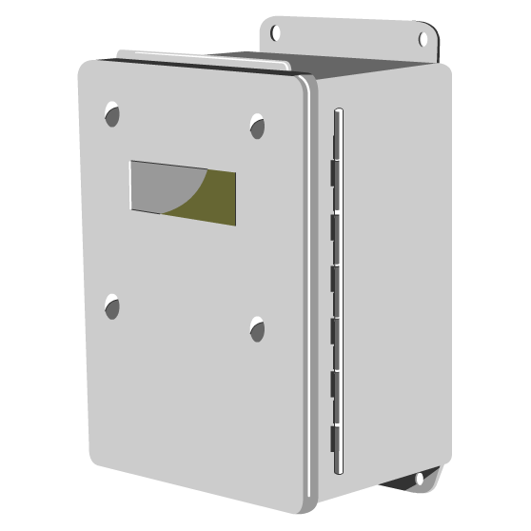
A Few Definitions
Interval Data Recorder (IDR) Meter
Usage is measured in 15-minute intervals
Data is already shaped for 15 minute Wholesale Settlement
Typically reported monthly through 867 transactions
Predominantly installed on large customers > 700 kW/kVA demand
Requires manual field activities
ERCOT Settles the Real-time Wholesale Market in 15-minute intervals

Slide 13
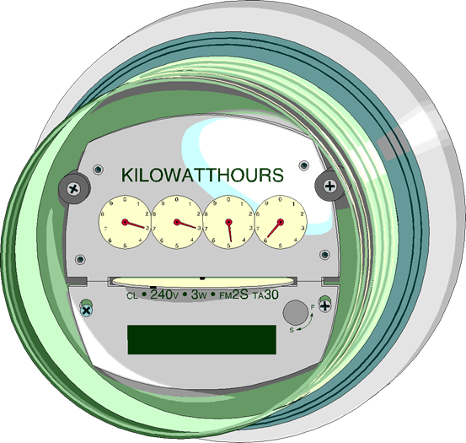
A Few Definitions
Non-IDR Meter
Traditional Meter
Usage is a scalar measurement for an entire month
Data must be shaped for 15 minute Wholesale Settlement
Requires manual field activities

Slide 14
A Few Definitions
Advanced Meter System (AMS) Meter
Usage is recorded in 15 minute intervals
Data is already shaped for 15 minute Wholesale Settlement
Remote capabilities
AMSR (≤ 200 amp)
Remote / automatic reading
Remote disconnect
AMSM
Remote / automatic reading
Manual Disconnect
Also known as a “Smart Meter”

Slide 15
Impacts of Advanced Meter Technology on the Retail Market

Slide 16
Impact of Advanced Meter Technology
So, what does Advanced Meter Technology mean for the Retail Market?
Meter data is more precise
Meter data is available faster
Greater visibility of data
More opportunities for retail products
Other benefits

Slide 17
More Precise Meter Data
Before Advanced Meters
~58% of competitive load was settled with NIDR meters
Had to be shaped with Load Profile
Actual customer load pattern might have been different
Errors contributed to UFE

Slide 18
More Precise Meter Data
After Smart Meters
~98% of competitive load is now settled using interval data
REP can discover customer’s actual usage pattern
More accurate REP settlement with QSE

Slide 19
Meter Data is Available Faster
More Accurate Initial Settlement
Today, ~73% actual load data used in Initial
Before Advanced Meters, ~ 39% actual load data was used in Initial
ERCOT Real-Time Settlements Timeline
Operating Day
Day 5
Day 55
Day 180
Initial Statement
Final Statement
True-Up Statement

Slide 20
Meter Data is Available Faster
Faster Execution of Retail Market Processes
Enrollment type Initiating Transaction | AMS Remote (AMSR) | AMS Manual (AMSM) | Non-AMS
Move-In 814_16 | Same Day | 2 Business Days | 2 Business Days
Standard Switch 814_01 | Same Day | Same Day | Within Next 4 Business Days
Self Selected Switch 814-01 | Same Day | Same Day | At Least 2 Business Days
Move-Out 814_24 | Same Day | 2 Business Days | 2 Business Days

Slide 21
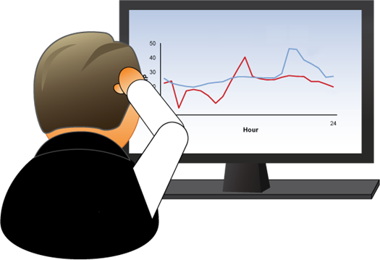
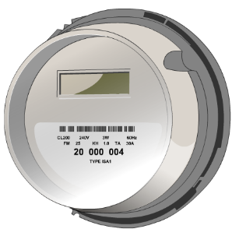
Greater Visibility of Data
AMS Meter Data – The Extra Picture
Available Day 2
Customer
Available Day 2
Transmitted periodically
Uploaded Day 1
Notes:
We saw this picture earlier in the course. <Click for animation> Load meter data is collected and sent to ERCOT by TDSPs. Ultimately, ERCOT must roll all meter data up to the QSE level in order to settle the Wholesale Markets. ERCOT adjusts the metered load data to incorporate Losses and UFE and calculates each QSE’s Adjusted Metered Load. <Click for animation> Since ERCOT settles the Wholesale Markets on a fifteen minute interval, the QSEs’ Adjusted Metered Load must be calculated for each fifteen minute interval.

Slide 22
More Opportunities
Advanced Meter technology offers the promise of new Retail products
Prepay
Demand Response
Time-of-Use Rate offerings
Qualified Scheduling Entity (QSE)
Retail Electric Provider (REP)
These products are available now. More are on the way!
Notes:
Smart Meter technology also offers the promise of new Retail products? The greater timeliness of meter data allows for better prepay products, where a customer pays in advance to use a certain amount of electricity over a certain period of time. The greater precision and interval measure of meter data allows for further enhancement of demand response products. Having interval data for most customers allows REPs to offer the long-sought time-of-use pricing.
<Click for animation> These products are available now, in some form. But there is probably more to come. Convenience and economic incentives should spur demand for these types of products, inproving the current offerings, and bringing new offerings to market!

Slide 23
Other Benfits
Fringe Benefits of AMS
Improved service reliability with automated outage notification
Earlier detection
Faulty meters
Meter tampering
Environmental benefits – remote service orders minimize the need for manual field activities

