Slide 1
ERCOT MARKET EDUCATION
Retail 101

Slide 2
Market Rules

Slide 3
Overview
Topics in this lesson . . .
Introduction to Market Rules
Public Utility Regulatory Act
PUCT Substantive Rules
ERCOT Protocols and Market Rules
Finding the Rules
Revision Process

Slide 4
Hierarchy of Rules
Public Utility Regulatory Act (PURA)
PUCT Substantive Rules
ERCOT Protocols and Market Guides

Slide 5
State of Texas Laws
Public Utility Regulatory Act (PURA)
Amended by Senate Bill 7 in 1999 to restructure the electric utility industry in ERCOT
Implement competitive choice in certain areas by January 1, 2002
PUCT and ERCOT responsible for determining specifics
Defines the Public Utility Commission of Texas (PUCT) and it’s role

Slide 6
Hierarchy of Rules
Public Utility Regulatory Act (PURA)
PUCT Substantive Rules
ERCOT Protocols and Market Guides

Slide 7
Public Utility Commission of Texas (PUCT) Rules
PUCT Substantive Rules
Implement PURA requirements, including
Customer protection rules
Standard terms and conditions for utilities
Electric Substantive Rules are contained in Chapter 25
Refer to PUCT Website for complete rules

Slide 8
PUCT Substantive Rules
A Few Key Rules for Retail Electric Providers
§ 25.43 | Provider of Last Resort (POLR). Default provider for customers in need of service Several chosen by PUC in each service area.
§ 25.107 | Certification of Retail Electric Providers (REPs). Financial Technical Managerial
§ 25.214 | Terms and Conditions of Retail Delivery Service Provided by Investor Owned Transmission and Distribution Utilities.
§ 25.454 | Rate Reduction Program. Low Income Discount (LITE UP) for eligible customers. Currently funded through August 2016.
§ 25.471 through § 25.500 | Customer Protection Rules

Slide 9
PUCT Substantive Rules
Customer Protection Rules (Part 1)
§ 25.471 | General Provisions of Customer Protection Rules | § 25.478 | Credit Requirements and Deposits
§ 25.472 | Privacy of Customer Information | § 25.479 | Issuance and Format of Bills
§ 25.473 | Non-English Language Requirements | § 25.480 | Bill Payment and Adjustments
§ 25.474 | Selection of REP | § 25.481 | Unauthorized Charges
§ 25.475 | General REP Requirements and Information Disclosures to Customers | § 25.482 | Prompt Payment Act
§ 25.476 | Renewable and Green Energy Verification | § 25.483 | Disconnection of Service
§ 25.477 | Refusal of Electric Service | § 25.484 | Electric No-Call List

Slide 10
PUCT Substantive Rules
Customer Protection Rules (Part 2)
§ 25.485 | Customer Access and Complaint Handling | § 25.492 | Non-Compliance with Rules or Orders
§ 25.487 | Obligations Related to Move-In Transactions | § 25.493 | Acquisition and Transfer of Customers from one REP to Another
§ 25.488 | Procedures for a Premise with No Service Agreement | § 25.495 | Unauthorized Change of REP
§ 25.489 | Treatment of Premises with No Retail Electric Provider of Record | § 25.497 | Critical Load, Critical Care and Chronic Condition Customers
§ 25.490 | Moratorium on Disconnect on Move-Out | § 25.498 | Prepaid Service
§ 25.491 | Record Retention and Reporting Requirements | § 25.500 | Privacy of Advanced Metering System Information

Slide 11
Hierarchy of Rules
Public Utility Regulatory Act (PURA)
PUCT Substantive Rules
ERCOT Protocols and Market Guides

Slide 12
ERCOT Protocols and Market Guides
ERCOT Protocols
Outline the procedures and processes used by ERCOT and Market Participants for the orderly functioning of the ERCOT system and markets.
ERCOT Market Guides
Based upon the ERCOT protocols
Detailed reference documents for establishing market and operating processes.

Slide 13
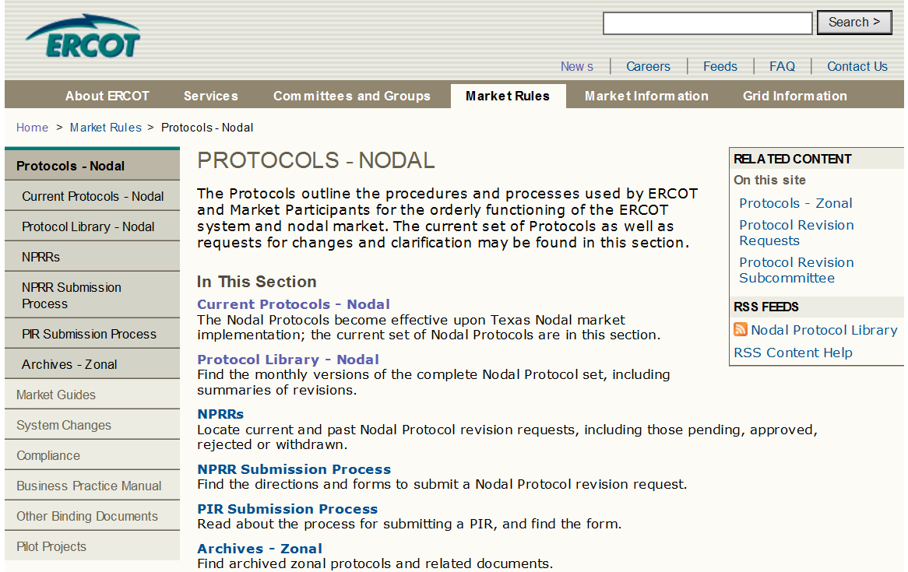
ERCOT Protocols

Slide 14
ERCOT Protocols
Protocol Overview for Retail Electric Providers
Sections | Description
1-2 | Construction and Definitions
3-9 | System Operations and Wholesale Markets
10 | Metering
11 | Data Aggregation
14 | Renewable Energy Credit Trading Program
15 | Customer Registration
16 | Market Participant Registration
19 | Texas Standard Electronic Transactions

Slide 15
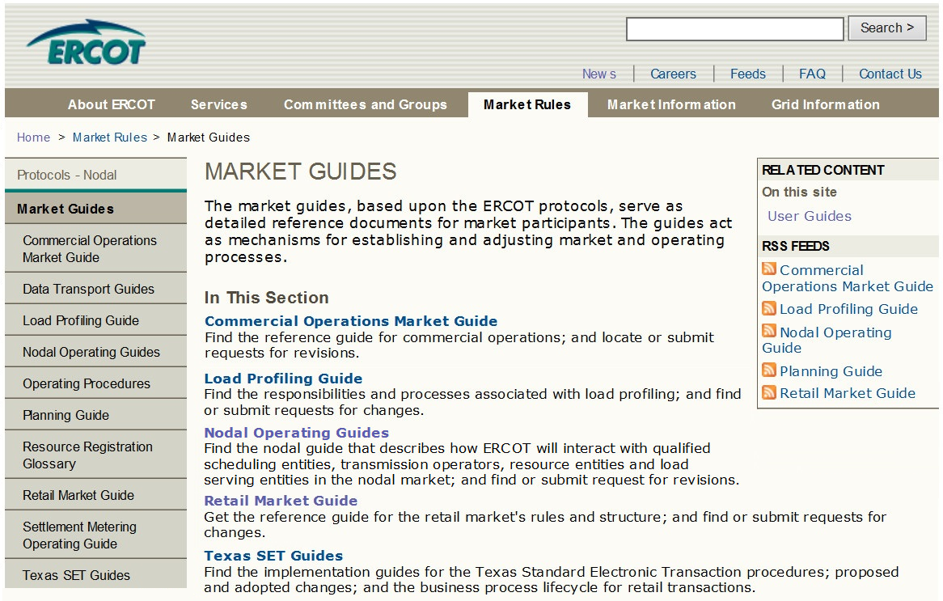
ERCOT Market Guides

Slide 16
Protocol and Market Guide Revision Process
Board must approve all ERCOT Protocols and Market Guides
Board
Of Directors
TAC recommends approval or sends changes back for further review
Technical Advisory
Committee
(TAC)
Retail Market Subcommittee (RMS)
Reliability Operations Subcommittee (ROS)
Wholesale Market Subcommittee (WMS)
Commercial Operations Subcommittee (COPS)
Protocol Revision Subcommittee (PRS)
Subcommittees recommend changes to the ERCOT Protocols and Market Guides

Slide 17
Protocol and Market Guide Revision Process
Changes are proposed through formal Revision Requests
NPRR – Nodal Protocol Revision Request
* GRR – [Name] Guide Revision Request, such as
RMGRR – Retail Market Guide
COPMGRR – Commercial Operations Market Guide
NOGRR – Nodal Operating Guide
NPRR711
RMGRR132
Revision Requests are posted with applicable documents on ercot.com

