Slide 1

Settlement Stability
2015 Q4 Update to COPS
Blake Holt
ERCOT
COPS
1/13/2016

Slide 2
8.2(c)(i) Track number of price changes
Reporting Period: 2015 Q4
Operating Day | # of Corrected Settlement Point Prices |  |  |  | # of Intervals Affected
 | DASPP | RTSPP | RTRMPR | ORDC Adders | DASPP | RTSPP | RTRMPR | ORDC Adders
- | - | - | - | - | - | - | - | -
Notes:
There were no price changes in Q4.

Slide 3
8.2(c)(ii) Track number and types of disputes submitted

Slide 4
8.2(c)(iii) Compliance with timeliness of response to disputes

Slide 5
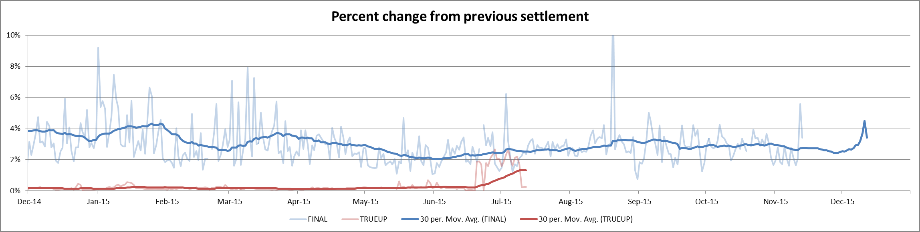
8.2(c)(iv) Other Settlement metrics
NOTE: ERS Final settlement OD data is not represented in graph.
Average percent change per year
Year | Final | True Up
2011 | 3.65% | 0.42%
2012 | 2.56% | 0.41%
2013 | 2.83% | 0.34%
2014 | 3.18% | 0.31%
2015 | 2.93% | 0.36%

Slide 6
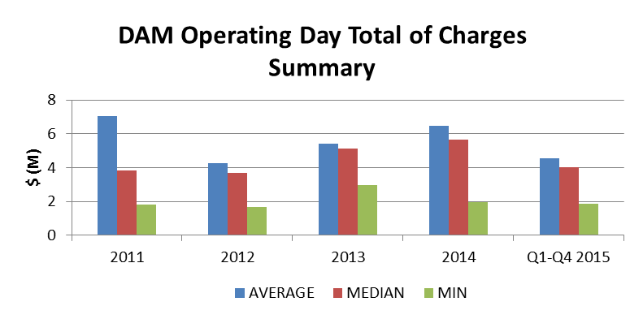
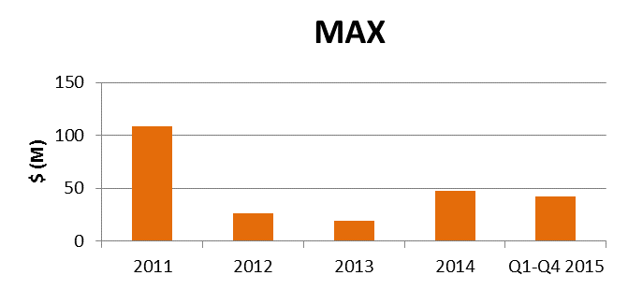
8.2(c)(iv) Other Settlement metrics
 | 2011 | 2012 | 2013 | 2014 | 2015 Q1-Q4
AVERAGE | $7.06 | $4.29 | $5.4 | $6.46 | $4.54
MEDIAN | $3.85 | $3.67 | $5.11 | $5.66 | $4.02
MIN | $1.81 | $1.70 | $2.96 | $1.96 | $1.86
MAX | $108.69 | $26.21 | $19.45 | $47.93 | $42.34
NOTE: “Total of Charges” represents the sum of statements that are a net charge to the Market Participant (i.e., the amount due to ERCOT)

Slide 7
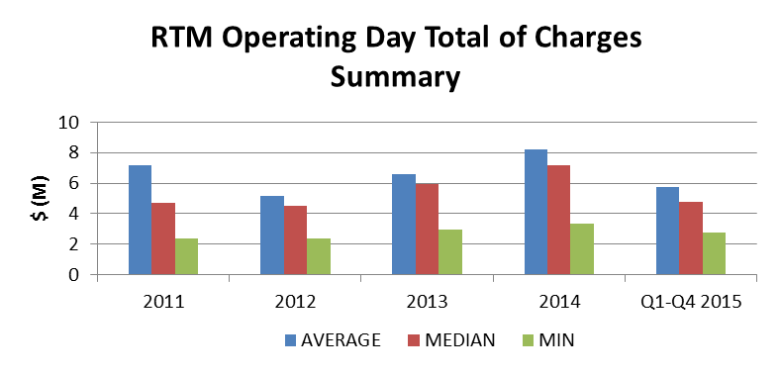
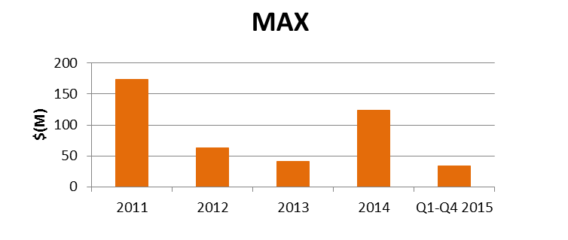
8.2(c)(iv) Other Settlement metrics
 | 2011 | 2012 | 2013 | 2014 | 2015 Q1-Q4
AVERAGE | $7.19 | $5.19 | $6.61 | $8.21 | $5.76
MEDIAN | $4.69 | $4.51 | $5.97 | $7.15 | $4.80
MIN | $2.38 | $2.34 | $2.98 | $3.32 | $2.77
MAX | $173.66 | $63.34 | $40.52 | $123.68 | $33.61
NOTE: “Total of Charges” represents the sum of statements that are a net charge to the Market Participant (i.e., the amount due to ERCOT)

Slide 8
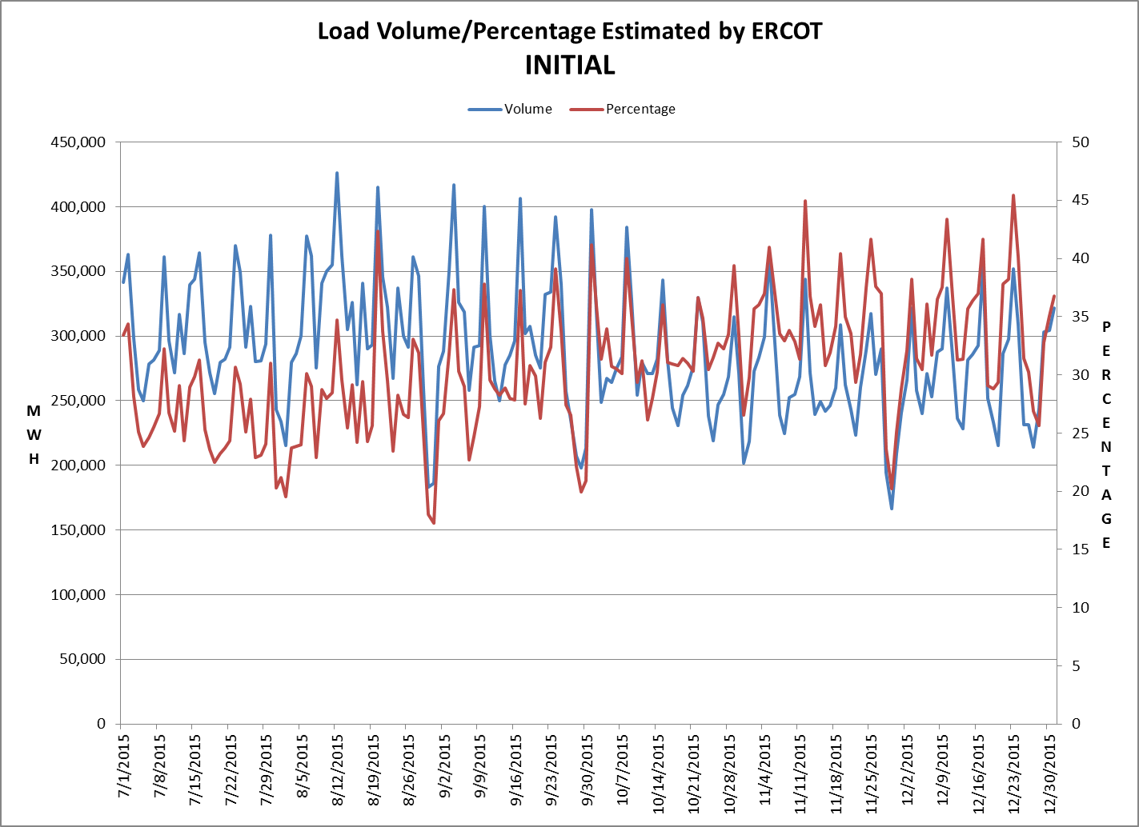
8.2(c)(v) Availability of ESIID consumption data

Slide 9
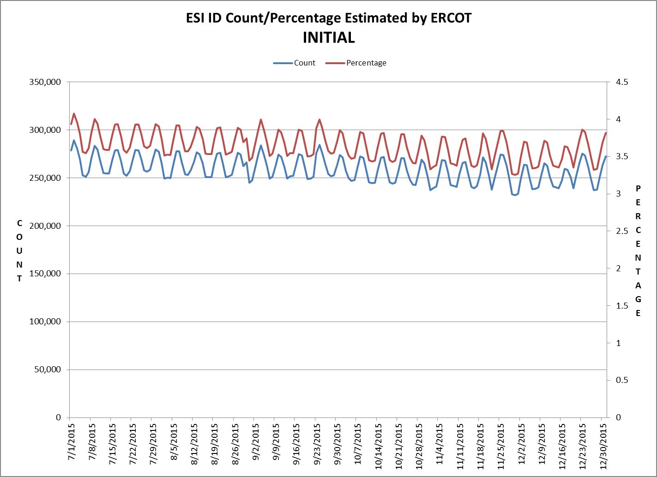
8.2(c)(v) Availability of ESIID consumption data

Slide 10
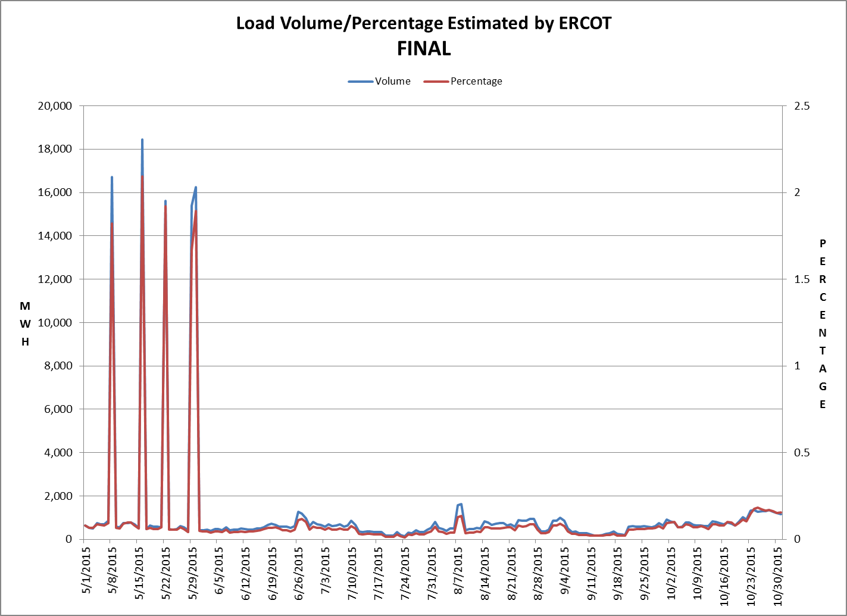
8.2(c)(v) Availability of ESIID consumption data

Slide 11
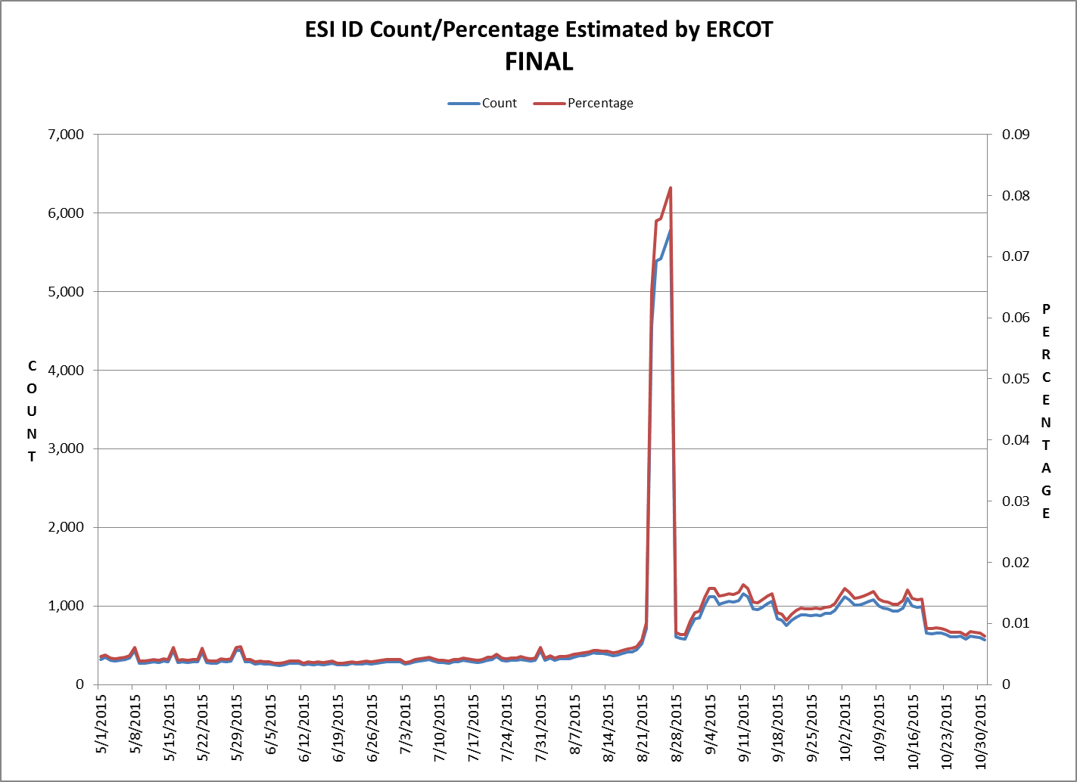
8.2(c)(v) Availability of ESIID consumption data

Slide 12
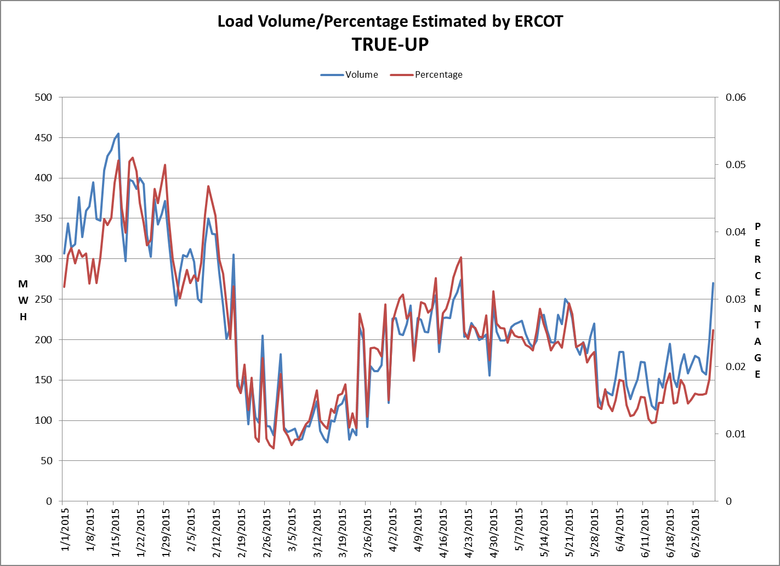
8.2(c)(v) Availability of ESIID consumption data

Slide 13
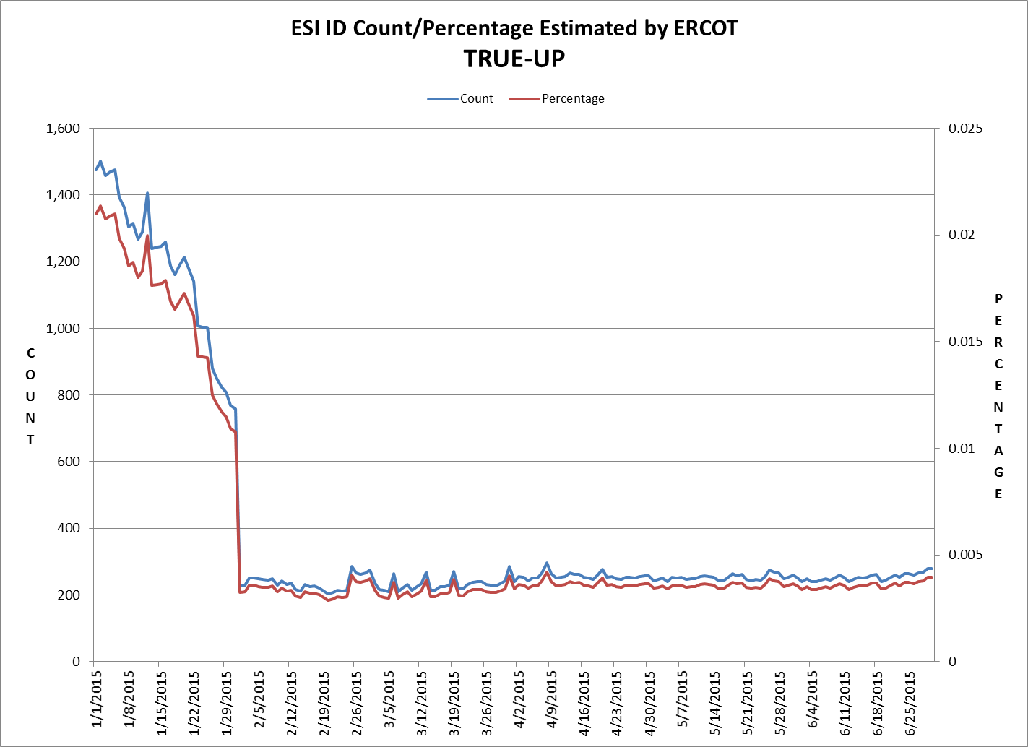
8.2(c)(v) Availability of ESIID consumption data

Slide 14
8.2(g) Net Allocation to Load (Board Report)- Totals and $/MWh
NET ALLOCATION TO LOAD (MM)
 | Dec-14 | Jan-15 | Feb-15 | Mar-15 | Apr-15 | May-15 | Jun-15 | Jul-15 | Aug-15 | Sep-15 | Oct-15 | Nov-15 | Dec-15
Balancing Account Payout to Load | $0.0 | $0.0 | $0.0 | $0.0 | $0.0 | $0.0 | $0.0 | -$4.3 | -$5.6 | -$3.5 | -$4.0 | -$2.1 | -$2.2
Non-Zonal Auction Distribution | -$3.9 | -$2.7 | -$2.7 | -$5.6 | -$7.8 | -$7.8 | -$6.2 | -$5.0 | -$4.7 | -$6.0 | -$5.6 | -$4.0 | -$1.9
Zonal Auction Distribution | -$21.2 | -$19.9 | -$18.6 | -$19.8 | -$23.8 | -$26.7 | -$29.3 | -$33.1 | -$32.3 | -$25.2 | -$21.8 | -$18.1 | -$17.0
RUC Settlement | $0.0 | $0.0 | $0.0 | $0.0 | $0.0 | $0.0 | $0.0 | $0.0 | $0.0 | -$0.2 | -$0.1 | $0.0 | $0.0
Ancillary Services Settlement | $21.6 | $17.6 | $19.3 | $33.6 | $31.9 | $26.1 | $25.0 | $39.9 | $89.1 | $18.6 | $31.2 | $33.2 | $32.6
Black Start Service Settlement | $0.6 | $0.6 | $0.6 | $0.6 | $0.6 | $0.6 | $0.6 | $0.6 | $0.6 | $0.6 | $0.6 | $0.6 | $0.6
Voltage Services Settlement | $0.0 | $0.0 | $0.0 | $0.0 | $0.0 | $0.0 | $0.0 | $0.0 | $0.0 | $0.0 | $0.0 | $0.0 | $0.0
RMR Settlement | $0.0 | $0.0 | $0.0 | $0.0 | $0.0 | $0.0 | $0.0 | $0.0 | $0.0 | $0.0 | $0.0 | $0.0 | $0.0
RMR Capacity | $0.0 | $0.0 | $0.0 | $0.0 | $0.0 | $0.0 | $0.0 | $0.0 | $0.0 | $0.0 | $0.0 | $0.0 | $0.0
Revenue Neutrality Total | $0.5 | $2.7 | $0.2 | $2.0 | $1.0 | $2.4 | $2.5 | $2.7 | $0.0 | $4.8 | $3.3 | -$0.3 | $1.3
Emergency Energy Charges | $0.1 | $0.0 | $0.1 | $0.1 | $0.1 | $0.1 | $0.0 | $0.0 | $0.1 | $0.1 | $0.0 | $0.1 | $0.0
Base Point Deviation Payments | -$0.2 | -$0.2 | -$0.3 | -$0.2 | -$0.2 | -$0.2 | -$0.2 | -$0.3 | -$0.3 | -$0.2 | -$0.2 | -$0.2 | -$0.2
ERS Settlement * | $3.7 | $3.7 | $3.6 | $3.6 | $3.6 | $3.6 | $4.8 | $4.8 | $4.8 | $4.8 | - | - | -
ORDC Settlement | $0.1 | $0.1 | $0.2 | $0.3 | $0.3 | $0.2 | $0.1 | -$0.4 | -$0.9 | $0.3 | $0.0 | $0.1 | $0.0
ERCOT Admin Fee Settlement | $12.1 | $13.4 | $11.7 | $11.8 | $11.5 | $13.0 | $15.1 | $17.2 | $17.2 | $15.0 | $12.8 | $11.2 | $12.0
Block Load Transfer Settlement | $0.0 | $0.0 | $0.0 | $0.0 | $0.0 | $0.0 | $0.0 | -$0.1 | -$0.1 | -$0.1 | $0.0 | $0.0 | $0.0
MW Charge for Excep. Fuel Cost | $0.0 | $0.0 | $0.0 | $0.0 | $0.0 | $0.0 | $0.0 | $0.0 | $0.0 | $0.0 | $0.0 | $0.0 | $0.0
Total $ | $13.4 | $15.3 | $14.1 | $26.4 | $17.2 | $11.3 | $12.4 | $22.0 | $67.9 | $9.0 | $16.2 | $20.5 | $25.2
Total Real-Time Adjusted Metered Load (MWh) | 26.0 | 28.9 | 25.2 | 25.4 | 24.7 | 28.0 | 32.5 | 37.0 | 37.0 | 32.2 | 27.5 | 24.0 | 25.9
$/MWh** | $0.52 | $0.53 | $0.56 | $1.04 | $0.70 | $0.40 | $0.38 | $0.59 | $1.84 | $0.28 | $0.59 | $0.85 | $0.97
AUCTION REVENUE PER CONGESTION MANAGEMENT ZONE ($MM)
Zonal Auction Distribution($) | Dec-14 | Jan-15 | Feb-15 | Mar-15 | Apr-15 | May-15 | Jun-15 | Jul-15 | Aug-15 | Sep-15 | Oct-15 | Nov-15 | Dec-15
HOUSTON | -$2.1 | -$1.5 | -$1.3 | -$1.7 | -$2.1 | -$2.6 | -$2.7 | -$2.8 | -$2.9 | -$3.2 | -$3.2 | -$2.0 | -$1.8
NORTH | -$4.4 | -$4.6 | -$3.8 | -$3.7 | -$3.8 | -$4.5 | -$4.8 | -$5.4 | -$6.4 | -$4.5 | -$3.4 | -$3.4 | -$3.5
SOUTH | -$7.4 | -$7.0 | -$6.9 | -$6.4 | -$7.2 | -$8.0 | -$8.3 | -$10.9 | -$10.8 | -$8.5 | -$7.7 | -$6.5 | -$6.7
WEST | -$7.4 | -$6.8 | -$6.5 | -$7.9 | -$10.7 | -$11.5 | -$13.5 | -$14.0 | -$12.2 | -$9.0 | -$7.5 | -$6.2 | -$5.1
TOTAL | -$21.2 | -$19.9 | -$18.6 | -$19.8 | -$23.8 | -$26.7 | -$29.3 | -$33.1 | -$32.3 | -$25.2 | -$21.8 | -$18.1 | -$17.0
* The total ERS charges have been evenly allocated across the contract period.
** The $/MWh value as calculated per PR 8.2 (2) g

