Slide 1
ERCOT Reporting of Demand Response DSWG Update
Carl Raish
January 8, 2016

Slide 2
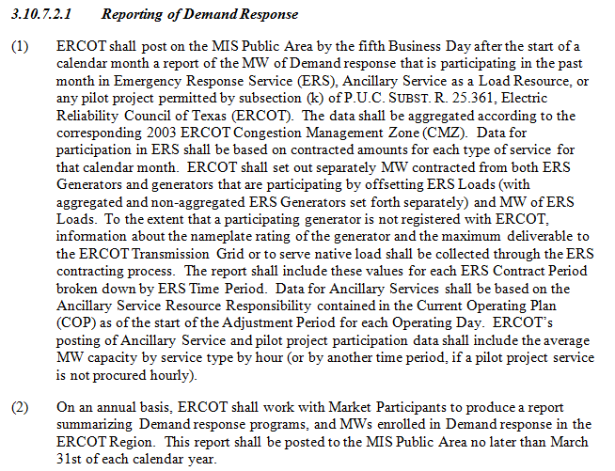
Reporting Requirement in Protocols

