Slide 1
January 14, 2016 MWG Meeting

Slide 2
Topics for discussion:
1.) ERCOT Anti-Trust Admonition (D. Sumbera) | 9:30 – 9:35
2.) Attendance roll-call and introduction (D. Sumbera) | 9:35 – 9:45
3.) Nomination & selection of new MWG Chairperson & Vice-chairperson (D. Tucker) | 9:45 – 10:00
4.) Discussion of NPRR/RMGRR with the concept of “Allow AMS data Submittal for TDSP-Read Non-Modeled Generators” (D. Tucker) | 10:00 – 11:00
5.) Break | 11:00 – 11:15
6.) Review proposed SMOGRR language change in SMOG 1.3.7 regarding Parallel CTs (H. Perez) | 11:15 – 11:30
7.) Review proposed SMOGRR language change in SMOG 1.4.7 regarding Loss of Potential (H. Perez) | 11:30 – 11:45

Slide 3
Topics for discussion:
8.) Review proposed SMOGRR language change in SMOG regarding TDSP’s submission of nameplate photos of newly-installed instrument transformers (CTs & VTs) as part of Site Certification Documents (H. Perez) | 11:45 – 12:00
9.) Lunch Break | 12:00 – 1:15
10.) EPS Meters via IP-Based Communications (P. Vinton) | 1:15 – 1:45
11.) New or other business items (D. Sumbera) | 1:45 – 2:45
12.) Meeting summary and Closing Remarks | 2:45 – 3:00
13.) End of Meeting | 3:00

Slide 4
Legal Disclaimers and Admonitions
Antitrust Admonition
ERCOT strictly prohibits market participants and their employees who are participating in ERCOT activities from using their participation in ERCOT activities as a forum for engaging in practices or communications that violate antitrust laws. The ERCOT Board has approved guidelines for Members of ERCOT Committees, subcommittees and working groups to be reviewed and followed by each market participant attending ERCOT meetings. For details, please review the guidelines in the attachments tab of this presentation (if available).

Slide 5
Attendance roll-call and introduction (D. Sumbera)

Slide 6
Nomination and selection of new MWG Chairperson and Vice-chairperson (D. Tucker) Nominations are now open.

Slide 7
4. Discuss proposed NPRR/RMGRR with the concept of “Allow AMS Data Submittal for TDSP-Read Non-Modeled Generators”. (D. Tucker)
Concept: Allow TDSPs an option to submit TDSP Read non-modeled generation meter data to ERCOT utilizing AMS transactions.
TDSP would specify data delivery method on the TDSP Read Generation Form
LSE or
867

Slide 8
5. Break

Slide 9
6.) Review proposed SMOGRR language change in SMOG 1.3.7 regarding Parallel CTs (H. Perez)
Current SMOG:
1.3.7 Paralleling of Current Transformers
Paralleling of current transformers is not recommended. However, when it is necessary, the following requirements apply.
All transformers must have the same nominal ratio regardless of the ratings of the circuits in which they are connected.
All transformers which have their secondaries paralleled must be connected to the same phase of the primary circuits.
The secondary circuits shall be connected in a configuration to allow for testing of individual instrument transformers. The secondary circuits shall be paralleled at the meter test switch.
There shall be only one ground on the secondary of all paralleled transformers at their common point. It is recommended that the ground be located at the meter or at the nearest terminal block to the meter.
Each current transformer must be capable of supporting n times the connected burden within the accuracy class of the transformers, where n = number of current transformers in parallel.
A common voltage must be available for the meter. This condition is met if the circuits share a common bus that is normally operated with closed bus ties.
The meter must have sufficient current capacity to carry the sum of the currents from all the transformers to which it is connected.
The secondary leads from all current transformers shall be such that the maximum possible burden placed on any transformer does not exceed its adjusted burden rating, as defined in paragraph (e) above.

Slide 10
6.) Review proposed SMOGRR language change in SMOG 1.3.7 regarding Parallel CTs (H. Perez)
Proposed Language presented on 1-29-2014 MWG meeting
SMOG 1.3.7 Paralleling of Current Transformers
Paralleling of current transformers is not recommended. However, when it is necessary, the following requirements apply. (a)……(d) (e) Each current transformer must be capable of supporting n times the total common connected burden on all CTs in parallel plus its own burden within the accuracy class of the transformers, where n = number of current transformers in parallel.

Slide 11
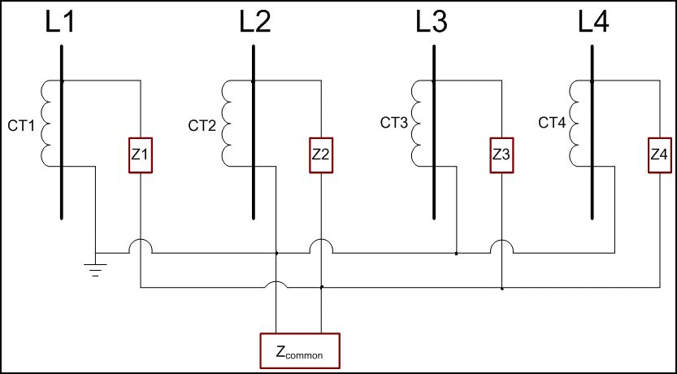
Example of CTs in parallel

Slide 12
CenterPoint’s suggested language changes on SMOG 1.3.7 (e) SMOG 1.3.7 (e) Paralleling of Current Transformers – Connected burden Paralleling of current transformers is not recommended. However, when it is necessary, the following requirements apply. (e) Each current transformer must be capable of supporting n times the common burden plus its own individual burden and stay within the accuracy class of the transformers, where n = number of current transformers in parallel. This is the effective burden for each current transformer.

Slide 13
7.) Review proposed SMOGRR language change in SMOG 1.4.7 regarding Loss of Potential (H. Perez)
Current SMOG 1.4.7:
“The secondary circuit shall be monitored for loss of potential on each phase.”
Proposed SMOG 1.4.7:
“The secondary circuit shall be monitored and event will be recorded for loss of potential on each phase or whenever meter input voltage falls below 75-85% (80% recommended) of the nominal voltage value for 1-10 (5 recommended) seconds. Nominal voltage value, for this section, is defined as the secondary output value of the voltage transformer, to which the EPS meters are connected, as specified on the name plate, manufacturer test report or Professional Engineer Letter.” When interrogated through MDAS, the event will be reported.
Consideration - Should this monitoring & logging be part of section 6.5.4 Event Logging?

Slide 14
8.) Review proposed SMOGRR language change in SMOG regarding TDSP’s submission of nameplate photos of newly-installed instrument transformers (CTs & VTs) as part of Site Certification Documents (H. Perez)
3.2.3 Site Approval Request Package The Site Approval Request Package should be provided within 60 days after the site has been certified and must include: (a) Site Certification Form; . . (i) Readable photos of the nameplates of newly installed or replaced instruments transformers; (j) Other information as required

Slide 15
9.) Lunch Break

Slide 16
10.) EPS Meters via IP-based Communications (P. Vinton)

Slide 18
11.) New or other business items (D. Sumbera)

Slide 19
12.) Meeting Summary and Closing Remarks (D. Sumbera)

Slide 20
13.) End of meeting

