Slide 1
ERCOT MARKET EDUCATION
Retail 101

Slide 2
Data Transparency and Availability

Slide 3
Overview
Topics in this lesson . . .
The Market Information System
Data Extracts
MarkeTrak

Slide 4
Market Information System (MIS)

Slide 5
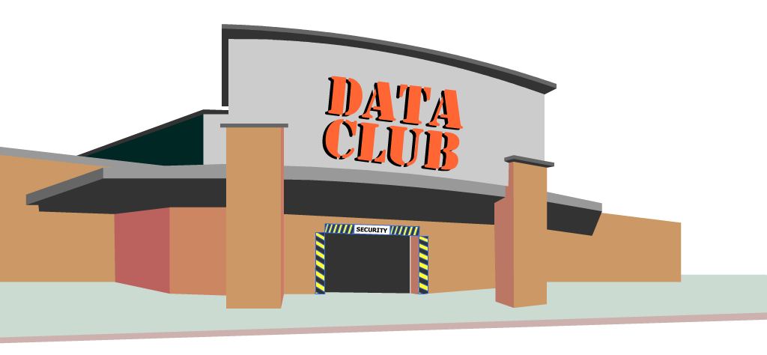
Market Information System (MIS)
Welcome to the ERCOT Data Club
. . . where membership has its perks!
Notes:
The ERCOT Market Information System (MIS) is like one of those membership stores. We’ll call this one the Data Club

Slide 6
Market Information System (MIS)
Don’t forget your membership card!
Notes:
Of course, like any membership store, you must scan your membership card to enter. For the ERCOT Market Information System, the membership card takes the form of a digital certificate. Your digital certificate is what gets you in the door!

Slide 7
Digital Certificate
Digital Certificates issued to each registered Market Participant by ERCOT
General access to MIS is defined by the Certificate and DUNS number
Specific access defined by users’ roles
Individual user Certificates issued by the company’s User Security Administrator (USA)
Determine which roles a user should have
Revoke certificates as users leave the company

Slide 8
Additional Digital Certificate Information

Slide 9
Inside the Market Information System (MIS)
Notes:
Once inside the door, there are three different levels of data available, depending on membership (Digital Certificate).
Public Data is information available to the general public, but is also provided here at the Data Club as a convenience to members.
Secure Data is information available only to club members (Registered Market Participants), but is available to all club members.
Certified Data is customized information available only to individual members. Access to these racks is controlled by the Digital Certificates.

Slide 10
Examples of Public Data
Load Profiles
Load Forecasts
Ancillary Service Plans
Market prices
Public Data is also available across the street at Bit Mart (www.ercot.com)

Slide 11
Examples of Secure Data
Network Model
System Planning Data
Transmission Outages
TDSP Monthly Load Report

Slide 12
Examples of Certified Data
Data Extracts
Missing Consumption Reports (TDSP)
Potential Load Loss Reports (REP)
Activity Reports
User’s assigned roles determine visibility

Slide 13
Launch other ERCOT Applications from within MIS
User’s assigned roles determine which applications are available
Notes:
The Data Club even offers additional Member Services, where you can launch other ERCOT Applications from one convenient location! Please note that your individual membership (Digital Certificate) determines the specific applications that are available to you.

Slide 14
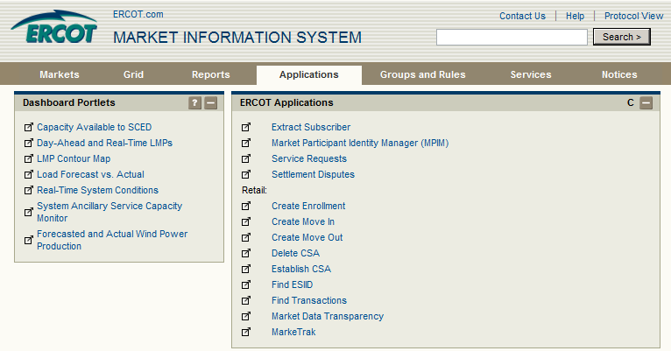
Launch other ERCOT Applications from within MIS
Notes:
Let’s look at two of these applications in particular: Find ESIID and Find Transactions

Slide 15
Find ESIID
Three ways to search
Single ESIID
Multiple ESIID
Premise Address
Notes:
Find ESIID is a quick way to find pertinent information about particular customers or potential customers. This tool allows you to search either for a single ESIID or a group or ESIIDs. If you don’t already know the ESIID, you may also search based on the Premise address.

Slide 16
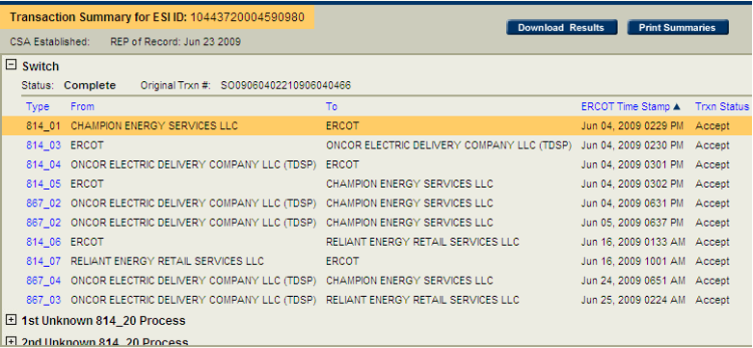
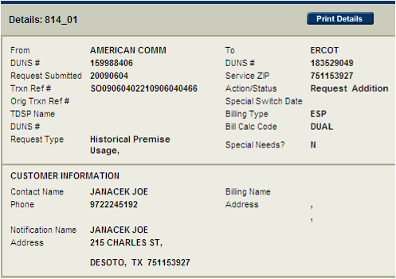
Find Transaction
Notes:
Find Transaction is a tool to research historical transactions associated with an ESIID or group of ESIIDs. Please note that if you are a Retail Electric Provider, you will be allowed to see only those transactions that took place when you were the REP-of-Record for that ESIID.

Slide 17
Can’t find what you’re looking for?
Just ask EMIL!
Notes:
However, as you browse the store, if you can’t find what you want, just ask EMIL.
EMIL knows where everything is. He knows when inventory is restocked and how long things stay on the shelf. He even knows what can be ordered for auto-delivery right to your mailbox!

Slide 18
ERCOT Market Information List (EMIL)
EMIL knows all
Location
Frequency of Posting
Who gets to see the data

Slide 19
Data Extracts

Slide 20
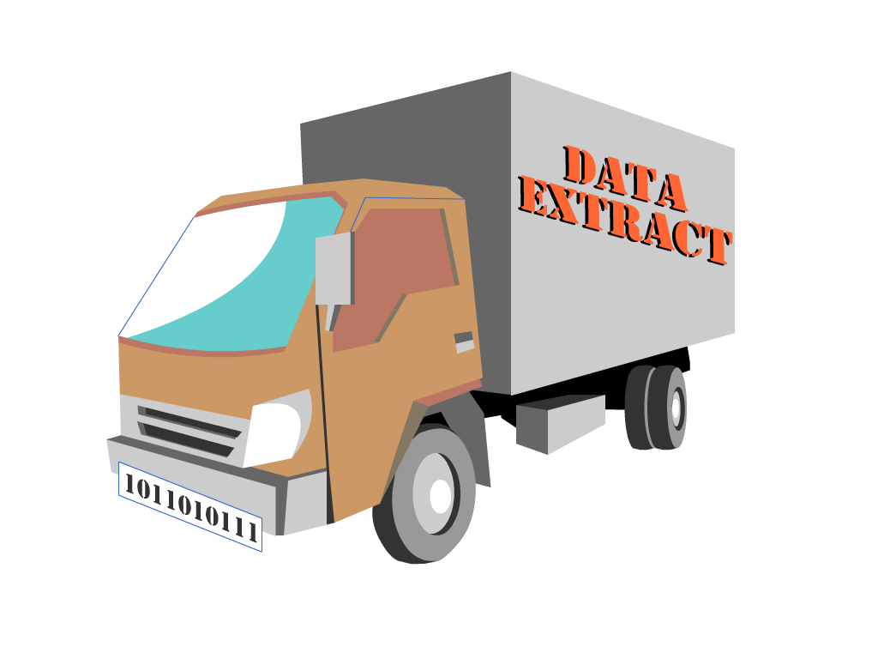
Data Extracts
Data Extracts are an automated delivery mechanism for certain packages of MIS data

Slide 21
Data Extracts – The Big Picture
Transport data from ERCOT database to your database
ERCOT
Taylor,TX
Great MP
Somewhere, TX
May contain:
Customer info
Usage data
Settlement Data
DBA
Notes:
Extracts are sets of data used by ERCOT to manage and settle the energy market. For example, information related to the Day Ahead Market and Real Time Market is available on a daily basis via a downloadable ERCOT data extract.
It is easy to confuse a data extract with a data report. An extract is a raw data file that is intended to be uploaded into a computer database for analytical purposes. Reports are more person-friendly and exist to provide readable, summarized information to the user.

Slide 22
Data Extracts – The Big Picture
Transport data from ERCOT database to your database
ERCOT
Taylor,TX
Great MP
Somewhere, TX
Packaged in two formats:
Comma Separated Value (.csv)
Extensible Markup Language (.xml)
DBA
Notes:
Extracts are sets of data used by ERCOT to manage and settle the energy market. For example, information related to the Day Ahead Market and Real Time Market is available on a daily basis via a downloadable ERCOT data extract.
It is easy to confuse a data extract with a data report. An extract is a raw data file that is intended to be uploaded into a computer database for analytical purposes. Reports are more person-friendly and exist to provide readable, summarized information to the user.

Slide 23
Data Extracts – The Big Picture
Transport data from ERCOT database to your database
Database must be structured properly to receive ERCOT Data
ERCOT provides structural files for Market Participant use
Data Definition Language (DDL) for .csv files
XML Schema Definition (XSD) for .xml files
DBA
Notes:
For this process to work as designed, the Market Participant database must be structured properly to receive data from ERCOT. Fortunately, this is not simply guesswork. ERCOT provides structural files for the Market Participant to execute against their database. The correct structure depends on the packaging format chosen by the Market Participant. For .csv files, a Data Definition Language or DDL file is used to build the appropriate database structure. For .xml files, the XML Schema Definition or XSD file should be used.
Please note that the DDL files created by ERCOT are designed to be executed against an ORACLE database. The DDLs can be modified by the user to accommodate other common database formats. Market participants should consult with a qualified database administrator to chose the best utilization of extracts for their company.

Slide 24
DDLs, XSDs and User Guides

Slide 25
Extract Subscriber

Slide 26
ESIID Service History and Usage Extract
Provides Service History Information
Start/Stop time for ESIID to REP relationship
Other ESIID-level data
Load Zone
Servicing TDSP
Profile Class
Retail Electric Provider (REP)

Slide 27
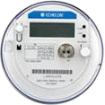
ESIID Service History and Usage Extract
Provides Usage Data by ESIID
Monthly Meter Data
Flows out three days after data posts with ERCOT
Retail Electric Provider (REP)

Slide 28
Supplemental AMS Interval Data Extract
Provides Interval Usage Data by ESIID
Daily Meter Data by 15-minute settlement interval
Flows out three days after data posts with ERCOT
Retail Electric Provider (REP)

Slide 29
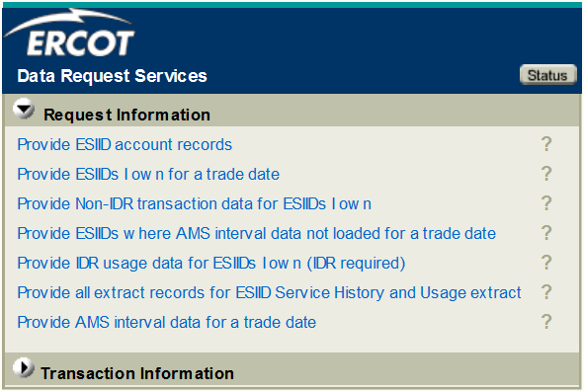
Market Data Transparency Web Service
Provides similar information on ad hoc basis

Slide 30
Market Data Transparency Web Service

Slide 31
MarkeTrak

Slide 32
Where to Turn When Things Go Wrong
So, what does a vigilant REP do with all this data?
Watch to make sure all expected transactions happen
Check usage data for planning and accuracy
Service History
Usage
Move-ins
Switches Meter Reads
ESIID Data
ESIID Data
Because sometimes things don’t go as planned

Slide 33
Where to Turn When Things Go Wrong
What happened?
ESIID should be with REP #1
ESIID is actually with REP #2
REP #1
REP #2
?
What can a Retail Electric Provider do?

Slide 34
Where to Turn When Things Go Wrong
What happened?
Last month’s meter read was 1520kWh
This month’s meter read is 14,950kWh
Retail Electric Provider (REP)
$$$
1224kWh
1520kWh
14,950kWh
1375kWh
What can a Retail Electric Provider do?

Slide 35
Where to Turn When Things Go Wrong
Retail Electric Providers turn to . . .
MarkeTrak
A web-based database application used to track and manage ERCOT Retail Market data discrepancies
MarkeTrak
MarkeTrak

Slide 36
Launching the MarkeTrak Application

Slide 37
Using the MarkeTrak Application
Common issues reported/resolved using MarkeTrak
Inadvertent Gains and Losses
Switch Holds
Missing Transactions
Usage and Billing issues
MarkeTrak
MarkeTrak

Slide 38
Using the MarkeTrak Application
Goals of MarkeTrak
Facilitate resolution of issues between REPs and TDSPs
Discovery and visibility
Tracking and status
Enable historical reporting of issues
MarkeTrak
MarkeTrak

