Slide 1
PDCWG Report to ROS
Chair: Mike Noth, LCRA
Vice Chair: Stewart Rake, Luminant
ROS
January 7th, 2015

Slide 2
Report Overview & Notes
Report Overview
  Meeting Minutes
  BAL-001-TRE-1 FMEs & IMFR
  Frequency Control Report
PDCWG wishes to file an SCR to update the Generation to be Dispatched (GTBD) equation to include ACE Integral. This will help minimize GTBD oscillations and reduce the amount of manual Time-Error Corrections

Slide 3
Meeting Minutes
PDCWG Meeting 10/14/15
  BAL-001-TRE-1
    As of October 1st, 100% of the Generation fleet (non-exempt) should be compliant with BAL-001-TRE-1 R6.
  GREDP Performance Analysis
  Regulation & Frequency Control Reports
  GTBD Analysis
    ERCOT is in the process of analyzing the benefit of adding ACE Integral component to the existing GTBD calculation.
    ERCOT is continually updating the current GTBD tuning parameters (K3 & K4) to adjust for seasonal load profiles and regulation performance.
PDCWG Meeting 11/11/15
  GREDP Performance Analysis
  Regulation & Frequency Control Reports
  GTBD Analysis
    ERCOT is in the process of analyzing the benefit of adding ACE Integral component to the existing GTBD calculation.
    ERCOT is continually updating the current GTBD tuning parameters (K3 & K4) to adjust for seasonal load profiles and regulation performance.
  Reviewed 3 ERCOT Frequency Disturbances
    102315 @ 0531
    102315 @ 0605
    102715 @ 1547

Slide 4
Meeting Minutes
PDCWG Meeting 11/11/15
  GREDP Performance Analysis
  Regulation & Frequency Control Reports
  GTBD Analysis
    ERCOT is in the process of analyzing the benefit of adding ACE Integral component to the existing GTBD calculation.
    ERCOT is continually updating the current GTBD tuning parameters (K3 & K4) to adjust for seasonal load profiles and regulation performance.
  Reviewed 3 ERCOT Frequency Disturbances
    110715 @ 0339
    113015 @ 1045
    113015 @ 1942

Slide 5
Frequency Measurable Events Performance
October - December 2015

Slide 6
Frequency Measurable Events
There were 3 FMEs during the month of October.
  10/23/2015 05:31:36
    Loss of 835 MW
    9 of 46 Generation Resources had less than 75% of their expected Initial Primary Frequency Response.
    8 of 46 Generation Resources had less than 75% of their expected Sustained Primary Frequency Response.
  10/23/2015 06:05:23
    Loss of 831 MW
    9 of 49 Generation Resources had less than 75% of their expected Initial Primary Frequency Response.
    7 of 49 Generation Resources had less than 75% of their expected Sustained Primary Frequency Response.
  10/27/2015 15:47:21
    Loss of 643 MW
    4 of 37 Generation Resources had less than 75% of their expected Initial Primary Frequency Response.
    3 of 37 Generation Resources had less than 75% of their expected Sustained Primary Frequency Response.

Slide 7
Frequency Measurable Events
There were 3 FMEs during the month of November.
  11/07/2015 03:39:45
    Loss of 755 MW
    8 of 41 Generation Resources had less than 75% of their expected Initial Primary Frequency Response.
    5 of 41 Generation Resources had less than 75% of their expected Sustained Primary Frequency Response.
  11/30/2015 10:45:35
    Loss of 574 MW
    6 of 36 Generation Resources had less than 75% of their expected Initial Primary Frequency Response.
    5 of 36 Generation Resources had less than 75% of their expected Sustained Primary Frequency Response.
  11/30/2015 19:42:41
    Loss of 575 MW
    10 of 41 Generation Resources had less than 75% of their expected Initial Primary Frequency Response.
    6 of 41 Generation Resources had less than 75% of their expected Sustained Primary Frequency Response.

Slide 8
Frequency Measurable Events
There was 1 FME during the month of December.
  12/30/2015 11:17:19
    Loss of 678 MW
    4 of 42 Generation Resources had less than 75% of their expected Initial Primary Frequency Response.
    4 of 42 Generation Resources had less than 75% of their expected Sustained Primary Frequency Response.

Slide 9
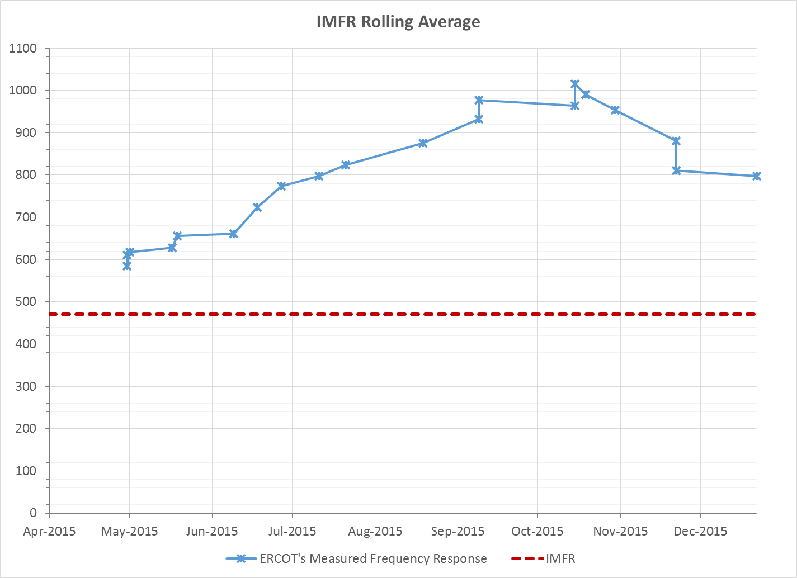
Interconnection Minimum Frequency Response (IMFR) Performance

Slide 10
Frequency Control Report
October - December 2015

Slide 11
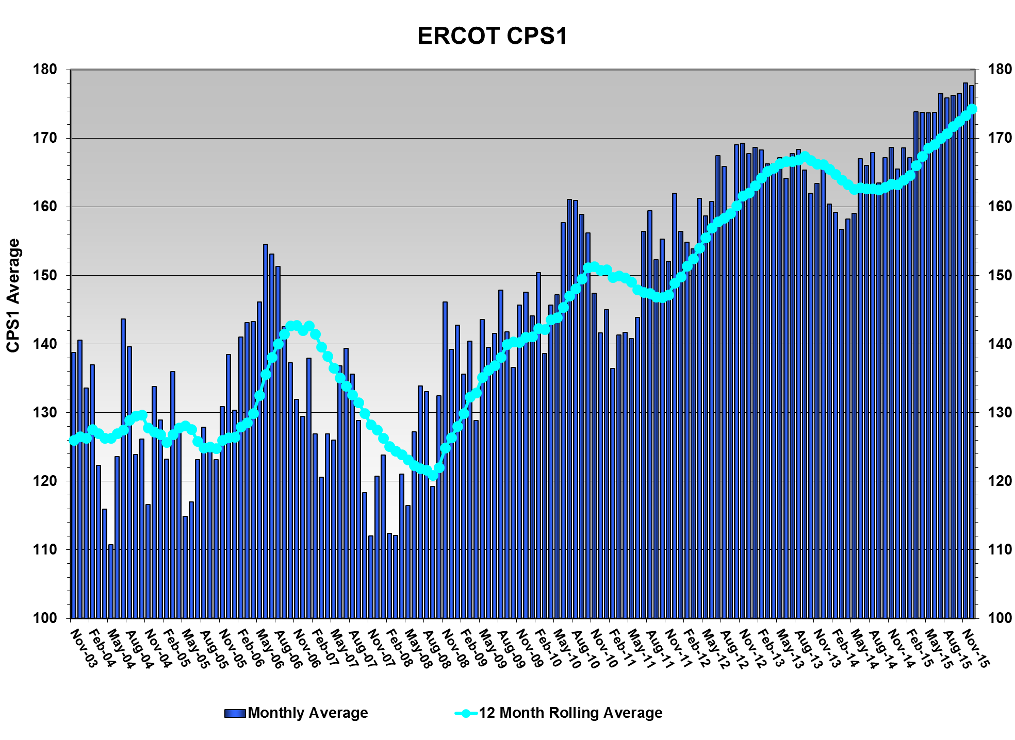
CPS1 Performance
CPS1 12 Month Rolling Average = 174.34%

Slide 12
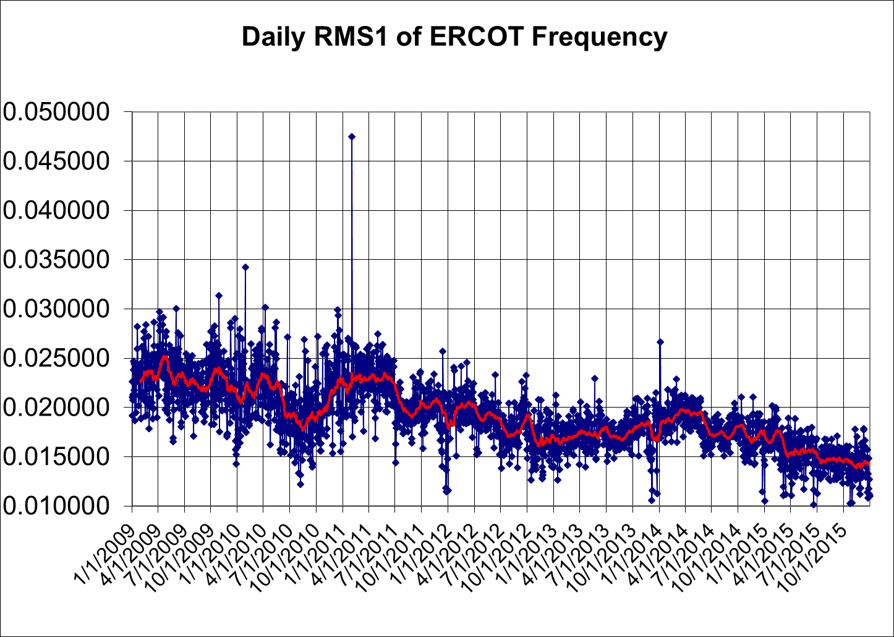
RMS1 Performance of ERCOT Frequency

Slide 13
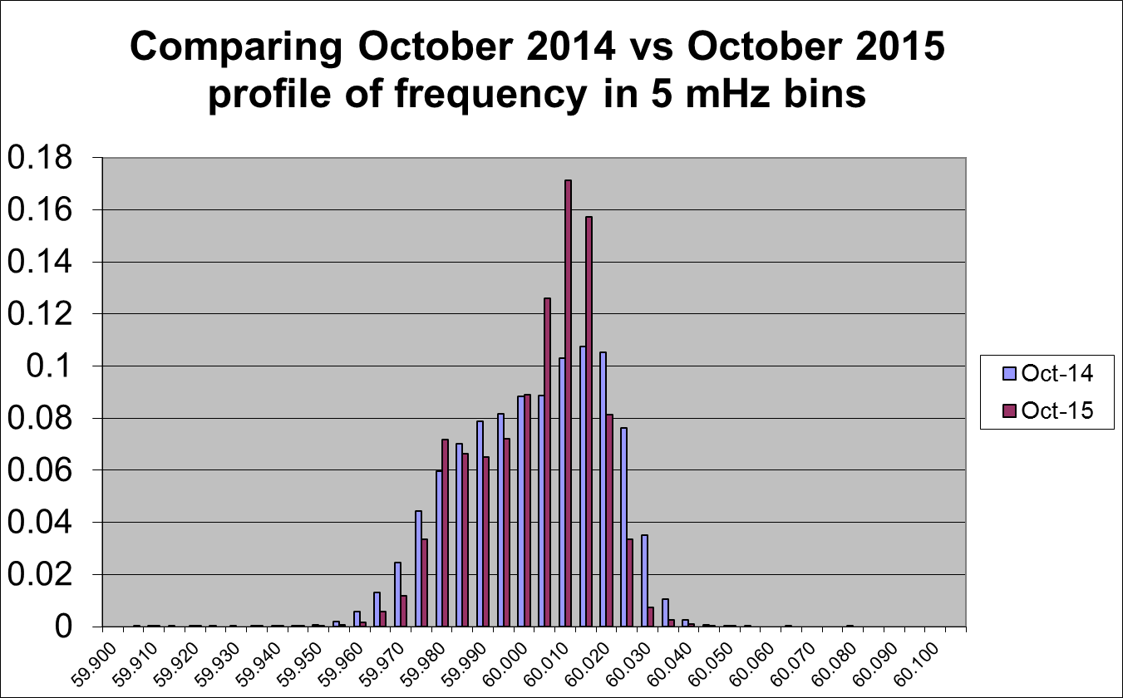
Frequency Profile Analysis

Slide 14
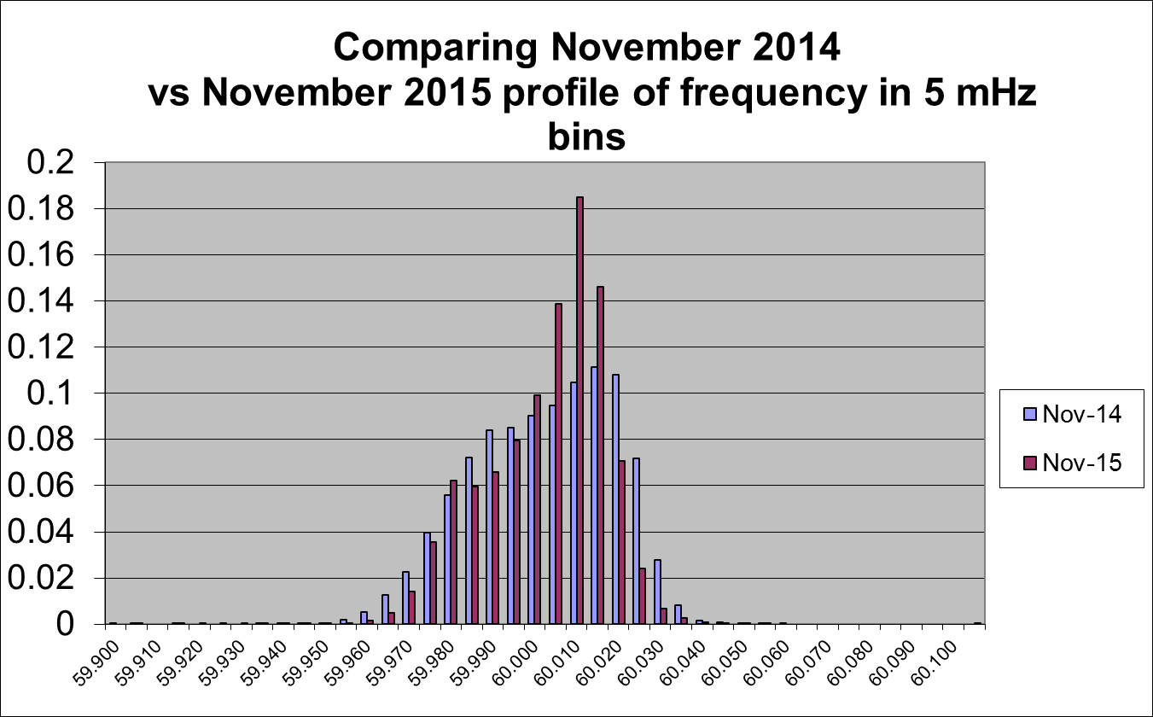
Frequency Profile Analysis

Slide 15
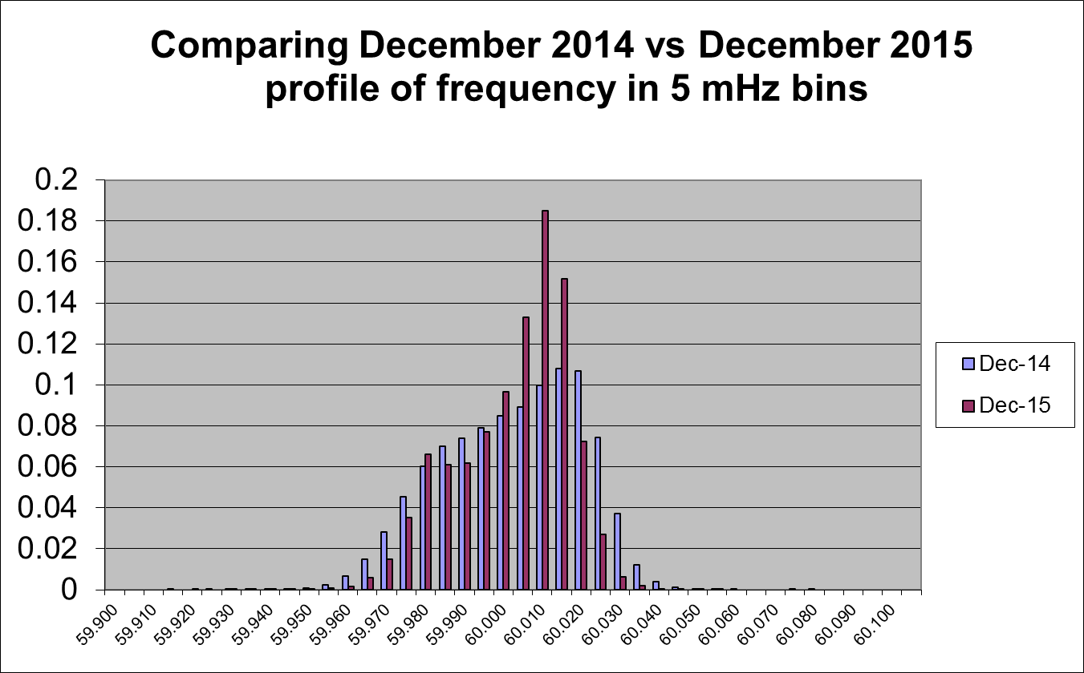
Frequency Profile Analysis

Slide 16
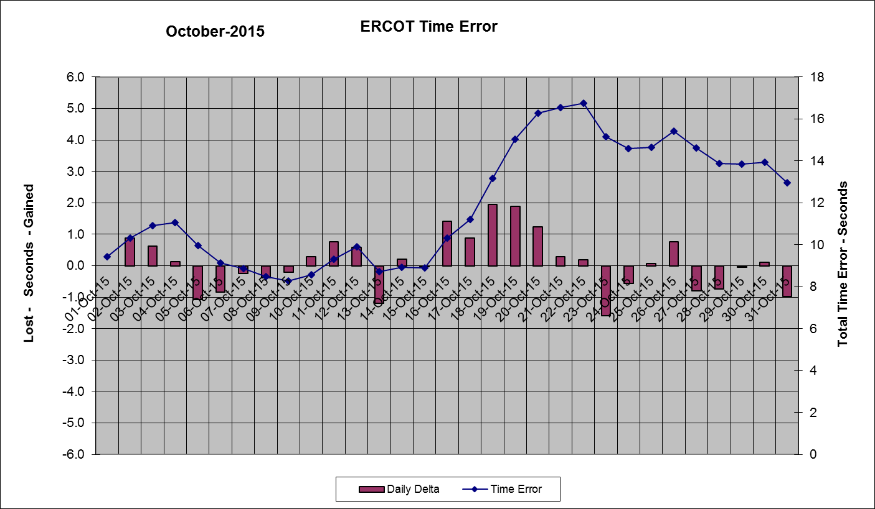
Time Error Corrections
There were no Time Error Corrections (TEC) in October. The last TEC was on May 18th, 2015.

Slide 17
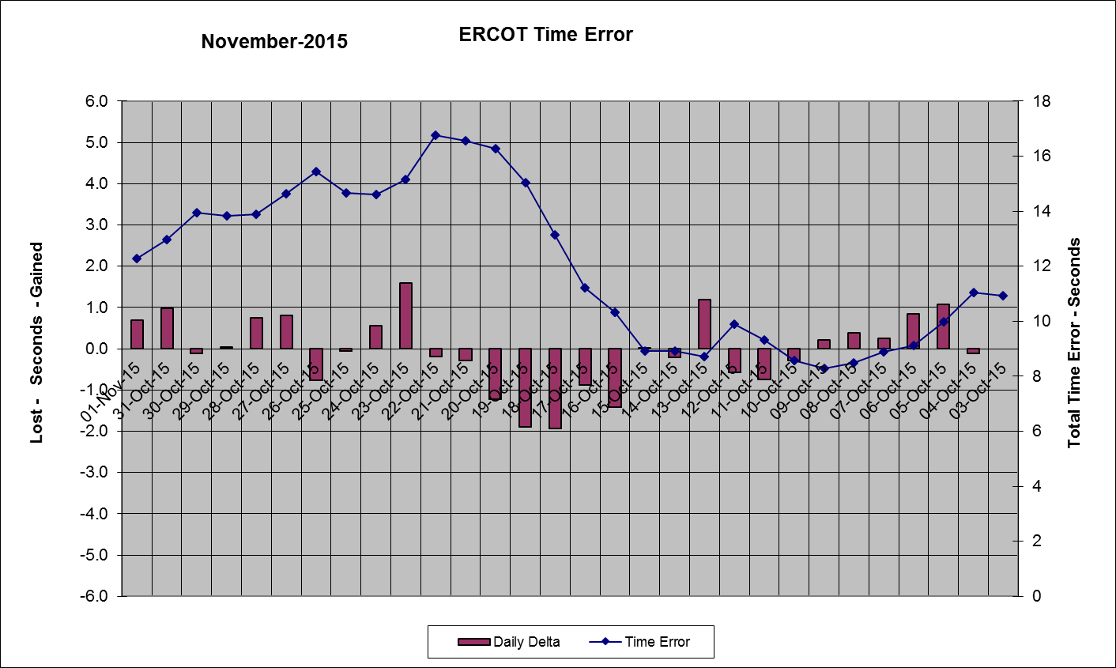
Time Error Corrections
There were no Time Error Corrections (TEC) in November. The last TEC was on May 18th, 2015.

Slide 18
Time Error Corrections
There were no Time Error Corrections (TEC) in December. The last TEC was on May 18th, 2015.

Slide 19
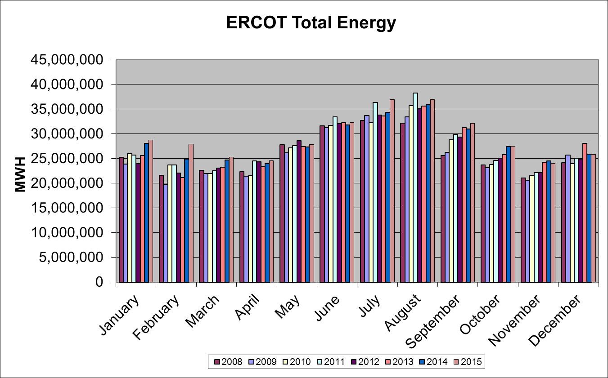
Wind Generation Performance

Slide 20
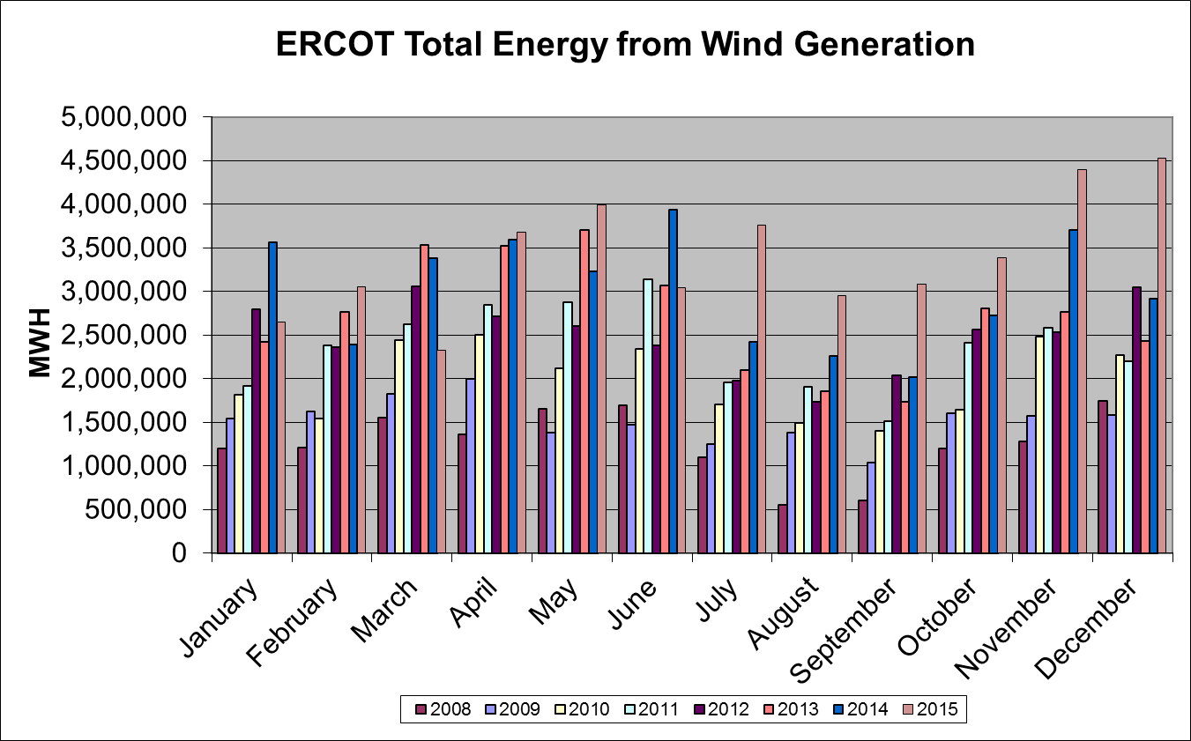
Wind Generation Performance

Slide 21
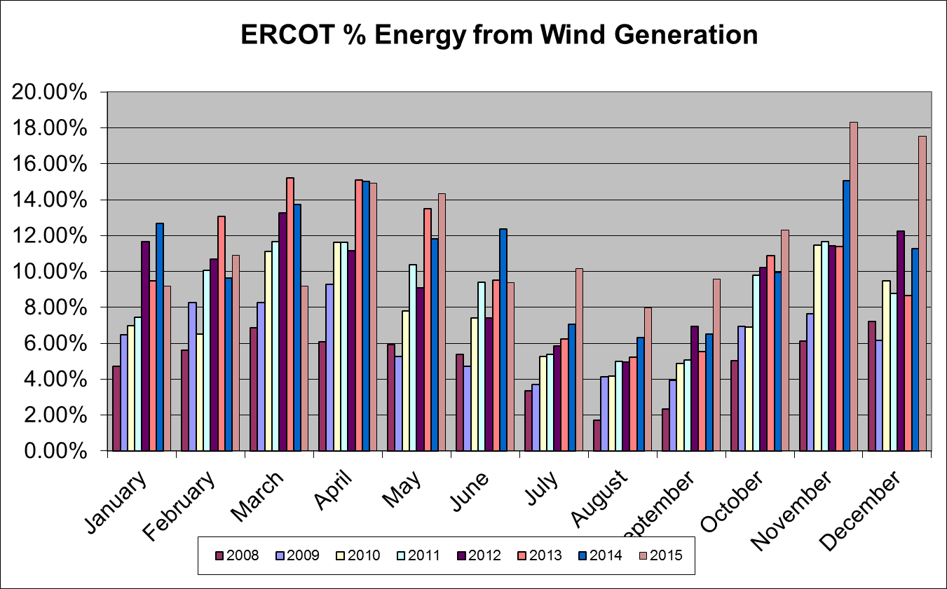
Wind Generation Performance

Slide 22
Questions?

