Slide 1
Market Credit Working Group update to the Wholesale Market Subcommittee
1/06/2016

Slide 2
MCWG update to WMS
Joint meeting of MCWG and CWG on Wednesday, December 16
5 NPRRs reviewed for credit impacts
4 NPRRs had no credit impact
NPRR743 - Revision to MCE to Have a Floor For Load Exposure
Review of NPRR741 Clarification to TPE and EAL Calculations
ABS(DARTNET)

Slide 3
MCWG update to WMS
ERCOT Forward Curve Evaluation
MCWG review of historical ICE data
Examine behavior of ICE ERCOT futures during pricing events and seasonal (See Appendix)
Discuss how we can use this data in Forward Credit Exposure calculations
Proposal to utilize forward curve data to calculate a factor to adjust calculated exposures
Stakeholder review and feedback requested
Credit updates
CMM Tech Refresh
6 Credit Related NPRRs in flight/12 Credit Related NPRRs implemented

Slide 4
Appendix

Slide 5
Review of ICE ERCOT Futures MtM Values
ERCOT North Hub
Peak Hour Average

Slide 6
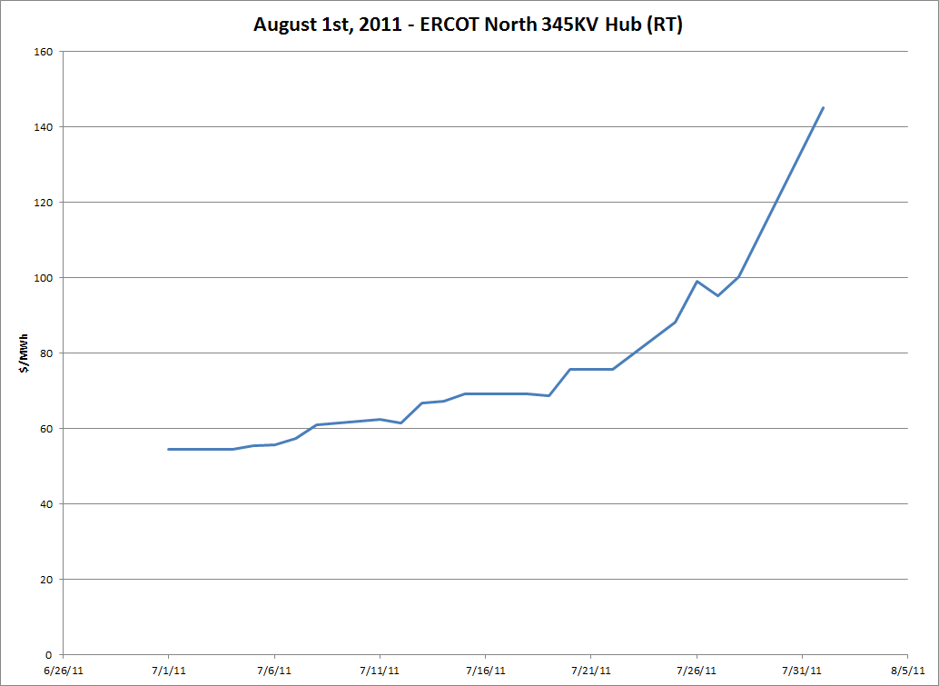

Slide 7
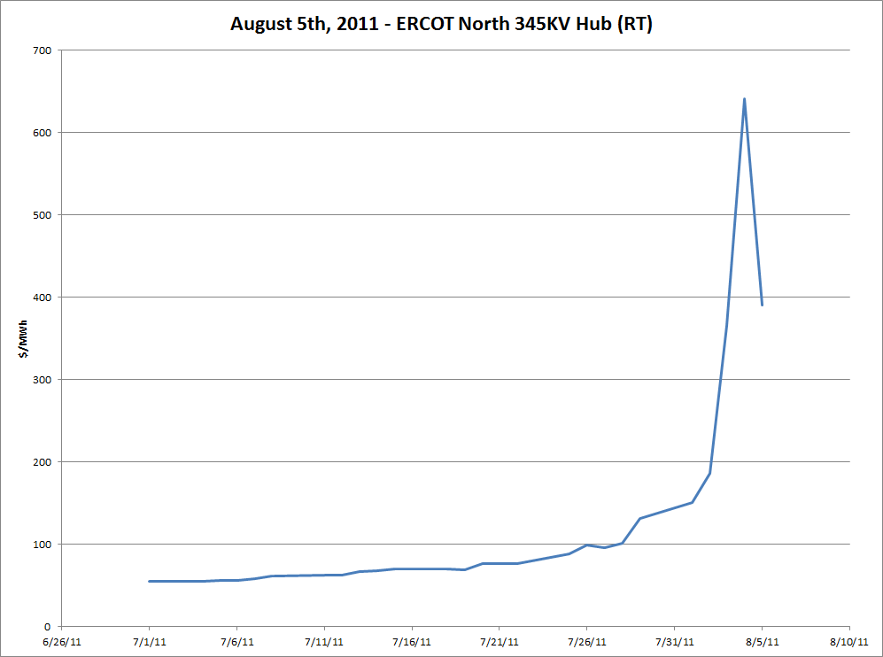

Slide 8
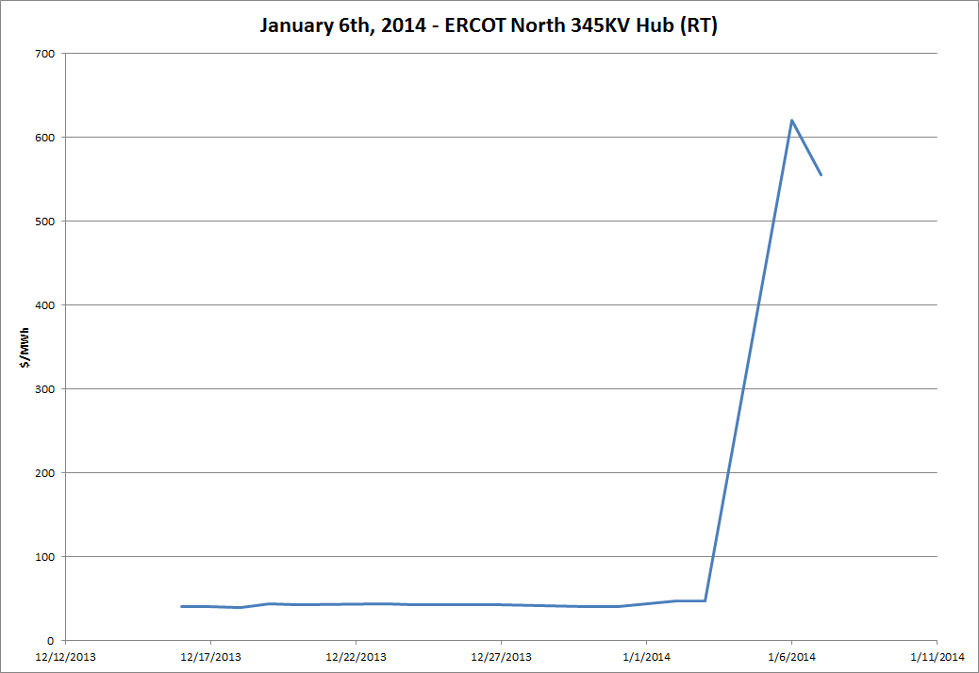

Slide 9
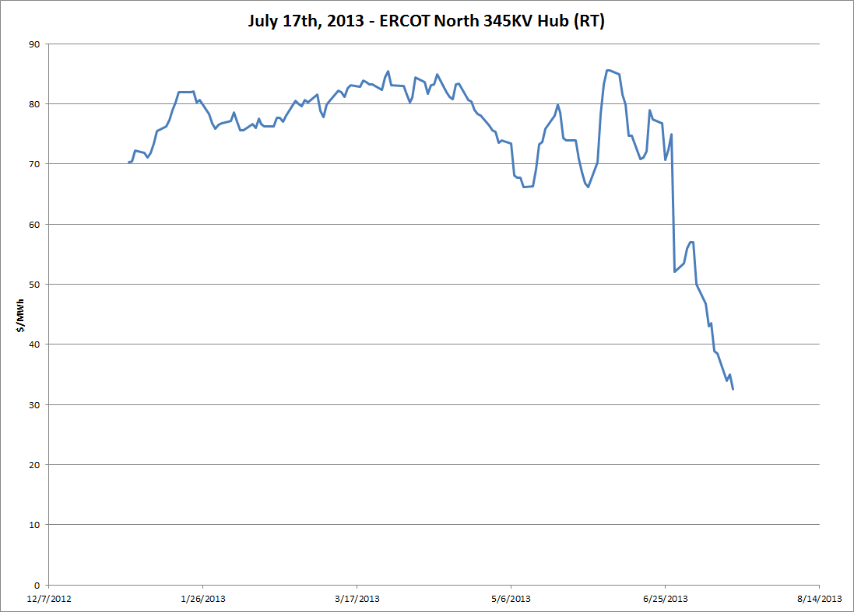

Slide 10
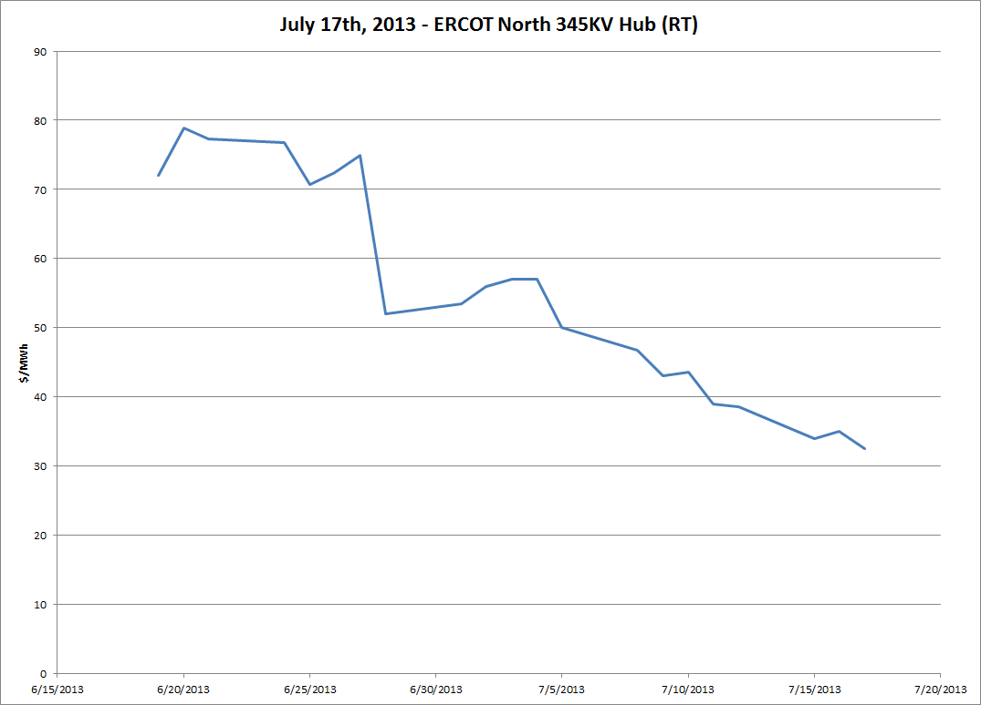

Slide 11
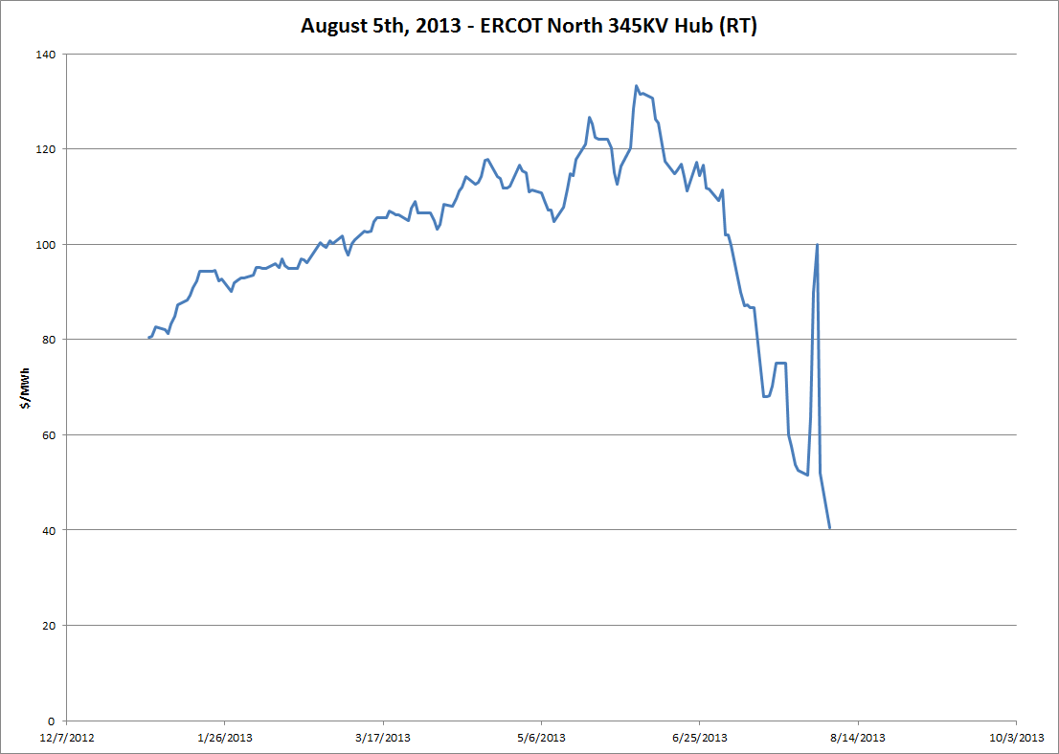

Slide 12
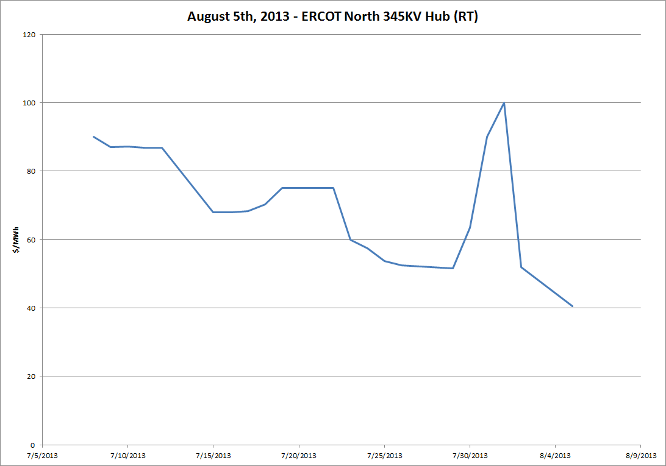

Slide 13
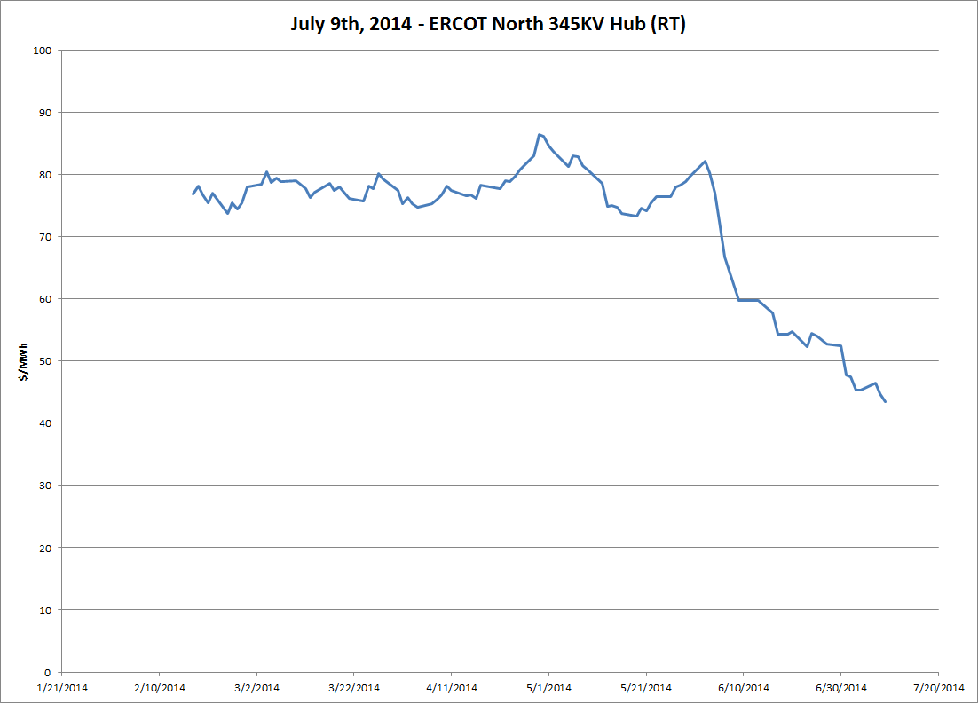

Slide 14
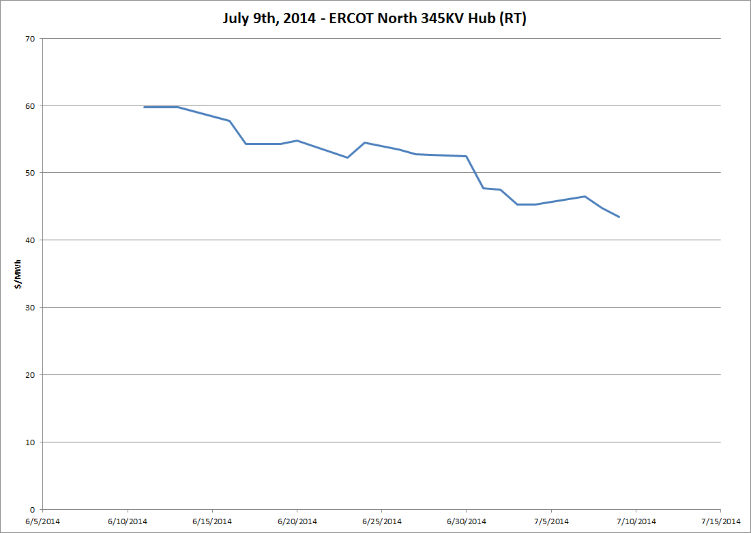

Slide 15
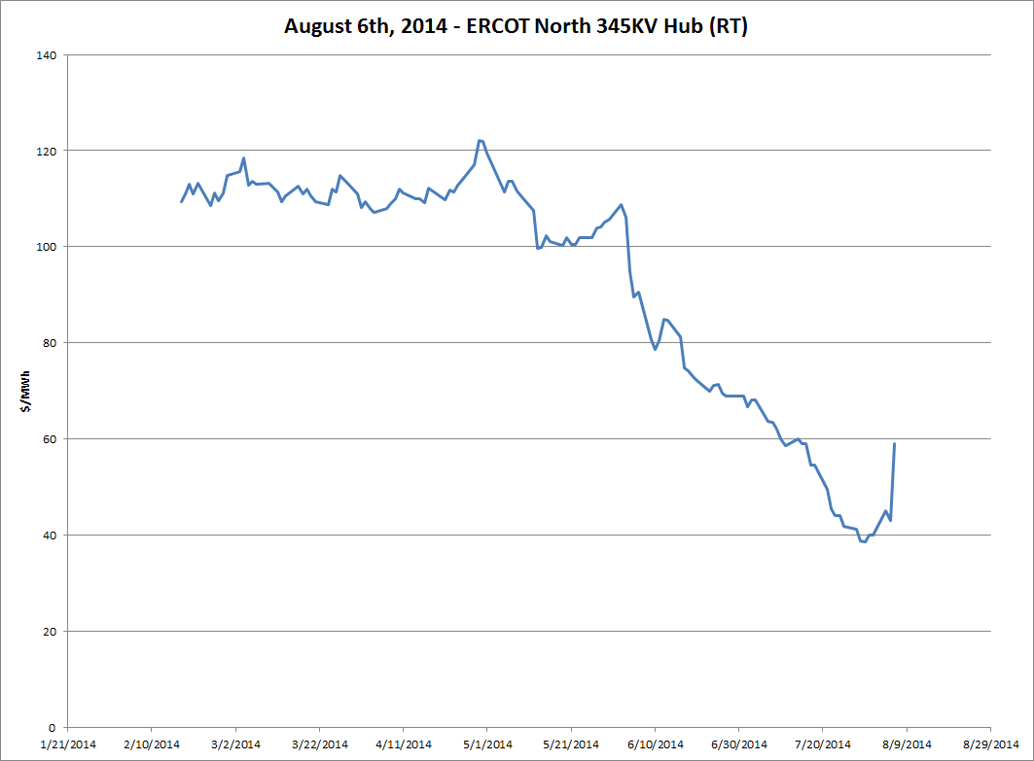

Slide 16
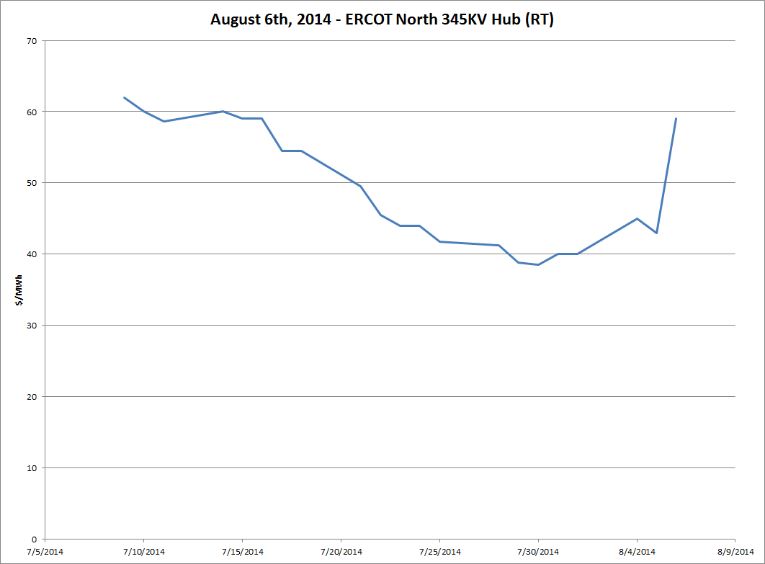

Slide 17
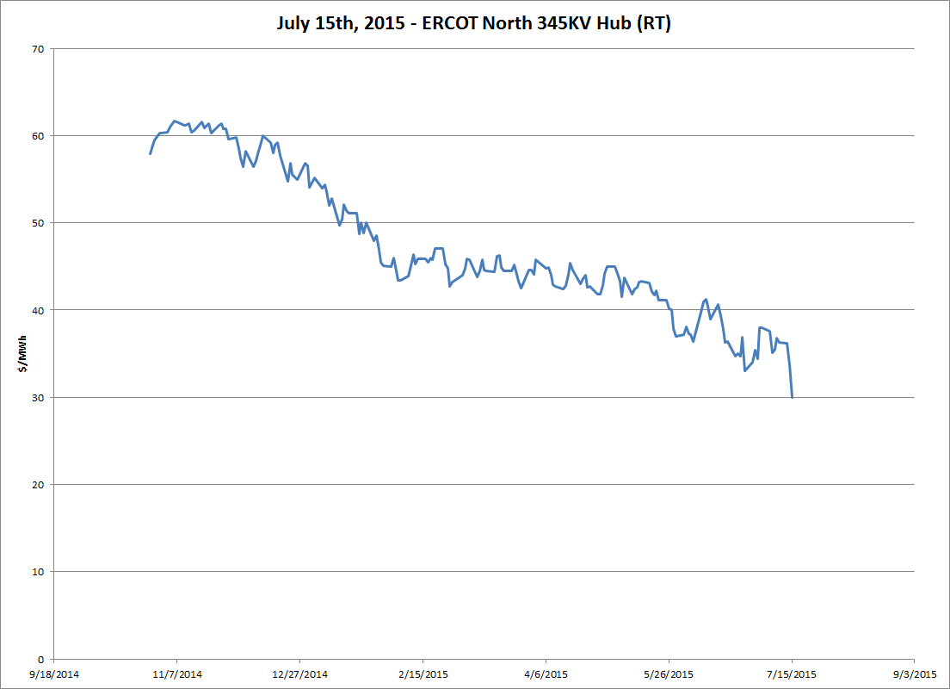

Slide 18
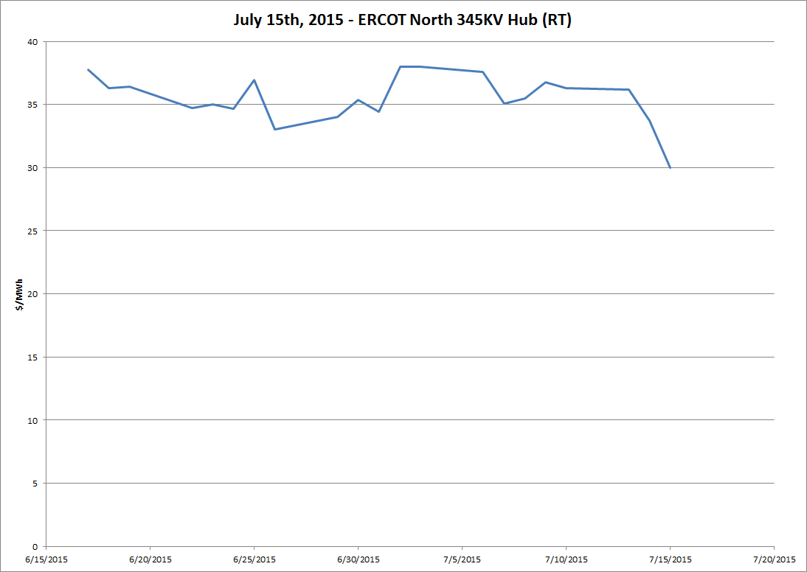

Slide 19
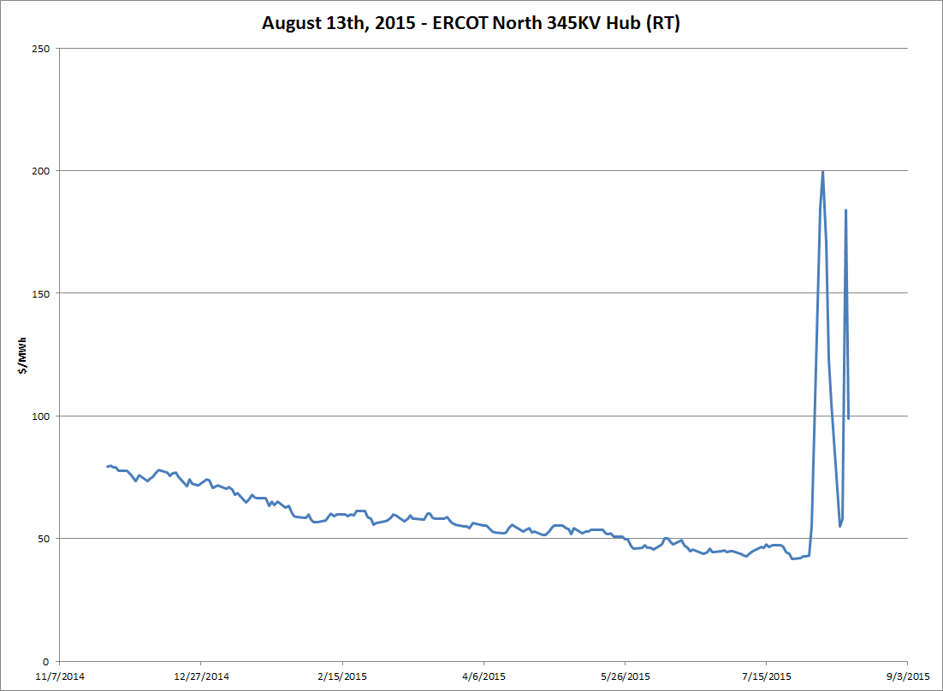

Slide 20
