Slide 1

ORDC Options Analysis
SAWG
Market Analysis
12/16/2015

Slide 2
Contents
Introduction
Section 1: June 1, 2014 – October 31, 2015 Backcast
Section 2: January 1, 2011 – December 31, 2011 Backcast
Section 3: Sensitivity Analysis
Section 4: Option 2: Add ORDC to DAM
Section 5: Options 6 & 7: X = URS + RRS

Slide 3
Introduction

Slide 4
Introduction
Options for changing ORDC parameters were proposed at 11/13/2015 and 12/2/2015 SAWG.
ERCOT was asked to analyze the options and present the following results:
  Additional PNM contributed by ORDC
  RTORPA
  # of hours histogram where RTORPA > $100/MWh, $500/MWh, $1000/MWh
ERCOT was asked to analyze the following dates with actual FIPs:
  June 1, 2014 – October 31, 2015
  January 1, 2011 – December 31, 2011
Market behavior changes after ORDC implementation, changes in SWOC, and changes in price floors will significantly affect the validity of 2011 backcast results. Since market behavior affects results in both periods, it is recommended to use the backcast only to compare options.

Slide 5
Options
Current ORDC implementation values are in red.
See ORDC Options Whitepaper Redline from 12-8-15 for more details.
Notes:
Option 0 Base Case: X = 2000; VOLL = $9,000; SWOC = $9,000; RDF = 0.99; PRC Threshold to set RTOFFCAP to 0 = 2300
Option 1: Base case with $75 Price Response for all offline units greater than a 30 minute cold start time
Option 2: Add ORDC to the DAM
Option 3: $75 Price Response for all offline units greater than a 30 minute cold start time; RDF = 0.98
Option 4: $75 Price Response for all offline units greater than a 30 minute cold start time; PRC Threshold to set RTOFFCAP to 0 = 2500
Option 5: Upon deployment of NSRS by the ERCOT operator, require all Quick Start Resources providing NSRS to come physically online: Does not change RTOLCAP if implemented but does increase PRC
Option 6: $75 Price Response for all offline units greater than a 30 minute cold start time; X = RRS + URS; Min. RRS = 2750; VOLL = $18,000
Option 7: $75 Price Response for all offline units greater than a 30 minute cold start time; X = RRS + URS; Min. RRS = 2750; Set Price to $4,500 when PRC<2500 and Price to $9,000 when PRC<2300
Option 8: $75 Price Response for all offline units greater than a 30 minute cold start time; X = 2300; VOLL = $12,000
Option 9: $75 Price Response for all offline units greater than a 30 minute cold start time; X = 2750; VOLL = $18,000
Option 10: $75 Price Response for all offline units greater than a 30 minute cold start time; X = 1708; VOLL = $18,000

Slide 6
Section 1
June 1, 2014 – October 31, 2015 Backcast

Slide 7
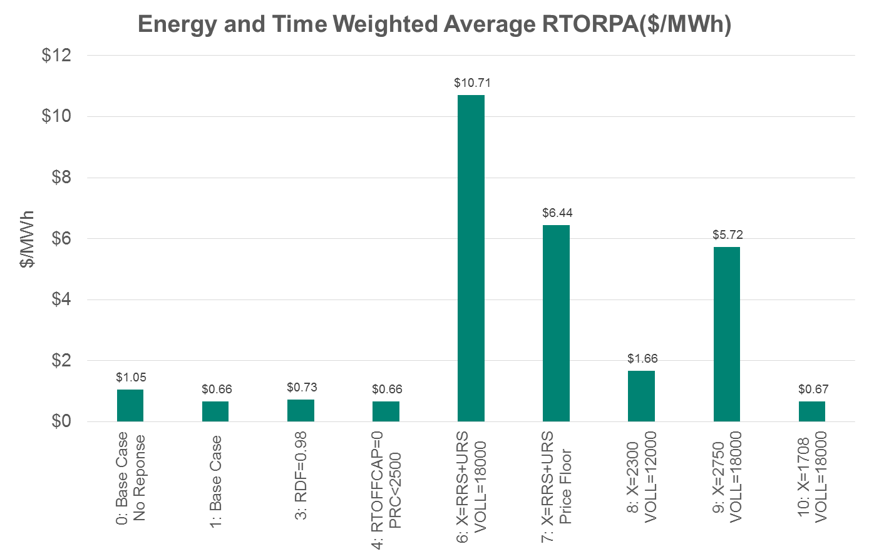
June 1, 2014 – October 31, 2015

Slide 8
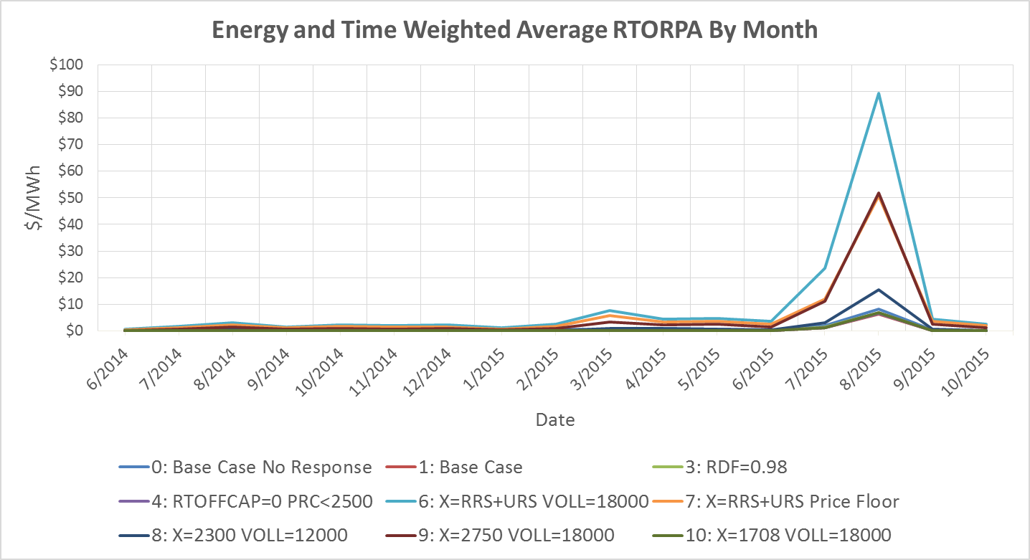
June 1, 2014 – October 31, 2015

Slide 9
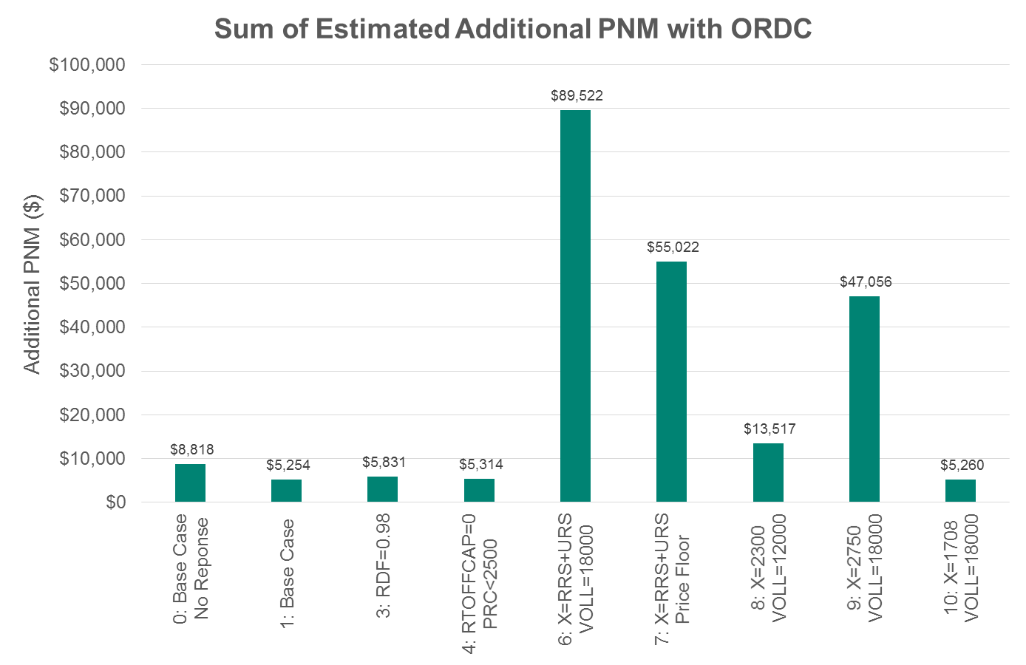
June 1, 2014 – October 31, 2015

Slide 10
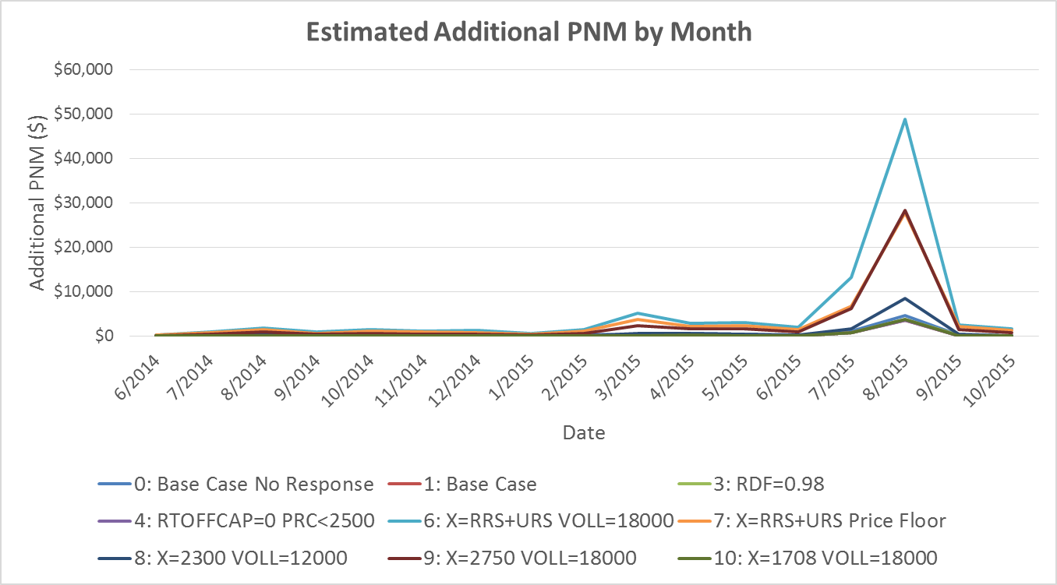
June 1, 2014 – October 31, 2015

Slide 11
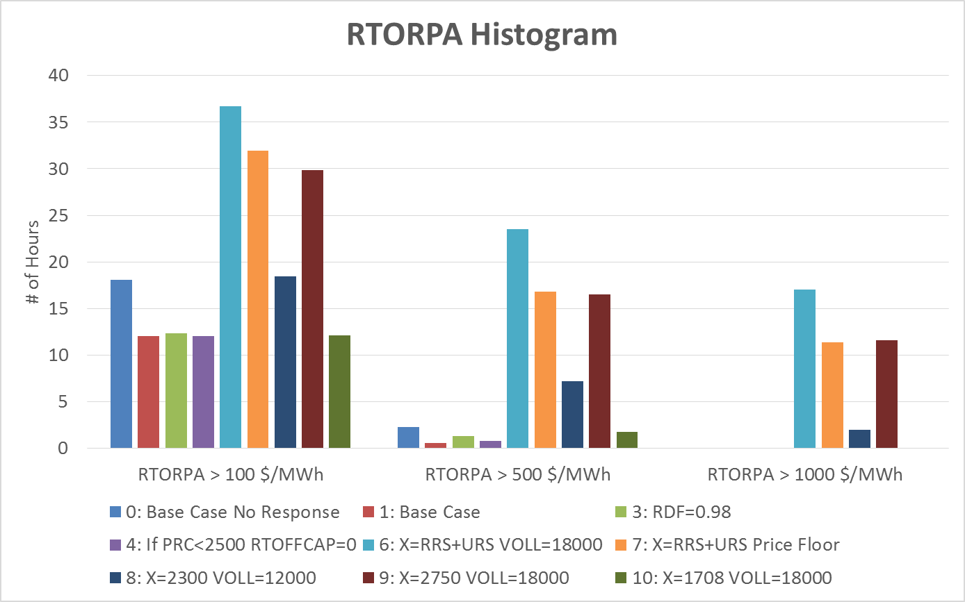
June 1, 2014 – October 31, 2015

Slide 12
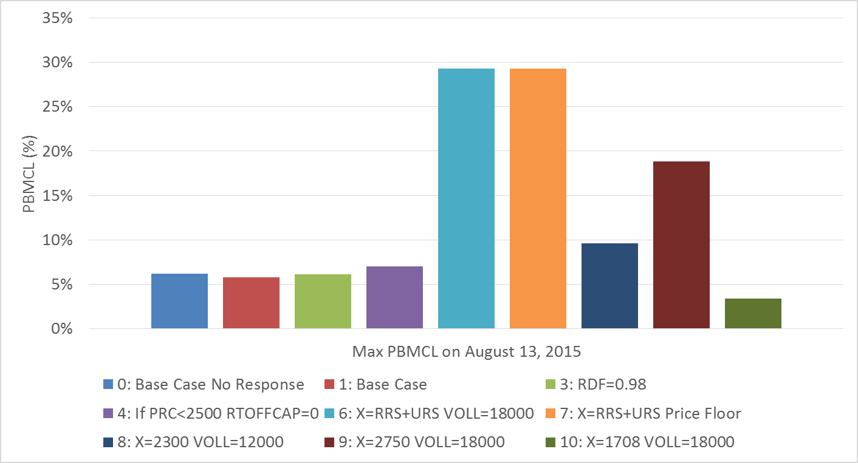
Probability of Falling Below Minimum Contingency Level on August 13, 2015
Min PRC at SCED snapshot on August 13, 2015 was 2374.12 MW

Slide 13
Section 2
January 1, 2011 – December 31, 2011 Backcast

Slide 14
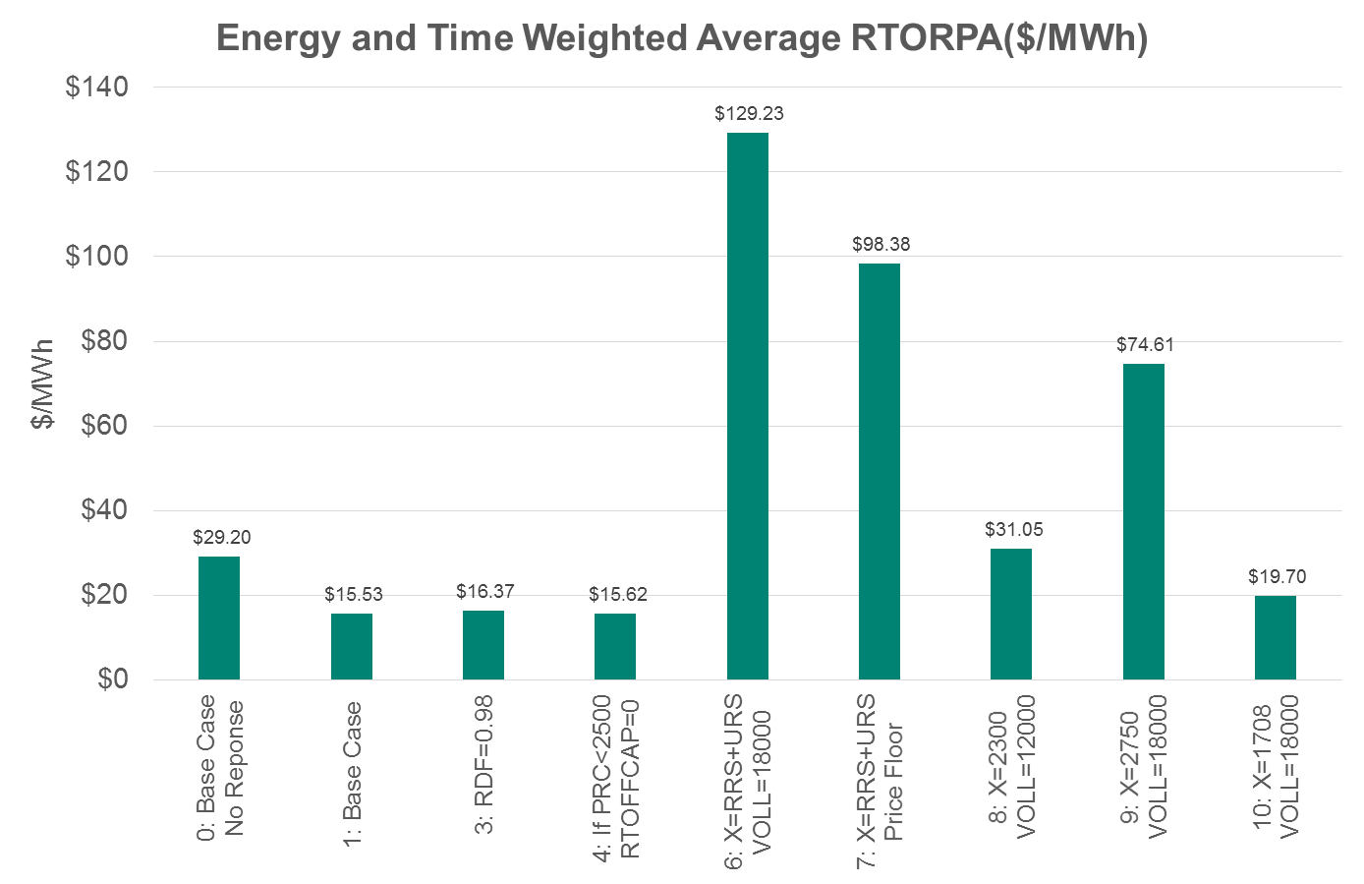
January 1, 2011 – December 31, 2011

Slide 15
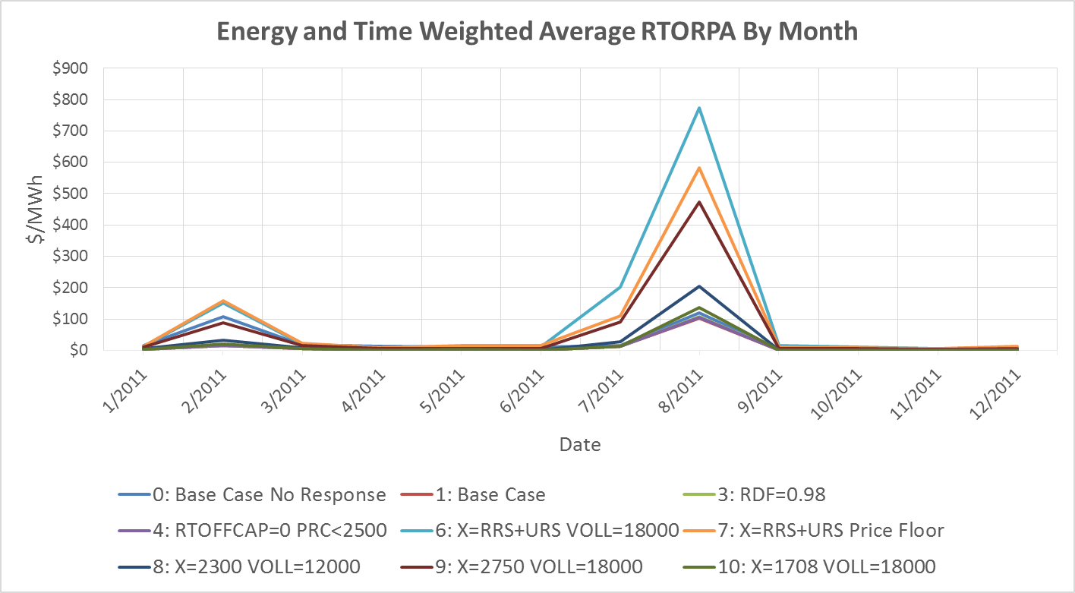
January 1, 2011 – December 31, 2011

Slide 16
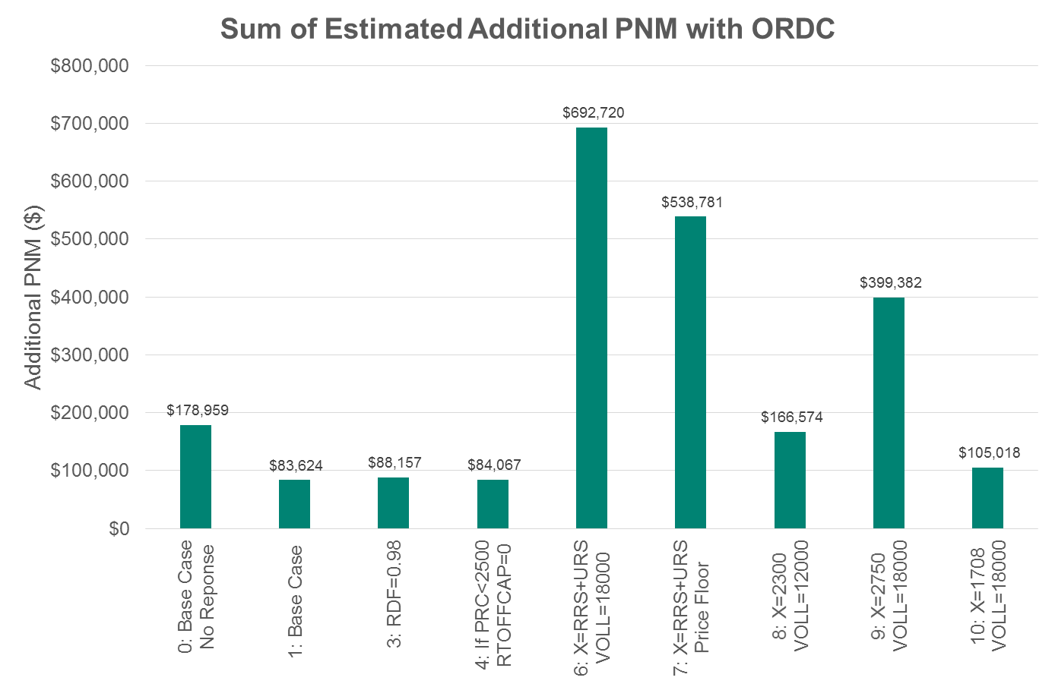
January 1, 2011 – December 31, 2011

Slide 17
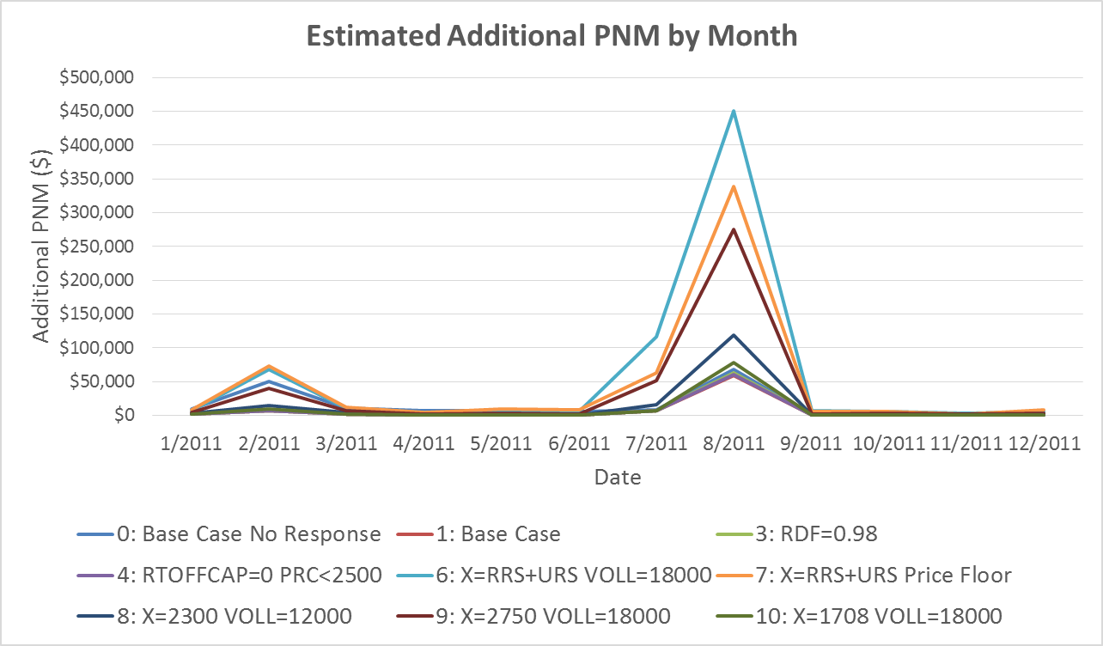
January 1, 2011 – December 31, 2011

Slide 18
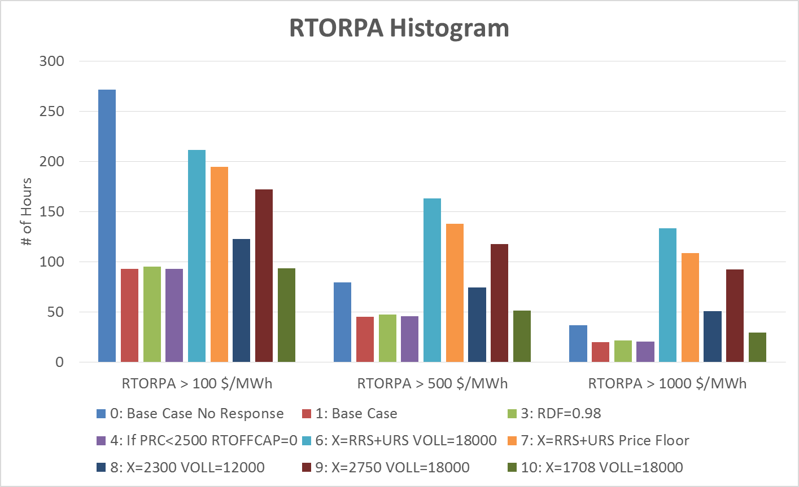
January 1, 2011 – December 31, 2011
* Price response at $75 significantly reduces non-summer month prices for all options

Slide 19
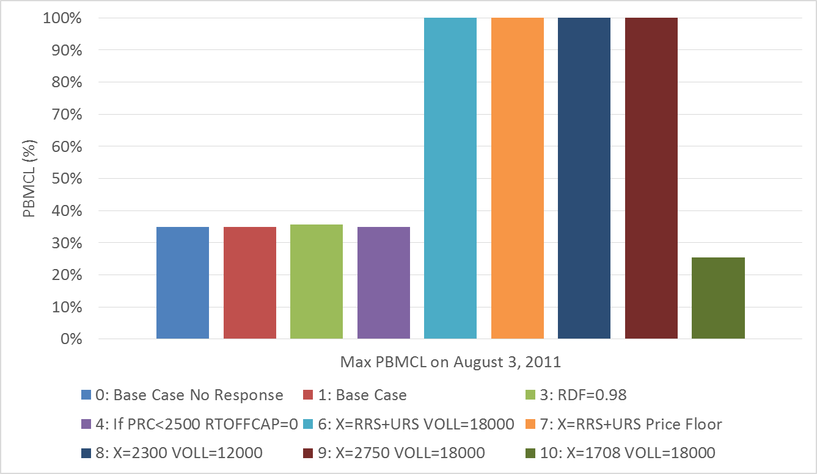
Probability of Falling Below Minimum Contingency Level on August 3, 2011
Min PRC at SCED snapshot on August 3, 2011 was 1722.42 MW

Slide 20
Section 3
Sensitivity Analysis

Slide 21
Sensitivity Analysis
Offline and available resources had varying levels of startup time and startup cost. Assuming that all those resources will be online any time prices were greater than a particular level might indicate over commitment.
Hence, a sensitivity analysis was done to show a range of outcomes:
  Price response any time prices were greater than $75/MWh
  Price response when prices go above $75/MWh for 2 hours
  Price response any time prices were greater than $250/MWh
  Price response when prices go above $250/MWh for 2 hours
  No price response
2 hours was estimated based on average start times, start costs, and time needed to recover average start costs.

Slide 22
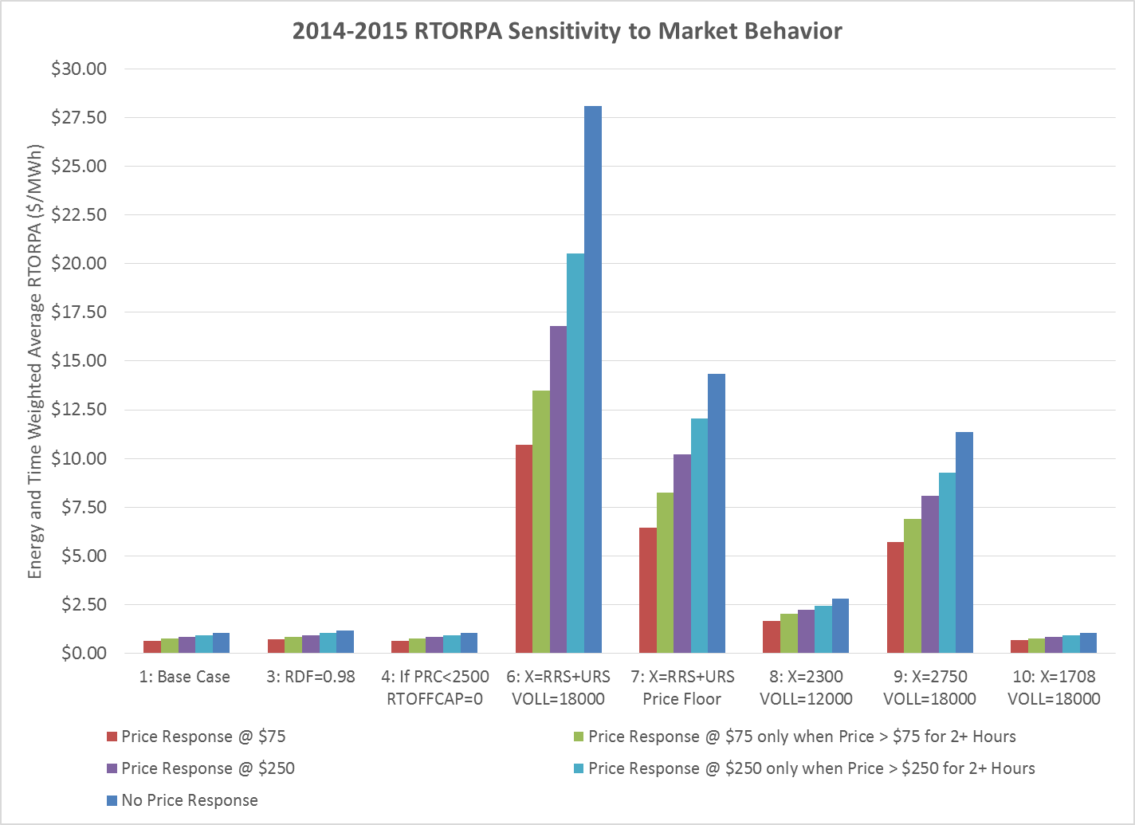
June 1, 2014 – October 31, 2015 (Sensitivity)

Slide 23
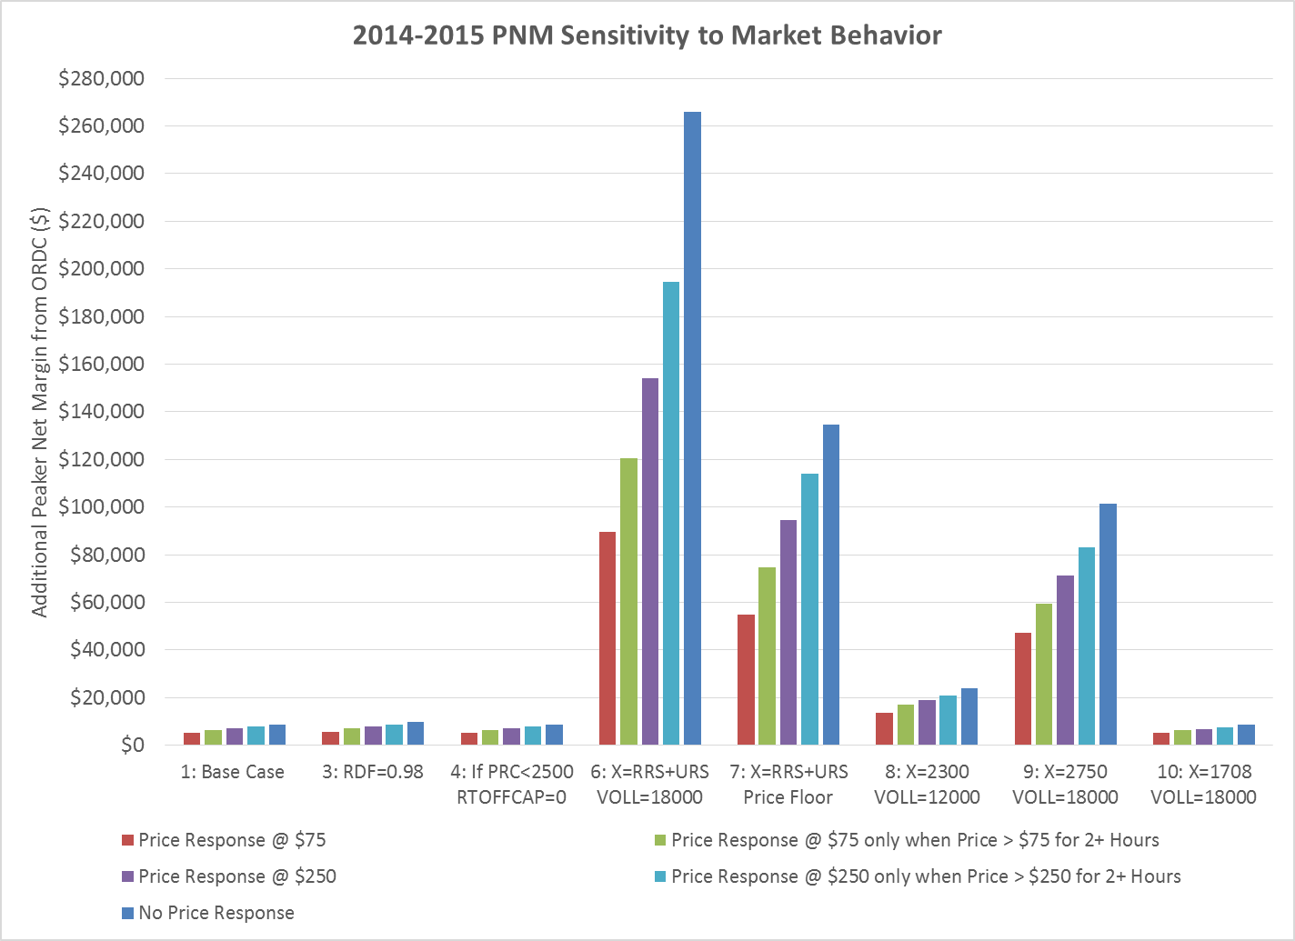
June 1, 2014 – October 31, 2015 (Sensitivity)

Slide 24
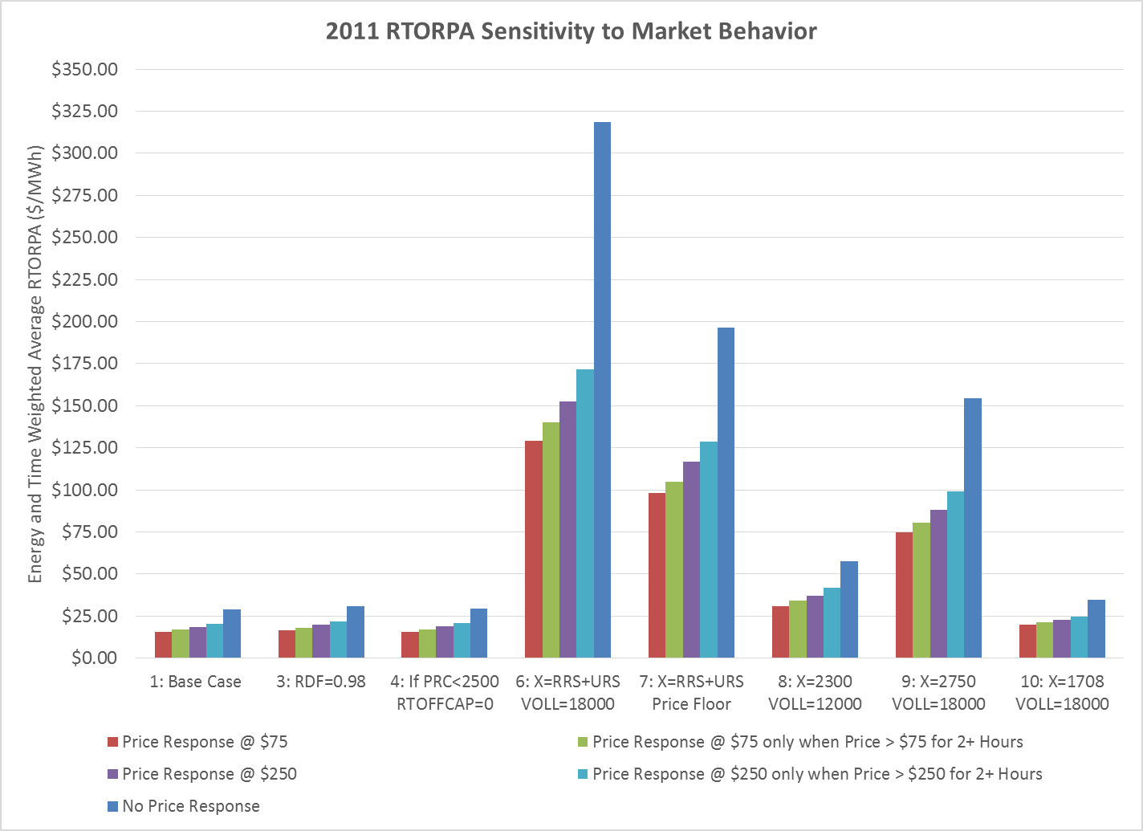
January 1, 2011 – December 31, 2011 (Sensitivity)

Slide 25
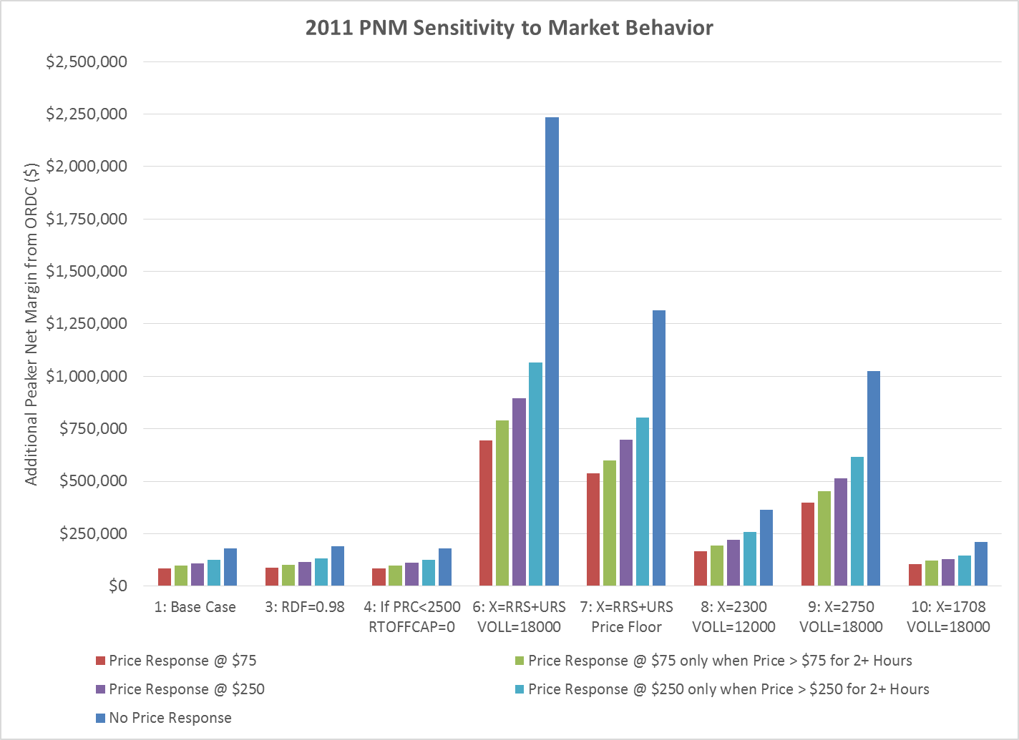
January 1, 2011 – December 31, 2011 (Sensitivity)

Slide 26
Section 4
Option 2: Add ORDC to DAM
Snapshot from August 13, 2015 as an example

Slide 27
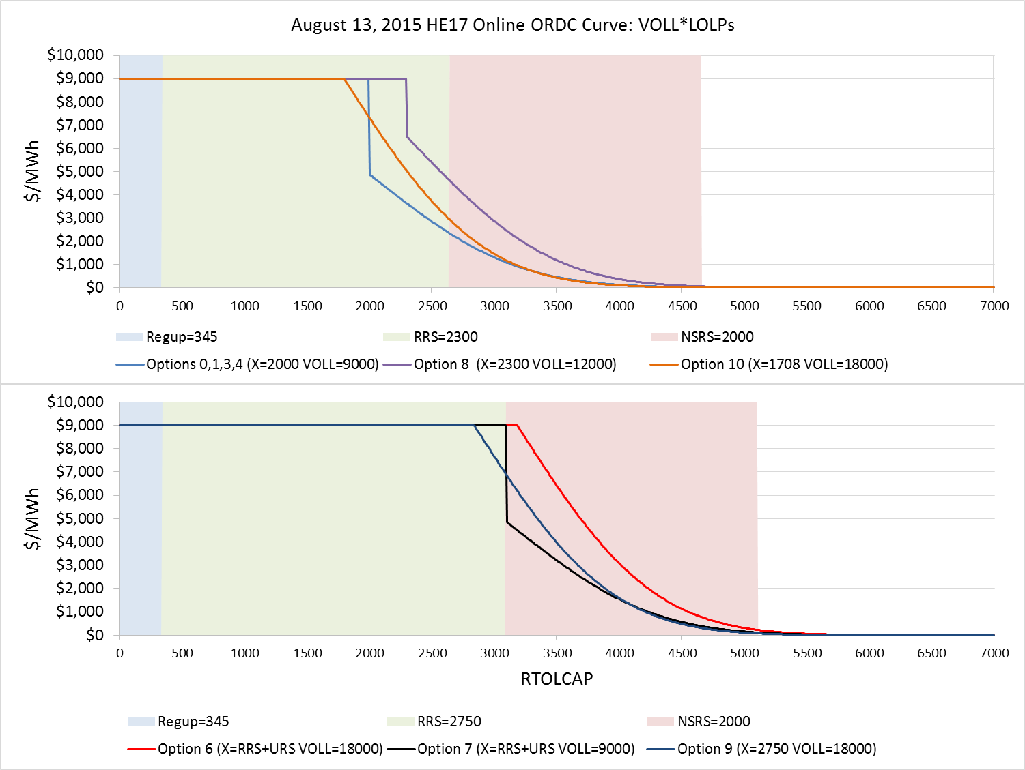
August 13, 2015 – HE 17

Slide 28
August 13, 2015 – HE 17
This table highlights points on the curve from the previous slide
Notes:
Example of options 0,1,3,4:
Last MW of URS = 345 MW where price would be $9,000/MWh on the curve
Last MW of RRS = 345 + 2300 = 2645 MW where price would be $2,319/MWh on the curve
Last MW of NSRS = 345 + 2300 + 2000 = 4645 MW where price would be $13/MWh on the curve

Slide 29
Section 5
Options 6 & 7: X = URS + RRS
A look at the 2016 AS methodology values

Slide 30
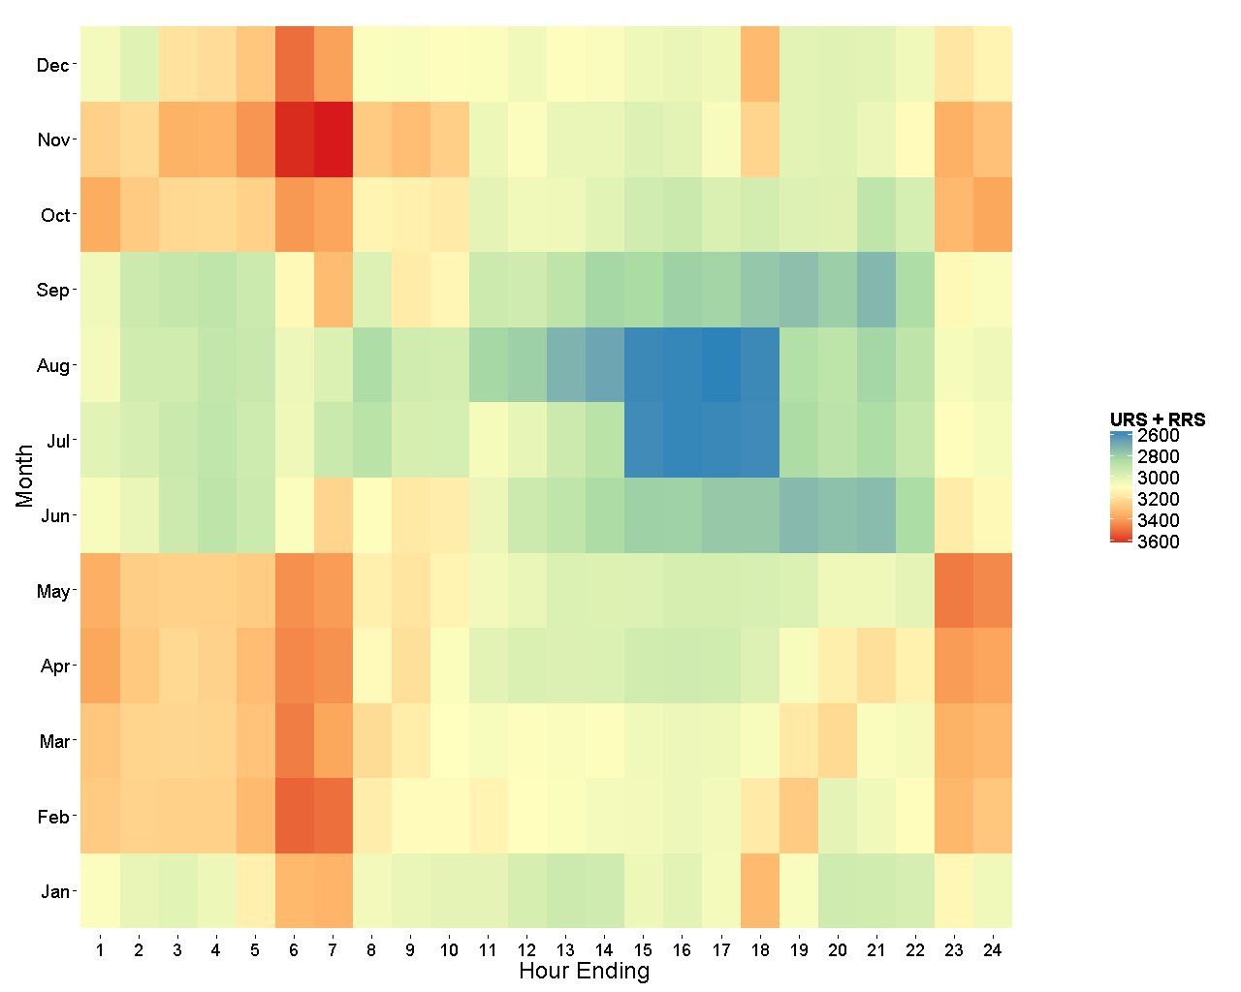
URS + RRS from 2016 Ancillary Service Methodology
Without RRS floored at 2750 MW

Slide 31
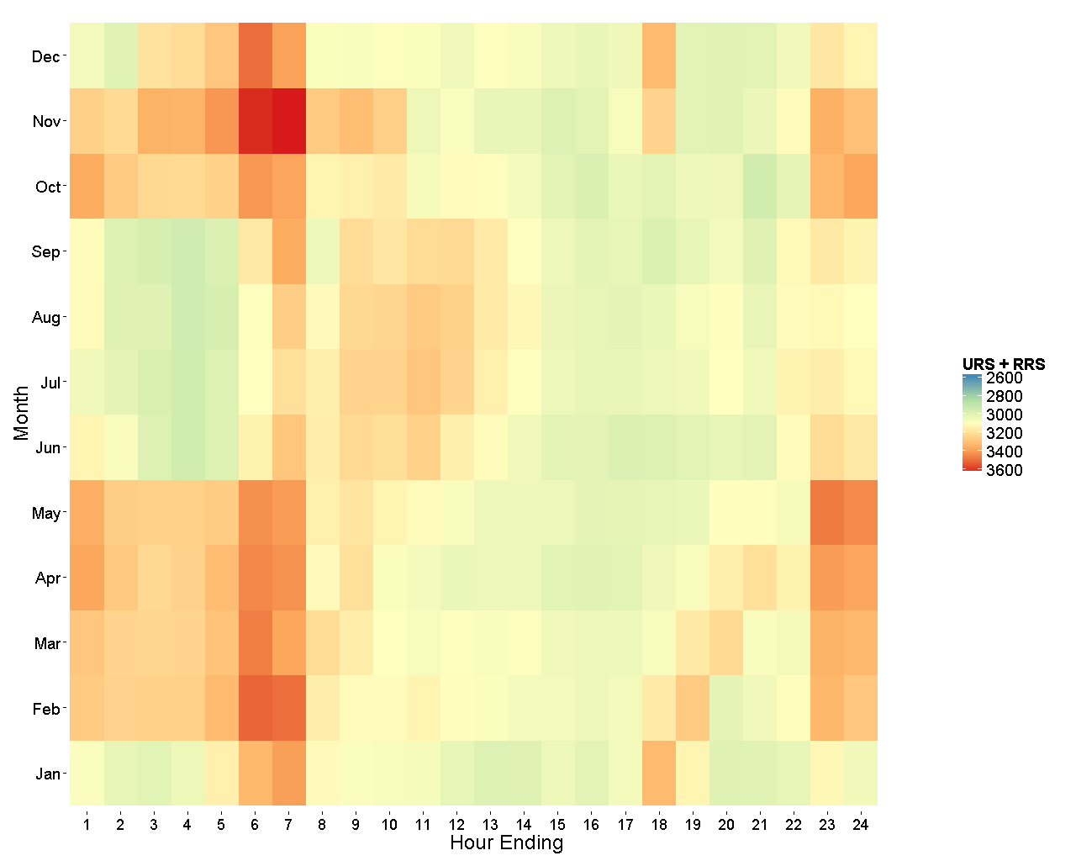
URS + RRS from 2016 Ancillary Service Methodology
With RRS floored at 2750 MW

Slide 32
For data and additional details, please see the following posted files on the 12/16/2015 SAWG Meeting Page:
20151216 SAWG ORDC Options Analysis 2011 Data.xlsx
20151216 SAWG ORDC Options Analysis 2014 – 2015 Data.xlsx
Further Information

Slide 33
End

